Slide 1
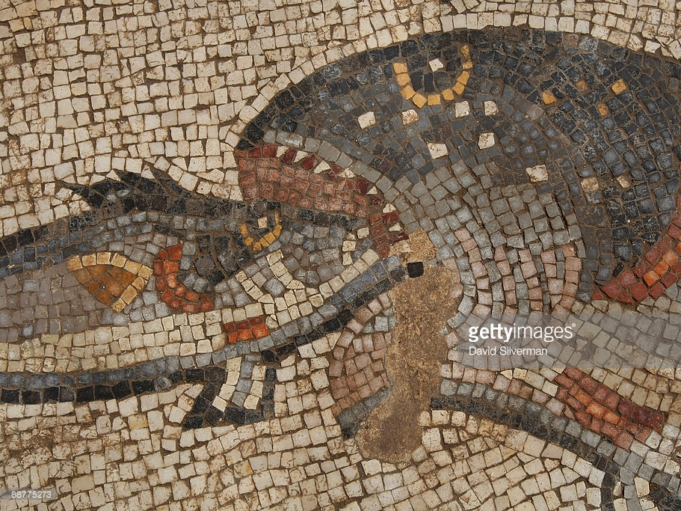
Persius and the poem made flesh (II)
Vulnerable body Term 2, lecture 3

Slide 2
Persius’ bitter (flavoursome?) brew
Is aggressive intensity necessarily painful?
Is there any way it could be pleasurable?

Slide 3

Persius: the problem/paradox/stimulus
The challenge is to harden/straighten up, as we immerse ourselves in poetry that is all about bending and mixing…
Consuming satire’s latest pungent, rich mixed dish will not leave you feeling detoxed and pure… Are you what you eat?
Is this problem resolvable, or indigestible?

Slide 4
Critical positions: recap/expand
S.Bartsch (2015, 11): Persius ‘plans to leave us with a self-canceling collection of images that demand to be transcended in favor of something else.’
K.Freudenburg (2001, 132): ‘…these poems hurl us back into the abyss, shattering smugness by leaving us there to spin in a bearing-less space.’
J. Henderson (1999, Writing Down Rome, 232, 237): Persius’ ‘writing acts out a scene of mastery, the fantasy/ideology of an absolute control of Self as boundary and teleology of human freedom’… ‘…he portrays a struggle towards self-criticism.’

Slide 5
Sat.3.58-9:
Yet you’re still snoring, your lolling head
With its jawbone unhinged,
Still yawning yesterday’s yawn, your mouth wide open.
Sat.3.98-105:
Stuffed from his feasting he goes white-bellied
To bathe, but as he drinks, his throat emitting long noxious
Belches, a sudden tremor makes the warm glass slip from
His hand, his bared teeth chatter, and the greasy food slides
From his slack mouth. Then it’s the bugle, the candles, and
Finally the dear deceased, thick-coated with perfumed balm,
On a tall bier, with his rigid heels extended towards the door.

Slide 6
The prologue: recap and expand
Questions:
What are ‘nostra verba’ (‘our words’)? What makes them distinct from parroted language? Is all human language repetition?
To what extent does Persius (get his audience to) ‘parrot’ / ‘crow’ in this poem, and to what extent does he manage to create something completely new?

Slide 7
No-one escapes bodies (=vulnerability)
Key images and themes:
Lips
Mouths (lapping up, eating, singing)
Statue bodies, licking ivy
Limp as you perform this poem
Pecked ears

Slide 8

The worst essay crisis ever
(Persius Sat.3.1-14)
– It’s always like this. Morning’s already bright through
the shutters, swelling the narrow cracks with light,
and I’m snoring enough to drown the wild Falernian,
and the shadow on the sundial’s now nearing eleven.
– ‘What are you up to?’ cries a voice. ‘The Dog-Star’s
been scorching the crops, madly, for hours already,
and all the cows are sheltering under the spreading elm.’
– Really? Truly? Here, quickly, you. No one there?
The green bile’s flowing, my head’s bursting, you’d
think all the donkey-herds in Arcadia were braying.
Now my book’s to hand, the two-toned parchment
purged of hair, the paper, and a jointed reed-pen.
now I groan, the liquid hangs heavily from the pen,
but adding water over-thins the black cuttlefish ink.
Groan, the reed (fistula) keeps gathering up the diluted blobs.

Slide 9
Fistula (3.14) = reed (pen), tube, urethra, ulcer

Slide 10
Sat.3.58-9:
Yet you’re still snoring, your lolling head
With its jawbone unhinged,
Still yawning yesterday’s yawn, your mouth wide open.
Sat.3.98-105:
Stuffed from his feasting he goes white-bellied
To bathe, but as he drinks, his throat emitting long noxious
Belches, a sudden tremor makes the warm glass slip from
His hand, his bared teeth chatter, and the greasy food slides
From his slack mouth. Then it’s the bugle, the candles, and
Finally the dear deceased, thick-coated with perfumed balm,
On a tall bier, with his rigid heels extended towards the door.

Slide 11
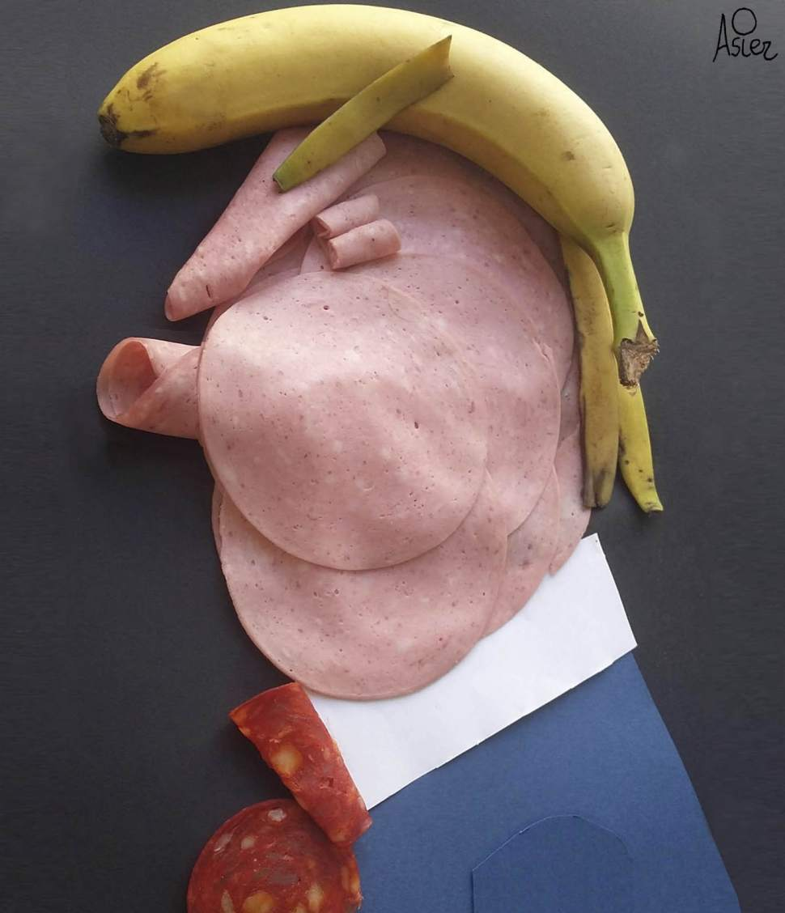
A recipe (New Yorker sketch)

