Slide 1
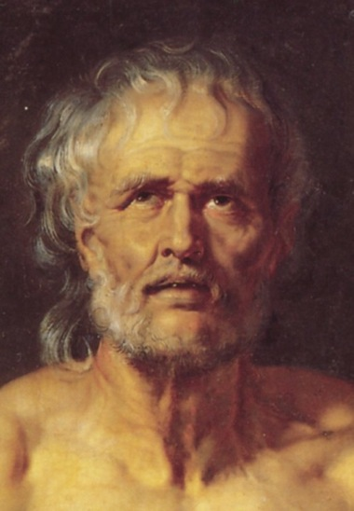
The Stoic Palestra: Learning how to die in Seneca’s Letters
The Vulnerable Body, T2, lecture 6

Slide 2
Seneca’s Letters
(Epistulae Morales ad Lucilium)
124 letters (we know there were more, as we hear elsewhere of a 22nd book)
Composed alongside the Natural Questions between 62 and 64/5 (period of political withdrawal)
Addressed to Lucilius, a career man of modest origins, slightly younger than Seneca, and a fellow Stoic, poet and writer.

Slide 3
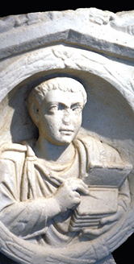
A program of therapy:
How do the Letters teach?
Indirectly
Provocatively
By spurring self-scrutiny
By reassurance: the journey is meant to be a struggle, and is not linear.
They emphasize the extent to which psychic resilience is inseparable from critical acumen

Slide 4
Why the letter form?
Long tradition of philosophical letter writing: Plato (dubious authenticity), Aristotle, pseudo-Pythagorean letters, Cynic epistles, letters of Epicurus.
Nods towards Socratic dialogue.
Intimacy – showcases amicitia.
Fiction of regular/daily letters: context specific therapy; Stoicism as quotidian praxis; tracks progress.

Slide 5
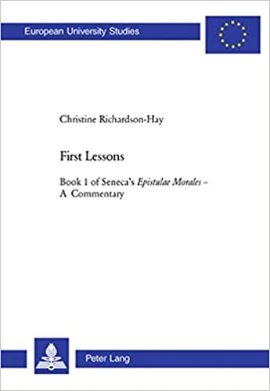
Prosaic letters?
[Seneca’s writing is] ‘…energetic, pointed, subtle, revealing, dense with ideas and discoveries, shifts of argument, interest and mood that pull a reader in, demand attention and hold him.’
(C.Richardson-Hay)

Slide 6
vulnerability in the Letters
Stoic cosmopolitanism as our ‘primary vulnerability to others’ (Butler)?
Political and personal precarity in the 60s
Old age; being in time; mortality
The daily drama of being/living in a body: seasickness (53), asthma (54), keeping fit (15.4)
Physical sickness as metaphor for psychic flaws/vices.

Slide 7
Body and soul
No (Platonic) mind-body dichotomy
Soul infused through body
Passions are (wrong) judgments
But body to be governed by soul/ratio
We must tend to the body as well as to the soul.

Slide 8
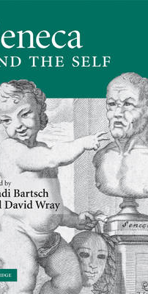
Shadi Bartsch, in Seneca and the Self (2009), 204
‘Seneca would have us transfer a normative concern for the integrity of bodily boundaries to a concern, instead, for the integrity of the philosophical boundaries of the soul. …Suffer the body to be penetrated, abused, flogged, mutilated: this is no violation of your libertas, which is now unyoked from the fate of your body. As the philosopher gives up his body it is his mental impenetrability that is figured as the new sign of masculinity… Seneca’s imagery of precious interiority versus expendable exteriority rings the changes on the sanctity of the elite body per se and allows for a recasting of ethical values without the loss of the combatant metaphor so important to the traditional self-representation of the male upper classes.’

