Slide 1
Encounters with Greek and Latin Texts (CX113 & CX114)
Pre-Module
Orientation Session
Prof David Fearn &
Dr Nicolas Liney
Notes:
NB DO NOT use tabula as an online file store…

Slide 2
Outline of Today’s Session:
Module Outlines, inc. assessment
Preparatory reading: recommended translations
Two case studies
Thematic issues and questions to be on the lookout for throughout
Further preparatory reading: orientation and approaches

Slide 3
Module taught via texts in translation, but providing parallel original-language content, especially for Classics Q800 and Classics & English students.
Introduction to many different kinds of classical texts in a variety of genres and forms, including historiographical, epigraphic, and rhetorical texts, and literary texts in poetry and prose: from the canonical to the marginal and ‘sub-literary’ (e.g. epigraphic/epigrammatic texts), categories whose definitions may have changed over time.
As well as expanding awareness of the texts Classicists study across different sub-fields (for instance, philology, archaeology, ancient history), these modules will explore critically the range of methodologies and approaches used in the interpretation of ancient texts in their cultural and political contexts, and allow students to test out their skills in their own responses to texts.
What is it to read a poem, for example, as a historian? What kinds of intellectual-emotional encounters might we have with ancient texts? What can they do for us as Classicists? But also, what might they do to us, in terms of exposing us to different experiences and different ways of viewing the world that matter to us now?
What do we know, and what can we never quite know, about ancient experiences of reading, listening to, or coming across a text, which might be studied in a library, performed in a theatre or recitation hall, or spotted on a wall or monument?

Slide 4
CX 113-15 Encounters with Greek Texts:
Week 1: Greek Epic 1: Encounters with Groups and Individuals (Homer, Iliad)
Week 2: Greek Epic 2: Journeys and Encounters (Homer, Odyssey; Apollonius, Argonautica)
Week 3: Historiography and historical consciousness (focus on Herodotus and Thucydides)
Week 4: Didactic, the divine, and causation: Hesiod, the Homeric Hymns, and beyond
Week 5: Lyric subjectivity (+ Seminars on Sappho)
Week 6: reading week : no lectures/seminars
Week 7: Fame and commemoration, monumentality, epigrams, ecphrasis
Week 8: Experiencing Greek Tragedy (with Emily Clifford)
Week 9: Greek Laughter: Athenian Comedy in and out of context (+ Seminars on Aristophanes, Clouds) (with Leo Kershaw)
Week 10: Imperial Greek Literature (with Elena Claudi)
Term 3 Weeks 1&2 Exam revision sessions

Slide 5
CX 114-15 Encounters with Latin Texts:
Week 1: Imagining the city of Rome (selections from Livy, Ovid, Propertius)
Week 2: Narratives: the story of Rome in epic (Virgil, Aeneid)
Week 3: Narratives: Historiography & biography (Tacitus, Annales, Agricola) (+ seminars : How to praise an emperor? Pliny, Panegyricus – with Jurriaan Gouw)
Week 4: Texts that teach: didactic poetry (Virgil Georgics, Lucretius, Ovid Ars Amatoria) (with Joe Watson)
Week 5: Lyric monuments (Catullus, Horace Odes)
Week 6: reading week : no lectures/seminars
Week 7: Verse that bites: iambic, invective, curse tablets (Cicero Philippics, Catullus, Horace Epodes) (with Joe Watson)
SEMINAR 2 = Ovid Ibis.
Week 8: Inscribing Rome: epigram, epigraph, graffiti (Martial’s Epigrams, CLE, CIL)
Week 9: Roman laughter: comedy, satire, mime (Plautus, Juvenal)
Week 10: Rhetorical persuasion: lover – actor – orator (Cicero, Quintilian, Ovid Amores)
Term 3 Weeks 1&2 Exam revision sessions

Slide 6
Assessment: same for both modules
Coursework essay, approx. 2500 words, worth 50%
Lecture/seminar attendance, worth 10%
1-hour in-person exam in term 3 summer exam period, worth 40%: 2x gobbet questions
(interpretative commentary on 2 passages in translation from a choice of 4)

Slide 7
Preparatory Reading
We strongly encourage you to familiarize yourselves with the texts/authors/genres covered in these modules well in advance of lectures.
In particular, we would encourage you to read the following over the Christmas vacation if you have not already done so:
Greek:
(and it makes sense to own copies of these translations specifically)
Homer, Iliad - Richmond Lattimore ISBN 978-0226470498
Homer, Odyssey - Richmond Lattimore ISBN 978-0061244186
Sappho - Anne Carson, If Not, Winter: Fragments of Sappho ISBN 978-1844080816
Why these translations specifically?

Slide 8
Greek Texts: further suggestions
For tragedy and comedy, we would recommend you using the Loeb online (https://www.loebclassics.com) for translations of Aeschylus, Sophocles, Euripides, and Aristophanes by, respectively, Alan Sommerstein, Hugh Lloyd-Jones, David Kovacs, and Jeffrey Henderson. (Beware of the less reliable translations in older versions of Loebs: try to find the most recent versions: online ones are up to date where a recent edition is available, as with these ones for Greek theatre)
For those with an interest in historiography, we can recommend the following translations of Herodotus and Thucydides:
Herodotus, The Histories (Robin Waterfield, Oxford World’s Classics, or Aubrey De Selincourt or Tom Holland – two different Penguin versions);
Thucydides, The History of the Peloponnesian War: Rex Warner (Penguin) or Steven Lattimore (Hackett) – latter is more in tune with the specific challenges of Thucydidean prose-style).

Slide 9
Preparatory Reading
Latin vacation reading:
Virgil, Aeneid – Barry Powell (2015) The Aeneid. (OUP).
(also! Shadi Bartsch (2020) The Aeneid: A New Translation. (Profile Books)
Tacitus, Agricola – A. Birley (2016) Tacitus - Agricola and Germany. (OUP)
Tacitus, Annales – J.C. Yardley (2008) The Annals. (Oxford World Classics) [book 4]

Slide 10
Latin Texts: Suggestions for Further Reading
While each lecture topic will cover a broad range of texts and examples, the following texts will be worth having to hand:
Horace Odes and Epodes - N. Rudd (2004) Loeb.
Ovid Ars Amatoria - Julia D. Hejduk (2015) Wisconsin.
Petronius, Satyricon. - P. Walsh (1997) OUP.
Livy 1-5 – Aubrey D.E. Sélincourt (rev. 2005) Penguin.
Lucretius. - Ronald, Melville (1997) On the Nature of the Universe. (OUP).

Slide 11
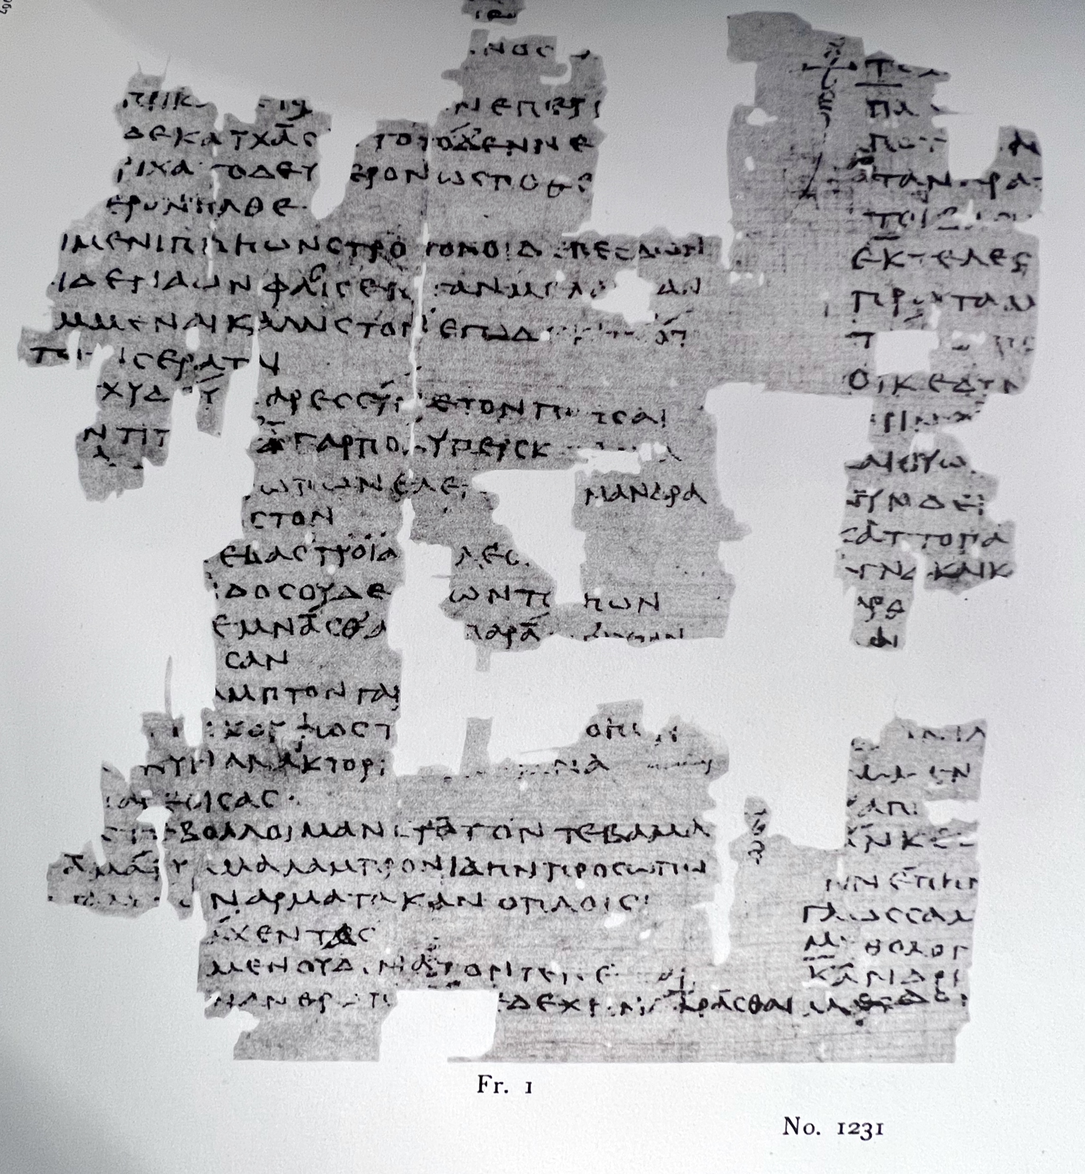
Case-study 1, Greek
Sappho fragment 22:
From POxy 1231, remains of a 2nd century CE Egyptian papyrus published in 1914. Including, as seen here on left, the extant fragments of Sappho poem 16.

Slide 12
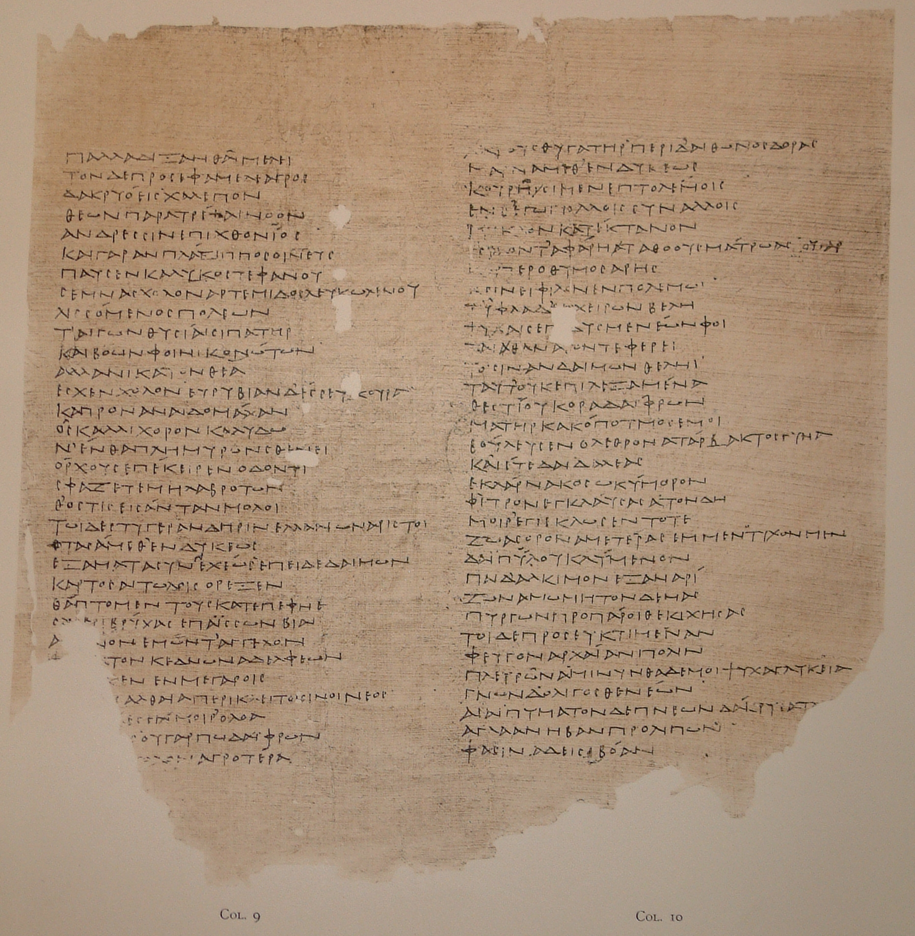
Sappho fragment 22:
]βλα ̣[
]εργον, ̣ ̣ λ’α ̣ ̣[
]ν ῤέθοϲ δοκιμ̣[
]ηϲθαι
]ν̣ αὐάδην χ ̣[
δ]ὲ μή, χείμων[
] ̣οιϲαναλγεα ̣[
]δε
̣] ̣ε ̣[ ̣ ̣ ̣ ̣] ̣[ ̣ ̣ ̣ κ]έλομαι ϲ’ ἀ[είδην
Γο]γγύλαν [Ἄβ]ανθι λάβοιϲαν ἀ ̣[
πᾶ]κτιν, ἆϲ ϲε δηὖτε πόθοϲ τ ̣[
ἀμφιπόταται
τὰν κάλαν· ἀ γὰρ κατάγωγιϲ αὔτα[ϲ ϲ’
ἐπτόαιϲ’ ἴδοιϲαν, ἐγὼ δὲ χαίρω·
καὶ γὰρ αὔτα δήπο[τ’] ἐμεμφ[ετ’ ἄγνα
Κ]υπρογέν[ηα
ὠς ἄραμα[ι
τοῦτο τὦ[ποϲ
β]όλλομα[ι
]
]work
]face
]
]
if not, winter
]no pain
]
]I bid you sing
of Gongyla, Abanthis, taking up
your lyre as (now again) longing
floats around you,
you beauty. For her dress when you saw it
stirred you. And I rejoice.
In fact she herself once blamed me
Kyprogeneia
Because I prayed
this word:
I want
(trans Anne Carson, If Not, Winter)

Slide 13
]
]work
]face
]
]
if not, winter
]no pain
]
]I bid you sing
of Gongyla, Abanthis, taking up
your lyre as (now again) longing
floats around you,
you beauty. For her dress when you saw it
stirred you. And I rejoice.
In fact she herself once blamed me
Kyprogeneia
Because I prayed
this word:
I want
Seasons ⟺ time ⟺ emotion
Address ⟺ time
Time for the poem: hers, … yours? … ours? – song/text as a space and the dynamics of address
Fragments of time ⟺ desire ⟺ experience
See further e.g. Purves (2021) under Recommendations for Further Reading
Notes:
So Gurd points us to the ways in which something so inviting, so alluring, also, by virtue of its very poetic artistry, gets us to think about what is and is not natural for us to feel, and to question and think hard about big ideas such as the nature of culture and the nature of art.
It can also show how much this imaginary realm can be a source of consolation (Payne):
Thinking through/with the bitter-sweet beauty-cum-transience of flowers makes the idea of human loss somehow more manageable. Flowers in a landscape stand in for, or act as a – however feeble – surrogate for things we have lost. They also articulate but mitigate our own (mortal) sense of distance: as from the natural, so too from the dead or departed; and so too, by extension, from the ancient.
That, I think we can agree, has taken us quite a long way from puzzling over a piece of broken pottery!

Slide 14
Case-study 2, Latin
CIL 4.5296
*a verse inscription, discovered 1888, in a narrow alley (a ‘doorway’ in a private dwelling) in Pompeii’s ninth region. Published with brief commentary: Sogliano, in Notizie degli scavi (1888)
*Should be in the Archaeological Museum in Naples, but has gone missing.

Slide 15
Oh, would that it were permitted to grasp with my neck your little arms
as they entwine [it] and to give kisses to your delicate little lips.
Come now, my little darling <pupula>, entrust your pleasures to the winds.
(En)trust me, the nature of men is insubstantial.
Often as I have been awake, lovesick <perdita> , at midnight <media nocte>,
you think on these things with me: many are they whom Fortune lifted high;
these, suddenly thrown down headlong, she now oppresses.
Thus, just as Venus suddenly joined the bodies of lovers,
daylight divides them and if...
Why wall (do you obstruct) love(rs)
Ovid, Metamorphoses 4.71-75
Often, when they were in place, Thisbe here, and Pyramus there, and they had each caught the sound of the other’s breath, they said “Unfriendly wall, why do you hinder lovers” (paries, quid amantibus obstas? ... ‘How great it would be, were you to allow us to join with our whole bodies
O utinam liceat collo complexa tenere
brac<ch>iola et teneris || oscula ferre label<l>is.
i nunc, ventis tua gaudia, pupula, crede. ||
Crede mihi, levis est natura virorum.
Saepe ego cu<m> media || vigilare<m> perdita nocte,
haec mecum medita<ri>s: multos || Fortuna quos supstulit alte
hos modo proiectos subito || praecipitesque premit.
Sic Venus ut subito coiunxit || corpora amantum,
dividit lux et se…
paries quid ama(ntibus obstas)

Slide 16
From context, then, we come back to text—or rather, to the intersection between them which is where graffiti exist. Classics generally, as a discipline, has long been interested in the distinction between two ways of understanding a written document, as something which is framed by a set of transhistorical formal concerns, and as an object which is both situated in, and gives us as scholars access to, a very distant moment in time. Over the past few decades, the field has moved away from its traditional focus on the first to be more concerned with the second, a circumstance which has done much to transform our views of both classical literature and history. Yet one of the effects of Pompeian graffiti like CIL 4. 5296 is to force us to confront not just how literary forms are framed by historical practices, but that literary forms sometimes are historical practices, on a real material level.
Milnor, K. 2014. Graffiti and the Literary Landscape in Roman Pompeii. Oxford UP.

Slide 17
Issues to consider, ideas to ponder, much more generally…
How to cope with being a classical reader:
access versus loss; context and contextualizability; worlds/realms of experience
Translation and translatability; translation as ALWAYS interpretation
Close-reading, and its stakes:
reading for form and with form, in relation to choosing (or choosing not) to read for context (and the limitations and dynamics of this kind of approach)

Slide 18
Recommendations for Further Reading:
General approaches to literary criticism alongside but also very much in tension with thinking with history:
Attridge, D. 2004. The Singularity of Literature. London: Routledge. Available as e-book.
Sedgwick, E. K. 2003. ‘Paranoid reading and reparative reading, or, you’re so paranoid, you probably think this essay is about you.’ Chapter 4 in Touching Feeling: Affect, Pedagogy, Performativity. Durham, NC: Duke. Available as e-book.
Essential for thinking about how extant products of classical culture and their influence (texts; art) make us begin to reassess our own understandings of our positioning in time:
Rood, T., Atack, C. and Phillips, T. 2020. Anachronism and Antiquity. London: Bloomsbury. Available as e-book.
Greek:
DuBois, P. 2005. Sappho. London: IB Tauris. Available as e-book.
Goldhill, S. 1986. Reading Greek Tragedy. Cambridge. Available online.
Graziosi, B. 2019. Homer: A Very Short Introduction. Oxford: OUP.
Pelling, C. B. R. 2019. Herodotus and the Question Why. Austin, University of Texas Press.
Purves, A. 2021. ‘Sappho’s lyric sensibility.’ In P. J. Finglass & A. Kelly eds. The Cambridge Companion to Sappho. 175–89. Cambridge. Available online.
Wiles, D. 2002. Greek Theatre Performance: An Introduction. Cambridge .

Slide 19
Latin:
recommended overview:
G.B. Conte 1994. Latin Literature. A History. Trans. J.B. Solodow. Johns Hopkins Univ. press, Baltimore and London.
companions and handbooks:
S. Harrison (ed.) 2005. A Companion to Latin Literature. Blackwell, London.
J. Marincola (ed.) A Companion to Greek and Roman Historiography. Blackwell, London.
The peculiarity of Latin literature:
Feeney, D. Beyond Greek: The Beginnings of Latin Literature. Cambridge, MA; London: Harvard University Press, 2016
Modes of literature: performance and writing
Lowrie, M. 2009, Writing, performance, and authority in Augustan Rome, Oxford University Press, Oxford.
The Cambridge ‘Roman Literature and its Contexts’ series (Available as e-books):
Catharine Edwards (1996) Writing Rome: textual approaches to the city.
Duncan Kennedy (1993) The Arts of Love: Five Studies in the Discourse of Roman Love Elegy.
Charles Martindale (1993) Redeeming the Text: Latin Poetry and the Hermeneutics of Reception.

