Slide 1
Wilding Stories
Chapters 1-14

Slide 2
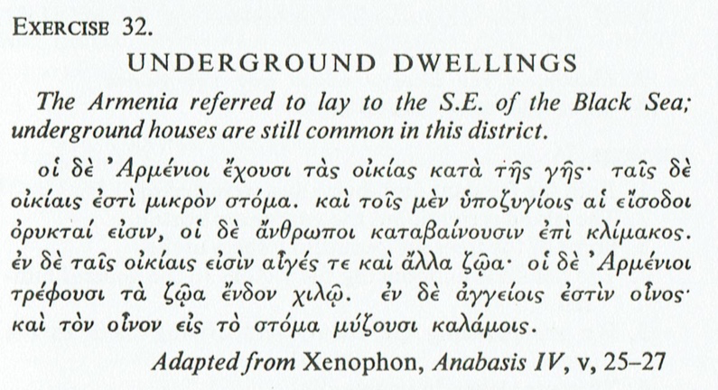

Slide 3
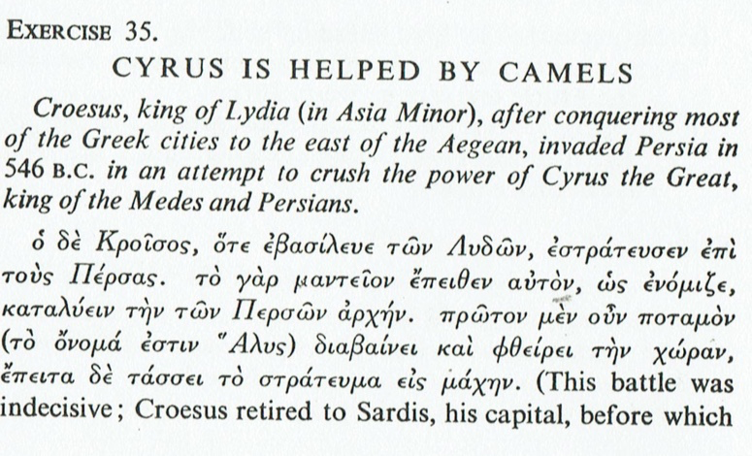
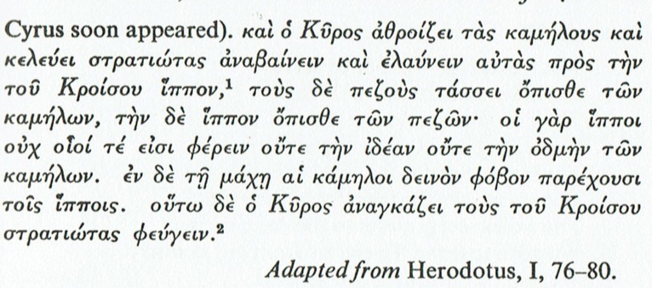

Slide 4
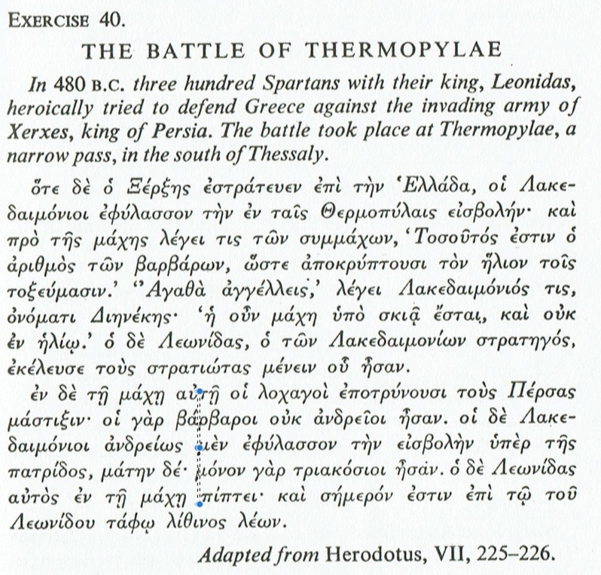

Slide 5
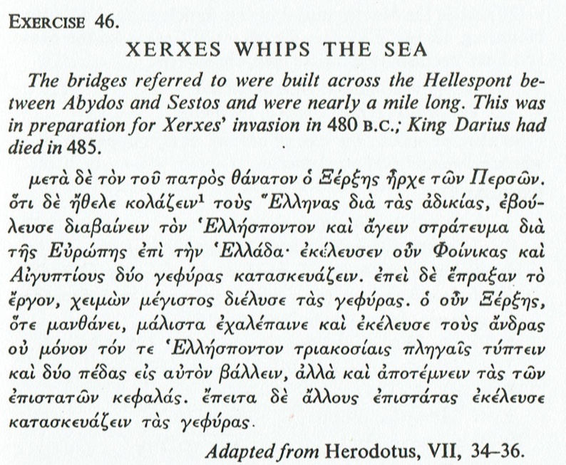

Slide 6
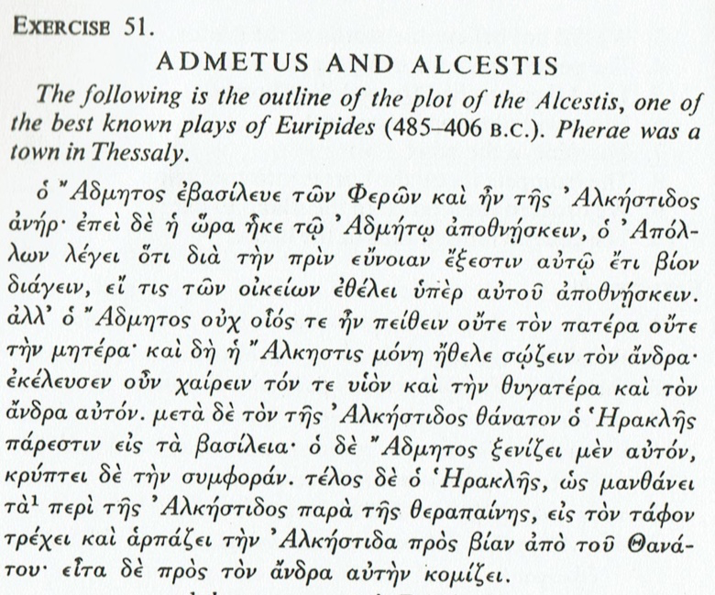
British Museum, Beazley Archive No.212127
Attic Red Figure, Kantharos
Attributed to the Amphitrite Painter
Alcestis and Admetus, House of the Tragic Poet, Pompeii

Slide 7
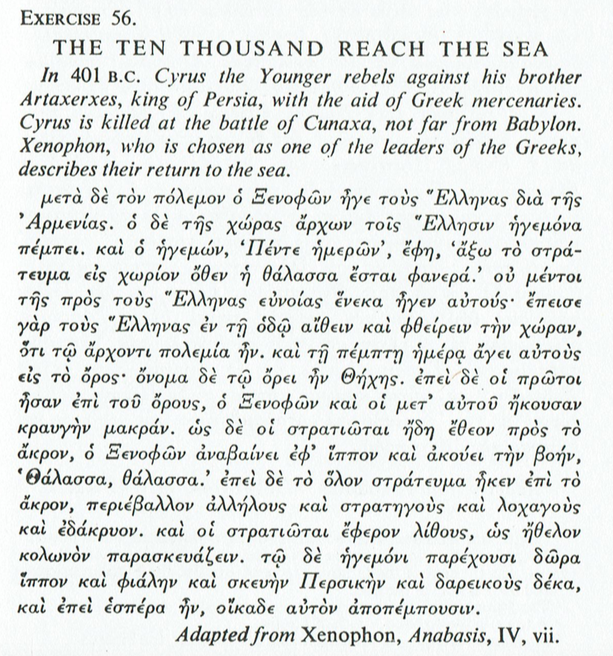

Slide 8
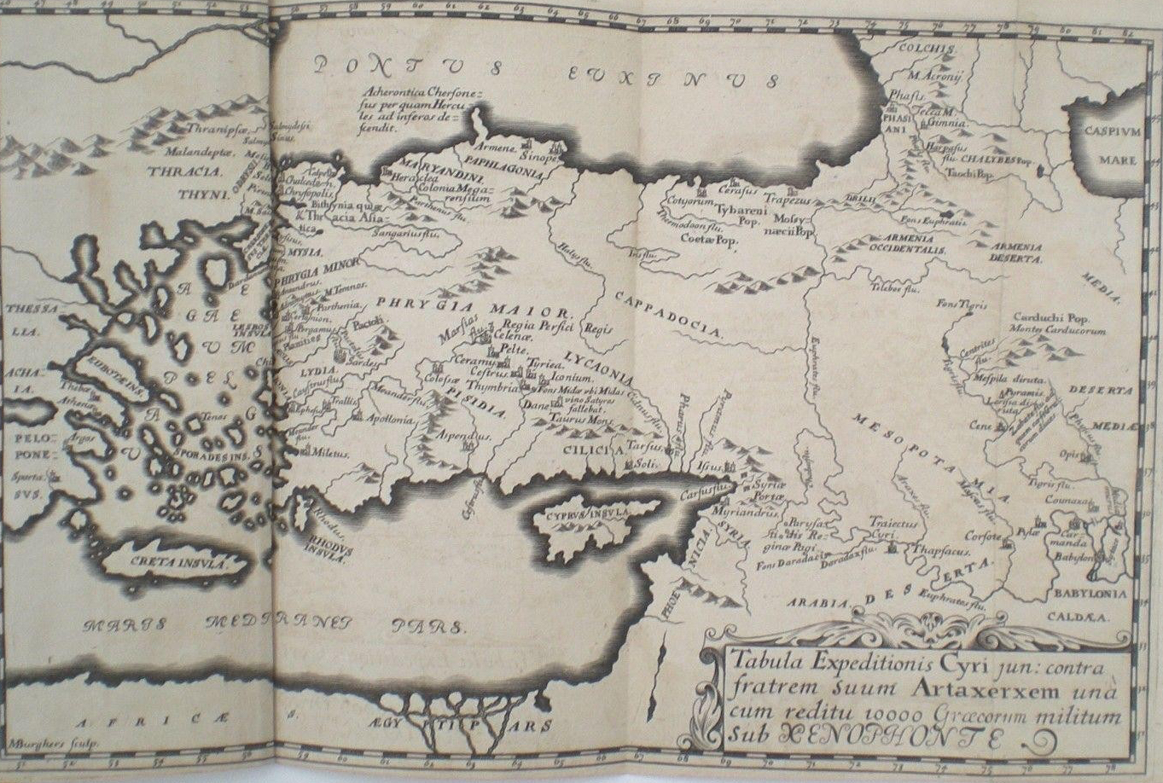
ANABASIS MARCH OF THE 10,000 BY XENOPHON VOL. II 1696 ED. IN LATIN & GREEK

Slide 9
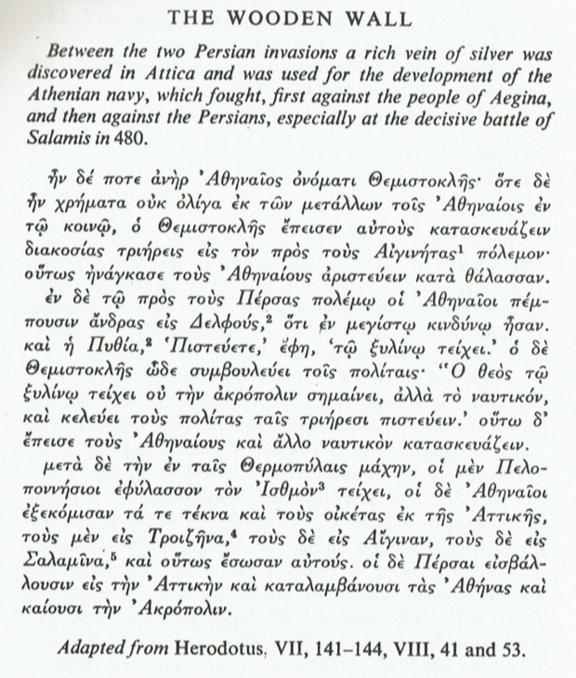

Slide 10
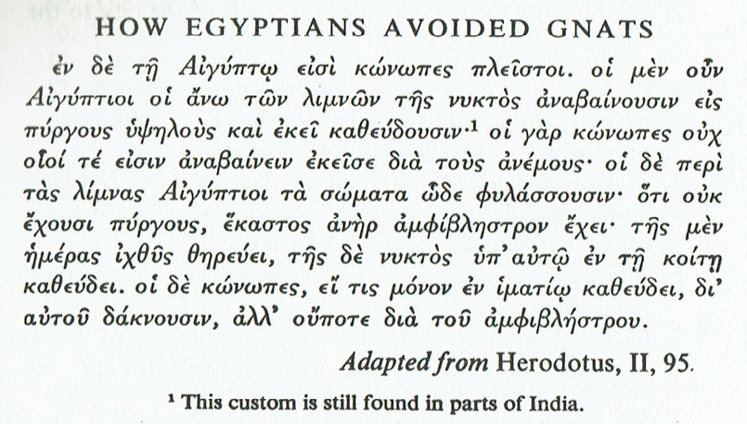

Slide 11
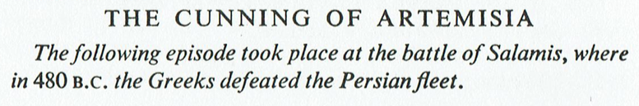
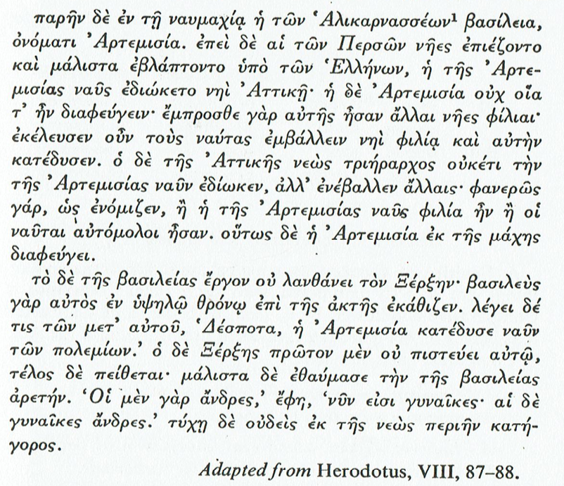
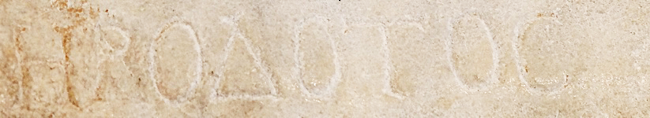
Battle of Salamis (Die Seeschlacht bei Salamis) Wilhelm von Kaulbach
Bust of Herodotus
with an inscription of his name in Greek.
Roman copy of the Imperial era (2nd century CE) after a Greek bronze original of the first half of the 4th century BCE. From Benha (ancient Athribis), Lower Egypt. (Metropolitan Museum of Art, New York)

