Slide 1
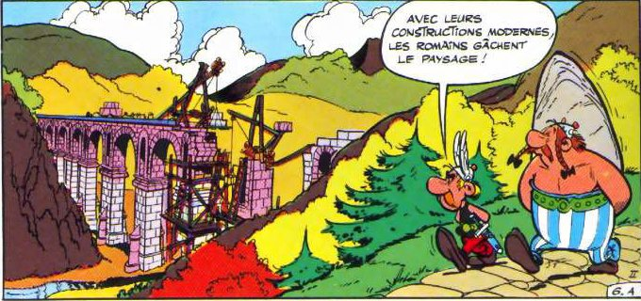
Roman Architecture
‘Alright, apart from the sanitation, medicine, education, wine, public order, irrigation, roads, a fresh water system, and public health, what have the Romans ever done for us??’
Monty Python, Life of Brian

Slide 2
What is ‘Roman’ Architecture?
How many of these concepts had precedents in Greece or the Near East?
Are Romans merely plunderers of other cultures?
What are factors in determining architectural style:
Climate
Raw Materials available
Population: Indigenous culture, religion and tradition
Type and function of objects
Urban Context
Ideology & Personal choice: who set up these buildings?

Slide 3
Sources on Roman Architecture
Vitruvius, De Architectura: 10 books
Frontinus, De Aquaeductu
Pliny the Elder, Natural History
Coins:
Archaeology:
Inscriptions

Slide 4
We built this city: Urban Plans
What do urban plans tell us about:
the nature of Roman urban planning
the location of public buildings
the function of architecture and its urban context
Urban growth and development
How ‘universal’ were Roman urban plans?

Slide 5
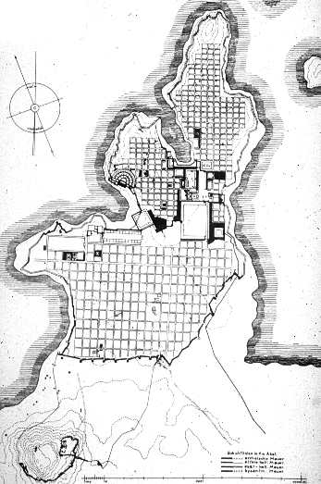
Hippodamian Grid Plan
Hippodamian Grid Plan: Miletos, 5th century colony (Asia Minor)

Slide 6
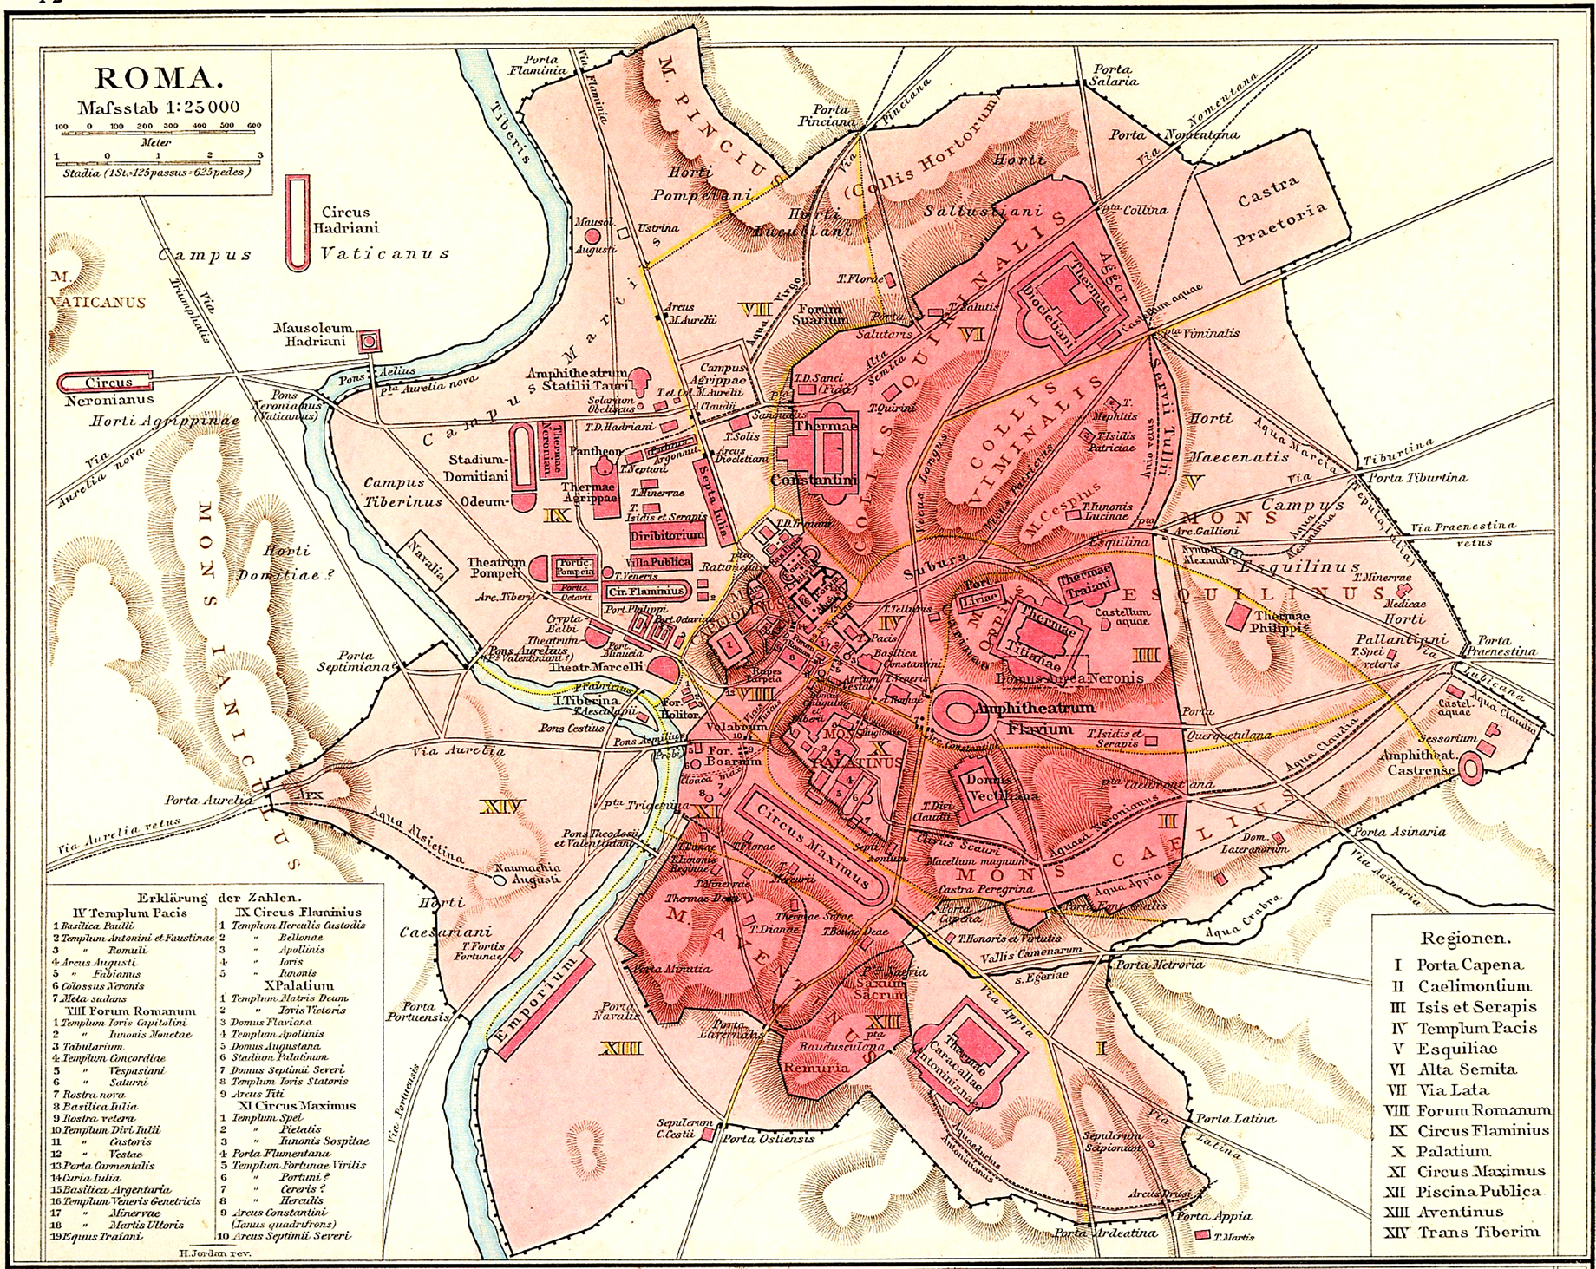
Urban Plans: Rome a case study in organic growth

Slide 7
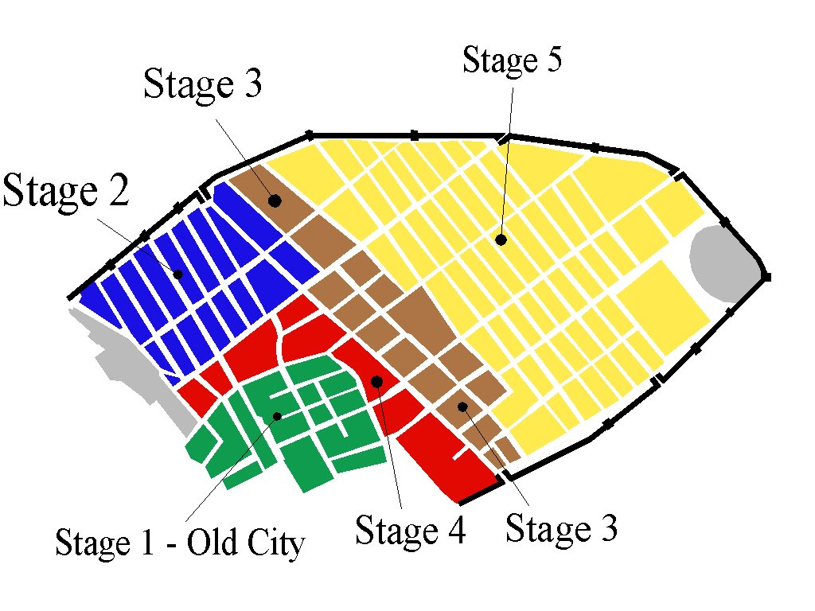
Pompeii: Gradual and regulated growth
Oscan/Etruscan 7th-6th c BC
Greek City 6^{th/5th} c BC
Samnite City 4th c. BC
Sullan Colony ca. 80 BC
Post Sullan City 79BC-AD 79

Slide 8
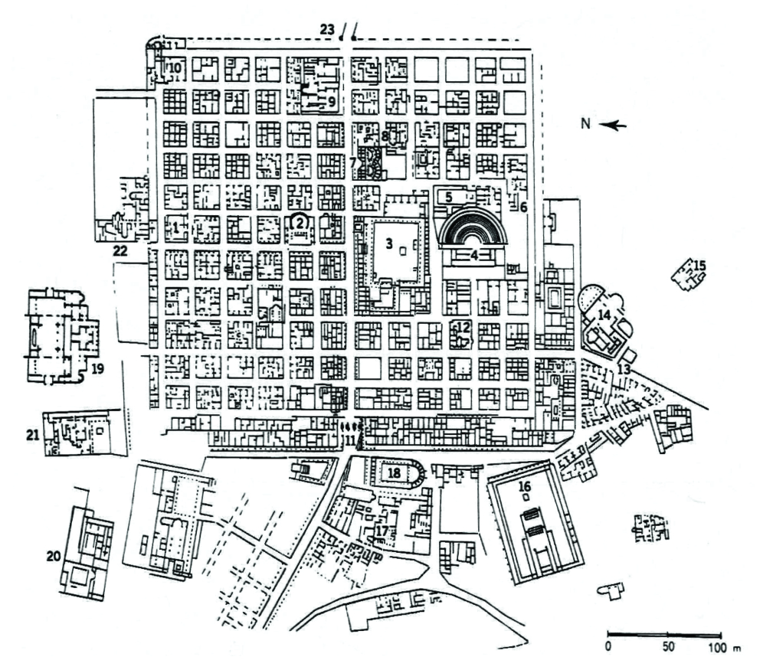
Timgad (Algeria): The Ideal Plan

Slide 9
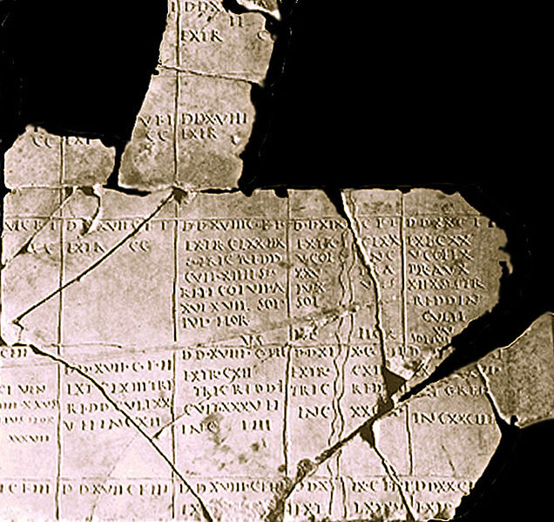
Centuriate Plan at Arausio (Orange)

Slide 10
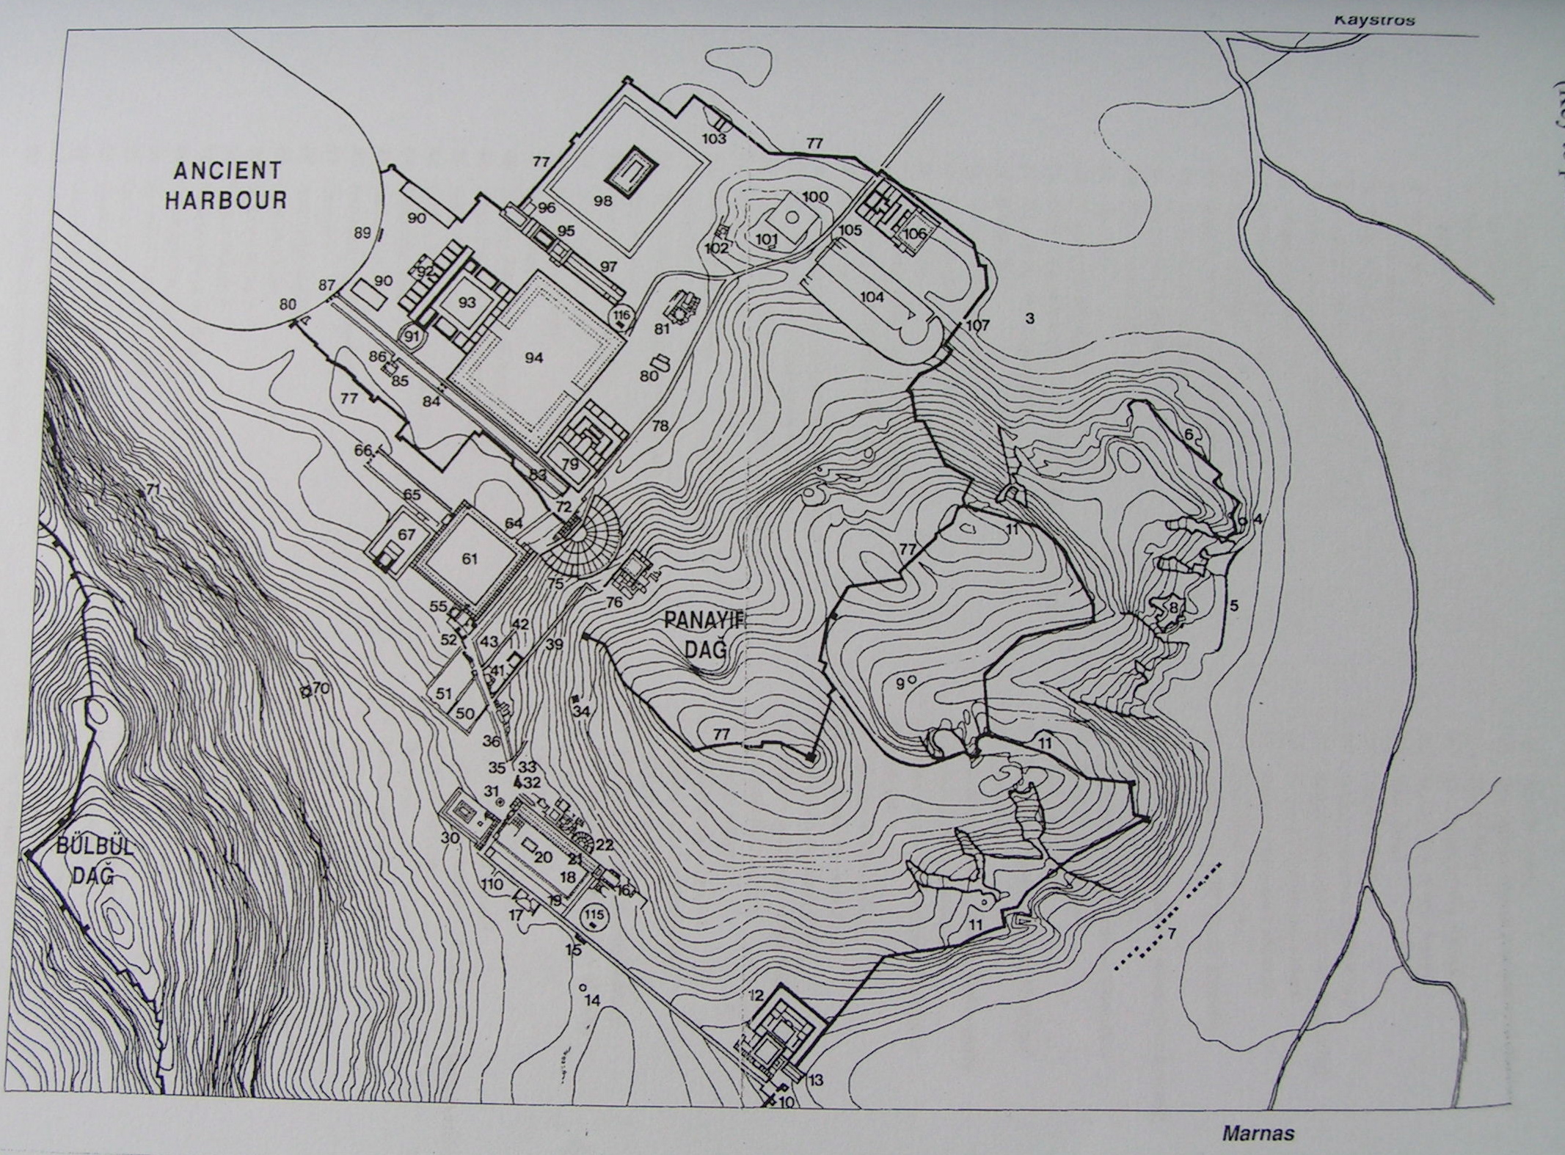
Urban plan at Ephesus (Asia Minor)

Slide 11
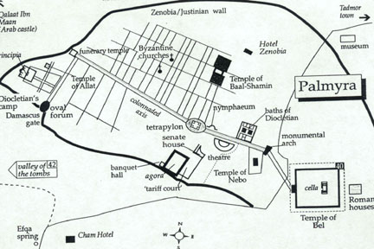
Urban Plan at Palmyra (Syria)

Slide 12
Part 1. ‘Roman’ Temples: Style & Ideology
What is the origin of a ‘Roman’ temple?
Are all ‘Roman’ temples to ‘Roman’ gods?
Who set up ‘Roman’ temples?
What does adoption of style reveal about identity?
Is adoption of style tantamount to adoption of ideology?

Slide 13
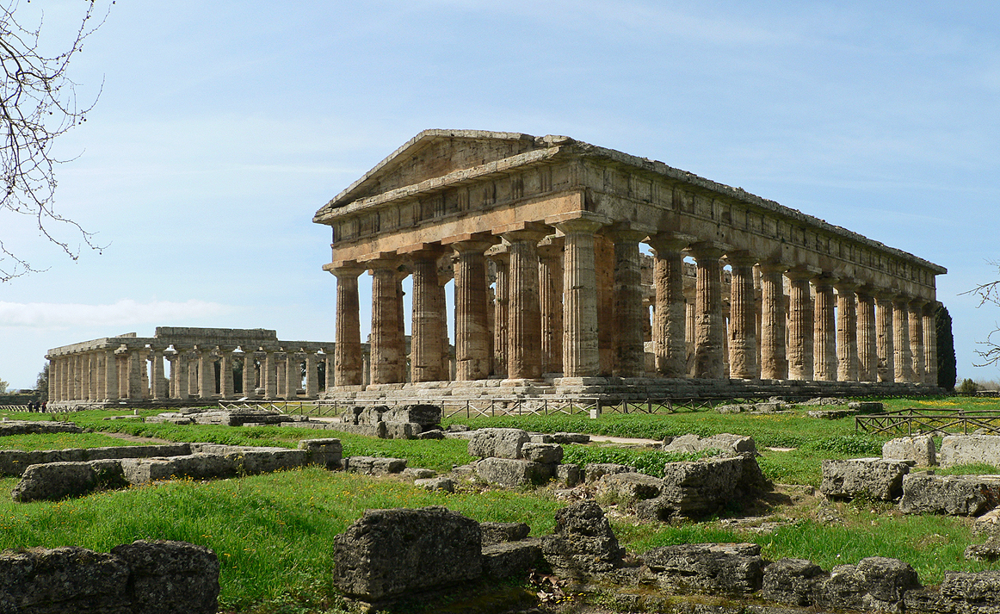
Greek temples in Paestum (Samnium)

Slide 14
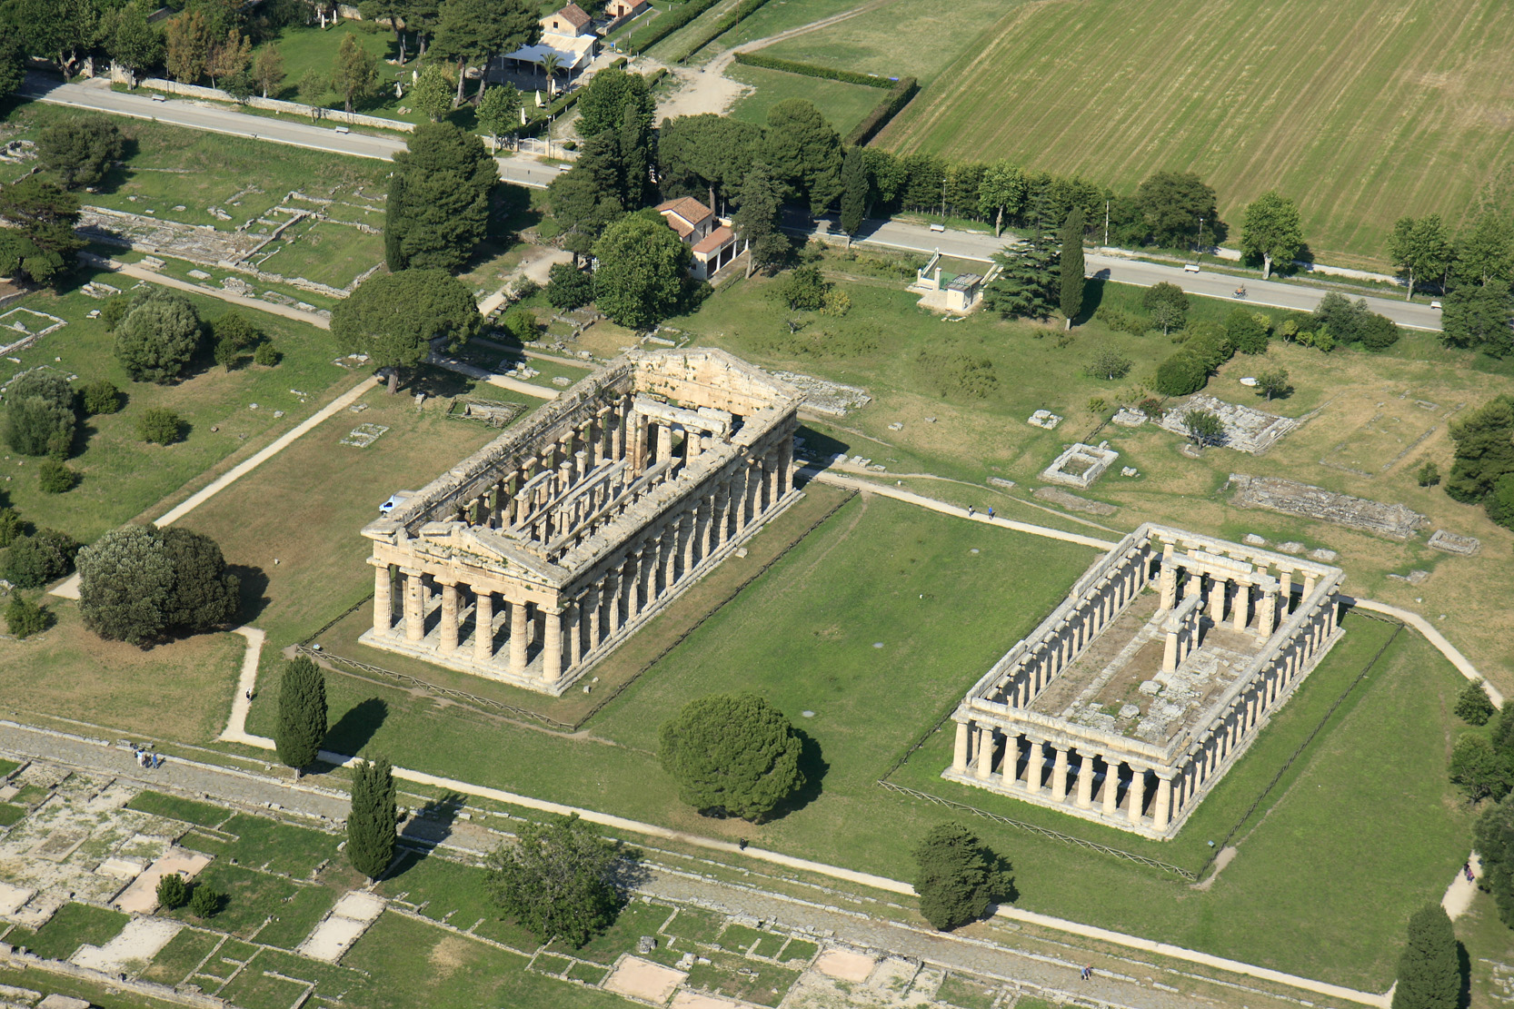
Greek Symmetry: cella, front porch/back porch
Vitruvius lays out the orders and plans of Greek temples
and orders (Doric, Ionic, &Corinthian) in De Architectura,
Book IV. Chapters 1-6

Slide 15
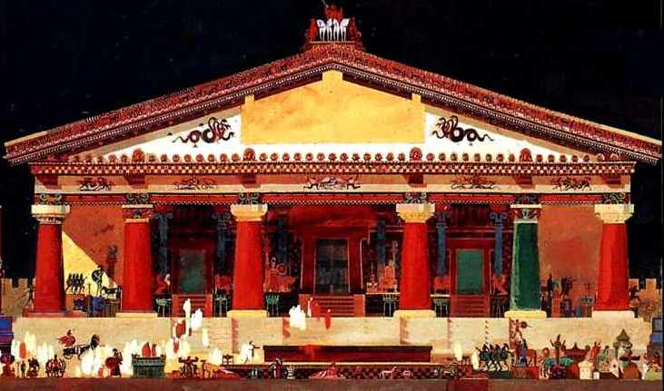
Etruscan Temples: spot the differences..

Slide 16
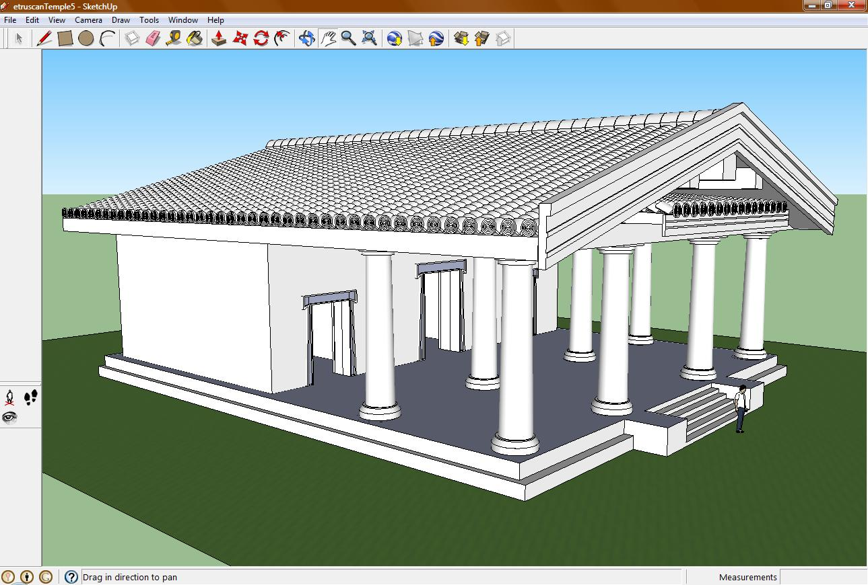
Etruscan Temples: axial plans & hierarchy
Etruscan temples are defined by Vitruvius in De Architectura Book IV. Chapter 7.

Slide 17
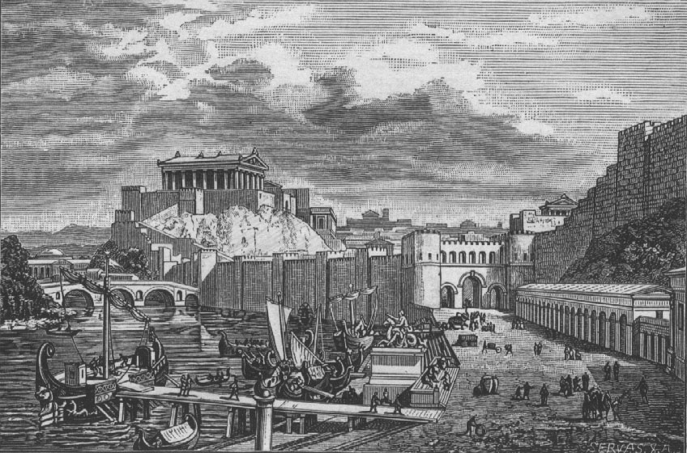
Roman’ Temples in Rome

Slide 18
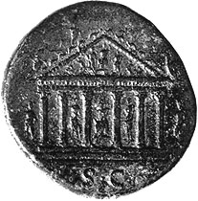
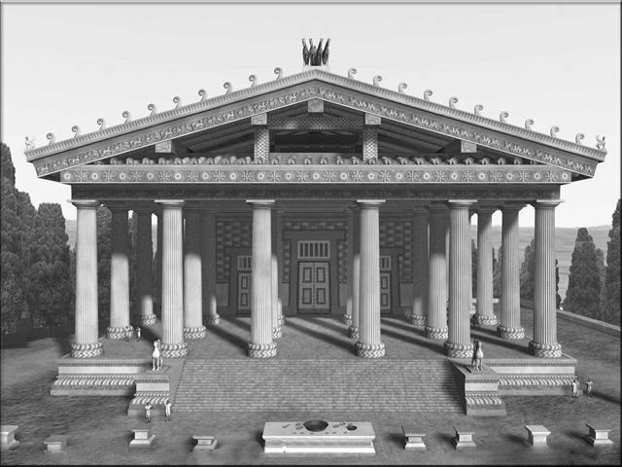
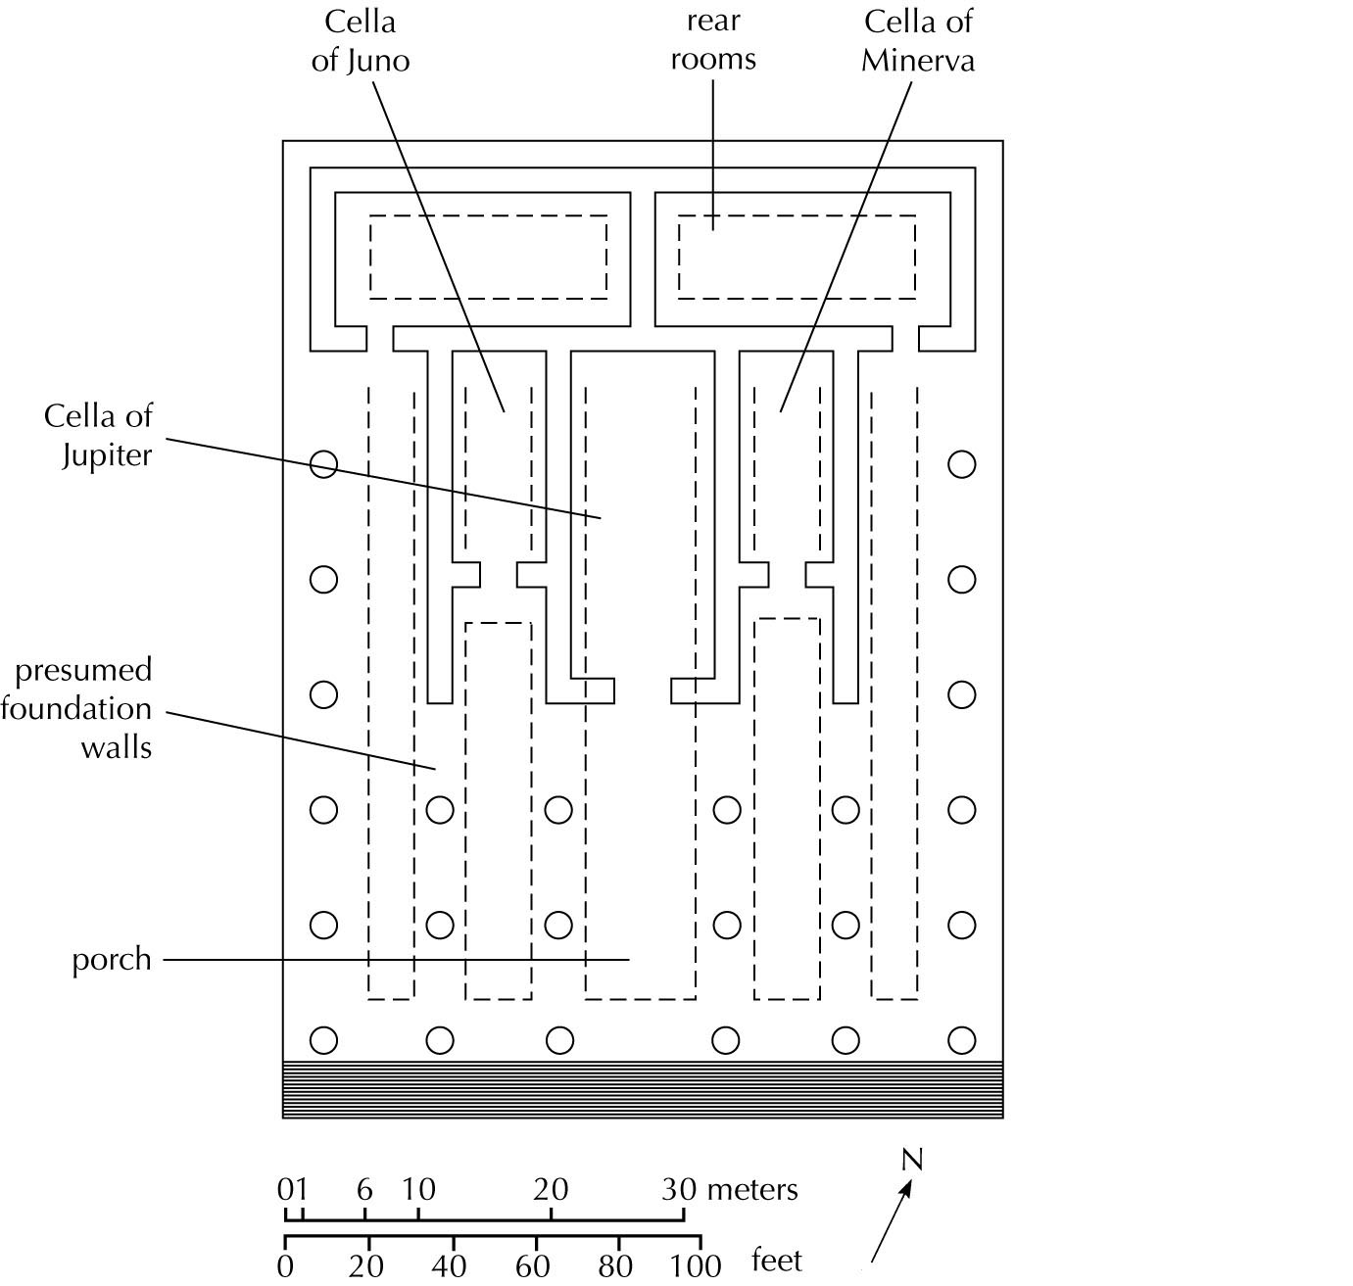
‘
Temple of Jupiter Optimus Maximus
Vowed in 509 at the top of the Capitoline hill

Slide 19
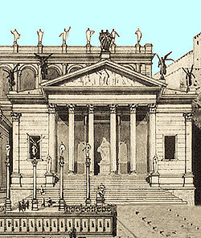
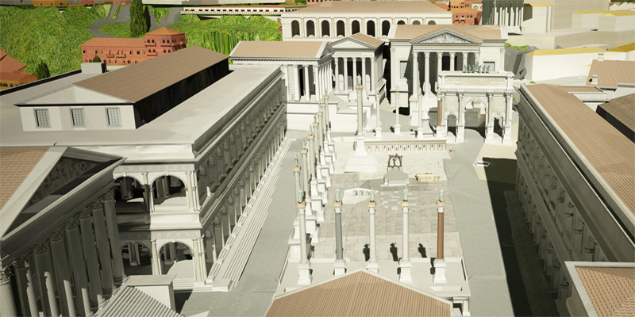
The Temple of Concord
Forum Romanum vowed 367 BC

Slide 20
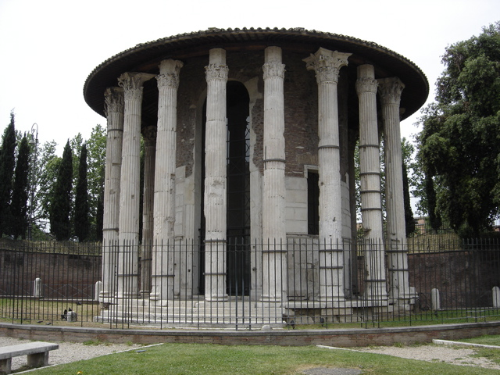
Temple of Hercules Victor:
Forum Boarium, Rome 100 BC

Slide 21
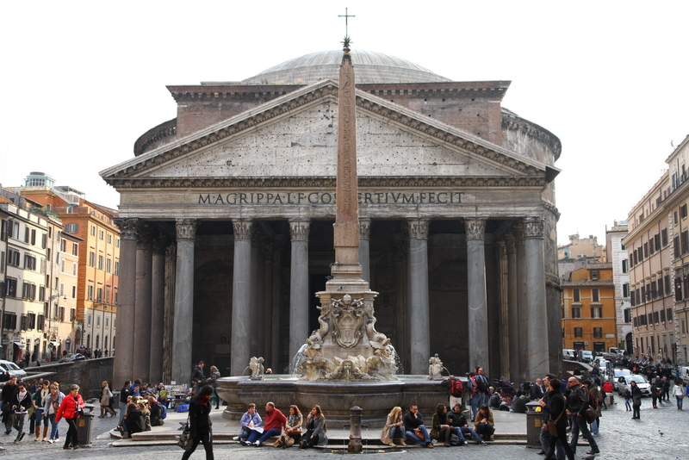
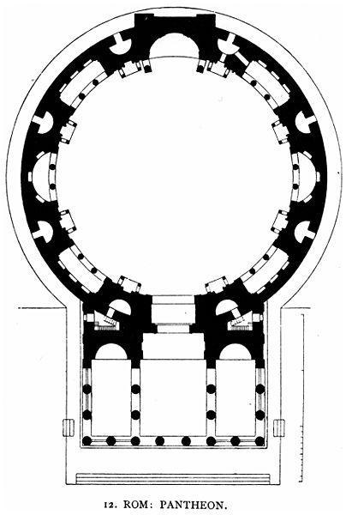
The Pantheon built by M. Agrippa in his third consulate.. Or so it says.

Slide 22
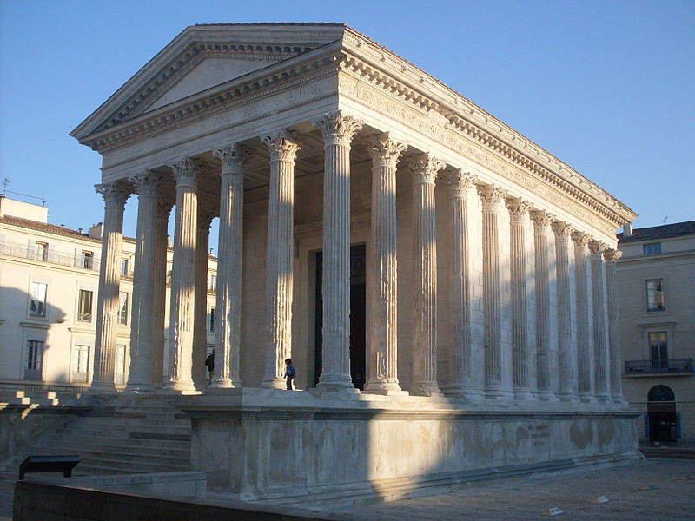
‘Roman’ temples in the Provinces:
Temple to Augustus at Nimes (Gallia Narbonensis) vowed by Agrippa in 16 BC (now called Maison Carée)

Slide 23
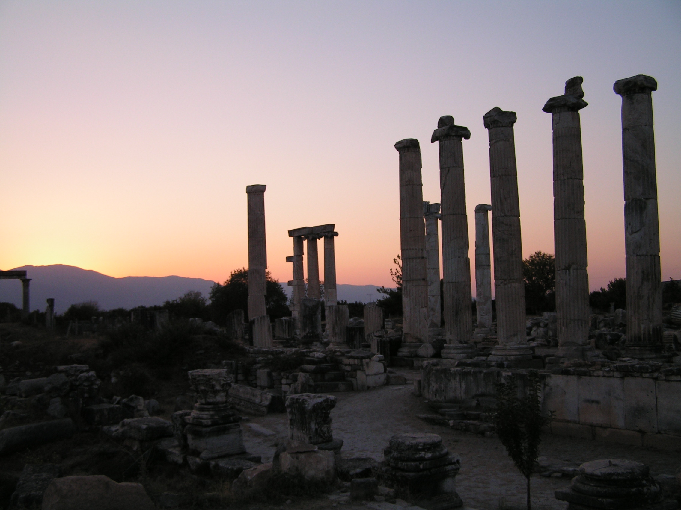
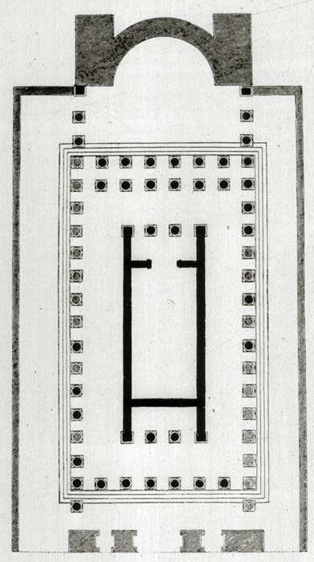
Temple of Aphrodite at Aphrodisias late 1st century BC

Slide 24
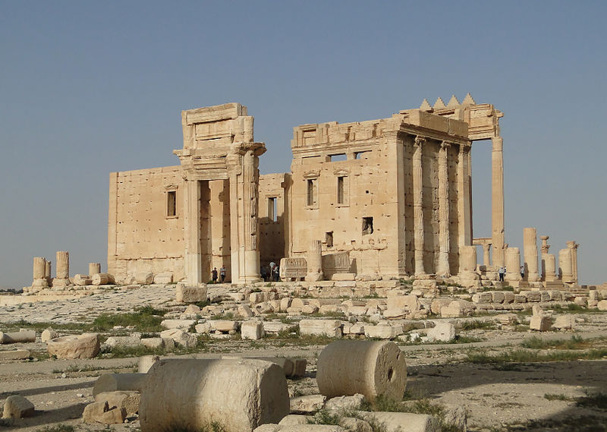
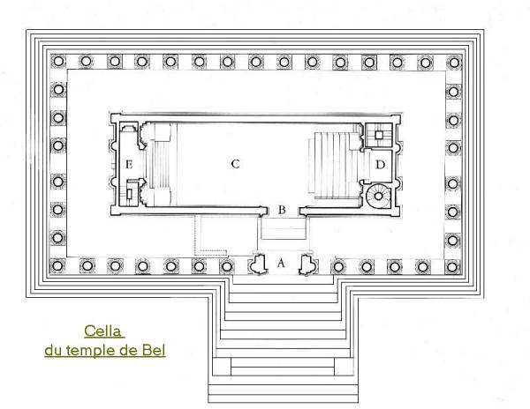
Temple of Bel: Palmyra (Syria)
built in ca. AD 32.

Slide 25
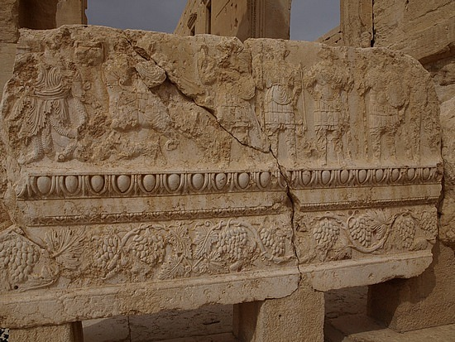
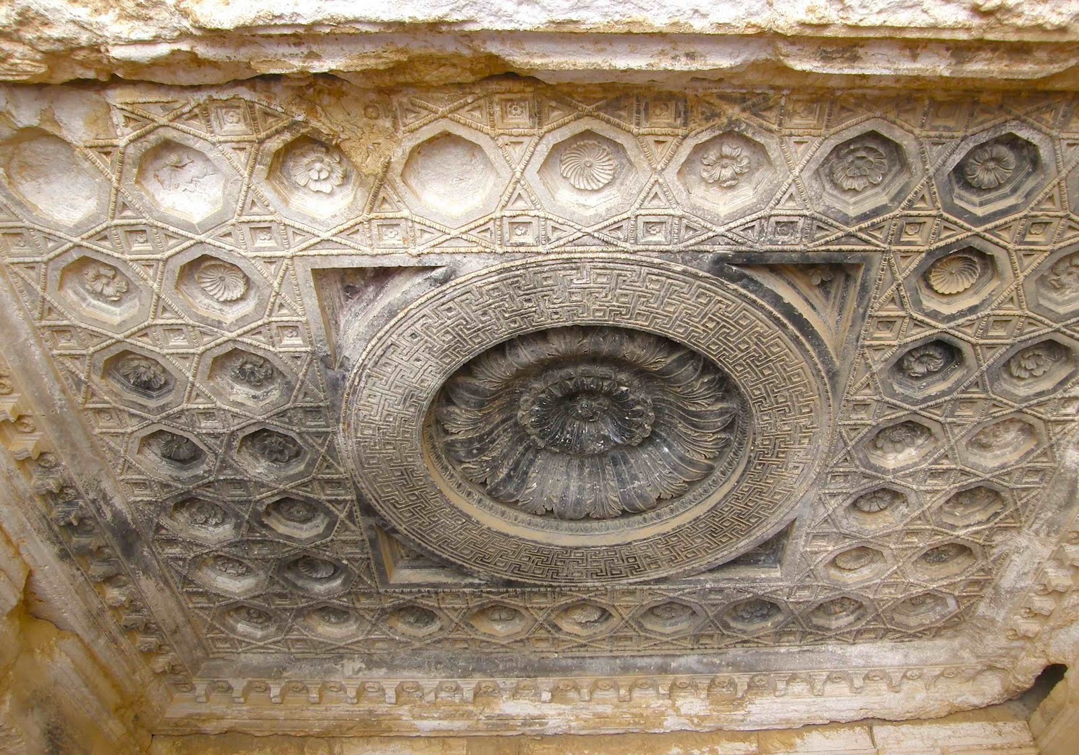
Reliefs from the Temple of Bel

Slide 26
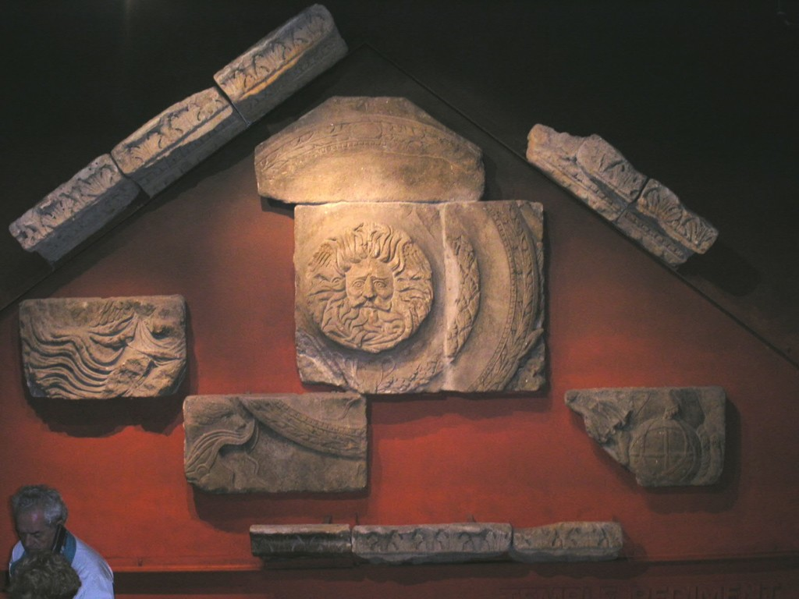
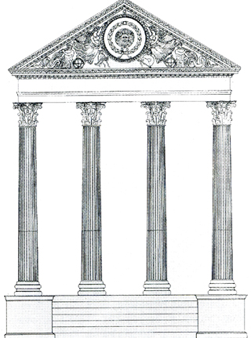
Temple of Minerva Sulis (Bath) dedicated in the 1st c.AD

Slide 27
Part 3. What is a ‘Roman’ Theatre?
Romans adapt the Greek theatre in terms of appearance and function, and design?
What does the location of the theatre reveal about its function and design?
What regional variations are evident?
Is Vitruvius’ ideal theatre useful?
What made the Roman scaenae frons so ‘dramatic’?

Slide 28
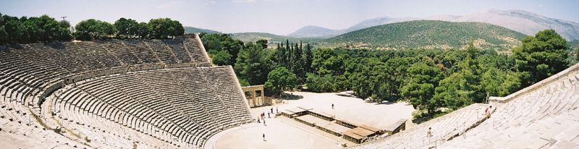
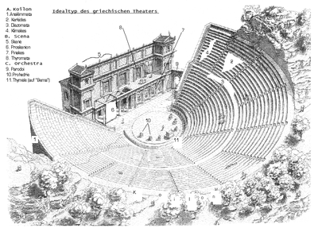
Greek Theatre at Epidaurus
The Greek Theatre
Greek theatre model>
Symmetry, Equality &Nature:
Seating, Entrances, &the Stage

Slide 29
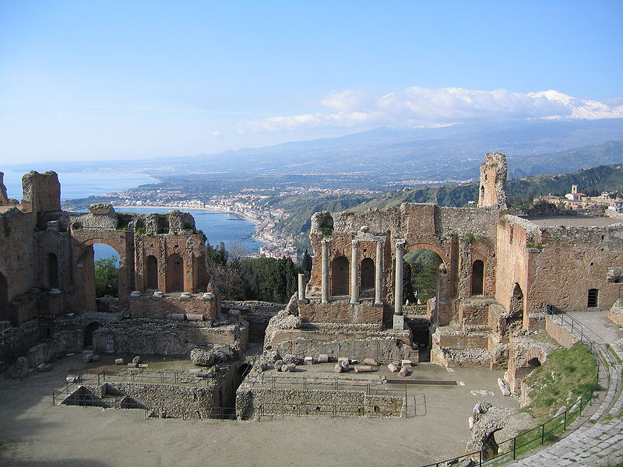
Greek Theatre at Taormina, Sicily
Original ca. 7thc. BC, Roman brick clearly
Dates later…

Slide 30
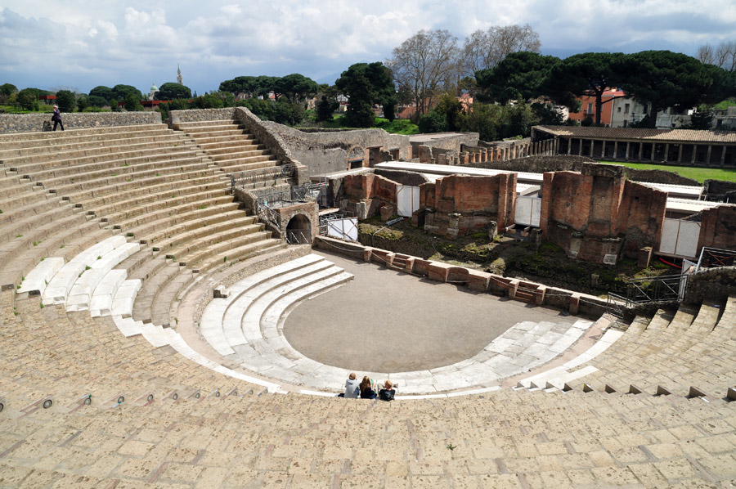
Roman theatres in Italy: Pompeii 2nd C. BC

Slide 31
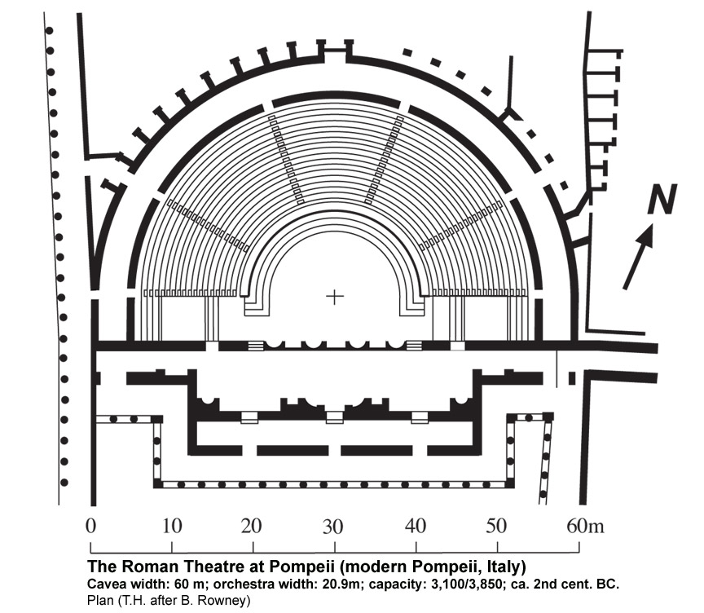
Plan of Grand theatre at Pompeii

Slide 32
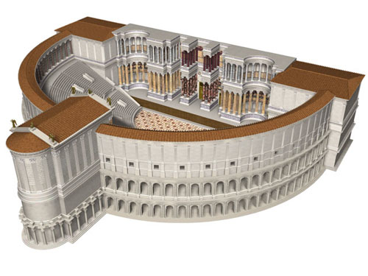
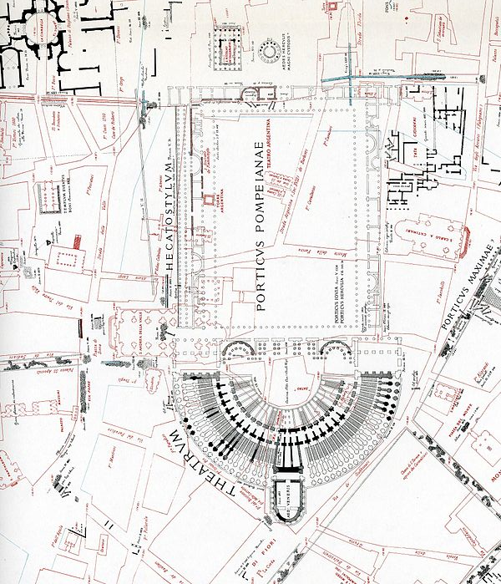
Theater of Pompey

Slide 33
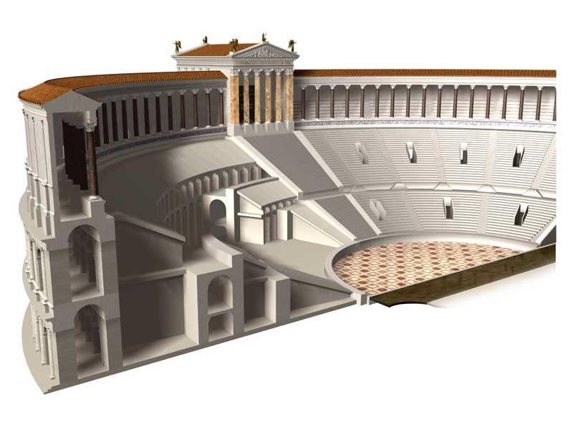
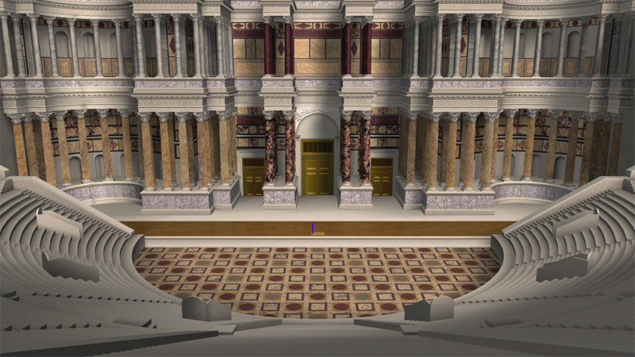
ca. 55 BC Rome

Slide 34
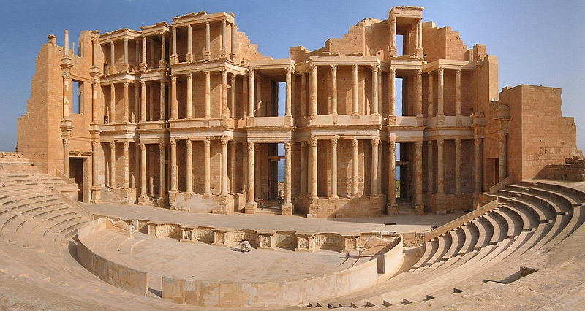
Scaenae Frons at Theatre in Sabratha (Libya)
3rd c. AD. Plan of a theatre: Vitruvius Book V, chapter 6

Slide 35
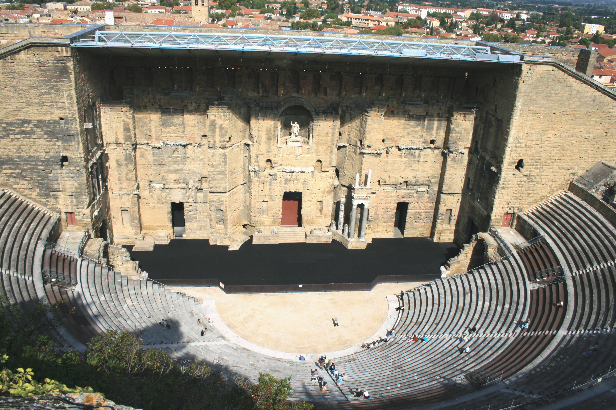
Brick Stage building at Arausio (Orange) 1st c. AD

Slide 36
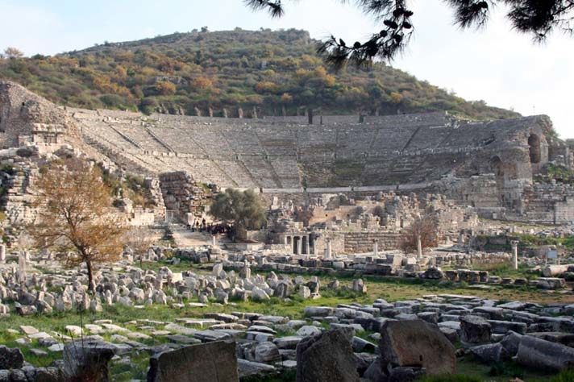
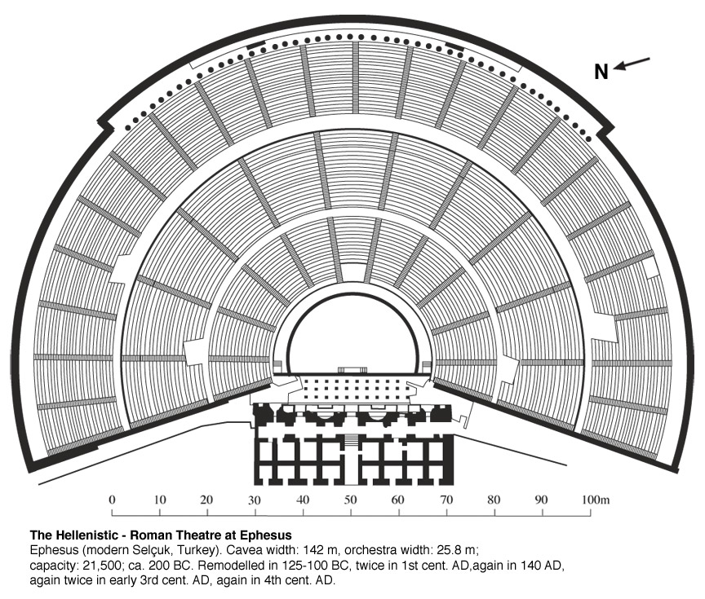
Graeco-Roman
Theatre at Ephesus
Foundations ca. 200 BC
Renovated numerous times until the 4th c. AD

Slide 37
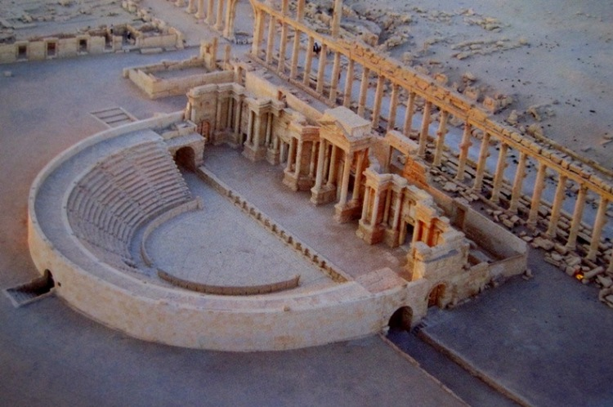
Theatre at Palmyra (Syria) ca. 3rd c. AD

Slide 38
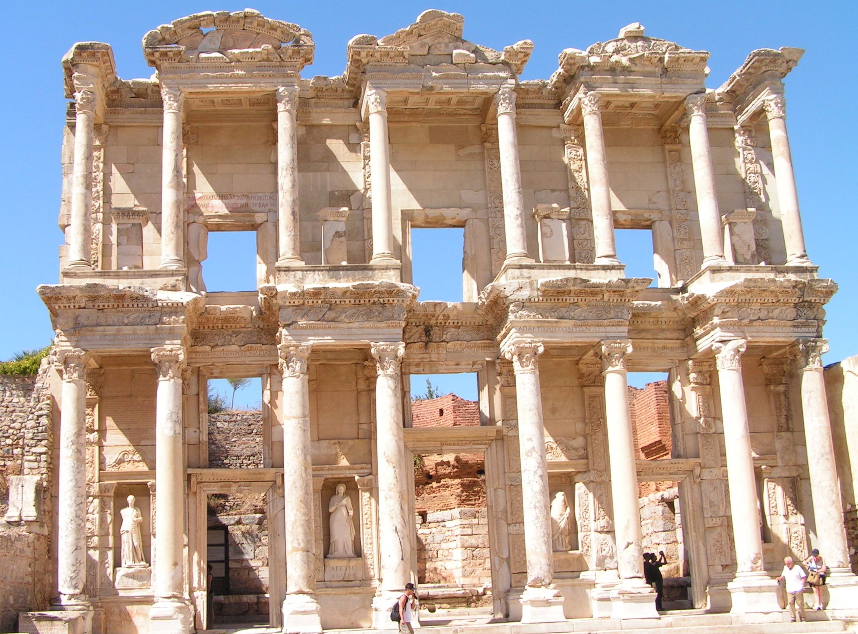
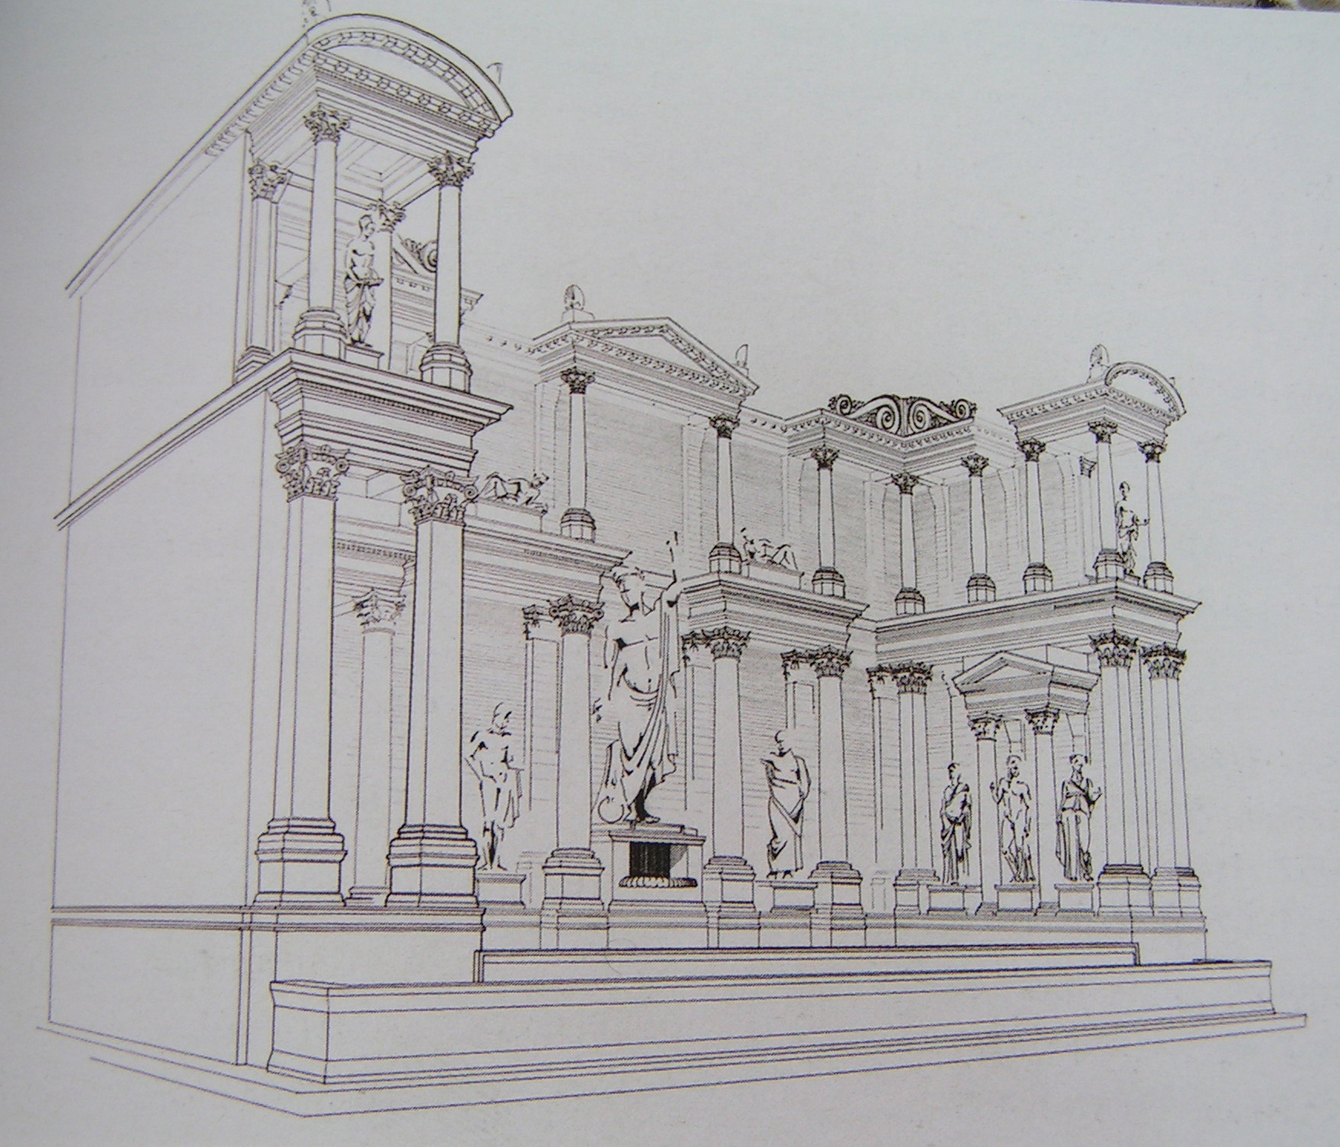
Scaenae frons: ‘dramatic’ architecture in Asia Minor
Above: Library of Celsus
Left: Nymphaeum Trajani
Both ca. early 2nd c. AD

Slide 39
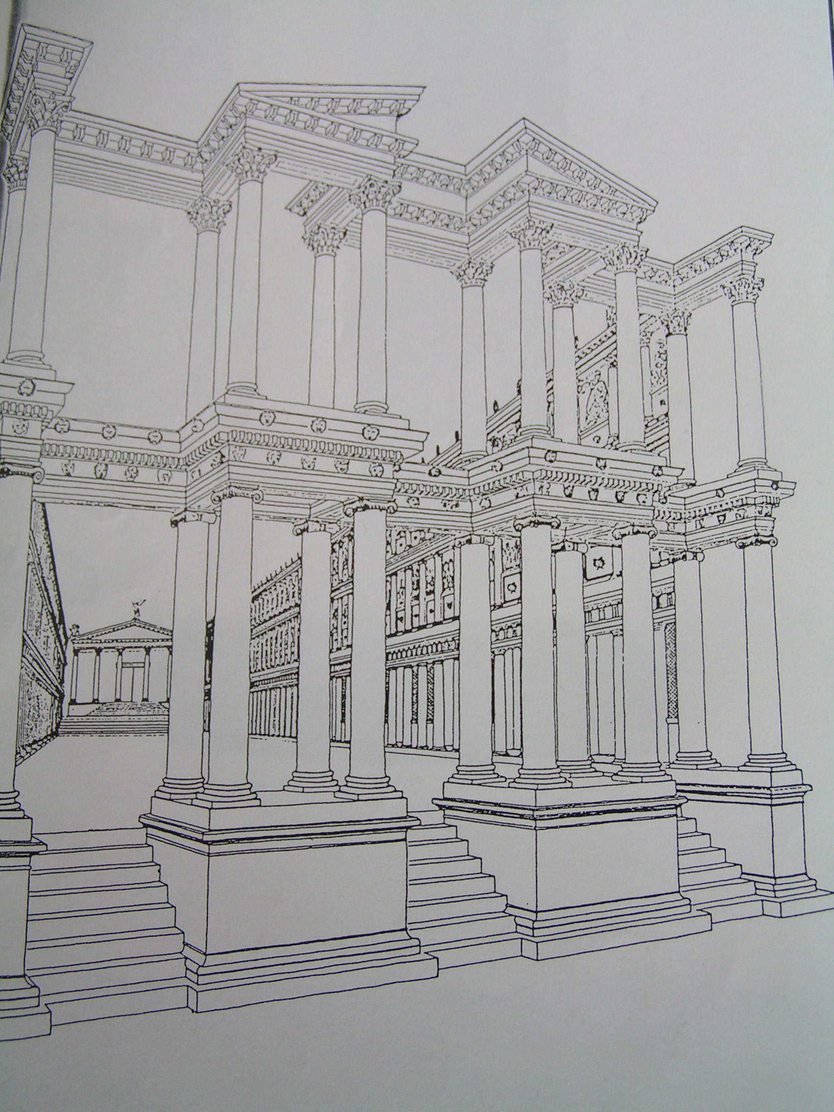
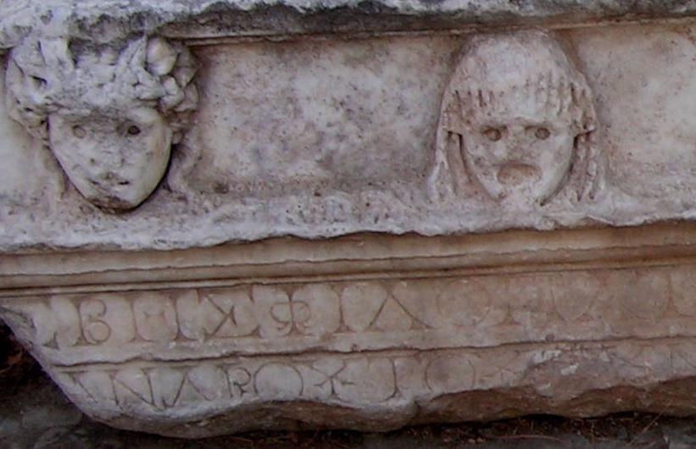
The Sebasteion at Aphrodisias:
Mythological, Imperial, Natural & local drama
Imperial Cult
Temple:
Dedicated early 1stc. AD
(took many generations to complete)

Slide 40
Part 4. Roman Baths

Slide 41
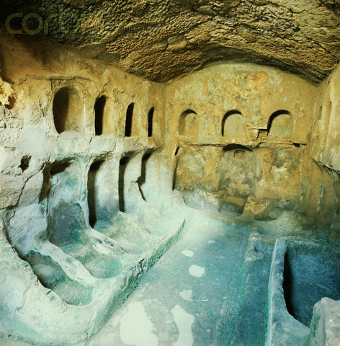
Underground Greek Baths from Cyrene

Slide 42
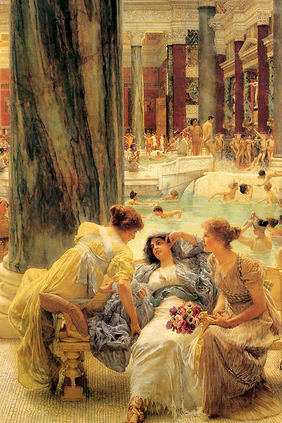
Roman Baths & Bathing
”I have lodgings over a bathing establishment;
Picture the assortment of sounds, which are strong enough to make me hate my powers of hearing! When your strenuous gentleman is exercising…flourishing leaden weights… I can hear him grunt …I can hear him panting in wheezy and high-pitched tones.. I notice some lazy fellow, content with heap rubdown and hear the crack of the pummeling hand on his shoulder....Add to this the arresting of an occasional pickpocket…the racket of the man who likes to hear his own voice in the bathroom, or the enthusiast who plunges into the pool with unconscionable noise and splashing.…imagine the hair-plucker with his penetrating shrill voice for purposes of advertising --never holding his tongue except when he is plucking armpits and making his victim yell instead. Then….all the vendors of food hawking their wares, each with his own distinctive intonation.” Seneca, Moral Epistles (LVI)

Slide 43



Forum Baths: Pompeii ca. 80 BC*renovated after earthquake in AD 62
Tepidarium
Frigidarium & plunge pool
Caldarium : Basin donated by duovirs ca. AD 3/4

Slide 44

Plan of Forum Baths

Slide 45

Baths of Agrippa: after 19 BC
Pantheon>
[In 25 BC] Augustus finished these wars. Agrippa, meanwhile, was beautifying Rome. He completed the Basilica for Neptune in honor of their naval victories and honored it with the painting of the Argonauts and built the “Spartan Bath” as well (it was called this with reference to its own gymnasium, where patrons exercised naked and oiled, a practice associated above all with Sparta at the time) Cassius Dio, History 53.27.1-3

Slide 46


Baths of Agrippa: what remains
Drawing by Palladio (16th century artist)
Remains by Basilica Neptune

Slide 47

Baths of Caracalla: Reconstruction

Slide 48


Slide 49


Reconstructions of the Baths of Caracalla

Slide 50



Baths of Caracalla: What remains..
A very special Chariot

Slide 51


Varius Baths & Latrines in Ephesus early 2nd c. AD

Slide 52




Baths in Bath
Plunge Pool in
Frigidarium
Spring overflow
Sacred Spring
Main Pool

Slide 53

Plan of the Baths

Slide 54

Health is to be clean!
Roman Baths at Sabratha

Slide 55


Hunting Baths
Lepcis Magna
Early 3rd c. AD

Slide 56


A closer look: Mosaics &
Wall Painting

Slide 57



Around the globe in hypocausts
Hypocausts at Timgad
Hypocausts in Ephesus
Hypocausts at Bath

Slide 58

How Hypocausts worked

Slide 59


Part 5. The Arch: Rome’s ultimate triumph
The Arch of Claudius: what survives
“The senate on learning of his achievement gave him the title Britannicus & granted him permission to celebrate a triumph. They voted also that there should be an annual festival to commemorate the event and that two triumphal arches should be erected, one in the city and the other in Gaul, because it was from that country that he had set sail when hecrossed over to Britain." Cassius Dio, Roman History (LX.22.)

Slide 60

Arch of Titus ca. 80 BC

Slide 61


< Siege of Jerusalem
Triumphant
Return

Slide 62

Arch of Constantine ca. 312-315 AD

Slide 63


IMP · CAES · FL · CONSTANTINO · MAXIMO · P · F · AVGUSTO · S · P · Q · R · QVOD · INSTINCTV · DIVINITATIS · MENTIS · MAGNITVDINE · CVM · EXERCITV · SVO · TAM · DE · TYRANNO · QVAM · DE · OMNI · EIVS · FACTIONE · VNO · TEMPORE · IVSTIS · REM-PVBLICAM · VLTVS · EST · ARMIS · ARCVM · TRIVMPHIS · INSIGNEM · DICAVIT
To the Emperor Caesar Flavius Constantinus, the greatest, pious, and blessed Augustus: because he, inspired by the divine, and by the greatness of his mind, has delivered the state from the tyrant and all of his followers at the same time, with his army and just force of arms, the Senate and People of Rome have dedicated this arch, decorated with triumphs.

Slide 64

Arches in the Provinces
Arch at Orange: What is the theme of its decoration?

Slide 65

Arch of Mithridates & Mazeus: Ephesus ca. 3BC

Slide 66


Latin Inscriptions IvE VII.1 3006
To Emperor Augustus, son of divine Caesar, pontifex maximus, consul for the 12th time, tribune
potestas for the 20th time, and Livia (wife of) Caesar Augustus. Mazeus (set up this monument)
for his patron
Marcus Agrippa, son of Lucius, consul for the third time, holder of Imperium, tribune potestas
for the 3rd time, and to Julia the daughter of Caesar Augustus, Mithridates (Set up this monument)
for his patron.

Slide 67

Greek Inscription
Mazeus and Mithridates ( set up this monument) for their patrons and the Demos.

Slide 68

The Arch at Timgad ca. AD 100

Slide 69


The Propylon: Where East Meets West
Palmyra
Aphrodisias

Slide 70



Arches Arches everywhere:
Roman Amphitheatres

Slide 71


The oldest Amphitheatre: Pompeii
Ca. 75 BC

Slide 72



Aqueducts
<Pont du Gard
Pollio’s aqueduct, Ephesus
Pollio’s Aqueduct
Ephesus
<Aqua Claudia, Rome

Slide 73
What is Roman Architecture?
What do ‘ideal’ models reveal about Roman architecture?
How do buildings reflect state ideology?
Is adoption of an architectural style tantamount to adoption of ideology?
How adaptive and innovative was Roman Architecture?
What is ‘Roman’ about Roman architecture?

