Slide 1
The Muslim Conquests and their Aftermaths
Dr Jamie Wood
University of Manchester
(jamie.wood@manchester.ac.uk)

Slide 2
Aims of this lecture
To introduce you to the social, political and religious situation in pre-Islamic Arabia
To provide you with an overview of key themes relating to the Muslim conquests
To enable you to identify key reasons for the early successes and later slowing down of the Muslim conquests
To provide you with a basic introduction to Islam as a religion in historical context

Slide 3
Structure of this lecture
Introductions and basics
Pre-Islamic Arabia
Romans (= Byzantines) and Persians (= Sassanids)
Muhammad and the unification of Arabia
Islam
Founding the Caliphate
Conquests: geographical overview
Conquests: common themes
Why did the conquests slow down?
Effects of the conquests
Conclusions

Slide 4


Introductions

Slide 5
The basics
Handouts of reading
  Each week, that I expect you to read for the following week
Questions or activities
  Each week, that I expect you to prepare for the next week
I will be in Warwick in weeks 8, 9, 10 (this term) and 1, 2, 3 (summer term)
At other times, I will be available via email (jamie.wood@manchester.ac.uk) if you have any questions/ problems

Slide 6
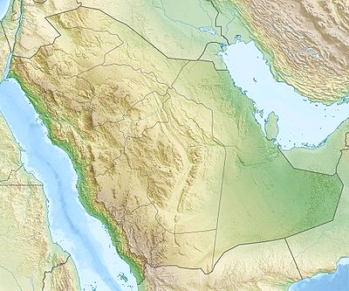
Arabia: geography

Slide 7
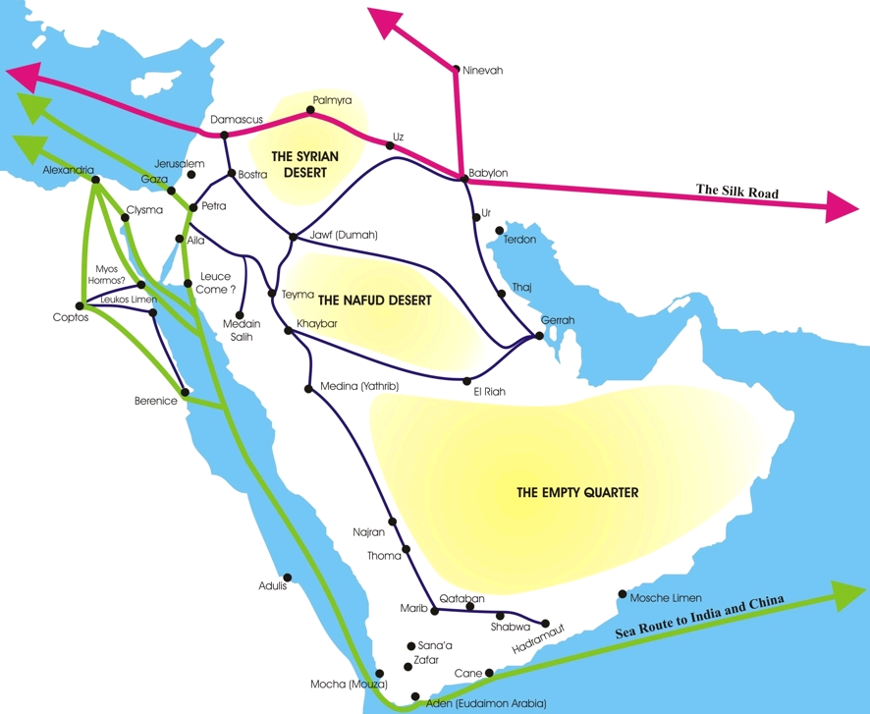
Pre-Islamic Arabia: economy and trade

Slide 8
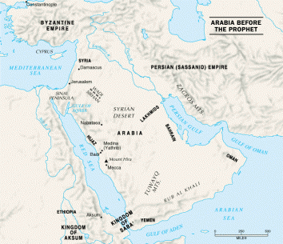
Pre-Islamic Arabia: the political context
Tribal
Urban-rural divisions
  Bedouin
Outside interference
  Byzantium and the Sassanids
  Other neighbouring powers, e.g. Axum

Slide 9
Roman-Persian wars
East-West conflict going back to ancient Greece and Persia
Continued into Roman Empire: e.g. Trajan (vs. Parthians), Julian (vs. Sassanids)
Sixth century: Justinian agrees ‘eternal peace’ with the Sassanids in 532
  This is soon broken and hostilities break out again; on and off until 620s, with Byzantine victory under Heraclius

Slide 10
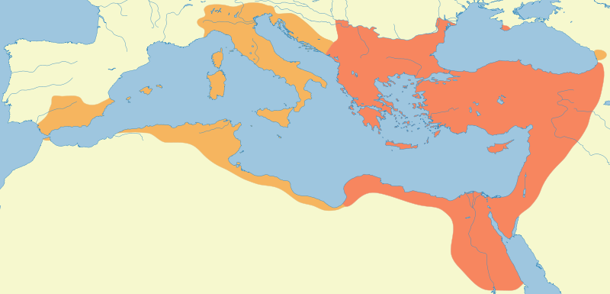
Justinian’s Empire (mid-6th C)

Slide 11
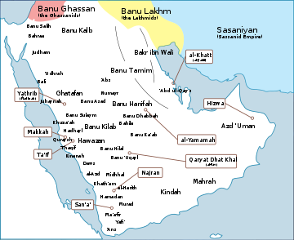
Roman and Persian wars:
Arabian involvement
Ghassanids and Lakhmids
Arab tribes on edge of empires
Irregular troops; managing borderlands
Client states (standard practice)
Religious sponsorship

Slide 12
Pre-Islamic Arabia: the religious context (i)
Paganism
  Many local pagan sanctuaries; e.g. Ka'ba at Mecca
  Qur’an: strong rhetoric against polytheists
  Jahiliyya: ‘period of ignorance’ – pre-Islamic Arabia
Jewish influence
  Qur’an: Ka'ba was built by Abraham and Ishmael
Christian influence
  e.g. from surrounding empires (Byzantium; Axum)

Slide 13
Pre-Islamic Arabia: the religious context (ii)
Read the extracts on your handout about religious affairs in Arabia before the coming of Islam
Think about the following questions:
  What does your source reveal about politics and society of pre-Islamic Arabia?
  What does your source reveal about the organisation of religious communities in the period?
  How do these religious communities relate to one another?
  How would you describe the relationship between religious identity and political power in this period in Arabia?

Slide 14
Muhammad
Member of an important tribe: Quraysh (guardians of Ka’ba)
Orphaned at an early age and brought up by uncle, Abu Talib
Educated away from the towns with tribes in the countryside
A trusted agent (e.g. first wife Khadijah)
Initial revelations and preaching met with hostility in Mecca
Moves to Medina and establishes base there
Conquest of Mecca and gradual unification of Arab tribes (through war and other means)
Marriages – cement political bonds
Revelations – 2 stages

Slide 15
Islam
Root: peace, purity, soundness, obedience, submission
Definition: The willing and active submission to the command of the One, Allah.
People who practice this are Muslims

Slide 16
5 Pillars of Islam
Testimony of Faith (Shahadah)
Five Daily Prayers
Fasting (Ramadan)
Charity/Almsgiving
Pilgrimage (Hajj)

Slide 17
7 Articles of Faith
Belief in:
Oneness of God
Angels of God
Revelatory Scriptures of God
  Peoples of the book
Prophets of God
  Including Jewish prophets and Jesus
Day of Judgement
Pre-Measurement:
  everything designed by God for good use under correct conditions (so, not predestination or fatalism)
Resurrection after Death

Slide 18
Key sources for studying Islam
Qur’an
Hadith (Sunna)
Biography of the Prophet (Sira)
History (Ta’rikh)
Schools of Islamic Law
Works on theology, Sufi literature, material on general guidance
But, what else can we use?

Slide 19
Muhammad’s successors: the conquests
Expansion begins under the Muhammad but takes off under his immediate successors
  We will look at specific moments of and responses to conquest in more detail in the next two weeks

Slide 20
Foundation of the Caliphate: Umar (634-644)
Provincial organisation:
  Governors, administration and offices established
  Chief secretary; military secretary; revenue collector; police chief; treasury officer; chief judge
  All officials: obliged to abide by strict code of conduct and to come to Mecca for Hajj
Record system – of official correspondence and complaints
Accountability: grievances can be aired; proceedings led by U personally
Paid high salaries to staff – to prevent corruption
Consolidation of power rather than pursuing new conquests; nevertheless, conquests proceeded at unprecedented levels
U = first to conquer Jerusalem = walking while his servant and slave is mounted
  Symbolic gesture of his justice

Slide 21
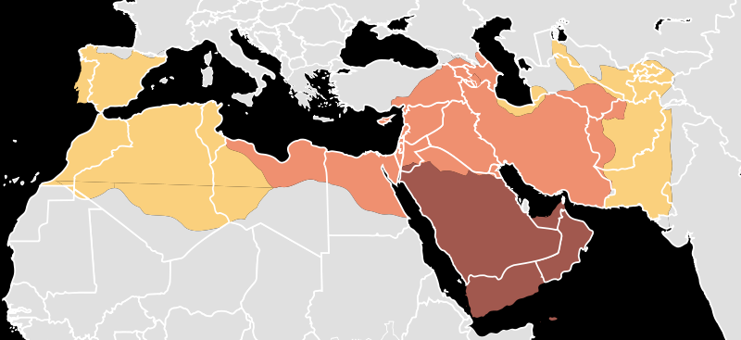
Stages of expansion
2
3
3
1
1: Expansion under Muhammad, 622–632/A.H. 1-11
2: Expansion during the Rashidun Caliphate, 632–661/A.H. 11-40
3: Expansion during the Umayyad Caliphate, 661–750/A.H. 40-129

Slide 22
Reasons for success and speed of conquests
Luck – right place, right time?
Weakness of enemies
  Fighting between empires
  Internal divisions (usurpers; rebellions; religious infighting)
Doing deals – accommodation
  E.g. cities that surrender are granted protection; a protection racket?
A rolling stone – momentum causes others to buy in
  Berbers from African form majority of forces invading Spain
Ideology? (next slide)

Slide 23
Conduct in War
“Stop, O people, that I may give you ten rules for your guidance in the battlefield. Do not commit treachery or deviate from the right path. You must not mutilate dead bodies. Neither kill a child, nor a woman, nor an aged man. Bring no harm to the trees, nor burn them with fire, especially those which are fruitful. Slay not any of the enemy's flock, save for your food. You are likely to pass by people who have devoted their lives to monastic services; leave them alone.”
    Sermon of Abu Bakr (Muhammad's successor and close companion), from H. Y. Aboul-Enein and Sherifa Zuhur, Islamic Rulings on Warfare, p. 22,

Slide 24
Success of the conquests: pragmatism, power and religion
Read the first two extracts on the handout for Week 9 (Covenant of Umar and Treaty of Tudmir)
  What are the main differences between these two texts?
  How prominent are religious matters in these texts?
  What other factors played a role?
  What do these sources reveal about how the Arab-Muslim conquerors interacted with the peoples they conquered?

Slide 25
Expansion slows and then halts
West:
    Battle of Poitiers (Frankia) and in northern Spain in 8th century
    Do the Muslim armies really want to conquer these places?
    Are they looking for easy pickings?
Eastern Mediterranean:
    Constantinople well-defended (by sea and strong land walls)
    Byzantine naval supremacy (at first)
East
    As far as India and Afghanistan by 750s
  Reasons
    Communications over-extended
    Physical/strategic conditions no longer favour Muslim forces
    Or: was the aim to consolidate and then extend conquests?

Slide 26
Impact of the conquests: an overview
Geographically-varied
Foundation of a new world empire
  From Spain to the borders of India by eighth century
  Mediterranean and Middle East tied together again
Common ruling elite and culture across the empire
Integration of existing elites provided they accept Caliphal authority (and Islam)
Economic expansion and prosperity

Slide 27
Impact: conversion to Islam
Relatively simple: profession of the faith; then adherence to 5 Pillars of Islam; no ritual or clerical involvement
Social aspect: entry into client relationship with existing Muslim-Arab group
Rate: probably relatively slow at first, but steady progress
Reasons:
  A condition of conquest
  Lower orders follow their leaders
  Economic incentives: jizya –poll tax paid in return for same rights and same protection as Muslim subjects of the Caliphate
    (but also possible disincentive from view of political leaders – loss of revenue?)
  Emergence of an elite culture (theology, literature, poetry) into which educated people can buy, e.g. Cordoba martyrs (850s)
  A means of advancement, e.g. within administration/ government (though Christians and Jews often play important roles, especially in early stages)

Slide 28
Impact: Islamic identity and culture
Development of an Islamic identity
Development of Islamic knowledge and culture
  Theology
  Law
  Time: Muslim calendar and dating system developed (begins with emigration of Muhammad and his followers to Medina, the Hijra, which occurred in 622 CE – therefore ‘AH’ dating)
Development of Islamic material culture
  Transformation of cities
    New buildings: mosques; dar al-imara (governor’s palace); markets
    Street plan changes
      Bulliet, The Camel and the Wheel (1975)
      Millwright, An Introduction to Islamic Archaeology (2010)
  Coins (ideological and economic roles/ connotations) – differentiation from Rome/ Sassanids

Slide 29
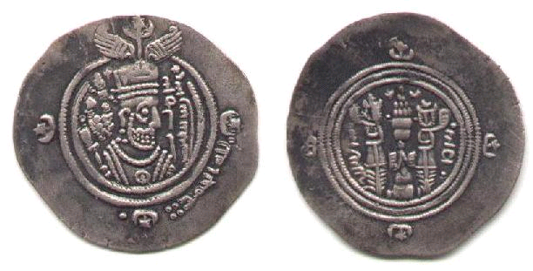
Arab-Sassanian coins
'Umar b. 'Ubaydallah b. Mi'mar; Governor of Fars (686-89 AD)
Ardashir-Khurra mint, 69 AH
Dirham, silver, 30 mm
Same pattern in former Byzantine areas

Slide 30
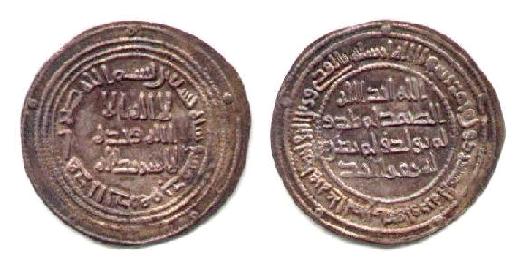
Coins of Umayyad Caliphate
Al-Walid I (705-15 AD)
Damascus mint, 90 AH
Dirham, silver, 27 mm.

Slide 31
Impact : political
Redrawing the political map of the Mediterranean/ Middle East: a new empire – the Caliphate
  End of two ‘superpowers’ of ancient world: Rome and Persia
Integration of new elites from conquered provinces
  Involvement of elites from former Sassanid Empire pushes centre of gravity East to old Iranian heartlands
    E.g. from Damascus to Baghdad with the Abbasid revolution of 751
    Creates further tensions: resurgence of Byzantium; Muslim Spain splits off

Slide 32
Impact of the conquests: economic
Beginning of the ‘Middle Ages’ economically (and therefore politically)?
  Henri Pirenne, Mohammed and Charlemagne
    breaks connection between northern Europe and the Mediterranean; an inward economic turn in the north; without Muhammad, no Charlemagne (= new western Roman Empire in Frankia)
    BUT: is this too focussed on the West? Many challenges to P’s theories
Islamic states
  control economic heartlands of former Rome/ Persia
  control trade routes between far east and northern Europe
  control centres of extraction and production of precious metals and manufacturing
    Result = realignment of trade routes: e.g. Russian rivers/Scandinavia (raw materials/ slaves exchanged for coin/ high status goods)

Slide 33
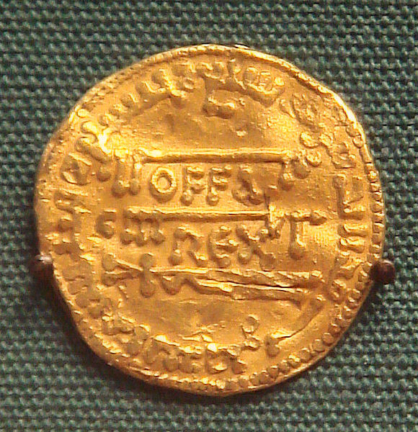
Offa’s dinar
Offa, King of Mercia (England), 757-796
Gold dinar; copy of dinar of the Abassid Caliph Al-Mansur struck in 774
‘OFFA REX’
Errors in the Arabic
Reverse of earlier imitation process?
E.g. dinar = denarius

Slide 34
Conclusions
Context is all important
  Muhammad catalyses changes that are already occurring in Arabia
  Roman-Persian wars important – creates opportunity
    Weakness of other polities that are encountered – e.g. Visigothic kingdom in Spain – reveal similar themes
Slow process of differentiation from that context
  From Roman and Persian systems (e.g. coins and calendars; administration; noble elites are integrated);
  From Christian and Jewish religious traditions
Emergence of a distinct Islamic identity/ culture over time
  Although in some senses there is a coming together

Slide 35
Preparation for next week: a summary
(see handout for full details)
All: read the primary source extracts on Christian responses to the Muslim conquests
All: do some independent research on ‘hagarism’
All: read the Conrad chapter on pre-Islamic Arabia
Two groups: each read a separate article by Tom Sizgorich on links between Christian and Islamic traditions

