Slide 1
THE WORLD OF LATE ANTIQUITY Week 9: responses to islamic expansion (by contemporaries and scholars)
Dr Jamie Wood
University of Manchester

Slide 2
Aims of today’s session
To introduce you to a key theory about the emergence of Islam as a religion (‘hagarism’)
To dig a bit more deeply into the impact of the Islamic conquests on the lives of the people of the conquered territories
To think about the different ways in which these peoples reacted to the Islamic conquests, especially in religious terms
To consider recent developments in the study of early Islamic religion and politics

Slide 3
Structure of today’s session
Revision of last week’s session
Hagarism
Reviewing research at home
A summary
Responses to the conquests
Reviewing primary source work
Responses to the conquests: overview
Sizgorich
Reviewing secondary reading
Relating Sizgorich to Hagarism and recent trends in scholarship of early Islam
Conclusions
Looking forward to next week

Slide 4
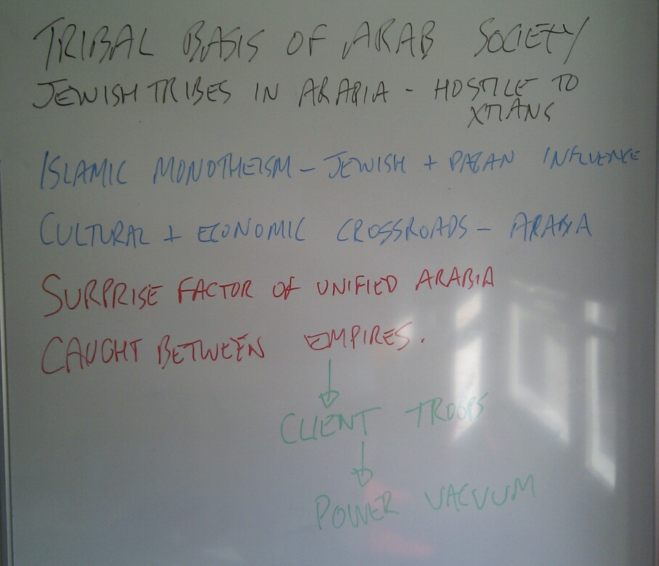
Revision of last week’s topic
Key points that you took away from the session last week or Conrad reading (‘The Arabs’)

Slide 5
Conclusions from last week
Context is all important
Muhammad catalyses changes that are already occurring in Arabia
Roman-Persian wars important – creates opportunity (within and outside Arabia)
Slow process of differentiation from context
From Roman and Persian systems (e.g. coins and calendars; administration; noble elites are integrated);
From Christian and Jewish religious traditions
Emergence of a distinct Islamic identity/ culture over time (this week’s topic)
Although in some senses there is a coming together

Slide 6
Hagarism (Cook and crone)
In pairs, discuss the following questions briefly and be ready to feed back to the rest of the class:
What is ‘hagarism’?
What did Cook and Crone argue in their work?
How has it been received by scholars and the public at large?
What do you think about the ideas behind it? Are you convinced?

Slide 7
Hagarism: a very brief summary
Based on premise that traditional Islamic sources for early Islam are unreliable (date; mode of transmission; theological focus)
Attempt to reconstruct early Islamic history from Greek, Syriac and other sources (archaeology)
Idea
Arabs, as children of Abraham, through concubine Hagar, had ancestral claim to Palestine and Jerusalem and were duty-bound to reclaim it (Mecca was of secondary importance)
Encouraged by Jews of Arabia and welcomed by those of Palestine (under Byzantine oppression)
As more Christian territories are conquered, Arabs incorporate Jesus as a prophet
Muslim civilisation emerges from longer-term contact between Arabs and Byzantine-Persian traditions

Slide 8
CRITICISMS OF HAGARISM
Are Greek/ Syriac accounts more reliable than Arab-Muslim ones?
Are C&C’s readings of the sources fair?
i.e. there are problems with the Greek and Syriac sources too
Are C&C guilty of ‘Orientalism’?, of privileging western over Arab-Muslim methods for recording and interpreting the past?
Is the hagarism thesis provable anyway?

Slide 9
Responses to the conquests: primary sources (i)
Think about the sources you read at home in relation to the following question:
What can these sources tell us about ... social and political life in the pre- and post-conquest period?
How Arab-Muslim leaders interacted with the peoples they met during the course of the conquests?
Different Christian responses to the expansion of the Arab armies and Islamic religion?
Together, we will fill in the handout to develop an overview of this topic.

Slide 10
Responses to the conquests
Key text: Robert G. Hoyland, Seeing Islam As Others Saw It: A Survey and Evaluation of Christian, Jewish and Zoroastrian Writings on Early Islam (Princeton, 1997)
Collects Greek, Syrian, Coptic, Armenian, Latin, Jewish, Persian and other primary sources written between 620 and 780 about the Middle East
Incidental and deliberate references to Islam:
Muslims as a punishment sent by God for collective sins or the sins of emperor
Jews saw Muslims as an instrument of God's deliverance
Muslims seen as primitive monotheists
Ascetic texts criticise Islam for its worldliness (common concern for ascetics, given new meaning by Islam’s success)
New developments
Non-veneration of images
Worship toward the south
Recycled polemics
Christians recycled old arguments against Judaism to use against Islam
Zoroastrians also recycled arguments against monotheism

Slide 11
Regional variation
Areas with larger Jewish population more accepting due to Byzantine persecution?
Areas with existing contacts with Arabs more accommodating?
Areas with problems of political/ religious authority more concerned about internal problems?
Areas nearer to Byzantine territory (and therefore influence) more resistant?

Slide 12
SizgoricH (i)
In pairs, think about the following questions relating to the Sizgorich article that you read at home
What is the article about?
[= the topic]
What is Sizgorich’s methodology?
[= how he approaches and deals with his evidence]
How is the article structured?
[= identify the different parts of the text]
What is the argument?
[= the key point being made]
How convincing do you find the argument?
[= problems or issues with it]
(refer to specific points in the text wherever possible to back up your suggestions)

Slide 13
Sizgorich (II)
Get into a larger group with others who have done the same reading
Discuss your answers to the questions
Come to a consensus and then prepare a short presentation back to the other group (who have done a different piece of reading)
Use the whiteboard/ marker pens to give this presentation a visual element

Slide 14
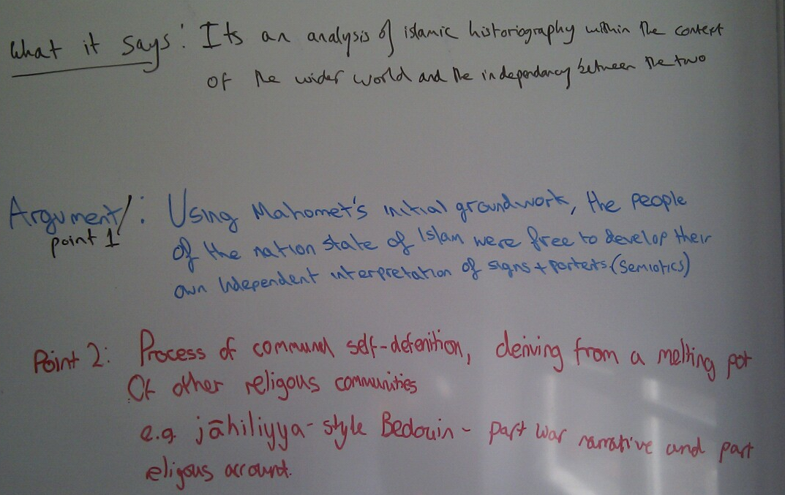
SIZGORICH, Narrative and community (2004)

Slide 15
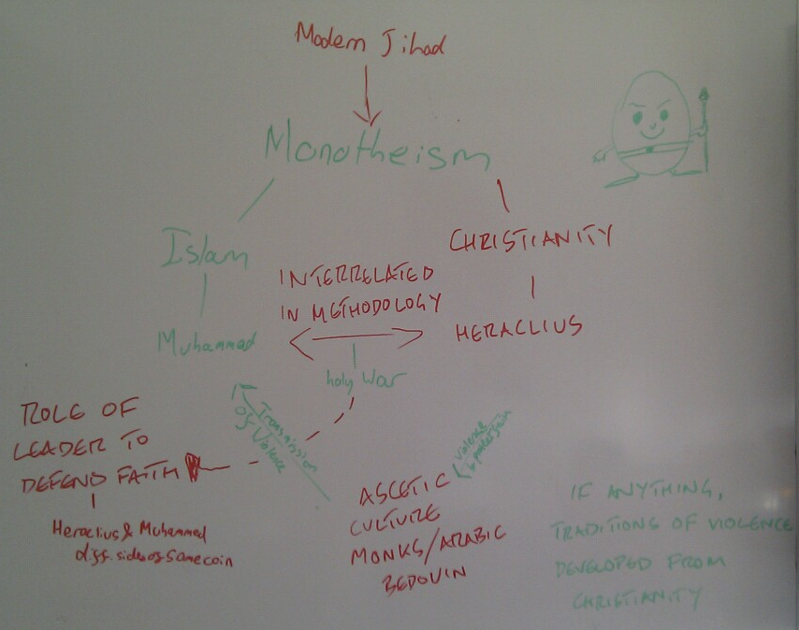
SIZGORICH, Sanctified violence (2009)

Slide 16
Sizgorich and hagarism
Individually, think about the following question and be ready to discuss it with the rest of the class:
In what ways do you think that Sizgorich’s work relates to that of Cook and Crone?

Slide 17
A VERY BRIEF summary of recent scholarship on islam
Not a total reliance on ‘hagarism’, but it did help to catalyse new ways of thinking about early Islam
Looking at it in Christian-Jewish-Arabian religious context
Looking at it in political-governmental context of Persia-Byzantium (and other political groups that were conquered)

Slide 18
EXAMPLE: Andrew Marsham, Rituals of Islamic Monarchy: Accession and Succession in the First Muslim Empire (Edinburgh, 2009)
Tendency in previous scholarship to accept uncritically classical sacralizing Sunni interpretations of Muslim past
Preferable to take a historical (not normative) approach to the early Muslim caliphate in context of late antique Roman and Sasanian universal monarchy
Focus of book: the pledge (bay‘a) given to a new caliph or to the person designated to succeed him
Caliphate preserved
tribal tradition of ‘pledged agreement’ for leadership, esp. in military affairs,
monotheistic and imperial traditions of ‘hereditary monarchy, acceptable to the military elites and sanctioned in religious terms' (p. 9)
bay‘a progressed
from fairly simple, oral pledge of obedience, primarily in warfare, confirmed by a handclasp
to detailed, written, highly legalistic contractual agreement between a caliph and his powerful retainers, often witnessed at ‘carefully scripted’ court ceremonies (p. 302)

Slide 19
conclusions
Importance of looking at early Islam in historical context
rather than accepting visions of later, normative sources (Islamic, Christian and modern scholarship)
Value of sources outside Islamic tradition for reconstructing early Islamic history
Relatively high, especially when they correlate with Islamic sources; though in many cases possibly more useful for Christian responses than Arab-Muslim developments?
Variety of Christian responses
Not one-size-fits-all hostility, but processes of social, political and religious accommodation and opposition
Vary with:
time; geography; existing political, social and religious structures; outside interference (e.g. by Byzantium)

Slide 20
For next week
Read the primary source handout and think about the following questions
How is the relationship between military success and religion presented in these sources?
Are there any differences between the eastern and western sources?
What can these sources tell us about social, political and religious thinking in late antiquity?
Do some independent research into the concept of ‘jihad’. Think about the following:
How many different conceptions of jihad can you identify?
What does jihad have to do with holy war?
Is there a difference between medieval and modern conceptions of jihad?

