Slide 1
Sex and Gender in the Ancient Greek World
Professor James Davidson

Slide 2
Characteristics of this module
Focussed on debates about gender and sexuality.

Slide 3
Discussion, discussion, discussion
Therefore each week begins with your impressions and arguments about the week’s materials.

Slide 4
Materials
The module is focused on using the widest possible range of ancient materials: vase-paintings, poetry, court-speeches, sculpture, even some coins and inscriptions.

Slide 5
Texts
Special sessions will be devoted to some key texts:
The Homeric Hymn to Aphrodite
The Speech Against Neaera
Some speeches from Plato’s Symposium
Aeschines Against Timarchus
These are also the texts that some students will be studying in Greek.

Slide 6
Assessment
2 x 2500-3000 word essays
2 hour Summer exam

Slide 7
Term 1 focused on Women and Sexuality
Questions we ask:

Slide 8
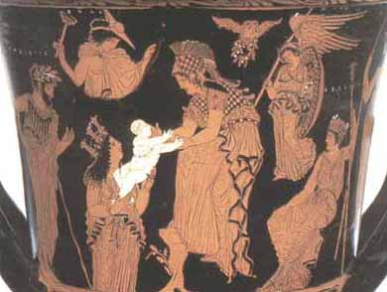
Why do ancient Greek men take a female goddess like Athena as their patron divinity?

Slide 9
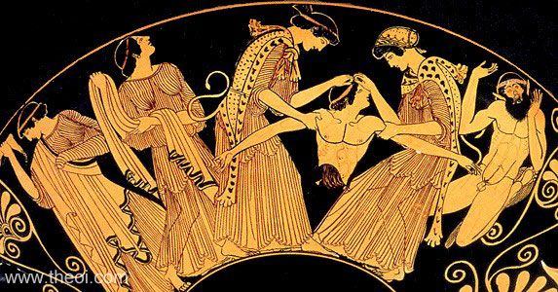
Did Maenads exist?

Slide 10
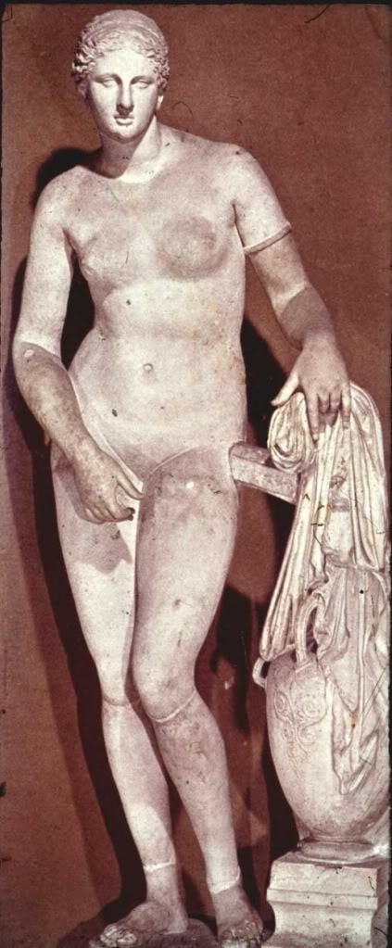
Is Aphrodite more than just a sex-goddess?

Slide 11
Aphrodite the Goddess of Sailing/Sailors
Euploia, Limenia, Pontia
Sex and Sailors
Corinth

Slide 12
Hymn To Aphrodite 2
[1] I will sing of stately Aphrodite, gold-crowned and beautiful, whose dominion is the walled cities of all sea-set Cyprus. There the moist breath of the western wind wafted her over the waves of the loud-moaning sea [5] in soft foam, and there the ribboned Seasons welcomed her joyously. They clothed her with heavenly garments: on her head they put a fine, well-wrought crown of gold, and in her pierced ears they hung ornaments of bronze and precious gold, [10] and adorned her with golden necklaces over her soft neck and snow-white breasts, jewels which the ribboned Seasons wear themselves whenever they go to their father's house to join the lovely dances of the gods. And when they had fully decked her, [15] they brought her to the gods, who welcomed her when they saw her, giving her their hands. Each one of them prayed that he might lead her home to be his wedded wife, so greatly were they amazed at the beauty of violet-crowned Cytherea.

Slide 13
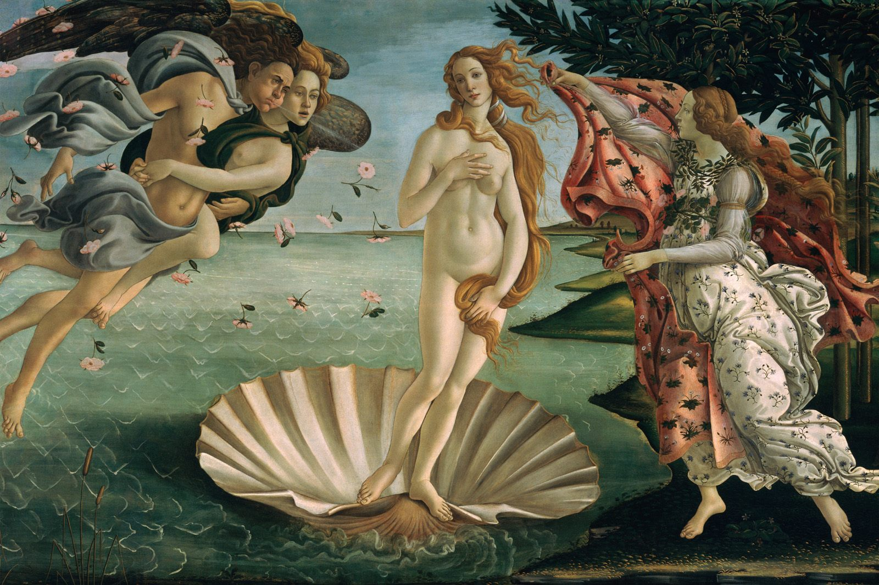
Botticelli, Birth of Venus, after Apelles, Uffizi Florence

Slide 14
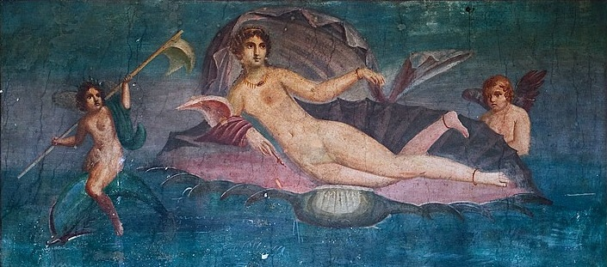
Venus Anadyomene, fresco from Pompeii after Apelles, Temple of Asclepius, Cos.

Slide 15
Ancient Poets on Apelles’s Painting
“Apelles saw Aphrodite herself brought forth naked from the wet-nurse sea, and that is how he drew her...”
“Apelles saw the Cyprian as she was escaping her mother’s loins, still murmuring with foam... not painted but alive”
“Apelles watched Aphrodite as she came up from the sea”
[Anthologia Palatina 5.179 (Archias), 182 (Leonidas of Tarentum), P. Berol. 9812.6-9.]

Slide 16
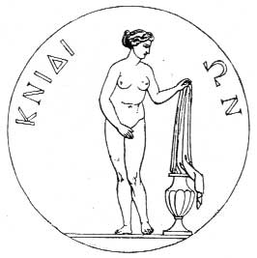
Praxiteles’s Cnidian Aphrodite on Coin from Cnidus

Slide 17
Aphrodite Euploia of Cnidus, First Female Nude

Slide 18
Hermippus of Smyrna: `in fact she was more beautiful in those parts not exposed to view. Because of that it was not easy to see her naked. She always wore a little chiton clinging to her flesh and did not use the public baths. But at the great festival of the Eleusinia and that of the Posidonia in full sight of a crowd that had gathered from all over Greece, she removed her cloak and let loose her hair before stepping into the sea; and it was from her that Apelles painted his likeness of Aphrodite coming out of the sea.' [Hermippus 68aI (Wehrli) ap. Ath 590ef., Ath. 13. 590de, 591f cf. [Plut.] Hyperides 849e, Harpocration sv. Euthias, Anon. de sublimitate 34.3, Quint. 10.5,2.]

Slide 19
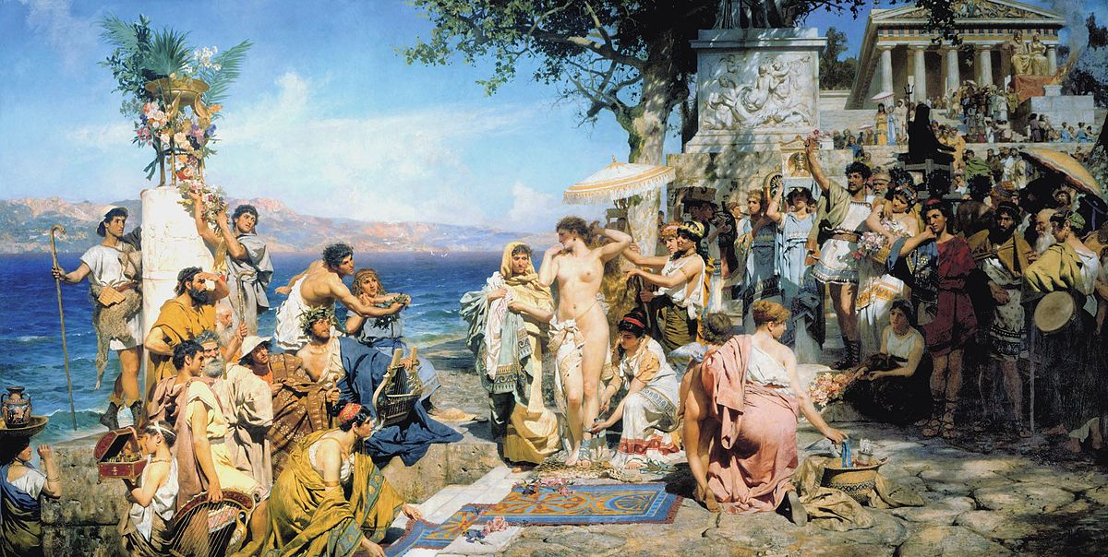
Phryne at the Poseidonia by Henryk Siemiradzki, c. 1889

Slide 20
“Hyperides led Phryne herself into view, tore off her underclothes, exposed her breasts and finished his speech with a pitiful finale. He filled the jurors with religious awe and stopped them from condemning to death Aphrodite’s representative and attendant, as they indulged their feelings of compassion.”
Hermippus 68aI (Wehrli) ap. Athenaeus 13.590ef.; cf. ibid. 590de, 591f; [Plutarch] Hyperides 849e, Harpocration sv. “Euthias”; Alciphron, Letters of the Courtesans 3-5 (1.30-32); Anon. de sublimitate 34.3; Quint. 10.5,2.

Slide 21
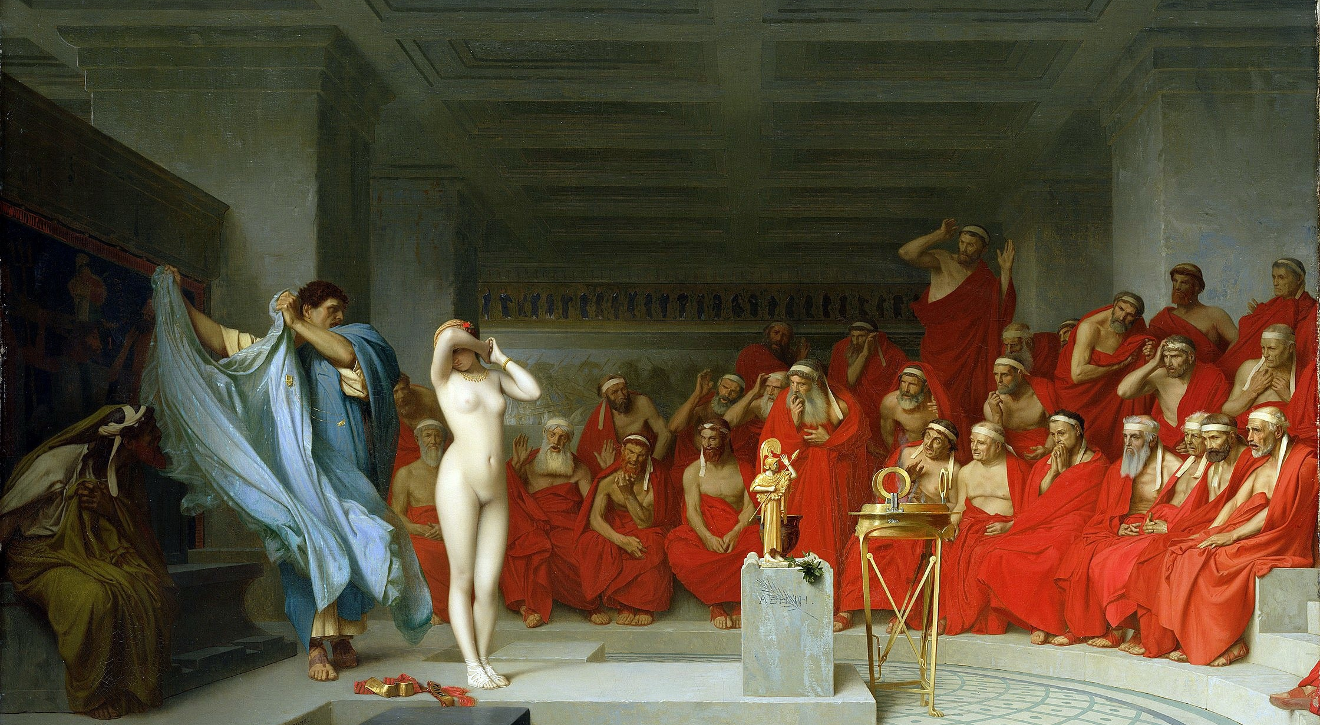
Jean-Léon Gérôme, Phryne revealed before the Areopagus (1861)

Slide 22
Term 2 focused on Men and Sexuality
Questions we ask:

Slide 23
Mythology
1. Was Achilles in a relationship with Patroclus?
2. What kind of question is that?

Slide 24
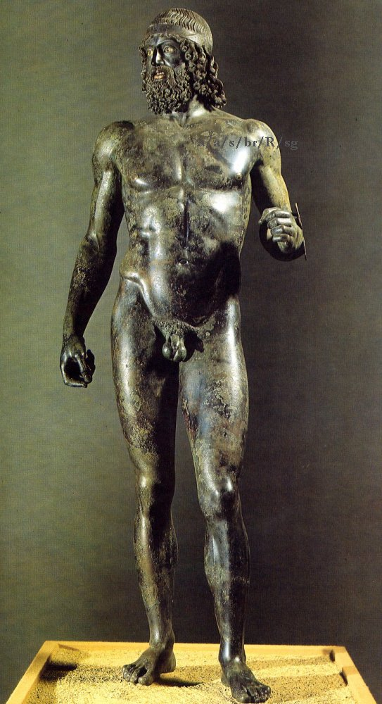
Are viewers supposed to feel lust for male nudes….?

Slide 25
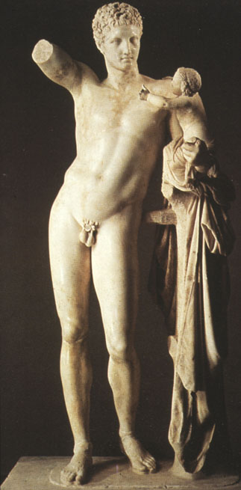
… even if they are gods?

