Slide 1

Ancient Medicine
2025/26

Slide 2
Ancient Medicine Module: basics
15 Cats
Term 1
9 lectures/seminars
Coursework: essay (60%) + gobbet (40%)
Greek Option (dedicated coursework)
Convened by Prof. Caroline Petit (guest lectures by PhD students or postdocs or colleagues)

Slide 3
Key questions
Defining health and illness
What is ‘medical’?
Culture vs. science?
Medical texts: contents, purpose, transmission

Slide 4
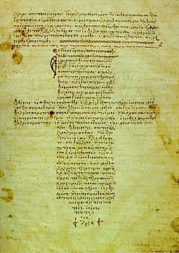
provisional syllabus
Week 1 Health, Illness and the Ancient World (sources, approaches)
Week 2 From Homer to Hippocrates
Week 3 Ancient Pandemics?
Week 4 Medicine and Religion
Week 5 Ancient Medical Ethics
Week 6 Reading Week, no class
Week 7 Ancient Remedies
Week 8 Medicine for Women
Week 9 Healing the Mind and the Body
Week 10 Ancient Medicine Beyond Antiquity
This Photo by Unknown Author is licensed under CC BY-SA

Slide 5
Past essay questions (examples)
1. To what extent can ancient medical texts help us understand ‘pandemics’?
Alexandra Hui and Matthew Lavine (eds), Bibliographic Essays on the History of Pandemics, special issue of ISIS 114 S.1, September 2023.
https://www.journals.uchicago.edu/toc/isis/current
in which see especially:
Rebecca Flemming, ‘Pandemics in the Ancient Mediterranean World’, pp. 288-312
Monica H. Green, ‘(Preface) The Black Death and Ebola: on the Value of Comparison’, in ead. Pandemic Disease in the Medieval World. Rethinking the Black Death, 2015, pp. ix-xx

Slide 6
4. To what extent can we reconstruct ancient patient perspectives from the evidence we have at hand?
P. A. Baker and G. Carr (eds.), Practitioners, Practices and Patients. New Approaches to Medical Archaeology and Anthropology, Oxford: Oxbow, 2002
J. Hughes, Votive body parts in Greek and Roman religion / Cambridge : Cambridge University Press, 2017
G. Petridou and C. Thumiger (eds), Homo Patiens. Approaches to the Patient in the Ancient World, Leiden, Brill, 2016
(especially the chapters by Thumiger and Petridou)

Slide 7
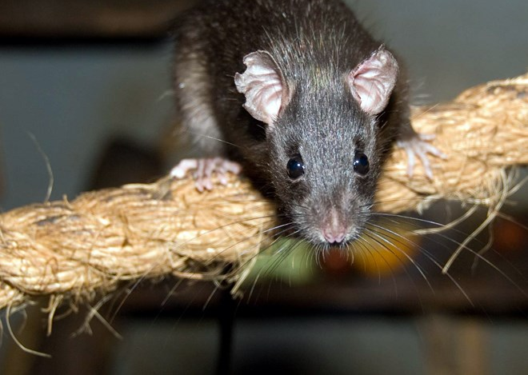
Source criticism examples
Texts by doctors (Galen, Hippocrates)
Patients (Aelius Aristides)
Temple inscriptions (Epidaurus: Iamata)
Other medicine-related narratives (epidemics: plague of Justinian, etc)
This Photo by Unknown Author is licensed under CC BY-SA-NC

Slide 8
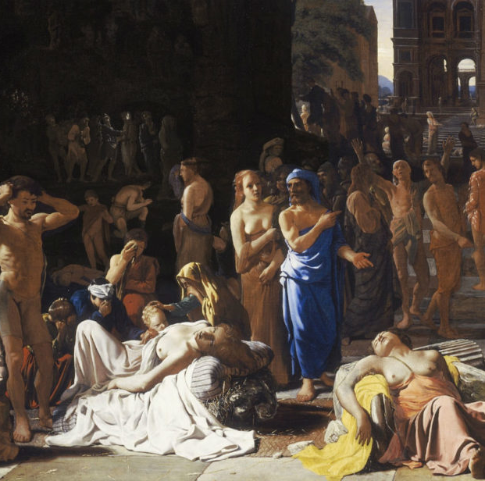
Greek option: texts
Thucydides, Plague of Athens (II, 47-54)
Hippocrates, Ancient Medicine
Hippocrates, Sacred Disease
This Photo by Unknown Author is licensed under CC BY-SA-NC

Slide 9
2025/26
Engagement with Medical School? (visit)
Online exchanges with students from Michigan (via Dr. Aileen Das’s module on ancient medicine)
Test simple remedies

