Slide 1
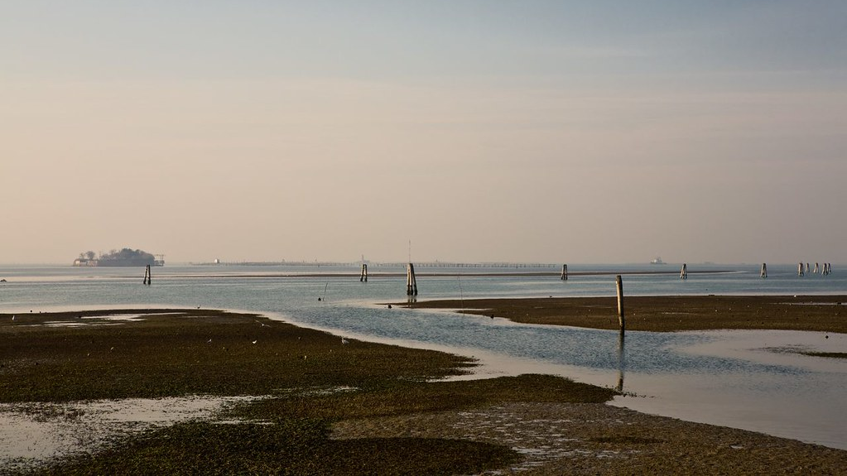
NEW WIISP module
Intensive, residential module in Venice
Health and the Environment from Antiquity to Renaissance Venice
This Photo by Unknown Author is licensed under CC BY-SA-NC

Slide 2
Aims of the module
Think of health and illness within environmental context(s)
Learn about, and link pandemics, ancient and (early) modern
Explore ancient and early modern medical thought together
Engage with the historic development of public health
Reflect on human responses to catastrophe (pandemic) - through science, religion, art, politics
Do all of the above whilst experiencing the unique environment of Venice and its long-term climatic and health-related challenges

Slide 3
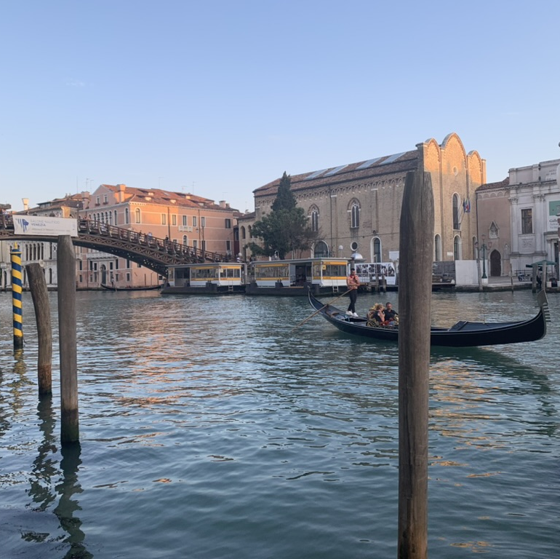
Health and the Environment from Antiquity to Renaissance Venice
https://warwick.ac.uk/services/studentopportunity/studentmobility/studyabroad/opportunities/short-term/wiisp/modules/health-and-environment-antiquity-to-venice/#course-tab-2
-Residential, intensive. Accommodation options: see document circulated for WIISP students
-PASTORAL CARE GUIDE (see dedicated doc)
-Schedule 1-12 July 2024 in Venice
preparatory work: term 3
assessment: autumn 2024

Slide 4
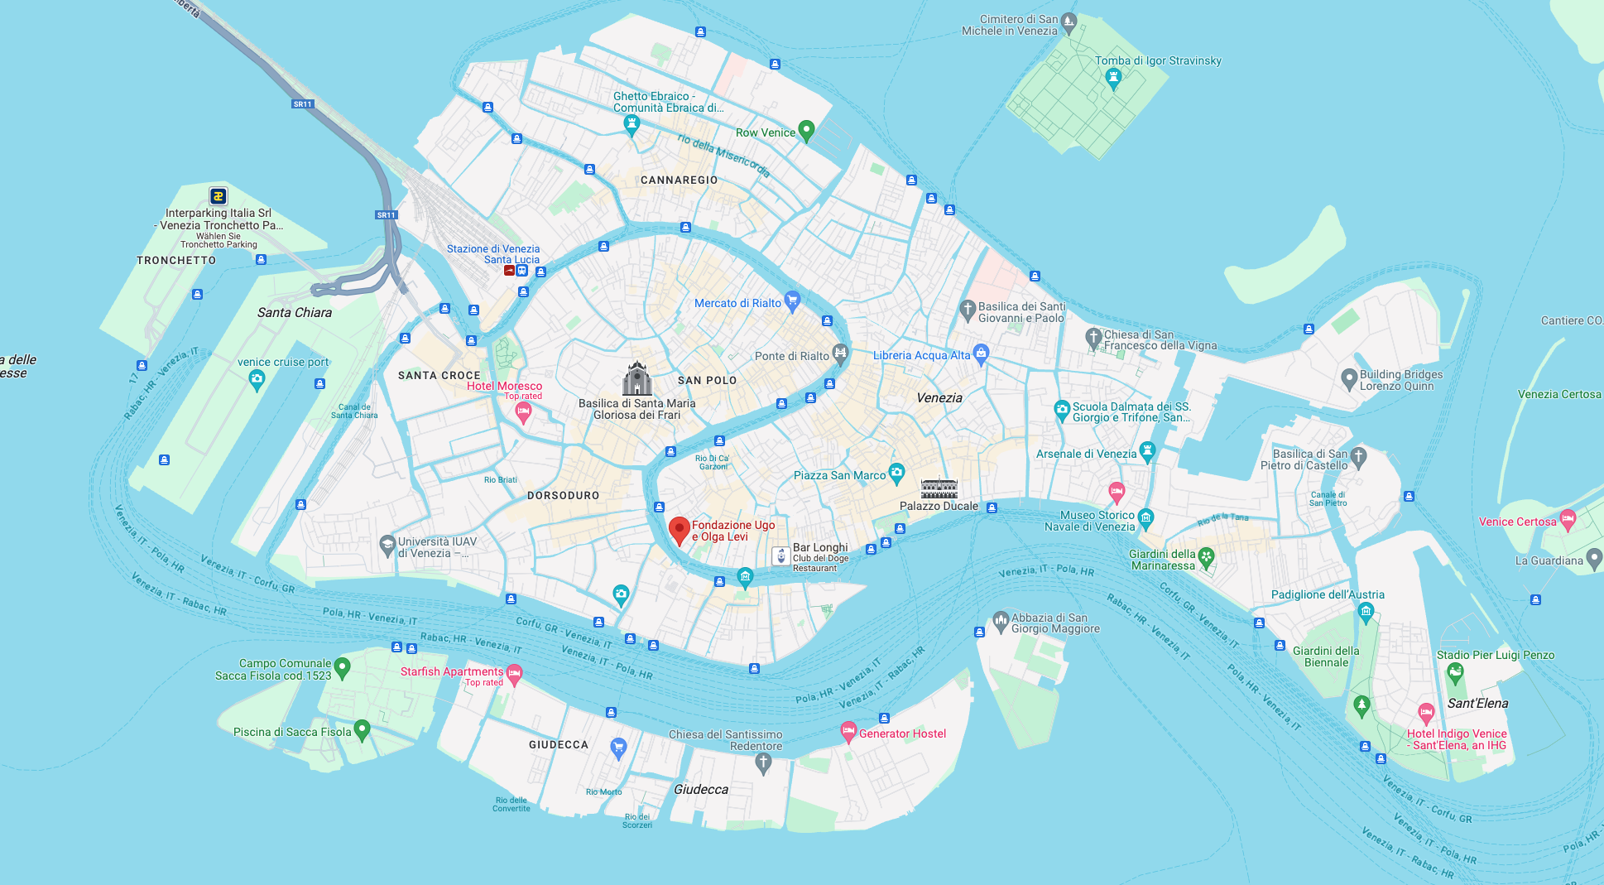

Slide 5
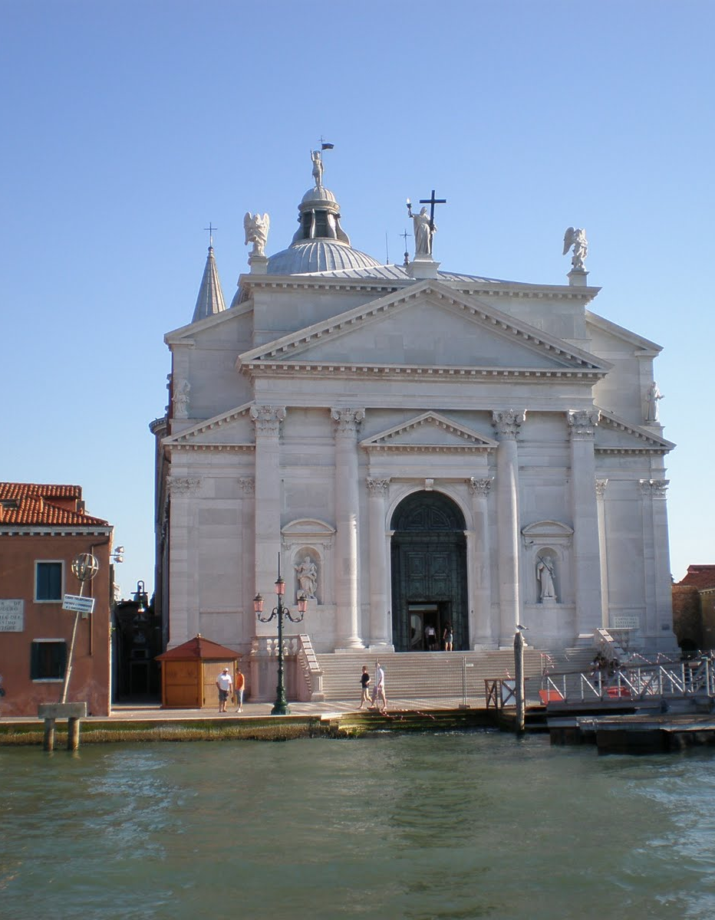
Preparatory work
…Not too onerous! (19 June)
Suggested reading, tailored to your needs:
-on the history of Venice
-on medical history (ancient and early modern)
-on pandemics across history
Questions to think about ahead of the course:
-What do we mean by ‘environment’? How was it conceptualized in earlier times?
-How can various environmental factors affect health?
-How can early pandemics/epidemic diseases help us understand our recent experience with covid-19?
…
This Photo by Unknown Author is licensed under CC BY-NC-ND

Slide 6
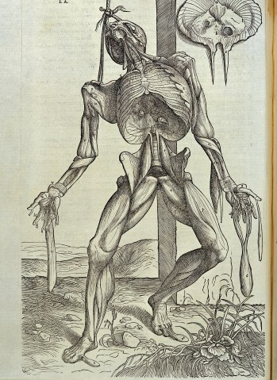
Lectures and seminars (detailed schedule to be posted on Moodle)
Health and the Environment: Ancient Ideas (lecture, CP)
Ancient Epidemics: Texts and History (seminar, CP)
Ancient Medical Texts in Renaissance Venice (lecture, CP)
The Venetian Environment: Health and Illness (lecture, CP)
Medical Teaching in an Expanding World: Padua (lecture, CP)
Guest lecture by Dr. Ignacio Sánchez (Castilla-La Mancha), 8 July :
‘Hippocrates meets Muhammad :Treatises of local medicine in the Medieval Middle East’
Guest lecture by Dr. Craig Martin (Ca’ Foscari, Venice), 10 July:
‘Renaissance Epidemics and Histories of Ancient Disease in the Republic of Venice and Beyond’
The plague of 1575 (seminar, CP)

Slide 7
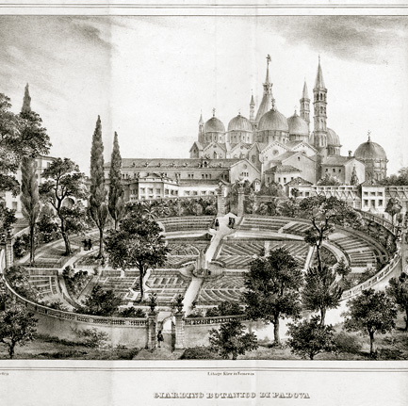
Site visits across Venice and the lagoon
Biblioteca Nazionale Marciana (booked: 3 July)
Lazzaretto Nuovo (booked: 4 July)
Padua: botanical garden, anatomical theatre (university) (booked: 5 July)
Scuola grande di San Rocco, di San Marco…
Late antique and Byzantine Venice: visit of Torcello (island)?
Guided walk around Venice (Ghetto)?

Slide 8
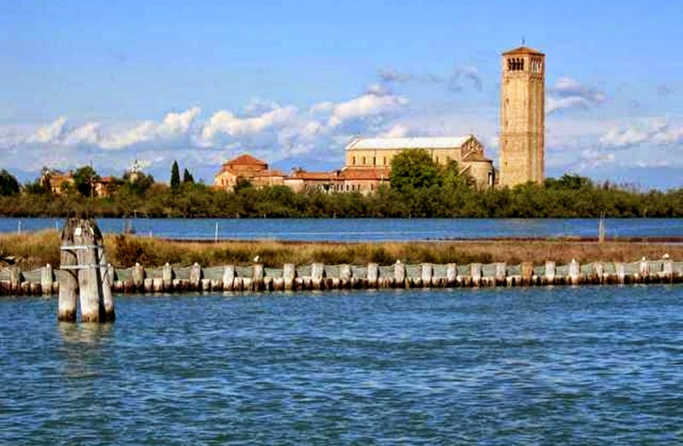
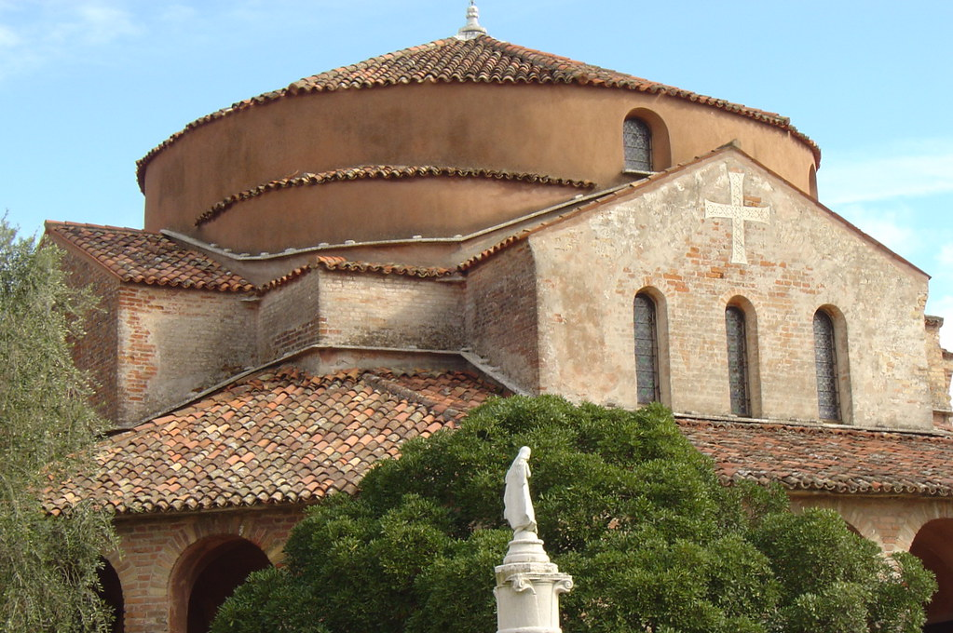

Torcello
This Photo by Unknown Author is licensed under CC BY-NC-ND
This Photo by Unknown Author is licensed under CC BY-NC

Slide 9
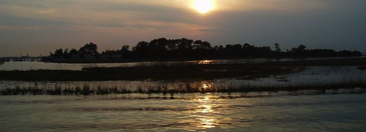
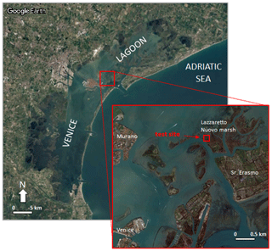
This Photo by Unknown Author is licensed under CC BY-SA-NC
Lazzaretto Nuovo (built 1468), a dedicated island for quarantine
This Photo by Unknown Author is licensed under CC BY

Slide 10
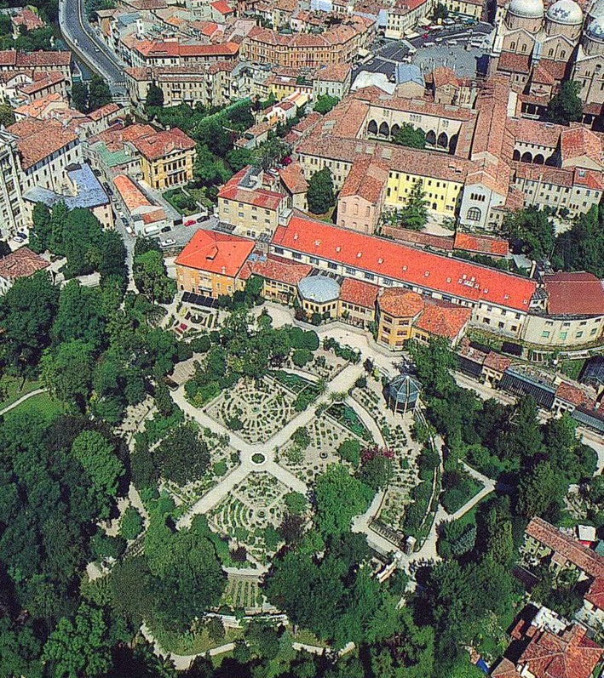
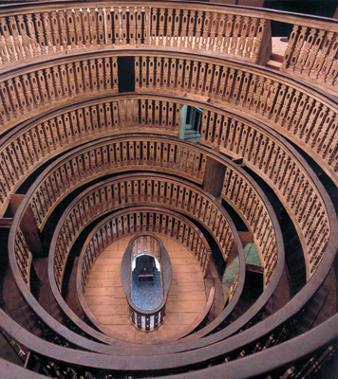
University of Padua (today)

Slide 11
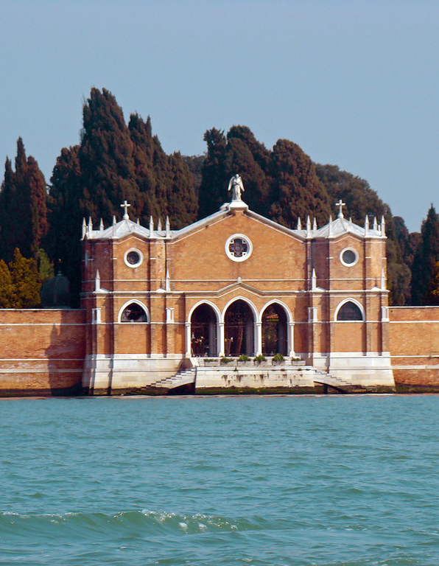
Self-guided (optional) walks
Option to walk and discover on your own and reflect, or explore in small groups:
Death and mourning in Venice (cemeteries: San Michele; Jewish cemetery, Lido)
The consequences of the plague of 1575 in Venetian art and architecture (Salute; Redentore, Giudecca;…)
Earth and water: The Venetian lagoon as a changing environment
This Photo by Unknown Author is licensed under CC BY-SA-NC

Slide 12
What you should expect to do in Venice
Attend lectures and seminars
Do the pre-reads (if required)
Take part in site visits
Engage in group activities and seminar discussions
Journaling

Slide 13

Assessment (for-credit option)
Essay (due in September 2024): 4000 words (60%)
Poster (following group work on site): individually marked 40% (also autumn 2024, FAB)
Rules, guidance, style? See the Classics UG handbook:
https://warwick.ac.uk/fac/arts/classics/intranets/students/
Extensions to be managed by the Classics department

Slide 14
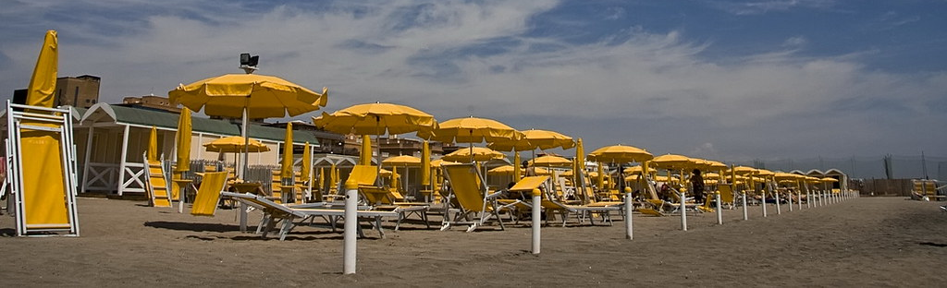
In your own time…
Suggested site visits: palazzo ducale, Accademia, …
Biennale
Islands: Lido (and beaches: Alberoni, where Death in Venice was shot)
Islands: Murano, Burano, San Lazzaro degli Armeni….
Walking Venice (also by night)
Take a traghetto across the Canal Grande (cheaper than a gondola…)
This Photo by Unknown Author is licensed under CC BY-SA-NC

Slide 15
Logistics III
Safety in Venice and Pastoral Care Plan
Please read through this carefully
Add emergency numbers and contacts to your phone before leaving
Bonus points- add the pastoral care plan to your NOTES application on your phone so you have it handy
Bring comfortable walking shoes, sun protection, and a water bottle!
Email module convenor with any questions you may have
Digital tools and readings
WARWICK EMAIL – Only way to contact you (please check regularly and add to your phone)
Moodle
Reading List (also Moodle!)
Module hashtag #SCFSVenice22
If you’d like your posts to be used/shared please make sure your profile is publicly visible
Posts will be collated and shared on the final day of class
Some posts may be used for marketing purposes

Slide 16
costs
Transport: airport transfer (cheapest: bus ACTV)
‘entrance fee’ for tourists? (students exempt)
https://cda.ve.it/en
Vaporetto/bus (ACTV) : Venice pass for 72 hours or 7 days
Food and drink: supermarkets (cheapest option)

Slide 17
Questions?

