Slide 1
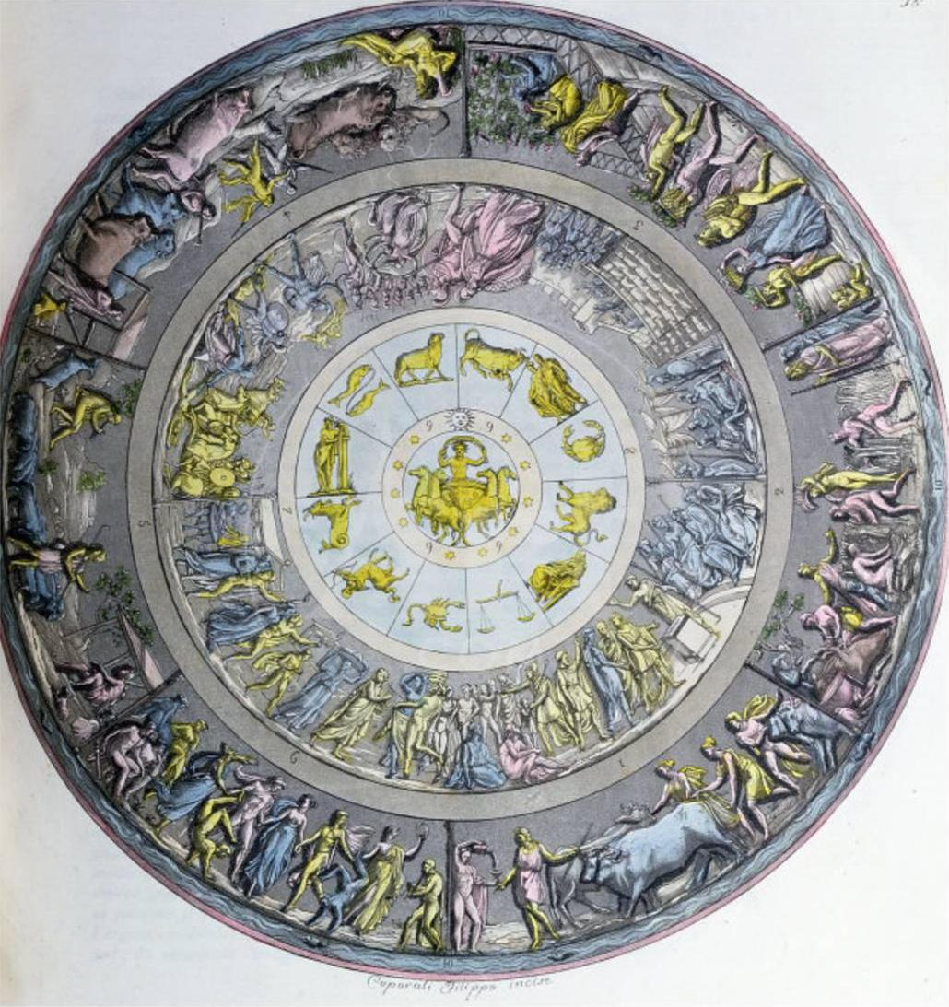
15-CAT module
(Terms 2/3)
2027
Dr Emily Clifford
emily.clifford@warwick.ac.uk, FAB 2.03
Greek Ecphrasis
Teaching
2x 50-minute classes per week.
This 15-CAT module explores the phenomenon of ecphrasis in Greek literature and thought. Now more narrowly conceived as a ‘verbal description of a work of art’, ancient ecphrasis was much broader in scope, encompassing descriptions of landscape, people, and objects as much as artifacts. It was far more than a literary flourish or conceit, offering more of a ‘way of seeing’ and, indeed, representing a core element of ancient education.
The material covered is wide ranging, beginning with the flagship literary ecphrasis – the shield of Achilles in Homer’s Iliad 18 – and moving on through a variety of poetry and prose drawn from near a thousand years of Greek literature (and beyond). From epic poetry to the epigram, you will probe the power and limits of the genre, delving into themes such as intermediality, visuality, materiality, rhetoric, erotics, and the old ‘rivalry’ between art and text.
Indicative Texts
Assessment
Indicative Themes/Lectures
Homer, Iliad 18
Homer, Odyssey 7.78–132
Hesiod, Shield of Heracles
Aeschylus, Seven Against Thebes 375–676
Euripides, Electra 432–86
Euripides, Ion 184–218, 1122–228
Euripides, Phoenician Women 103–201
Xenophon, Anabasis 1.8
Sappho, fragment 2
Plato, Phaedrus esp. 230b2–c5
Theocritus, Idyll 15
Callimachus, Hymn 5
Longus, Daphnis and Chloe Prologue
Achilles Tatius, Leucippe and Cleitophon 1.1–2, 3.6–8, 5.3–5
Greek Anthology 9 and 16
Philostratus the Elder, Imagines 1 (selection)
Progymnasmata (selection)
1. 40% close reading (also known as a ‘gobbet’).
1,500-1,750 words
Epic ecphrasis 1: Homer Iliad 18
Epic ecphrasis 2: Homer Odyssey 7.78-132
Some more shields… Hesiod, Shield of Heracles; Aeschylus’ Seven Against Thebes 375-676; Euripides’ Electra 432-86
Tragic ecphrasis: Euripides’ Ion 184-218, 1122-1228 (messenger speech)
Ecphrasis and the art of war: Euripides Phoenician Women 103-201 alongside Xenophon Anabasis
Ecphrasis and desire: Sappho fragment 2
Ecphrasis and truth: Plato’s Phaedrus esp. 230b2-c5
Ecphrasis and the sacred: Theocritus Idyll 15 + Callimachus’ Hymn 5
Ecphrasis, nature, and the landscape: Theocritus Idyll 15
Ecphrasis in the Greek novel: Longus’ Daphnis and Chloe Prologue and Achilles Tatius Leucippe and Cleitophon 1.1-2, 3.6-8, 5.3-5.
Ecphrastic epigrams: Greek Anthology 9 and 16
Ecphrasis, rhetoric, and education: Philostratus’ Imagines + Progymnasmata
Ecphrasis and its legacy: e.g. W. H. Auden and William Carlos Williams on the Fall of Icarus; John Keats ‘Ode on a Grecian Urn’; Anne Carson ‘Hopper: Confessions’ …
2. 60% essay. Choose one title from a selection.
2,500-3,000 words.

Slide 2
15-CAT module
(Terms 2/3)
2027
Dr Emily Clifford
emily.clifford@warwick.ac.uk, FAB 2.03
Greek Ecphrasis
Teaching
2x 50-minute classes per week.
This 15-CAT module explores the phenomenon of ecphrasis in Greek literature and thought. Now more narrowly conceived as a ‘verbal description of a work of art’, ancient ecphrasis was much broader in scope, encompassing descriptions of landscape, people, and objects as much as artifacts. It was far more than a literary flourish or conceit, offering more of a ‘way of seeing’ and, indeed, representing a core element of ancient education.
The material covered is wide ranging, beginning with the flagship literary ecphrasis – the shield of Achilles in Homer’s Iliad 18 – and moving on through a variety of poetry and prose drawn from near a thousand years of Greek literature (and beyond). From epic poetry to the epigram, you will probe the power and limits of the genre, delving into themes such as intermediality, visuality, materiality, rhetoric, erotics, and the old ‘rivalry’ between art and text.
Indicative Texts
Assessment
Indicative Themes/Lectures
Homer, Iliad 18
Homer, Odyssey 7.78–132
Hesiod, Shield of Heracles
Aeschylus, Seven Against Thebes 375–676
Euripides, Electra 432–86
Euripides, Ion 184–218, 1122–228
Euripides, Phoenician Women 103–201
Xenophon, Anabasis 1.8
Sappho, fragment 2
Plato, Phaedrus esp. 230b2–c5
Theocritus, Idyll 15
Callimachus, Hymn 5
Longus, Daphnis and Chloe Prologue
Achilles Tatius, Leucippe and Cleitophon 1.1–2, 3.6–8, 5.3–5
Greek Anthology 9 and 16
Philostratus the Elder, Imagines 1 (selection)
Progymnasmata (selection)
1. 40% close reading (also known as a ‘gobbet’).
1,500-1,750 words
Epic ecphrasis 1: Homer Iliad 18
Epic ecphrasis 2: Homer Odyssey 7.78-132
Some more shields… Hesiod, Shield of Heracles; Aeschylus’ Seven Against Thebes 375-676; Euripides’ Electra 432-86
Tragic ecphrasis: Euripides’ Ion 184-218, 1122-1228 (messenger speech)
Ecphrasis and the art of war: Euripides Phoenician Women 103-201 alongside Xenophon Anabasis
Ecphrasis and desire: Sappho fragment 2
Ecphrasis and truth: Plato’s Phaedrus esp. 230b2-c5
Ecphrasis and the sacred: Theocritus Idyll 15 + Callimachus’ Hymn 5
Ecphrasis, nature, and the landscape: Theocritus Idyll 15
Ecphrasis in the Greek novel: Longus’ Daphnis and Chloe Prologue and Achilles Tatius Leucippe and Cleitophon 1.1-2, 3.6-8, 5.3-5.
Ecphrastic epigrams: Greek Anthology 9 and 16
Ecphrasis, rhetoric, and education: Philostratus’ Imagines + Progymnasmata
Ecphrasis and its legacy: e.g. W. H. Auden and William Carlos Williams on the Fall of Icarus; John Keats ‘Ode on a Grecian Urn’; Anne Carson ‘Hopper: Confessions’ …
2. 60% essay. Choose one title from a selection.
2,500-3,000 words.

