Slide 1
Sex and Gender in the Ancient Greek World
Professor James Davidson

Slide 2
Characteristics of this module
Focussed on debates about gender and sexuality.

Slide 3
Discussion, discussion, discussion
Therefore each week begins with your impressions and arguments about the week’s materials.

Slide 4
Materials
The module is focused on using the widest possible range of ancient materials:
Vase-paintings
Poetry
Law-court-speeches
Sculpture
Even some coins and inscriptions!
A necessary element relates to the Reception of Ancient Sexuality in Later periods. Why this is so will be something else we can talk about…

Slide 5
Texts
Special sessions will be devoted to some key texts:
The Homeric Hymn to Aphrodite
The Speech Against Neaera
Some speeches from Plato’s Symposium
Aeschines Against Timarchus
These are also the texts that some students will be studying in Greek.

Slide 6
Assessment
2 x 2500-3000 word essays
2 hour Summer exam

Slide 7
Term 1 focused on Women and Sexuality Questions we ask:

Slide 8
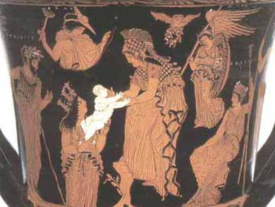
Why do ancient Greek men take a female goddess like Athena as their patron divinity?

Slide 9
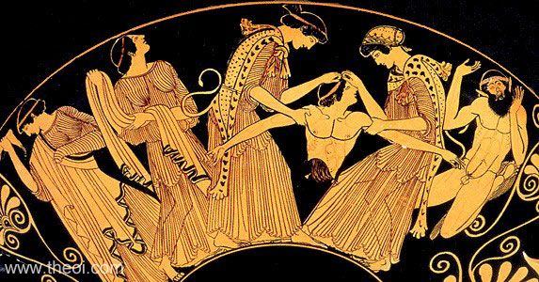
Did Maenads exist?

Slide 10
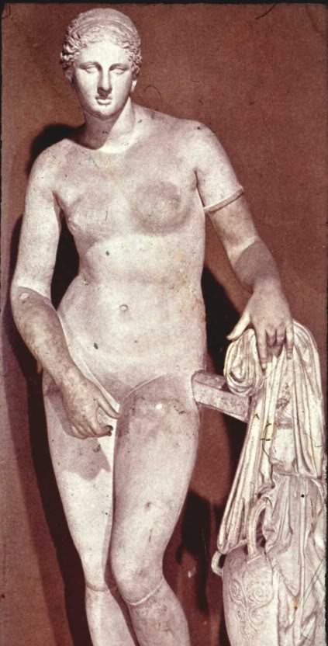
Is Aphrodite more than just a sex-goddess?

Slide 11
Hymn To Aphrodite 2
[1] I will sing of stately Aphrodite, gold-crowned and beautiful, whose dominion is the walled cities of all sea-set Cyprus. There the moist breath of the western wind wafted her over the waves of the loud-moaning sea [5] in soft foam, and there the ribboned Seasons welcomed her joyously. They clothed her with heavenly garments: on her head they put a fine, well-wrought crown of gold, and in her pierced ears they hung ornaments of bronze and precious gold, [10] and adorned her with golden necklaces over her soft neck and snow-white breasts, jewels which the ribboned Seasons wear themselves whenever they go to their father's house to join the lovely dances of the gods. And when they had fully decked her, [15] they brought her to the gods, who welcomed her when they saw her, giving her their hands. Each one of them prayed that he might lead her home to be his wedded wife, so greatly were they amazed at the beauty of violet-crowned Cytherea.

Slide 12
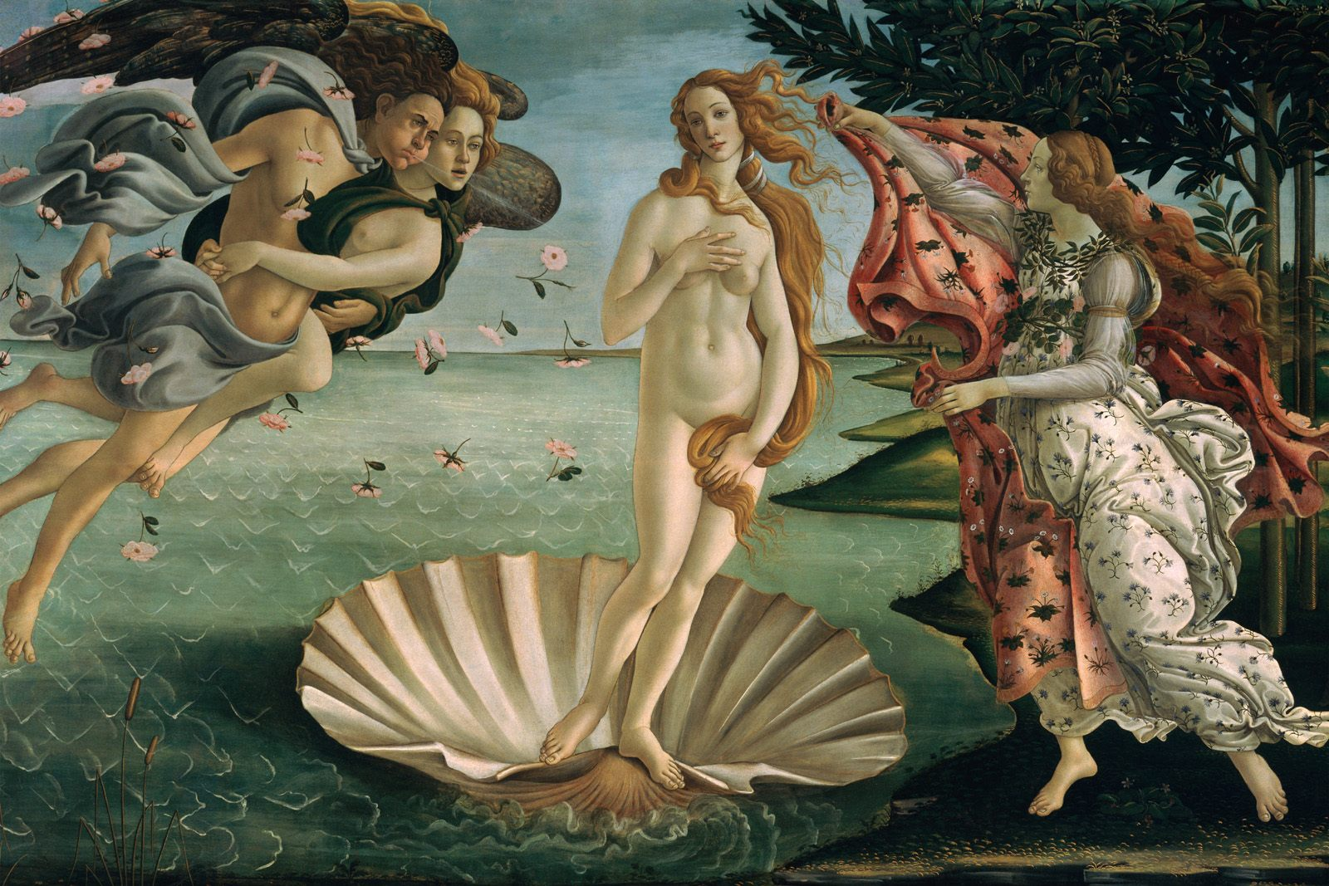
Botticelli, Birth of Venus, after Apelles, Uffizi Florence

Slide 13
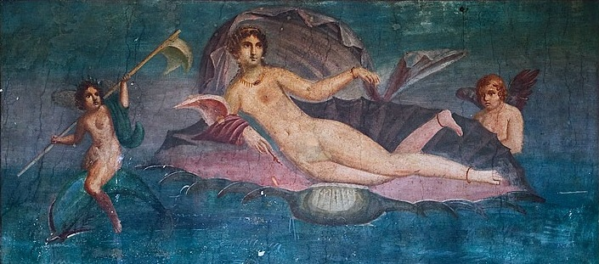
Venus Anadyomene, fresco from Pompeii after Apelles, Temple of Asclepius, Cos.

Slide 14
Term 2 focused on Men and Sexuality Questions we ask:

Slide 15
Mythology
1. Was Achilles in a relationship with Patroclus?
2. What kind of question is that?

Slide 16
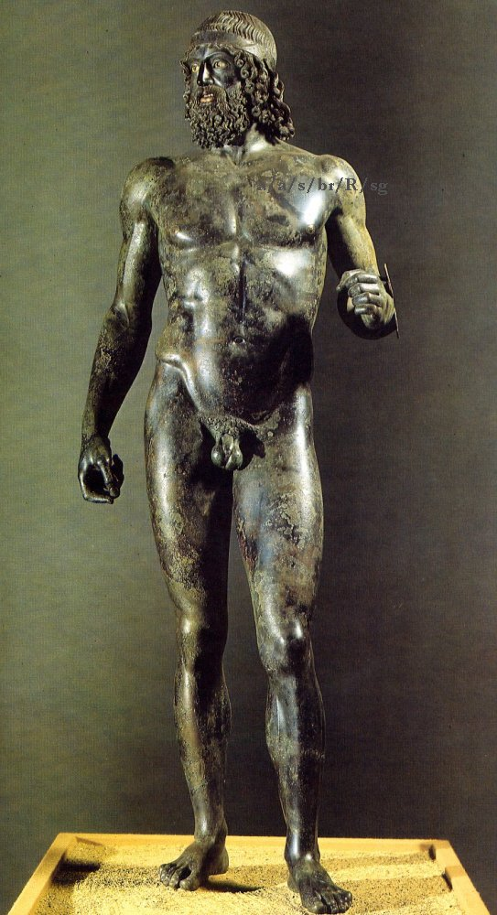
Are viewers supposed to feel lust for male nudes….?

Slide 17
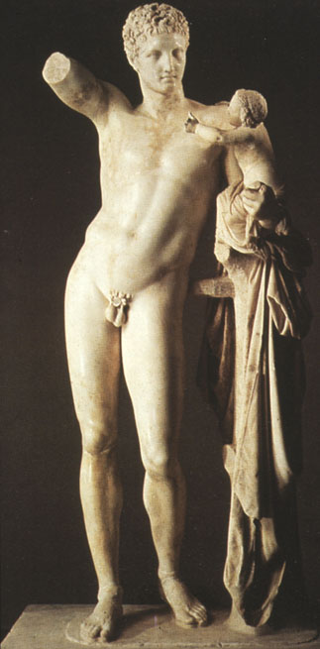
… even if they are gods?

Slide 18
And what’s with all the male nudity anyway?
Was this a “gay culture” ?!!!

