Slide 1
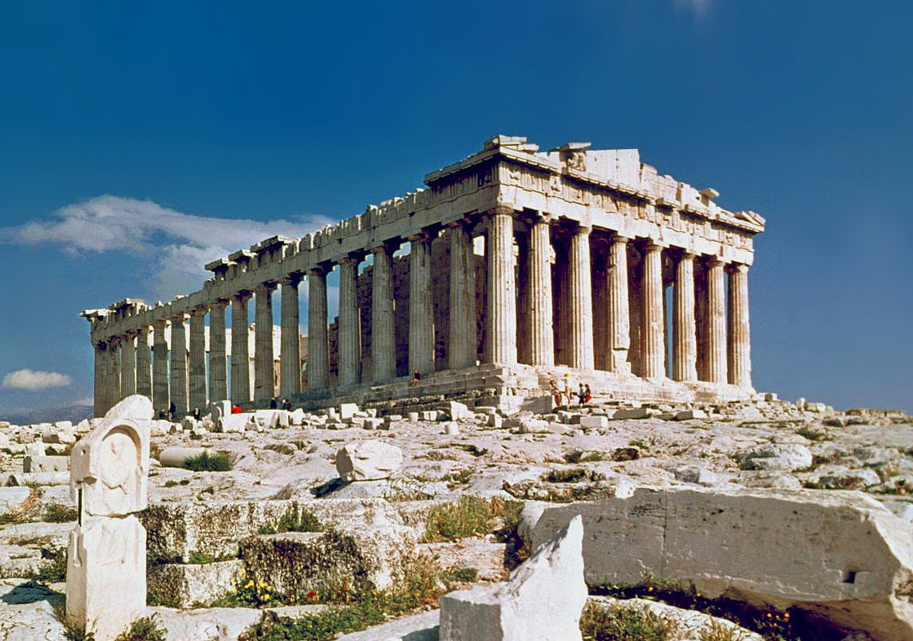
Retelling Myths in Greek and Roman Art
Professor Zahra Newby
15 CATS (2nd years and finalists)
Term 2/3

Slide 2
Outline
The module explores the re-telling of mythological stories in Greek and Roman visual art, from the sixth century BCE to the fourth century CE. It will consider the ways such narratives may have generated meaning in their social, political and cultural contexts, as well as the ways we as scholars can interrogate them. Key questions to consider include
how does art portray narrative?
how do visual mythological narratives interact with other forms in which these stories were told?
what sorts of meanings could mythological narratives in art generate within different social, political and cultural contexts?
how does our engagement with these re-tellings fit within our wider approach to myths in Antiquity

Slide 3
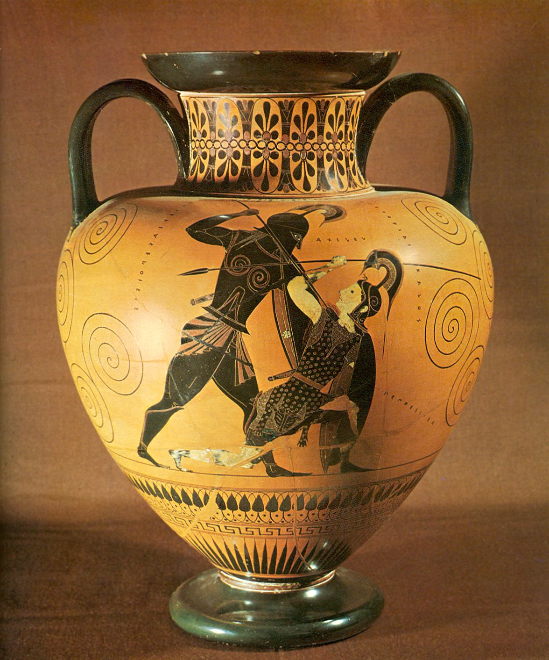
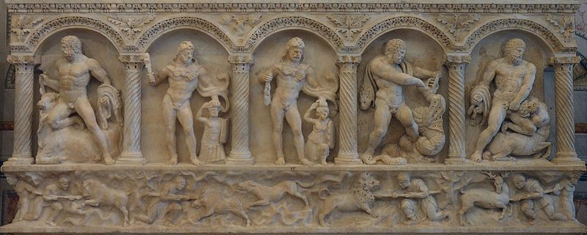
The module explores the representation of mythological narratives in a range of media including architectural and free-standing sculpture, painting, mosaics, vases, reliefs
Covers a range of different contexts: funerary, domestic and public, from both the Greek and Roman worlds.
This module will complement the module Greek Myth: Narratives, sources, approaches running in Term 1, but can also be taken separately. A museum field trip will be organised for Reading week.
Students will be expected to read up on the details of myths independently – the focus in lectures and seminars will be on how these narratives are portrayed in art.

Slide 4
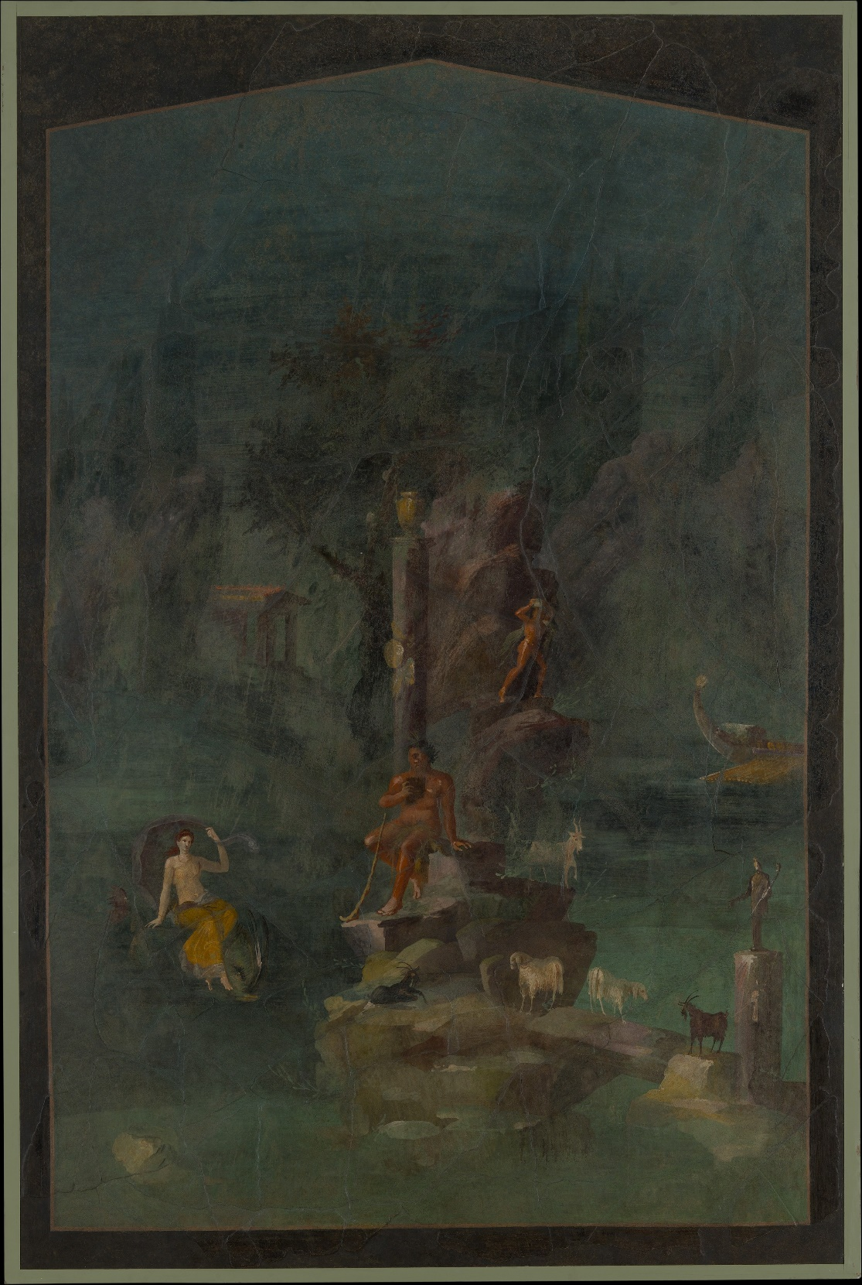
Provisional Syllabus
Term 2:
1: Introduction: narrating stories in Art; theories and approaches
2: Myth in architectural sculpture 1
3: Myth in architectural sculpture 2
4: Myth on Greek vases (+ Seminar group presentations)
5: Myth in the public sphere in Rome: triumph and connoisseurship
6: Reading Week: Museum field trip
7: Mythological sculpture in the Roman domestic sphere
(+ seminar group presentations)
8: Roman Wall-paintings: myth and narrative
9: Mosaics: myth and paideia
10: Myth in Funerary Art (+ Seminar group presentations)
Term 3: 2 Revision seminars.
1: Revision: approaching seen picture gobbets.
2: Revision: approaching unseen picture gobbets.

Slide 5
Teaching Style
Lectures identifying the ways myths are displayed in different contexts
Group work investigating particular examples in depth and training visual analysis.
3 sets of group presentations on individual monuments.

Slide 6
Learning outcomes
Show fully developed research, writing and communication skills
Describe and interpret the composition, style and iconography of a range of ancient monuments and art-works, including those not previously studied
Demonstrate critical awareness of the advantages and limitations of visual material in the study of the ancient world.
Demonstrate the ability to evaluate the merits of different methodological approaches to the material
For finalists:
Set their findings into a wider comparative context, drawing in other aspects of the study of the ancient world
Show the ability to seek out appropriate secondary literature and show discernment in the types of primary evidence addressed.

Slide 7
Assessment
1 2500-3000 word assessed essay (60%)
1x 1 hour exam (40%)
This exam will consist only of gobbet-style visual analysis
Students will be required to comment on 2 previously-seen images (from a choice of 6) and 1 unseen image (from a choice of 3).
Module costs: travel to London or Oxford for museum trip.
Any questions? Do email me! Z.l.newby@warwick.ac.uk

