Slide 1
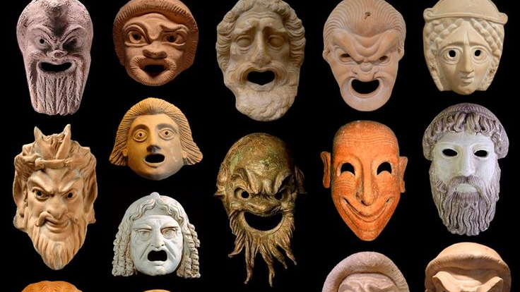

Roman Laughter
Wit and transgression in Roman literature and thought
Honours module 2021-22 [in translation, or with texts in LATIN]

Slide 2
Syllabus (texts in Latin in bold)
Terence The Eunuch
Cicero, On the Orator 2.216-90
Virgil, Eclogue 4
Ovid, The Art of Love, selected passages
Seneca Apocolocyntosis
Petronius, Satyricon 48-65
Seneca Letters, 56, 57
Martial Epigrams Book 1, and further selected epigrams
Juvenal, Satires 1 and 4
Quintilian, Handbook on Oratory 6.3
Suetonius, Lives of the Caesars, selected passages

Slide 3
Assessment
Summer Exam 50%
Coursework (50%), i.e.
Term 1: 2250-2500 word essay (25%)
Term 2: 1800-2000 word essay (15%) plus 800-1000 word blog post (10%), submitted together, as one piece of coursework, for the same deadline. Students will be given a training session in blog post writing.
In each year, students taking the module with texts in Latin must write a practical criticism in place of the term 2 essay.

Slide 4
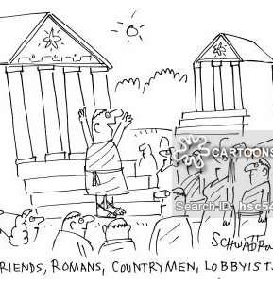
Examples of key questions and problems:
Did the Romans learn how to laugh?
To what extent would it be simplistic to draw sharp contrasts between the joking cultures of Greece and Rome?
Through our surviving texts, can we ever access how women, slaves, the lower classes experienced humour?
How to gauge the performance and timing of Roman comic moments from written texts?
How do instances of Roman humour work to reinforce social and political norms / test and challenge beliefs?
When is humour immoral? Is laughing at immoral humour itself immoral?
Can modern theories of humour (superiority, incongruity, play, release) help us to understand the humour of Roman texts?

Slide 5
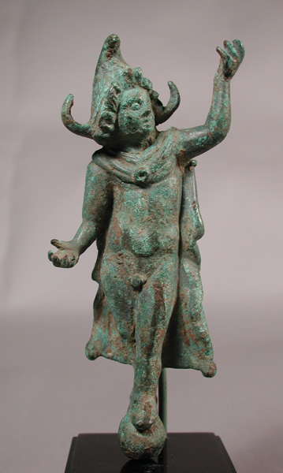
Examples of blog post topics
The Roman Smile
Roman stand-up
The laughing philosopher
Topsy-turvy Saturnalian wit
The Roman joke book
The performance of gender in Roman comedy
Grotesque bodies in Roman Laughter
Lapping it up: the philosophy and comedy of food
The Stoic poker face
Laughing with/at Roman emperors
Monkey business: Roman laughter and the animal
Laughter and looking in Latin literature
The Freudian slip, in Latin
Roman punchlines
Crossing boundaries in Roman laughter

Slide 6
Any questions?
Email me at
V.Rimell@Warwick.ac.uk

