Slide 1
The “Dead Cities”
The villages of the limestone hills of northern Syria

Slide 2
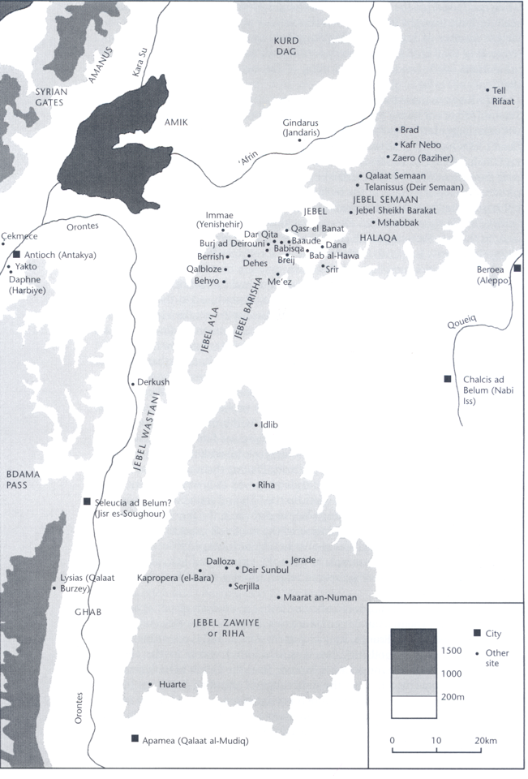

Slide 3
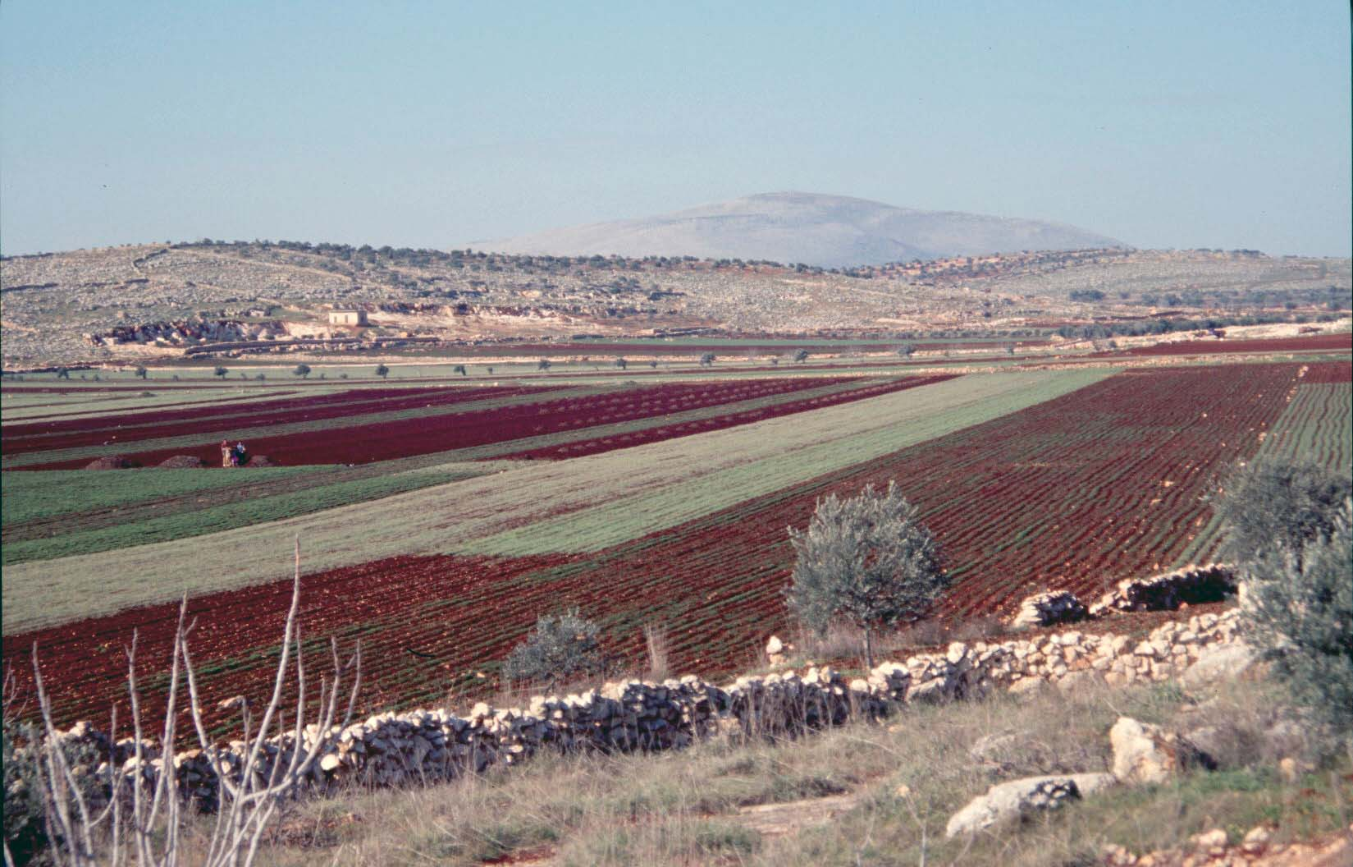
Broad stretches of limestone hills and fertile plains

Slide 4
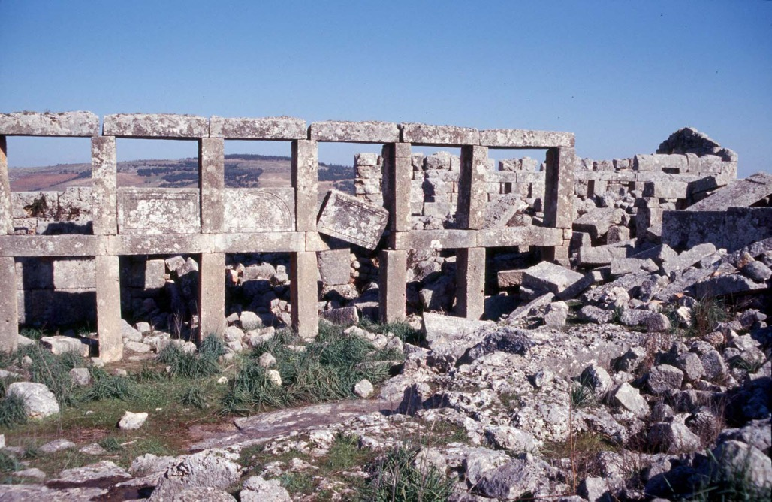
More than 700 settlements, ranging from large villages to small collections of houses. They are not cities

Slide 5
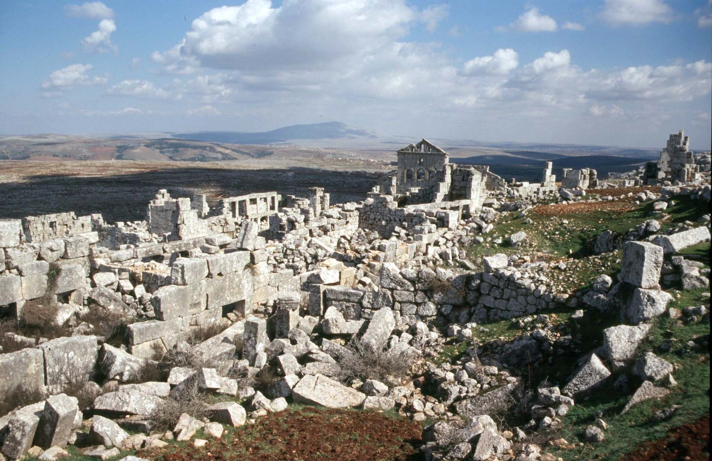

Slide 6
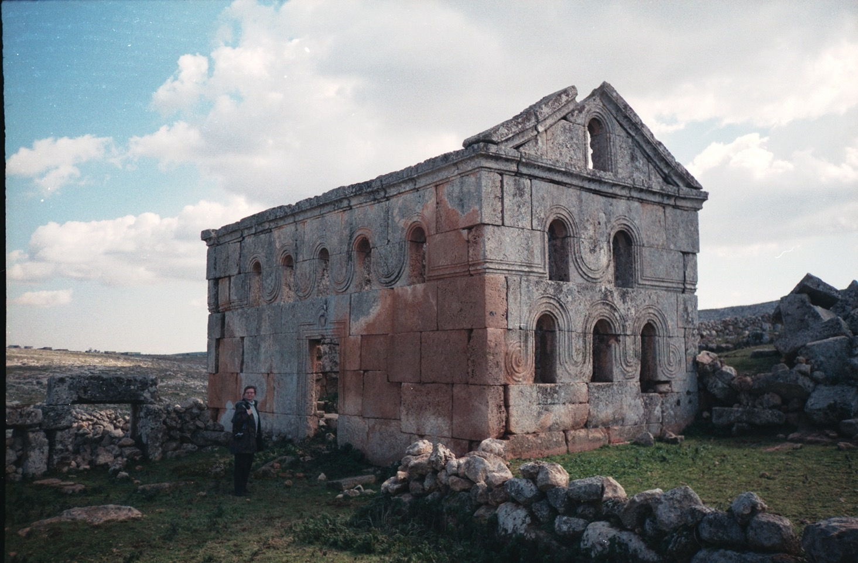

Slide 7
Most buildings are houses, but there are also oil presses and other agricultural installations, churches and monasteries, and even some bath buildings
Entire landscapes, with field boundaries, survive
Most of the surviving buildings belong to the fourth, fifth and sixth centuries, when occupation and cultivation of the limestone hills were at their most intense
The reason why the villages are so well preserved is that they occupied marginal land, which was not much inhabited after the early Islamic period

Slide 8
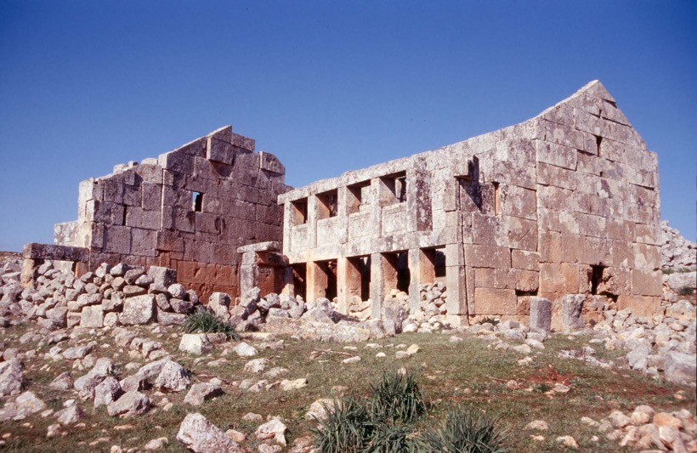
Many buildings still stand to full height, lacking only roofs, doors and shutters for the windows

Slide 9
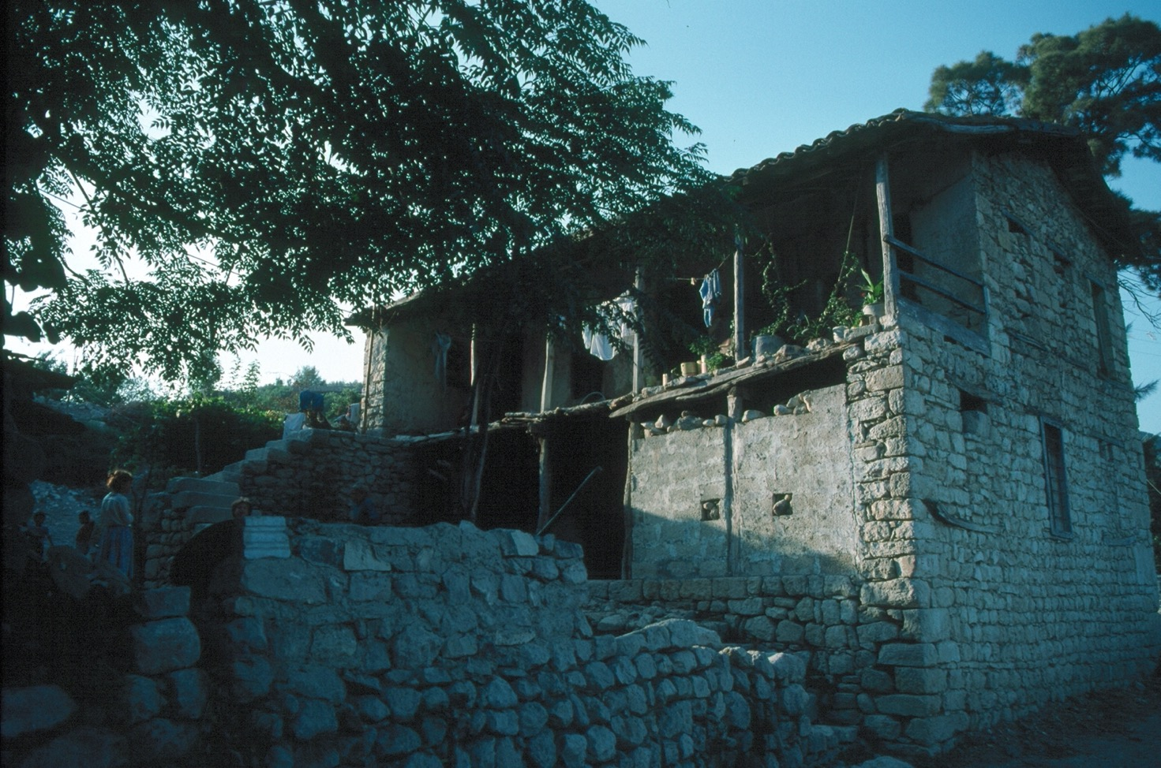

Slide 10
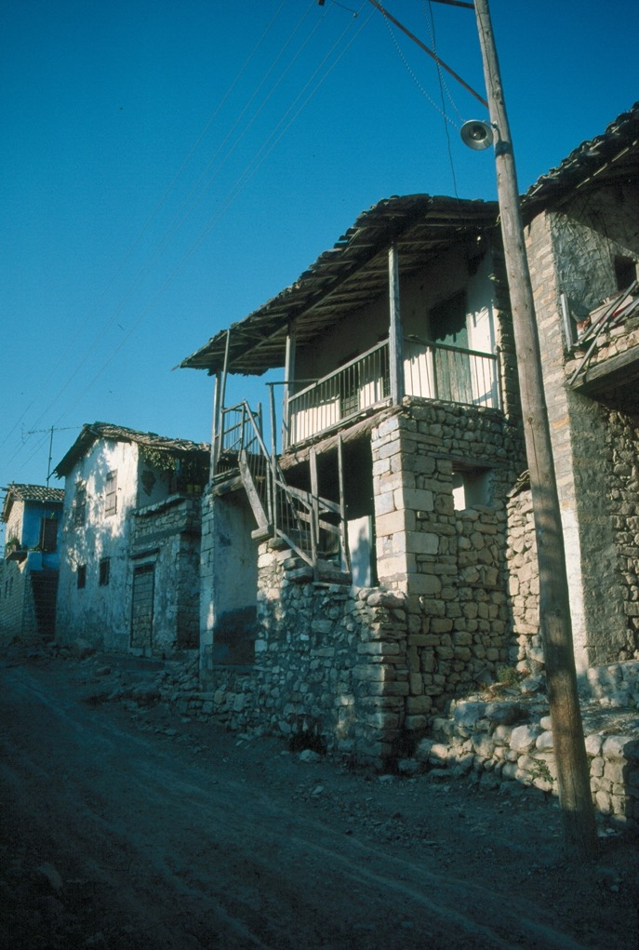
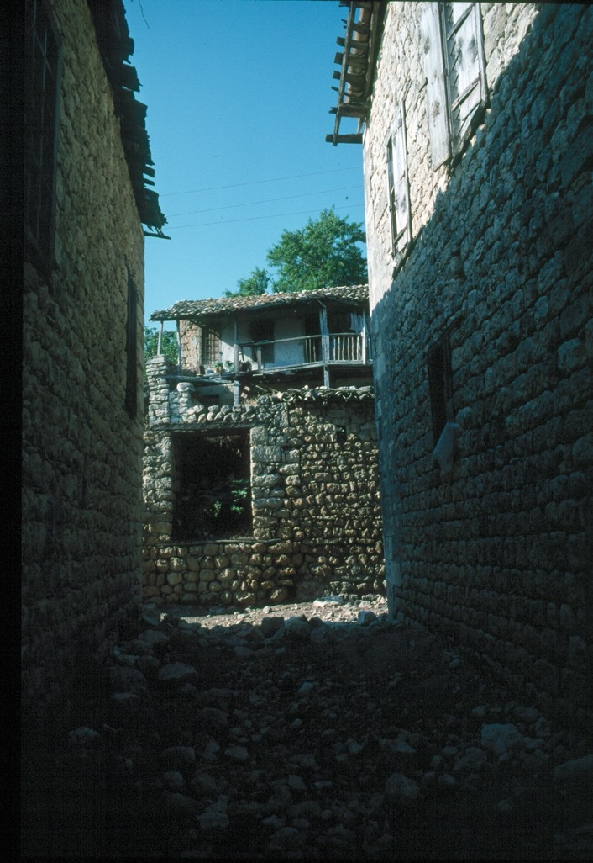

Slide 11
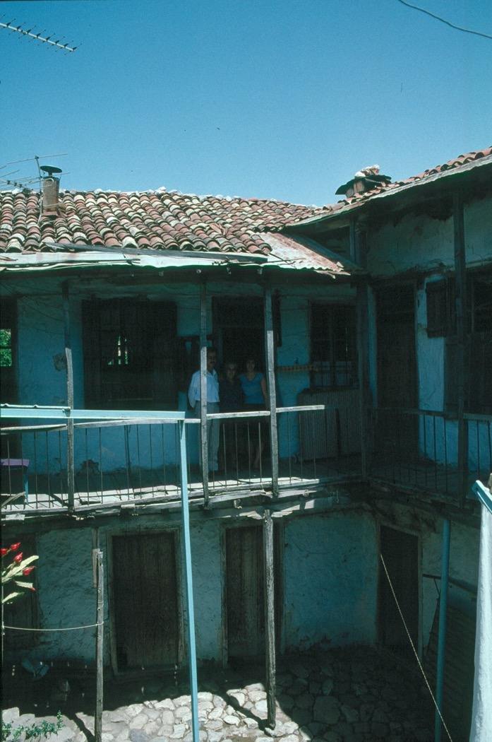
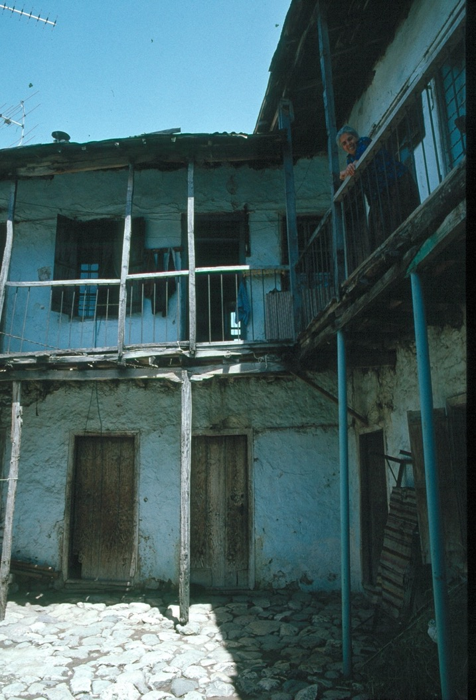

Slide 12
The region may have been underdeveloped in the Hellenistic period, although the evidence for settlement there is increasing
In many cases old houses were demolished and new ones built, so that the remains of buildings before the fourth century do not survive
However, tombs, temples and inscriptions suggest that the region was being developed during the second century AD

Slide 13
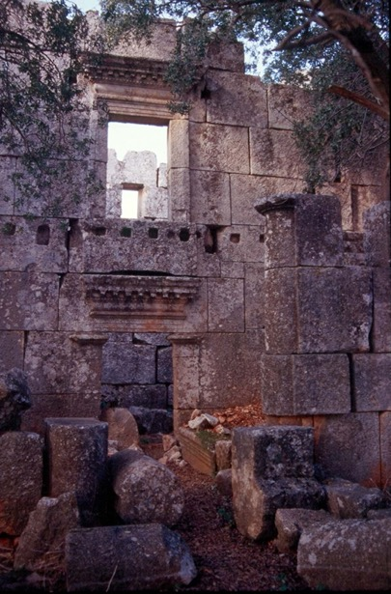
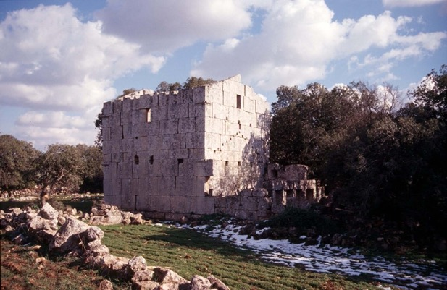
A rare early house: a third century building at Bammuqa

Slide 14
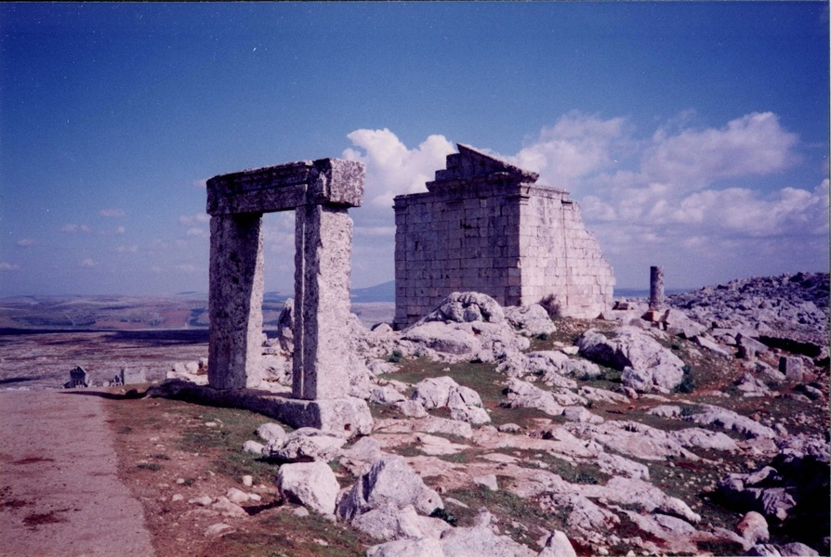
Temple at Burj Baqhira

Slide 15
From about AD 330 onwards the population increased considerably, and building activity reached a peak in about 450-480. Many of the houses have inscriptions giving the date of their construction
A number of very fine houses were constructed in the first half of the sixth century
There is evidence of stagnation and decline in the period after 550, but the villages continued to be inhabited well after the Muslim conquest

Slide 16
Who were the inhabitants?
Independent, land-owning farmers?
Tenants of a wealthy estate owner?
Originally they were thought to be villas of a wealthy bourgeoisie: Marquis de Voguë
Re-interpreted in the 1950s as a major economic zone: cities like Antioch invested in intensive olive cultivation, and the villages made olive oil in large quantities, not only for the cities, but for overseas export: Georges Tchalenko
Support for the thesis from excavations abroad. A major amphora type, Late Roman 1, was thought to be associated with the north Syrian olive oil industry, and Late Roman 1 amphoras were found in large quantities in southern France, Italy and north Africa.

Slide 17
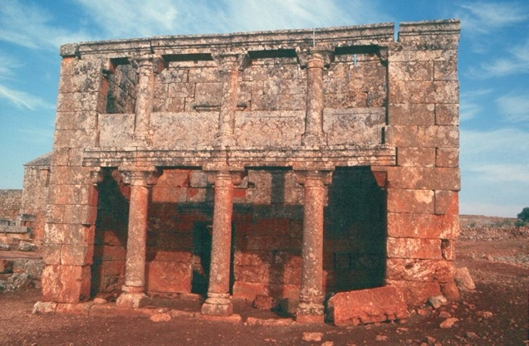
It was also suggested that the villages had a variety of buildings for special purposes: e.g. the andron (a market-hall?)

Slide 18
Recent studies have stressed agricultural diversity over olive monoculture: Georges Tate
There are lots of communal olive presses, but also wine presses
Many olive presses were perhaps not suitable for producing very fine quality olive oil, such as might have been required for export, suggesting that much oil might have been for local consumption
Certain regions have many more oil presses than others; other regions have more stone troughs or mangers, suggesting livestock was important there; in the south rectangular and elongated strip fields may have been suitable for grain or fruit trees

Slide 19
The villages
Lack any formal planning
The majority of buildings are houses
The houses were simple buildings, with storage areas downstairs and living quarters upstairs
The next most common type of building is the church
There are also monasteries, which must have owned estates
Another common structure is the tower. Sometimes attached to houses, sometimes free standing

Slide 20
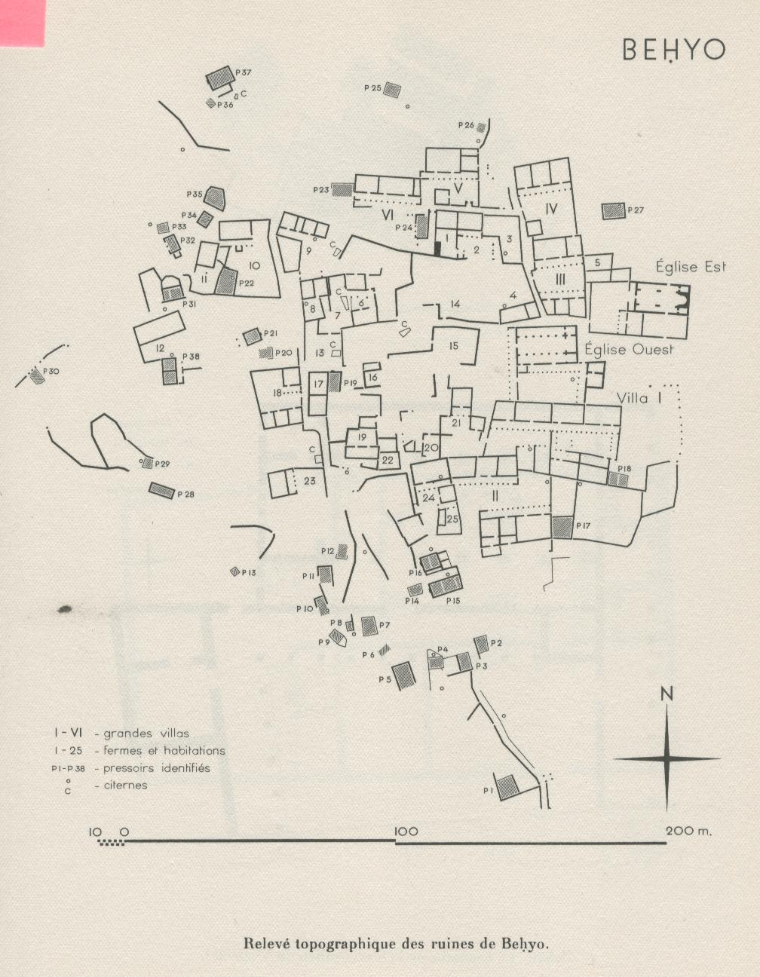

Slide 21
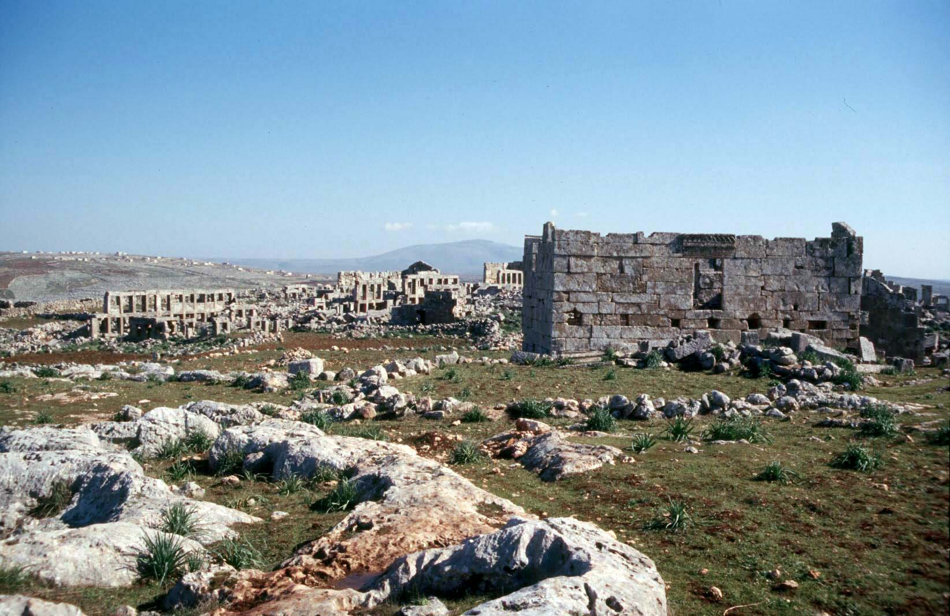
Baude

Slide 22
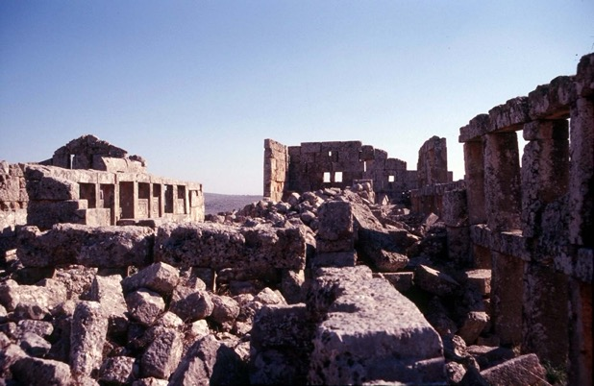
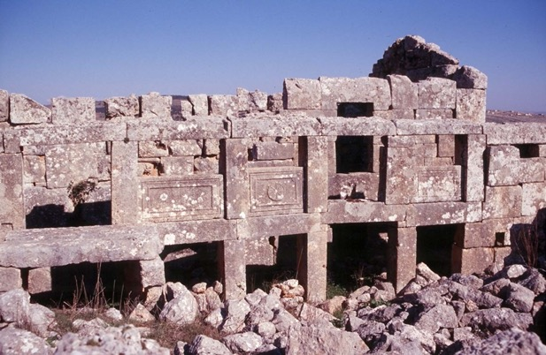

Slide 23
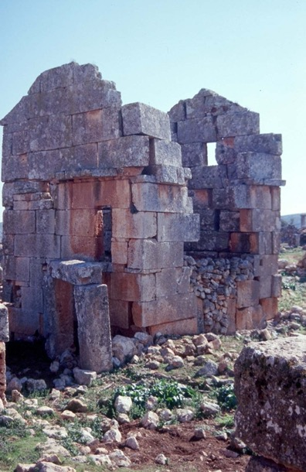


Slide 24
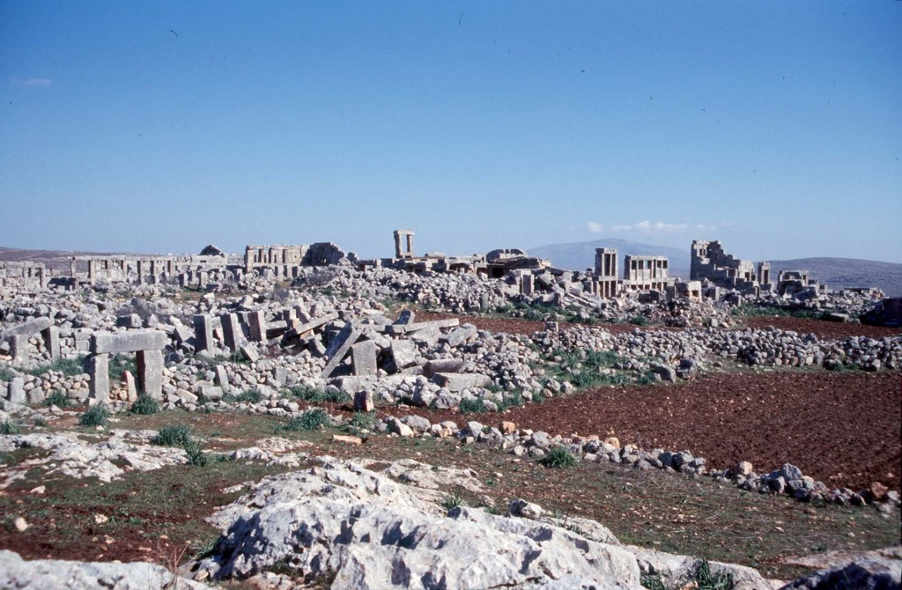

Slide 25
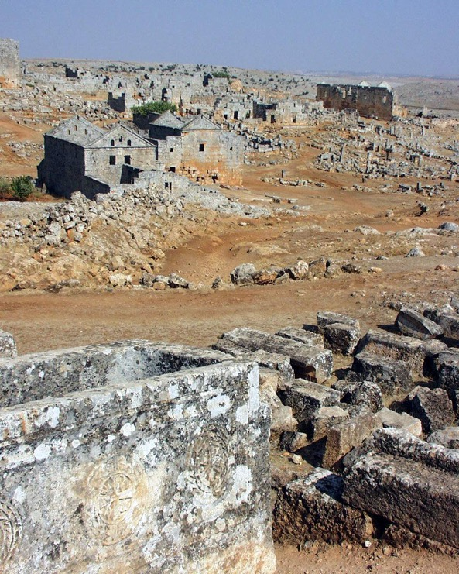
Serjilla

Slide 26
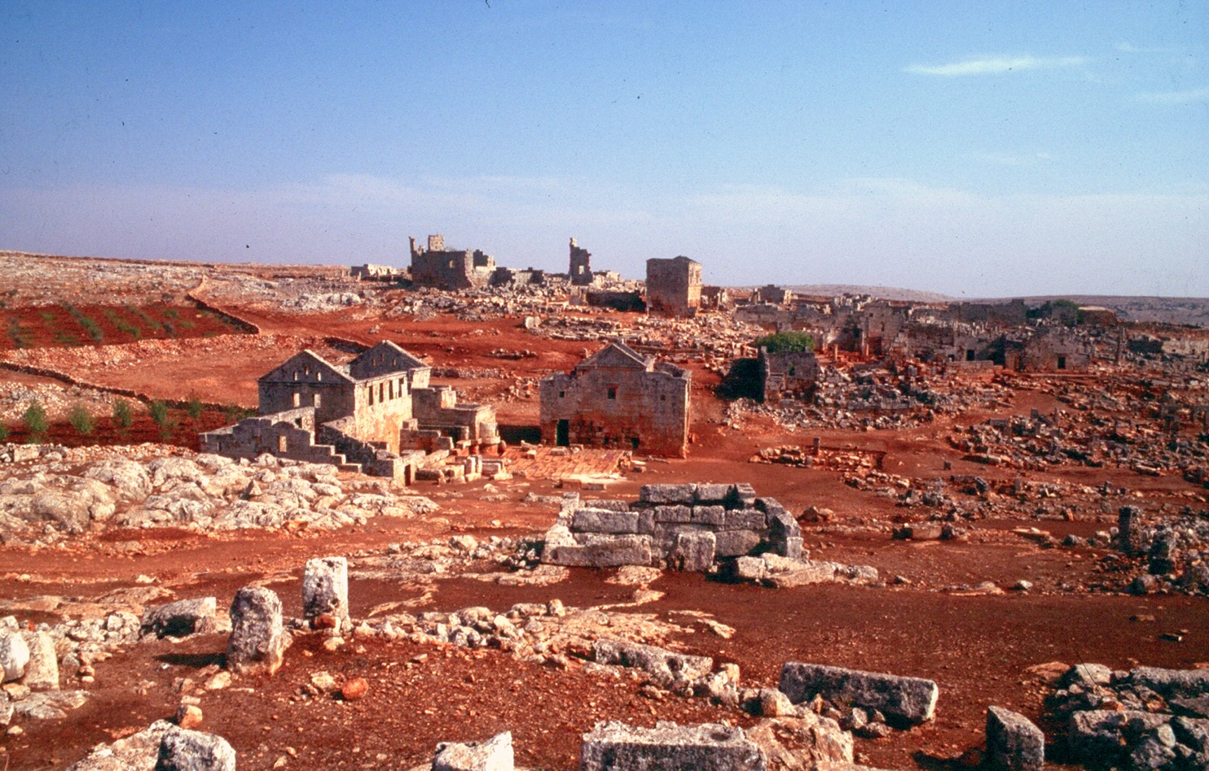

Slide 27
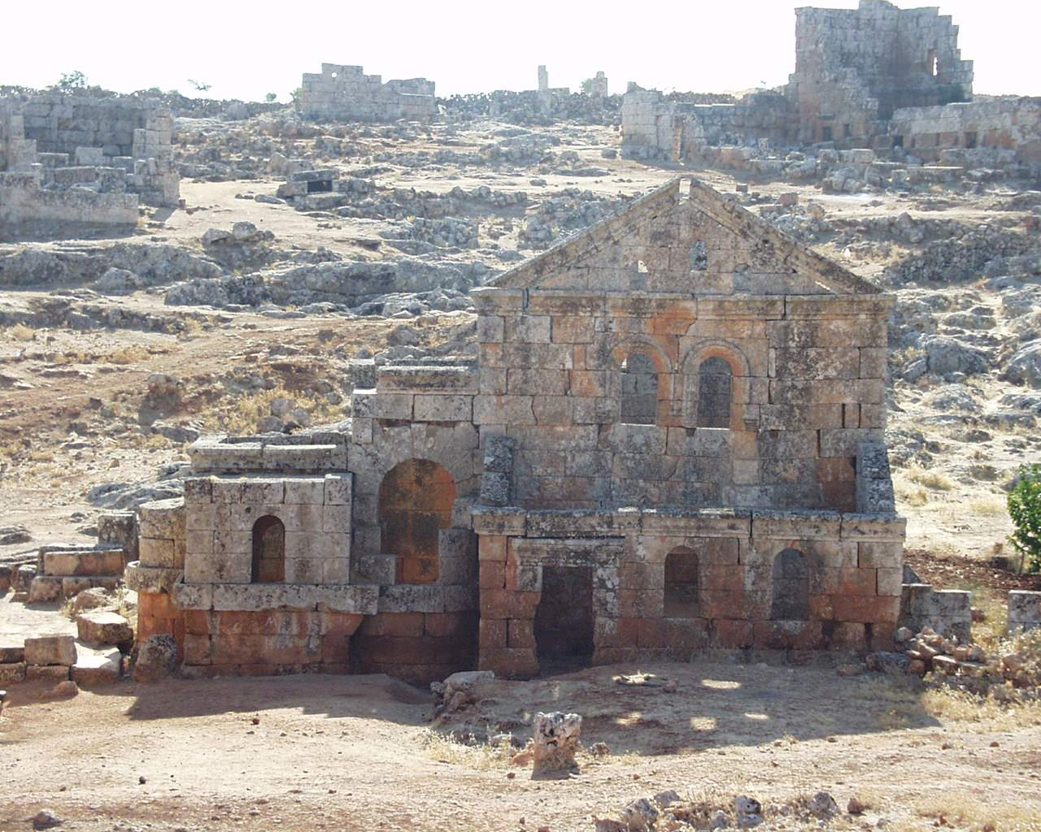

Slide 28
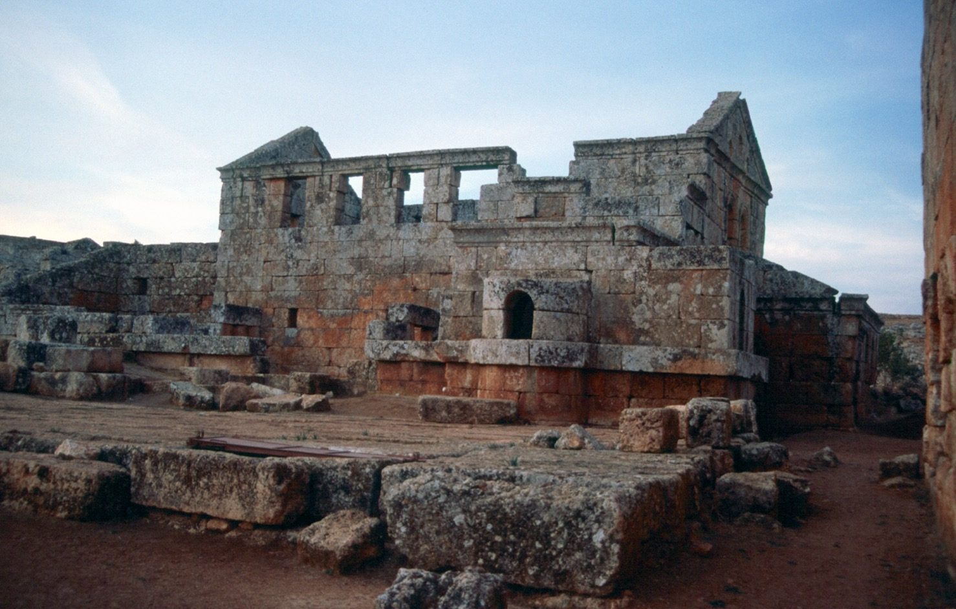

Slide 29


Slide 30
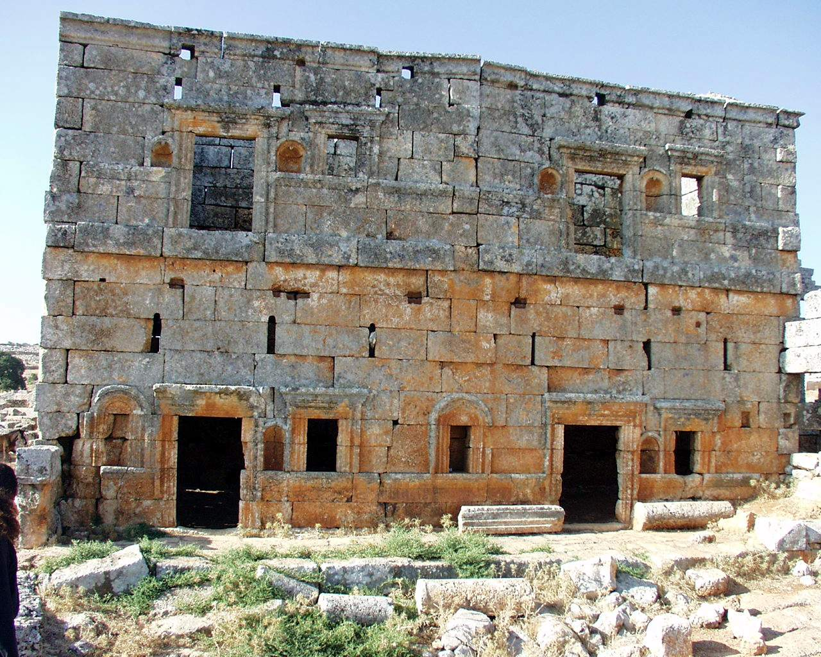

Slide 31
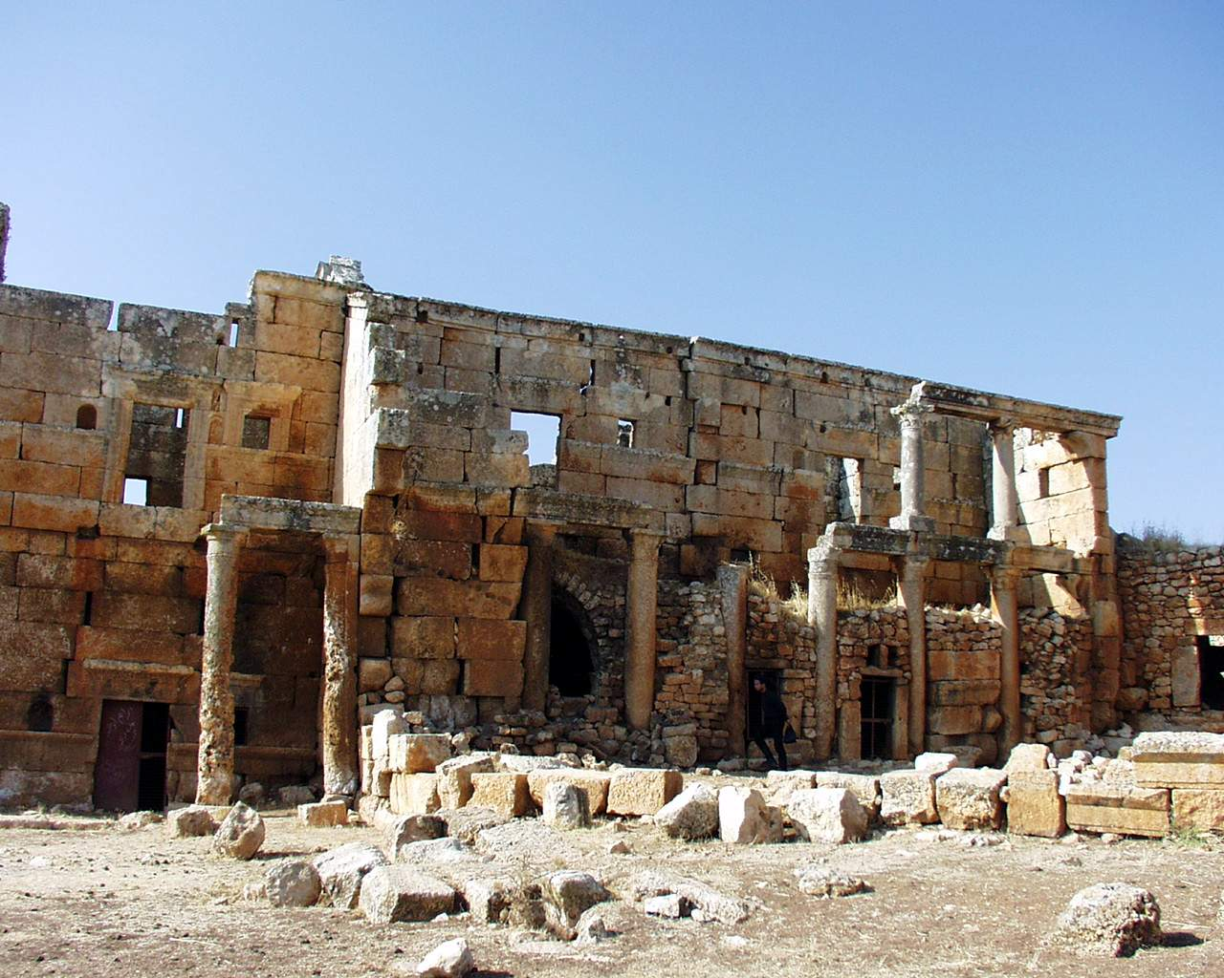

Slide 32
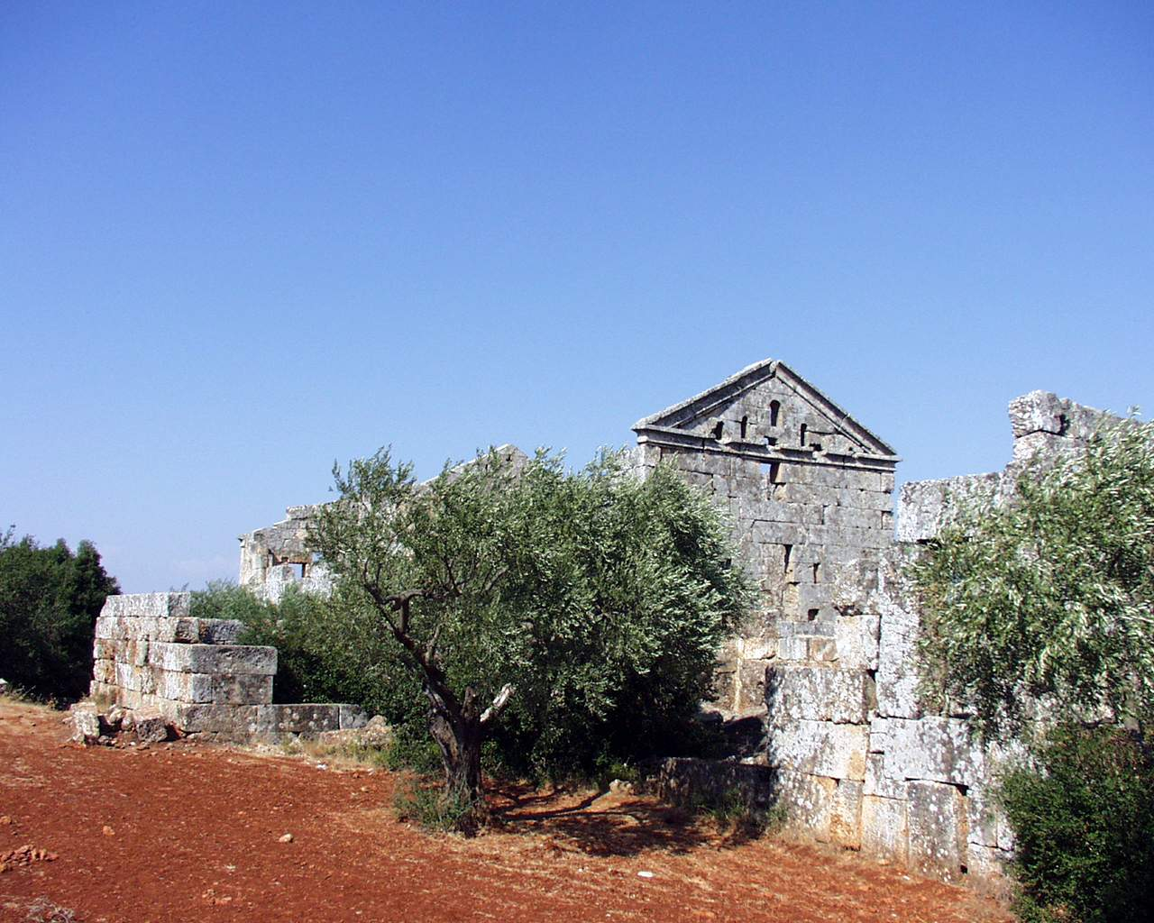
El Bara

Slide 33
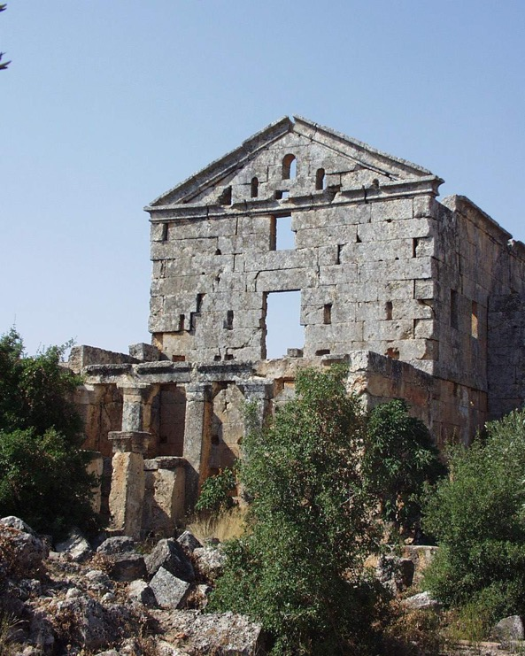
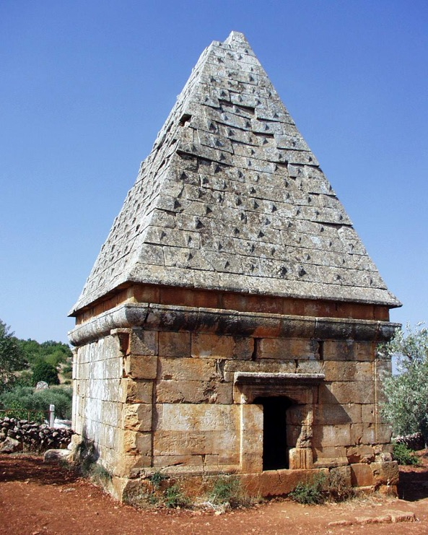

Slide 34
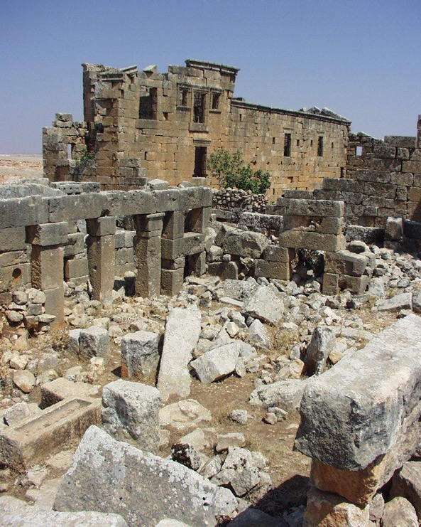
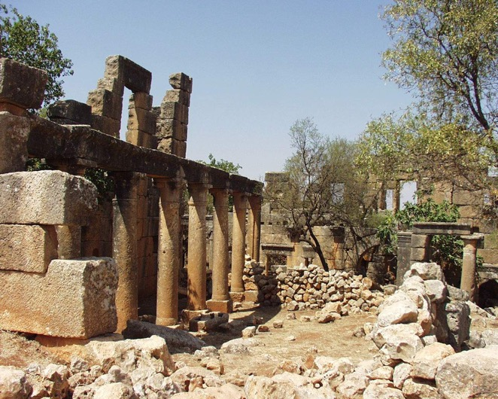
Jeradeh

Slide 35
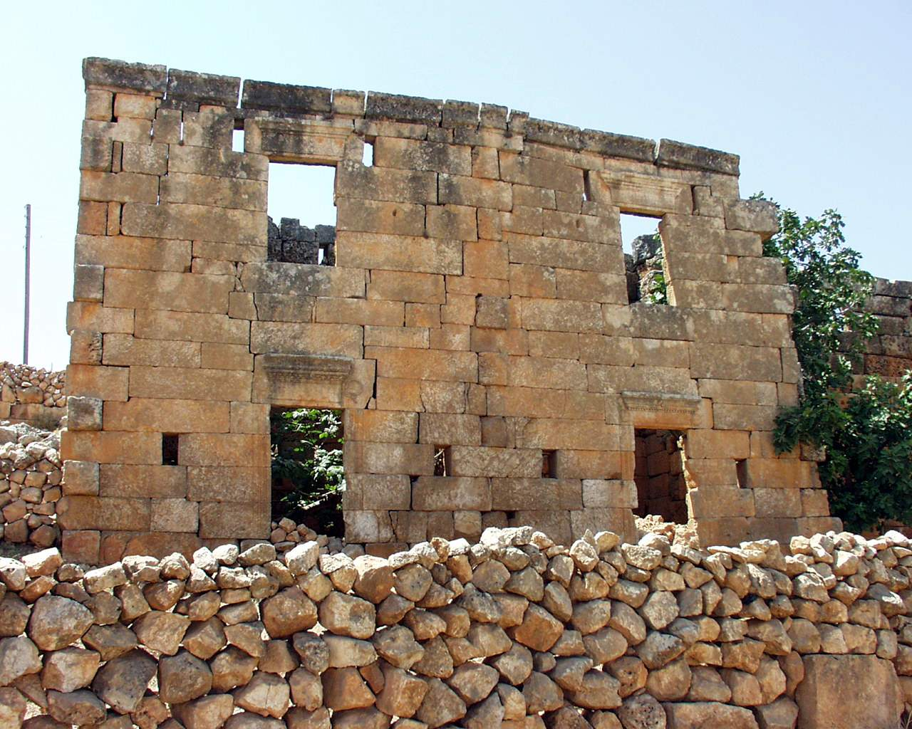

Slide 36
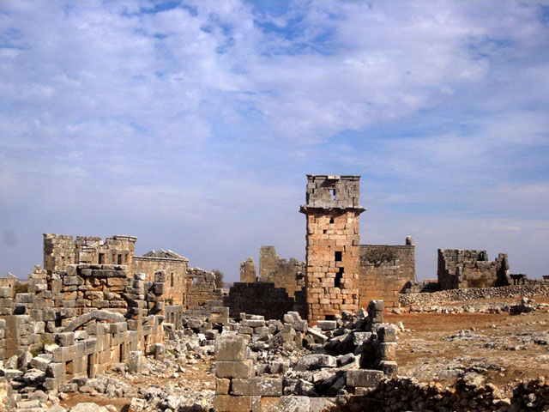

Slide 37
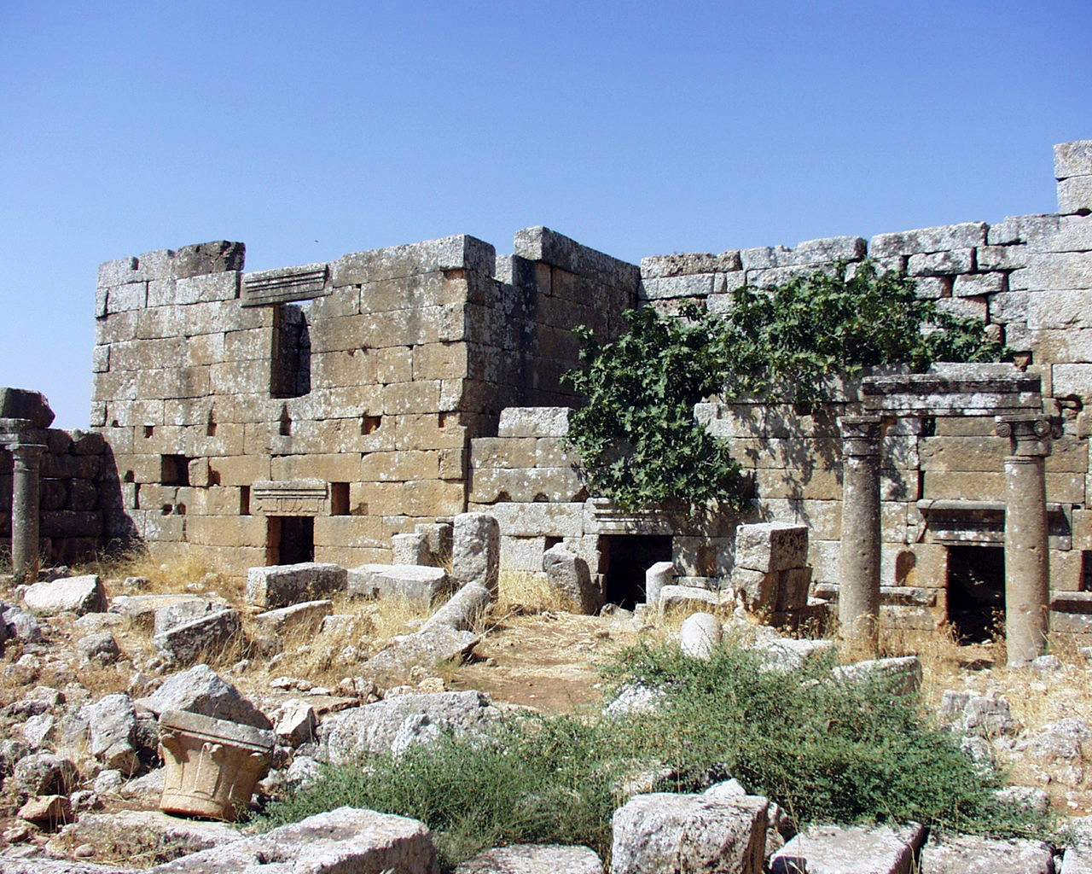
Ruweiha

Slide 38
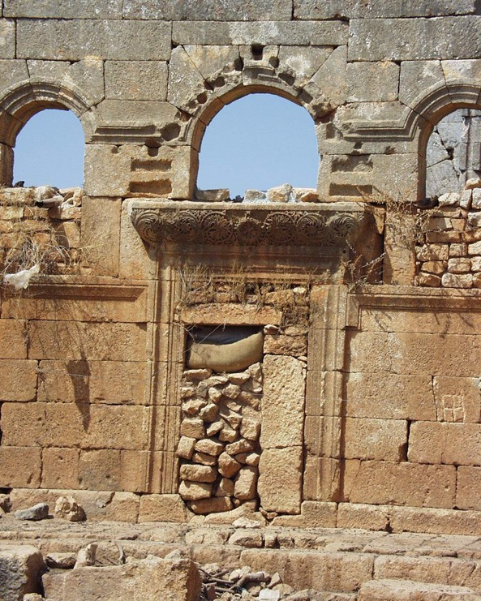
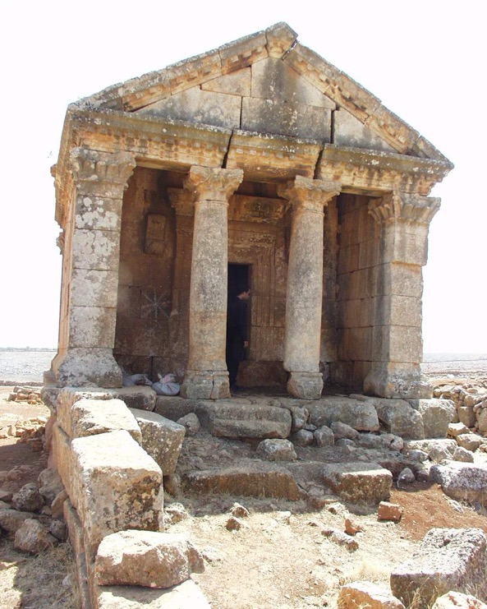

Slide 39
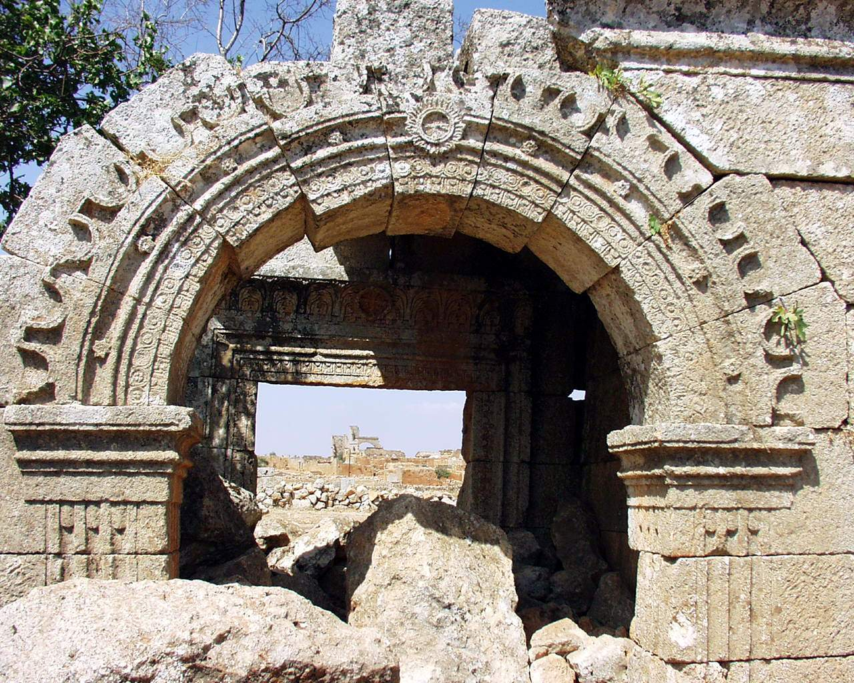

Slide 40
The rise and decline of the villages seems to follow the growth and decline of the great cities of Antioch, Apamea etc.
Likely that there was an intimate link between the cities and the villages
Recent evidence from the plains suggests a strong relation between villages there and the success of the cities

Slide 41
Chalcidice and the Eastern Steppe

Slide 42
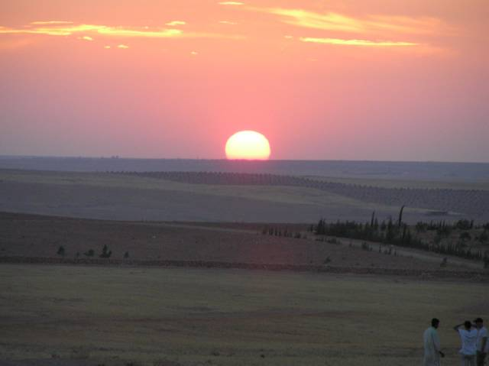

Slide 43
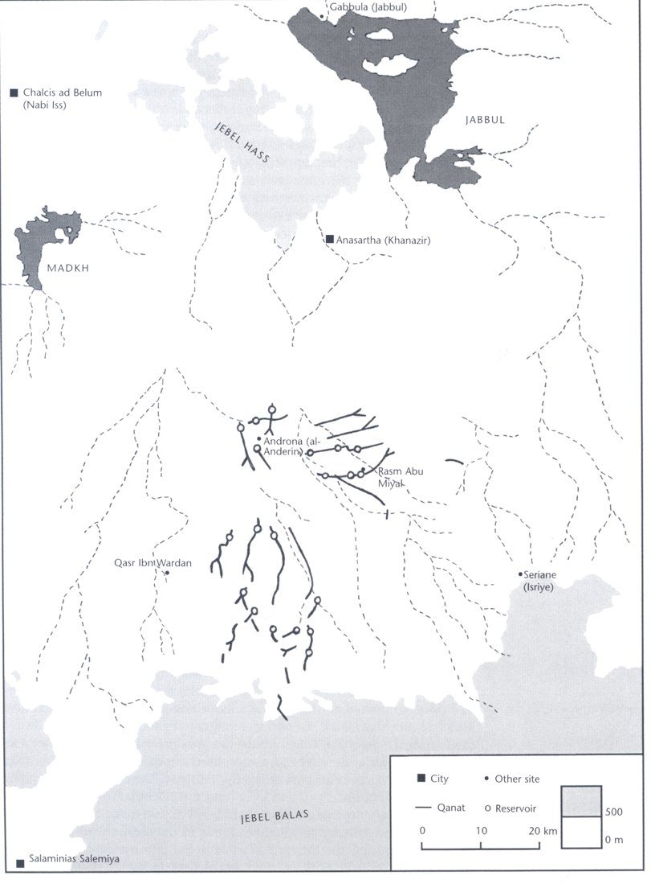

Slide 44
The western part of this region is suitable for vines, olives and cereal crops
The east is very dry
Early studies suggested that this was a military zone, a network of forts and roads and civilian settlement – the limes: ‘Les limes de Chalcis’ (René Mouterde & Antoine Poidebard, 1945)
Recent research has shown that the ‘forts’ are mostly farms

Slide 45
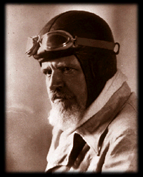
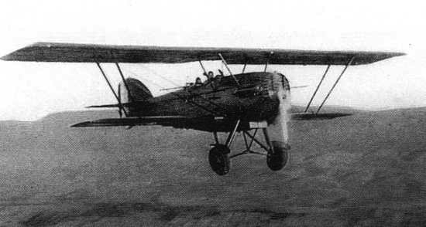
Antoine Poidebard – the flying priest
1878-1955

Slide 46
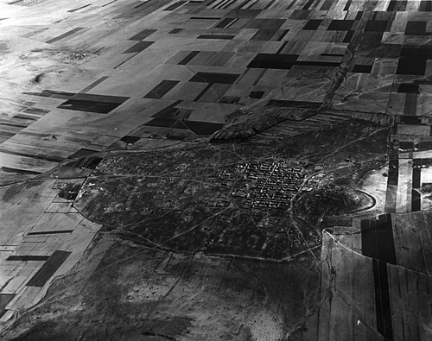
Anasartha

Slide 47
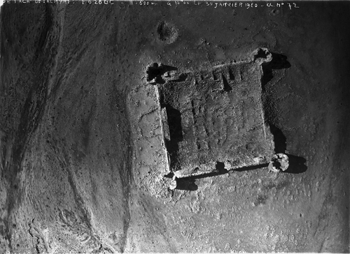
Khan el-Hallabat (ancient Veriaraca, c. AD 300, on the strata Diocletiana)

Slide 48
In the early empire most of this region was inhabited by nomads
Some settlement in the northern hills, and a large third-century temple at Isriye
A growing population from the fourth century onwards seems to have been responsible for the development of the region
Exploitation depended on careful water management

Slide 49
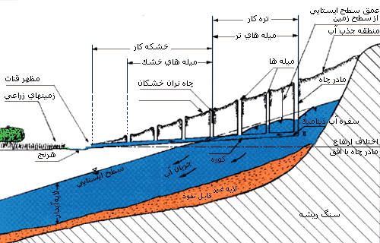
Qanat technology

Slide 50
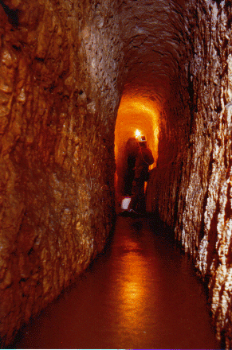
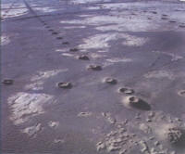
The inhabitants could draw water from quite distant sources

Slide 51
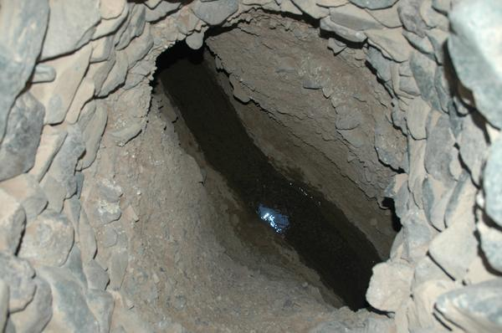
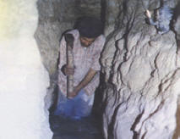
They can run for more than 10 kilometers

Slide 52
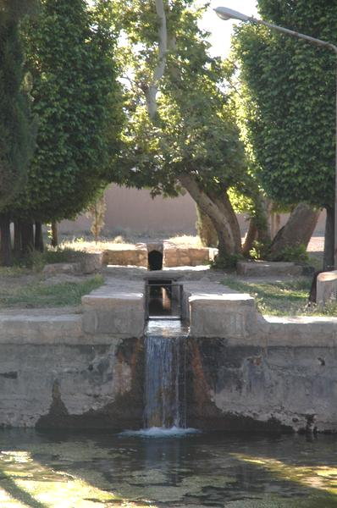
They supplied basins and reservoirs and were used for irrigation
In the far east it was too dry even for this technology, but farms could be positioned to take advantage of moisture (e.g. positioning fields alongside wadi beds)

Slide 53

Isriye

Slide 54



Slide 55


Slide 56


Androna – a developing city?

Slide 57



Slide 58


Slide 59

Qasr Ibn Wardan

Slide 60

Probably an administrative and military complex serving the surrounding regions
The palace is dated AD 564
This type of settlement, perhaps the center of a large estate, became normal under Muslim rule in this region
Rural elites rather than city-based elites

