Slide 1
The Hauran

Slide 2
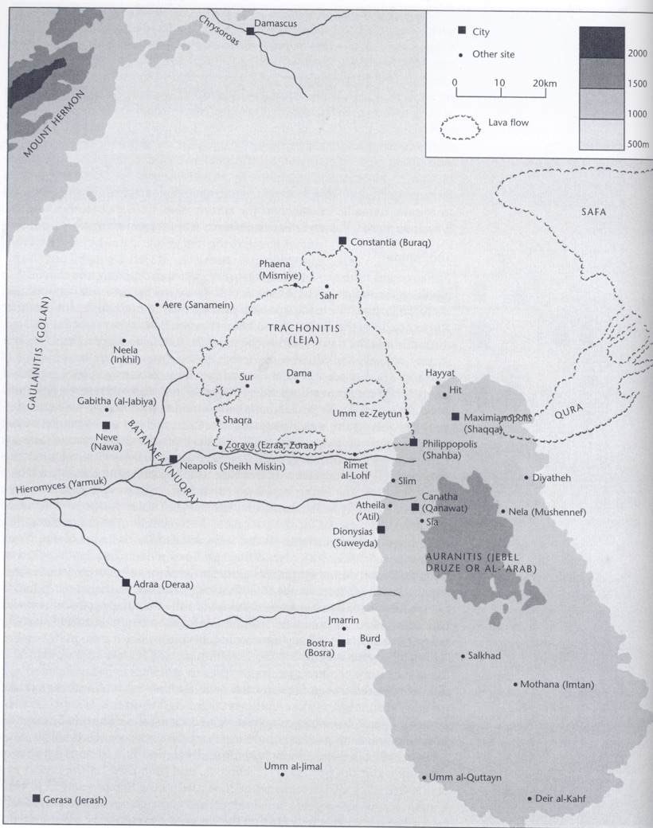

Slide 3
Auranitis = Jebel Arab
Trachonitis = Leja
Batanaea = Nuqra
The main cities of the region: Canatha; Adraa; Bostra
Later Dionysias, Philippopolis, Maximianopolis, Constantia, Neve
Parts of Trachonitis and Batanaea may have been imperial estates
The best evidence for village life comes from the northern part of Auranitis and from Trachonitis, where the villages do not appear to have been subject to any city

Slide 4
Main phases of development: first from late third / early fourth century to early fifth; and second from early sixth to seventh centuries.

Slide 5
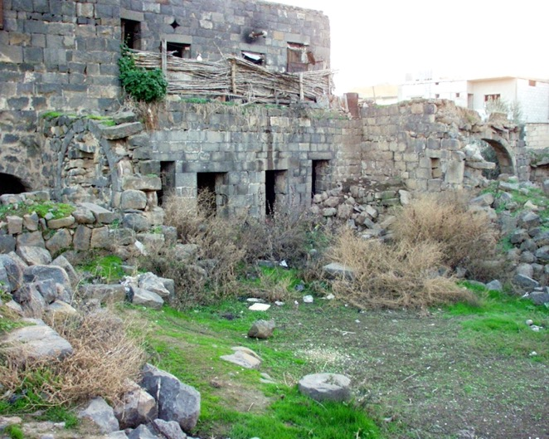
The villages have no formal plans
The immediate environs of the villages had small gardens and plantations, with the larger fields lying beyond these
Water was supplied by rainfall, and collected in communal reservoirs

Slide 6
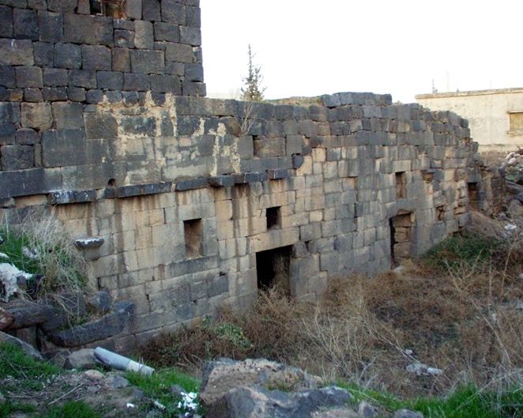
Houses like those of Dead Cities: storage downstairs, courtyards
But flat roofs
Staircases are internal, except for those that give access to the roof
Sometimes several stories, so that the houses resemble towers
Considerable variation in houses: some much more elaborate and larger than others – probably the residences of late Roman rural aristocrats

Slide 7
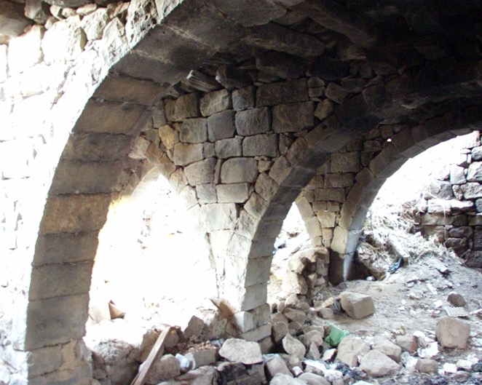
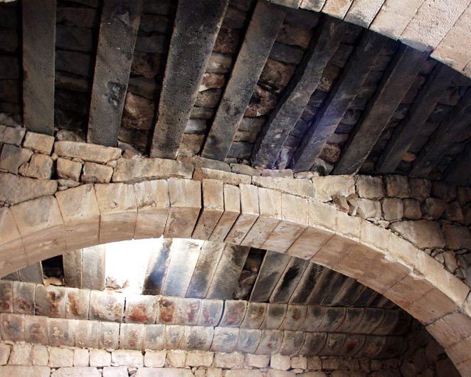

Slide 8
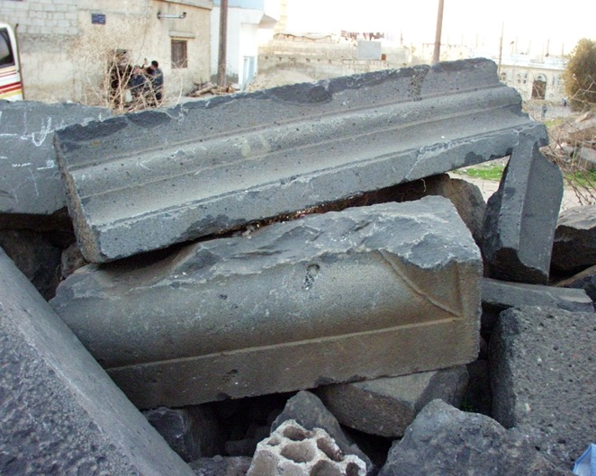
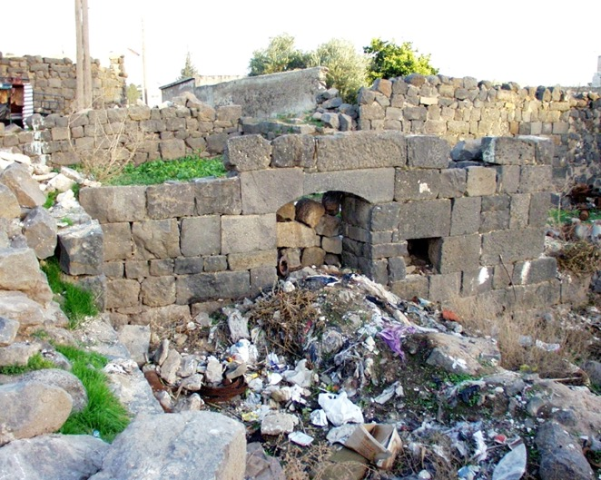

Slide 9
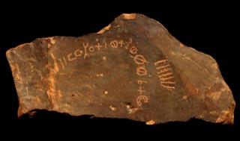
Many of the villagers may have been former nomads who adopted a settled life; there is some uncertainty about the relationship of the Hauran villagers to the writers of Safaitic graffiti in the desert to the east

Slide 10
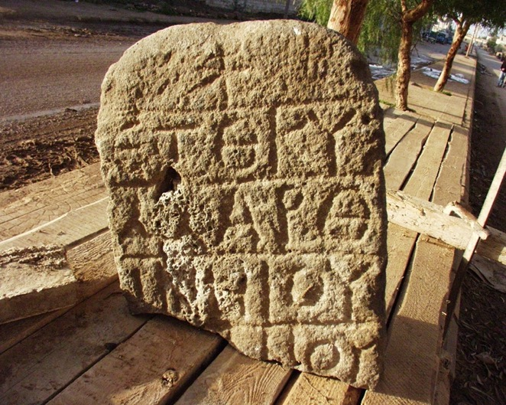
Inscriptions suggest that the villages of the Leja and northern Hauran may have had administrative bodies: the villagers had communal funds and communal land, and may have had special buildings for public meetings
The inscriptions also mention a variety of village officials, which implies an elaborate system of self-government

Slide 11
Are such villages developing cities?
The variety of officials might suggest that these villages were developing proto-civic administrations
However, most of the inscriptions are concerned with building projects, and the officials named may be temporary posts
Some titles may be inexact translations of Aramaic terms for “village chief” or “head man”
The inscriptions provide us with important information about the way in which the villages managed their affairs: religious duties; land management; property ownership; social organization

Slide 12
Some villages, such as Dionysias, Philippopolis, Maximianopolis, Constantia, and Neve achieved city status
Is this part of a deliberate Roman policy of urbanization?
Some have thought that the title metrokomia, found in Trachonitis and Batanaea, represents an intermediate stage between village and city
An alternative view is that metrokomiai were villages that were on imperial estates, and therefore could never become cities
If they had lain outside imperial estates, the metrokomiai would perhaps have been promoted to cities

