Slide 1
Term 1 Recap
What difference did Roman rule make?
Historical developments:
First century BCE: insecure control of region (temporary Parthian conquest)
First century CE: consolidation, particularly after Nero (road building, removal of “client kings”)
Second and third centuries: aggressive campaigns against Parthians and Sasanians (with some reversals)
Fourth and fifth centuries: competition between Romans and Sasanians for control of Mesopotamia
Sixth century: Rome’s relations with the Arab tribes

Slide 2
Political structures:
Provinces, increasing number of these over time
“Client kingdoms” – outside the normal structure of Roman command, appointed or dismissed by the emperor
Cities – the basic political/cultural unit; increase in the number of cities under Roman rule; competition for honours between cities (but the older cities tended to be the ones that were the most influential)

Slide 3
Roman impact on ability to travel (infrastructure for travel) and on calendars and organization of time (365-day year, alignment with tax cycle)
Impact of Rome on the development of the countryside (laws concerning abandoned or unused land, growth of cities serving as markets for village products and places of export)
Examples of the Dead Cities, Chalcidice, the Hauran

Slide 4
Seems to be a link between the prosperity of the cities and the villages in the countryside
Increase in settled rural population during Roman period, and its expansion into marginal zones (e.g. the Dead Cities), is striking
Some rural regions experienced tremendous growth, becoming major centres of agricultural production
In late antiquity some of the villages were even elevated to city status
Some of this expansion could be achieved only by large-scale projects aimed at altering the environment: building dams, aqueducts, planning and laying out of field systems

Slide 5
Water supply

Slide 6
Distribution of water very uneven
Water has shaped the pattern of settlement more than any other resource
Below an annual average rainfall of 250 mm farming becomes extremely difficult without irrigation
In the 250-150 mm zone, livestock raising is possible
Below 150 mm is true desert, supporting only seasonal presence of livestock, but camels can be raised here

Slide 7
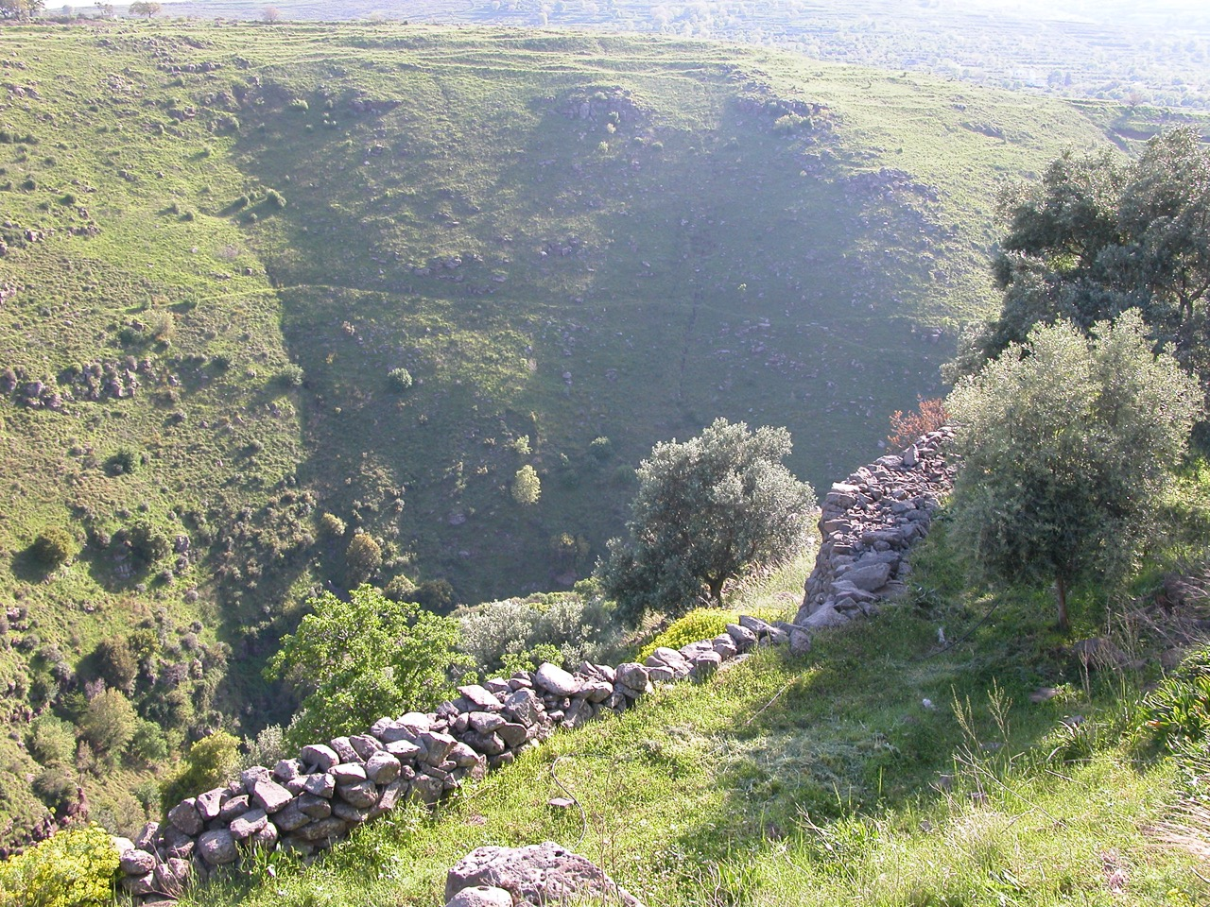

Slide 8
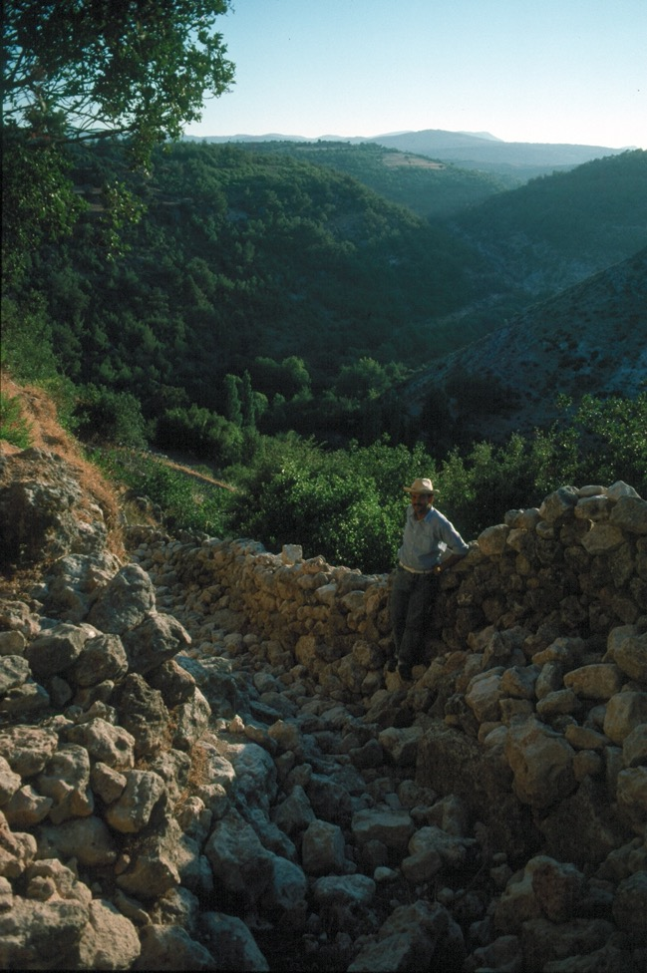

Slide 9
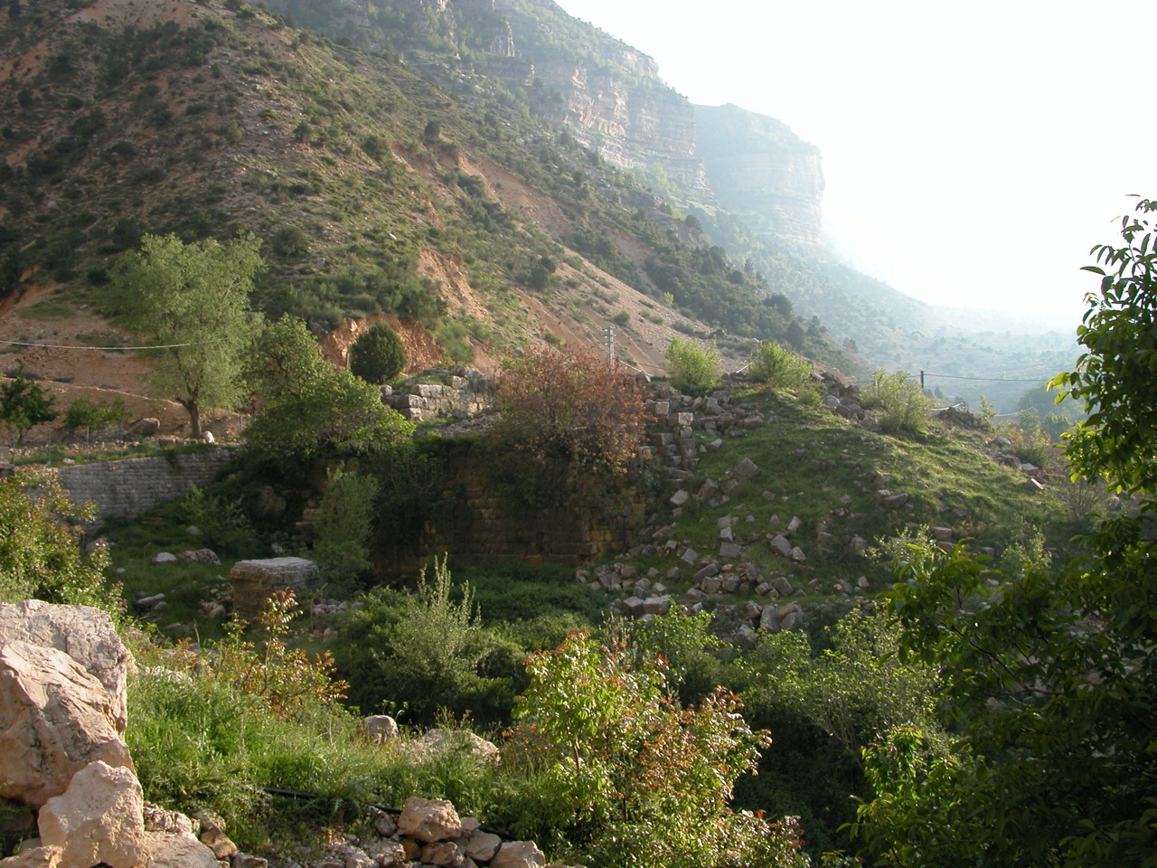

Slide 10
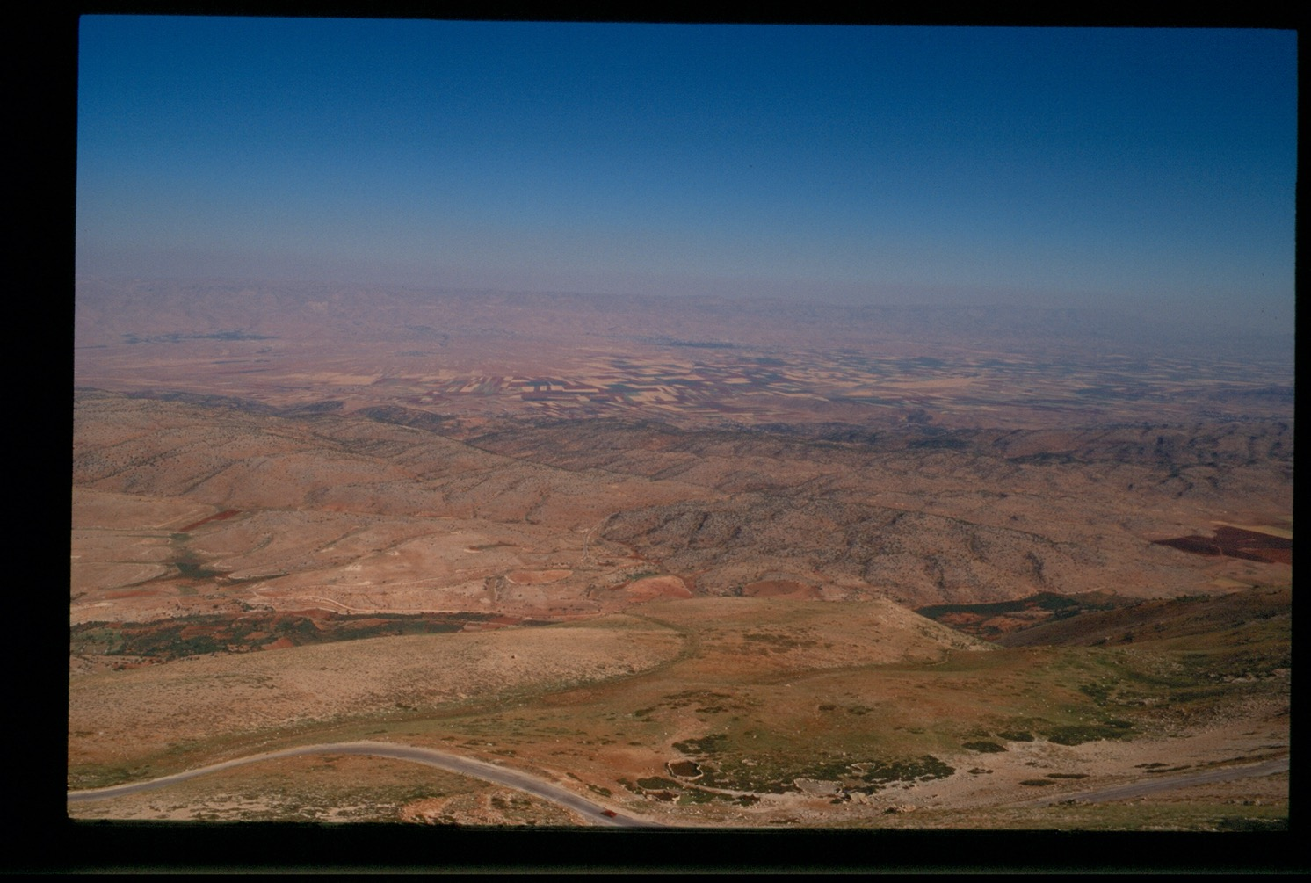

Slide 11
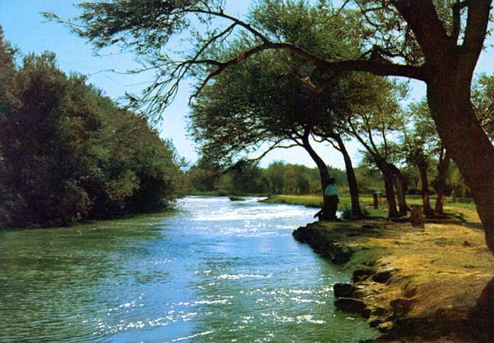
Orontes river in the northern Bekaa Valley

Slide 12
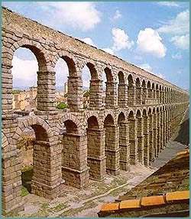
Ways of transporting water
Aqueducts
Expensive, unlikely that villages could afford to build them
Mainly used to transport water to cities, but villages could tap water from them

Slide 13
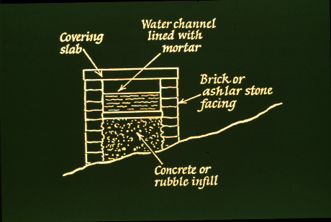
Aqueducts operated on gravity, so the water source had to be higher than the place where the water was needed
Often the channel was not visible, and ran underground

Slide 14
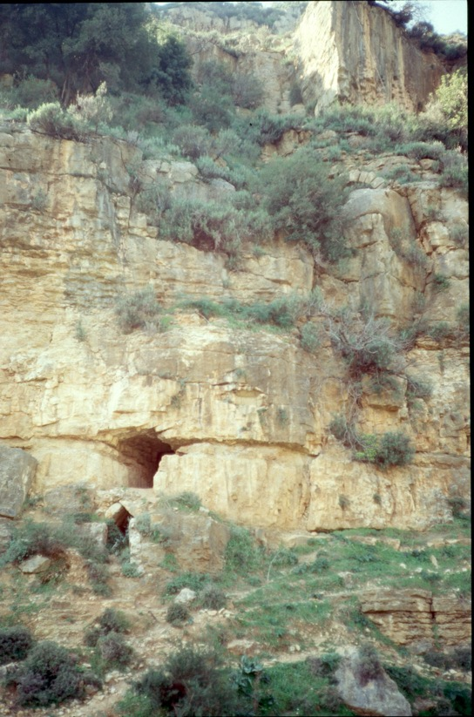
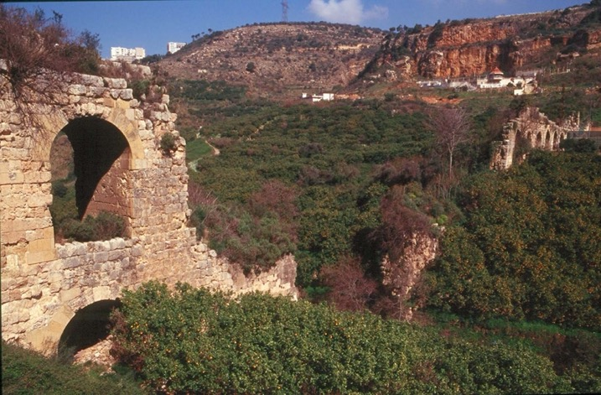
Zubeidah aqueduct that supplied Beirut

Slide 15
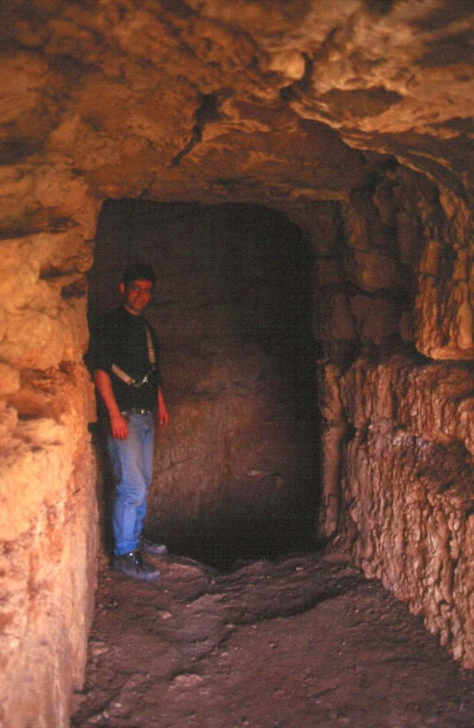
Large channel in Zubeidah acqueduct; access to the water channel was necessary to keep the structures functioning

Slide 16
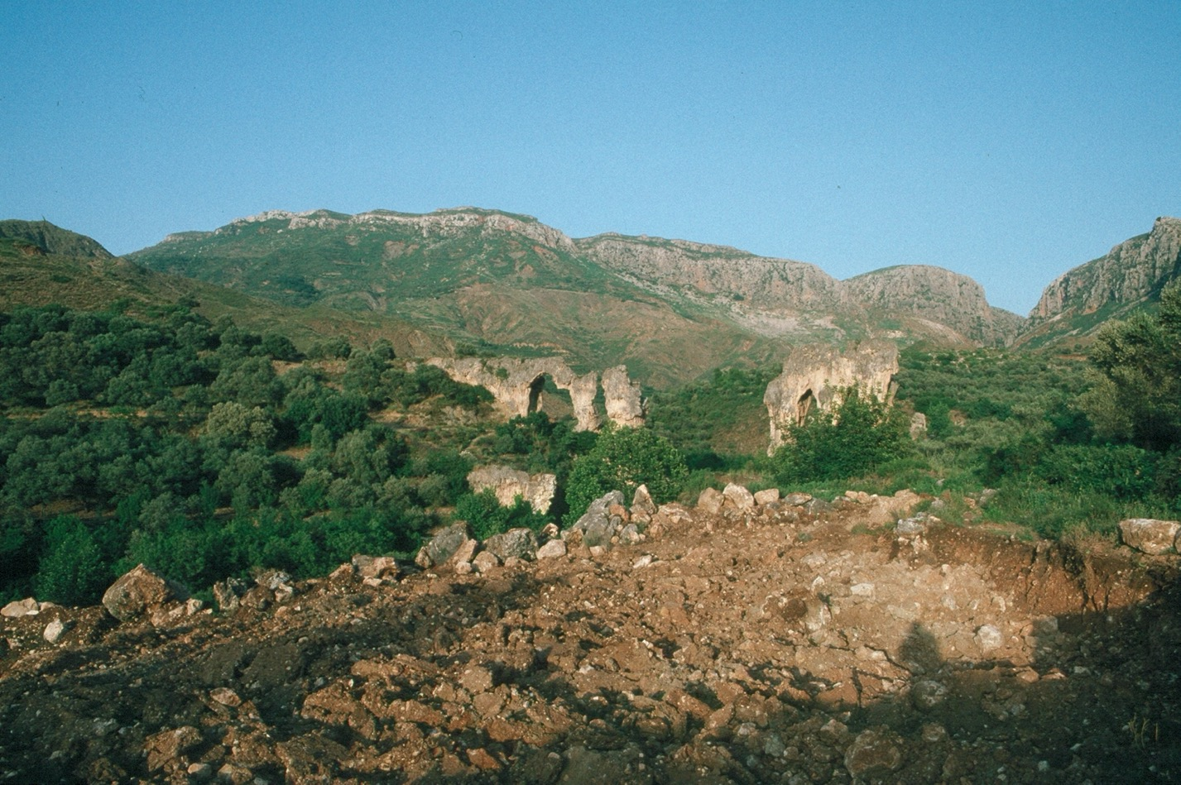
Aqueduct at Antioch

Slide 17
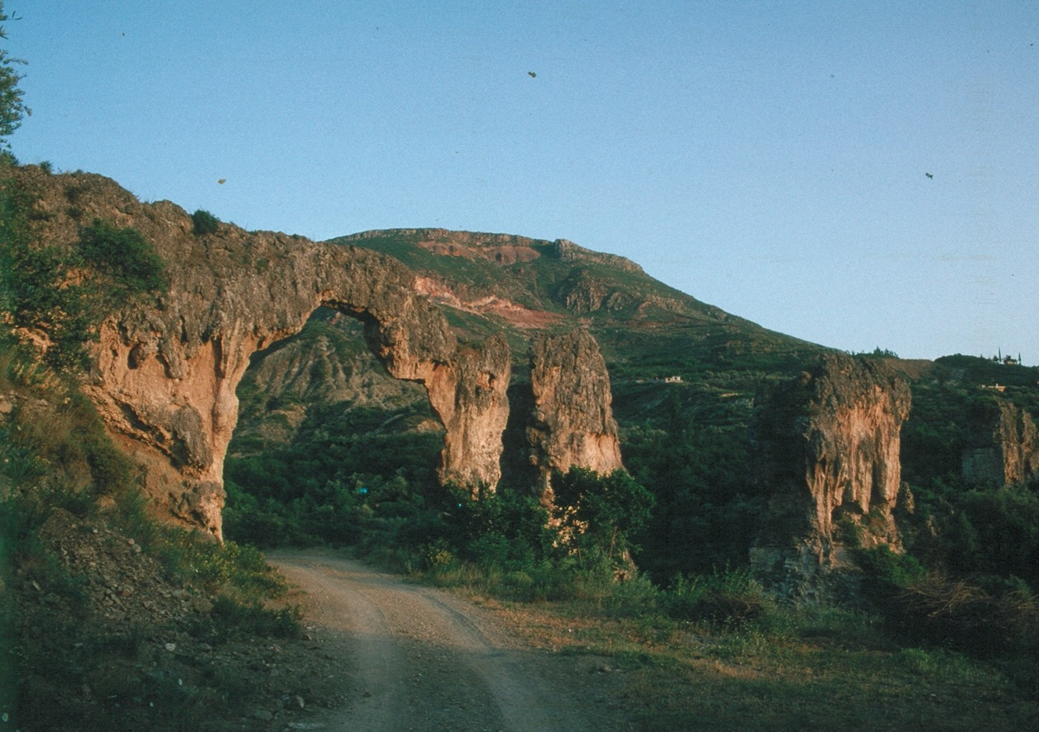

Slide 18
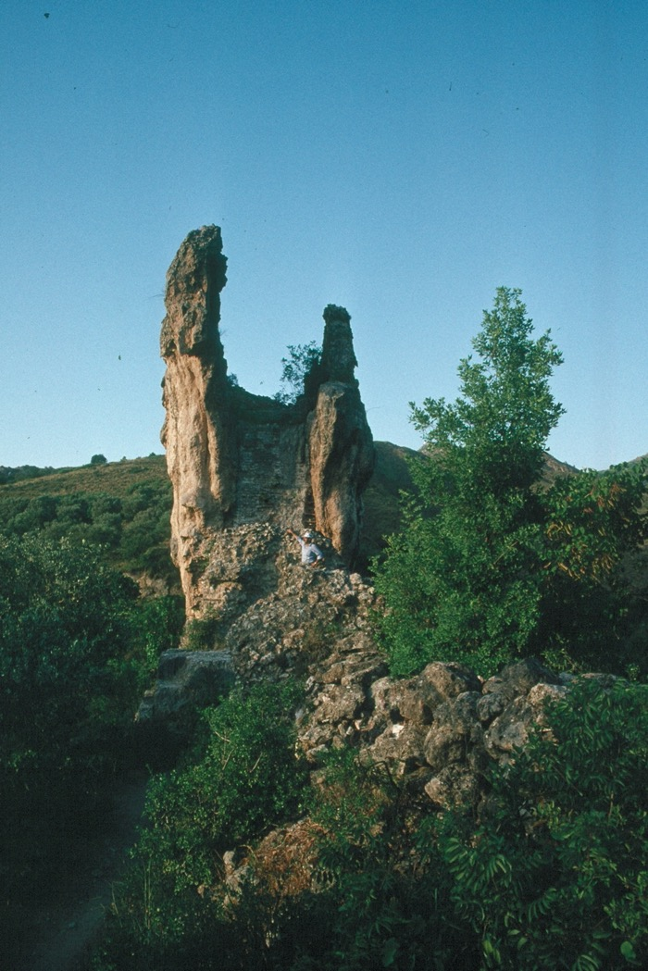
Limescale
deposits

Slide 19
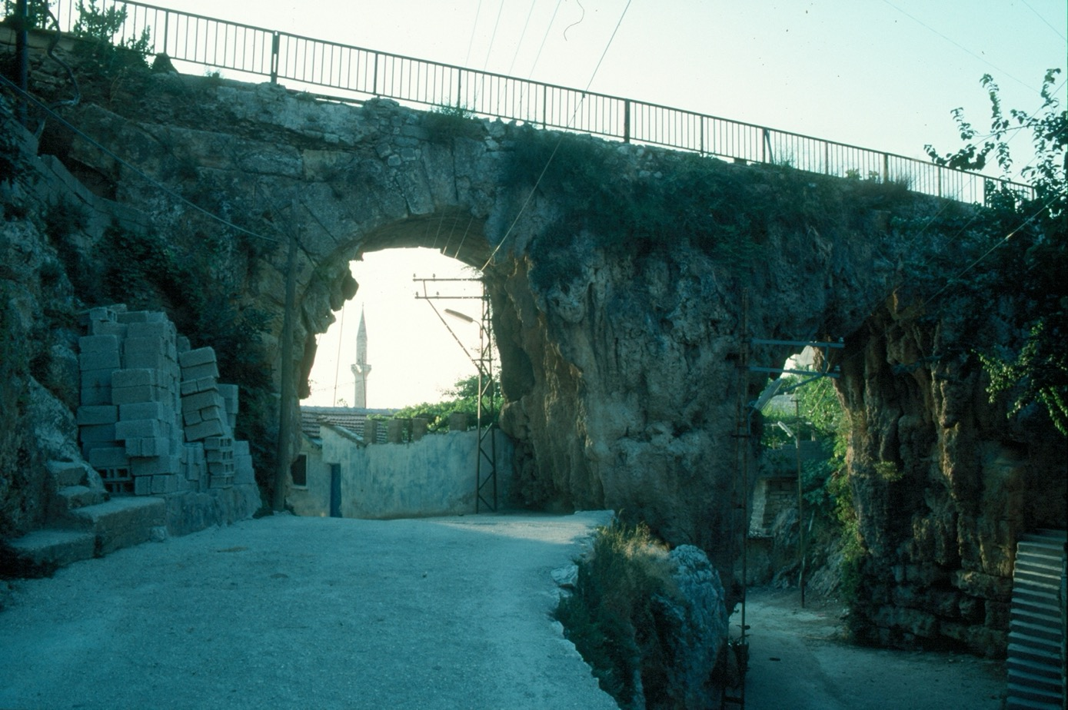

Slide 20
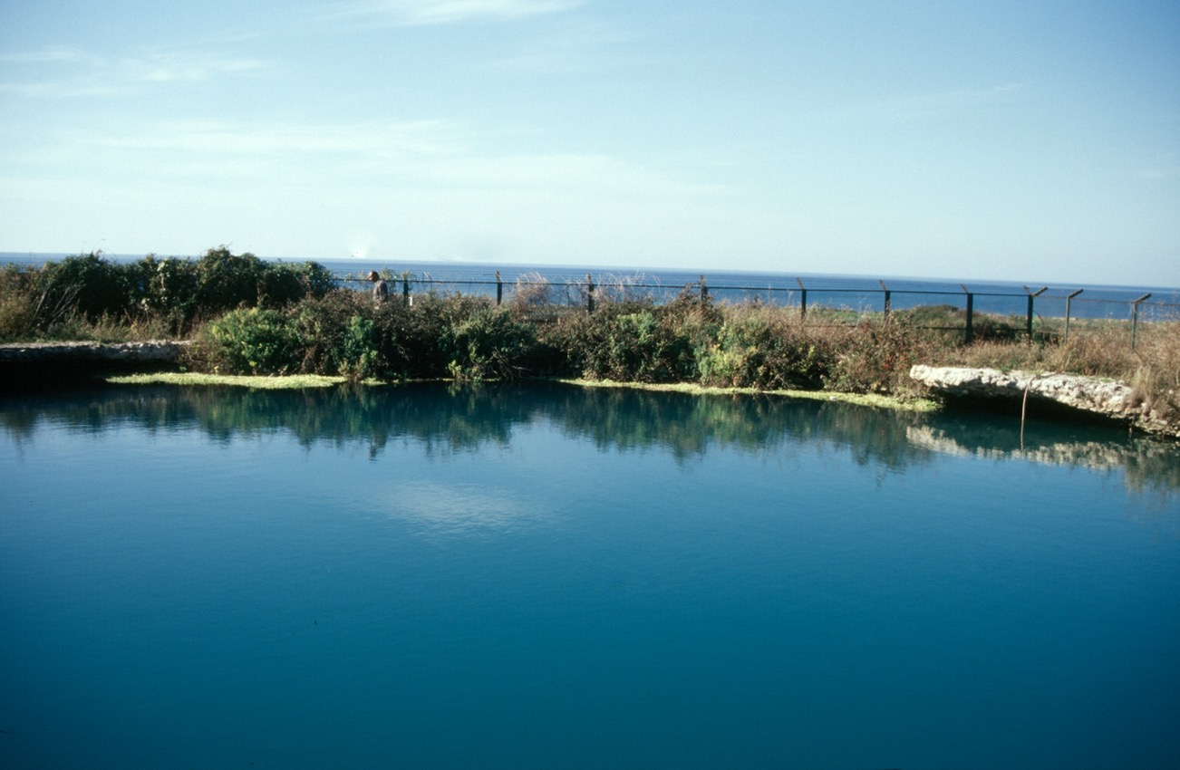
Ras al Ain spring, Tyre

Slide 21
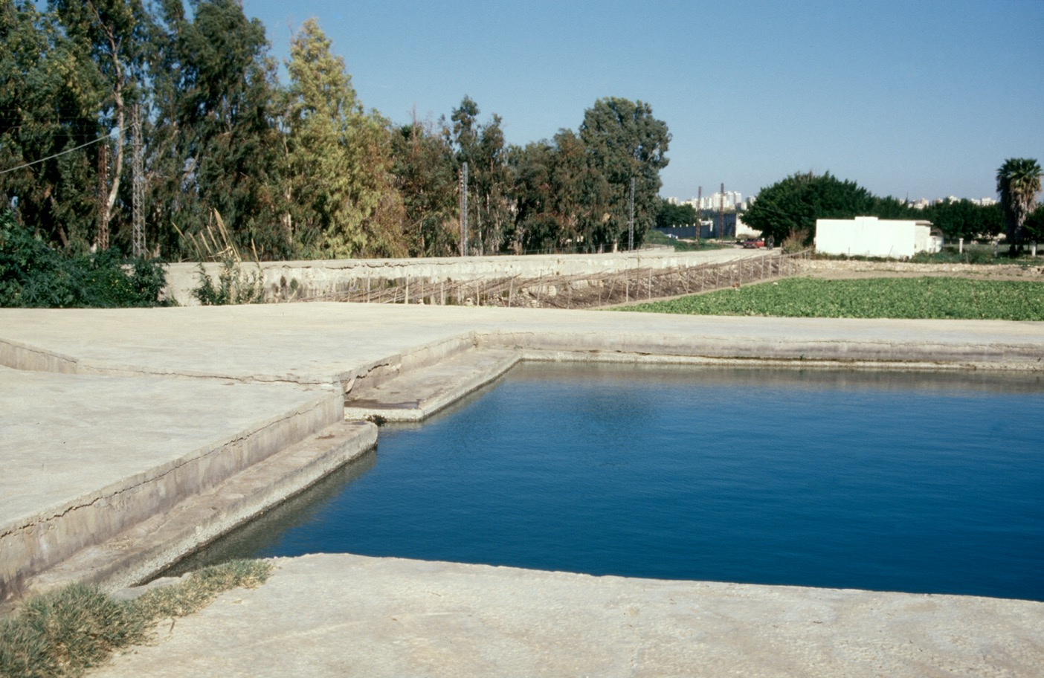

Slide 22
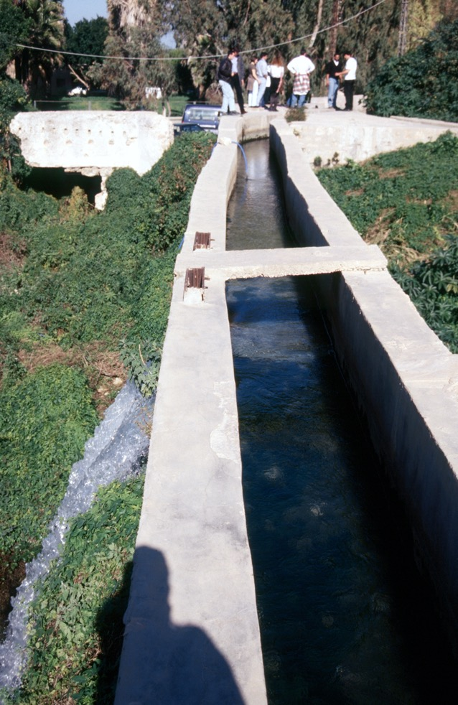
A Roman acqueduct
That still functions

Slide 23
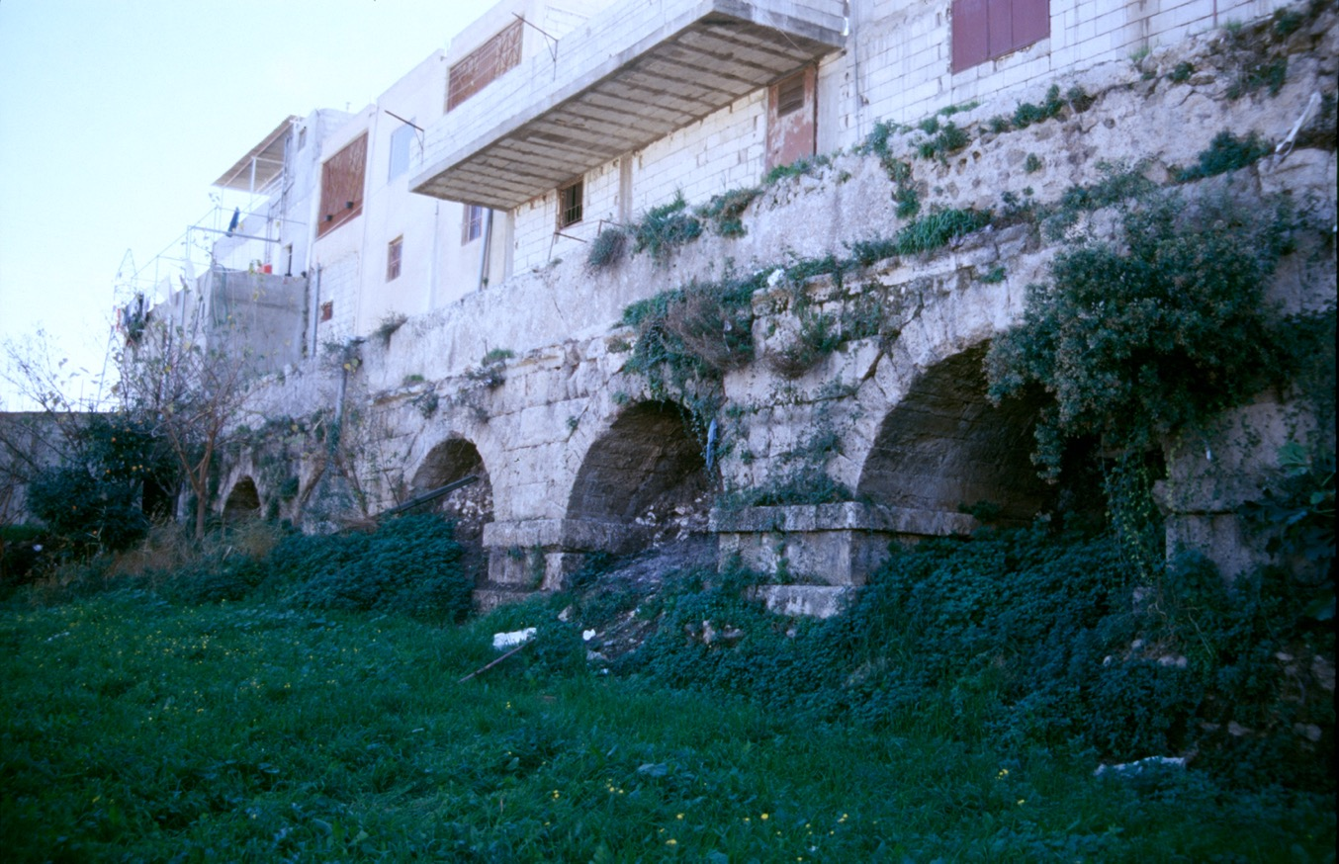

Slide 24
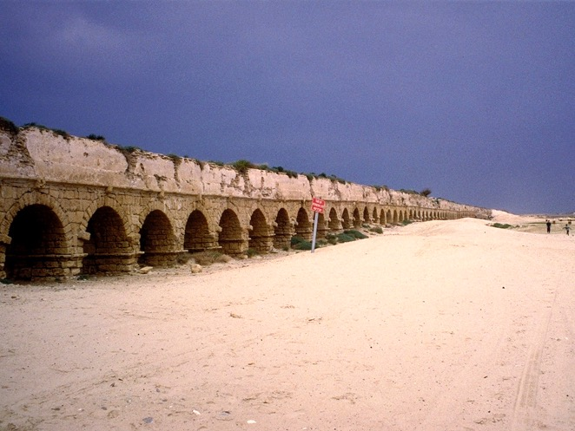
Aqueducts were sometimes constructed by the Roman military
Aqueducts were very wasteful
Once inside the city, they usually supplied a nymphaeum, and could distribute water in terracotta or lead pipes to other parts of the city (public baths, public toilets, sometimes private houses)
Acqueduct at Caesarea

Slide 25
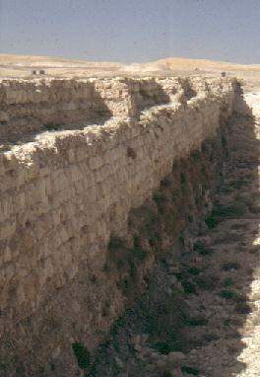
Dams
Used to create artificial lakes, or increase size of existing lakes
Water channels and aqueducts led off from these lakes
Homs (Emesa),a natural lake enlarged by a dam originally perhaps 5-7m high and 2 km long, supplied canals for irrigation
Harbaqa dam

Slide 26
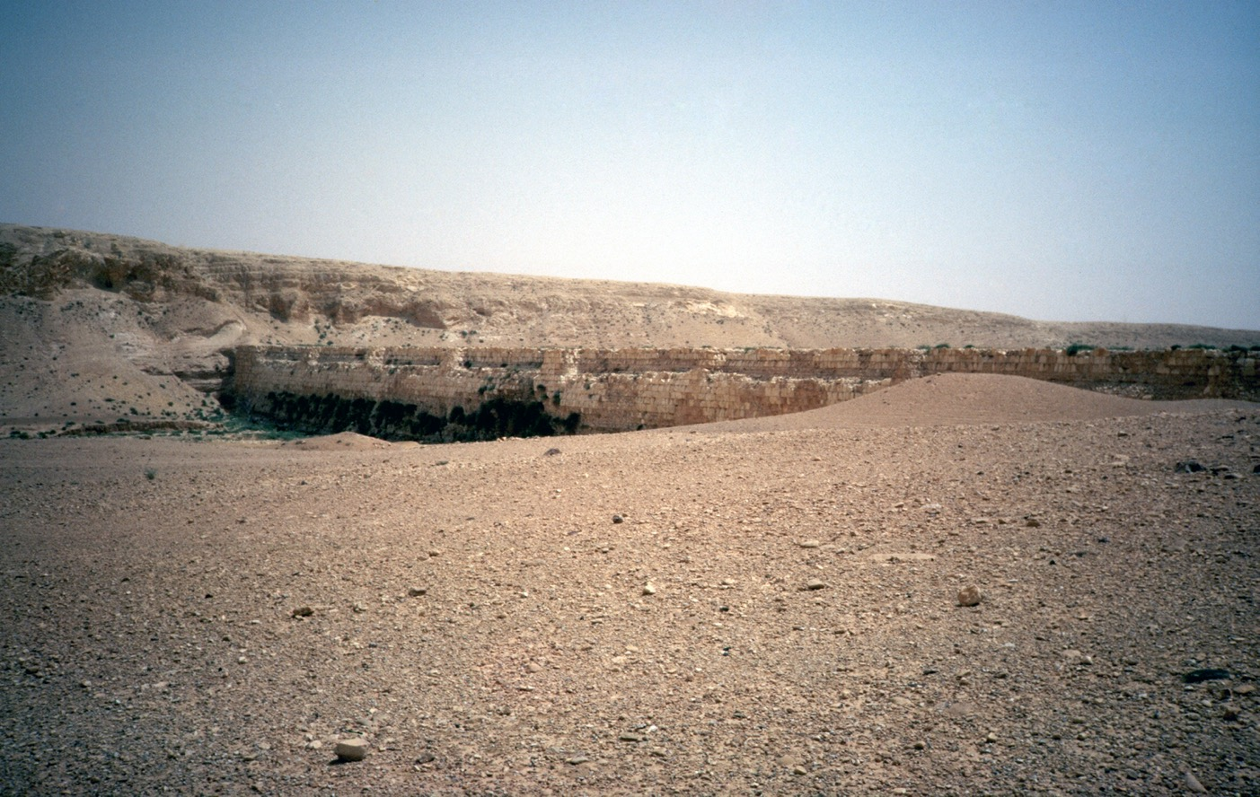
Harbaqa dam near Palmyra
20 m high, 345 m long

Slide 27
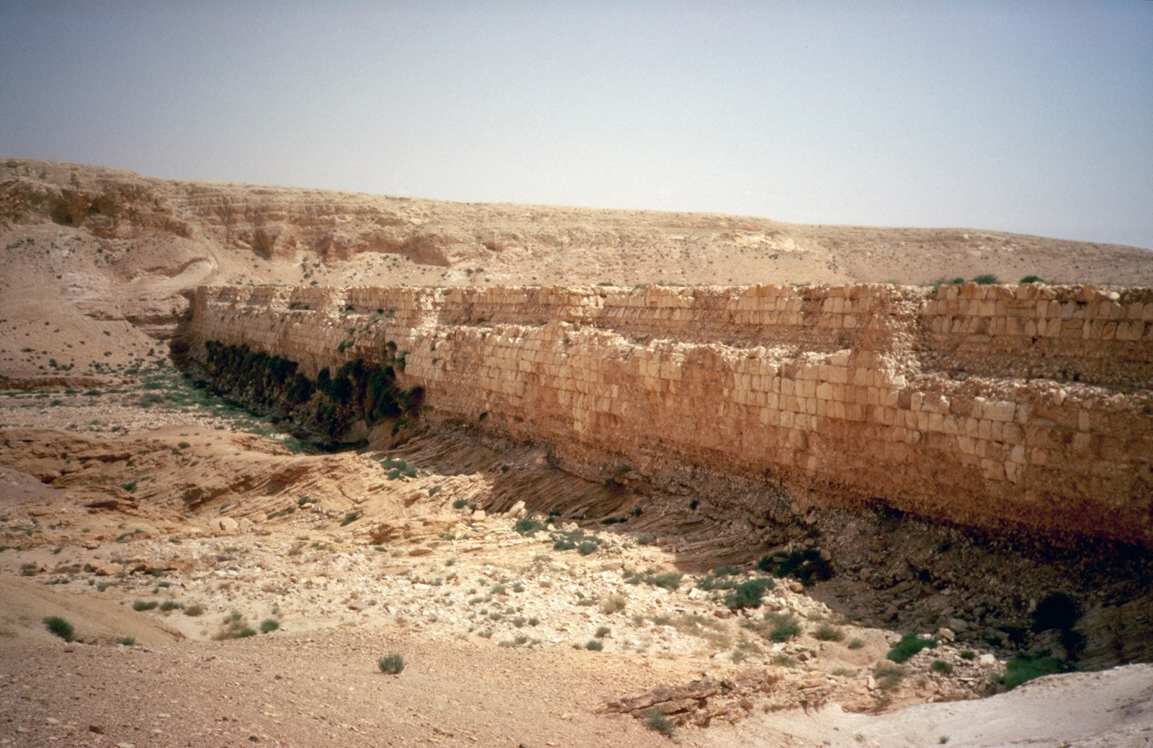

Slide 28
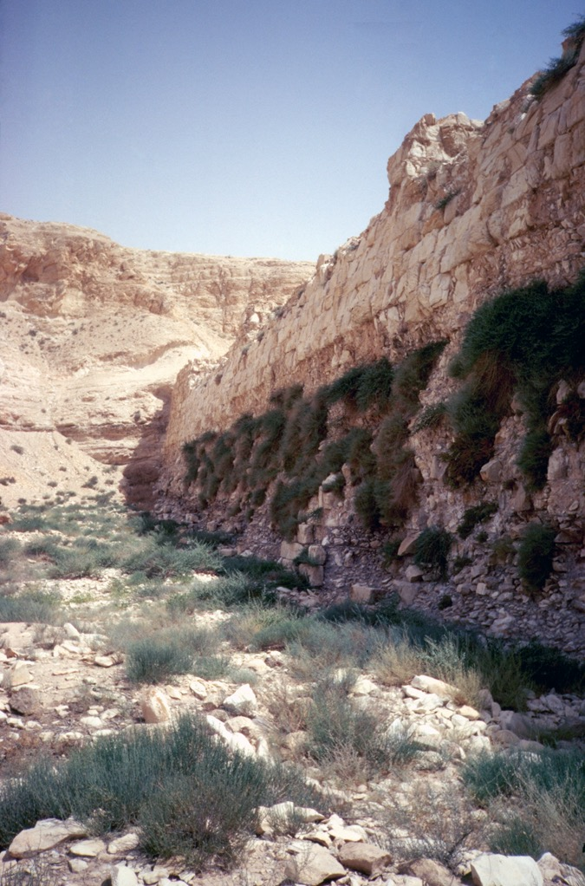
Built to block a wadi (seasonal
river), so that in the winter it
filled with water behind the dam.
This provided water all year.
Outlets at the base of the wall
controlled the outflow, irrigating
the valley below.

Slide 29
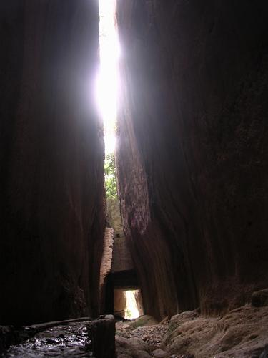
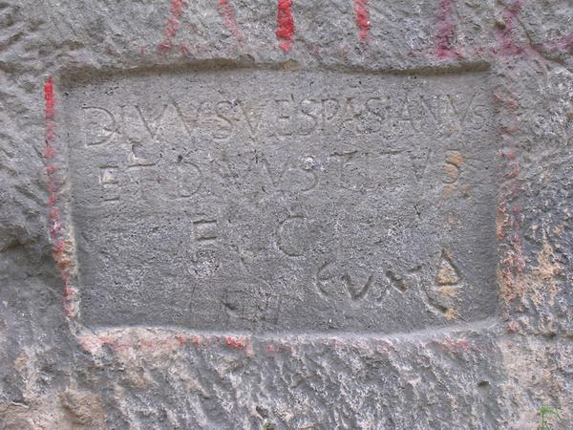
Canals
‘Titus tunnel’, Seleucia Pieria
Built to divert a seasonal stream away
from the city’s harbour

Slide 30
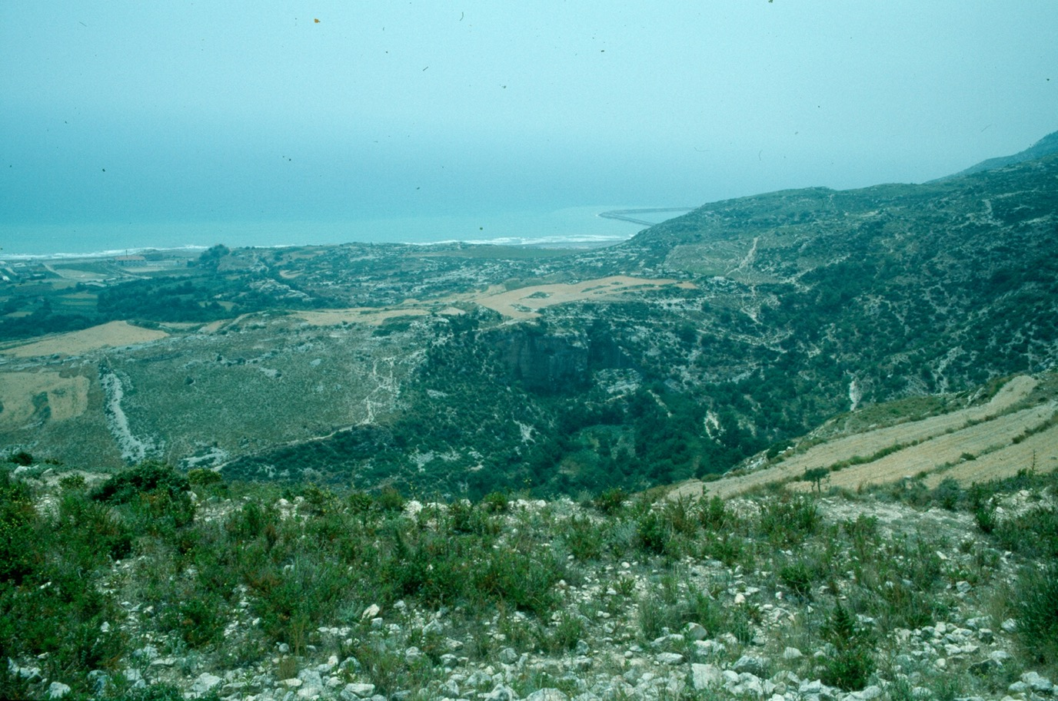

Slide 31
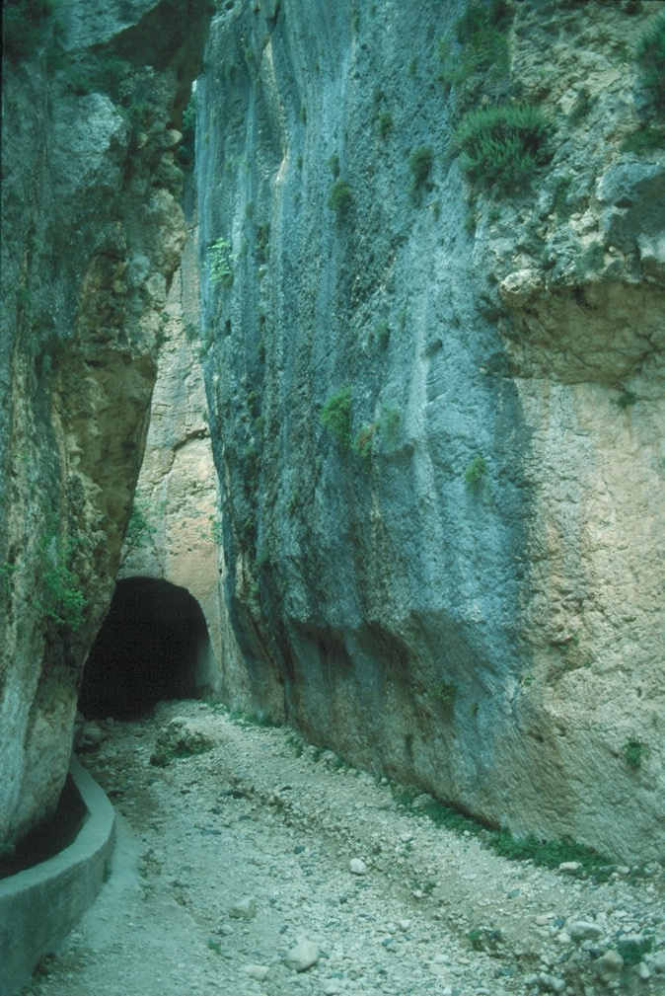
1300 m long

Slide 32
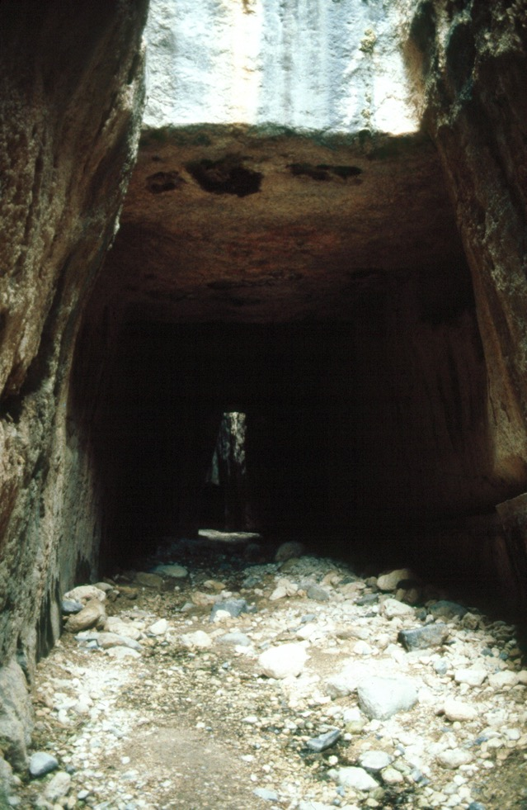
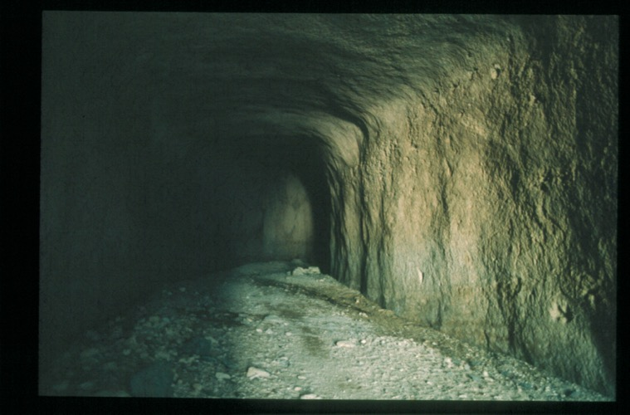
In some places the channel is 50m
below the surface

Slide 33
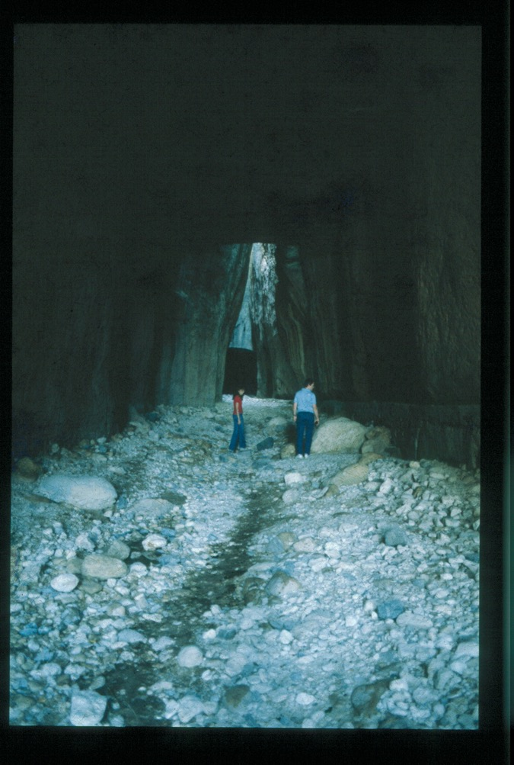
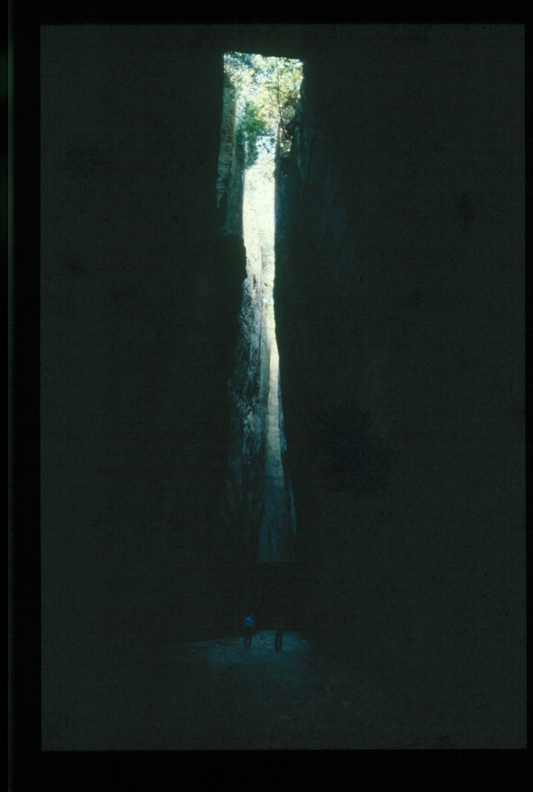

Slide 34
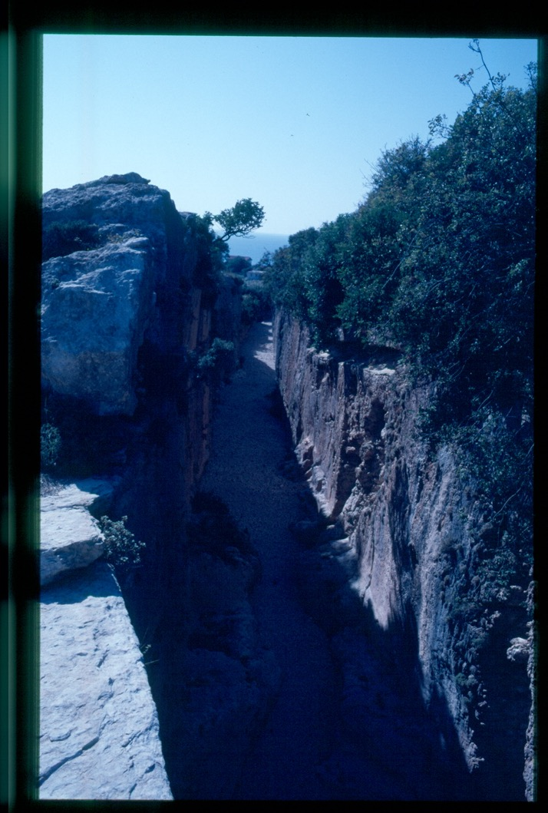
Like aqueducts, canals required
considerable labour power, and
cities and the military were the
chief builders.
Could be used for irrigation.
One at Antioch supplied fulling mills.
Others used to improve water
transport, making rivers more
navigable

Slide 35
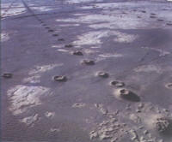
Qanats

Slide 36
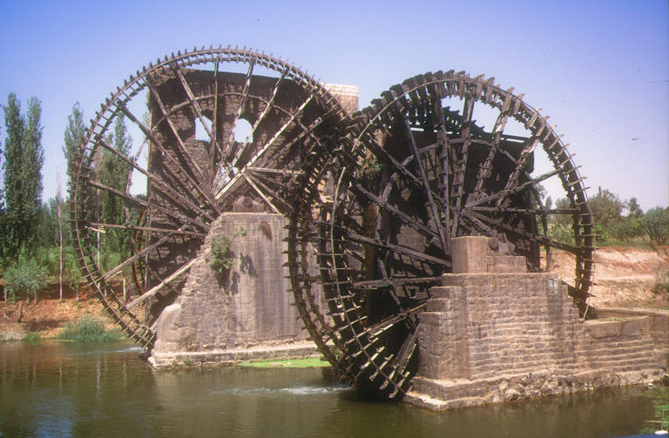
Noriahs
Used to lift water from a river into an aqueduct

Slide 37
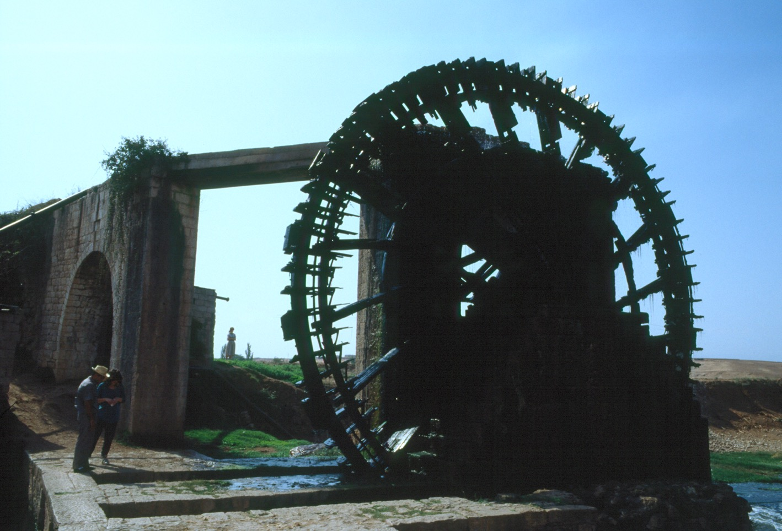

Slide 38
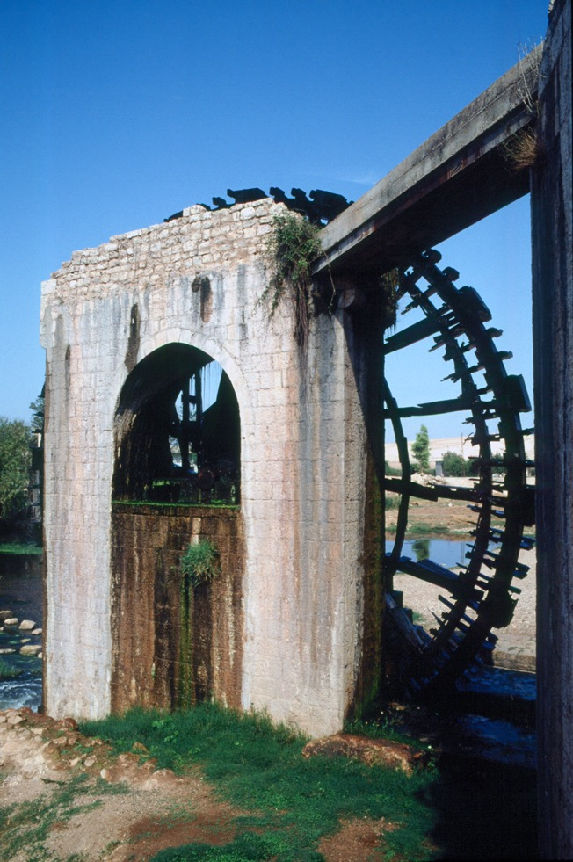
Seem to be purely for irrigation.
Once thought to be an invention
Of the Islamic period, but a fifth-
century mosaic from Apamea
depicts one.

Slide 39
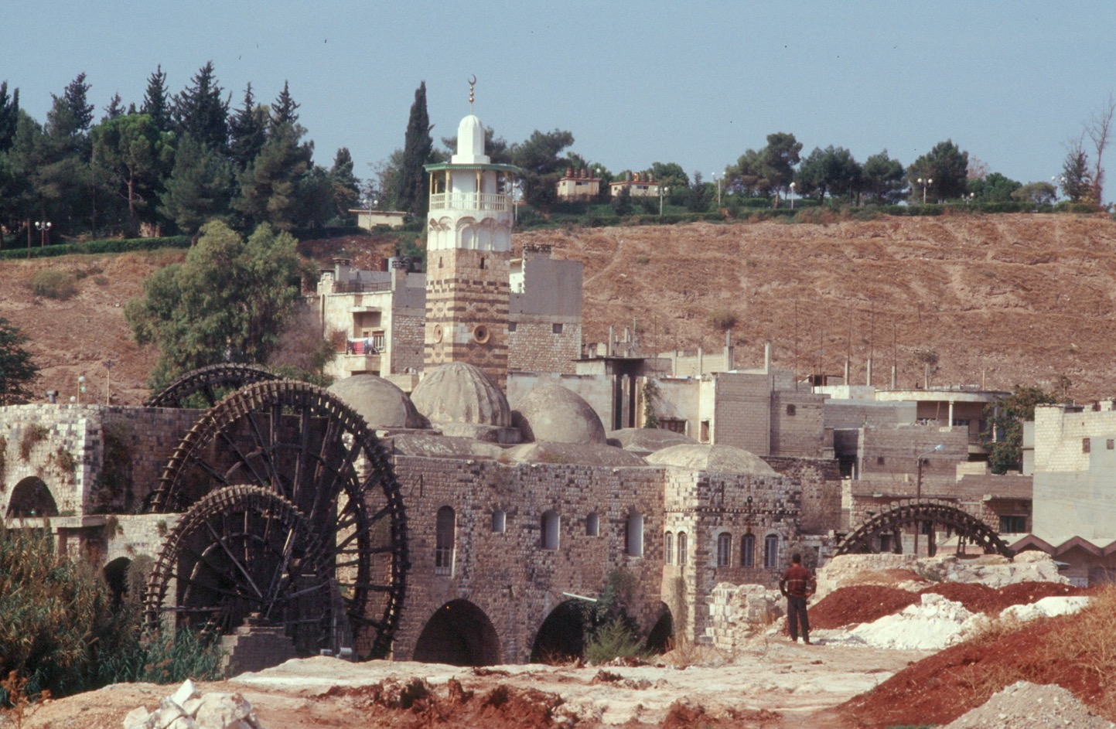
The Orontes and Euphrates rivers probably had many

Slide 40
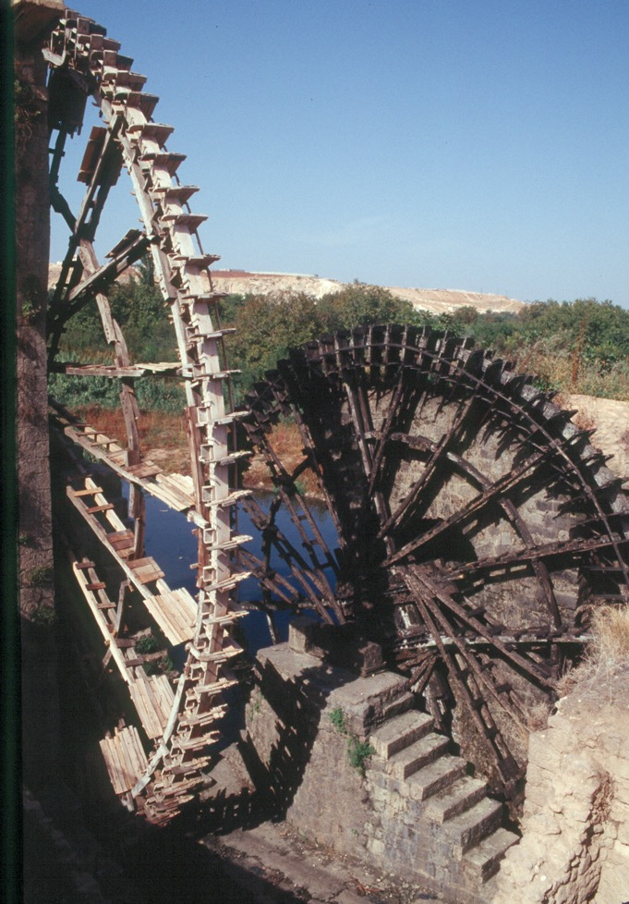

Slide 41
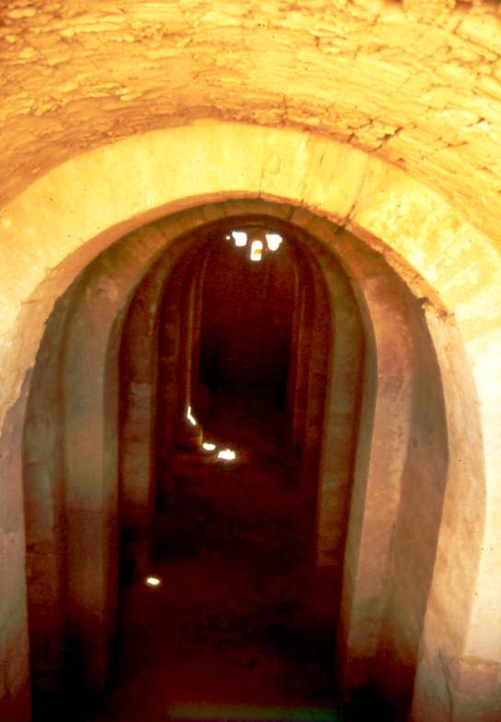
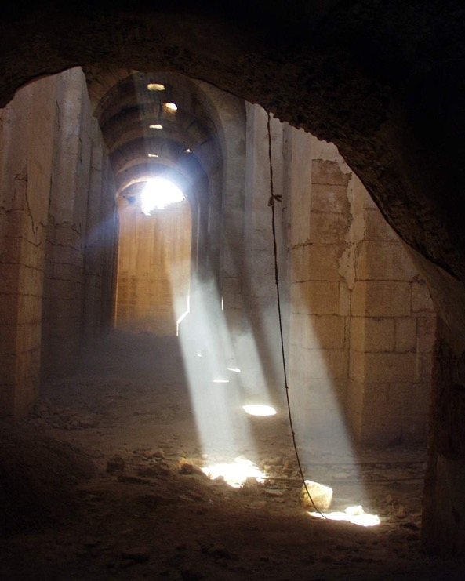
Cisterns
Resafa

Slide 42
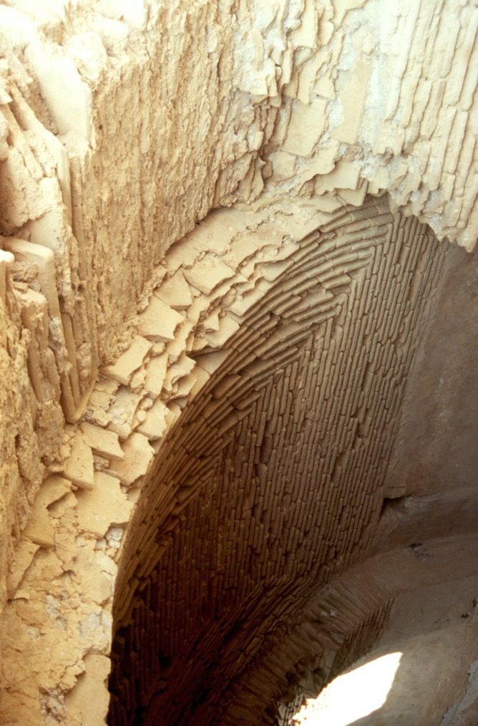
Three giant underground cisterns.
Largest has a capacity of 15,000
cubic metres of water.
More than enough for the city to
last through the dry season.
Perhaps a sign that the city was
expected to receive refugees
from the surrounding countryside
during Sasanian attacks?

Slide 43
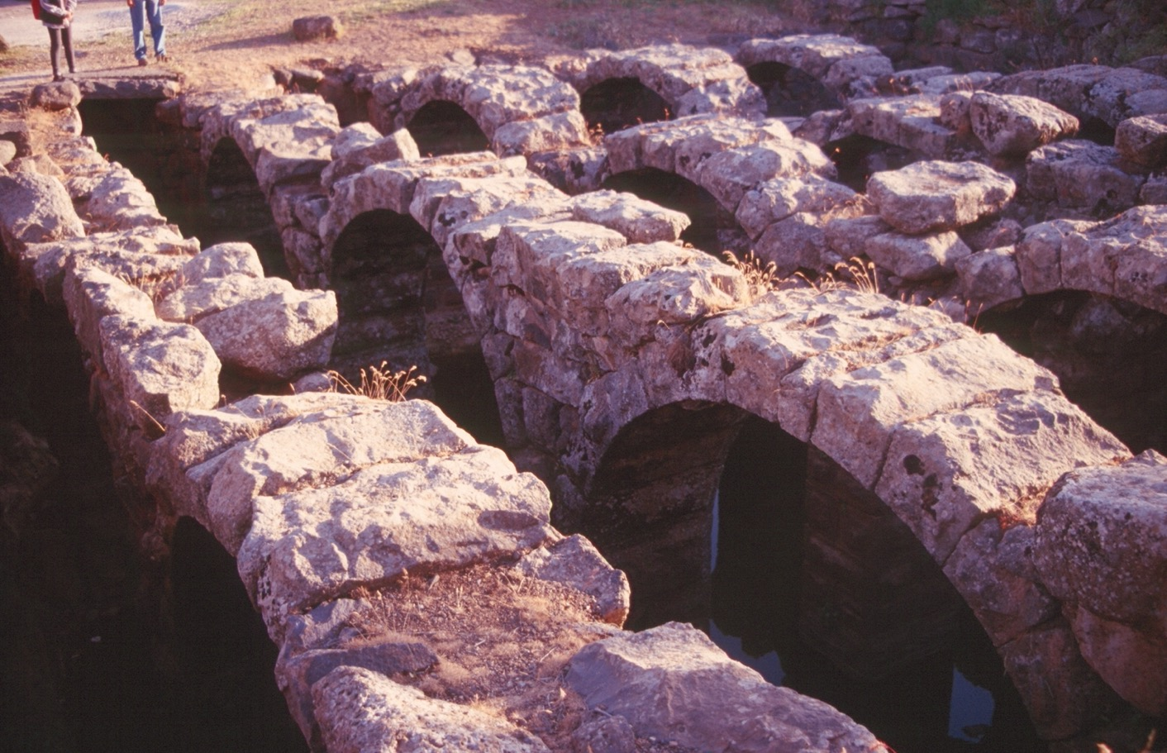
Cistern at Canatha in the Hauran

Slide 44
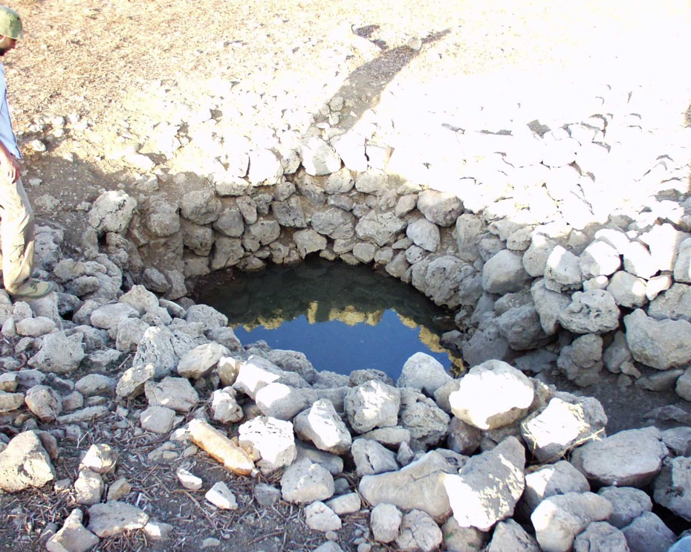
Birkets (open cisterns)

Slide 45
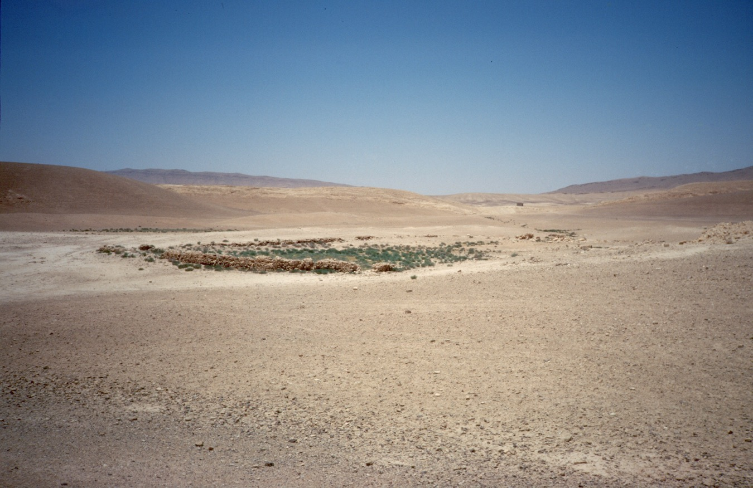
These provided water for animals in very dry environments

Slide 46
Local products

Slide 47
The ‘Mediterranean triad’: grain, grapes, and olives
Grain was the staple of the ancient diet
Surpluses from the countryside could be marketed in the cities
They were also used to supply the army
Cities could also sell surpluses to other cities, perhaps in exchange for other agricultural products
There is some textual evidence to suggest that wheat from the province of Syria was regarded as superior to wheat from Egypt, but that did not stop Syrian cities importing wheat.

Slide 48
Crop failures and famines were frequent
It was possible to alleviate starvation by importing grain from other provinces, or by cities stockpiling grain, although stockpiles were usually formed by rich speculators to gain a profit
State officials could intervene to lower prices, but their methods did not always work
The presence of large numbers of soldiers on campaign could also disrupt supplies and prices, and additional grain might have to be imported

Slide 49
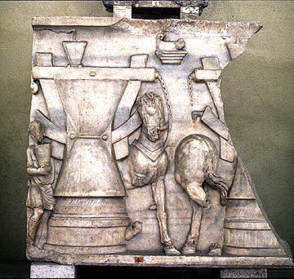
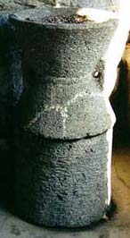
Grain mills
Usually made of rough volcanic basalt (plentiful in some regions of the Near East)
Vary in size from small, hand operated querns to large installations

Slide 50
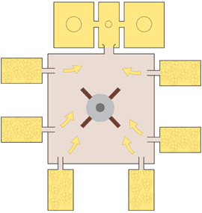
Wine: production process
Production of wine:
Grapes piled up in plaster-lined basins
Crushed under their own weight, the juice ran out
It was the best quality, very sweet because it had minimal contact with the grape skins

Slide 51
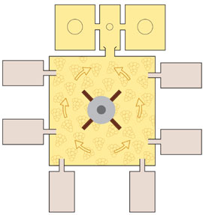
The grapes were then tipped onto the treading floor and crushed by workmen
The mustum then flowed into vats with recessed jars that acted as settling tanks to collect the dregs (at top of picture)
The grape juice was then collected and put in large jars (dolia) and allowed to ferment

Slide 52
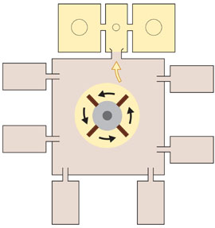
After treading, the crushed grapes could be placed in a press to extract more juice for an inferior wine
This wine would be cheap; it was also commonly used when fermented with herbs in medicine

Slide 53
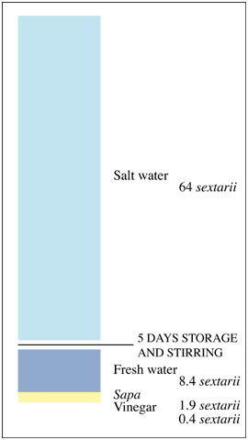
An inferior wine could be produced after pressing by mixing the crushed remains with fresh water and then, after a few days, with salt water
This would have had a minimal alcohol content, but could be given to laborers and slaves, or to soldiers if their normal rations were running low
The residue could be used for animal fodder or fertilizer

Slide 54
Certain regions of the Near East famous for the quality of their wines and the products were widely exported in the Mediterranean: e.g. the Orontes Valley around Apamea; Laodicea and Berytus on the coast; or the coastal regions around Ascalon and Gaza
Gazan amphorae found in significant quantities in Gaul in the fifth and sixth centuries

Slide 55

Olives

Slide 56

Material evidence for olive processing is extensive
Harvested olives were placed in large mills and crushed to a pulp

Slide 57


Slide 58

Olive press at Chhim, Lebanon

Slide 59

Next the pulp, consisting of crushed olives, olive stones, olive oil and water, was pressed to produce the oil
Layers of pulp were stacked in flat baskets, one on top of the other, to form a pile that was pressed
The first pressing produced the best quality

Slide 60


Slide 61


Slide 62


Slide 63

Chhim, Lebanon

Slide 64


Slide 65


Slide 66
The oil produced by this process still had to be refined a second time
The pressed oil ran into settling tanks. The detritus sank to the bottom. Water was added: water was heavier than the oil, so the oil separated at the surface
The oil could then be ladled off
It was then filtered, either using a hand held strainer, or using a special installation

Slide 67
The pulp could be mixed with water and pressed again, but with each pressing the quality of the oil decreased
The residue could be used as animal fodder, or, because it burns easily, as fuel for lighting fires

Slide 68


Slide 69


Slide 70
Specialized products
Styrax: a gum from a tree like a quince, used in the preparation of medicines and perfumes. The north Syrian coast, around Laodicea, was a styrax-producing area
Balsam was produced in Palestine, as was papyrus, which grew in the Jordan valley

Slide 71
Purple
Very valuable commodity
Price Edict of Diocletian: 175 denarii for a pound of best-quality wool; 50,000 denarii for a pound of purple-dyed wool; maximum daily wage for skilled labourer 50 denarii

Slide 72


Obtained from carnivorous sea snail, the murex (several species)
Caught on lines, using meat as bait

Slide 73

The snails had their shells broken, so that they began to die, and were transferred to vats (example here from Djerba, Tunisia)
When stressed or dying the murex produces a secretion that turns purple when exposed to sunlight and oxygen

Slide 74
Over about 3 days the liquid in the vats would turn purple
The liquid and rotting murex were then transferred to heated vats and processed for about 9 days, before being strained to produce the dye
Thousands of snails were needed to make a few grammes
Purple was an important export

Slide 75
Bibliography
See my book chapter 5, ‘Exploiting the Available’, under the section ‘Rural resources an,d their exploitation’.
Greene, K., The Archaeology of the Roman Economy, London, 1986, at pp. 138-140.

