Slide 1
Rome, Syria, Parthians and Persians

Slide 2
Expansion of Rome into the Eastern Mediterranean
Various political entities incorporated by Rome: kingdoms; tribes; city states; temple estates
Larger kingdoms generally removed; smaller kingdoms often retained, but kings appointed or removed by Rome
Cities paid taxes; kings perhaps did not – they were technically “independent”

Slide 3
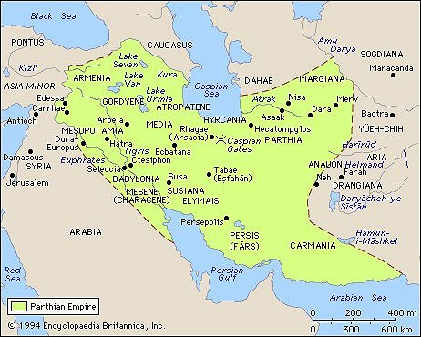
The Parthian empire

Slide 4
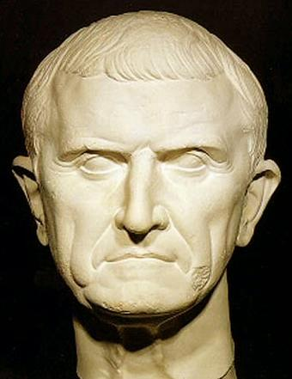
Crassus and the battle of Carrhae

Slide 5
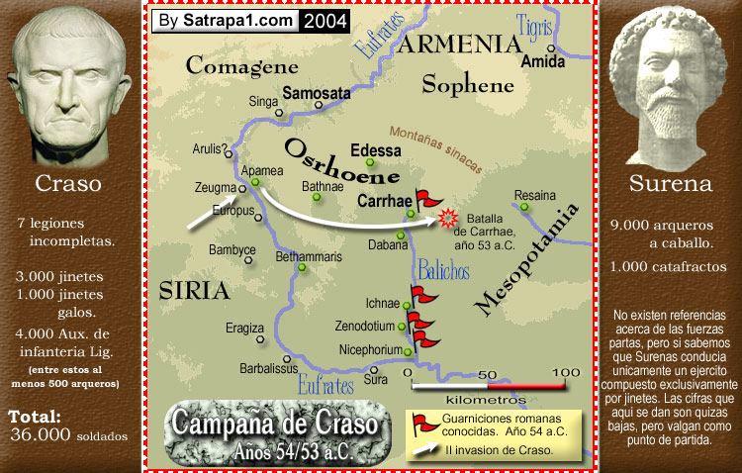

Slide 6
The end of the Roman Republic
A series of civil wars as military commanders fought for supreme control

Slide 7
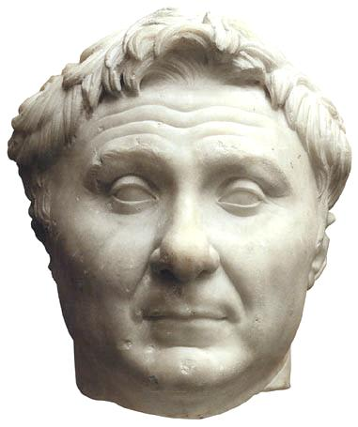
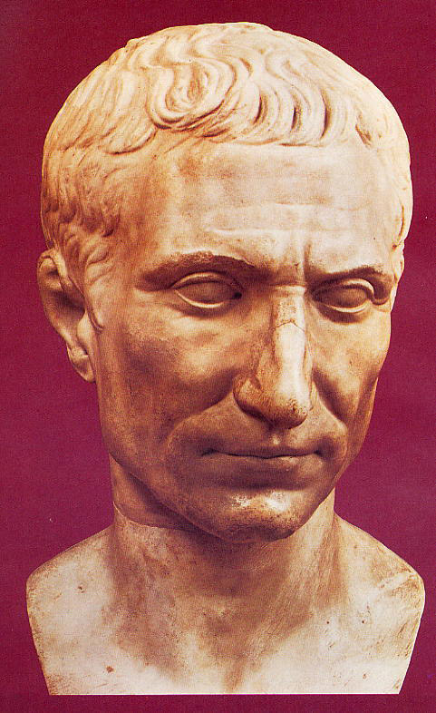

Slide 8
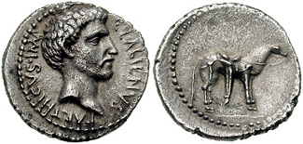
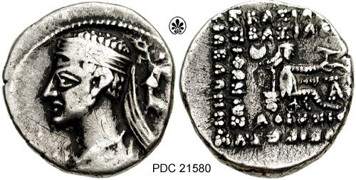
Labienus and Pacorus

Slide 9
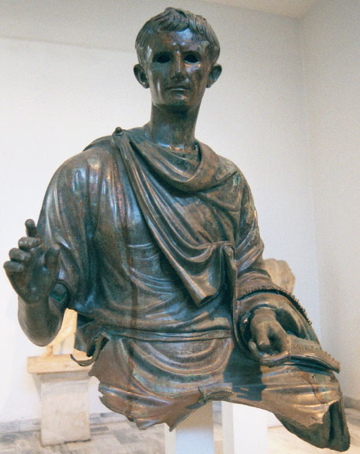
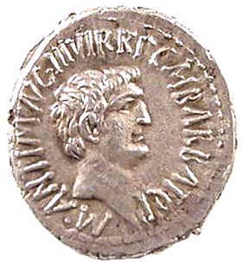

Slide 10
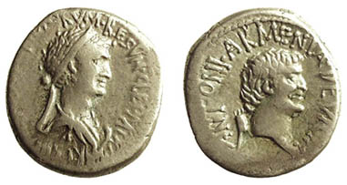

Slide 11
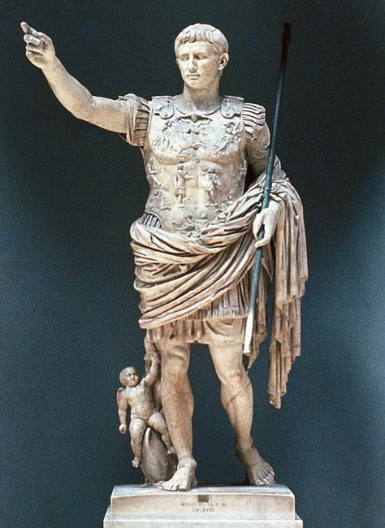
Augustus, 27 BC – AD 14

Slide 12
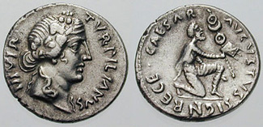
Augustus preferred to use diplomacy with the Parthians

Slide 13
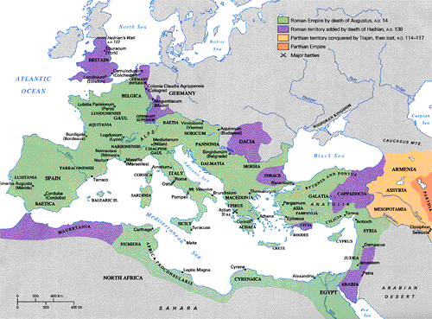
Another reason for avoiding war was the relative isolation of the province of Syria from the rest of the empire

