Slide 1
Cities

Slide 2
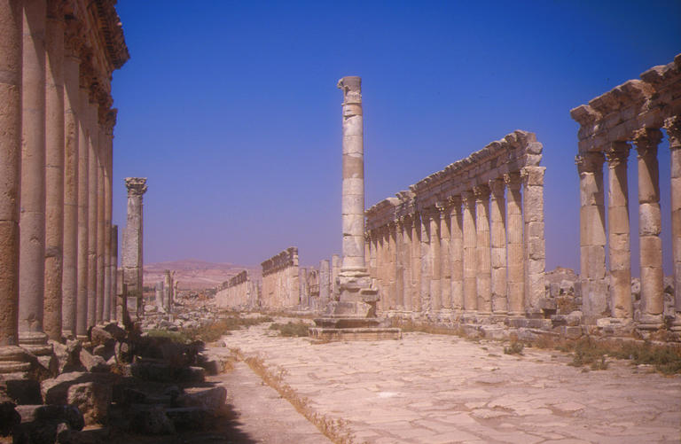
The city state was the Romans’ preferred form of local government, and in the east the model was the Greek polis
City governments were expected to maintain public order in their territories, arrange for tax collection, and oversee the production and distribution of food

Slide 3
What defined a city?
There are really only two types of settlement in the Roman east: a city (polis) and a village (kome)
There are no intermediate settlements
A city was a settlement that the Roman government recognized as a polis
It was an institutional concept, not a physical distinction

Slide 4
Cities were both large and small, wealthy and not very wealthy
Some villages were as large as small cities, and some had monuments of the sort that we might expect from a city

Slide 5
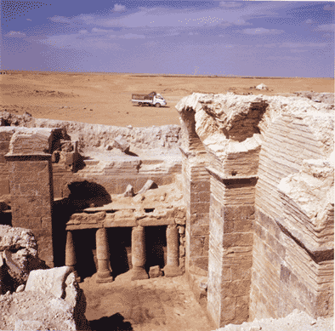
The late Roman site of Androna in north Syria had defensive walls, barracks, a bath, several churches and monuments with imported marble – all the sorts of buildings that we associate with Roman cities, but it was still a kome

Slide 6
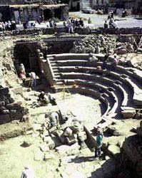
Some cities were villages that had been raised by the Romans to city status, and had only small village territories
The resources that cities with small territories could draw on were limited compared to those with large territories, and it is unlikely that these small cities could ever acquire great wealth and influence

Slide 7
Provincial hierarchies
The cities of the provinces of the Near East were organized in a fairly well-defined, if never explicitly stated, hierarchy, with some cities being more favored than others
Rewards and honors for cities were controlled by the emperors
Competition and rivalries were normal among the cities, but this rivalry was normally controlled by the Roman state

Slide 8
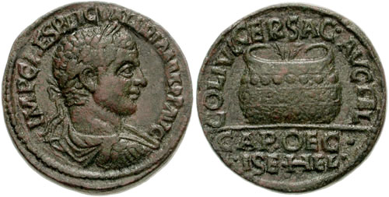
The rewards and honors were important to the cities, and often brought economic advantages
Rewards included the right to celebrate Greek cultural festivals, which brought in people from all over the eastern Mediterranean, donations of buildings, food, or relief from taxation
Famous cities attracted wealthy patrons

Slide 9
Small cities were vulnerable. They could not easily attract rewards honours or patrons (except from among their own populations) and might lose their city status if they could not perform the tasks expected of a city
Most small cities existed in the drier inland areas, or on fertile land close to larger cities

Slide 10
Each province had a chief city
Antioch was the most famous and largest city in Syria, and was effectively its capital
When Judaea was made a separate province, Herod’s Greek city of Caesarea became its chief city
In Arabia the cities of Bostra and Petra were equally important, although the administrative headquarters of the legion was at Bostra
When Septimius Severus divided Syria in two, Tyre became the chief city of Syria Phoenice
Antioch remained ahead of the others by taking on the role of imperial capital

Slide 11
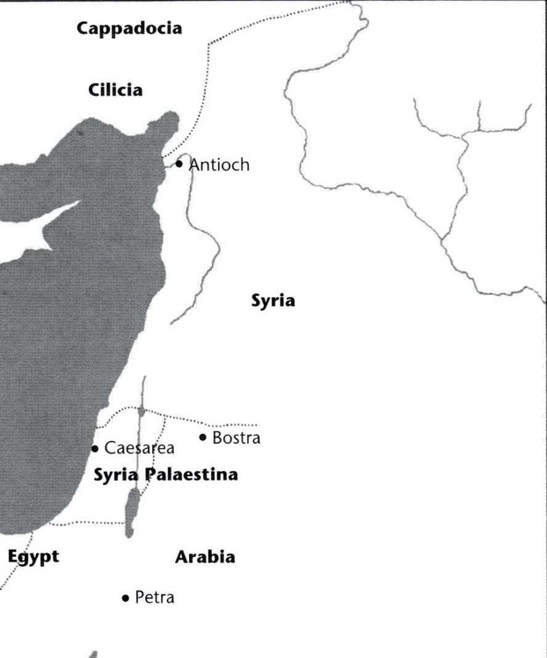
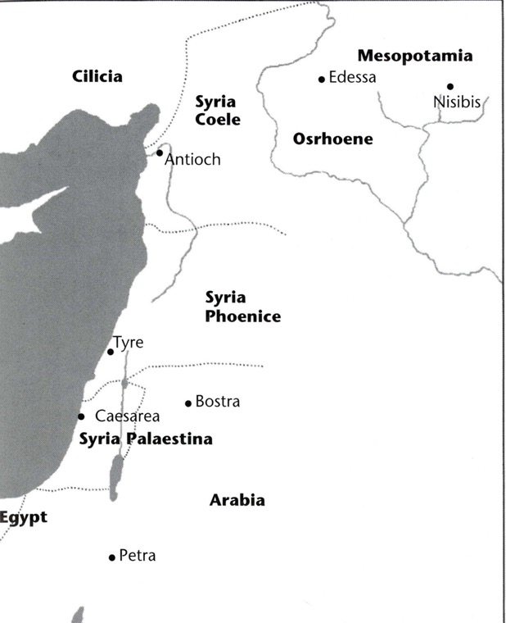

Slide 12
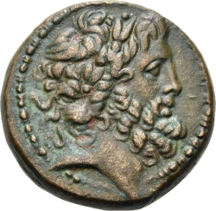
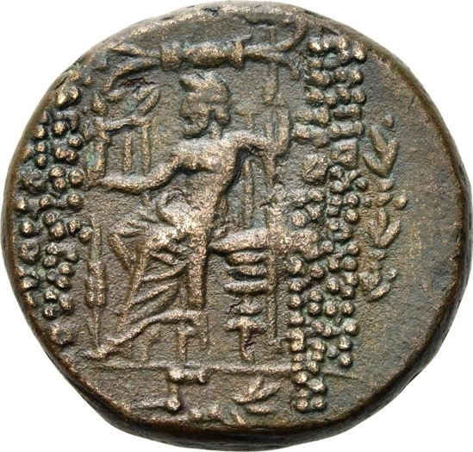
City titles
Coin of Antioch minted in 46/47 BC:
ΑΝΤΙΟΧΕΩΝ ΤΗΣ
ΜΗΤΡΟΠΟΛΕΩΣ ΚΑΙ
ΙΕΡΑΣ ΚΑΙ ΑΣΥΛΟΥ
ΚΑΙ ΑΥΤΟΝOΜΟΥ

Slide 13
Metropolis
Mother city
Originally used to describe a city that had founded new cities
Tyre could be regarded as a metropolis
Under Roman rule the title was given to cities by the emperor, and it was a very exclusive one
Antioch was a metropolis, and only later did Tyre acquire the title

Slide 14
In the second century other cities acquired the title: Samosata in Commagene, and Damascus in Syria; Petra in Arabia
But other chief cities such as Bostra and Caesarea did not acquire the title until the third century, so the title does not always indicate which cities were preeminent
There may be a connection between the use of this title and the geography of the imperial cult

Slide 15
Colonia
Originally a city in which Roman veterans were settled.
Used by Julius Caesar and Augustus to reward retiring legionaries: given a plot of land in a colonia.
The only colonia of the Near East belonging to this period was Berytus (Beirut), founded under Augustus.
Later it became a title, like Metropolis, that could be bestowed on cities as a reward
We’ll look at other colonies later …

Slide 16
Rivalry
The positions of chief cities might be challenged by other important cities
Antioch had a rival in Laodicea
In the civil war of AD 193-194, Antioch supported Pescennius Niger and Laodicea Septimius Severus
Severus punished Antioch by making it a kome of Laodicea and promoted Laodicea to metropolis and Roman colonia

Slide 17
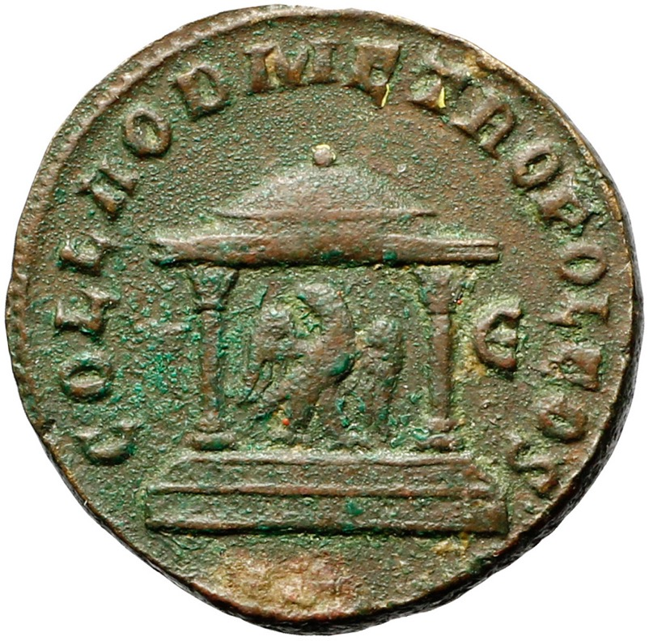
Coin of Laodicea: COL LAOD METROPOLEOS

Slide 18
In late Roman times metropolis was used to describe a city with a bishop who had jurisdiction over the other bishops in his province
Bishops in rival cities might try to challenge this status; e.g. Berytus and Tyre in the fifth century

Slide 19
Most challenges were not wholly successful: a challenger might acquire titles, but generally the chief city did not lose status in the long run, and usually managed to keep ahead
The hierarchy was therefore comparatively stable
One partial solution to the rivalry was the division of provinces into smaller units, allowing major rivals to become chief cities of new provinces

Slide 20
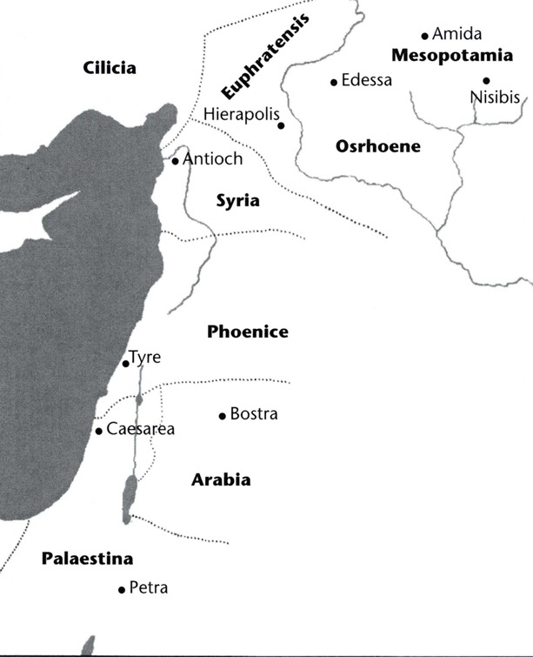
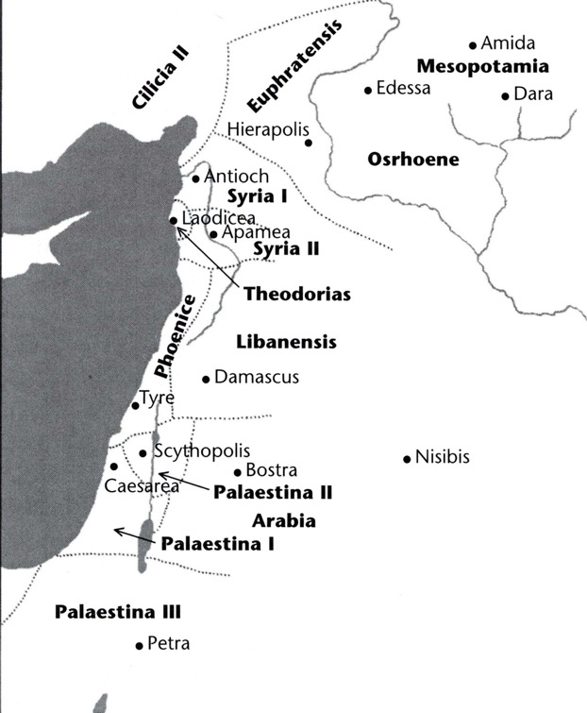

Slide 21
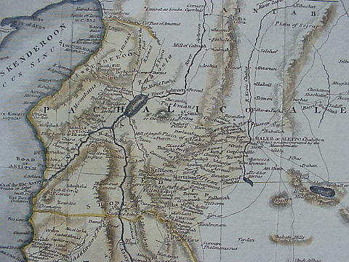
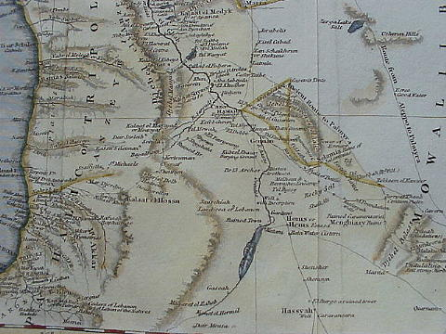
Introduction to the cities
The Syrian Tetrapolis (Antioch, Seleucia, Apamea, Laodicea)

Slide 22
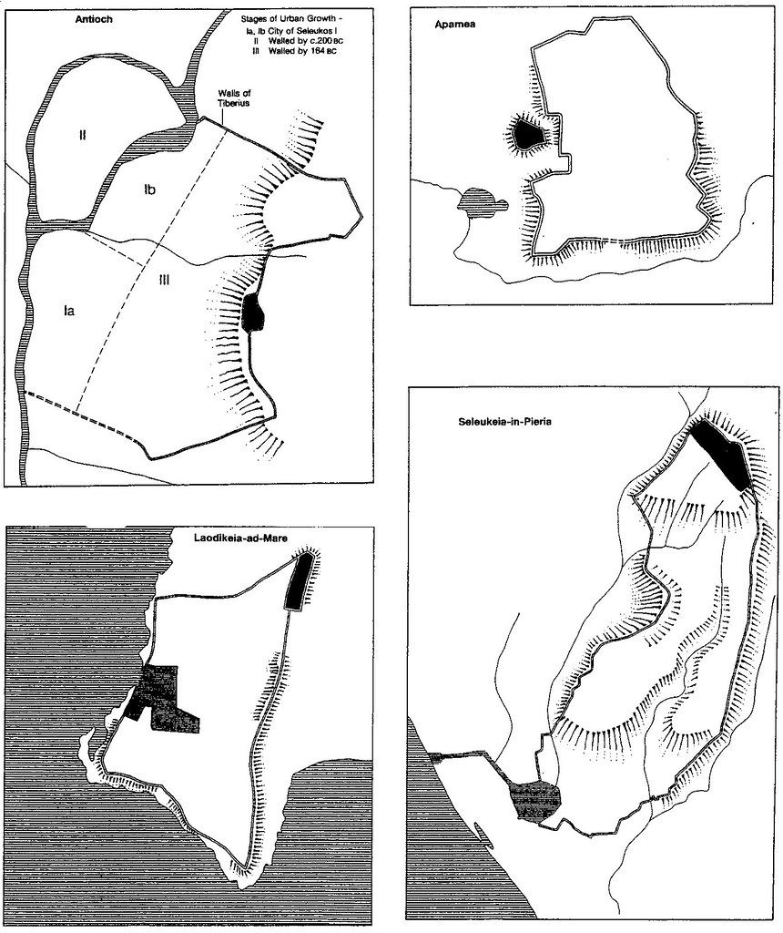

Slide 23
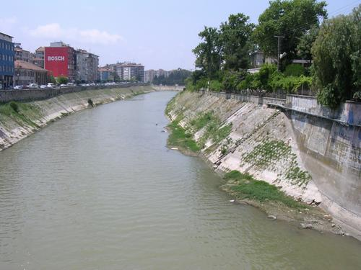
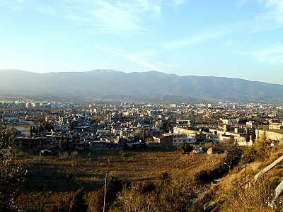
Antioch

Slide 24
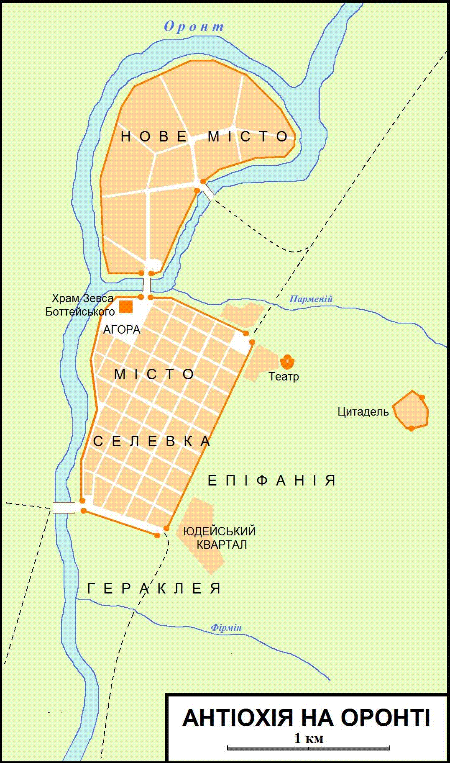


Slide 25
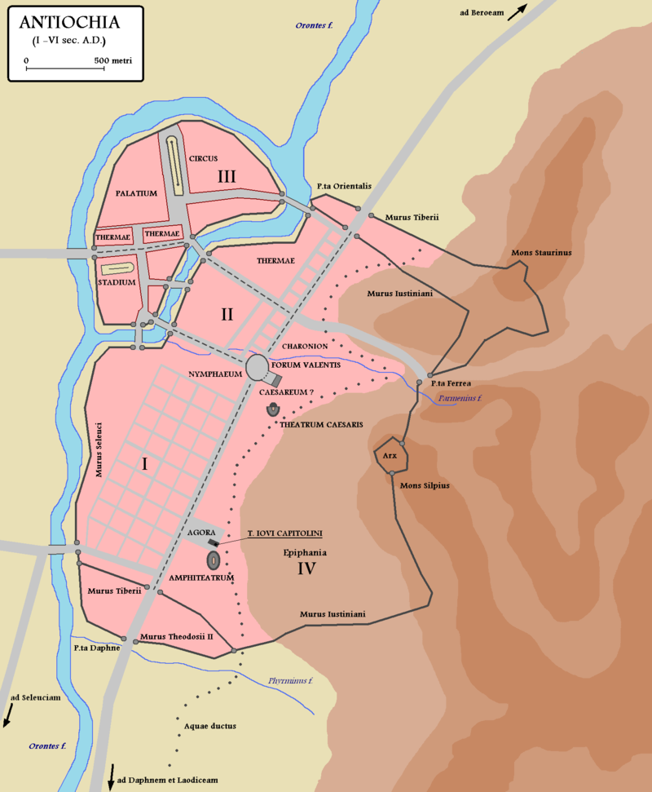

Slide 26
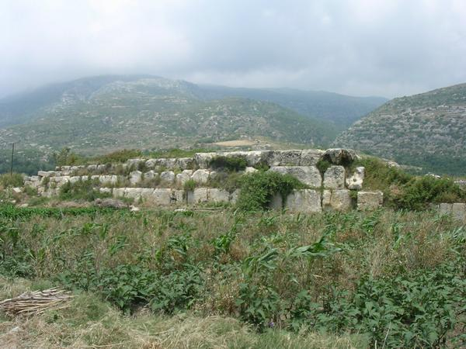
Seleucia Pieria

Slide 27
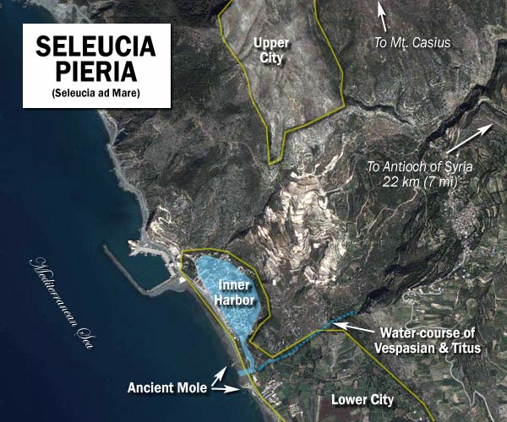

Slide 28
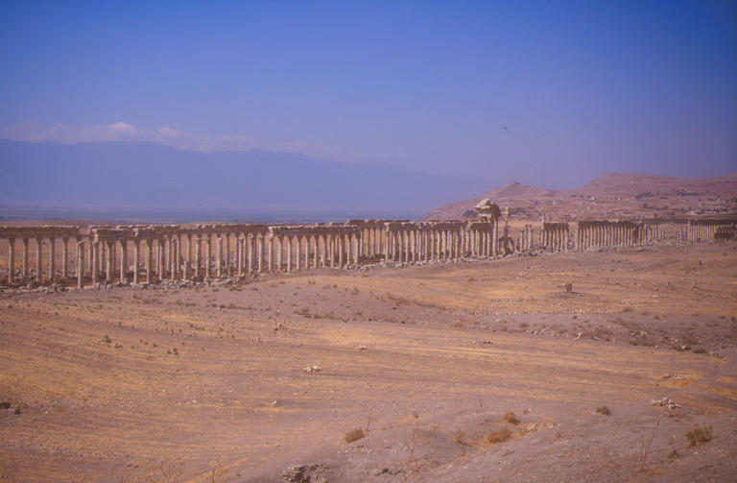
Apamea

Slide 29
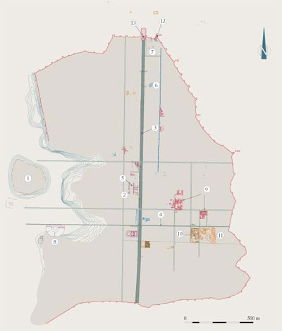

Slide 30
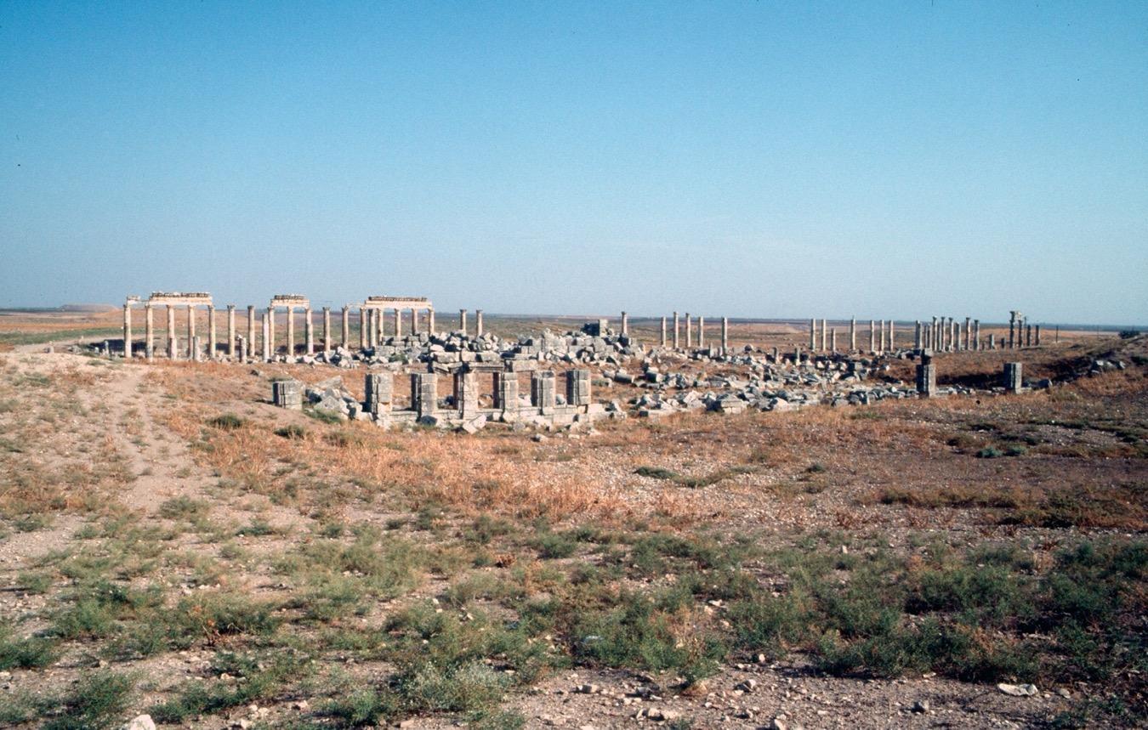

Slide 31
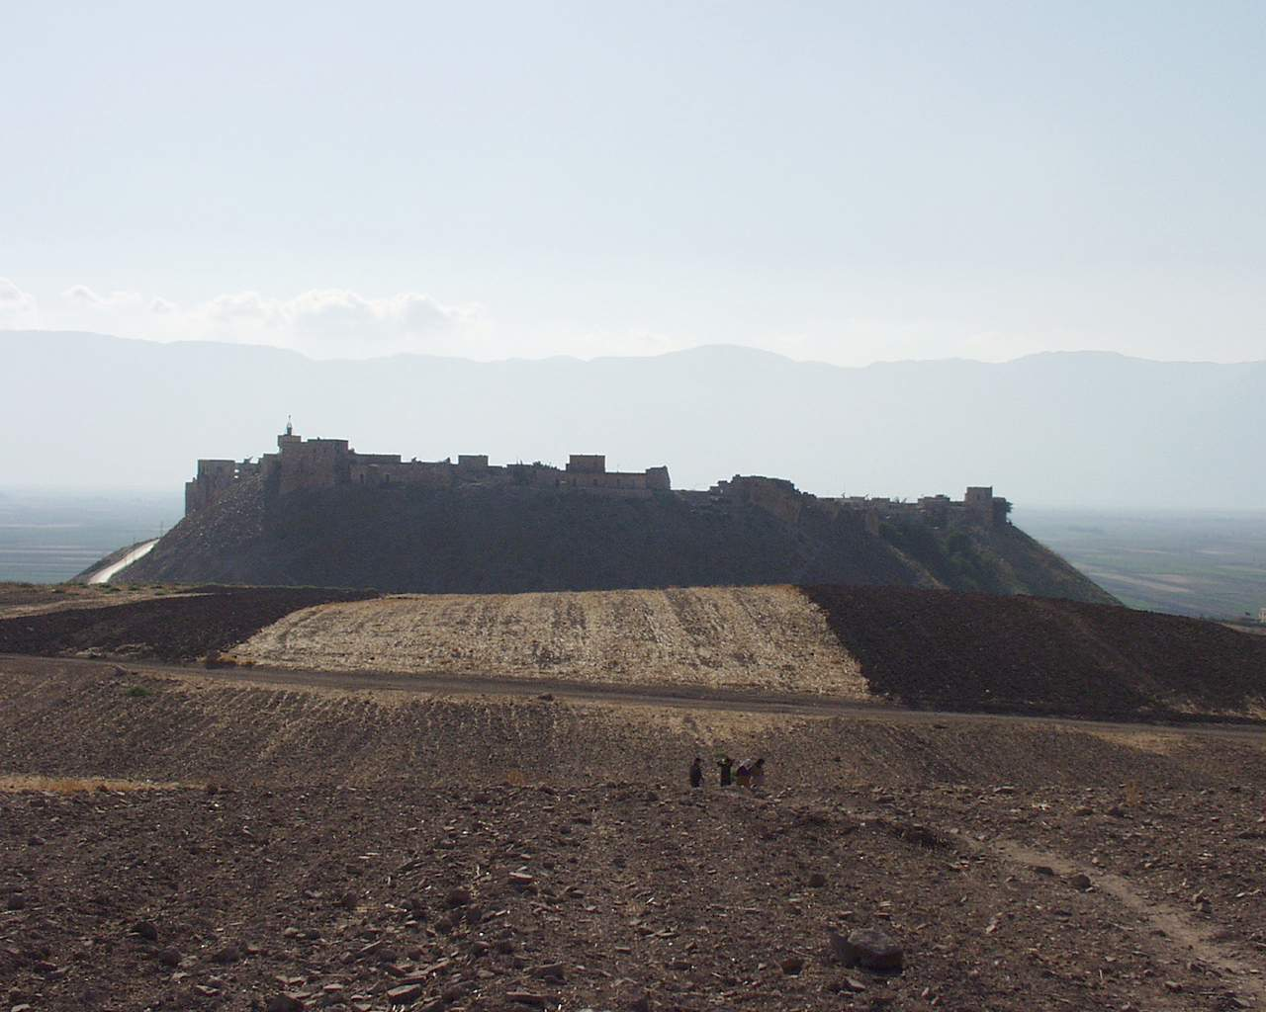

Slide 32
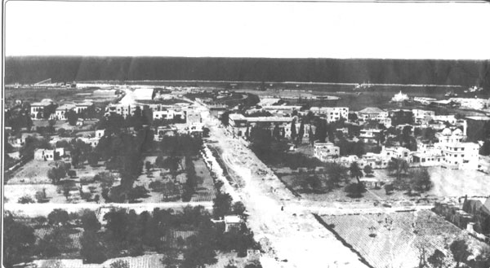
Laodicea

Slide 33
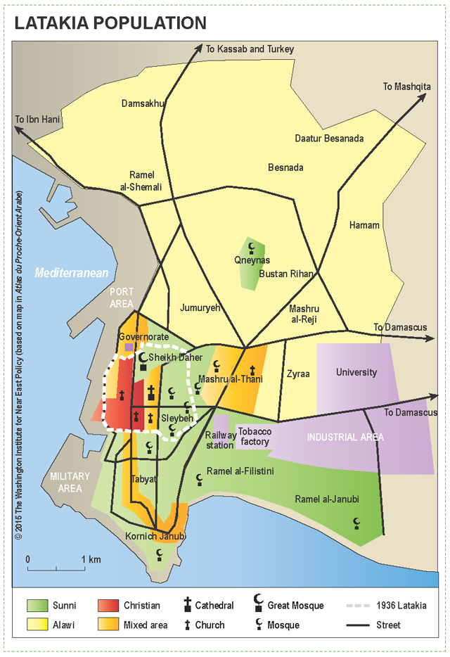

Slide 34
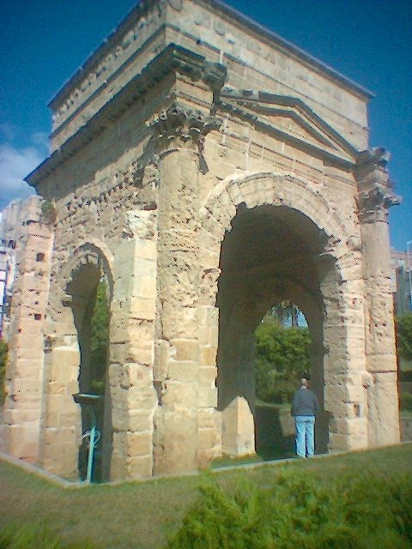
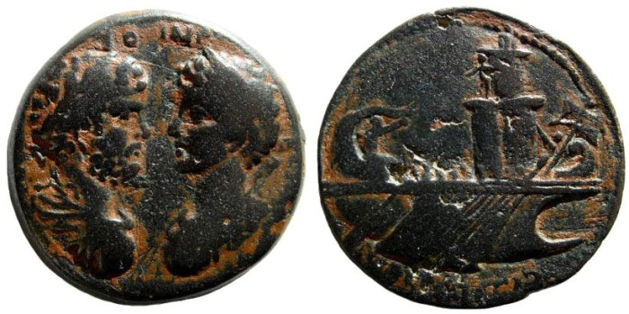

Slide 35
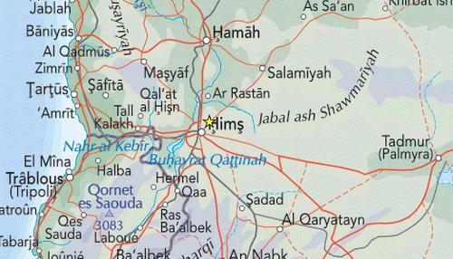
The Orontes valley

Slide 36
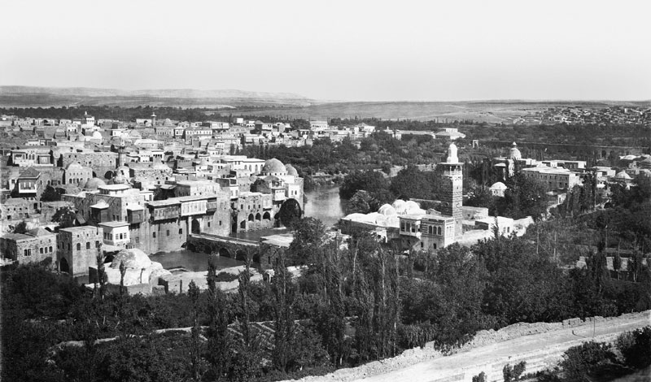
Epiphaneia (Hama)

Slide 37
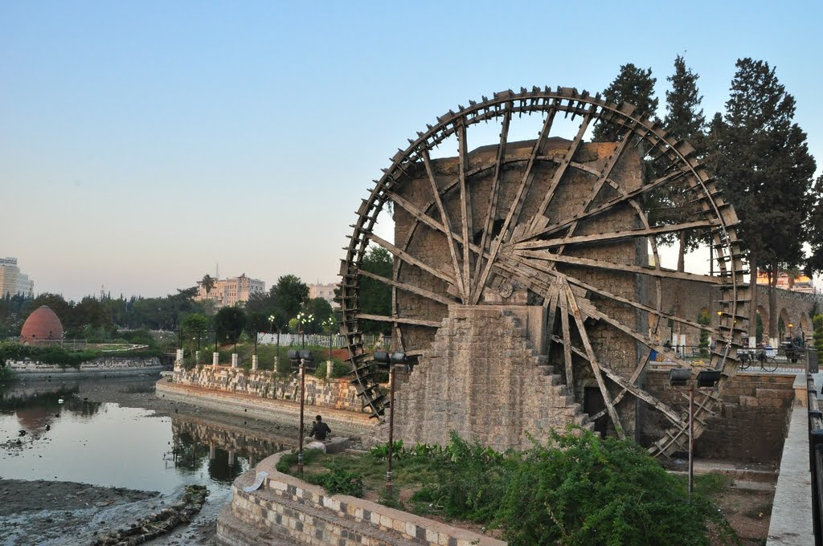

Slide 38
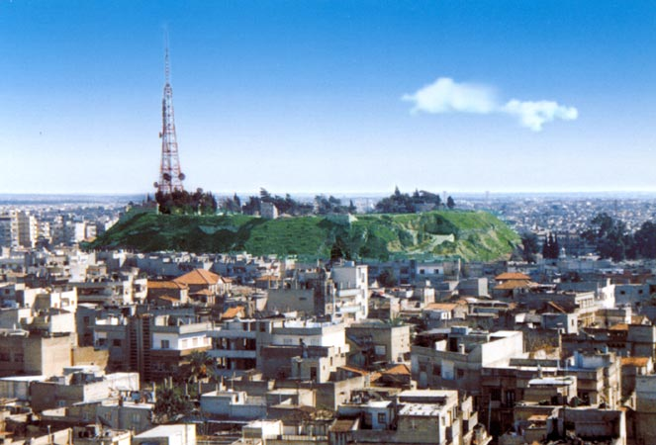
Emesa (Homs)

Slide 39
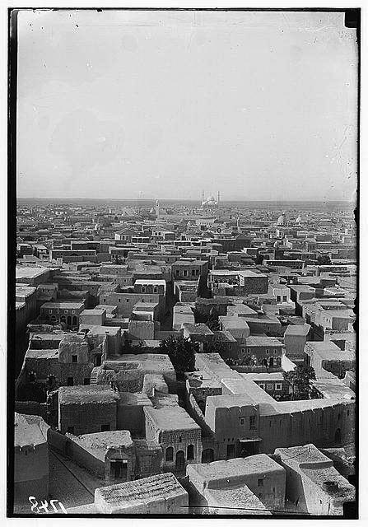

Slide 40
The north

Slide 41
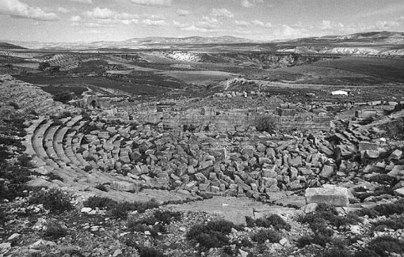
Cyrrhus

Slide 42
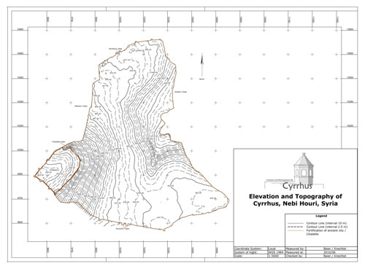

Slide 43
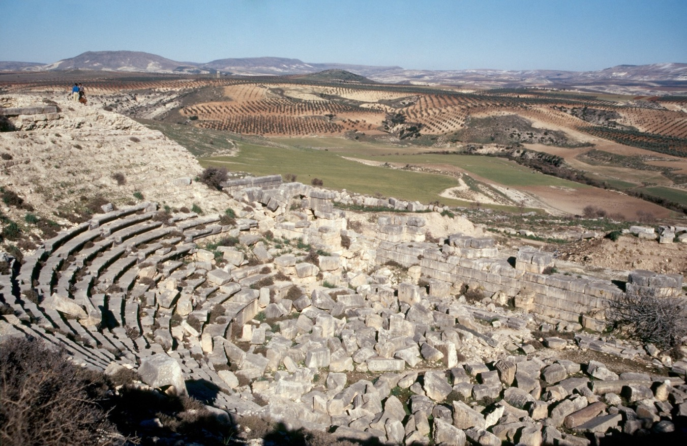

Slide 44
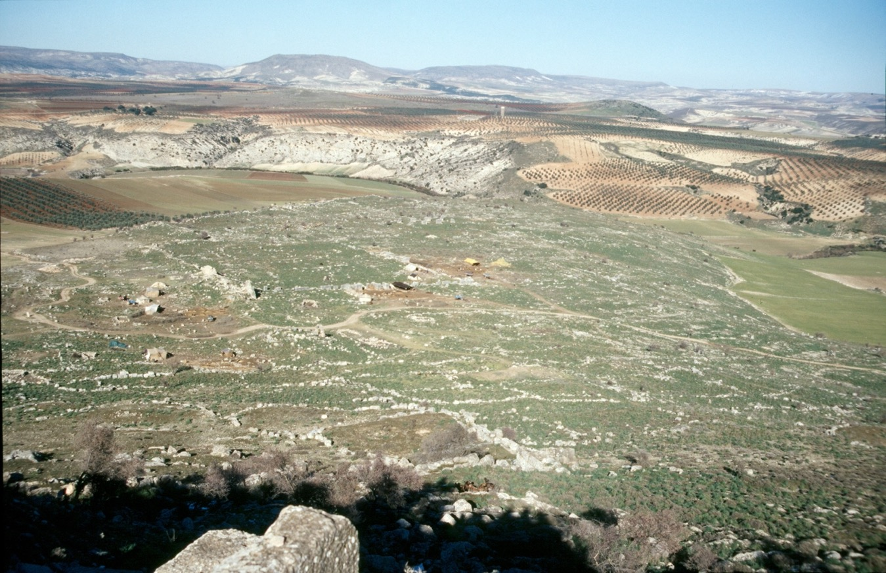

Slide 45
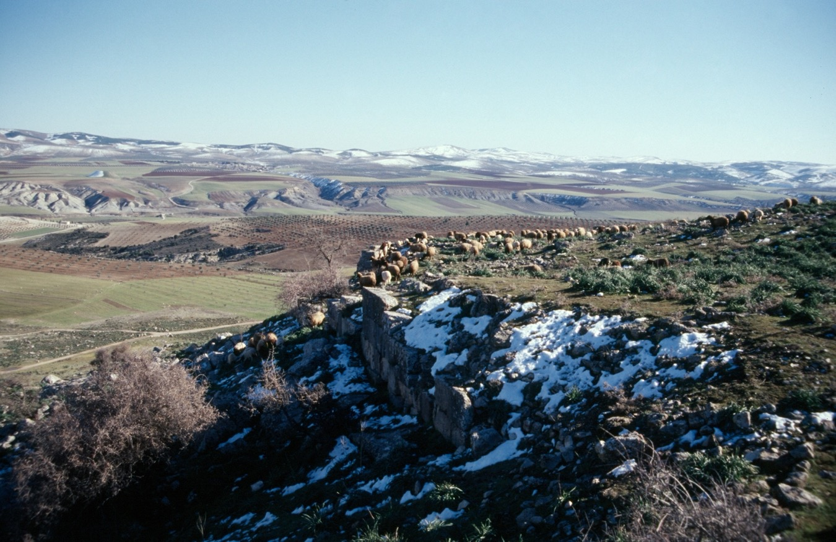

Slide 46
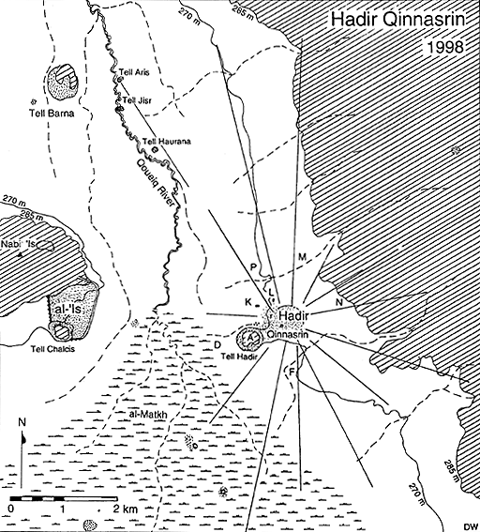
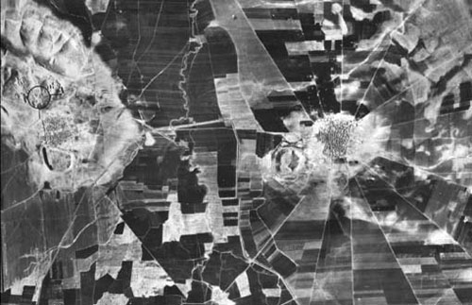
Chalcis

Slide 47
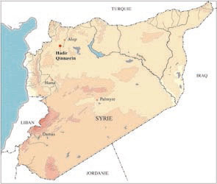

Slide 48
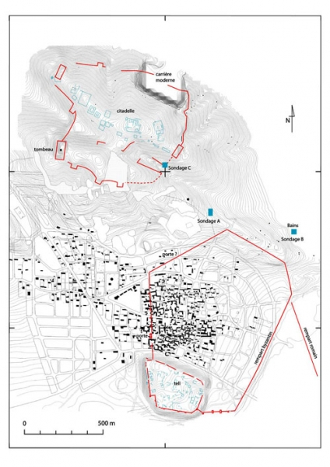

Slide 49
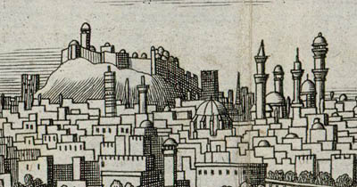
Beroea (Aleppo)

Slide 50
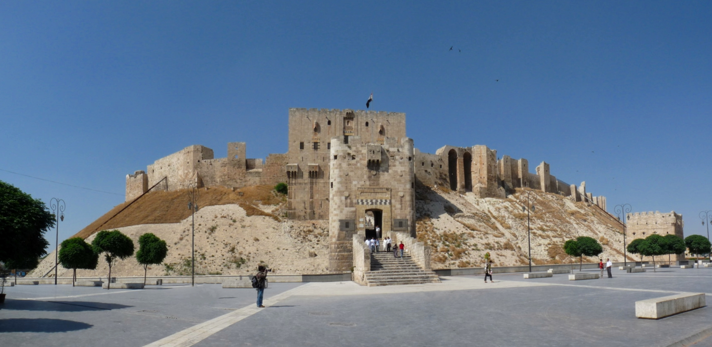

Slide 51
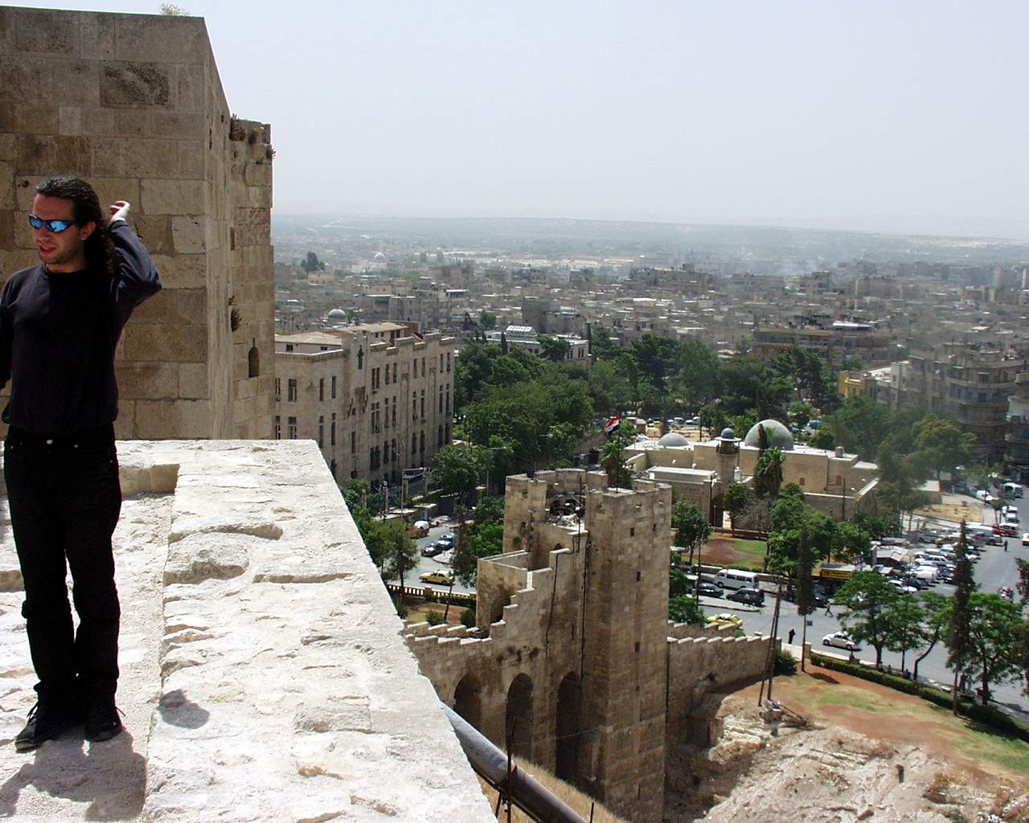

Slide 52
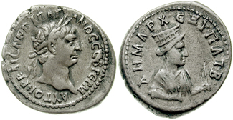
Hierapolis (Mambij)
An important cult center for the worship of Atargatis, the Syrian goddess

Slide 53
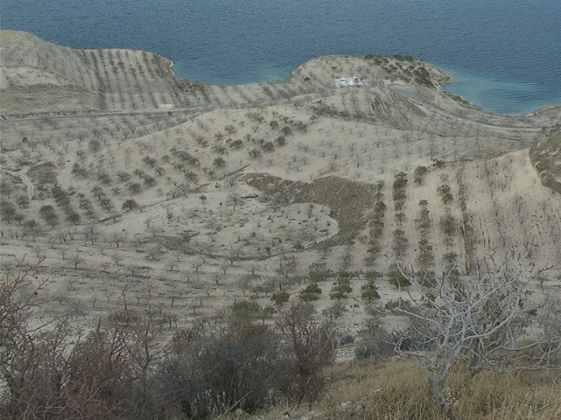
Commagene
Zeugma (Belkis), a city on the Euphrates, originally a twin settlement on both banks of the river, called Apamea and Seleucia

Slide 54
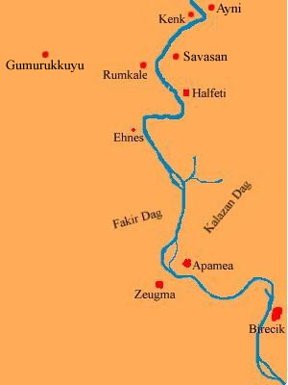

Slide 55
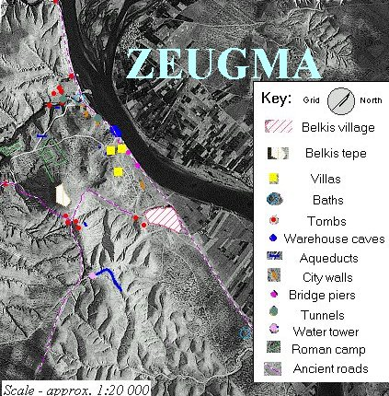

Slide 56
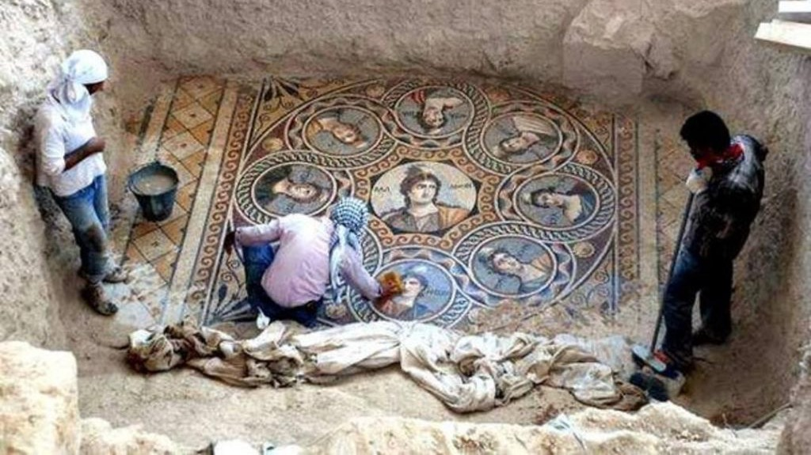

Slide 57

Samosata (Samsat), originally the capital of the kings of Commagene, also on the Euphrates and probably a twin settlement

Slide 58


Slide 59


Slide 60


Slide 61

Cities of the Phoenician coast: Aradus (Arwad)

Slide 62


Slide 63


Slide 64


Slide 65

Tripolis (Trablus)

Slide 66


Slide 67

Botrys (Batroun)

Slide 68

Byblos

Slide 69


Slide 70

Berytus

Slide 71


Slide 72


Slide 73

Sidon

Slide 74


Slide 75


Slide 76


Slide 77


Tyre

Slide 78


Slide 79


Slide 80


Slide 81

Ptolemais (Akka)

Slide 82


Slide 83

Heliopolis (Baalbek)

Slide 84


Slide 85

Damascus

Slide 86


Slide 87


Slide 88

Palmyra

Slide 89


Slide 90

Dura Europus

Slide 91


Slide 92


Philippopolis

Slide 93

Canatha (Kanawat)

Slide 94


Slide 95

Dionysias (Suweyda)

Slide 96

Bostra (Busra ash-Sham)

Slide 97


Slide 98


Slide 99

Gadara (Umm Qais)

Slide 100


Slide 101


Slide 102

Philadelphia (Amman)

Slide 103


Slide 104


Slide 105

Gerasa (Jerash)

Slide 106


Slide 107

Scythopolis (Nysa)

Slide 108


Slide 109

Tiberias

Slide 110


Slide 111


Slide 112

Sepphoris (Diocaesarea)

Slide 113

Sebaste

Slide 114


Slide 115

Neapolis
Mount Gerizim on left; Mount Ebal on right

Slide 116


Slide 117

Octagonal church of
fifth century date, built
on site of Samaritan
temple

Slide 118

Caesarea

Slide 119


Slide 120

Jerusalem (Aelia Capitolina)

Slide 121


Slide 122

Ascalon

Slide 123


Slide 124


Slide 125

Gaza

Slide 126


Slide 127

Petra

Slide 128


Slide 129


Slide 130


Slide 131


Slide 132


Slide 133



Slide 134


Slide 135


Slide 136
Cities and empire

Slide 137
Renaming the landscape
The heritage of Macedonian imperialism: Macedonian and Greek settlers
Beroea; Chalcis; Pella; Axius (another name for the Orontes river); Pieria
Names of cities and places in Macedonia and Greece
Renaming as a way of appropriating the landscape and history
Indigenous names persist through subversion

Slide 138
Myths adapted to the landscape
Daphne, near Antioch: where Apollo had pursued the nymph Daphne, who turned into a laurel tree
Stories from the myths about Dionysus used by many cities in Syria
Ioppe (Jaffa) one of several places claiming to be where Perseus rescued Andromeda from the sea monster

Slide 139
Were cities an instrument of Roman imperialism?
Roman coloniae
Emperors saw the success of cities, and a province full of cities, as a measure of success
Elevation of village to city status usually seems to have been reactive rather than proactive
But few foundations in the Roman period directly founded by emperors: Philippopolis in the Hauran a rare example
Late Roman fortresses that were likely to be the focus of Sasanian attacks elevated to city status

Slide 140
Probably no long-term strategy to increase urbanisation
But their growth and proliferation was regulated by Rome, so in this sense emperors promoted urbanisation by encouraging demand for it from provincials
But some cities were abandoned or declined (Dura Europus, Zeugma, Aradus)
These failures compensated for by the creation of new cities (though mostly small)

Slide 141
Did the creation of more and more cities increase political fragmentation?
Perhaps indicative of a divide-and-rule strategy by Rome
Though important cities may have partly driven the division of administrative units (provinces) in late antiquity
A number of places that gained civic status in late antiquity did not acquire the monumental buildings normally found in the older cities (except for city walls)
An increase in settlement in the formerly nomadic steppe zone resulted in villages becoming cities there

Slide 142
Religious motives: Constantine reputedly made Antaradus a city because it was predominantly Christian, in opposition to declining Aradus, where the citizens were pagan
He made the port of Gaza a separate city too, for similar reasons
The late antique cities often probably did not have extensive territories (or at least, not territories that were very fertile); ‘glorified villages’
But by favouring cities with ‘independence’, Rome made city status desirable

