Slide 1
Coinage

Slide 2
Coinage in the Near East to the mid-third century
A variety of coinages produced
Imperial coinage / Provincial coinage
Imperial: Roman gold aurei and silver denarii, mostly made at Rome (circulated all over the empire)
Provincial:
Silver tetradrachms, mostly made at Antioch (circulated all over the Near East)
Bronze “SC” coinage, made at Antioch (circulated all over the Near East)
Civic bronze coinages, circulated in city territories

Slide 3
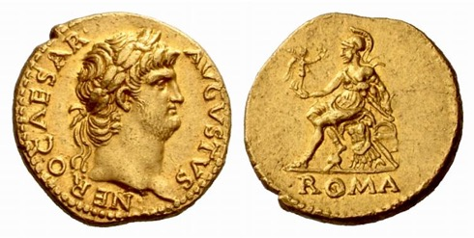
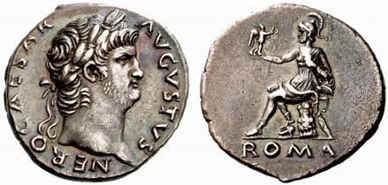
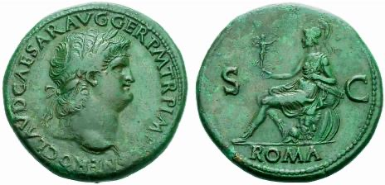
Roman imperial coinage

Slide 4
This type of coinage found all over the western provinces of the empire
In the east, the base metal imperial coinage generally did not circulate, although the gold and silver is found in the east
Relationship of each denomination to the other is clearly understood
Romans were able to maintain this complex system for about three centuries

Slide 5
Roman provincial coinage
Coinage struck by regional or local authorities. There are several categories (bear in mind that these categories are the product of modern attempts to classify the coins and do not necessarily reflect what people in antiquity thought about the coinage).
‘Provincial’ / ‘Civic’ / ‘Royal’
Mostly copper or copper alloy (e.g. bronze)
Bronze denominations generally uncertain
Silver coins struck in relatively few centres
Silver denominations based on Greek coinage systems

Slide 6
‘Provincial’ issues
Issues in silver and base metal (no gold)
The main silver unit was the tetradrachm, a four-drachm coin. Initially there were two main centres of production for tetradrachms: one based at Antioch; and the other at Tyre.
The Antiochene tetradrachm was based on the Attic standard coinage of Alexander the Great, which had been adopted by the Seleucids (though its weight had declined under the Seleucids and continued to do so under the Romans, when it was a coin of about 14.7g).

Slide 7
Tetradrachm = 4 drachms
1 tetradrachm = 4 drachms (but some tetradrachms with a lower silver content might have been worth 3 denarii)
Tetradrachms circulated widely in Syria, Phoenicia, Palestina, Arabia and Mesopotamia, but did not circulate in other provinces
They were a kind of ‘provincial imperial’ coinage, but it isn’t certain who was responsible for producing them (the emperor? The cities?)

Slide 8
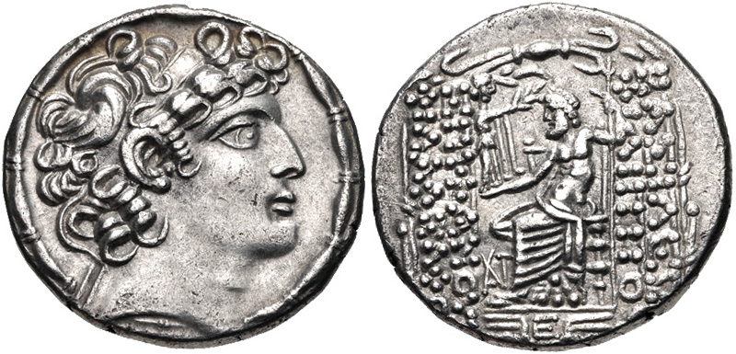
Antiochene silver tetradrachm copying the coinage of the Seleucid king Philip Philadelphus (98-83 BCE), dated year 5 of the Julian era of Antioch (46-45 BCE).
RPC I 4129

Slide 9
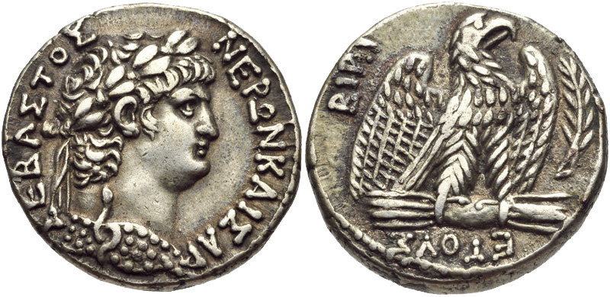
Antiochene silver tetradrachm of Nero, dated Julian year 112 of Antioch and regnal year 10 (63-64 CE).
RPC I 4188

Slide 10
The Tyrian tetradrachm
However, Tyre used a different standard, which had been created by the Ptolemies (weight about 14.1g).
The Tyrian tetradrachm bore traditional, pre-Roman types, and never had an imperial portrait
Tyrian tetradrachms circulated in the south (Phoenicia, Judaea), and Antiochene tetradrachms in the north. They formed two separate systems of silver circulation

Slide 11
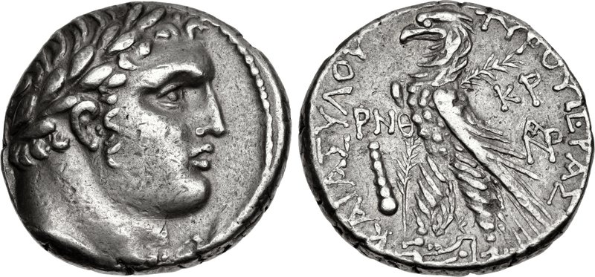
Silver tetradrachm (shekel) of Tyre, dated civic year 159 (33-34 CE). Head of Heracles - Melkart / Eagle.
RPC I 4663

Slide 12
Under Nero the Tyrian tetradrachms ceased to be issued, and Antiochene tetradrachms began circulating in both north and south – unification of the system of silver tetradrachm circulation
Antiochene tetradrachms became the main silver coinage in use throughout the Near East.
They circulated in Syria and Mesopotamia, and perhaps in Cilicia, but not elsewhere in the Roman world.

Slide 13
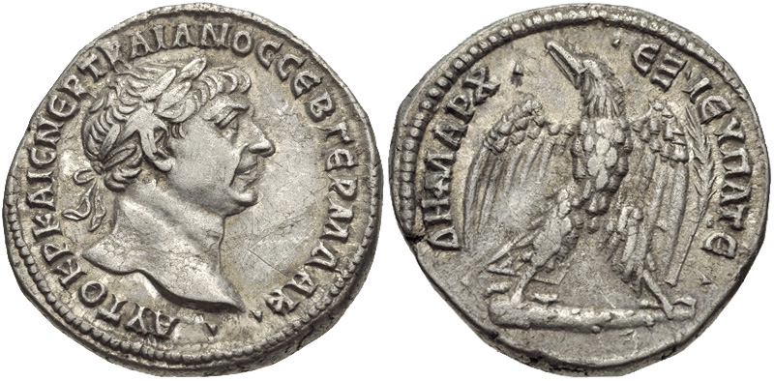
Antiochene silver tetradrachm of Trajan, dated by the 15th renewal of his tribunician power, 110-111.
RPC III 3541

Slide 14
The silver coinage became progressively more debased, but was issued in large quantities towards the middle of the third century AD, before ceasing abruptly in 253/254.
Under Caracalla (212-217 CE) and Macrinus (217-218 CE) other Syrian and Mesopotamian mints occasionally minted tetradrachms. These mints have usually been identified through the use of different symbols thought to be connected with a particular mint city.
Only rarely do tetradrachms bear the explicit reference to a city.

Slide 15
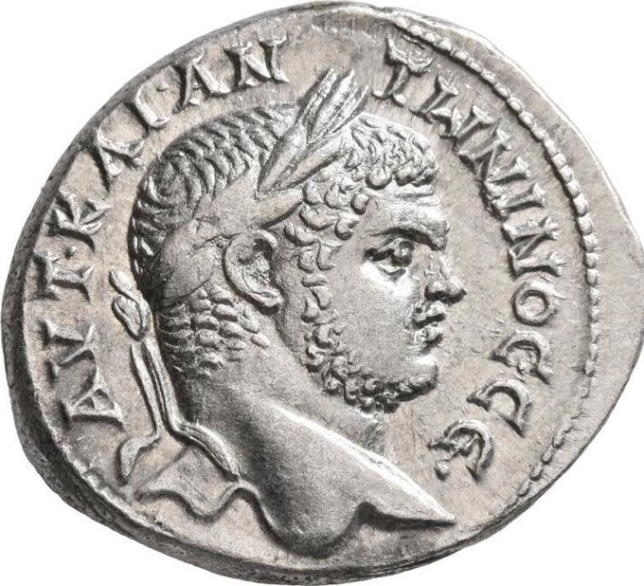
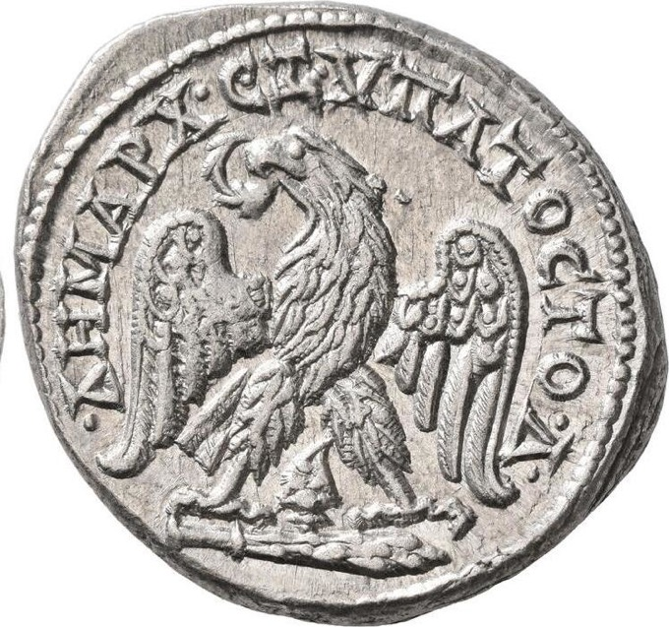
Base silver tetradrachm of Caracalla, dated by his fourth consulship, 212-217. The murex shell between the eagle’s legs is a symbol of the city of Tyre, and this issue is thought to have been struck there.
RPC Online: https://rpc.ashmus.ox.ac.uk/type/81890

Slide 16
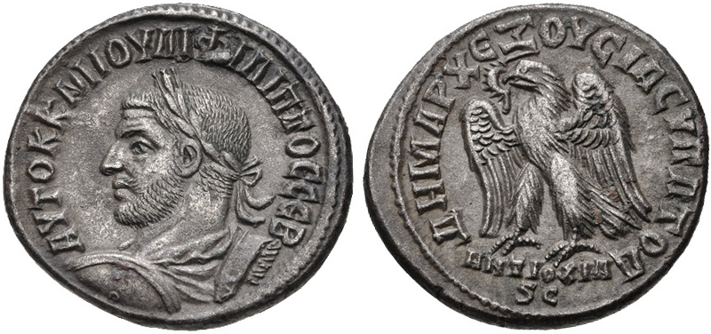
Base silver tetradrachm of Philip (244-249), with the mint mark ANTIOXIA under the eagle, and dated to a fourth consulship (there is no other evidence that Philip held a fourth consulship, but the date is presumably 249).
RPC Online: https://rpc.ashmus.ox.ac.uk/type/58801

Slide 17
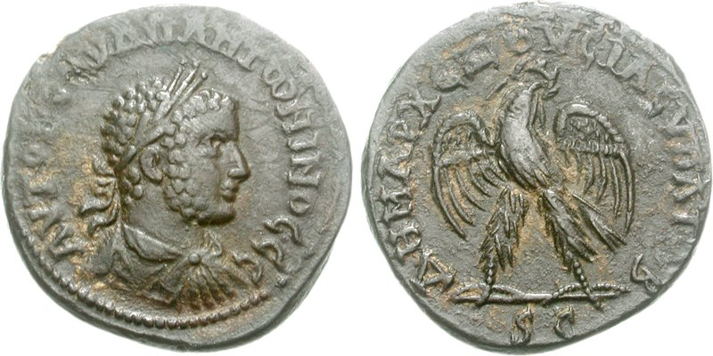
Base silver tetradrachm of the usurper Uranius Antoninus, 253-254, from Emesa. He was the last ruler to issue this denomination in Syria.
RPC IX 1892

Slide 18
Also some bronze coins circulated widely, and are categorized as ‘provincial’ rather than ‘civic’
The SC coinage of Antioch
From the reign of Augustus Antioch issued a coinage with a standardised type: the letters SC in a wreath.
The significance of the type is not clear. Normally SC would be understood as senatus consulto, ‘by a decree of the senate’, but the senate had no special authority in Syria, so it is difficult to understand what is meant, if this is the correct interpretation.

Slide 19
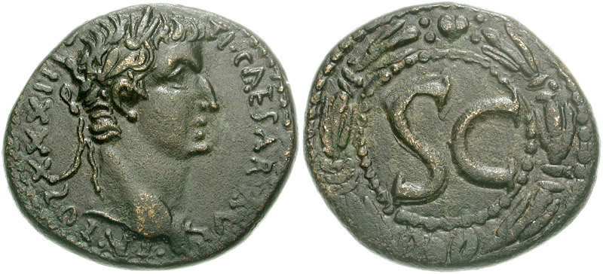
SC bronze of Tiberius (14-37), dated by his 23rd renewal of tribunician power, 31-32.
RPC I 4272

Slide 20
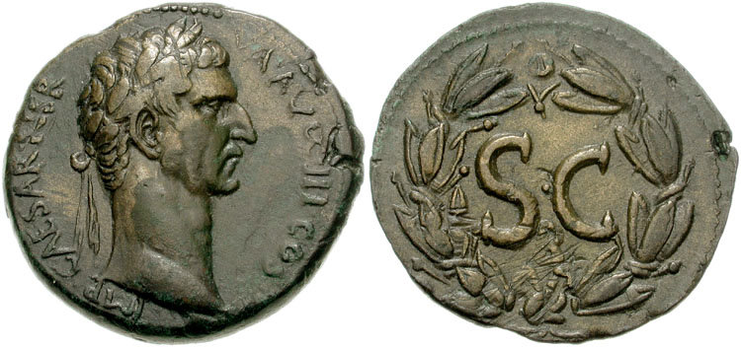
From Augustus to Nerva (96-98) the inscriptions are in Latin, but under Trajan they switch to Greek (apart from the letters SC).
SC bronze of Nerva (96-98), dated by his third consulship, 97 CE.
RPC III 3840

Slide 21
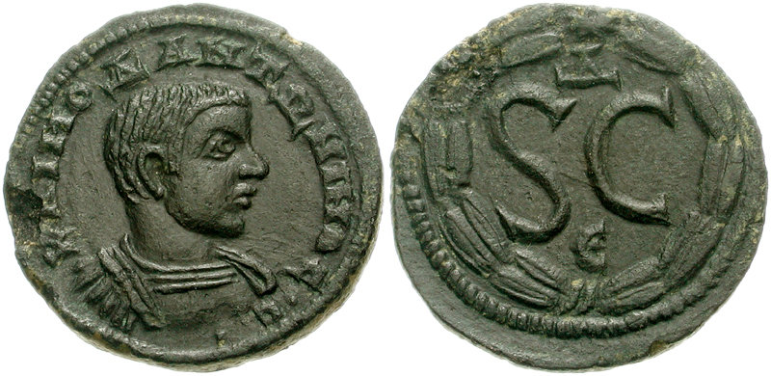
The SC coinage circulated widely in the Near East, but not in other regions. In the third century the letters SC were transferred to the civic bronze coinage of Antioch (and to the silver tetradrachms), but small denominations were still produced with the SC in a wreath down to the reign of Philip (244-249).
SC bronze of Diadumenian, son of the emperor Macrinus (217-218)

Slide 22
Other non-civic bronze coinage
A series of coins were issued in Judaea without portraits, probably in deference to Jewish mosaic law forbidding 'graven images'. These generally followed the tradition of the earlier Hasmonaean and Herodian kings.
After the fall of Jerusalem following the First Jewish War in AD 70, a series of coins with imperial portraits were issued celebrating the Roman victory, with imperial portraits.

Slide 23
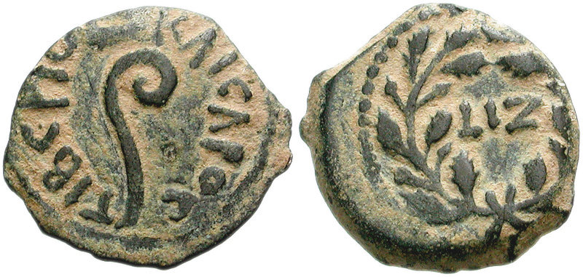
Coin issued for Judaea under Pontius Pilate
Judaea, under Tiberius, regnal year 17 (30 CE, when Pontius Pilate was prefect).
Lituus (Roman priest’s wand) / date in wreath. RPC I 4968

Slide 24
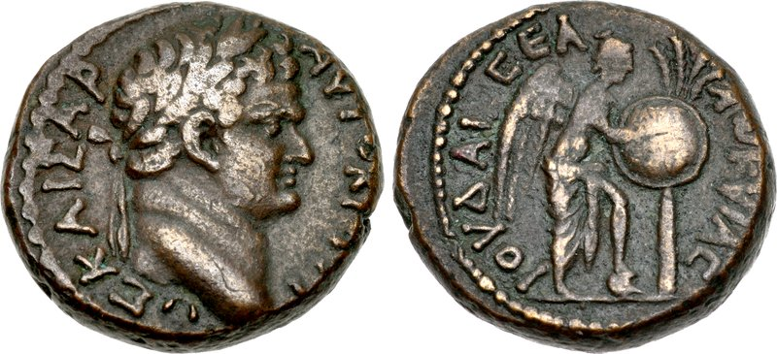
Judaea capta coin of Titus, as Caesar, 69-79, possibly struck at Caesarea. Victory inscribing shield attached to palm.
RPC II 2311

Slide 25
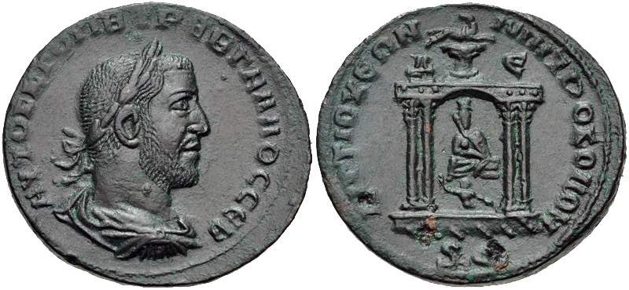
Civic coinage
Antioch, civic bronze of Trebonianus Gallus (251-253).
The Tyche of Antioch in a portable shrine (note the carry-bars on the base of the shrine).
RPC IX 1851

Slide 26
Many cities of the east issued their own copper alloy coinages = ‘civic coinage’
Part of a long standing tradition whereby Greek cities had issued their own coinages
This was a custom that the Romans respected
Not every city issued its own coins, and those that did not, or which issued coins only rarely, seem to have made do with coinages of neighbouring cities
How they acquired these neighbouring coinages is not clear

Slide 27
Civic coins seem to have been issued for the benefit of the cities, and not for the Roman authorities
Civic coin production came to and end in the third century
These civic coinages are extremely informative about the political status of cities, local cults, myths associated with the city, and important monuments
Often they are the only evidence for these things

Slide 28
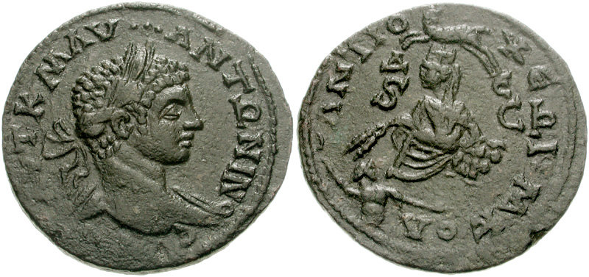
Antioch, civic bronze of Elagabalus (AD 218-222). The reverse type depicts the Tyche of Antioch, the river Orontes swimming at her feet, and what appears to be an astrological symbol (Aries) above.
RPC Online: https://rpc.ashmus.ox.ac.uk/type/54626

Slide 29
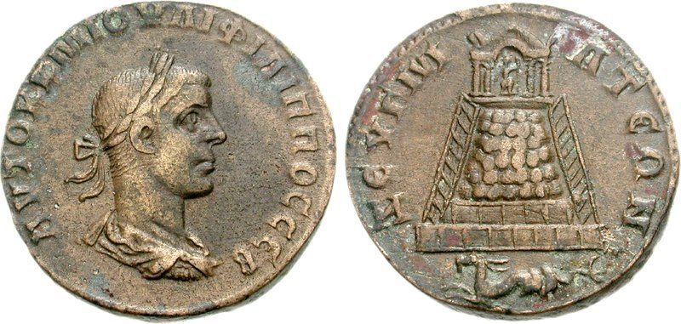
Zeugma, Philip II as Augustus, 246-249. A temple on a prominent hill. Note the astrological symbol Capricorn (a symbol of the legion stationed there?).
BMC Galatia etc., Zeugma 32

Slide 30
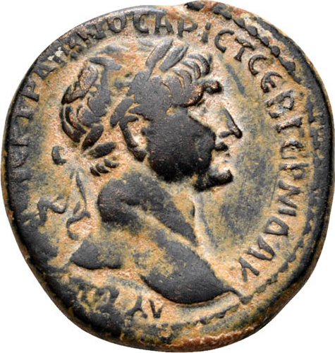
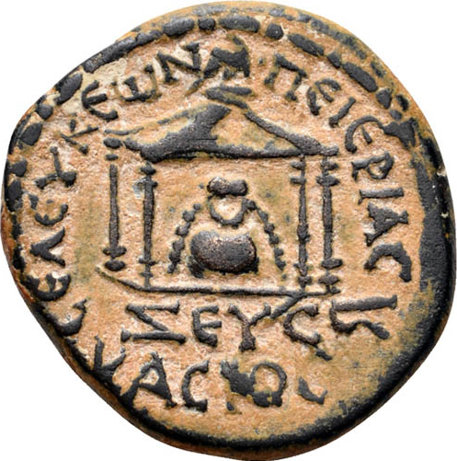
Seleucia Pieria, Trajan (98-117). Stone or mountain image associated with Zeus Casius (a localmountain), in a shrine
RPC III 3775

Slide 31
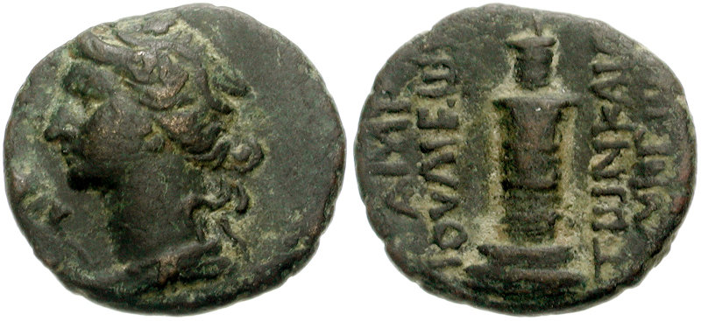
Laodicea, ‘pseudo-autonomous’ issue of the late first or early second century CE. Head of Dionysus / the lighthouse of Laodicea.
RPC II 2035A

Slide 32
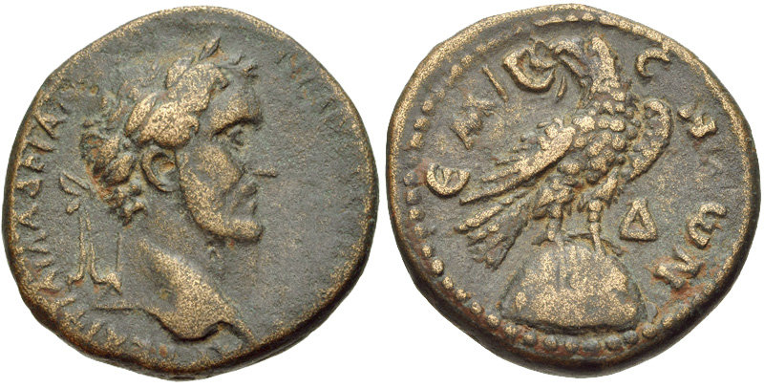
Emesa, Antoninus Pius (AD 138-161). Eagle perched on cult stone of Elagabal.
RPC Online: https://rpc.ashmus.ox.ac.uk/type/41758

Slide 33
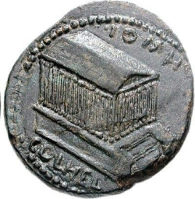
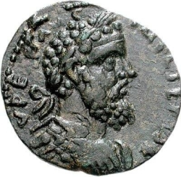
Septimius Severus (193-211), Heliopolis (Baalbek). The temple of Jupiter
RPC Online: https://rpc.ashmus.ox.ac.uk/type/84865

Slide 34
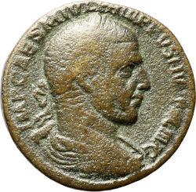
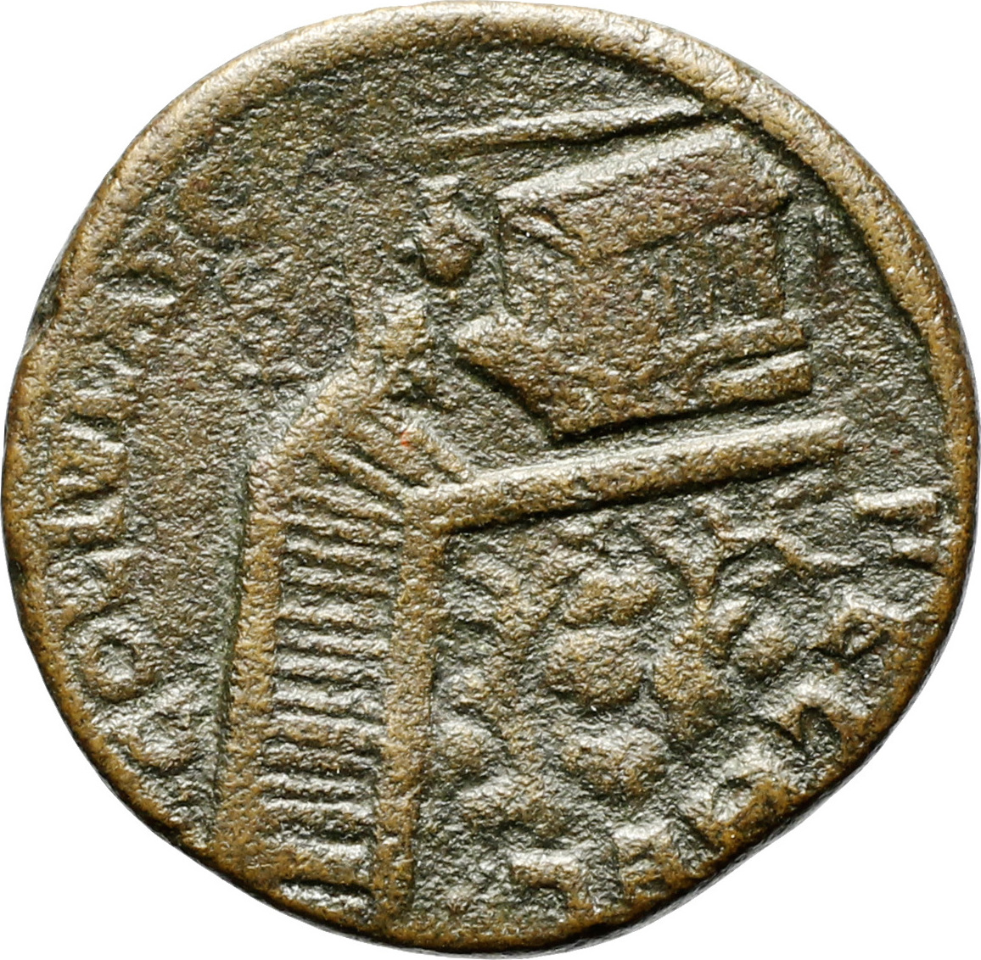
Heliopolis, Philip I (244-249). The temple of Mercury on a hilltop
BMC Galatia etc., Heliopolis 18

Slide 35
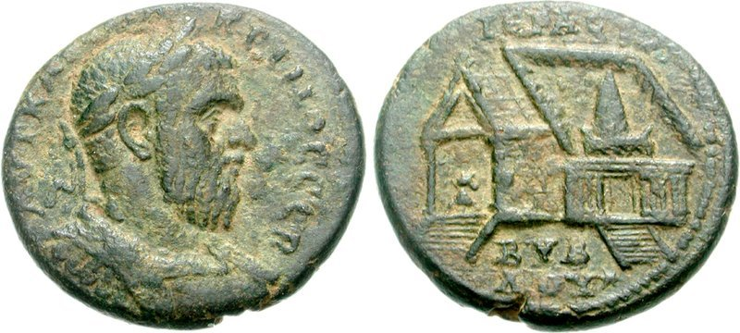
Byblus, Macrinus (AD 217-218). Temple with large conical or pyramidal cult object in colonnaded court.
BMC Phoenicia, Byblus 37-38

Slide 36
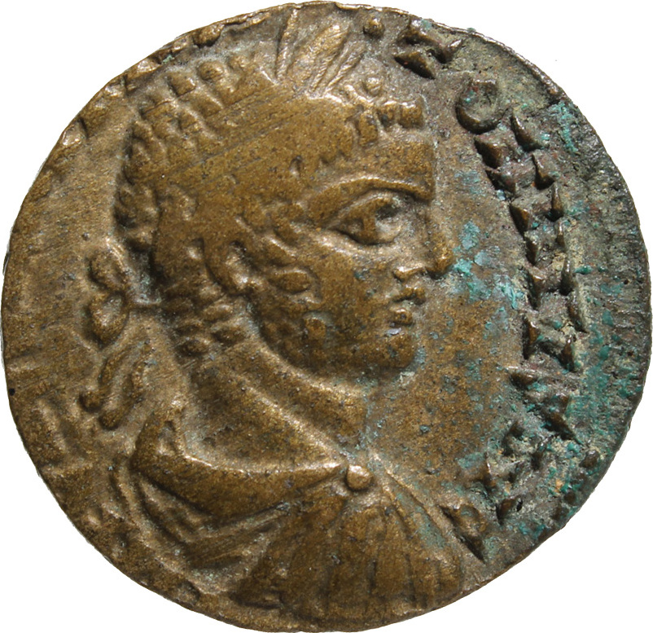
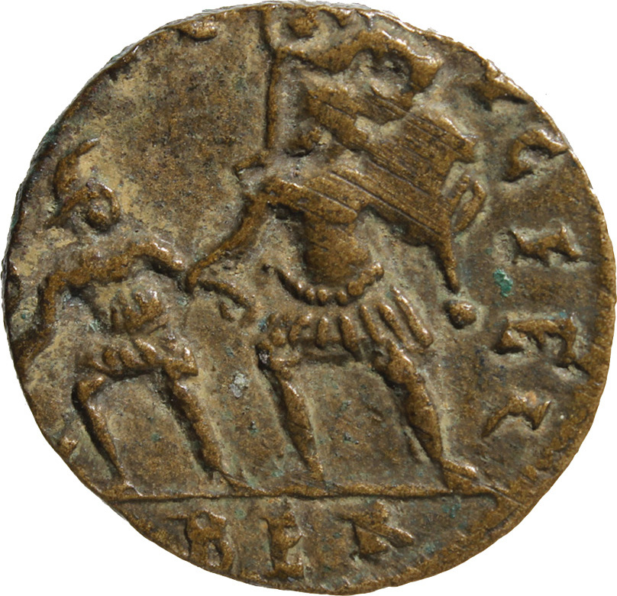
Colonia of Berytus, Elagabalus (218-222). Aeneas fleeing the destruction of Troy, carrying his father Anchises and holding his son Ascanius by the hand (message: we Berytians are Romans)
BMC Phoenicia, Berytus 213-215

Slide 37
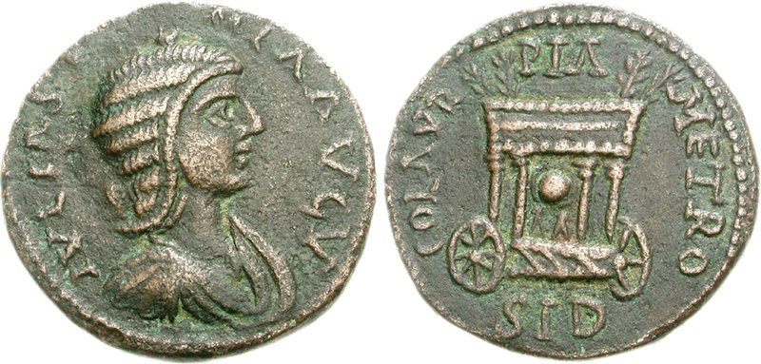
Sidon, Julia Soaemias, mother of Elagabalus. Cult object (spherical stone?) in wheeled portable shrine. When Tyre rebelled against Elagabalus, Sidon remained faithful and was awarded the title Colonia Aurelia. It also gained the title Pia (‘faithful’).
RPC Online: https://rpc.ashmus.ox.ac.uk/type/51524

Slide 38
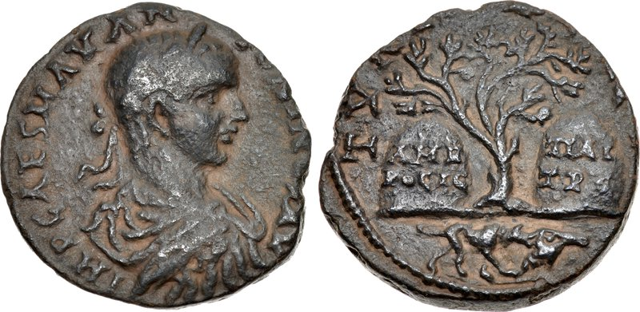
Tyre, Elagabalus (AD 218-222). The Ambrosial Rocks, the legendary origin of Tyre as two rocks floating in the sea. Beneath is a reference to the discovery of sea purple: Heracles’ dog found a murex on the beach and chewed it, producing a purple froth.
RPC Online: https://rpc.ashmus.ox.ac.uk/type/54115

Slide 39
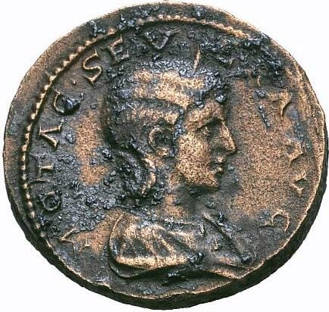
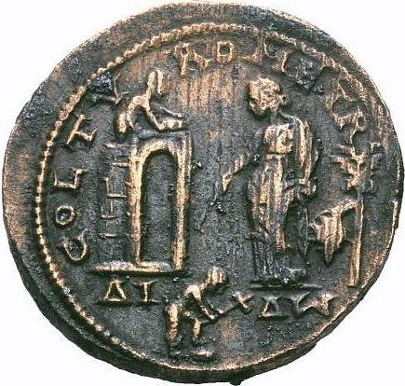
Tyre, Otacilia Severa, wife of Philip I (244-249). Dido supervising the building of Carthage
RPC Online: https://rpc.ashmus.ox.ac.uk/type/26496

Slide 40
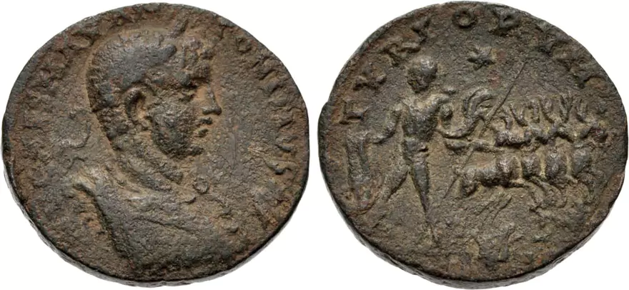
Tyre, Elagabalus. An unexplained scene that must be associated with the myth of Dido, queen of Carthage: Pygmalion, king of Tyre, holding four stags by the reins
BMC Phoenicia, Tyre 408

Slide 41
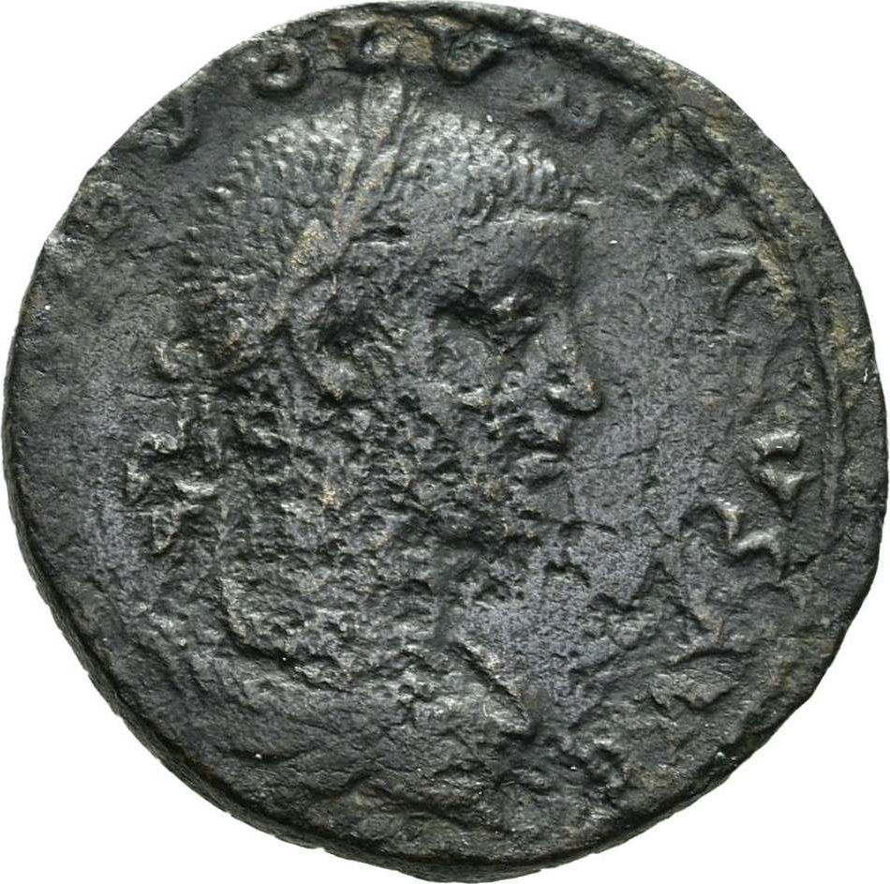
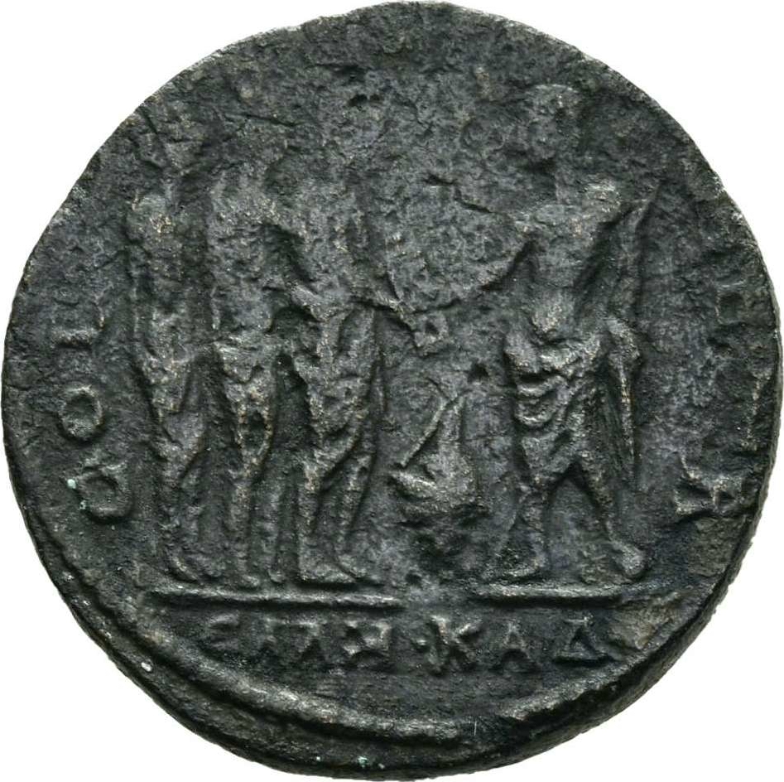
Tyre, Volusian (co-emperor with Trebonianus Gallus, 251-253 CE). Phoenician hero Cadmus giving a scroll to the Greeks (i.e. the Greeks owe the Phoenicians for the ability to write)
RPC IX 2019

Slide 42
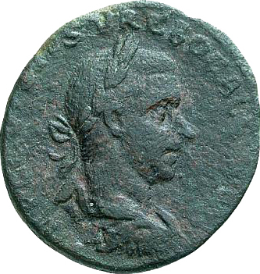
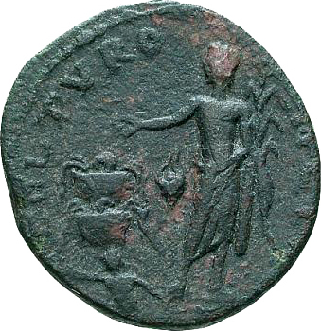
Tyre, Trebonianus Gallus (251-253). River god and the water tanks at Ras al Ain?
RPC IX 1985

Slide 43
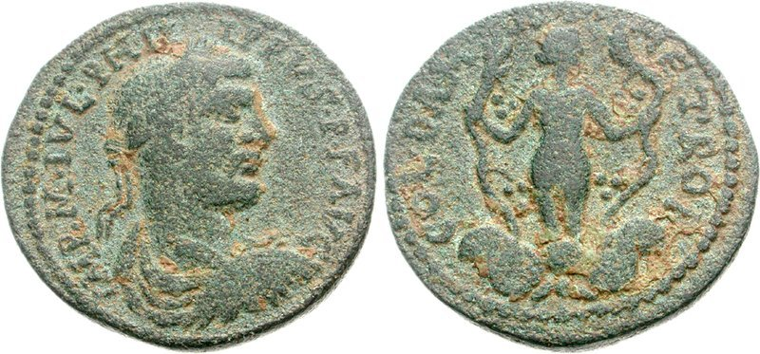
Damascus, Philip I (AD 244-249). Naked female figure clasping vine tendrils. This is probably a representation of the nymph Ambrosia, who turned herself into a vine plant when helping Dionysus fight Lycurgus. The battle was supposed to have taken place in this region (although an alternative tradition placed it in Thrace).
RPC Online: https://rpc.ashmus.ox.ac.uk/type/26786

Slide 44
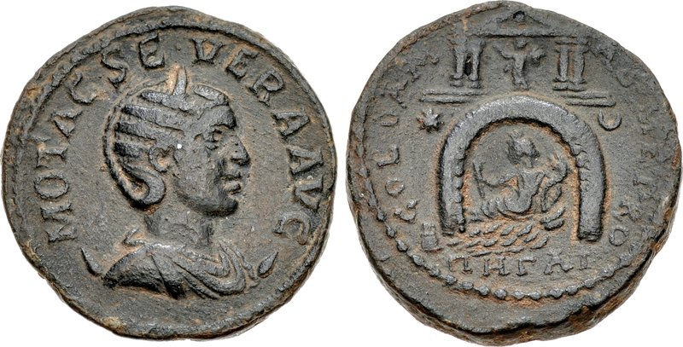
Damascus, Otacilia Severa, wife of Philip (AD 244-249). Water emerging from a grotto, with river god reclining in it; above, temple. The inscriptions are in Latin (appropriate for a colonia), but beneath the spring is the Greek word pegai (‘springs’). This is almost certainly a representation of the temple at the source of the Barada river which flows through Damascus.
RPC Online: https://rpc.ashmus.ox.ac.uk/type/15976

Slide 45
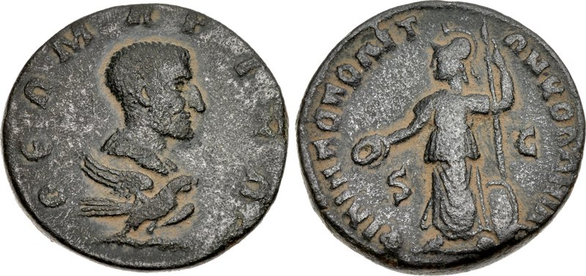
Philippopolis, Divus Julius Marinus, father of the emperor Philip (244-249). A cult of Philip’s father seems to have existed at Philippopolis, the city thought to be Philip’s birthplace; this is the only known coinage in the name of the emperor’s father.
BMC Arabia, Philippopolis 2

Slide 46
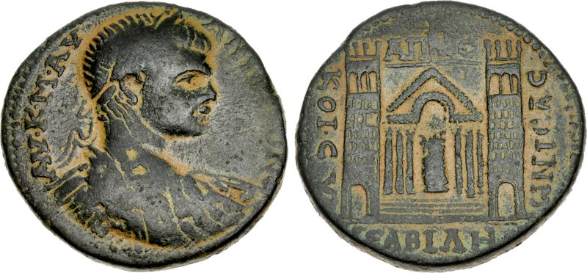
Abila, Elagabalus (218-222), dated civic year 281 (218). Unidentified temple with flanking towers.
RPC Online: https://rpc.ashmus.ox.ac.uk/type/50614

Slide 47
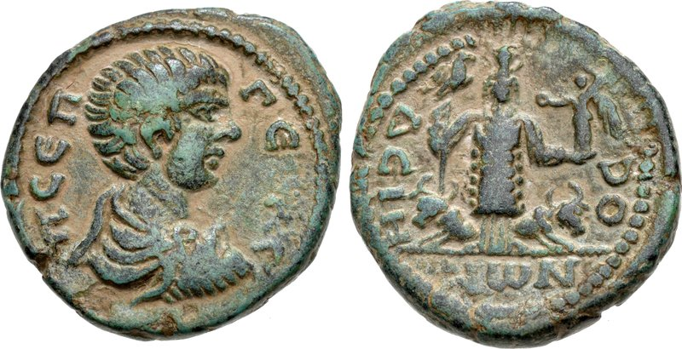
Dium, Geta, son of Septimius Severus, as Caesar, 198-209. Deity holding a victory and eagle tipped sceptre, flanked by two bulls.
BMC Arabia, Dium 1-2

Slide 48
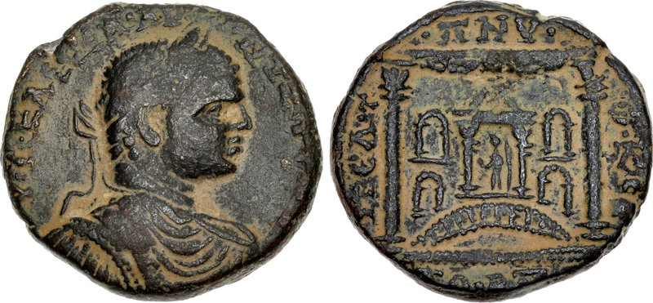
Pella, Elagabalus (218-222). Unidentified building with columns and niches, perhaps a nymphaeum. Dated civic year 282 (218-219).
RPC Online: https://rpc.ashmus.ox.ac.uk/type/52213

Slide 49
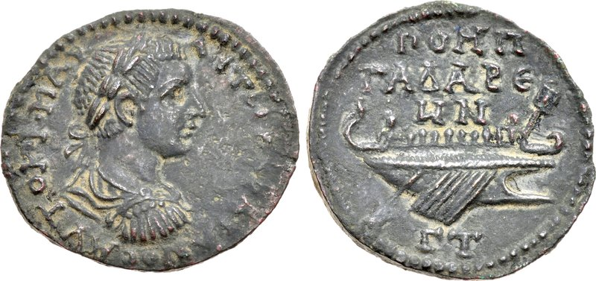
Gadara, Gordian III (AD 238-244), dated civic year 303 (AD 239-240). Galley. This perhaps refers to a naumachia (mock sea battle) performed on the nearby Sea of Galilee. The city’s titles include ‘Pompeia’, a reference to its re-foundation by Pompey.
RPC VII.2 3625

Slide 50
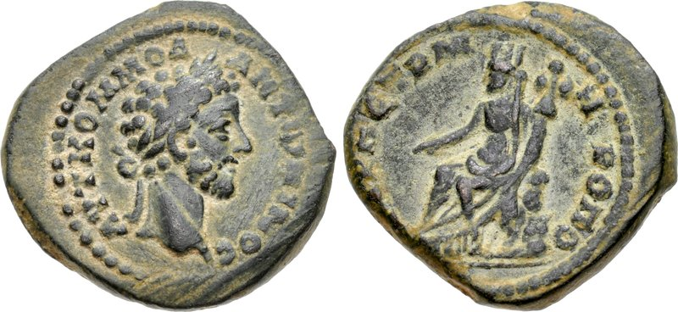
Petra, Commodus (177-192). City goddess (Tyche) of Petra, holding a military trophy over her shoulder.
RPC Online: https://rpc.ashmus.ox.ac.uk/type/42478

Slide 51
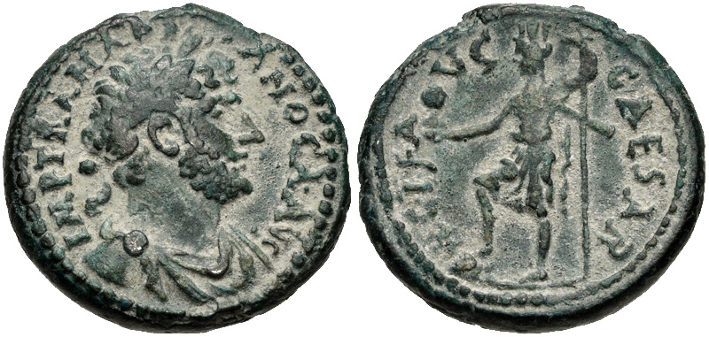
Caesarea, Hadrian (117-138). The city goddess (Tyche) of Caesarea.
RPC III 3960

Slide 52
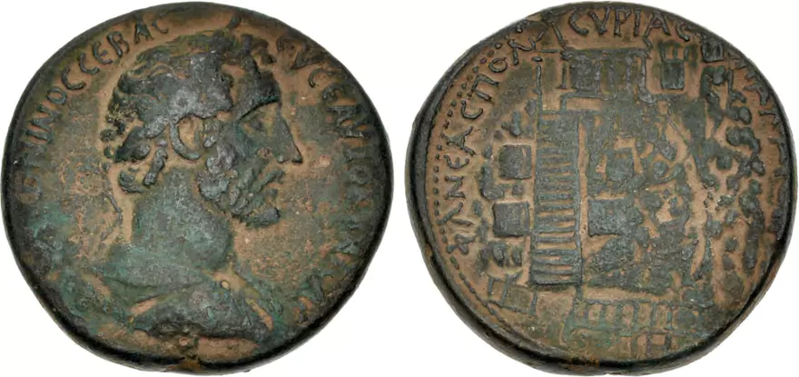
Neapolis, Antoninus Pius; dated civic year 88 (159/160). Mount Gerizim with buildings
RPC Online: https://rpc.ashmus.ox.ac.uk/type/41957

Slide 53
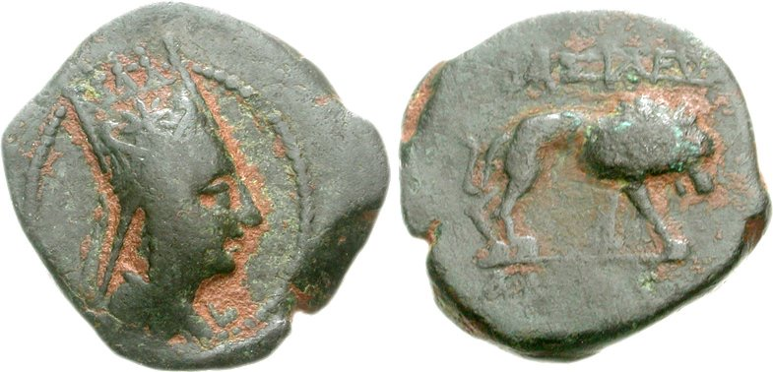
In addition, some coins were issued for or by the koinon of Syria and by kings
Commagene, Antiochus I (c. 69-34 BCE). Lion.

Slide 54

Commagene, Antiochus IV (38-72 CE). Scorpion in wreath.
RPC I 3854

Slide 55

Chalcis, Cleopatra and Mark Antony, dated by Cleopatra’s 21st Egyptian regnal year and 6th regnal year in Chalcis, 32-31 BCE.
RPC I 4771

Slide 56

Herod the Great (40-4 BCE), dated regnal year 3 (37-36 BCE), minted in Samaria. Helmet / Tripod.
RPC I 4901

Slide 57

Agrippa I (37-43 CE). Paneas (Caesarea Philippi). Bust of Caesonia (wife of Caligula) / figure of Drusilla (daughter of Caligula). These coins bear the only certainly identifiable portraits of Caesonia.
RPC I 4977

Slide 58

Agrippa I (37-43 CE). Caesarea, dated regnal year 7 (42-43 CE). Bust of Agrippa / Tyche of Caesarea.
RPC I 4986

Slide 59
Bibliography
My book, chapter 6, has a brief overview.
@K. Butcher, ‘Syria in the Roman period, 64 BC – AD 260’, in W Metcalf (ed.), Oxford Handbook of Greek and Roman Coinage, Oxford, 2012: 468-484.
@K. Butcher, ‘Numismatics’, in T Kaizer (ed.), Blackwell Companion to the Hellenistic and Roman Near East, Oxford, 2021: 135-153.
See also https://warwick.ac.uk/fac/arts/classics/intranets/students/modules/romanneareast/resources/ for more of these coins
K. Butcher, Roman Provincial Coins. An Introduction to the Greek Imperials, London, 1988.
K. Butcher, Coinage in Roman Syria: Northen Syria, 64 BC – AD 253, London, 2004.

Slide 60
Third century changes
Debasement of imperial silver in the third century, and less gold produced
Antioch began producing imperial coins, and was followed by some other important eastern cities (e.g. Alexandria in Egypt)
Gradually a single denomination for imperial coinage began to dominate
Its ancient name is unknown, but it is conventionally called an ‘antoninianus’ or ‘radiate’
Its value in relation to other denominations is also unknown

Slide 61


Radiate of Caracalla, issued at Rome in
215 CE
Radiate of Gallienus, issued at Antioch c.
260-268 CE
RIC IV 257b
RIC V.1 618

Slide 62

Radiate of Vaballathus and Aurelian
RIC V 381

Slide 63
Civic coinage ceased to be produced altogether
At the end of the third century, Diocletian introduced some changes
A new silver ‘denarius’ was introduced, called the ‘argenteus’, but was soon abandoned
The aureus was once again produced in quantity
A new base metal coin, made of copper with a small amount of silver, was introduced
This coin was called a nummus and was worth a quarter of an argenteus, like the old sestertius

Slide 64

Nummus of Diocletian minted at Antioch: ANT
RIC VI Antioch 52a
Mintmarks were now normal to show where coins were made

Slide 65

The types were now usually standardized, regardless of where they were minted, so during a given period, most nummi would bear the same design
ALE = Alexandria
ANT = Antioch
RIC VI Alexandria 101a

Slide 66

However, in c. 310-313 CE the mint of Antioch produced types unique to that city
The Tyche of Antioch
The statue of Apollo at Daphne,
a suburb of Antioch

Slide 67

In the early fourth century Constantine introduced a new, lighter gold coin, the solidus, which became the main tax coin
Solidus of Constantius II minted at Antioch, RIC VIII Antioch 81, 347-355 CE

Slide 68

A floating exchange rate developed between copper alloy coins and gold
During the fifth century the copper alloy coinage became increasingly degraded; old coinage circulated as long as it was the right size (very small) and lots of forgeries were produced
Coin of the emperor Leo (457-474 CE), diameter 10mm
RIC X Leo 714

Slide 69

At the end of the fifth century (498 CE) the emperor Anastasius introduced a new base metal coinage, with value marks on it
Conventionally this is regarded as the beginning of Byzantine coinage
Dumbarton Oaks Catalogue, Anastasius 23i
(Constantinople)
With the value mark M = 40

Slide 70

Byzantine follis of the emperor Maurice, minted at Antioch (re-named Theupolis after an earthquake in 527 CE)
Dumbarton Oaks Catalogue, Maurice 167b, regnal year 15 (596/597 CE)

Slide 71
A single monetary system?
Main model for the circulation of coinage developed by Keith Hopkins, a Cambridge academic
Requires a standardised coinage
As the Roman empire expanded, it imposed money taxes on conquered regions, and introduced its coinage to those regions
Taxes in coin flowed out of tax-producing provinces to the centre (Rome), and were redistributed to tax-consuming provinces (those where armies were stationed)
Tax-producing provinces earned to coin needed to pay tax by engaging in overseas export of produce
In this way, taxation stimulated trade

Slide 72
@K Hopkins, ‘Taxes and Trade in the Roman Empire (200 BC – AD 400), Journal of Roman Studies 70 (1980): 101-125.

Slide 73
Problems
Main tax coin of the early empire is assumed to have been the silver denarius, but it did not circulate in every province of the east
The role of provincial silver in this system is not clear: if it was used for tax, it was not exported to Rome

Slide 74
How were coins put into circulation?
The minting authorities did not give away money for free
Payment for services
Civic coinages presumably made to meet local needs

Slide 75
Monetization
Finds of coins from ancient sites imply a high degree of monetization
Two basic categories of finds: hoards and single finds
Hoards are deliberately concealed and usually contain valuable coins
Single finds are probably the result of casual loss or deliberate discard
So site finds cannot tell us much about the circulation of silver or gold, and hoards cannot tell us much about the circulation of small change

