Slide 1
The Rise and Fall of Palmyra

Slide 2
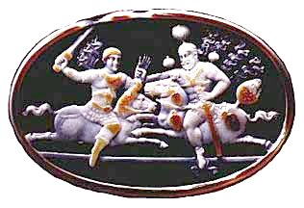
Palmyra
In AD 260 the emperor Valerian was captured by Shapur in battle
Shapur could portray himself as victorious over three emperors (Gordian III, Philip and Valerian)

Slide 3
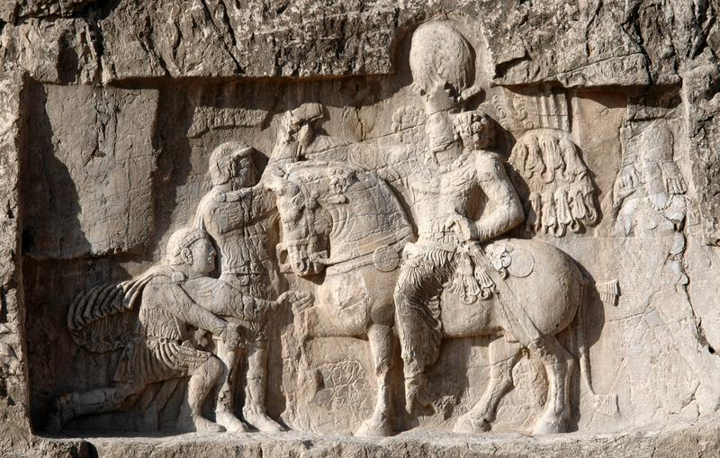

Slide 4
The Sasanians raided Syria, but the Romans forced them to retreat, and Odaenathus of Palmyra defeated them
Nobody negotiated for the return of Valerian
The Roman army in Syria appointed two new emperors, Macrianus and Quietus
Macrianus took part of the army west to fight Valerian’s son Gallienus
Quietus stayed in Syria

Slide 5
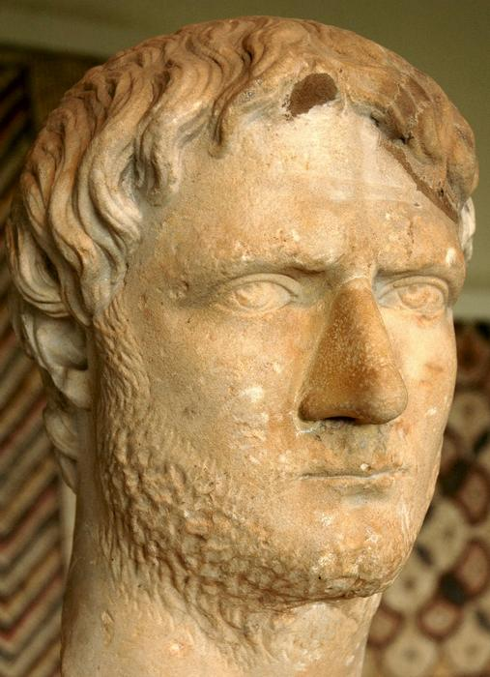
Gallienus’ armies defeated and killed Macrianus
In Syria, Quietus was defeated and killed by Odaenathus of Palmyra

Slide 6
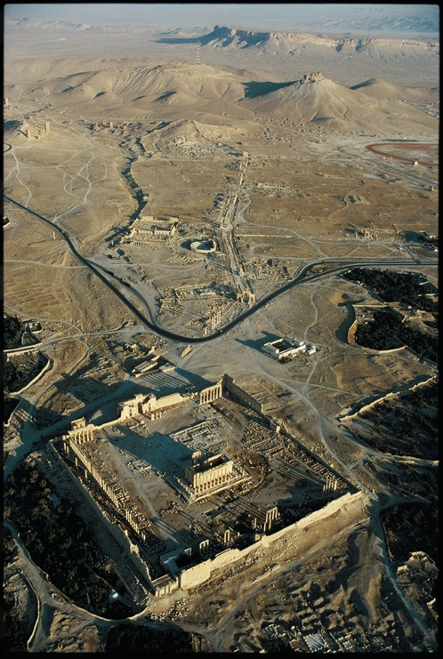
Gallienus remained in direct control of the central part of the Roman empire
Odaenathus protected Roman interests in the east
He remained loyal to Gallienus, but died in 267/8 and was succeeded by his son Vaballathus

Slide 7
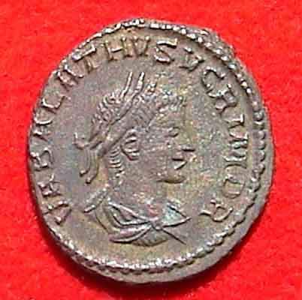
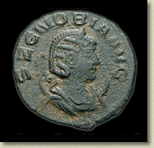
Vaballathus and Zenobia
Real power rested in the hands of Vaballathus’ mother Zenobia
Initially the Palmyrenes continued to recognize the central emperor

Slide 8
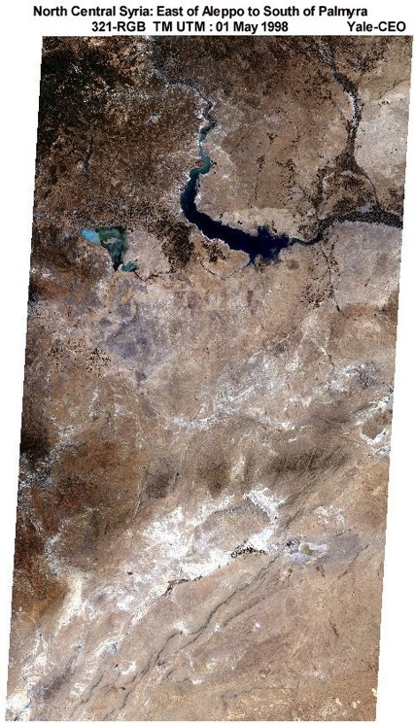
Palmyra’s economic position may have been declining
The city relied heavily on long distance trade coming from India through the Gulf and up the Euphrates, but conflict with the Sasanians seems to have ruined this trade
The Palmyrenes were also in conflict with a nomadic tribe called the Tanukh
The Palmyrene empire may have been an attempt to restore Palmyra’s position

Slide 9
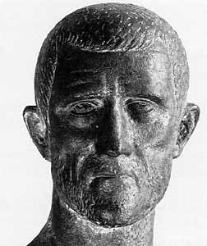
The central empire began to revive
In 270 the Palmyrenes attacked the province of Arabia and invaded Egypt and Asia Minor
The new emperor, Aurelian, refused to negotiate with Zenobia

Slide 10
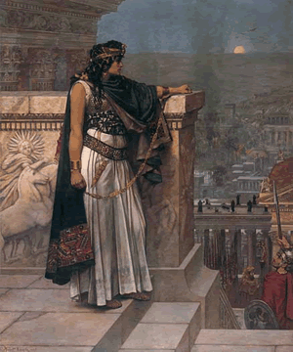
Zenobia proclaimed Vaballathus emperor, and herself empress
Aurelian invaded Syria and defeated her
Some Palmyrenes aided Aurelian
Zenobia was taken to Rome as a captive

Slide 11
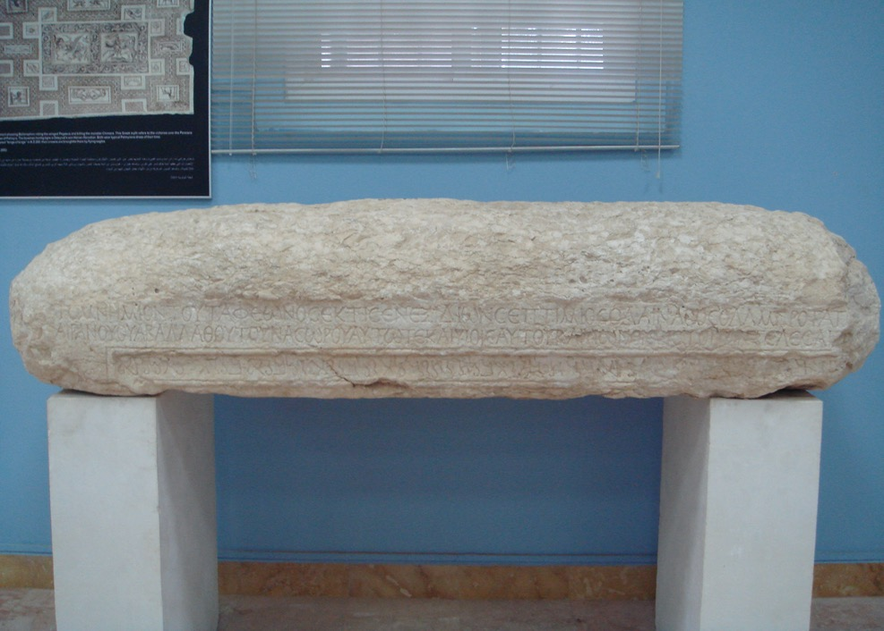
Materials for a history of the Palmyrene revolt
The career of Septimius Odaenathus

Slide 12
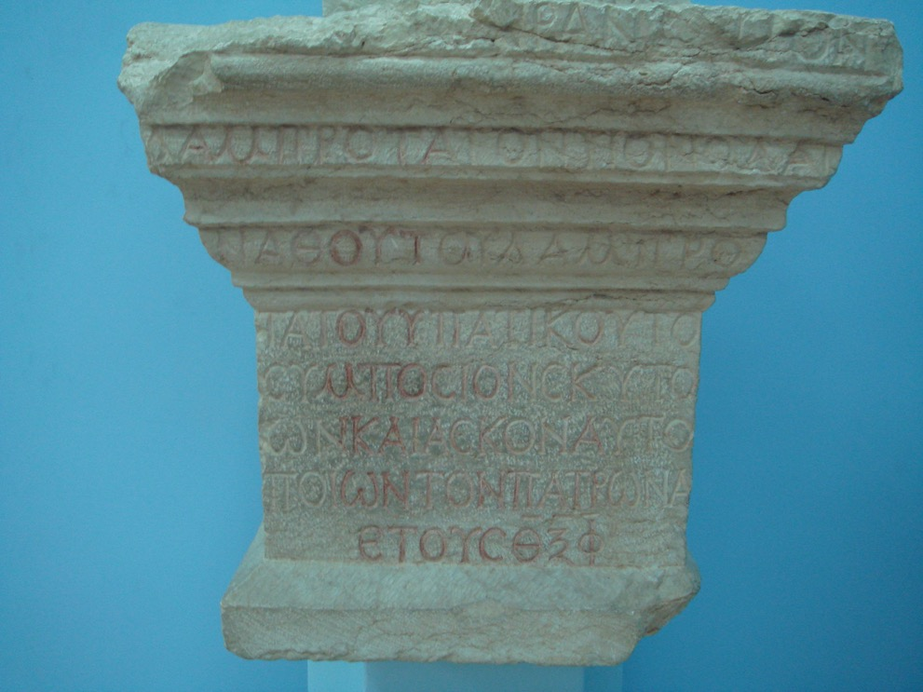
Dedication to Septimius Hairan

Slide 13
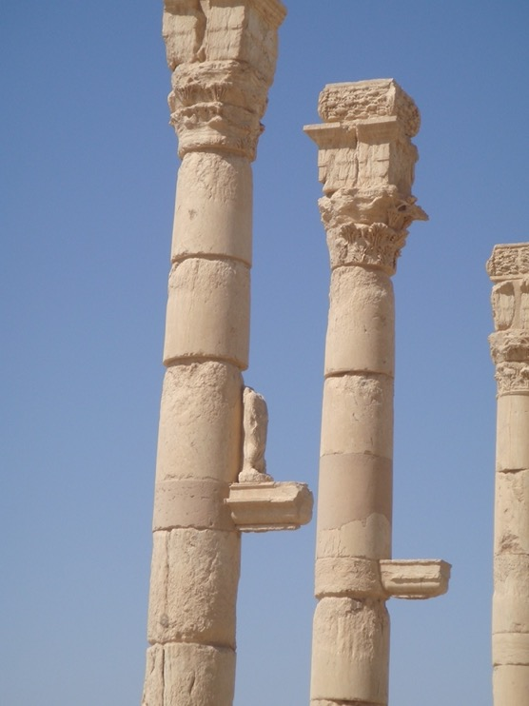
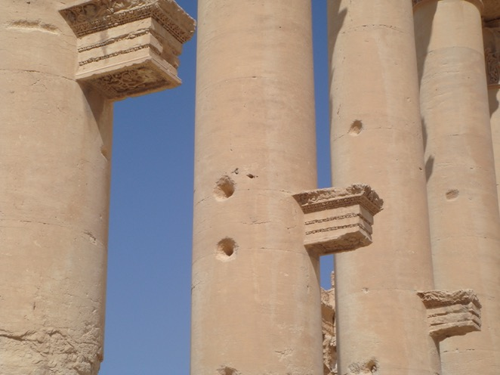

Slide 14
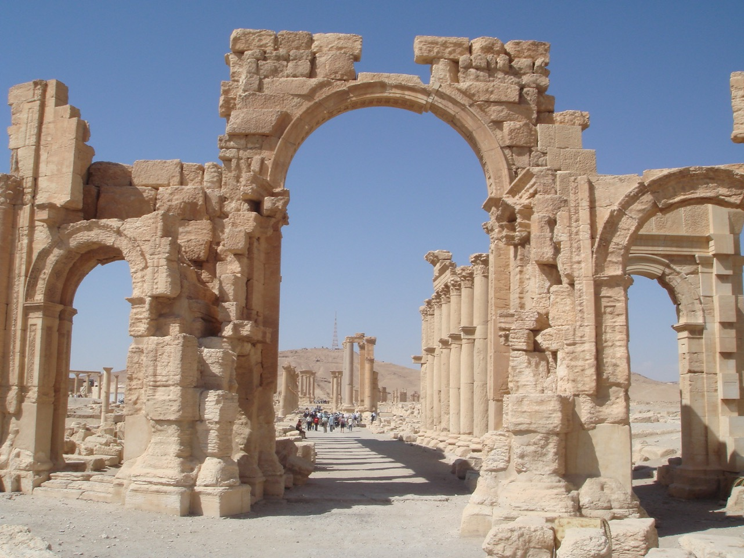

Slide 15
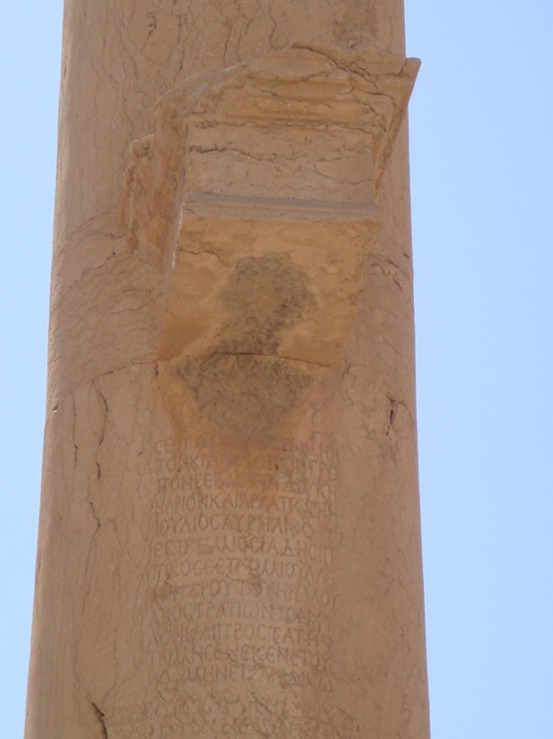
Septimius Vorodes

Slide 16
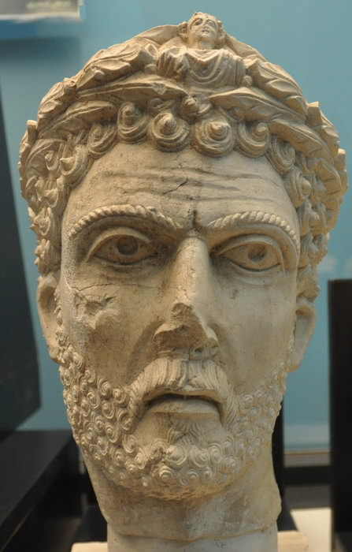
Portrait of Odaenathus?

Slide 17
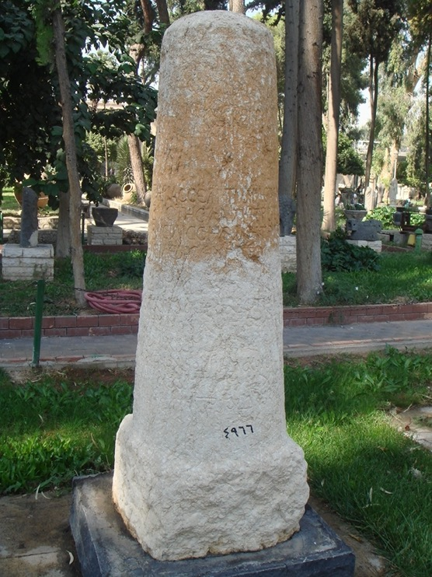
Vaballathus rules the east

Slide 18
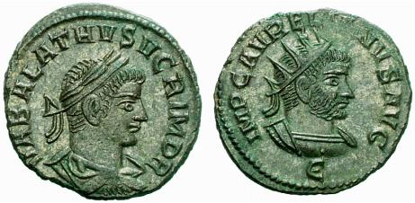
Coin of Antioch

Slide 19
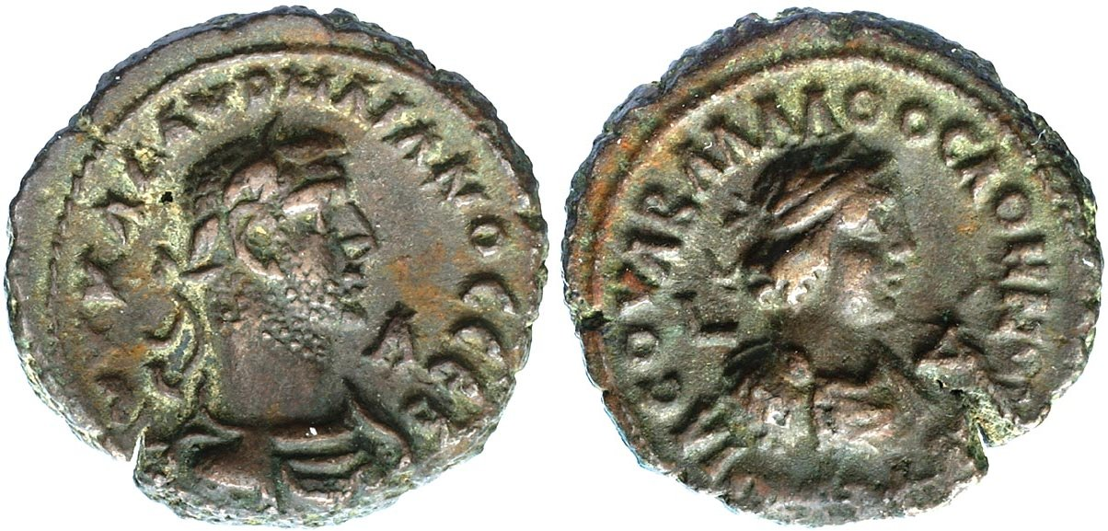
Coin of Alexandria

Slide 20
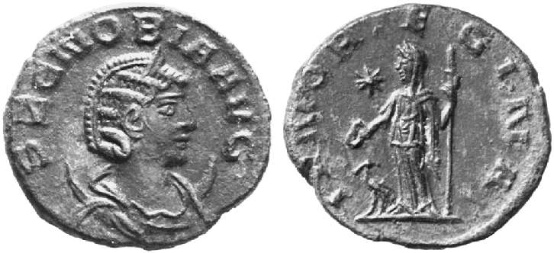
The rebellion of Zenobia

Slide 21
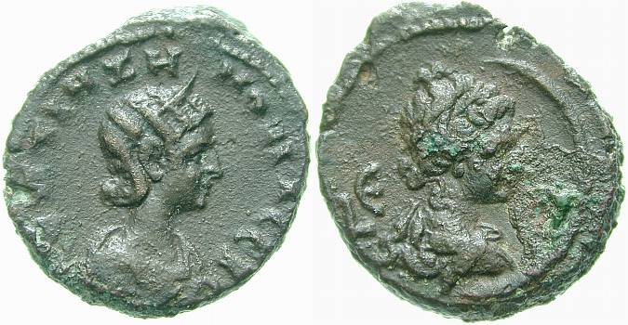

Slide 22
