Slide 1
Q800 – Going into your second year….
guidance, developing skills, challenges, your questions

Slide 2
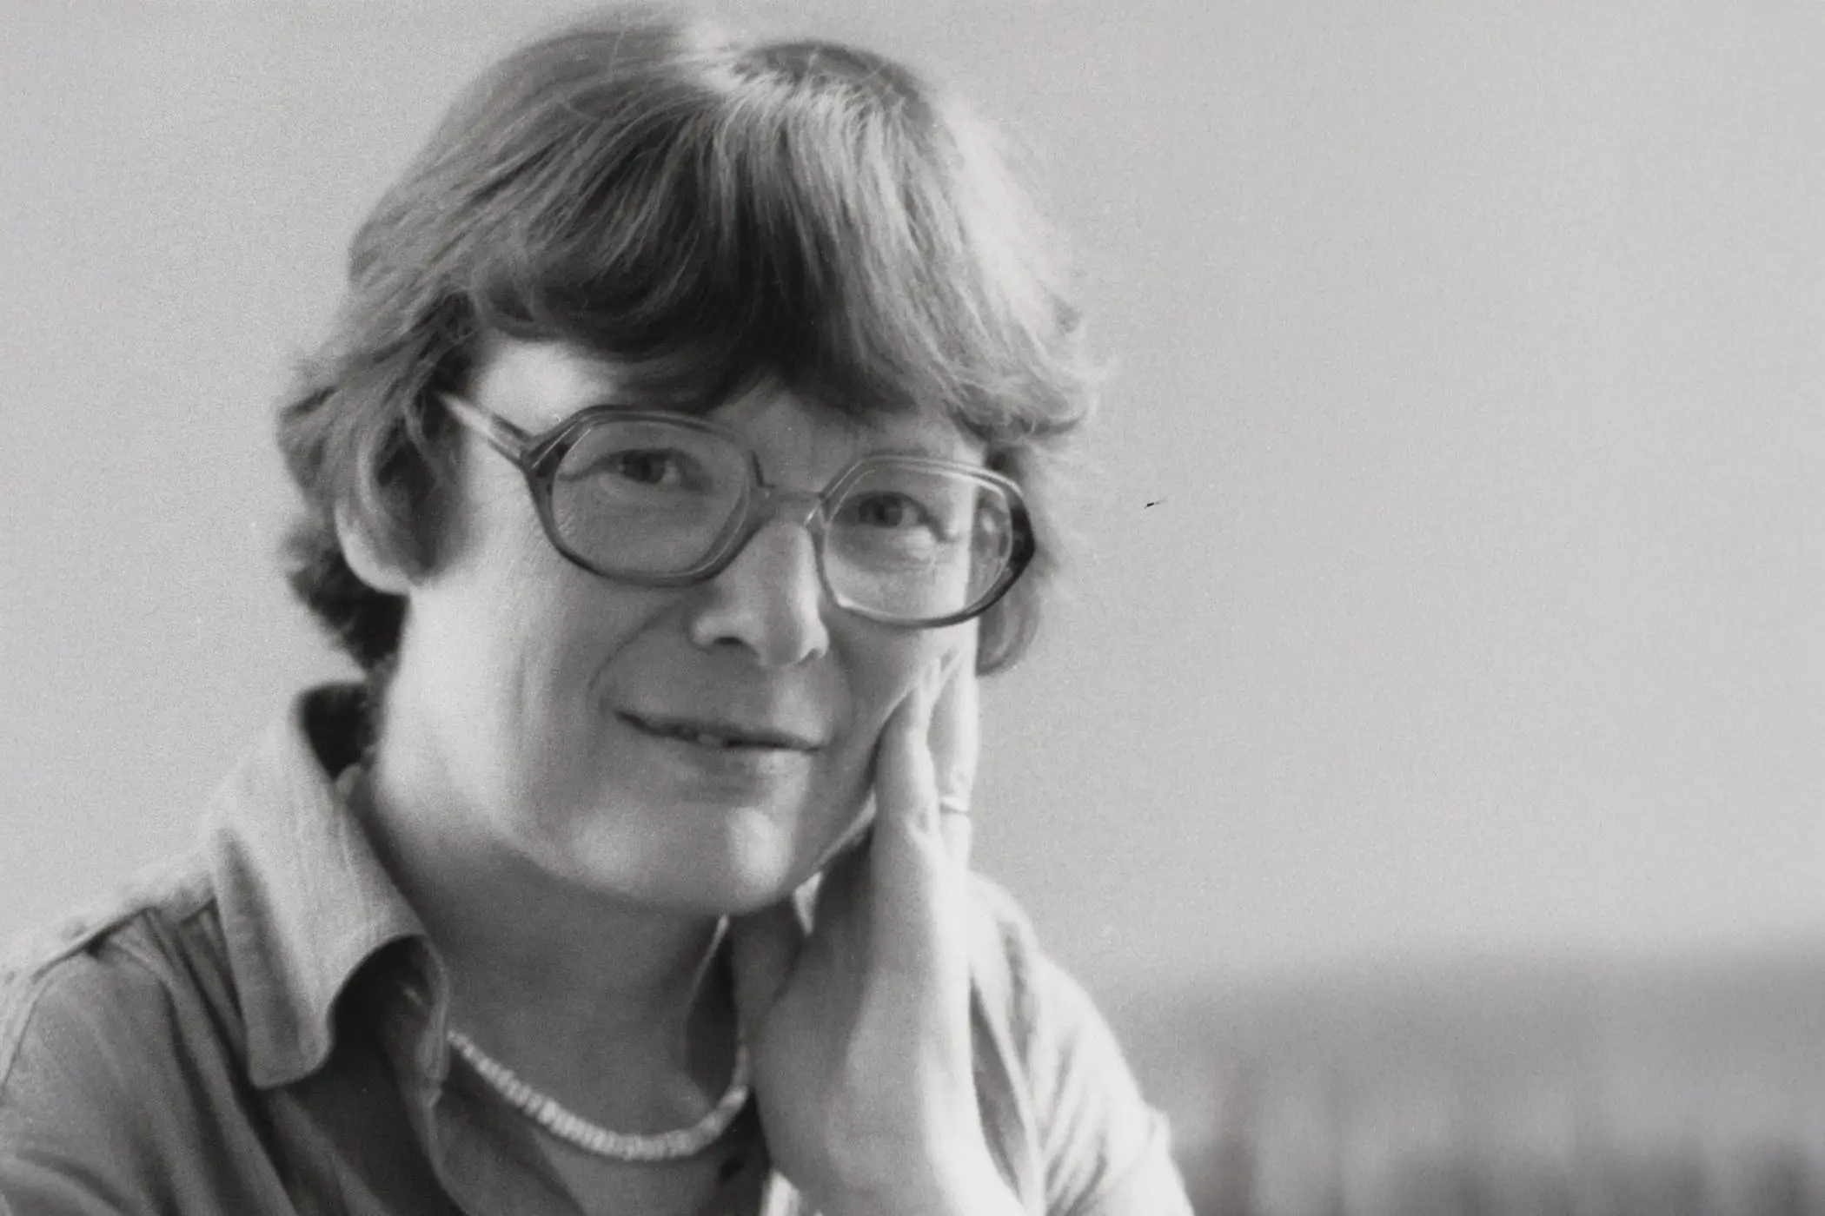
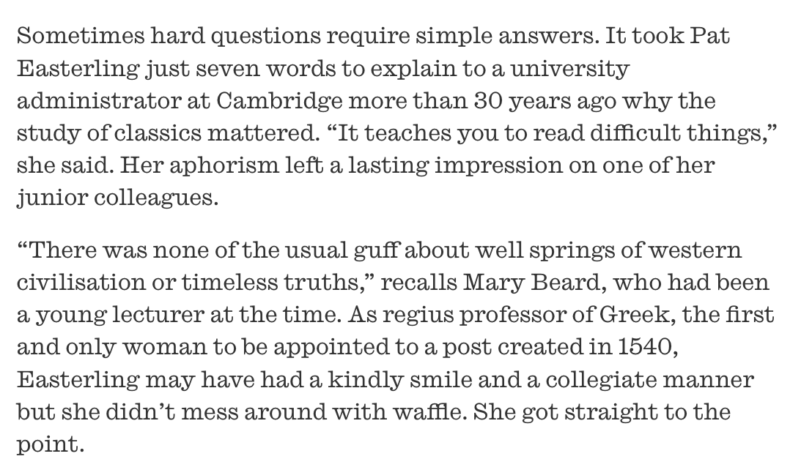
Embrace the challenge, with Pat!

Slide 3
Steps, leaps, changes, challenges
Both with and beyond GLT/LLT and intensive language-learning (focusing on individual texts and authors or on specific forms and structures of expression) to wide-ranging, thematic modules with a conceptual frame
Some honours modules (e.g. Greek Lyric, Question of Grief, Poetless Poems) involve new assessment methods
A much greater exposure to different genres, authors, forms, sources, across a wider historical period
More independent reading of Latin and Greek texts
Stimulus to develop more advanced skills in literary and cultural interpretation
Indeed: many of our latest honours modules in literature invite you to expand in both directions – within the classical period, and beyond the classical period, inviting you to think and engage directly with our research-led teaching (which is why we are here!)
Building on writing and communication skills (in the lead up to your final year, and dissertation work)
Asking more questions; engaging more confidently and critically with scholarship; mediating between critical positions; intervening in debates; going beyond description and summary

Slide 4
How many things can you do with a text?
(or how many things can a text do to you?)

Slide 5
Questions, questions, questions
What kind of text? Form, genre, style, metre, date and politico-historical context, location, author, persona, voice, audience, use, performance, reception, scholarly expectations…
Where are we? Plot, timing, time-layering, tenses, beginning/middle/juncture/end, speed, rhythm, narrative patterns (e.g. setting up the future/echoing or remaking the past), location, space, frame.
How is form working with content, and vice versa? What work is the text doing? …Interaction, illustration, performance, polyphony, paradox, visual/verbal/phonic/sensory.

Slide 6
Where do I begin and *end* with form?
When dealing with the verbal, look/listen for:
Rhythm, repetition (and where?), frames, phonic effects like assonance, alliteration, echo; word order; key words and word choice (why this word and not another?); tenses; conjunctions (or lack of them).
In poetry, metrical effects: e.g. specular shapes, rhymes and half-rhymes, speed or sluggishness, enjambement, lengthenings and shortenings, pauses, delays or postponements; rhetorical tricks and tropes.
Register, tone, diction, voice
Metaphor, simile, imagery.
Ambiguity, doubleness, hybridity, polyphony, puns, innuendo, untranslatability.

Slide 7
Interactions: the 3-D text
Vocabulary: allusion, intertextuality, echoing, borrowing, citation, quotation, interaction, influence, indebtedness, tradition, memory.
This passage/line/word alludes to
echoes
evokes
suggests
is reminiscent of
cites/ replays/remakes/reworks/ transforms/transfigures pays homage to
is indebted to/much influenced by

Slide 8
And the effect of all this is……?!!!
Think in terms of:
Interaction between form and content
(How) does it create levels of meaning, paradox, contradiction, disorientation? Or does it make emphatic, underscore, highlight, direct or re-direct?
A window onto what, with what stakes?
Humour
Politics
Power and authority
Timing, plot, teleology, narrative patterns
Temporalities of literary experience

Slide 9
Thinking critically, theoretically, comparatively
There is no such thing as an untheoretical interpretation
Politics is pervasive
Language is constitutive
Truth is provisional
Meaning is contingent
?Human nature is a myth?
Question and analyse the givens, the ‘natural’, the canonical: be suspicious about antiquity and what we think we know about it (whilst trying not to become paranoid readers!)
Join the dots between your modules: compare and contrast evidence, approaches, perspectives, in your study of the ancient world
Take up the opportunity to engage creatively with a wider range of secondary literature that discusses (or allows you to discuss) your texts and themes within broader comparative, critical-theoretical, frames

