Slide 1
1: Source Criticism (Gobbets)
https://warwick.ac.uk/fac/arts/classics/intranets/students/guidance/gobbets

Slide 2
Oxford English Dictionary’s Definition
A part, portion, piece, or fragment, esp. of something which is divided, cut, or broken.
A piece of flesh or raw meat; frequently in ‘to cut (also chop, hack, etc.) into (also in) gobbets’.
A piece or section of a literary or (less commonly) musical work removed from its context; spec. an extract from a text selected for translation or comment, esp. as part of an examination or course of instruction.

Slide 3
What is a Gobbet?
Gobbets are not essays — they are short explication of a passage or object, whereas essays are more general discussions.
The aim is to demonstrate your ability to understand, interpret, and interrogate the sources you come across.
What can we learn from this evidence? Why is it important? Is it trustworthy? How does it fit into the broader context?
Broadly, there are two types of ‘gobbet’ questions: ‘literary’ (in which you will be asked to comment on a written passage) and ‘picture’ (in which you will be asked to comment on an image).

Slide 4
General Advice
Read the passage at least twice. Read the caption.
Underline any names, places, dates, key information that you think might need defining.
Highlight/circle any details that might be unusual or interesting.
Think about other things you could compare this passage/object to. Is this a standard example? Why, or why not?

Slide 5
General Advice
Make sure every point is related to a detail about the passage/object you are given.
Remember to analyse and evaluate, not just describe!
Time is key, don’t waste it!

Slide 6
General Structure
Introduction (context)
Point 1
Point 2
Point 3 (if time/space allows)

Slide 7
Literary Gobbets – Introduction (Context)
Author, genre, work, date, historical context.
Who wrote it? What is their background?
What kind of work is it? What might we expect from such a text?
When was the passage written?
If the passage describes a historic event, when was this? And when was the author writing?
How does this passage fit in the work it appears in? What is the work about? What comes before? What comes after?
If the passage is direct speech, identify the speaker.
Is there anything in the passage (e.g., names, technical terms) that you think need describing/explaining?

Slide 8
Literary Gobbets – Introduction (Context)
[In drama] stagecraft and scene-setting;
[In narrative works] place in the plot and narrative development;
[In speeches and rhetorical works] logical and rhetorical structure (argument, coherence);
[In historiography] historical / mythological events and persons; elements of historiographical style; relation to/development of previous historiographical tropes if relevant;
Intertextuality / allusion - significant remodelling of earlier literature (some obvious examples: Aeschylus reused by Euripides; Homer in Virgil);
Any relevant literary conventions which determine the overall character of a passage - e.g. hymn-style, catalogue, supplication-scene, messenger-speech, priamel, panegyric, ekphrasis, locus amoenus, paraklausithyron, propemptikon, stichomythia.

Slide 9
Literary Gobbets – Thematic Paragraphs
What is interesting, different, or important about this passage?
Detailed examples of the elements you identified in the introduction, specifically keyed to the wording of the passage.
Think both within and beyond the work the passage belongs to.
Does something important to the plot/characters happen in this passage? How does this passage fit with the general themes of the work?
Is this typical or unusual of the author/genre/period? How/why? What other works might you compare it to?
Can we trust the information in this passage? Why or why not?

Slide 10
Literary Gobbets – Thematic Paragraphs
2-3 ideas: don’t go overboard!
You don’t need to comment on every detail, just whatever you think are the most interesting points.
You won’t be able to talk about everything – be selective!

Slide 11
Literary Gobbets – Thematic Paragraphs
Literary techniques to pick up on:
Metaphor and related figures (simile, personification, etymological play, metonymy);
Verbal style (general linguistic register, unusual/colourful vocabulary); [Esp. for students working with texts in the original language]
Word order (e.g. artistic rearrangement of natural order, esp. in poetry); [Esp. for students working with texts in the original language]
Metrical effects, where possible. [Esp. for students working with texts in the original language].

Slide 12
Picture Questions - Introduction
What type of object is it? What are its features? What is its purpose?
Do we know who made/designed it? When/where was it made? Who used it? What is its style? Who was its audience?
Think of historical context.
Where is the object now (museum, in situ)?
What is the condition of the object? Has it been repaired?
What angle can we see it from? How much of it can we see? Is there another side of it that we can’t see on the photo/drawing/model?
If the object is decorated, describe the decoration.

Slide 13
Picture Questions – Thematic Paragraphs
Is this a typical example of the object/period/designer/location? Why or why not?
Is this an innovative creation? Did its function change its society?
Is the object decorated in a special way? Does its decoration tell us something about how a particular story/event was received?
How does it relate to other comparable objects?
Not just form or function, also time, place, designer, etc.
What can we learn from this object?
Imagine discovering it for the first time – how would it change what we know/believe about the ancient world?

Slide 14
Checklist
Literary Gobbets
Have you identified the author?
Have you identified the literary genre?
Have you located the passage in the historical work in which it appears?
Have you located the episode in its historical context?
Have you explained the details necessary to understand the passage (people, places, etc.)?
Have you explained why this passage is significant?
Have you checked whether it relates to other source material?
(For gobbets in the original language) Have you thought about the style and manners of expression?
Picture Questions
Have you described and explained the features of the object?
Have you dated the object?
Have you located the episode in its historical context?
Have you commented on how typical or distinctive it is?
Have you checked whether it relates to other source material?

Slide 15
Marking Criteria
A 1st class answer will identify the item and its context with precision show a high degree of knowledge of its wider context and a high degree of ability to critically analyse any points of interest.
An Upper 2nd class answer will satisfactorily identify the item and its context and show good knowledge of its wider context and a good level of ability to critically analyse any points of interest.
A Lower 2nd class answer will indicate some knowledge of the item and its context and make sound observations about its content.
A Third class answer will provide some indication of knowledge about the gobbet and its pertinence.
A Near Fail (32. 38) answer will provide a very little indication of knowledge of the gobbet and/or its pertinence.
A mid-Fail (25) will provide no indication of knowledge of the gobbet and/or its pertinence but will indicate some knowledge of material relevant to the paper.
A Low Fail (12) will provide no indication of knowledge of the gobbet and/or its pertinence but will indicate some knowledge of material relevant to the course.
Complete fail (0) - no material submitted

Slide 16
Examples
Plutarch, Pompeius 42.13
But that divine agency which always takes pains to mingle with the great and splendid gifts of fortune a certain portion of evil, had long been secretly at work preparing to make his return a very bitter one. For Mucia his wife had played the wanton during his absence. While Pompey was far away, he had treated the report of it with contempt; but when he was nearer Italy and, as it would seem, had examined the charge more at his leisure, he sent her a bill of divorce, although he neither wrote at that time, nor afterwards declared, the grounds on which he put her away; but the reason is stated in Cicero’s letters.

Slide 17
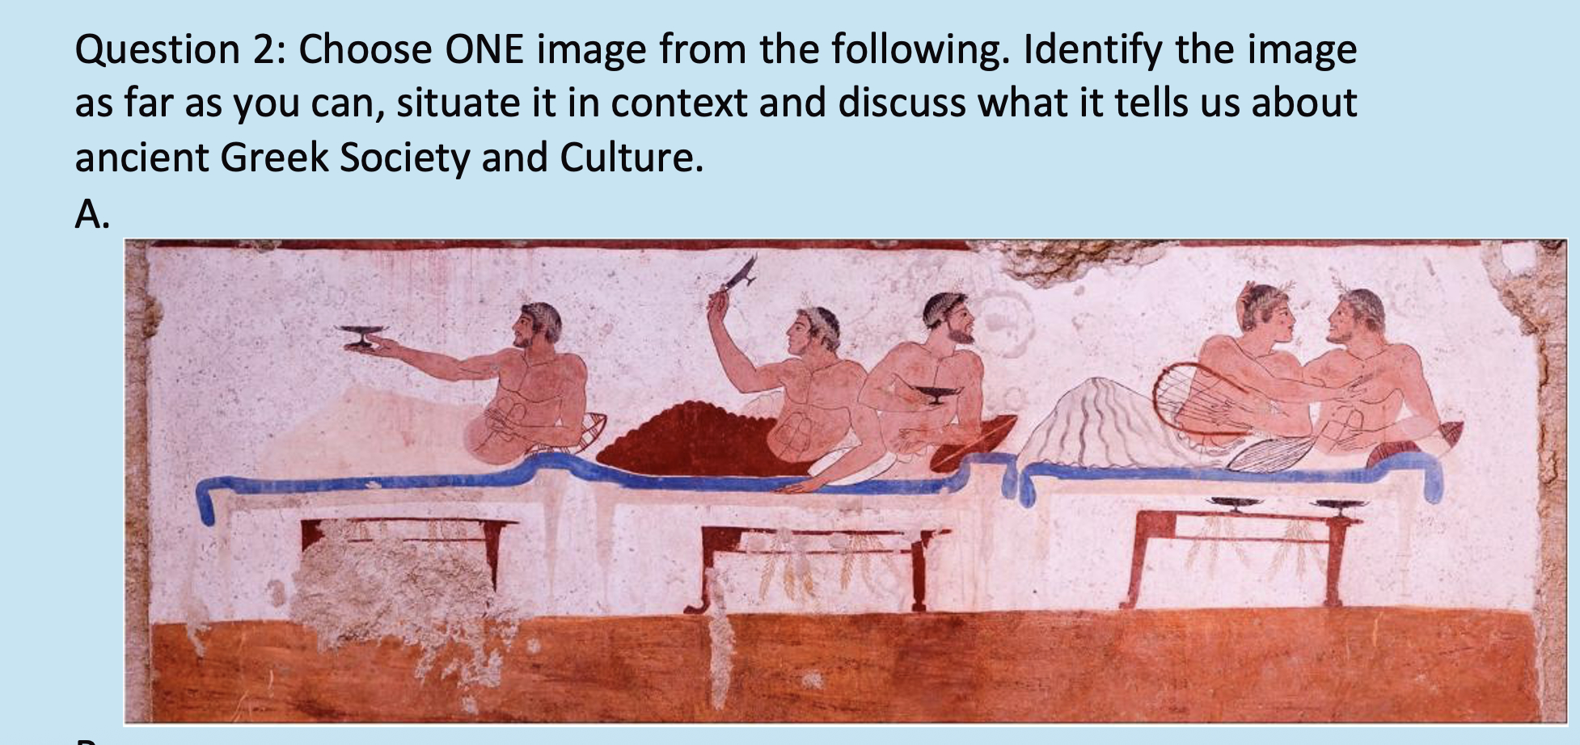

Slide 18
Recap
A gobbet is not an essay, but a test of your critical reading of sources.
Show understanding of what you are asked to look at as well as how it fits with its context.
Don’t just describe!
Briefly give the context, then 2-3 points on the significance.
Use your time wisely!

