Slide 1
2: Finding and Using Primary and Secondary Sources

Slide 2
Aims and Objectives
Distinguish between primary and secondary sources.
Discover resources to find primary sources relevant to what we are looking at.
Discuss how to approach primary sources critically.
Share tips on finding/using primary sources.
Discover resources for finding scholarship relevant to our research.
Discuss how to approach secondary literature and how to incorporate it into our essays.

Slide 3
Primary or Secondary – what’s the difference?
Primary: immediate, first-hand account from people who had a direct connection.
Secondary: based on (multiple) primary sources, removed from the time, people who did not witness the events they describe.
  Scholarly works, histories (written in modernity), literary analysis, textbooks.
  Archaeological reports, reconstructions, documentaries.

Slide 4
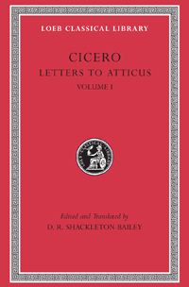
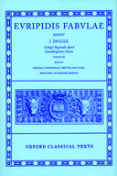
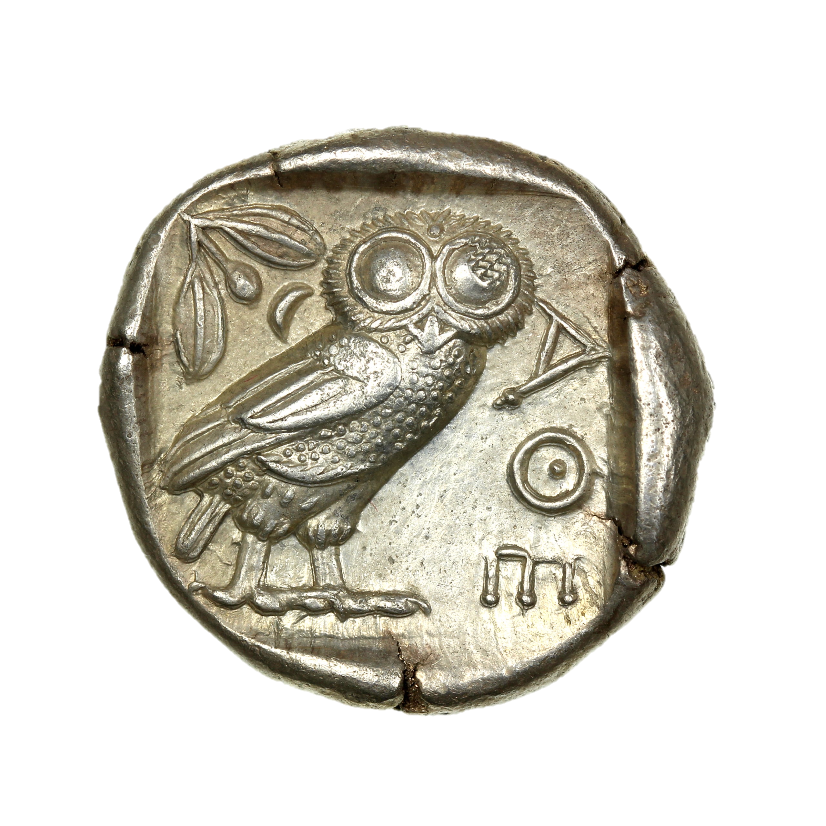
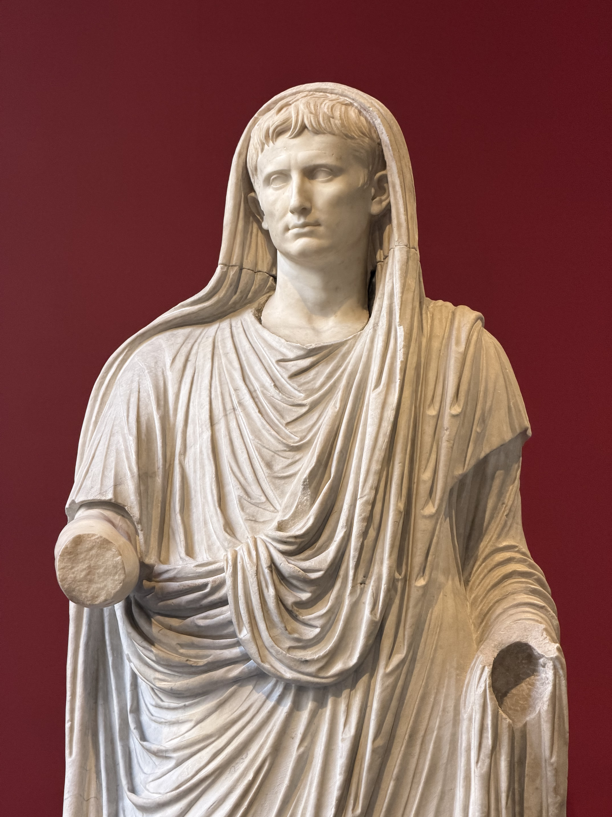
Primary Sources
Literature, poetry, plays, history (written in antiquity), letters, speeches, philosophy, papyri.
Coins, inscriptions, statues, buildings, pottery, art, archaeological evidence.

Slide 5
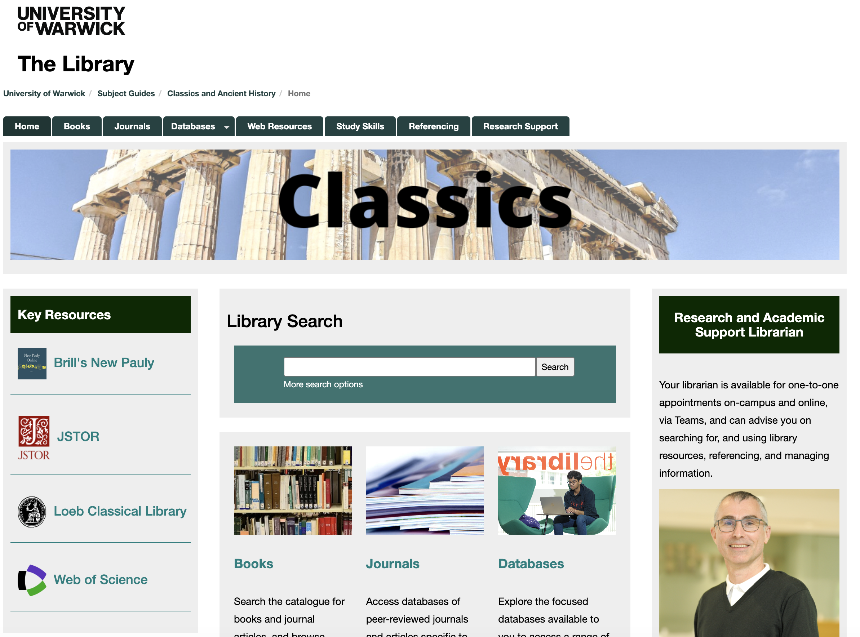
Finding Sources – libguides
UoW Library’s subject support guide – links to various useful resources for primary and secondary sources.

Slide 6
Finding Primary Sources - Literature
Attalus.org – gives lists of events by year and ancient sources, runs from 323 – 20 BC.
Internet Ancient History Sourcebook – gives thematic lists linked to place/period of study (N.B.: not all links work properly).
IntraText – full-text versions of several Latin works.
LacusCurtius – full-text versions of several ancient sources and translations.
Loeb Classical Library – online access to Loeb texts with facing translations.
Perseus – catalogue of ancient texts (both in original language and in translation) with parsing tool (to be used with caution) and database searching.
The Latin Library – online collection of Latin texts.
Thesaurus Linguae Graecae (TLG) – online collection of Greek literature.
University of Washington Research Guide – links to other databases.

Slide 7
Finding Primary Sources - Coins
Coinage of the Roman Republic Online (CRRO) and Online Coinage of the Roman Empire (OCRE) – browsable and searchable catalogue of Roman coinage.
MANTIS – Greek, Roman, and Byzantine coins from the American Numismatic Society database.
Roman Provincial Coinage (RPC) Online.
Sylloge Nummorum Graecorum – records and images of 25,000+ coins from the Sylloge Nummorum Graecorum in British collections.
Physical coin catalogues are also available in the library.

Slide 8
Finding Primary Sources - Inscriptions
Epigraphik-Datenbank Clauss/Slaby (EDCS) – searchable database for Latin inscriptions.
Roman Inscriptions of Britain (RIB) – searchable and browsable online database of the printed RIB.
PHI Searchable Greek Inscriptions – searchable and browsable database of Greek inscriptions, sorted by region.
Attic Inscriptions Online (AIO) – English translations of inscriptions from Athens and Attica.
Supplementum Epigraphicum Graecum (SEG) – online version of the SEG, published annually.
L’Année Épigraphique – journal published annually, available online.
Physical inscription catalogues are available in the library, e.g. Corpus Inscriptionum Latinarum (CIL), Inscriptiones Latinae Selectae (ILS).

Slide 9
Finding Primary Sources – Art
PompeiiinPictures – database of images from Pompeii and Campania.
Beazley Archive Pottery Database (BAPD) – largest database of ancient Greek vases.
Lexicon Iconographicum Mythologiae Classicae (LIMC) online – searchable database of depictions of mythical figures in ancient art.
Artstor – searchable database of images from museums around the world.
Museum collections: British Museum or Ashmolean Museum.
Portable Antiquities Scheme: archaeological small finds from Britain.

Slide 10
Using Primary Sources
What are the limitations we need to consider?
Author, artist, designer, minter, etc.
  Can we learn more about this person/people?
Date of creation
  Do we know exactly when it was produced? Why does it matter?
Form/material
  What does this particular form not tell us? Is there something that cannot be communicated by the medium from which we have access to it?
How has it survived?
  Do we have it in its entirety? What might be missing? Has something happened to it in its history that has changed it? Has it been restored?

Slide 11
Using Primary Sources – Tips
Keep a factfile on ancient authors.
  Include name, dates, works, place(s) lived, any interesting or relevant facts, etc. If you want a brief overview, look on Oxford Classical Dictionary.
Keep a record of where you found something.
  Which website/book you saw it in so you can find it again in the future.
Browse with purpose.
  Endlessly scrolling through pages of (e.g.) coins gets boring very quickly. If you look with something in mind, you can keep focused more easily. Also, use the advanced search functions for a more specific set of results.
Use your secondary sources as a guide.
  What primary sources do they use? Look them up yourself and see if you agree with what the author says about them.

Slide 12
Useful Tools
Pleiades – map searchable by ancient place names.
Orbis – calculates journey length and duration in the ancient world.
Digital Prosopography of the Roman Republic – searchable database of main political figures of the Roman Republic (509 – 31 BC).

Slide 13
Secondary Sources
Anything written by scholars (books, articles, etc.).
  This also includes works that don’t refer to the ancient world (e.g. theoretical works).
Archaeological reports, analysis of primary evidence.

Slide 14
Finding Secondary Sources – General
Module Reading Lists – great for introductory reading for specific modules.
Oxford Bibliographies Online – search for bibliographies on a variety of topics, ancient and otherwise (also helpful for finding the best editions of ancient texts).
L’Année Philologique – similar to the above.
Oxford Classical Dictionary – gives brief overview and some bibliography for ancient topics/people/terms.
Brill’s New Pauly Online – similar to the above.
Theoi Greek Mythology – encyclopaedic entries for mythological characters.
Web of Science – search for keywords in titles of newly released articles/books.

Slide 15
Finding Secondary Sources – Archaeology
Archaeology Data Service – repository of archaeological data.
BAR Digital Collection – collection of archaeological reports published by BAR.
Fasti Online – record of archaeological sites since 2000.
Digital Augustan Rome – map of ancient Rome with information about topographical sites.

Slide 16
Finding Secondary Sources
Check the footnotes and bibliographies in articles/books you have already read.
  This will also help you to understand a bit more about the ideas that article/book was working with.
You might find works in languages other than English…
  Don’t worry if you can’t speak that language!
  Look for review articles that summarise the arguments being made to give you an idea of what it is about (Bryn Mawr Classical Review, most journals will have a ‘reviews’ section).
If you find a book/article that we don’t have in the library and can’t access online, use the library’s Get It For Me service.
  N.B.: this can take a few days, so make sure you order it well in advance of any deadlines!

Slide 17
Using Secondary Sources
What is the argument being made?
  How does it use primary sources? How does it refer to other scholarship?
  Do you find it convincing? What are the flaws in the argument? Has it oversimplified a concept that you think could be more nuanced?
Question everything! Don’t just assume that this person knows more than you!
  Views change over time as new evidence/ideas emerge, so there’s a good chance you know something the author didn’t.
Check the footnotes for the sources being used, make sure they are using them properly!
  Is the author skating over something you aren’t really familiar with? It might be worth having a skim read of the works they have cited.
  Is the author making any claims that aren’t backed up by evidence?

Slide 18
How to incorporate scholarship into your essays
Summarise
  (e.g.) As [author] explains, …
Quote
  (e.g.) According to [author], “…”
Footnotes
  (e.g.) ¹ Author (20xx) pp writes that …
Then analyse!
  Show the marker that you are aware of the debates at stake, then explain how your ideas fit with them.

Slide 19
How to incorporate scholarship into your essays
Highlight previous approaches in your introduction, then state how your approach is different.
  (e.g.) [Author 1]’s argument that … was rejected by [author 2], who proposed that … I will demonstrate that … by …
Don’t just state what someone else says, analyse it!
  Do you agree or disagree? Why or why not?
  Can you add to/improve their argument? Can you think of any responses to shortcomings?
  Does it sufficiently respond to other scholarship?
  How does it relate to the question you are trying to answer?

