Slide 1
Essay Planning and Writing
How to approach and structure essays

Slide 2

What are the aims of essay writing?
Present a coherent argument on a topic, based on primary evidence and secondary scholarship.
Not just showing knowledge – you should be selective in your material to show that you are properly engaging with the question.
You are expected to present your own thoughts on the topic (the more original, the better!).
Essays test your ability to analyse what you read, criticise sources, and evaluate arguments. What do you think and why?

Slide 3

Plan your time
Check your deadlines at the start of term.
You may have two due close together (or even on the same day!).
When will you need to start researching/planning/writing each essay?
Remember to give yourself a bit more time than you think!
How can you make sure you keep up with your timelines? What motivates you?

Slide 4
Choosing a title
Read all the titles available. Which one is most interesting to you? Is there one that isn’t as appealing?
Don’t be put off by titles that seem ‘hard’ – sometimes these lead to the most interesting essays!
Don’t be led by the question – examine and scrutinise what the question is asking you.
Think about the question in a new light, but don’t stray too far from the question.
What are the key terms of the question? What themes does the question pick up on?

Slide 5
Question words
Account for – explain
Analyse – break down into parts and examine the relationship between
Appraise or Assess – decide the importance of, judge the worth of, give the advantages and disadvantages of
Comment – make pertinent remarks, whether factual or evaluative, based on evidence
Contrast – set into opposition to bring out differences
Define – give the precise meaning of
Discuss – examine by reasoned argument and reference to the facts; consider the implications or characteristics of
Evaluate – make a judgement using specified criteria, eg. reason and/or available facts
Examine – investigate or inquire into in detail
Explain – make clear; give reason for; set out in detail the meaning of
Explore – examine by going through
Illustrate – make clear by giving examples
Justify – present adequate grounds for
Reconcile – make compatible that which is apparently in conflict
Relate – show how things are connected to each other
State – present clearly
Summarise – give a concise account of the essential points
Trace – follow the development of, from some point of origin

Slide 6
Examples
(GCS) What do we learn from Aristophanes’s Ecclēsiazusae [‘Assemblywomen’] about women in late-fifth century Athens?
(RCS) Was there a place for regional identity (e.g. Gallic, Syrian) in the Roman world? Use examples from a specific site or region to support your answer.
"Romans were merely borrowers of Greek culture." Do you agree? Use specific examples to support your argument.

Slide 7
Planning your essay
Read your notes, refresh your memory. What are the big ideas of the module and how does the question relate to them?
What is your main argument going to be?
List 3-4 different ideas that build your argument. These will be your main points.
What are the primary sources that support your argument?
Who are the scholars who agree with your argument? Does anyone disagree?
Introduction, 3-4 main points, conclusion.

Slide 8
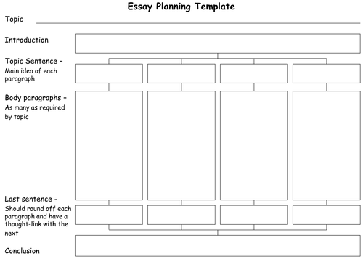
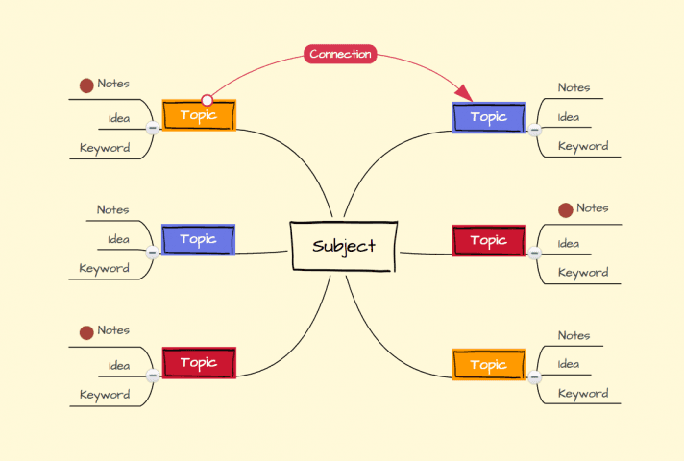
Essay planning – what works for you?

Slide 9
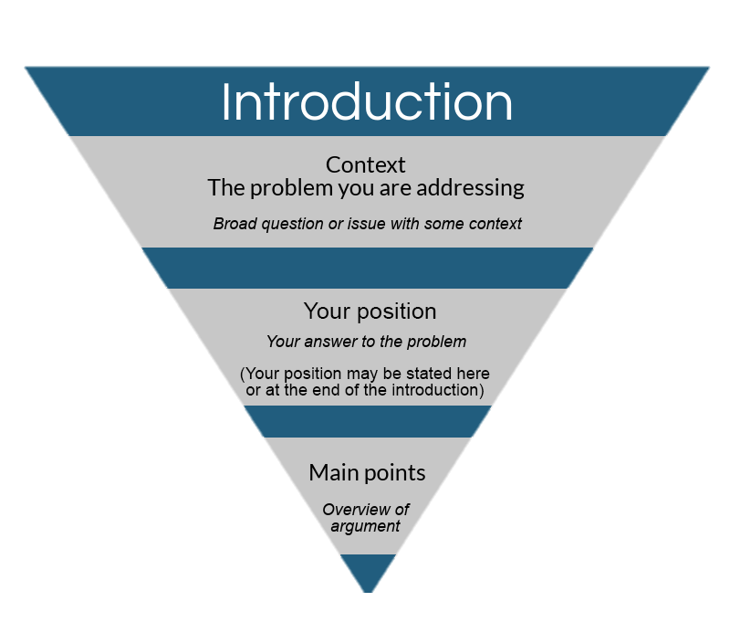
Introduction
Brief context/background of the topic.
Explain any keywords in the question.
Define or open up multiple definitions, but don’t leave it too open-ended.
What is your interpretation of the question?
How are you going to answer the question?
Give a quick outline of your main points and what approach you will take.
Indicate what your answer will be without giving too much away.
You may choose to write this first to provide some focus, or you might find it easier to write the introduction (and conclusion) last.

Slide 10
Main paragraphs
Usually 3 or 4 main points, organised into paragraphs.
One point per paragraph.
Usually, your strongest point will be kept for last.
Develop your argument with every paragraph: each point should build upon the last.
Keep the points relevant to the question and don’t go too far off track.
Be selective – you won’t be able to write about everything you know about a topic, so choose your ideas wisely.

Slide 11
Writing body paragraphs
Point
Briefly introduce what this paragraph is about. How does it relate to the previous paragraph? Use signposting words.
Evidence
Introduce your sources for why you think this.
Analyse your sources: what can they tell us (explicitly and implicitly)? Don’t just quote!
Evaluate your sources: is this a reliable source, what are its limitations?
Explain
Explain why the evidence brings you towards the point you made at the start of the paragraph.
What have others said about this evidence or the topic more generally? Do you agree or disagree with their interpretations? Explain why.
Link
Link your argument to the question: how does this paragraph answer your question? How does it build on what you have already shown and why is it important?

Slide 12
Cohesion between body paragraphs
Use your first and last sentences to situate your argument.
First sentence refers to what came before and how this paragraph progresses your argument.
Last sentence summarises what has been said in the paragraph and how that relates to the question.
Signpost:
First/Firstly, To begin with, Second/Secondly, Afterwards, Next, Then, Following this, Finally, Lastly, …
As well as, In addition/Additionally, What is more, Besides, Also, Further, …
Similarly, Likewise, Correspondingly, Complementary to this, …
In contrast, In comparison, However, Rather, Conversely, Instead, Whereas, On the other hand, Even so, Otherwise, Alternatively, Despite this, Actually, Nonetheless, Nevertheless, That aside, While this may be true, And yet, Notwithstanding, Then again, On the contrary,…

Slide 13
Conclusion
Re-state your answer to the question.
Summarise your arguments, how they build on each other, and how this answers the question in the way you claim it does.
Show that you have answered the question in the way you said you would in the introduction.
Do not add any new evidence, you should have already done this in your main points!

Slide 14
Marking Criteria
Presentation:
Marks awarded for good English expression and correct presentation of footnotes and bibliography;
Marks deducted for poor presentation, including poor grammar and spelling.
Clarity of analysis:
Marks awarded for work which is organised coherently on the basis of arguments.
Marks deducted for work which is incoherent or presents a mass of amorphous material.
The case being argued should be clear to the assessor in every paragraph.
Primary data:
Marks awarded for good use of a range of ancient texts and other materials (inscriptions, images, coins, archaeology, etc.), pertinent quotation and for thoughtfulness about its usefulness as evidence.
Marks deducted for unsubstantiated arguments and opinions.
Don’t use quotations of primary materials or images merely as illustrations. Think about what contribution they make to your argument, what role they play as evidence, where the producers of the text or artefact are 'coming from’.

Slide 15
Marking Criteria
Secondary material:
Marks awarded for isolating the main issues and debates in modern scholarship on the subject.
Marks deducted for overdependence on a single unquestioned modern authority.
Think also about where modern scholars are 'coming from’ (e.g. by reading reviews of their work from the websites of JSTOR, BMCR, or Project Muse).
Marks will not be awarded for essays that consist mainly of quotations from secondary sources instead of your own words.
Originality and Sophistication:
Marks awarded for thoughtfulness, well-founded scepticism and original ideas which attempt to surpass the issues and debates found in modern discussions in order to take the argument in a new direction.

Slide 16
