Slide 1
Corinthian Pottery
New styles developed in Corinth from 725 BC
Characterised by growing list of motifs
Whereas humans in Corinthian style are rare
Distinguishable from repetitive friezes
Caused Athens to begin their Athenian style pottery

Slide 2
Paspalas
Geometric pottery of Corinth from 9th C BC – was to serve local demand.
Although piece could and certainly did travel.
Characterized mainly by its distribution, primarily to the west.
Latter part of the 8th Century Greek entered the Orientalizing phase.

Slide 3
ProtoCorinthian
Dated 720-690 B.C
Innovations included:
New curvilinear motifs
More life like fauna
Often saw figures rendered in outline next to other painted in silhouette
Usually pots are miniature in size
First to decorate in black figure

Slide 4
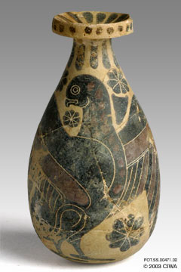
Pyriform Aryballos, Corinth 700-660 BC

Slide 5
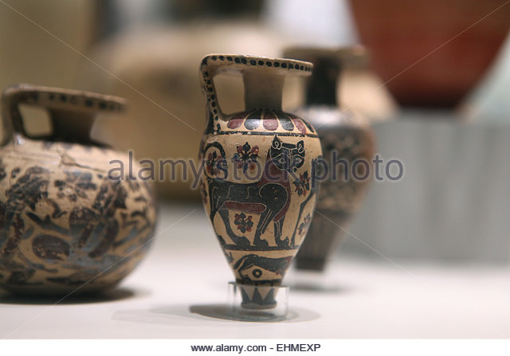
Circa 700 BC

Slide 6
Middle Protocorinthian Period (690-650)
Introduction of incision.
For detail
Supposedly at this time Black Figure did not exclusively “hold the field”
Mid 7th Century - Painters of small vessels introduced “brown wash” for human flesh
Use of Animals continues.

Slide 7
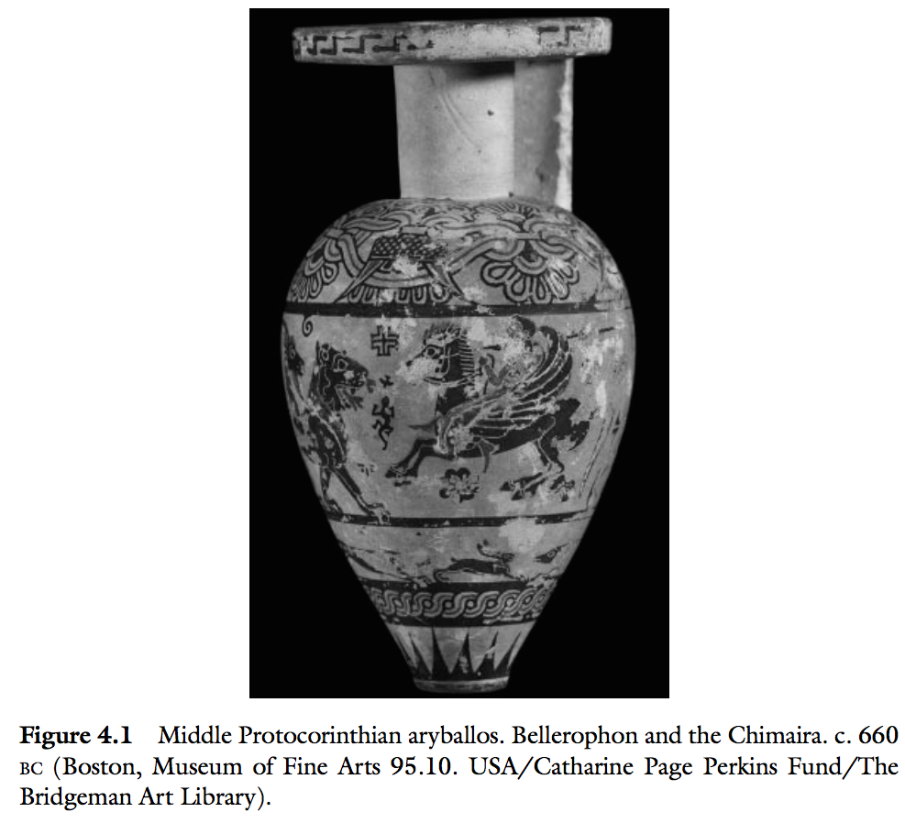
Animals…”may have even been used to comment through simile, in a fashion comparable to Homeric usage (Benson 1995). Such interpretations stress that figured pots were not simply decorated vessels, but were meant to engaged with knowledgeable users.”

Slide 8
Late ProtoCorinthian and Transitional c 650-615/10
Again characterized by animal friezes.
The “Background” ornaments, become more prominent
In comparison animals become “slipshod”
Mass Production

Slide 9
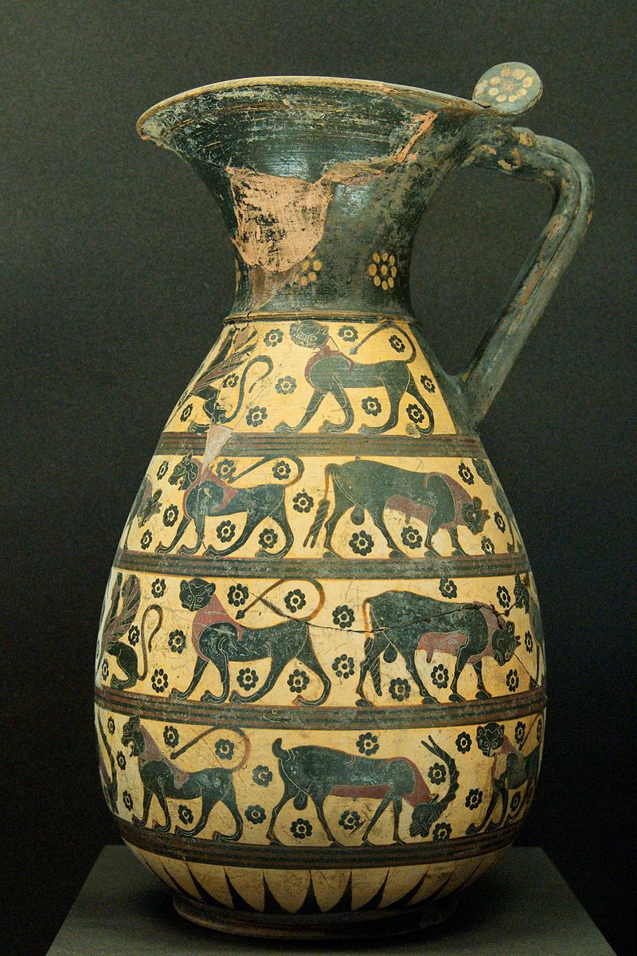
Proto-Corinthan Olpe 635 BC

Slide 10
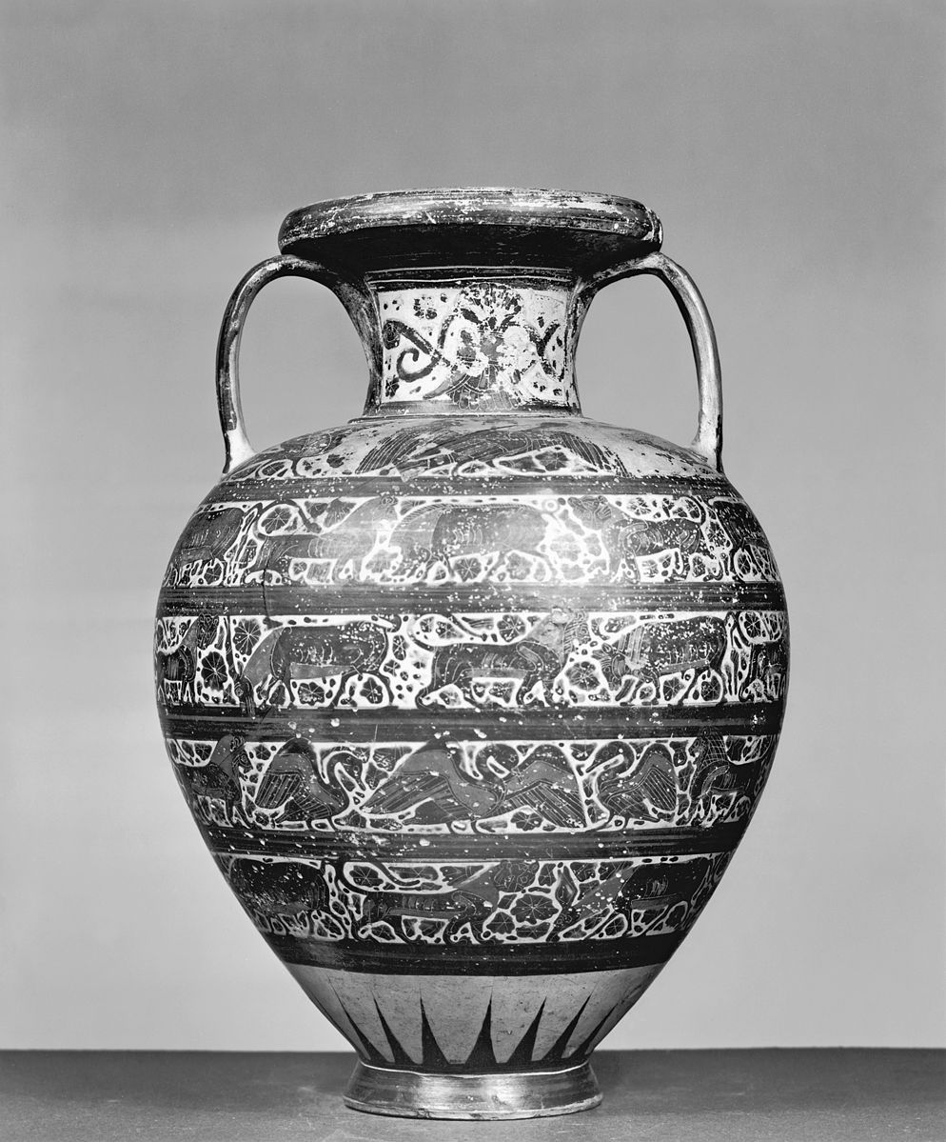
Early Corinthian Amphora with Animals
Dated to 625 – 600 BC

Slide 11
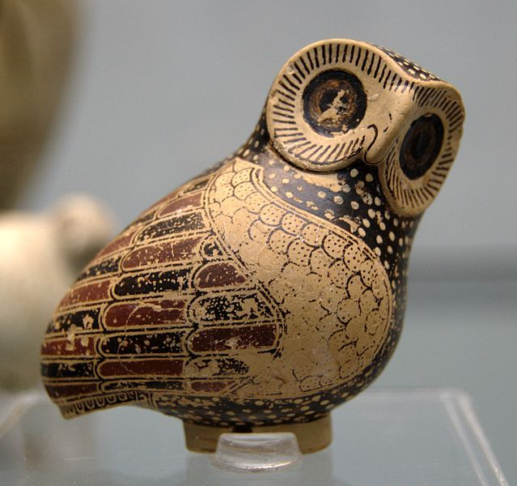
Proto-Corinthian Owl Aryballos c.630 BC
An aryballos (Greek: ἀρύβαλλος; plural aryballoi) was a small spherical or globular flask with a narrow neck used in Ancient Greece. It was used to contain perfume or oil, and is often depicted in vase paintings being used by athletes during bathing.

Slide 12
Early (615-590) & Middle Corinthian (590-575 BC)
Characterised by the degeneration in painting of Animal frize vessels.
Introduction of neck amphora’s
Human figures more carefully drawn than animals

Slide 13
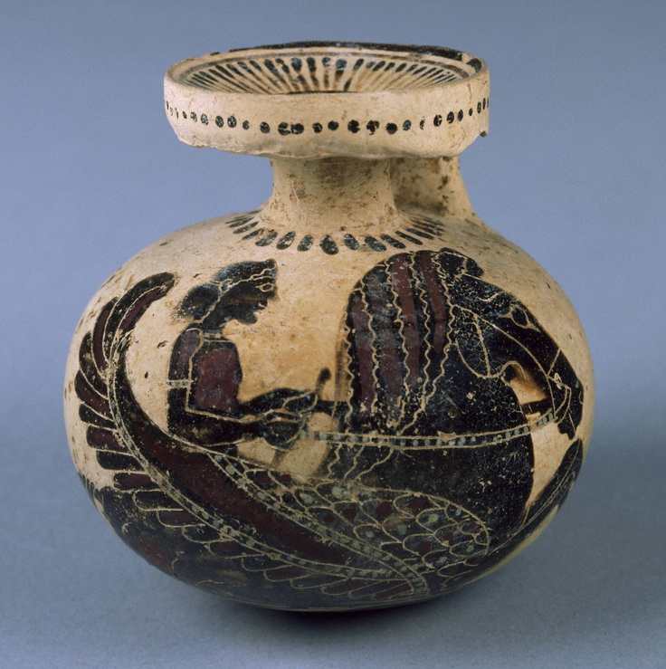
Bellorophon riding Pegasus 625-600 BC

Slide 14
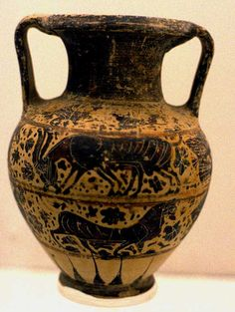
600-500 Black Figure Amphora with Goat

Slide 15
Archaic Corinthian Period (575-550)
Saw the “Last Hurrah” of Corinthian Pottery.
Also saw dramatic drop in number of exports.
Along with the tired animal subject, Corinthians began developing red-ground vessles.
Black figures on a red back ground

Slide 16
It not quite Black Figure
Red-ground was last major Archaic Corinthian figured style.
A small number of local pots imitate Attic black-figure; known from second half of 6th Century
Rarely use incisions and addes color very differently to Attic black figure.
Blamed on migration of immigrant Athenian vase-painters.

Slide 17
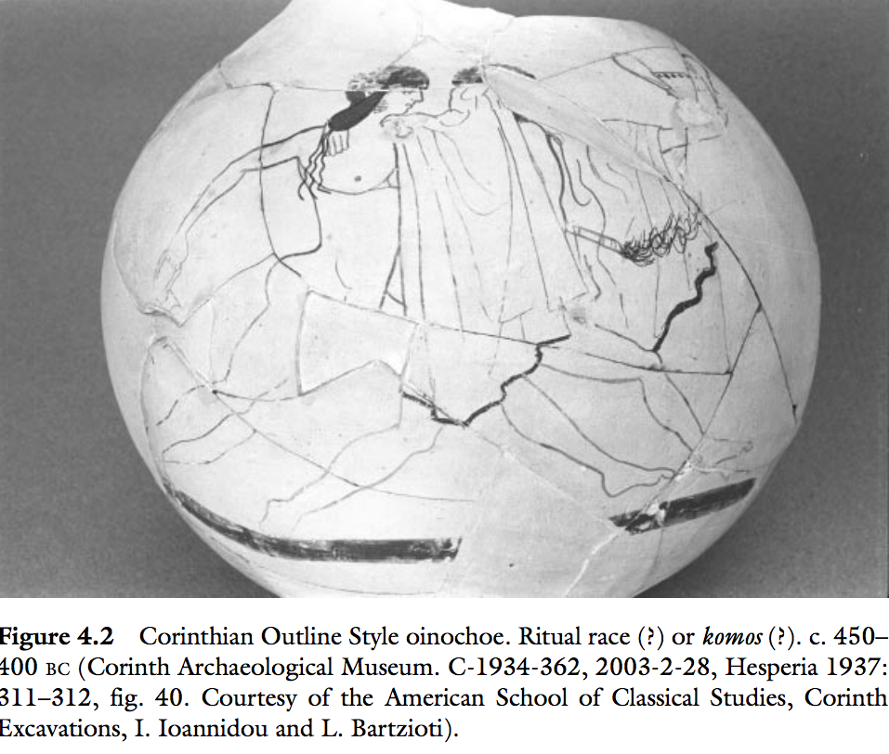

Slide 18
Humour in Greek Pottery

Slide 19
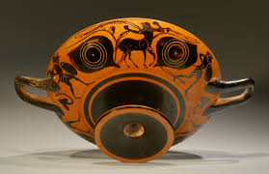
“Visual humour begins with eye-cups,” Mitchell

Slide 20
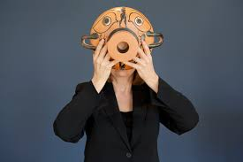

Slide 21


Slide 22
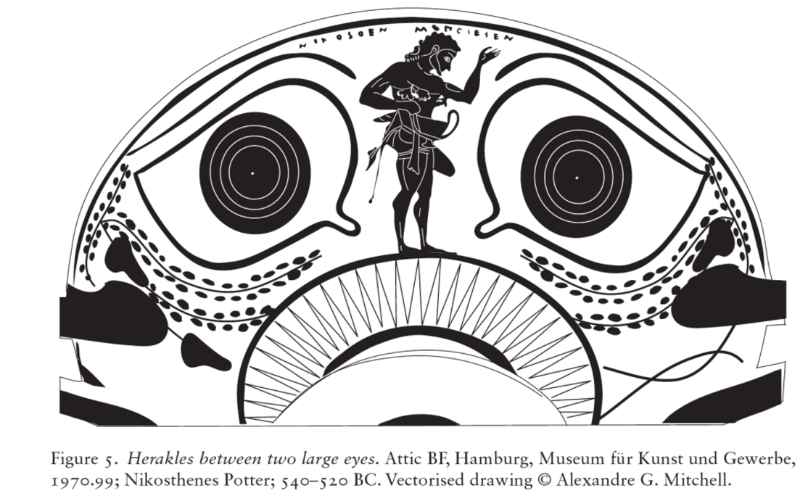
Would often display a nose as well

Slide 23
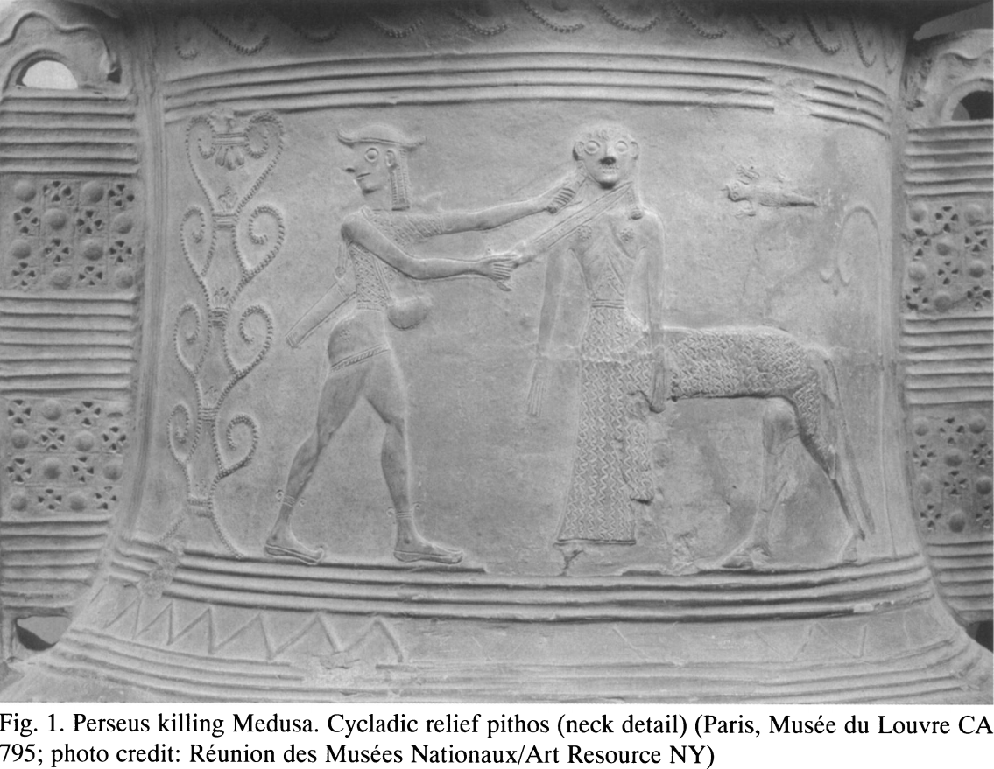
Mitchell – 4-5% of pottery was humor based

Slide 24
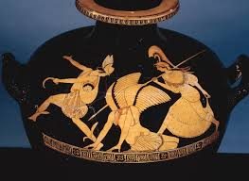
Perseus and Medusa – Pan Painter (475 BC)

Slide 25
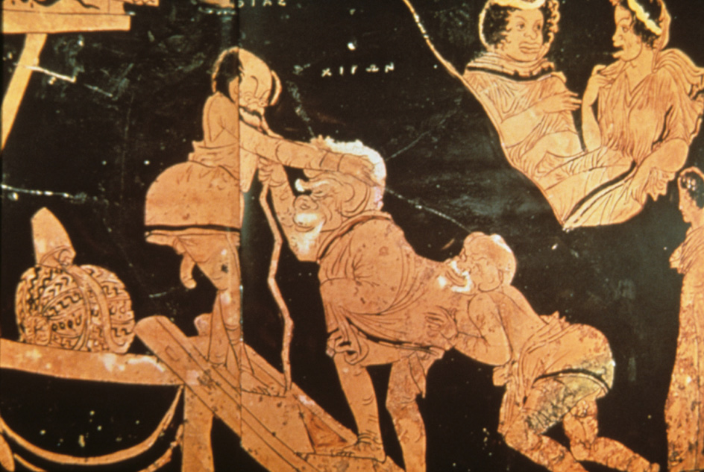
Comedy in Greek Pottery

Slide 26
