Slide 1
Greek Vases
The change from black figure to red-figure painting and the change of styles and narratives

Slide 2
Black figure
Invented in Corinth in the years around 700 BC→ involves painting figures in black silhouette, incising all linear detail so that the pale clay shows through the black, and adding if required, touches of red and white paint, all applied before the vase was fired
It was a revolutionary method of decoration for pottery

Slide 3
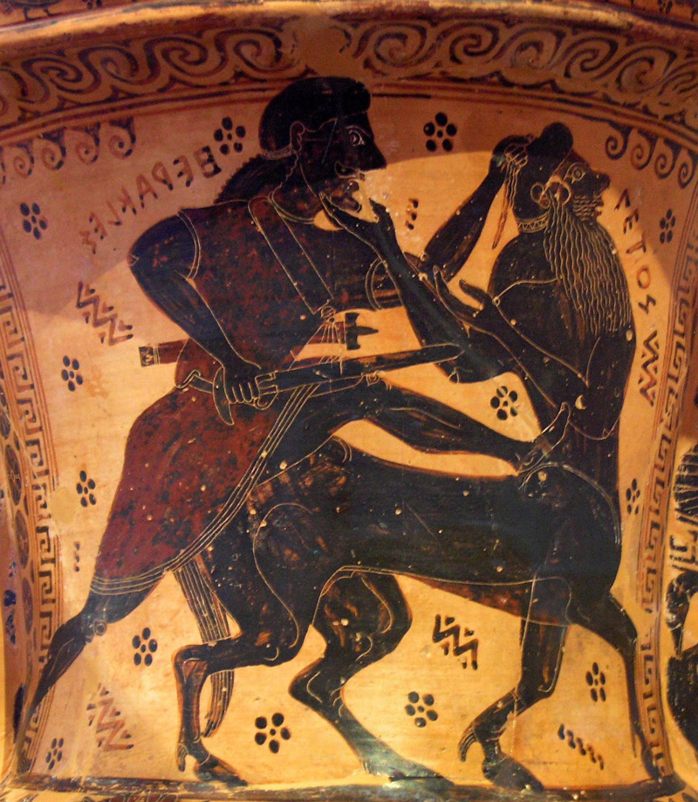
Neck amphora by the Nessos Painter (Heracles fights Nessos)

Slide 4
Red-figure technique
Red figure→ the reverse of black figure→ figure and patterns are reserved in the colour of the red clay ground with linear detail painted upon them and the background filled in with black
Invention of the red-figure technique seems to have occurred in about 530-520 BC→ it was a great turning point in the history of Athenian vases
Easy enough to assume that red-figure technique was invented by one man at one moment, but it is much more difficult to put a name to that man→ he must have been a vase-painter
Three possible candidates: Nikosthenes, Amasis and Andokides

Slide 5
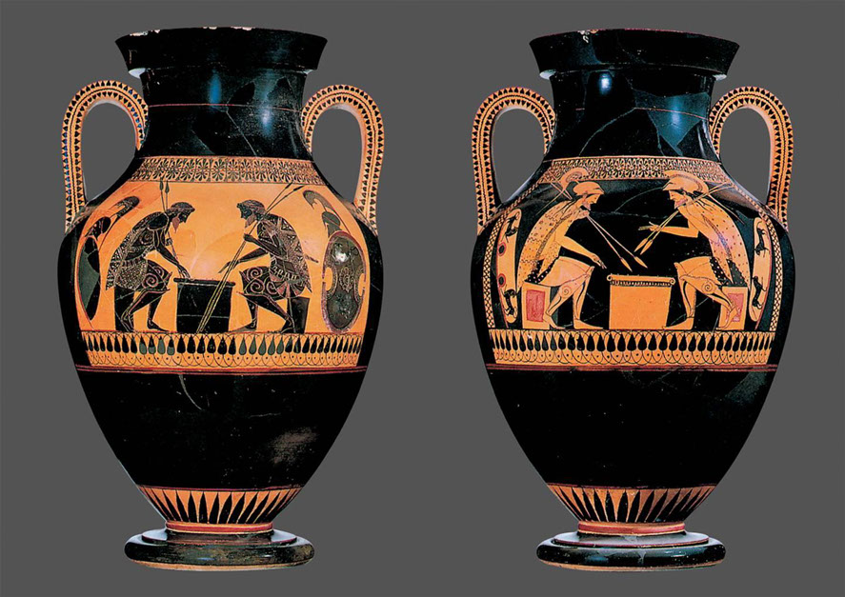
Belly amphora by the Andokides Painter (Ajax and Achilles play)

Slide 6
How was the new technique invented?
External influences, such as other media that employed light-on-dark schemes (sculpture, metal-working and textiles) may have prompted the idea of the new technique
Although these are possible theories, there is no clear indication that any of these sources proved to be the impetus for the invention of the red-figure technique
It is more possible that such an idea came from the sphere of pottery-making itself, namely of those in the black-figured technique combined with the search for new ideas

Slide 7
Impact of the new technique on the vase painting in term of style
Iconographic conventions were never more stereotyped in Greek art than in Athenian black figure→ many persist in red figure but a characteristic of the new technique is the freedom of composition it offers
There were three-quarter views, overlapping and attempts at perspective
The simple black=male, white=female sex distinction was gone
The red figure technique→ threw more vivid relief than black figure

Slide 8
Iconography and narratives in red-figure technique
In red figure, especially after 500, the Olympian gods are seen more often in independent studies or involved in stories peculiar to them.
Herakles dominated the myth repertory of Athenian black figure, but he had a reduced role on the later vases→ reason for this is that there was a preference for the new democracy’s hero Theseus
From around 490 BC there is a general tendency towards fewer reorientations of myths and more scenes taken from everyday life

Slide 9
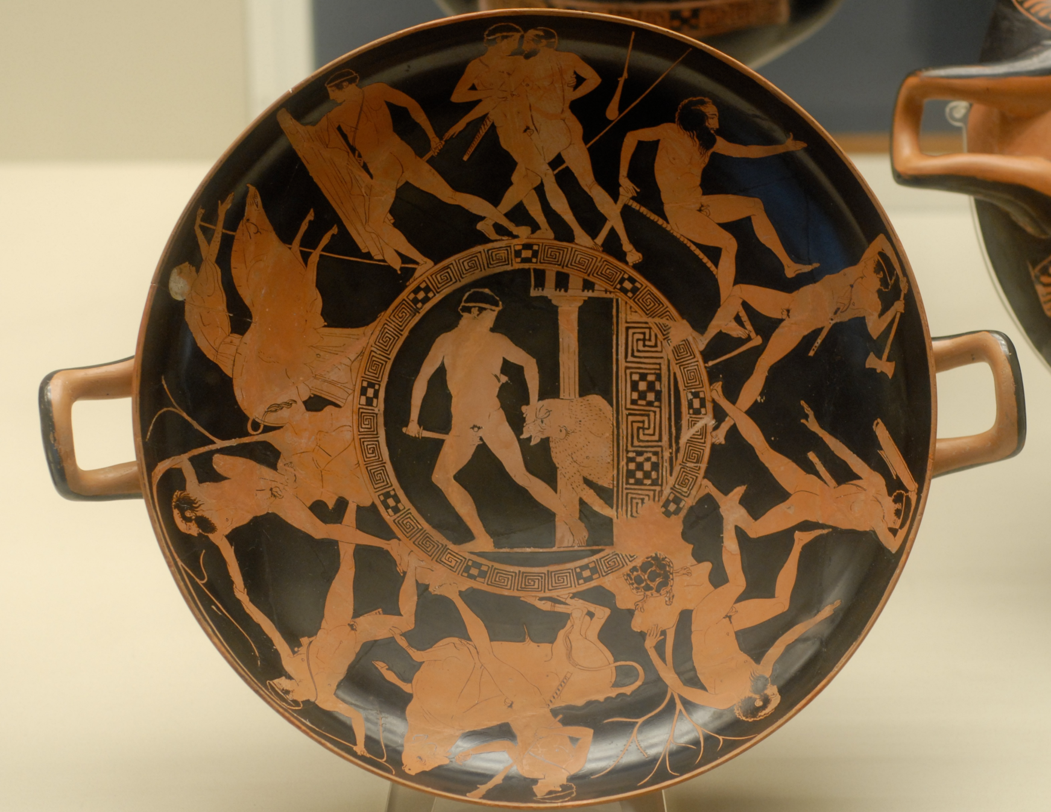
Depiction of Theseus’ adventures on the road from Troizen

