Slide 1
Classics Postgraduate Students Library Resources
University of Warwick Library
October 2015
Helen Ireland, Academic Support Librarian
h.ireland@warwick.ac.uk

Slide 2

Finding Information in the Library – the Old and the New

Slide 3

Most of an iceberg is below the water…so the Library has more than what you see on the shelves

Slide 4
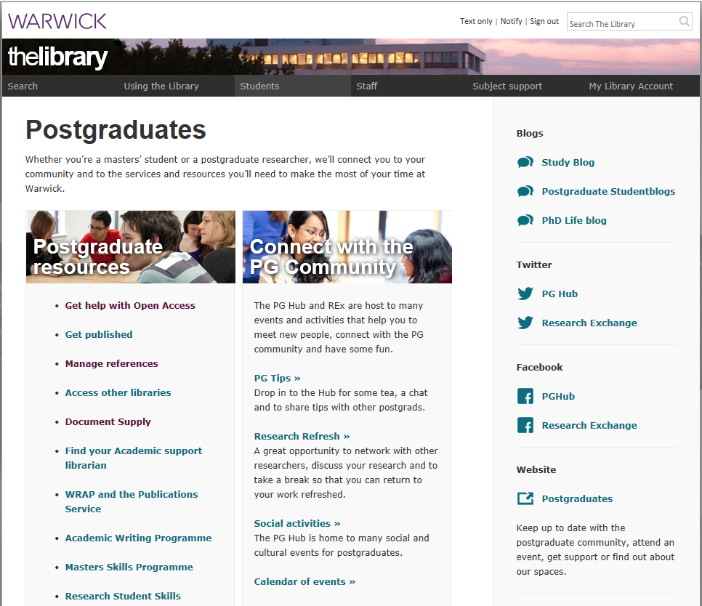

Slide 5
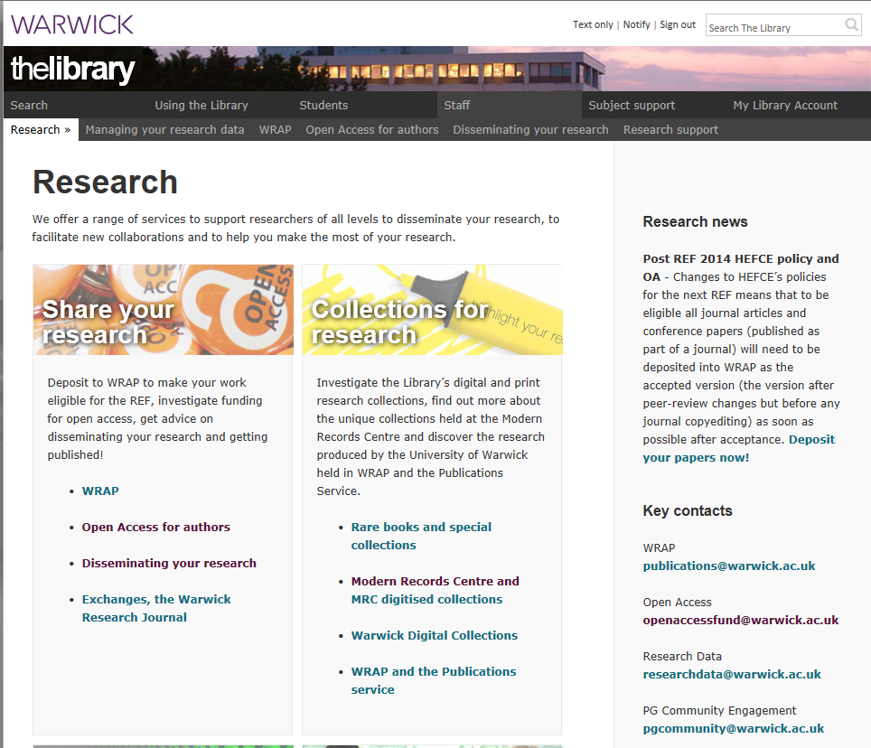

Slide 6
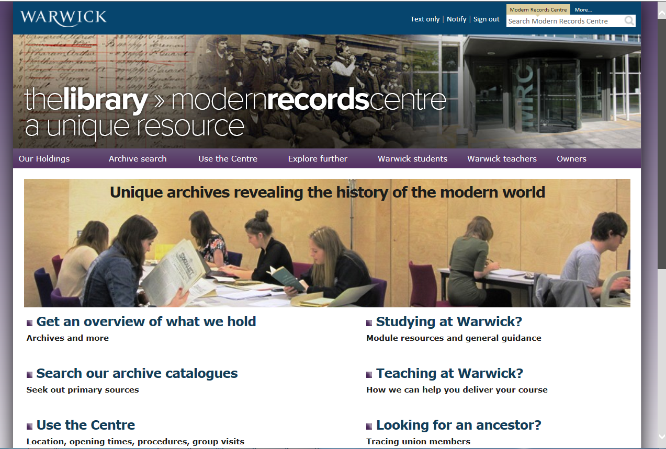

Slide 7
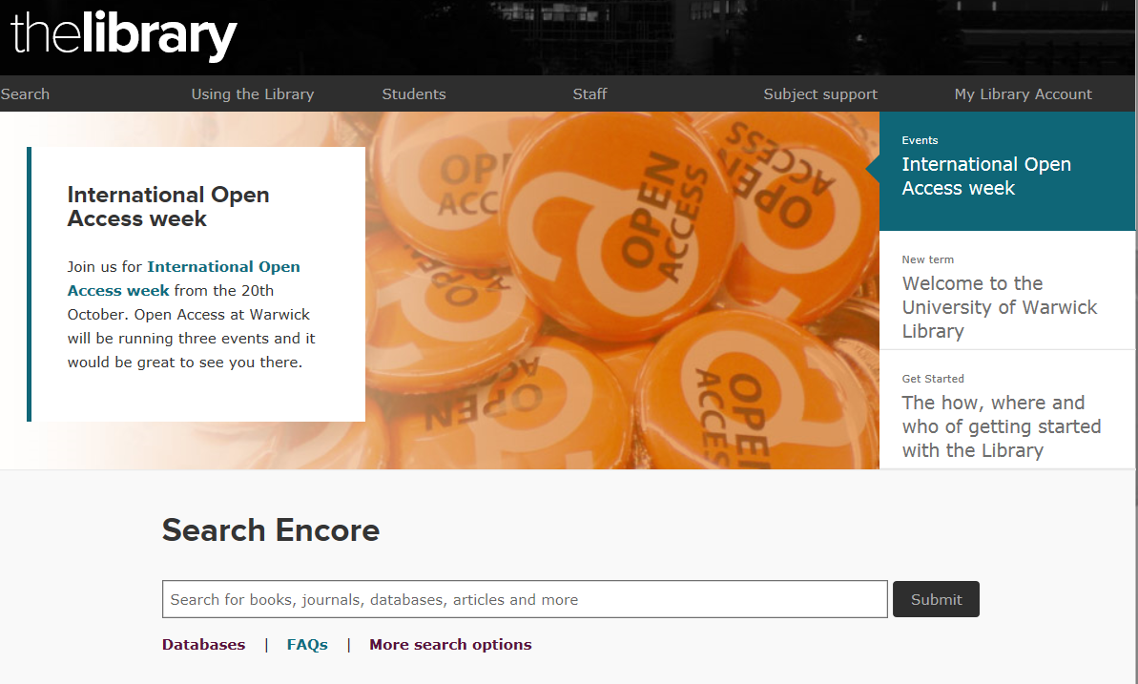

Slide 8
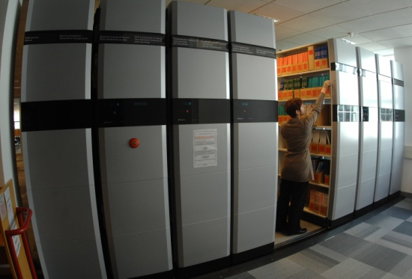
Books
PA Latin and Greek Literature
DE-DG Greek and Roman History
N-NX History of Art
B-BJ Philosophy
C-CN Archaeology, Numismatics, Epigraphy
Floor 3 and Floor 3 Extension
Reference books (Mobile shelving)
Oversize books (Mobile shelving)
Electronic books (E-books)

Slide 9
Encore
Simple Search, Scholarly Results
Searches content of e-books, e-journals and databases
“Quick & Dirty” search
Doesn’t cover all the Library’s e-resources
For a systematic and thorough search, use the advanced search option on individual databases

Slide 10
E-books
Brill’s New Pauly
Cambridge Books Online
Cambridge Collections Online
Cambridge Histories Online
Loeb Digital Library
Oxford Scholarship Online
Oxford Bibliographies
Taylor and Francis e-book collection
Translated texts for historians
Wiley-Blackwell Companions to the Ancient World

Slide 11
Print Journals
Mobile shelving in Floor 3 Extension
A-Z by title of journal or publisher
Some early volumes in Store – fetched on request
Online request form

Slide 12
Google Scholar
Better quality research information than Google
Scholar preferences
Click on Library Links and enter “Warwick” to get access to all our full text journal subscriptions
Click on Settings and then on Bibliography Manager to import references into EndNote or other reference management packages
Scholar Advanced Search

Slide 13
Evaluating Internet Resources
Who has written it? Bias and authority.
When was it written?
Are there contact details on the site?
Is there any way of validating the information?

Slide 14
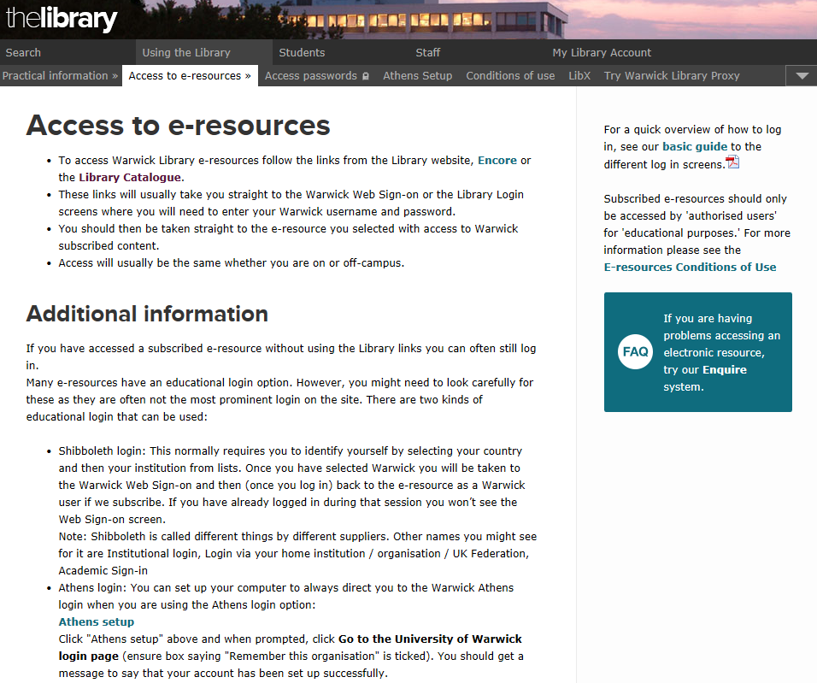

Slide 15
Why use databases?
Saves you searching through individual journal titles looking for relevant articles
Search by keyword or subject area
Regularly updated with most current research
Sometimes will give a link to the full text article if the library has a subscription

Slide 16
Developing a Search Strategy
Be clear about your topic / objectives
Think about the best databases to use first
Be systematic, recording which databases you use and the value (or limitations) of each one
Be flexible!
Keep track of your references

Slide 17
Planning Your Search
Think about the different ideas / concepts covered by your topic
Identify keywords or phrases
Think about any synonyms or alternative spellings
Use truncation symbols or wildcards for different word endings and spellings
Phrases can often be placed in “speech marks”
Decide how to combine the search terms together
Do you need to limit your search?
specific dates
types of publications

Slide 18
Basic Database Searching Combining your Search Terms
Boolean operators
OR Will find articles containing either word OR broadens a search
AND Will find articles containing both words AND narrows your search.
NOT Will exclude a term from your search. Use Not with caution! You might exclude something useful!

Slide 19
Keeping Up to Date
Create a personal account or register with a database
Save searches, to return to, edit and re-run later
Set up alerts on individual databases for newly-published articles
Use general alerting services such as Zetoc

Slide 20
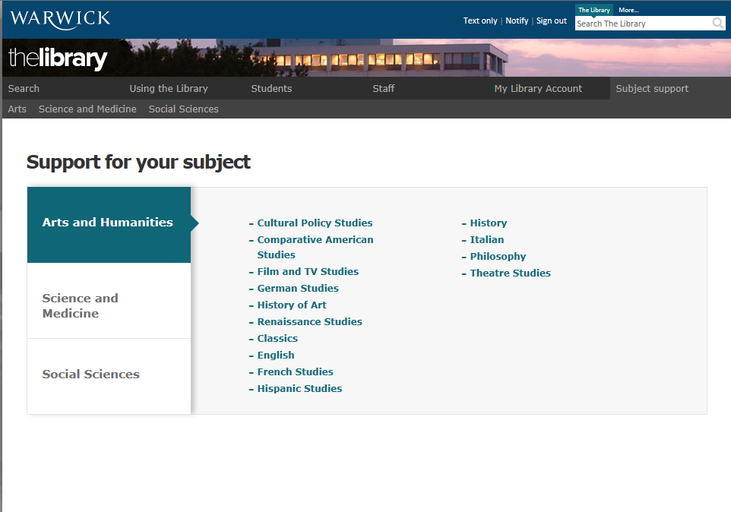

Slide 21
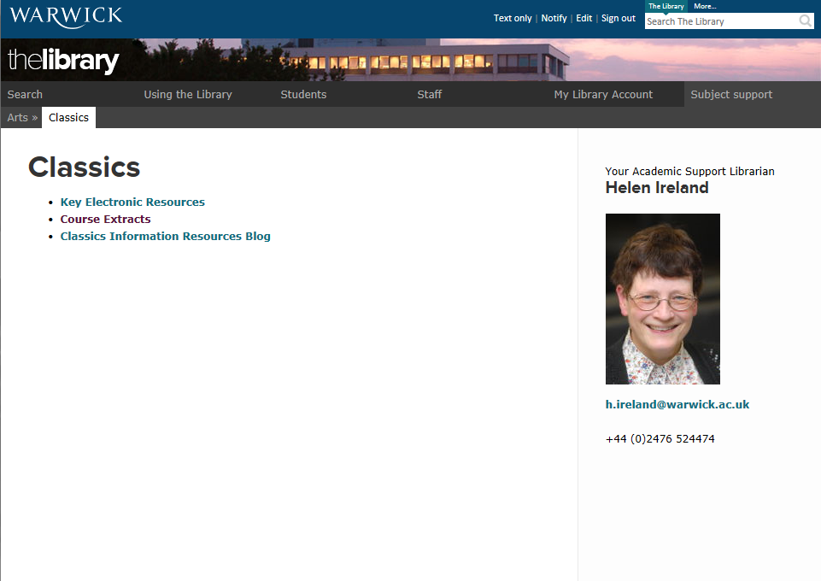

Slide 22
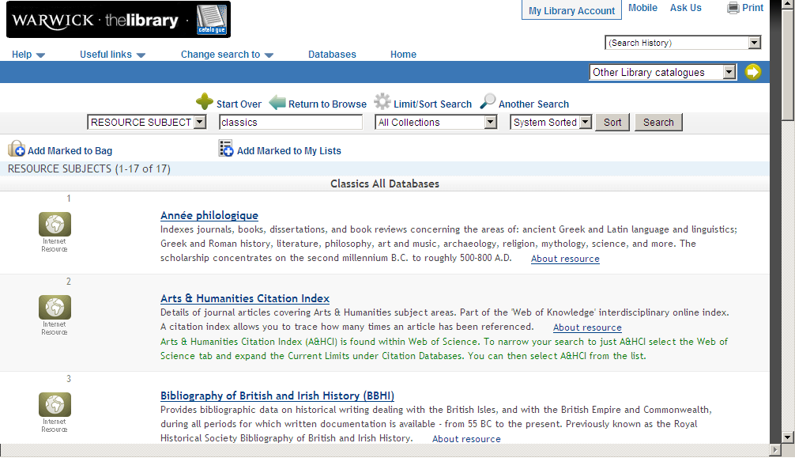

Slide 23
Reviewing the Search
Review results and identify possible additional keywords which could be used
Consider alternative spellings, word endings or broader or narrower terms
Edit and re-run the search
Re-run the search in alternative databases / resources

Slide 24
Search Results
Link to full text if available
Mark useful references
Email, download or print references
Always keep a note of your references!

Slide 25
Referencing
Departmental guidelines
Library online tutorial on referencing
http://www2.warwick.ac.uk/services/library/students/referencing
GetWISE module on Referencing and avoiding plagiarism
Reference Manager software such as EndNote Online

Slide 26
Finding, using and attributing images
If you are using someone else’s image, the least amount of information you will need to include is:
–The creator’s information
–The title
–A link to the original source
–The date accessed
If you found the image in a book or journal (either electronic or in print), you need to include details of the publication you took the image from
If the image is licensed under Creative Commons, you should also include the licence type, e.g. used under a Creative Commons Attribution 3.0 (http://creativecommons.org/licenses/by/3.0/)

Slide 27
No Link to Full-Text?
Check the Library Catalogue for a paper or electronic copy – search for the journal title
Check the A-Z list of titles on the Electronic Journals webpage for an electronic copy.
Not in the Library?
Ask for the article through ArticleReach or Document Supply
Visit another library.

Slide 28
Document Supply
For students working on dissertations or projects
For material not available through ArticleReach
Forms are available from the Library.
No charge.
Your supervisor needs to countersign the form.
You need to sign the copyright declaration.

Slide 29
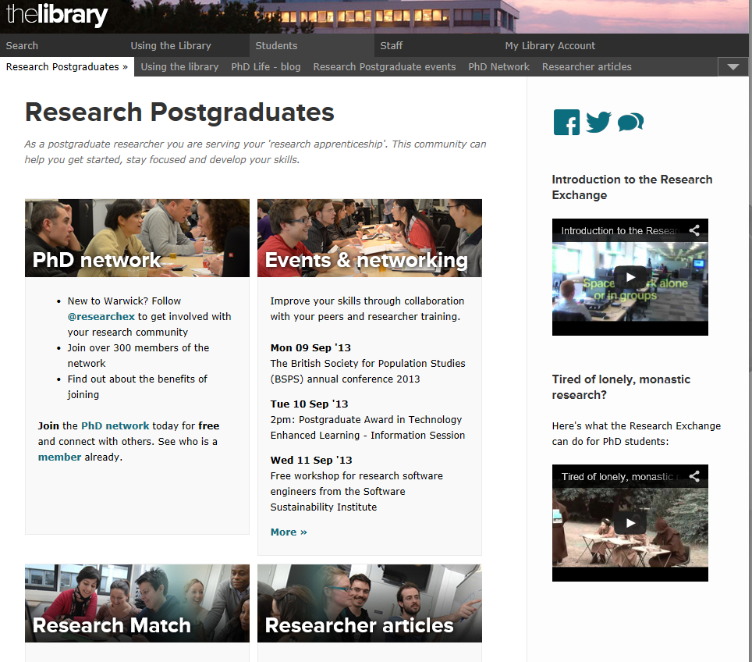
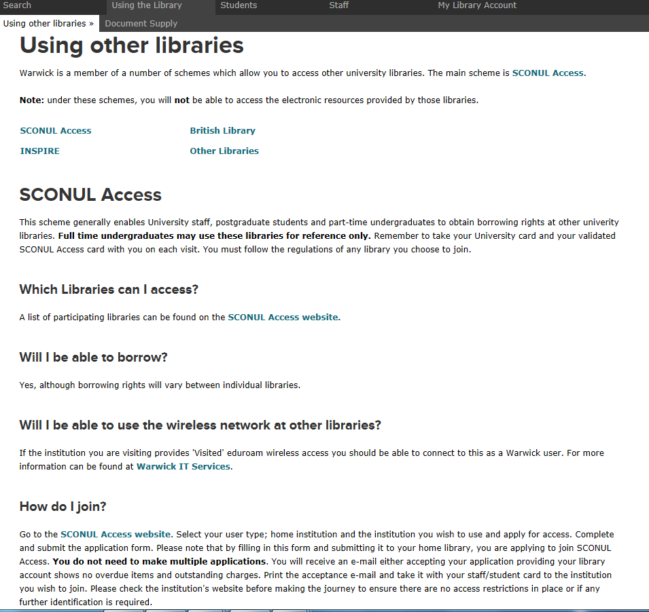

Slide 30
Further Help

Slide 31
GetWISE and Study blog
GetWISE is a Moodle course, designed to cover finding information beyond the basics, including advice on developing your research skills, referencing and avoiding plagiarism
The Study Blog offers tips and advice to enhance your study experience at Warwick
http://studyblog.warwick.ac.uk/

Slide 32
Things to help your studies
Library webpages
Library online tutorials
Academic Support Librarians
Library Helpdesk
Enquire (online enquiry service)

Slide 33
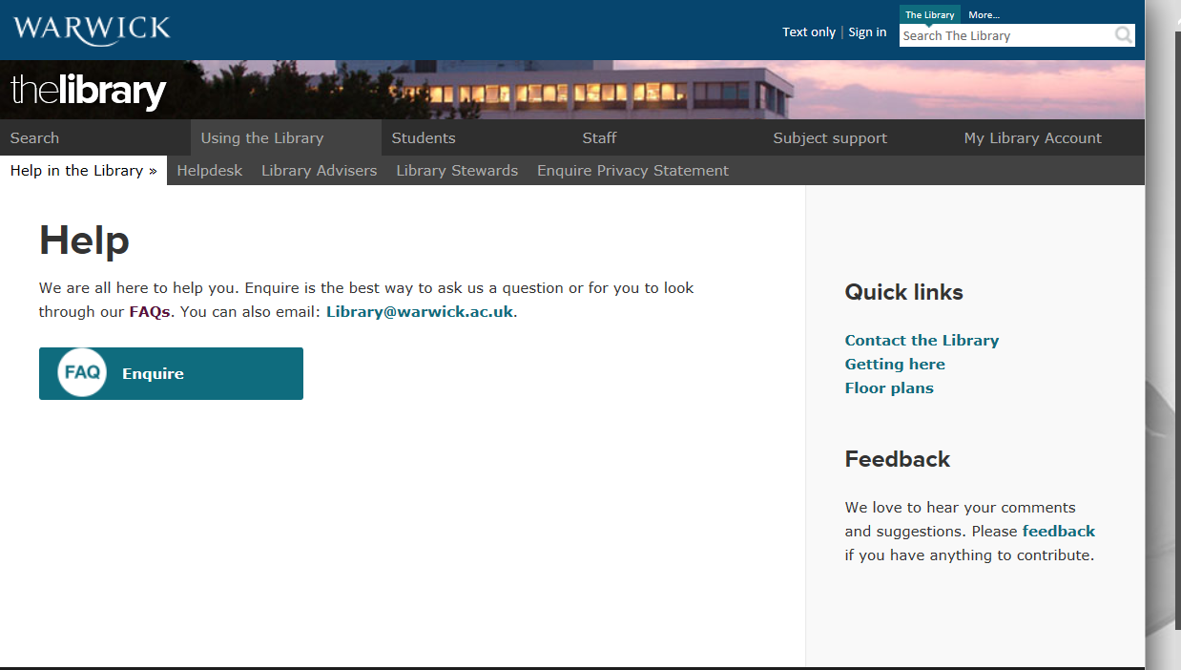

Slide 34
Specific Queries
Email: h.ireland@warwick.ac.uk
Phone: 024 76 524474
Good Luck!

