Slide 1
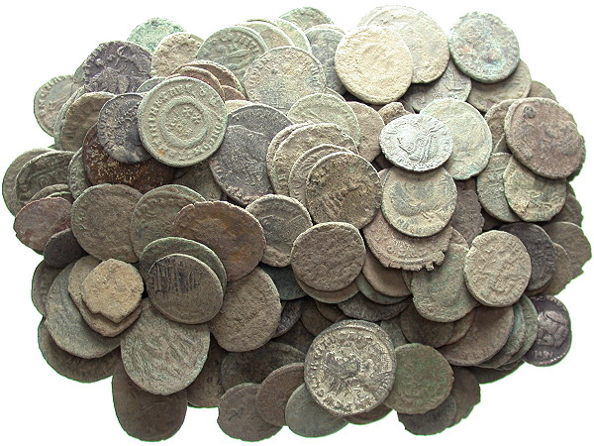

Engaging with Ancient Coins
Clare Rowan

Slide 2
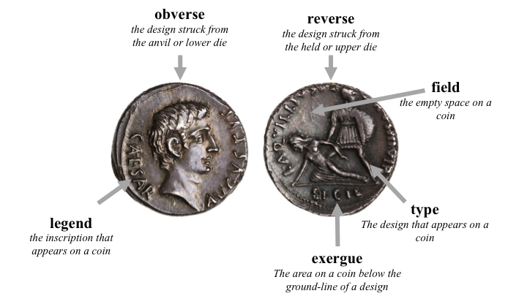

Slide 3
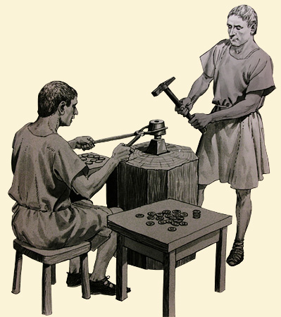
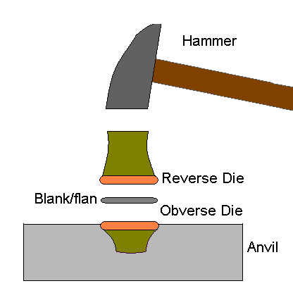

Slide 4
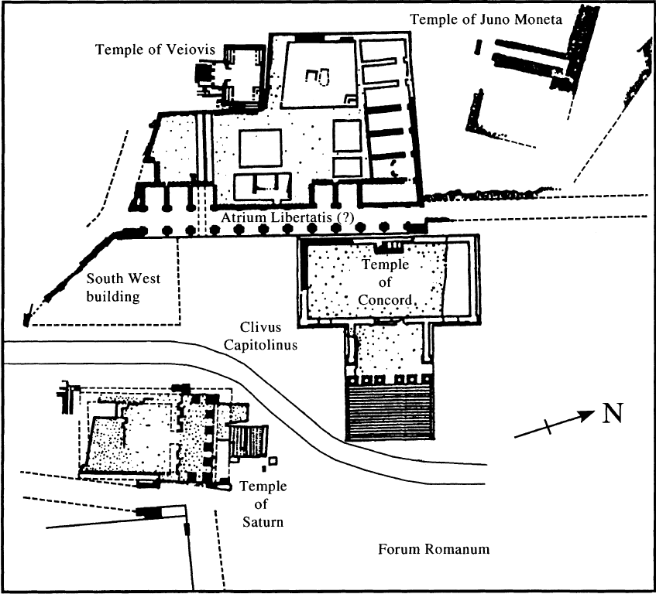
Moneta (moneo)
Mnemosyne

Slide 5
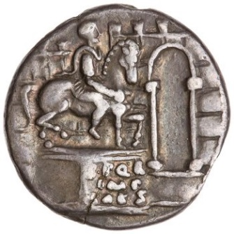
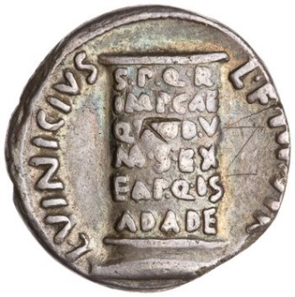
Augustus, Denarius, Rome, c. 16 BC (RIC 1² 362).
Obv: Equestrian statue of Augustus with pedestal inscribed S P Q R IMP CAES, before city-walls and gate .
Rev: Cippus inscribed S P Q R IMP CAE QVOD V(iae) M(unitae) S(unt) EX EA P(ecunia) Q(u)IS AD A(erarium) DE(dit); L VICINIVS L F IIIVIR around.
(The senate and people of Rome to Imperator Caesar because the roads have been paved out of the money which he gave to the treasury)

Slide 6
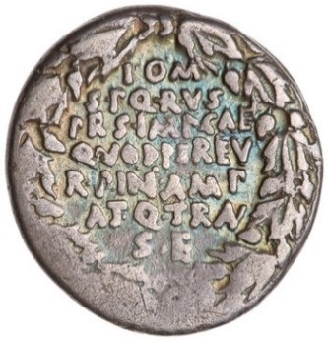
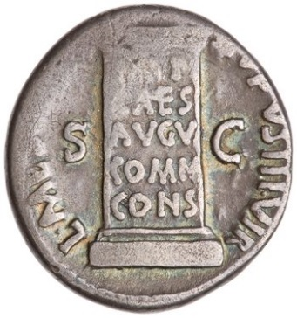
Augustus, Denarius, Rome, c. 16 BC (RIC 1² 358).
Obv: I(ovi) O(ptimo) M(axiom) S P Q R V(ota) S(uscepta) PR(o) S(alute) IMP(eratoris) CAE(saris) QVOD PER EV(m) R(es) P(ublica) IN AMP(liore) AT Q(ue) TRAN(quilliore) S(tatu) E(st) within oak wreath (Vows offered to Jupiter Optimus Maximus by the Senate and People of Rome on behalf of the safety of Imperator Caesar because through him the Republic is in a more ample and tranquil state)
Rev: Cippus inscribed IMP(erator) CAES(ar) AVGV(stus) COMM(uni) CONS(enservatori), flanked by S(enatus) C(onsulto). Around, L. MESCINIVS RVFVS IIIVIR.

Slide 7
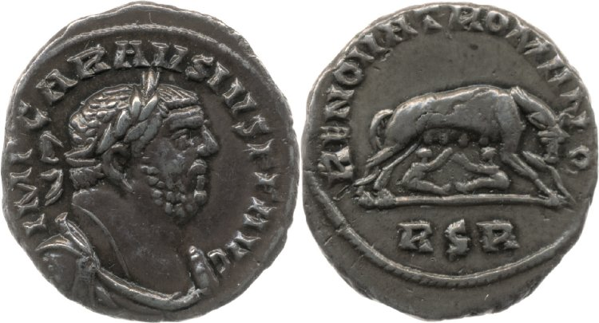
RIC V Carausius 571
RSR: Redeunt Saturnia Regna (the reign of Saturn returns) (6th line of Virgil’s Fourth Eclogue)

Slide 8
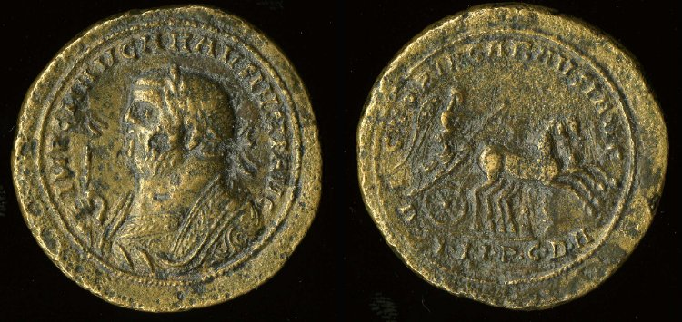
BM 1967,0901.1 (Medallion, AD 287)
I.N.P.C.D.A: Iam Nova Progenies Caelo Demittitur Alto
‘Now a new generation is let down from Heaven above’
(4th eclogue line 7.)
Notes:
4th eclogue line 7.

Slide 9
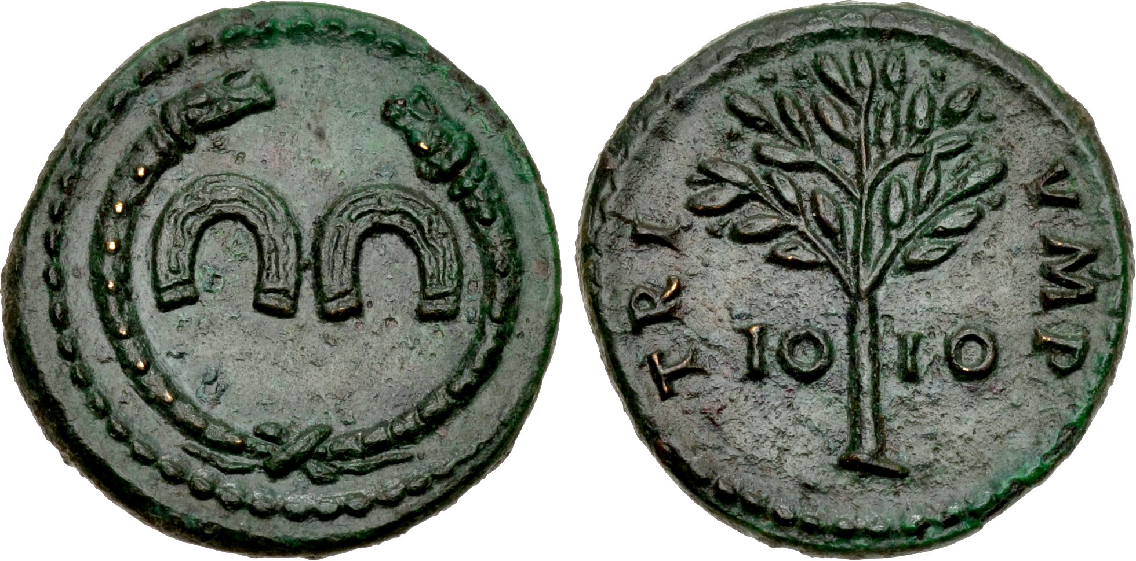
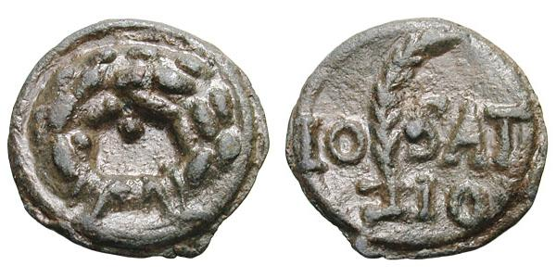
Lead Tokens

Slide 10
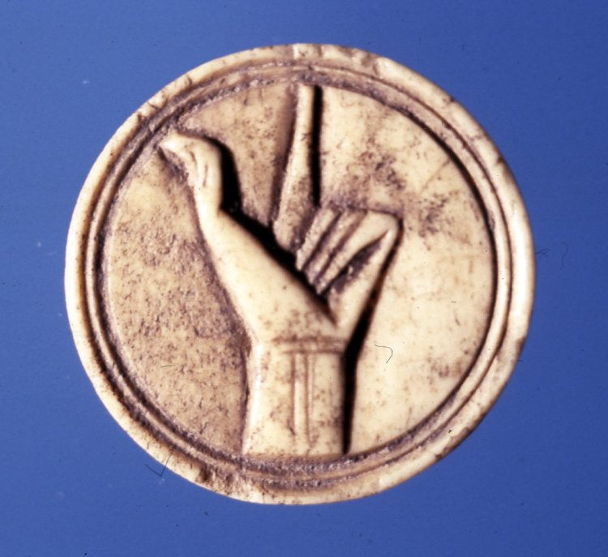
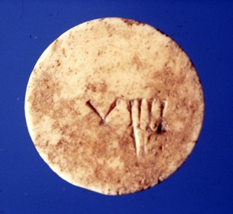
Lead Tokens

Slide 11
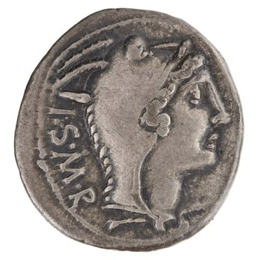
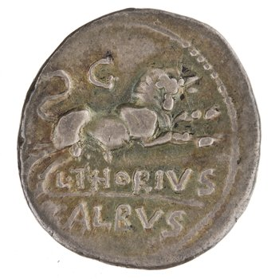
RRC 316/1 (105 BC)
Lanuvium
taurus
ILLRP 170: Iunone Seispitei Matri Regine
L.Thorius Balbus moneyer
Obverse: Head of Juno Sospita right, wearing goat-skin. Border of dots. I.S.M.R.
Reverse: Bull charging right; above, control-mark . Border of dots. A L·THORIVS

Slide 12
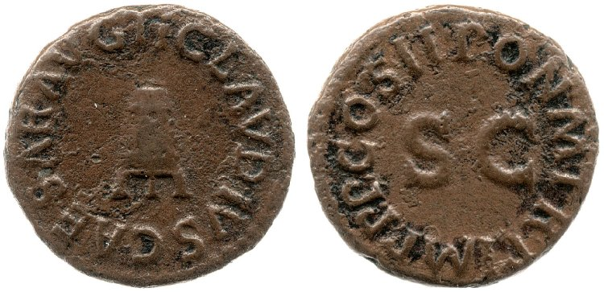
RIC Claudius 90
Obverse: Modius. TI CLAVDIVS CAESAR AVG
Reverse: PON M TR P IMP P P COS II around S C.

Slide 13
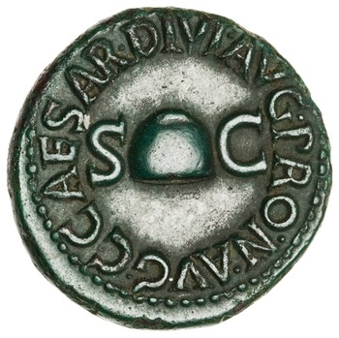
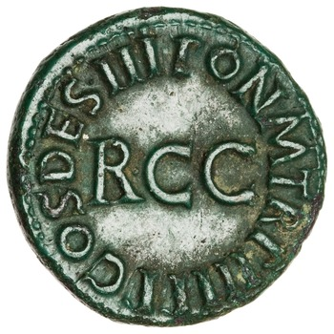
RIC Gaius/Caligula 39
Return of elections to the popular comitia / remission of sales tax (remissa ducentessima; Suetonius 16.3)
OR
Conspiracy in AD 39? (Restituti Concordia Consensus)
Obverse: C CAESAR DIVI AVG PRON AVG. Pileus flanked by S C.
Reverse: PON M TR P III P P COS DES III around RCC.
Notes:
Cornelius Lentulus Gaetulicus (legate upper Germany), associated with Sejanus and who survived his dowfall.

Slide 14
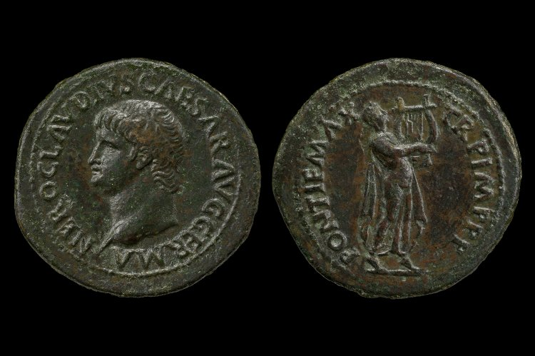
RIC Nero 79
'He placed the sacred crowns in his bed-chambers around the couches, as well as statues representing him in the guise of a lyre-player; and he had a coin too struck with the same device.’
Suetonius, Nero 25.2
Obverse: Laureate bust of Nero left. NERO CLAVDIVS CAESAR AVG GERMANIC
Reverse: Apollo Citharoedus, laureate, advancing right, playing lyre. PONTIF MAX TR P IMP P P

Slide 15
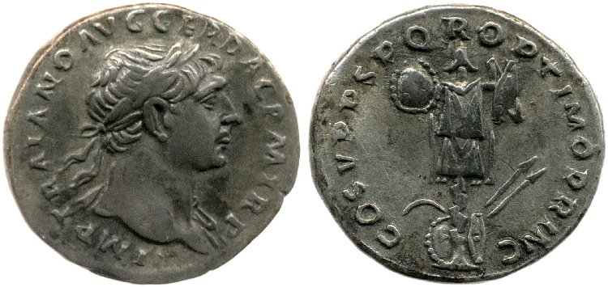
RIC Trajan 147B
Obverse: Bust of Trajan, laureate and draped, right. IMP TRAIANO AVG GER DAC P M TR P COS V P P
Reverse: Military trophy. COS V P P S P Q R OPTIMO PRINC

Slide 16
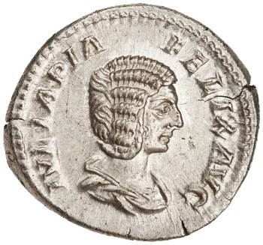
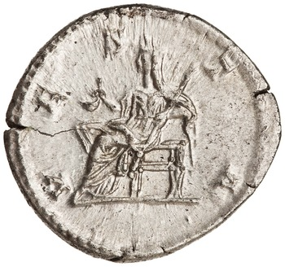
RIC IV Caracalla 391
Obverse: Draped bust of Julia Doma, right. IVLIA PIA FELIX AVG
Reverse: Vesta, draped, seated left, holding simpulum in right hand and sceptre in left hand. VESTA

Slide 17
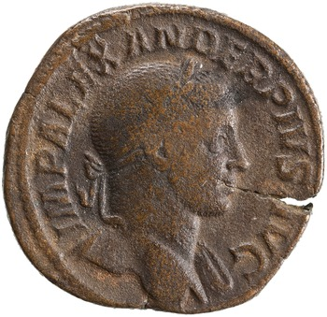
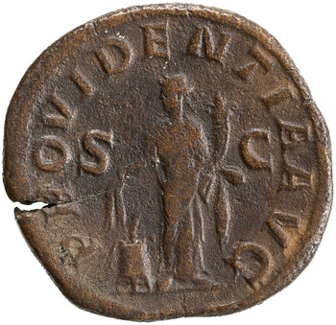
RIC IV Severus Alexander 391
Obverse: IMP ALEXANDER PIVS AVG. Bust of Severus Alexander, laureate, draped over left shoulder, right.
Reverse: Providentia, draped, standing front, head left, holding two corn-ears in right hand over modius and cornucopiae in left hand. PROVIDENTIA AVG S C

Slide 18
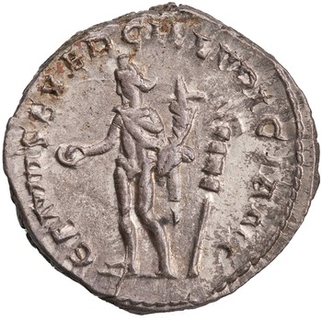
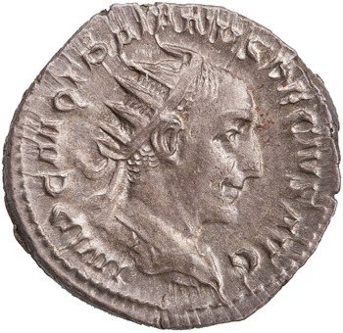
RIC Trajan Decius 16C (AD 249-51)
Obverse: Bust of Trajan Decius, radiate, draped, cuirassed, right. IMP C M Q TRAIANVS DECIVS AVG
Reverse: Genius, wearing polos on head, nude except for short cloak on shoulders, standing left, holding patera in right hand and cornucopiae in left hand; to right, standard. GENIVS EXERC ILLVRICIANI.
Notes:
Caesar Gaius Messius Quintus Traianus Decius Augustus

