Slide 1
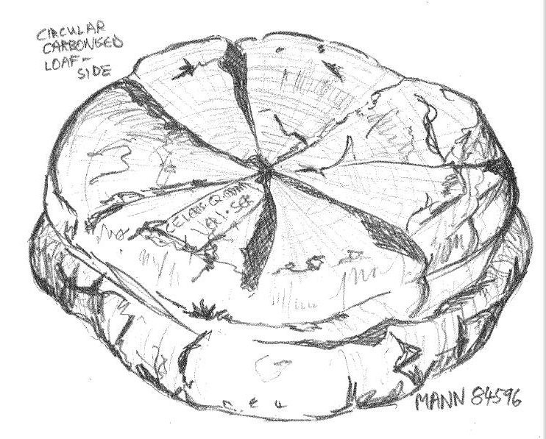
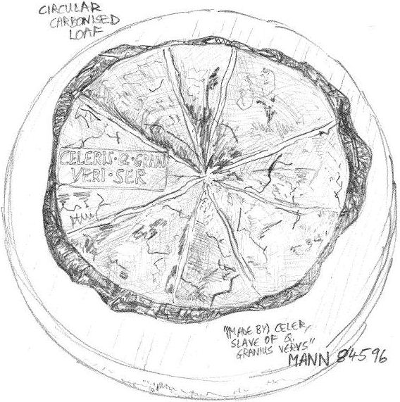
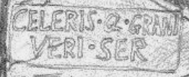



Carbonised Bread: Produce of Campania
Student no. 0801845
Student no. 1210878
All illustrations produced by the authors
A highlight of the British Museum’s exhibition, Life and Death in Pompeii and Herculaneum, this preserved loaf is the outcome of an interesting ancient journey: from the fields of Campania, through the pistrina of Herculaneum, to the table of Quintus Granius Verus or one of his customers. Here, we follow the trail of breadcrumbs left by the baking industry of 79ad in the locality of the Bay of Naples, attempting to define its niche in Herculaneum’s economy. | Bread with baker’s stamp | Inventory no. MANN 84596
 | From the Naples Museum collection, excavated at the ‘House of the Stags’, Herculaneum.
 |  | Diameter: 21cm
4. 1934 years later, at the British Museum…
Circular carbonised loaf: side-view
Provenance of grain at Herculaneum
Florus, born in 74ad and therefore writing after the eruption of Vesuvius, tells us that the god of the vine and Ceres, the goddess of grain, competed to outdo each other in Campania – a flowery description of the region as agriculturally productive. ¹ Wheat was being produced which was finer than the rough variety used by early Italians for their porridge. ² This wheat was the type used for a raised loaf such as ours.
However, just to the north-west of Campania, Rome was unable to satisfy her one million inhabitants with locally produced grain, and took pains – both political and economic – to import large quantities, a lot from Africa. ³ We might question whether there were similar concerns at Herculaneum:
Mayeske points out that farmsteads and villas surrounding Pompeii had storage rooms, as did bakeries in the town. This indicates the bakers could purchase sufficient grain from those farms, store it and process it as required. ⁴ If the larger town of Pompeii suffered no scarcity of grain, neither did Herculaneum.
Maiuri’s dated but detailed guide notes that Herculaneum’s roads do not show “deep cart-wheel ruts caused by heavy commercial traffic” as in Pompeii. ⁵ It is improbable, then, that wagonloads of grain were being continuously hauled from the port to the town bakeries.
Our loaf was found in a wealthy house – the House of the Stags – whose owners would have required the best leavened bread available. In Pliny’s (biased) opinion, no other wheat could compare to Italy’s for whiteness or weight; Africa’s was of an inferior third rank. ⁶ Arguably, only Campanian grain would have satisfied the rich citizens of Herculaneum, who were in Pliny’s social class.
From the evidence above, it seems reasonable to conclude that the grain used to make our bread was of local origin.
Approaching this carbonised loaf, one might be convinced that it was bread baked only yesterday, neglected in the oven until charred black and rock hard; the smell of burning still seems to hang in the air. The positioning of the loaf next to a glirarium (minus live dormice) ¹⁵ and opposite a lararium, complete with pedestal and alcove, ¹⁶ helps to transport the viewer to a Vesuvian kitchen, 79ad.
Though the information displayed next to each object in the exhibition is not extensive, some artefacts have been cross-referenced to highlight links between them: for instance, the ‘Distribution of bread’ fresco signposts our own carbonised loaf. ¹⁷
Yet, to create a complete Roman kitchen using the best-preserved objects, the curators have been obliged to mix finds from various sites. Thus, the glirarium from Pompeii is next to our loaf from Herculaneum, which is opposite the lararium from Terzigno.
Although this structure is imposed, the concept illustrates the unique nature of Vesuvian archaeology. The progression from the atrium’s fine statues and frescoes, to the kitchen’s carbonised organic debris, and then to the casts of the dead, mirrors the progression of the Vesuvian cities from ordered civilisation to accelerated decay: from life to death.
While we would argue that the exhibition’s video material and special effects look plain next to the artefacts themselves, the overall experience is probably the closest we can get to the slopes of Roman Vesuvius in 79ad, outside of Italy, and in the year 2013.
3. House of the Stags: A Final Resting Place?
The House of the Stags was built around twenty-five years before Vesuvius erupted. It featured a triclinium (a dining room) in the centre of the building, from which a corridor led to the culina (the kitchen) where cooking pots were found, still sitting atop a charcoal stove where they had been abandoned during the eruption. ¹²
The stamp on our loaf (right) shows that it was made by the slave ‘Celer’, owned by Quintus Granius Verus. The identity of the slave is a puzzle:
Perhaps the bread was baked where it was found and Celer was Granius’ household slave.
Perhaps Granius had a bakery in which Celer worked, where the bread was purchased. It is known that Granius held official posts in Herculaneum in the 50s and 60s, and was named as a “high-ranking witness” on wax tablets, but we cannot be certain that he owned the House of the Stags. ¹³
Curiously, an inscription in Herculaneum tells us a man called ‘Celer’ was a freedman of Quintus Granius. The inscription was made shortly before the eruption. It is questionable whether this ‘Celer’ was the man who baked our loaf, however, because the stamp on the bread does not reflect the change in his status. ¹⁴
Despite all this, it is still tempting to imagine that the slave Celer, nicknamed ‘Speedy’, had earned his freedom, and earned it by the virtue of being such a very quick worker…
Circular carbonised loaf: top view
2. The Bread Making Process
In the first century bc, the tasks of a pistor (a baker) included those of a miller. ⁷ In a bakery the pistrinium (the milling area) housed vast rotary mills and an oven. Mills had a meta and a catillus, the lower and upper millstones, which were made from solid porous lava. The corn would be threshed, and frumentum (grain) was ground into flour as the millstones rotated; finer flour was obtained by grinding twice. ⁸
Pliny tells us that the flour might be sifted using Spanish flax or Egyptian papyrus – the finest flour had the least bran and made the best loaves . ⁹ Enmer was the commonest variety of wheat grown in Campania in the first century, so it is likely that this type was incorporated into our loaf. ¹⁰
Not everyone ate bread of the same quality: pane puero was ‘bread for the boy [or slave]’ and pane cibarium was bran-rich bread of an inferior grade. ¹¹
The regular shape of a raised loaf was circular and grooved into eight sections, as can be seen from our illustrations . Our variety of loaf is a panes quadrati.
“CELERIS Q. GRANI VERI SER[VUS]”
1) Florus, Epitome, 1.16. 2) Grant, M. Cities of Vesuvius: Pompeii and Herculaneum (1974, Book Club Associates, London) 197. 3) Rathbone, D.W. food supply, in the Oxford Classical Dictionary 4th Edition, Ed. S. Hornblower, A. Spawforth, E. Eidinow (2012, Oxford University Press, Oxford) 584. 4) Mayeske, B.J. A Pompeian Bakery on the Via dell’Abbondanza, pp. 149-165 in Studia Pompeiana & Classica, Volume I, Ed. Curtis, R.I. (1988, Aristide D. Caratas, Publisher, New York) 152. 5) Maiuri, A. trans. Priestley, V. Herculaneum (1956, Istituto Poligrafico Dello Stato, Rome) 13. 6) Pliny, Natural History, 18.12. 7) Mayeske (1988) 149. 8) Mayeske (1988) 151-2. 9) Pliny, Natural History, 18.108. 10) Sallares, R. ‘cereals’, in the Oxford Classical Dictionary 4th Edition (2012) 301. 11) Mayeske (1988) 154. 12) Deiss, J.J. Herculaneum: Italy’s Buried Treasure, Revised and Updated Edition (1989, The J. Paul Getty Museum, Malibu California) 47-50. 13) Wallace-Hadrill, A. Herculaneum: Past and Future (2011, Frances Lincoln Limited, London) 242. 14) Wallace-Hadrill (2011) 244. 15) Glirarium (dormouse jar), SAP 10744 . 16) Kitchen Lariarium, SAP 86755. 17) Distribution of bread fresco, MANN 009071.

