Slide 1
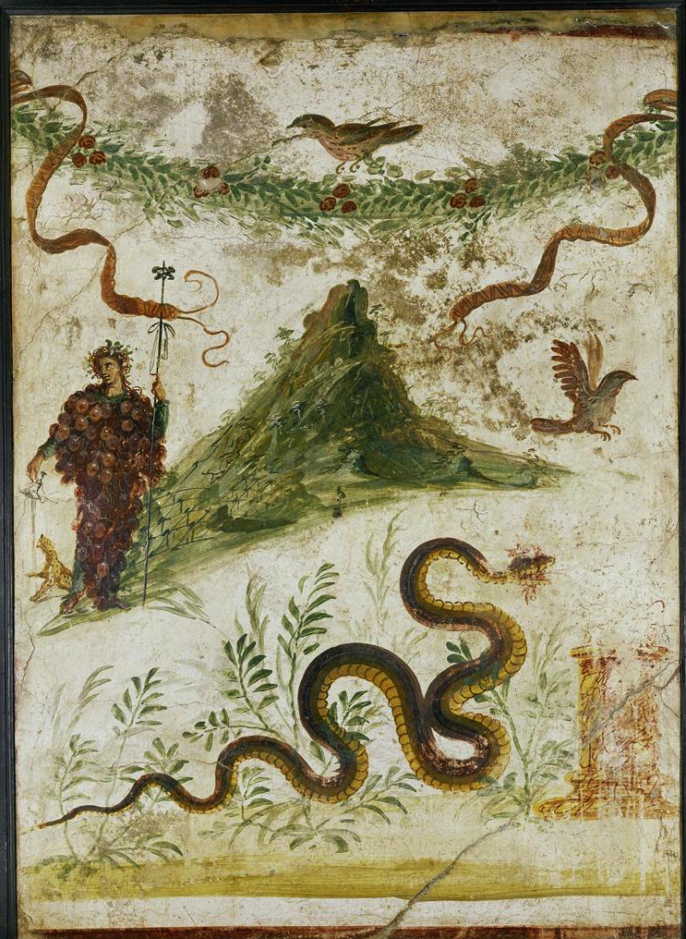
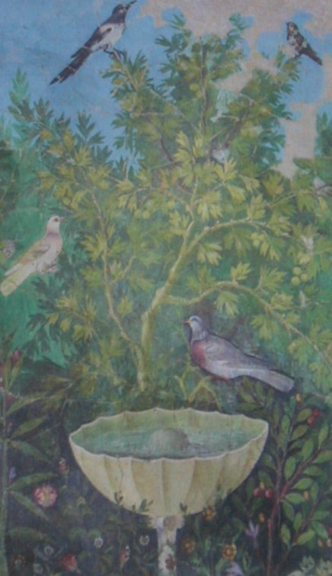
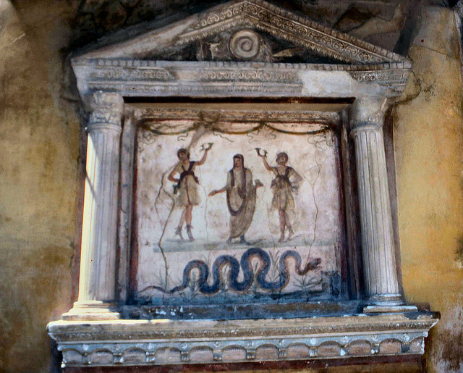


Making a mountain out of a molehill?
Is the mountain depicted Vesuvius or Mount Nysa? Mount Nysa is the Mountain attributed to being Bacchus’ home, and is single peaked, like the Mountain in the Fresco. Vesuvius however, has two peaks. This has led some scholars to question whether it is indeed Vesuvius or not. We would argue that it is Vesuvius, as lararia were primarily concerned with worshipping gods on a local scale, and so the inclusion of the focal point of the Pompeian landscape would make more sense.
FRESCO OF BACCHUS:
Where: Lararium in the slave quarters of the House of the Centenary, Pompeii
What: Painted Fresco on the side of a domestic shrine
Date: 55-79AD
Fresco in Focus:
Bacchus, the god of wine, is depicted standing next to Vesuvius, his whole body covered with grapes (which is very unusual), holding his Thyrsus in one hand and proffering a kantharos to a panther at his feet. The lower slopes of the volcano are covered with vine trellises. The serpent depicted is known as Agathodaemon, which was the “good spirit” of vineyards and grain fields, and snakes in general were also a symbol of protection.
Context in Vesuvian archaeology:
Frescoes throughout Pompeii and Herculaneum are incredibly well preserved. Artifacts such as leather and wood were instead turned to charcoal, but frescoes on the other hand have remained intact and still exhibit their colour. A good example of this is the vividly coloured Garden Fresco at the House of the Gold Bracelets in Pompeii.
Bacchus in Roman Religion:
The lararium as a domestic shrine was very personal to each specific family and can therefore we can analyse their chosen gods to build a more personal picture of their lives. It has been suggested that the family at the House of the Centenary were involved in the wine trade because the fresco shows Bacchus as important to them. Their worship of Bacchus as a deity indicates that he was a form of protector to their family business. The House of the Vettii’s lararium also contained frescoes depicting serpentine imagery but their frescoes instead have images of smaller, often locally invented, deities called lares.
Image: Erich Lessing, House of the Centaur; Bacchus on Mount Vesuvius [photograph] Available at: www.artstor.org [Accessed 8th May 2013]
Is it unique in the context of other lararia?
This painting is interesting because it differs from the other things usually found in a domestic shrine. For instance, the mini-altar (Pompeii ad79 SAP 3217) was used in domestic worship for giving offerings; things such as fruit, nuts, incense, flowers and meat would be burned on them. This contrasts the painting because it is very small in comparison, although some houses did have full size altars. Similarly, the lares figures made of terracotta and bronze (Pompeii SAP 5050 and Pompeii MANN 133261-2) were also very small but nonetheless vital to worship.
Imago, 2013, Perfect Garden [photograph] Available at: http://www.flickr.com/photos/55397833@N00/8566394950/ [Accessed 2nd May 2013]
Exhibition in spotlight:
Our object stood out due to its size, despite not being focal point of the room. You could get close enough to see individual brushstrokes and get a feel for the artist’s individual style. We would however have appreciated some form of miniature accompanying booklet to the exhibition with more details of each artefact. The small excerpts of writing on the wall did not go into as much detail on our particular object as it did on some others.
Room-by-room organisation of exhibition meant that you could easily build a mental picture of a Pompeian house as you walked through the exhibition. The inclusion of an impluvium was clever and added to the atmosphere. We really liked how they had sponge-painted the walls of the exhibition to make them look authentic. This was particularly well employed in the bedroom section of the exhibit.
Image: Mr Fogey, 2012,Pompeii: House of the Vettii. [photograph] Available at: http://www.flickr.com/photos/fogey03/6950104752/ [Accessed 2nd May 2013]
1225116
1210644

