Slide 1
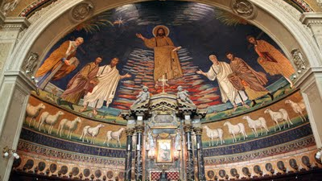
PG studies in classics and ancient history, Warwick
Welcome!!!!

Slide 2
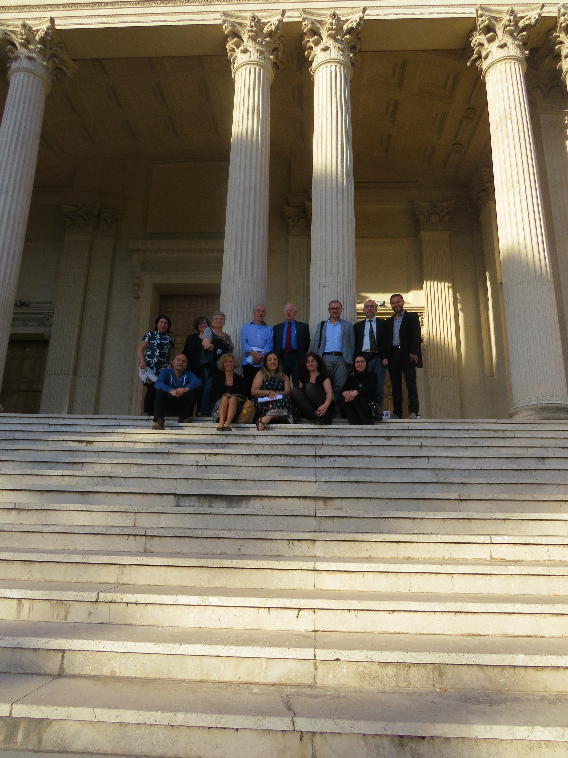
Research culture
Collaborative, congenial atmosphere (staff + research fellows)
Dynamic and proactive attitude (conferences and workshop organization, on site and beyond: BSR, Warburg Institute, …)
Network: links with prominent institutions, research institutes, publishers etc around the world
Range of expertise: visual and material culture, including coinage, archaeology, palaeography (Greek and Latin), textual criticism, literary criticism, … archaic Greece to Renaissance
Resources on campus (incl. TLG, online journals and other resources)
Collaboration with other centers in the Faculty of Arts (Renaissance, History of Art, etc)

Slide 3
PG student support
Access to our full range of expertise
Inclusive research practices: involve students in our research/events/publications
Help towards raising funds or getting grants (apply with the help of supervisor + DGS)
Warwick funding to organize PG workshops/conferences (HRC)
Support to travel for field work/ attend conferences (apply through external/internal funding)
Support for outreach/public engagement projects
Cross-faculty services : Sports, Wellbeing, etc
Work opportunities + teaching (from year 2 of PhD)
PG community

Slide 4
Steps in your phd
Year 1: mandatory training
End of year 1: UPGRADE (submission of 1 chapter and detailed plan of thesis with assessment by 2 members of staff)
End of year 2/3 : annual review by 2 members of staff
6 months from completion: final interview re. progress etc.
If need for field work (esp. abroad) then flexibility is usually granted
(different periodization if part-time study)

Slide 5
Mandatory training
Departmental training (year 1: term 1) for PhD students and MAR
Faculty training: CADRE workshops (year 1) for PhD students and MAR
Work in Progress Seminar (Classics & Ancient History)
OPTIONAL : GERMAN CLASSES

Slide 6
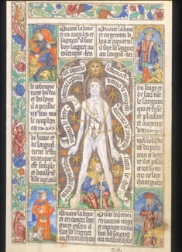
Questions/contact
Caroline Petit : c.c.l.petit@warwick.ac.uk (Director of Graduate Studies)
Suzanne Frey-Kupper :
s.frey-kupper@warwick.ac.uk (MAT)
Alison Cooley : A.Cooley@warwick.ac.uk (current Head of Department)
Zahra Newby: Z.L.Newby@warwick.ac.uk
(Head of Department from September 2018)

