Slide 1
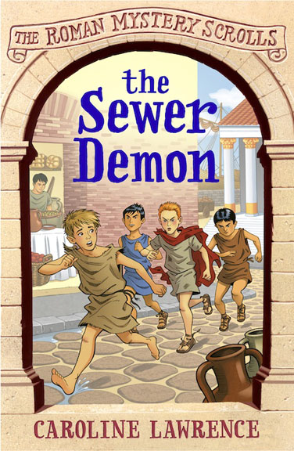
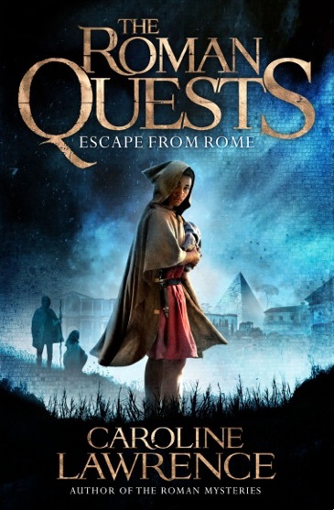

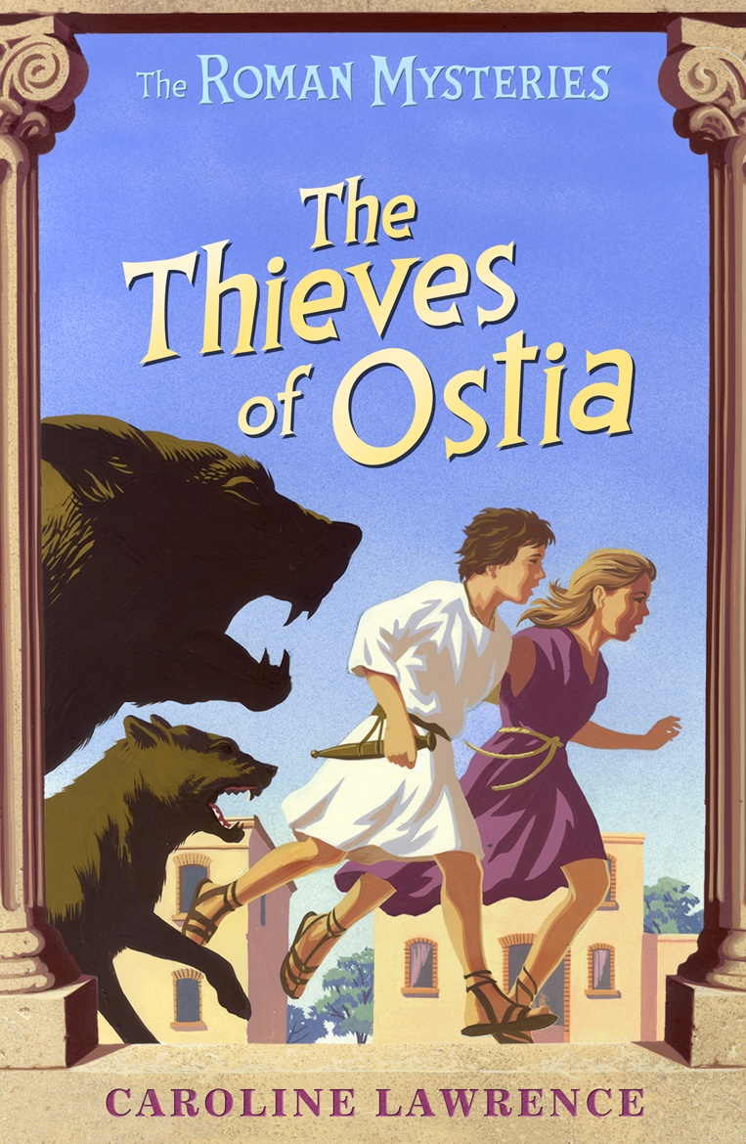

Myth, Movies and Storytelling
carolinelawrence@me.com

Slide 2


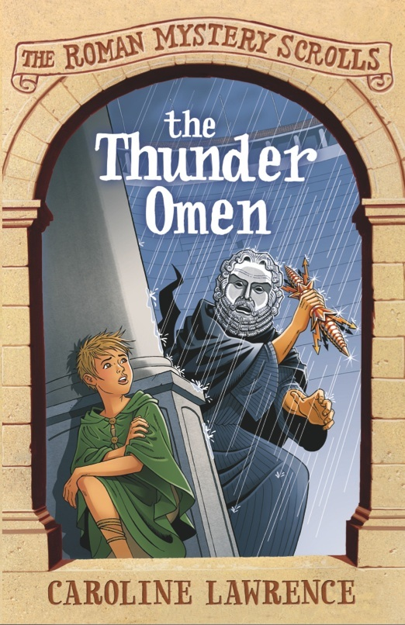


Slide 3

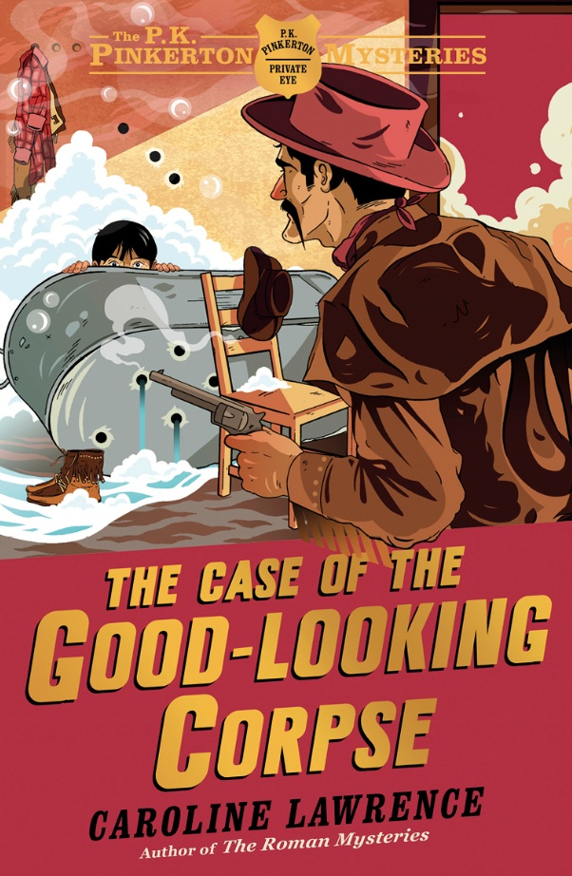

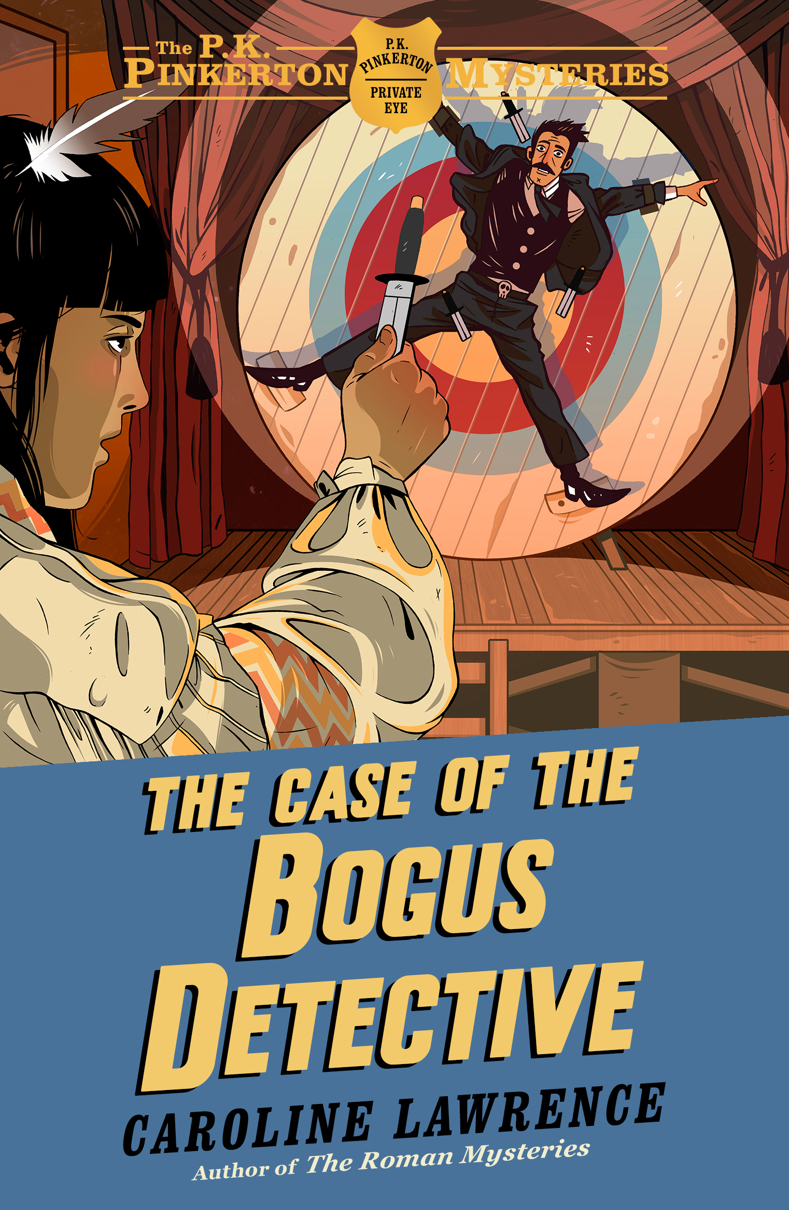
The P.K. Pinkerton Mysteries
a kid detective in the Wild West

Slide 4

dark stories from Virgil’s Aeneid

Slide 5
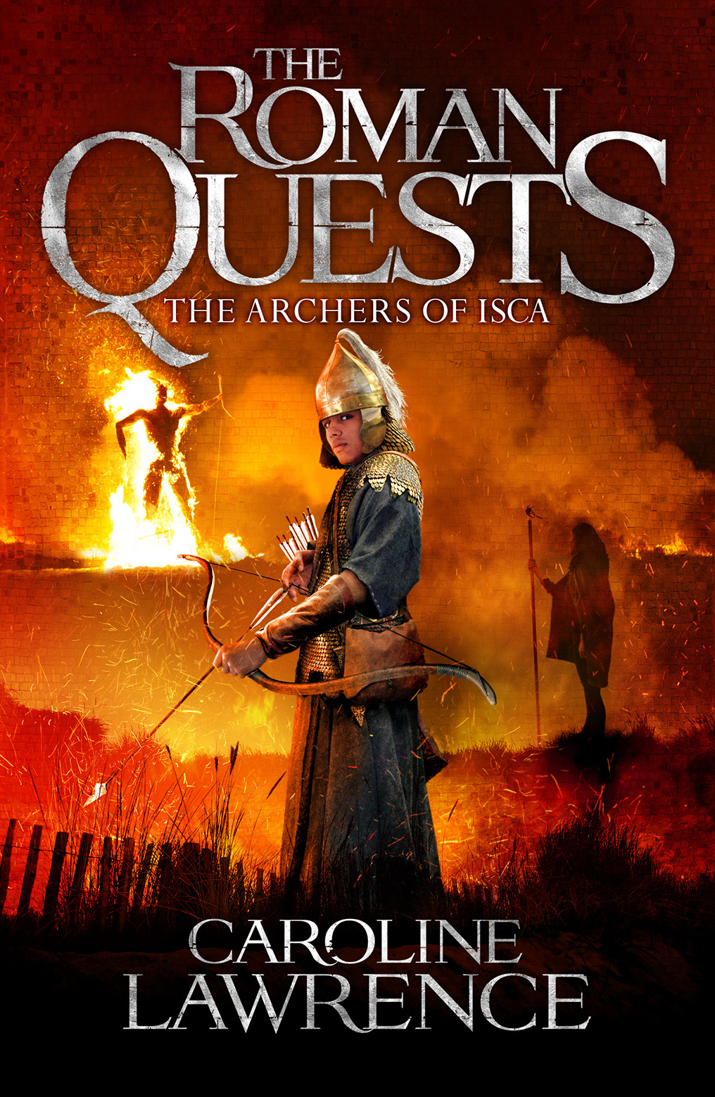
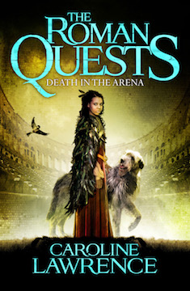
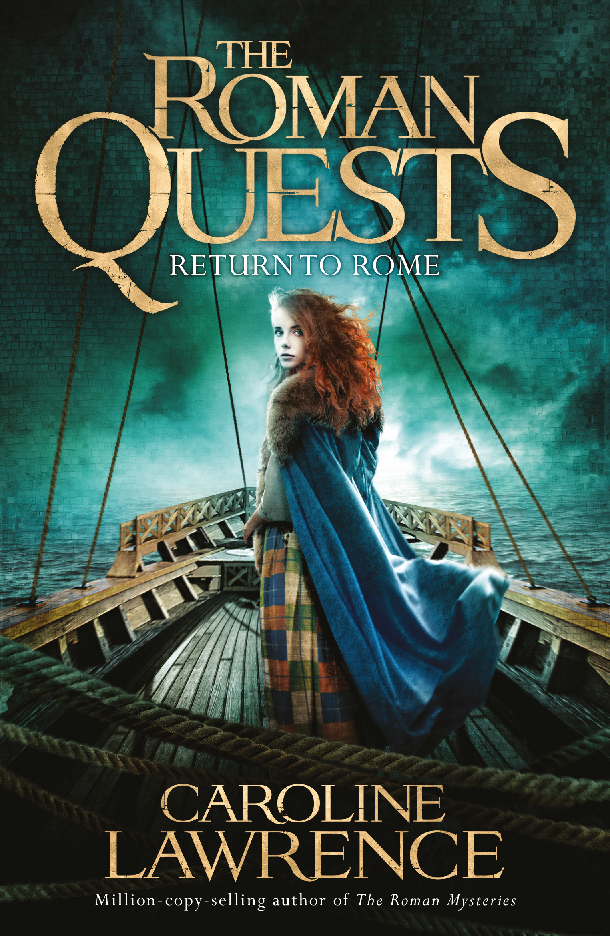
The Roman Quests
set in Roman Britain

Slide 7
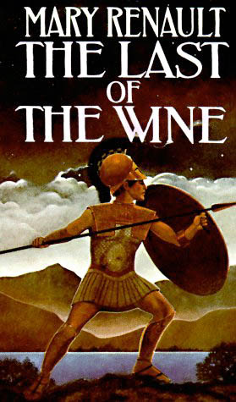

Slide 8
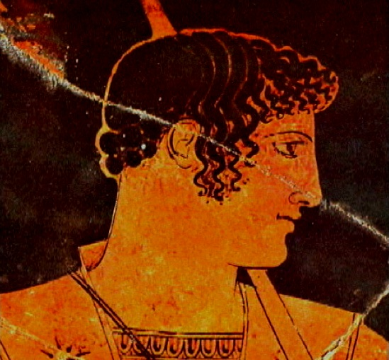

Slide 9
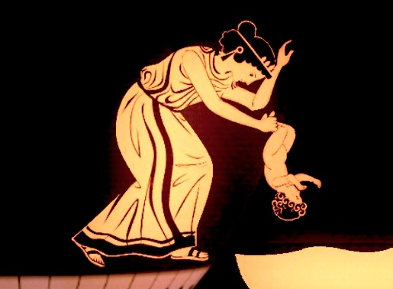

Slide 10
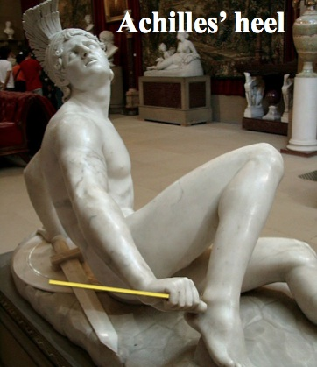

Slide 11
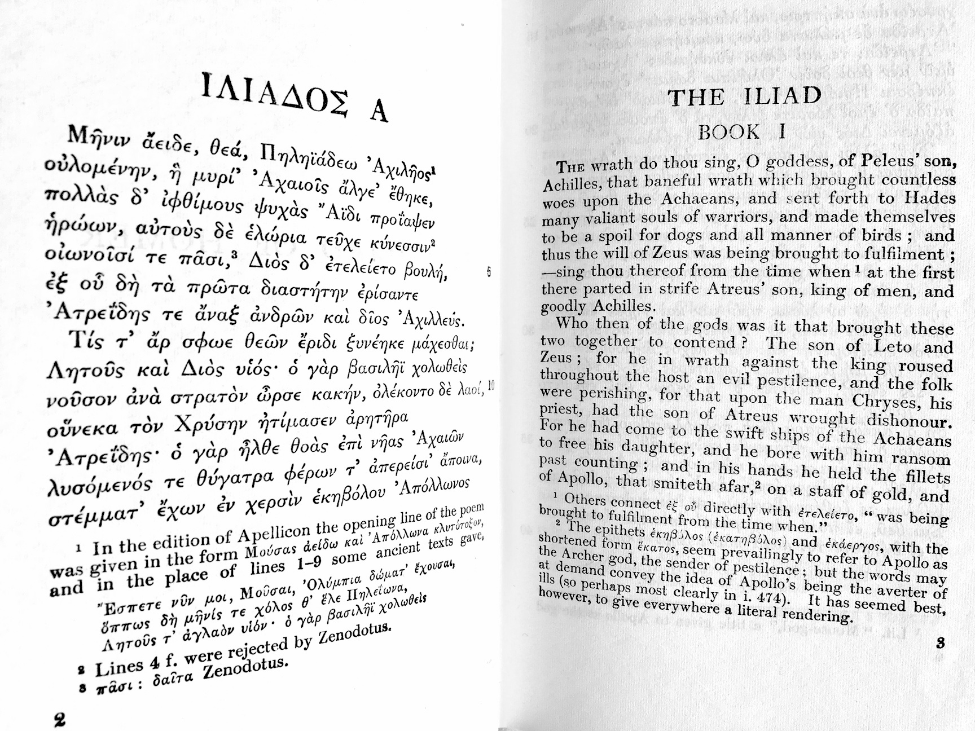

Slide 12
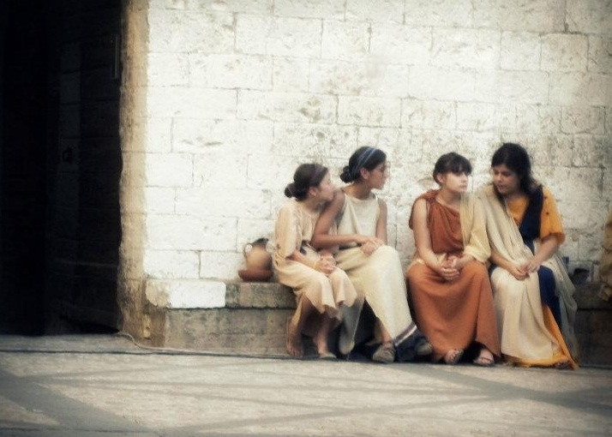
The world of Ancient Rome

Slide 13

Nancy Drew

Slide 14

Nancy Drew in Ancient Rome

Slide 15
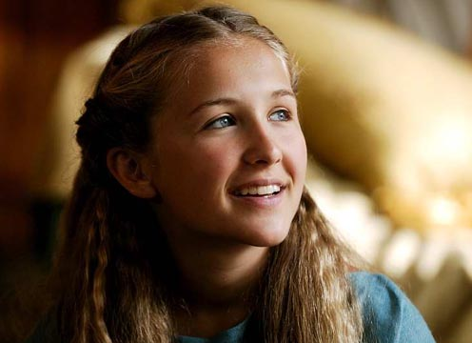
Flavia Gemina, detectrix

Slide 17
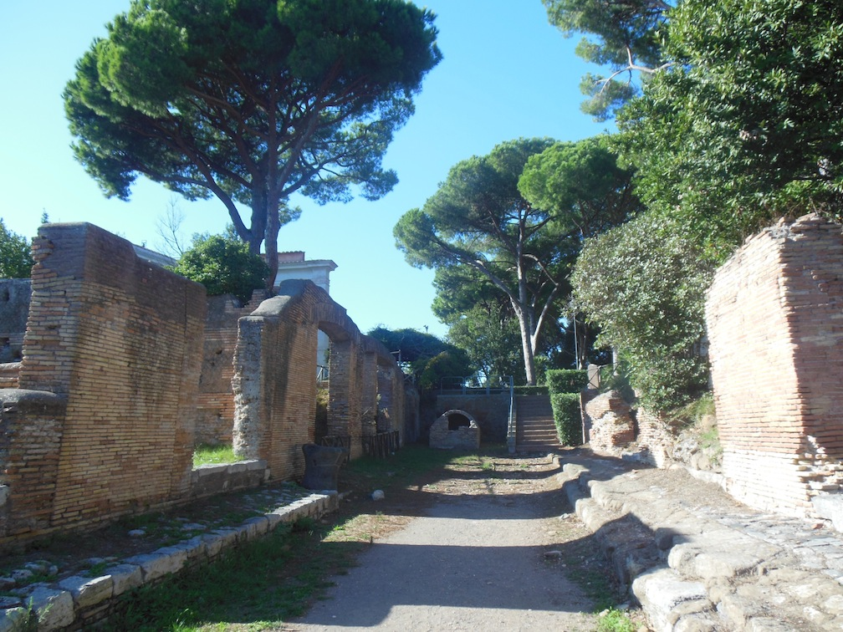
Ostia Antica today

Slide 18
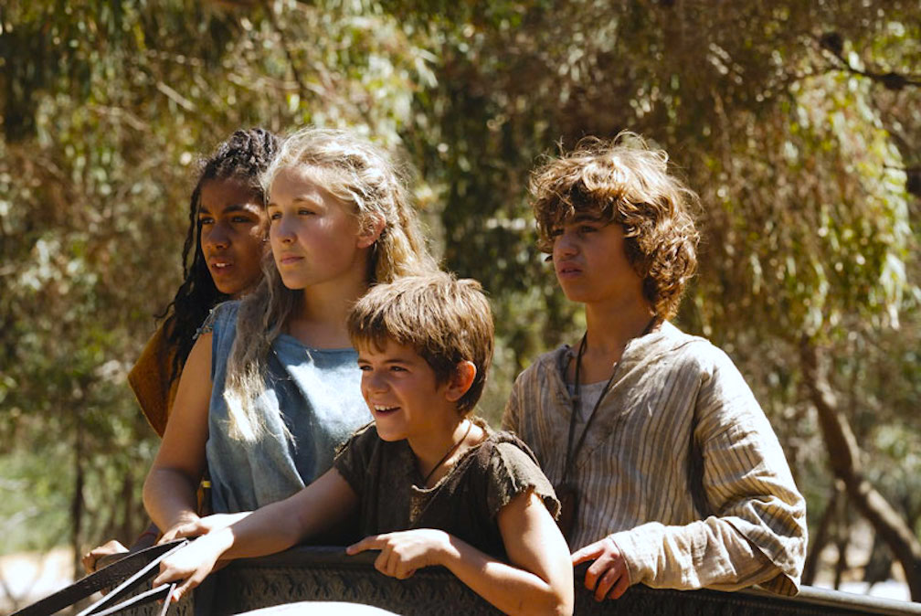
The Hero’s Journey

Slide 19
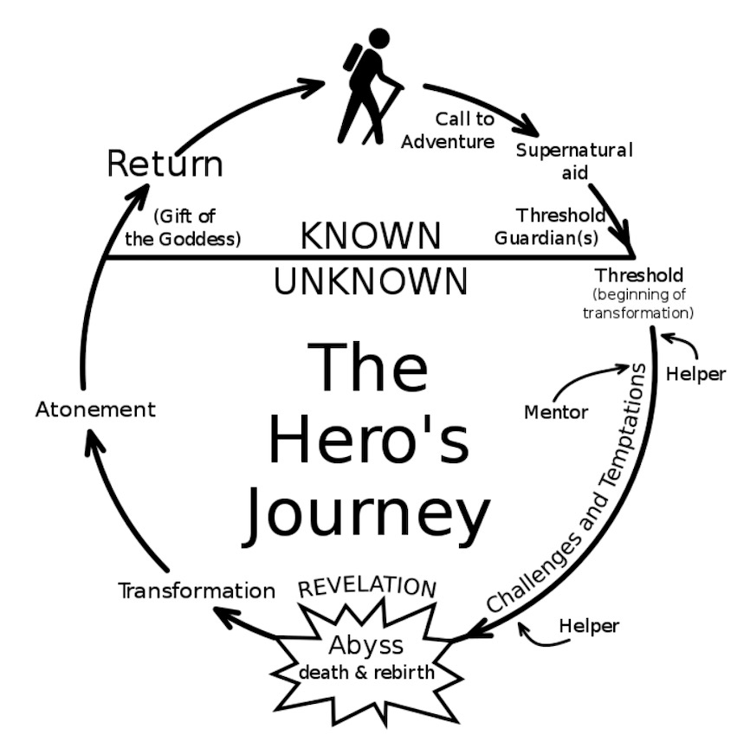
The Hero’s Journey

Slide 20
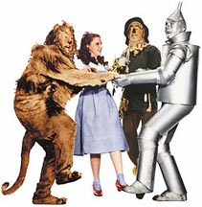
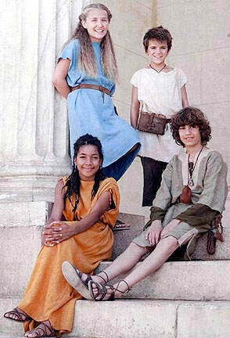
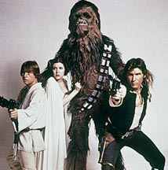

5 Archetypal Characters
Notes:
I figured out the concept of a hero and his entourage by watching movies. I noticed my favourite films always have a hero with about three sidekicks. I tried to identify them and it was pretty easy.

Slide 21
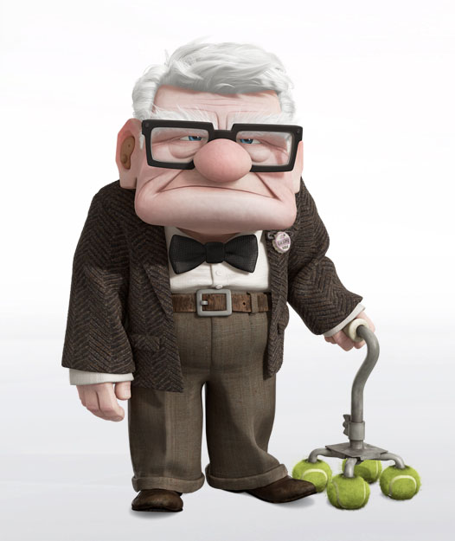
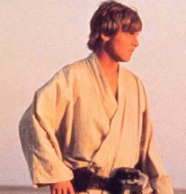
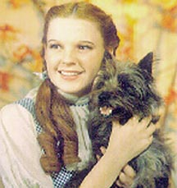
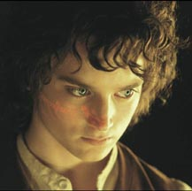
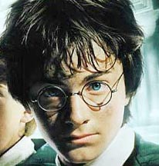
The Hero

Slide 22
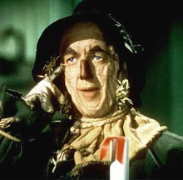

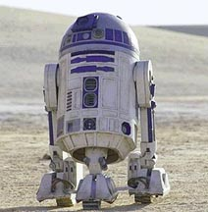
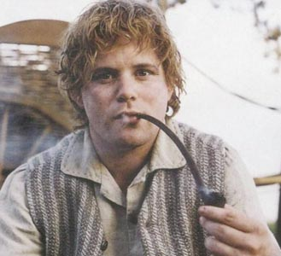
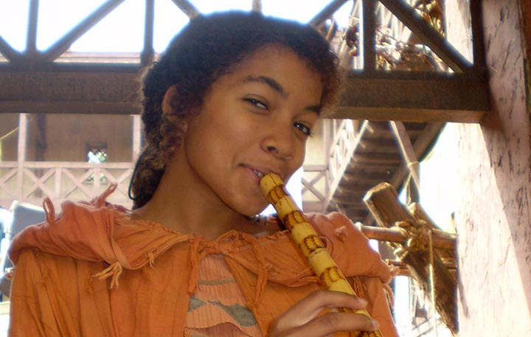
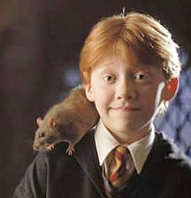
Faithful
Sidekick

Slide 23
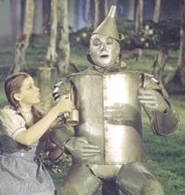

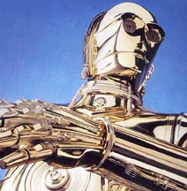
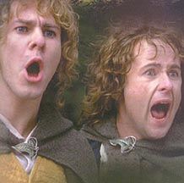
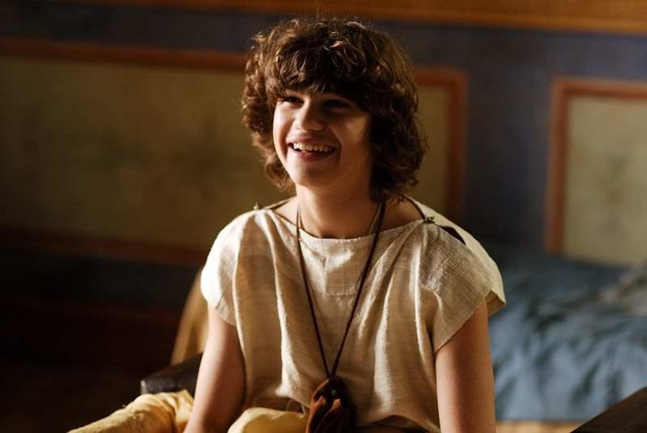
Funny One

Slide 24

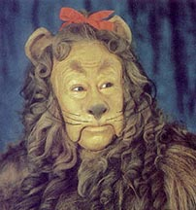
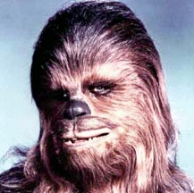
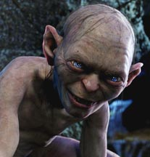
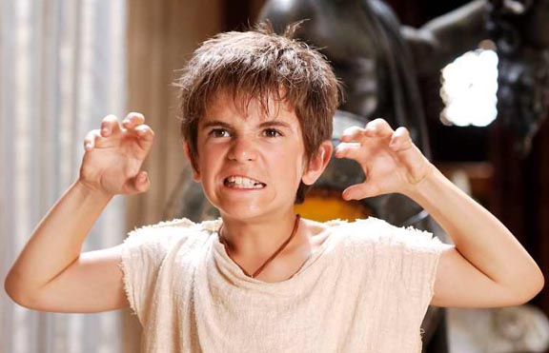
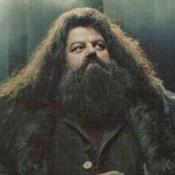
Wild One

Slide 25

The Mentor

Slide 26
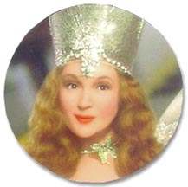
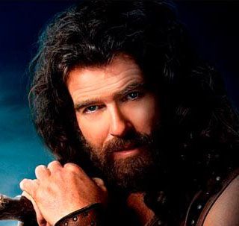
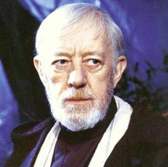
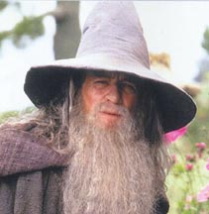
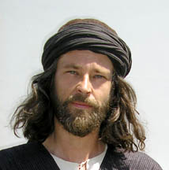
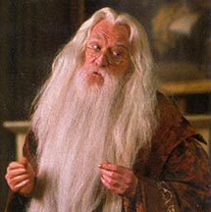
The Mentor

Slide 27
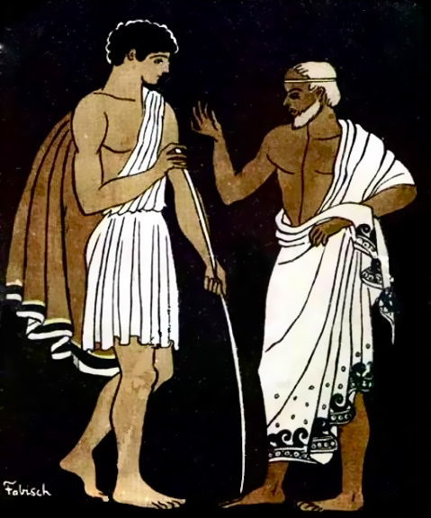
The Mentor

Slide 28
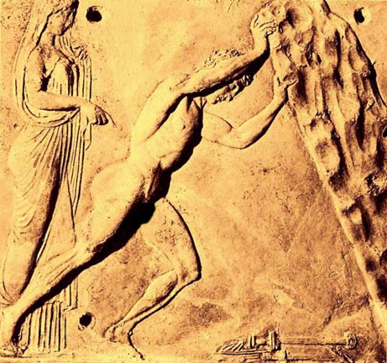
The Mentor & the Talisman

Slide 29
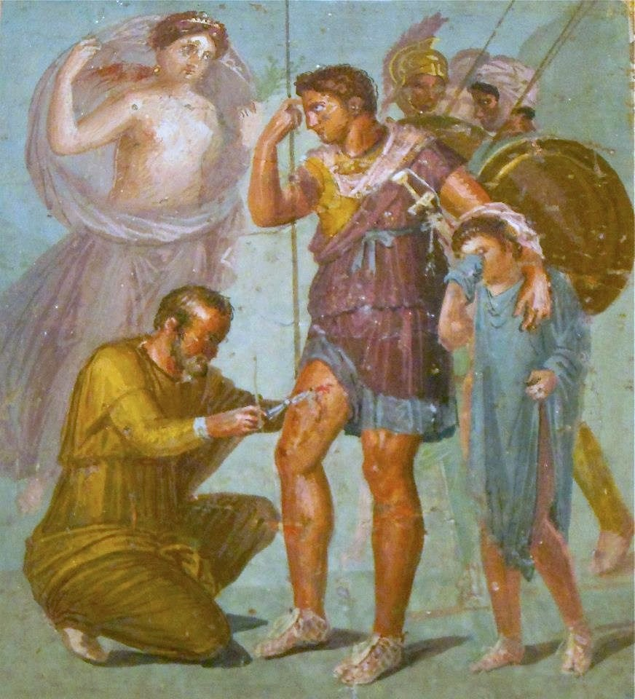
Aeneas the Trojan

Slide 30

Crossing the Threshold
Aeneas & family flee burning Troy

Slide 31

The Hero’s Journey
Crossing the Threshold

Slide 32

Crossing The Threshold
Jason & the Argonauts (1963)

Slide 33

Crossing The Threshold
Cocteau’s Orphee (1950)

Slide 34

Crossing The Threshold
The Matrix (1999)

Slide 35

Crossing the Threshold
The Wizard of Oz (1935)

Slide 36

Crossing the Threshold
Pixar’s UP (2009)

Slide 37

Crossing the Threshold
WALL-E (2008)

Slide 38

Crossing the Threshold
Aeneas visits the Underworld

Slide 39

Paddington (2014)
Notes:
Paddington’s story and that of Aeneas are essentially the same: the search for a new home.

Slide 40

The Mentor & the Talisman

Slide 41

Crossing the Threshold

Slide 42

Crossing the Threshold

Slide 43

Crossing the Threshold

Slide 44

Crossing the Threshold

Slide 45

Crossing the Threshold

Slide 46

Crossing the Threshold
Paddington goes to the Underworld
Notes:
Often as part of the journey, the middle of the story, your hero makes a visit to death and face their own mortality. This can be literal or metaphorical.

Slide 47

Crossing the Threshold
Paddington goes to the Underworld

Slide 48

A kind of ‘mentor’
Paddington goes to the Underworld

Slide 49

A kind of ‘talisman’
Paddington goes to the Underworld

Slide 50

Crossing the Threshold

Slide 51

Crossing the Threshold

Slide 52

Threshold Guardians!

Slide 53

Romans Knew About Thresholds
Notes:
There is something PRIMAL about Thresholds, too. The Romans believed that where two worlds met was a powerful place.

Slide 54

CAVE CANEM!

Slide 55

Staring faces keep away evil

Slide 56

Left hand to ward off evil

Slide 57

Shrine with lucky snake

Slide 58

Lucky snake

Slide 59

Cacator, cave malum…
Cacator, cave malum…

Slide 60

Graffiti of a Demon

Slide 61

public toilets at Ostia

Slide 62

Sponge on a stick

Slide 63


Slide 64

latrines in Roman Britain

Slide 66

Introducing a new hero…
Threptus!

Slide 67

Crossing the Threshold!!

Slide 68


Slide 69



Slide 70


Slide 71






Tips, Tricks and Tropes
Ninja Description

Slide 72
Myth, Movies and Storytelling
carolinelawrence@me.com

