Slide 1
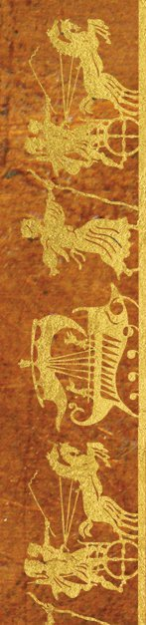
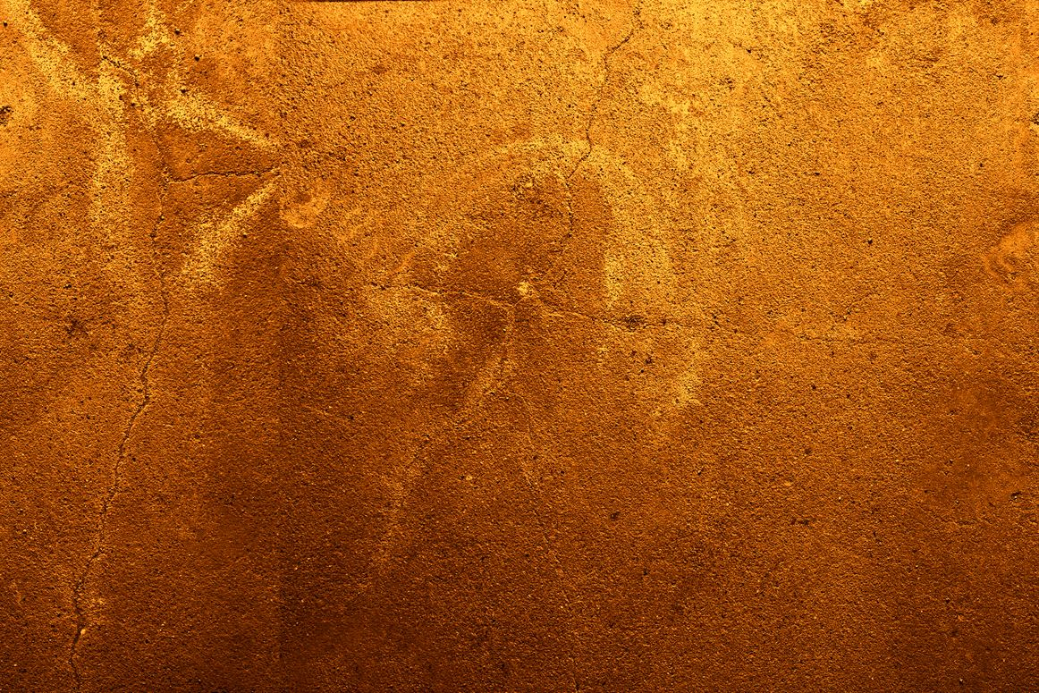
REWRITING ANCIENT GREEK MYTH IN FICTION
WARWICK ANCIENT WORLDS DAY
21 NOVEMBER 2019
Dr. Emily Hauser
University of Exeter
e.hauser@exeter.ac.uk
@ehauserwrites
www.emilyhauser.com

Slide 2
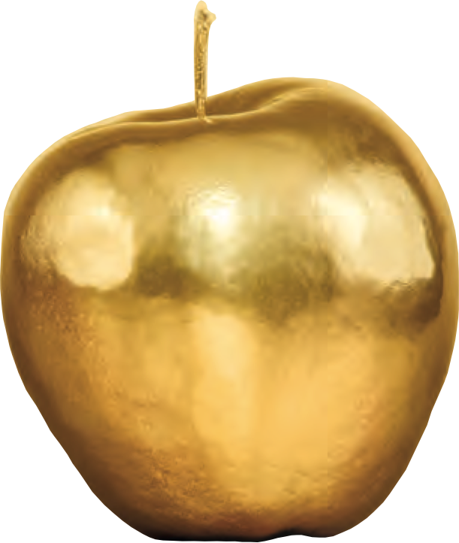
SCROLL 1
BEFORE THE TROJAN WAR
Before we set out in search of the Trojan War, it’s helpful to know more about the heroes on our quest, what you already know, and what you’re looking to discover!
Q
How would you describe your gender?
Please tick the appropriate box.
Q
Have you ever thought about writing fiction yourself?
☐ Male
☐ Female
☐ Non binary
☐ Prefer to self-describe ___________
☐ Prefer not to say
☐ Yes
☐ No
Detail, if appropriate:
________________________________
________________________________
________________________________
Q
How old are you?
☐ Under 11
☐ 11-16
☐ 16-25
☐ 26-35
☐ 36-45
☐ 46-55
☐ 56-65
☐ Over 65
Q
Do you think it’s useful to retell the stories of the ancient world for a modern audience?
☐ Not useful
☐ Slightly useful
☐ Moderately useful
☐ Very useful
Why?
________________________________
________________________________
Q
How much do you feel you know about women in Greek myth?
☐ Nothing
☐ Slight level of knowledge
☐ Moderate level of knowledge
☐ High level of knowledge
Q
How confident are you discussing the ways in which fictional retellings rework ancient myth?
Q
Which of these women are told of in ancient Greek myths about the golden apples?
☐ Not confident
☐ Slightly confident
☐ Moderately confident
☐ Very confident
☐ Helen of Troy
☐ Cleopatra
☐ Hippolyta
☐ Atalanta

Slide 3




Slide 4
It was a war that gave birth to legends – to Achilles, the greatest of the Greeks, and Hector, prince of Troy.
Three thousand years later, it’s time for the women of Troy to tell their story…
“Stunning” — MANDA SCOTT, bestselling author of Boudica
“Written with energy and passion” — THE TIMES
“Fascinating” — BBC HISTORY

Slide 5
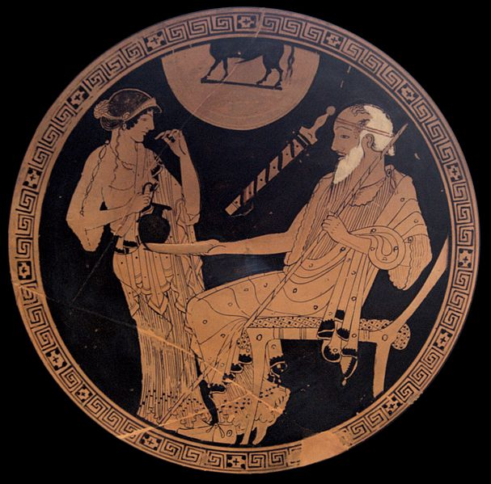

Slide 6
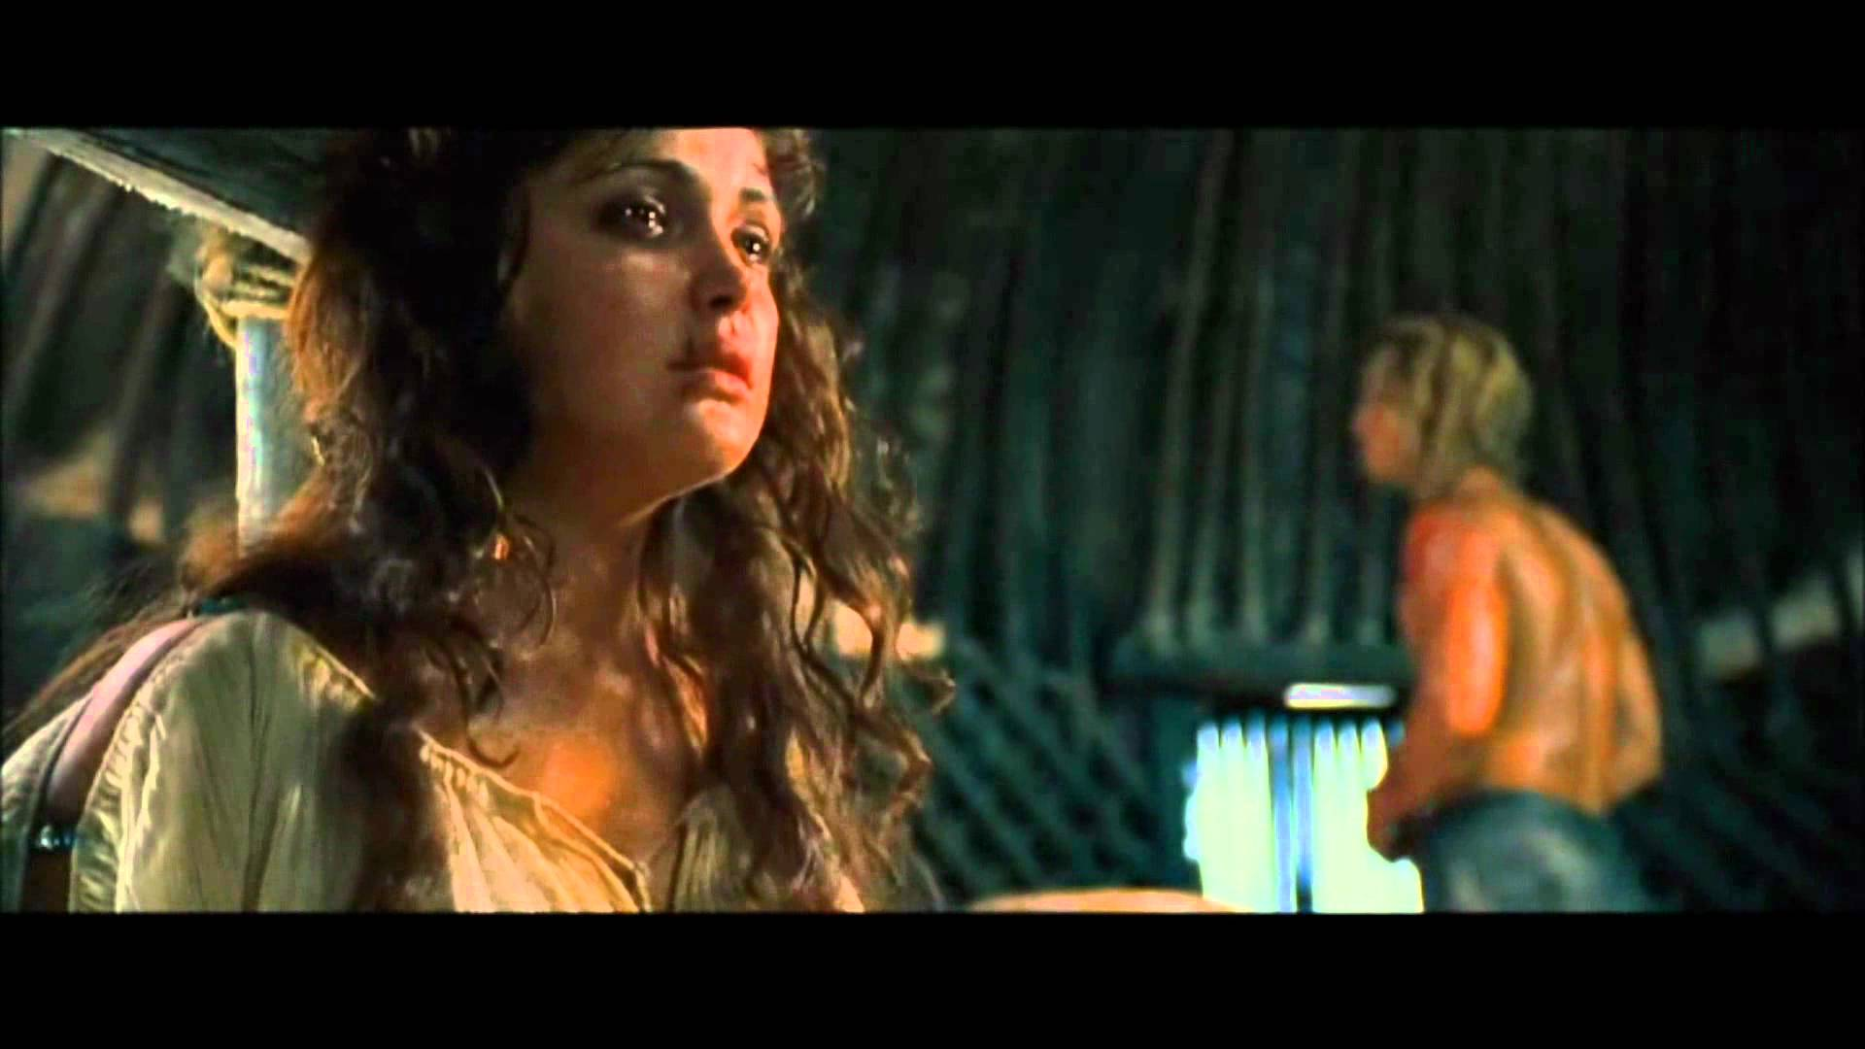

Slide 7
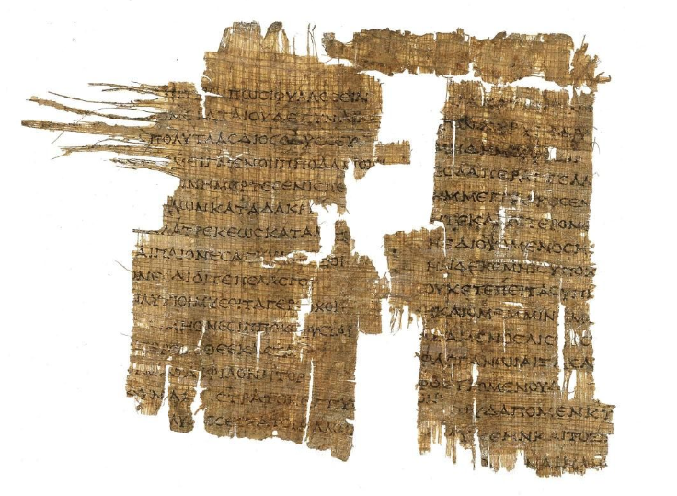
Papyrus fragment of the Iliad
Iliad. Book 10. 421-434, 445-460
(P. Mich. Inv. 6972)
2nd century BCE

Slide 8
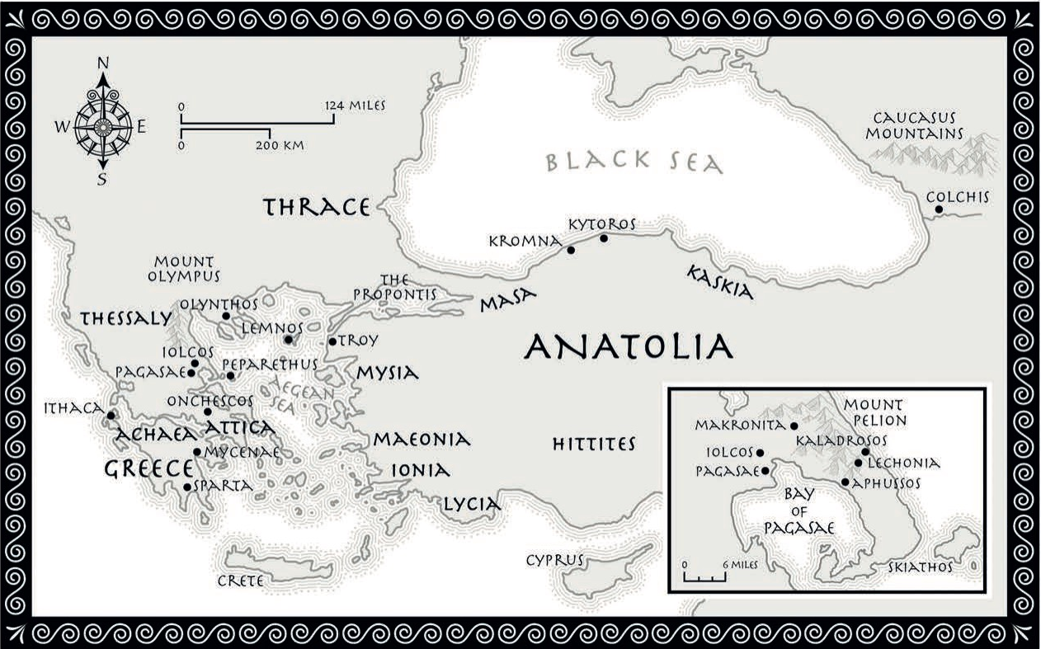

Slide 9
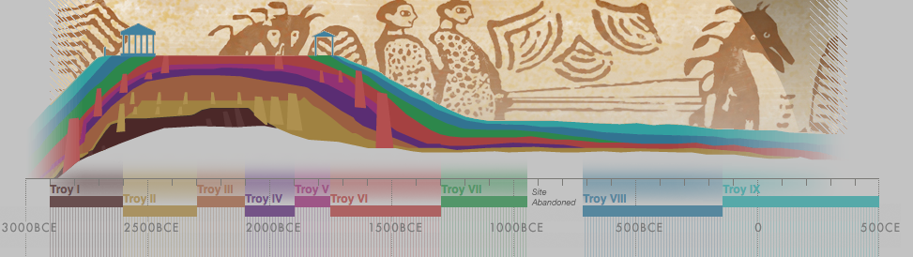
Cross-section: Site of Troy
Source: University of Cincinnati CERHAS Project, http://cerhas.uc.edu/troy/timeline.html

Slide 10
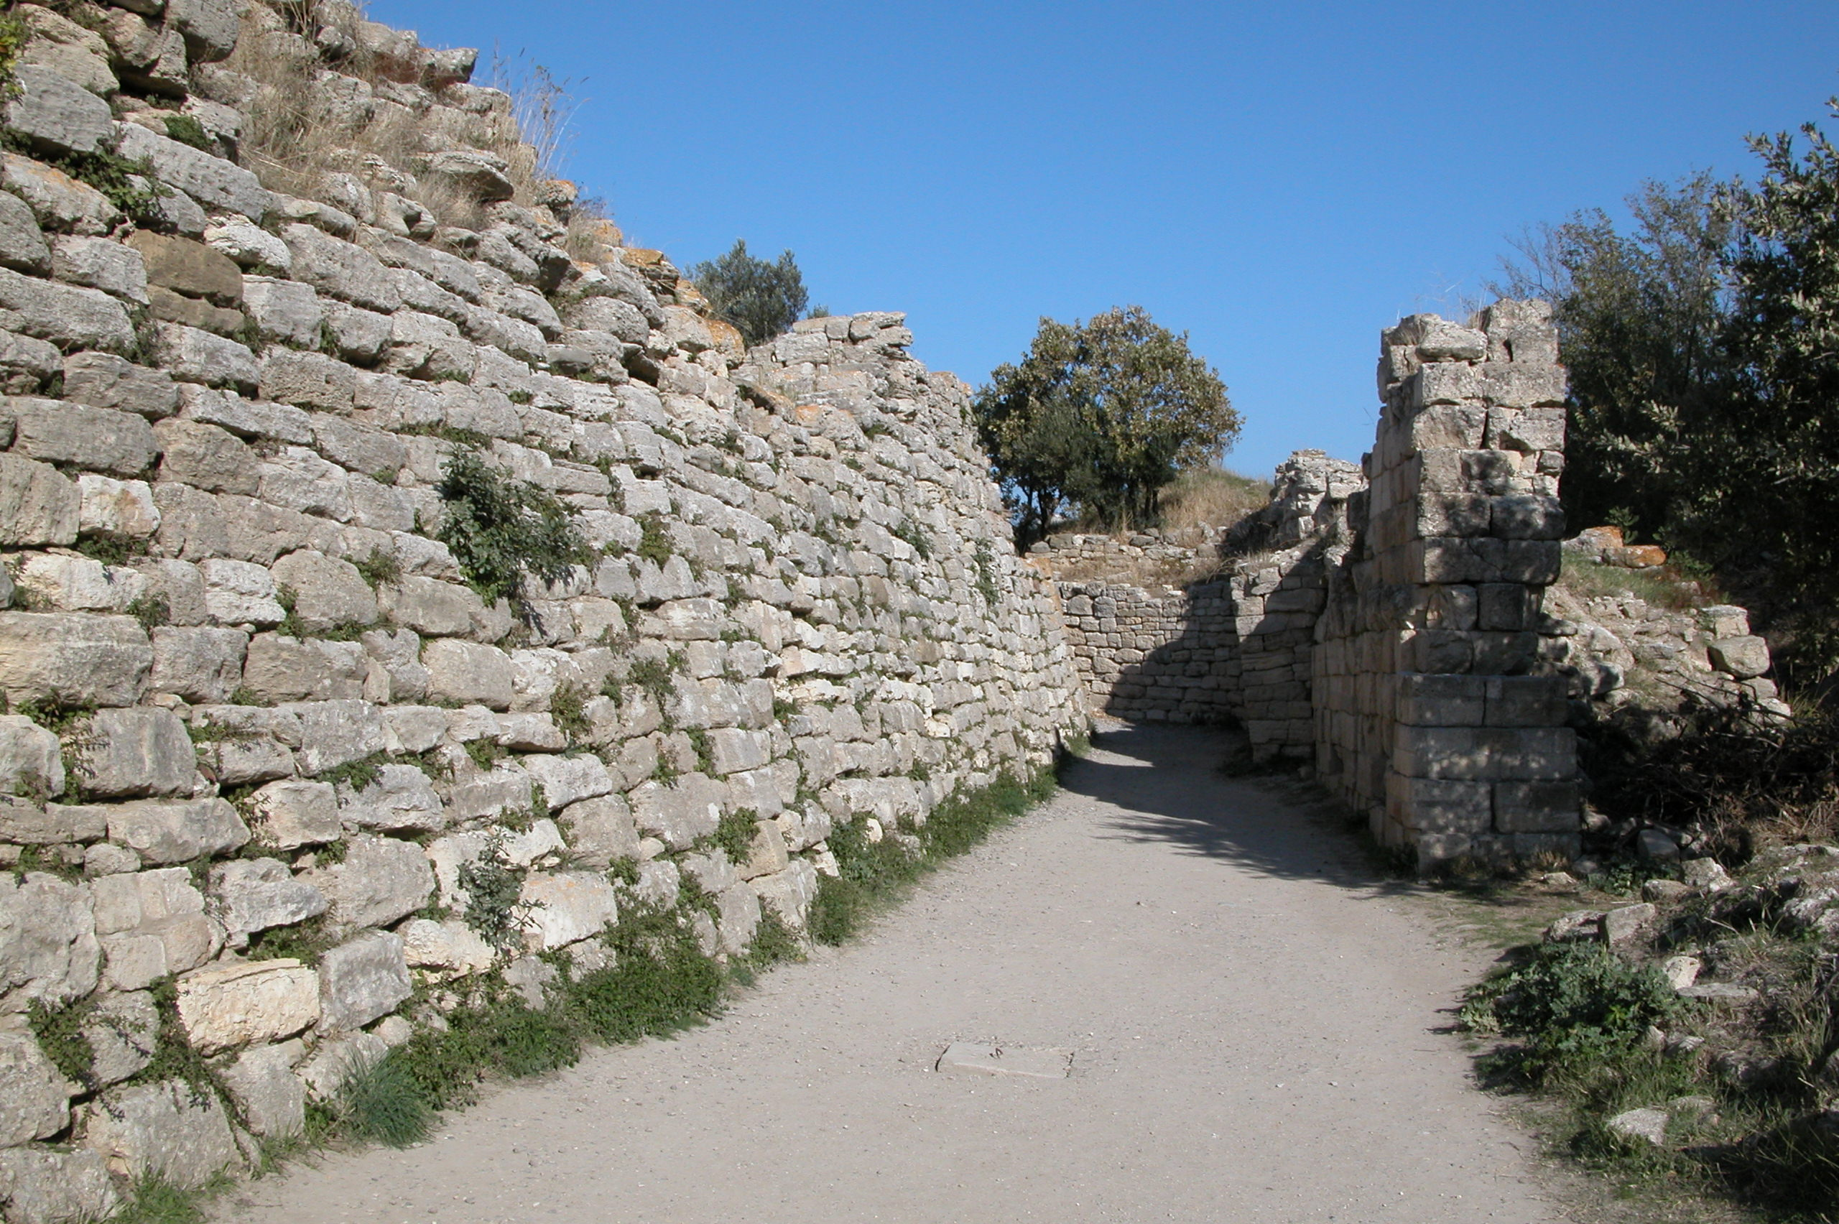
The walls of Troy VI (Homer’s Troy)
τρὶς μὲν ἐπ᾽ ἀγκῶνος βῆ τείχεος ὑψηλοῖο Πάτροκλος…
Three times Patroclus tried to scale the bend/slope/angle of the high wall…
Iliad 16.702-3

Slide 11
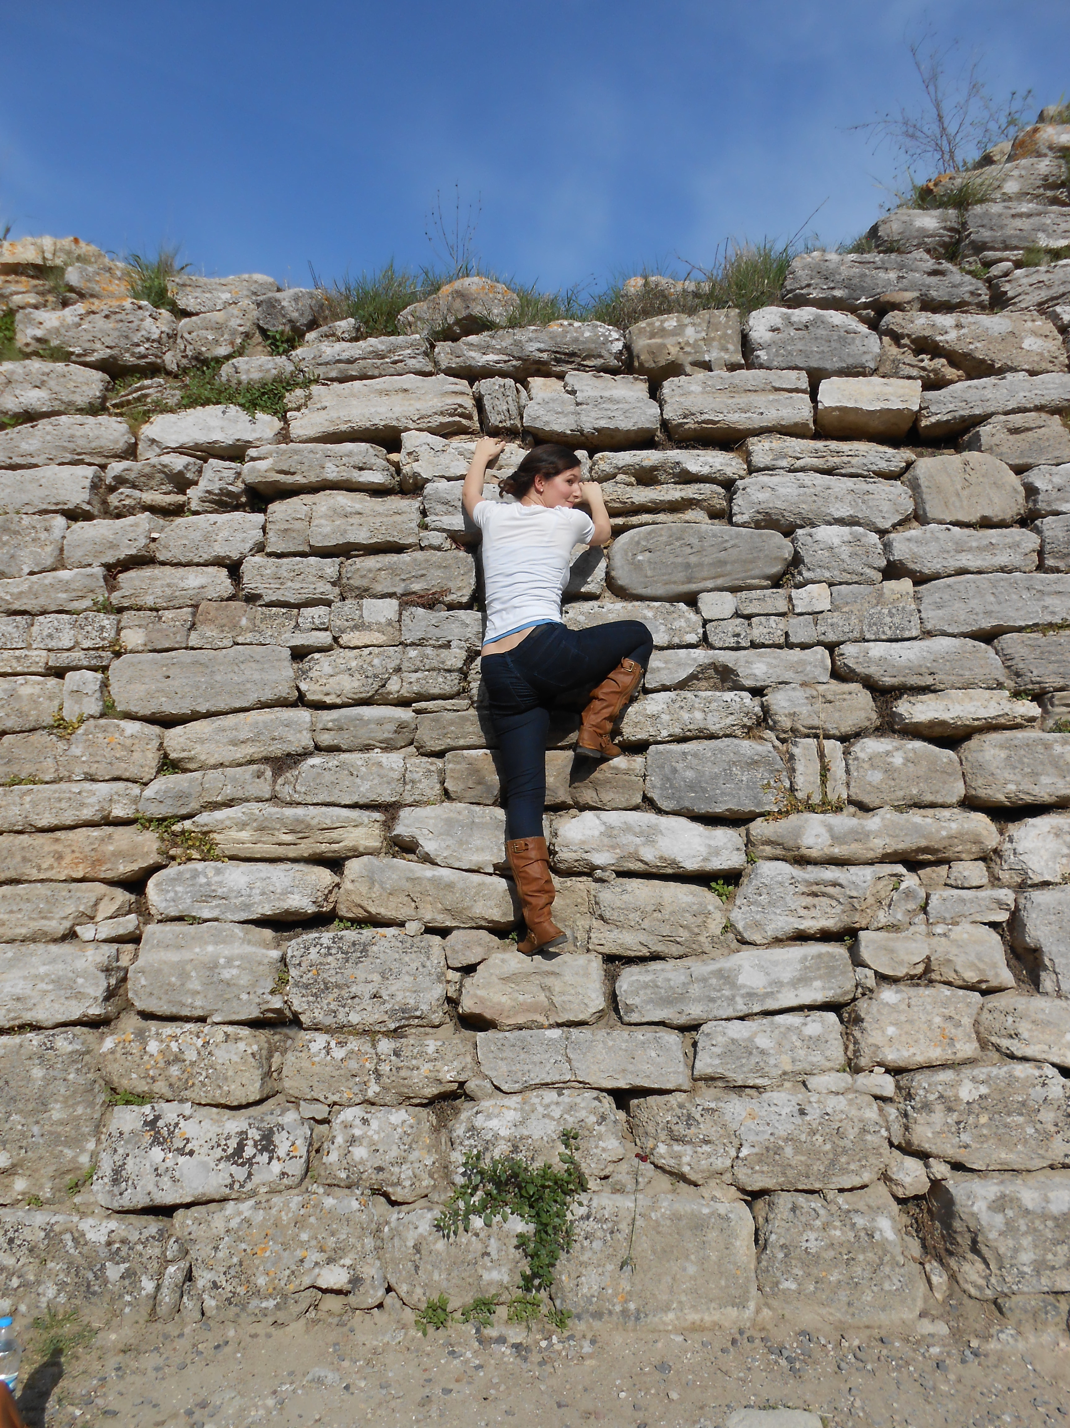

Slide 12
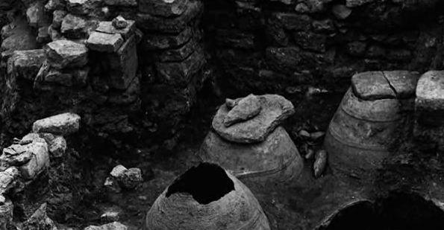
Evidence of a siege mentality: buried clay vessels

Slide 13
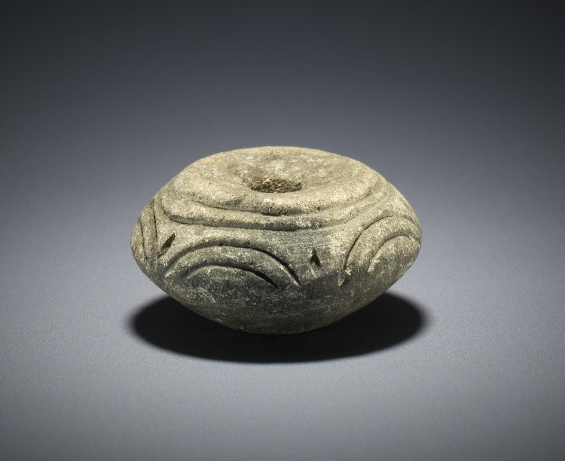
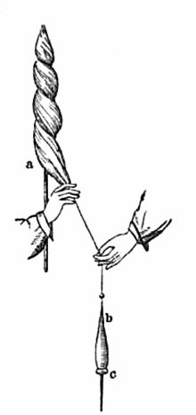
Spindle whorl from Troy, 3000–2000 BCE
The British Museum
3.1 x 1.6 cm

Slide 14
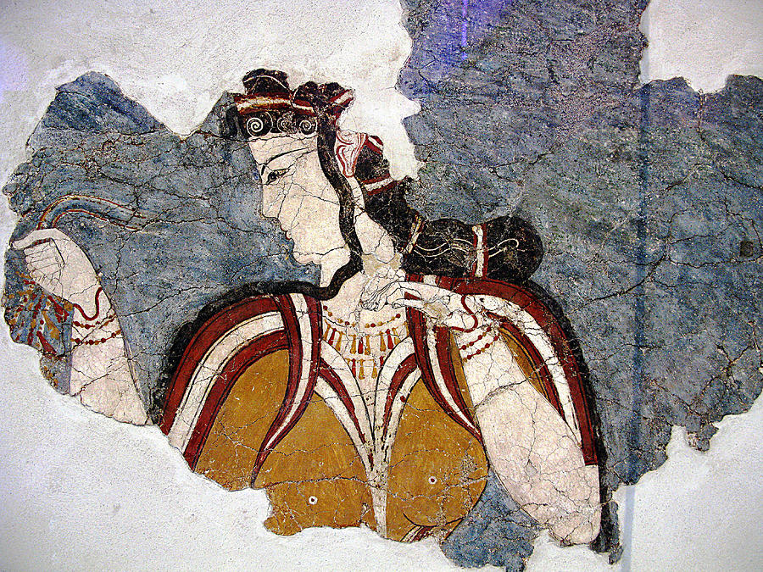
The Mycenaean Lady Fresco
Mycenae, 13th cent. BCE

Slide 15
κεῖτο γὰρ ἐν νήεσσι ποδάρκης δῖος Ἀχιλλεὺς
κούρης χωόμενος Βρισηΐδος ἠϋκόμοιο,
τὴν ἐκ Λυρνησσοῦ ἐξείλετο πολλὰ μογήσας
Λυρνησσὸν διαπορθήσας καὶ τείχεα Θήβης,
κὰδ δὲ Μύνητ᾽ ἔβαλεν καὶ Ἐπίστροφον ἐγχεσιμώρους, υἱέας Εὐηνοῖο Σεληπιάδαο ἄνακτος…
Briseis and Mynes in the Iliad
Iliad 2.688-694
noble Achilles, the swift of foot, rested idle among the ships, filled with his wrath because of fair Briseis, whom he’d won by his exploits at Lyrnessus, razing it and storming Thebe’s wall, slaughtering Mynes and Epistrophus, bold spearmen, warrior sons of King Evenus, Selepus’ son.

Slide 16
per tamen ossa viri subito male tecta sepulcro,
semper iudiciis ossa verenda meis;
perque trium fortes animas, mea numina, fratrum,
qui bene pro patria cum patriaque iacent …
Briseis, Mynes and her brothers in Ovid
Ovid Heroides 3.103-6
But by the bones of my husband, poorly covered in a quick-raised tomb,
Bones which I will ever hold sacred;
By the brave souls, the sacred ghosts of my three brothers,
Who died well for their country, and with their country they lie…

Slide 17
It was a war that gave birth to legends – to Achilles, the greatest of the Greeks, and Hector, prince of Troy.
Three thousand years later, it’s time for the women of Troy to tell their story…
“Stunning” — MANDA SCOTT, bestselling author of Boudica
“Written with energy and passion” — THE TIMES
“Fascinating” — BBC HISTORY

Slide 18
Some three thousand years ago, in a time before history, the warriors of Greece journeyed to the ends of the earth in the greatest expedition the world had ever seen.
One woman fought alongside them.
“Recreates one of the oldest tales in Greek myth with great skill and panache”
— THE SUNDAY TIMES
“Brilliant” — CRYSTAL KING, author of Feast of Sorrow
“Fascinating and innovative” — ANTONY MAKRINOS, Fellow in Classics at UCL

Slide 19
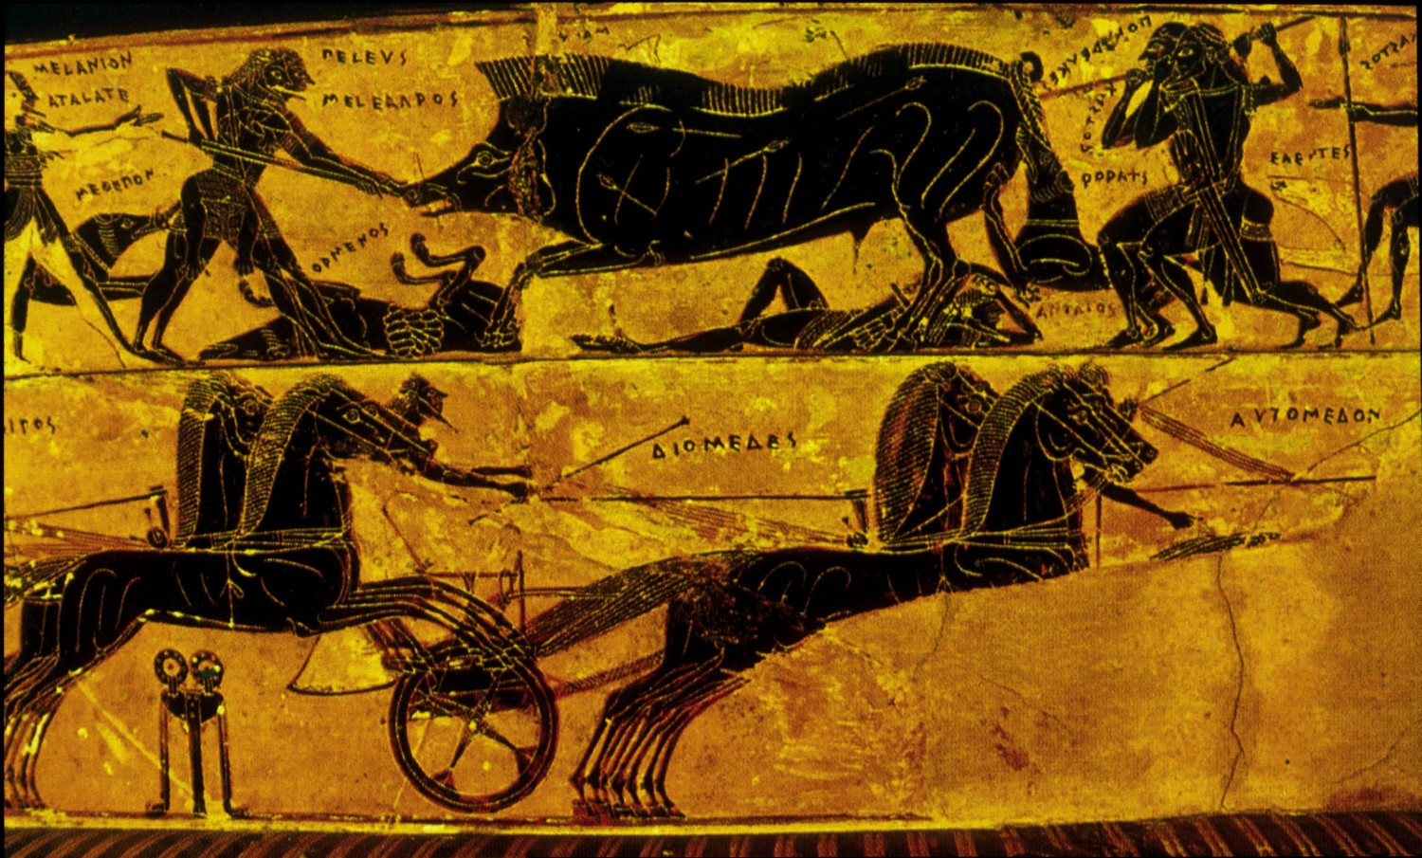
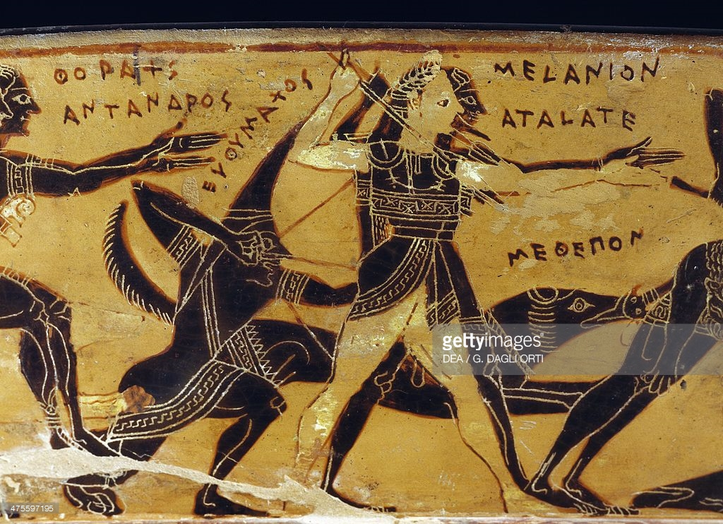

Slide 20
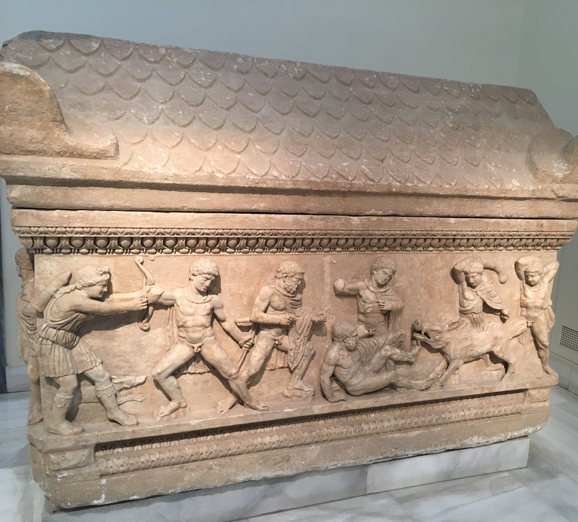
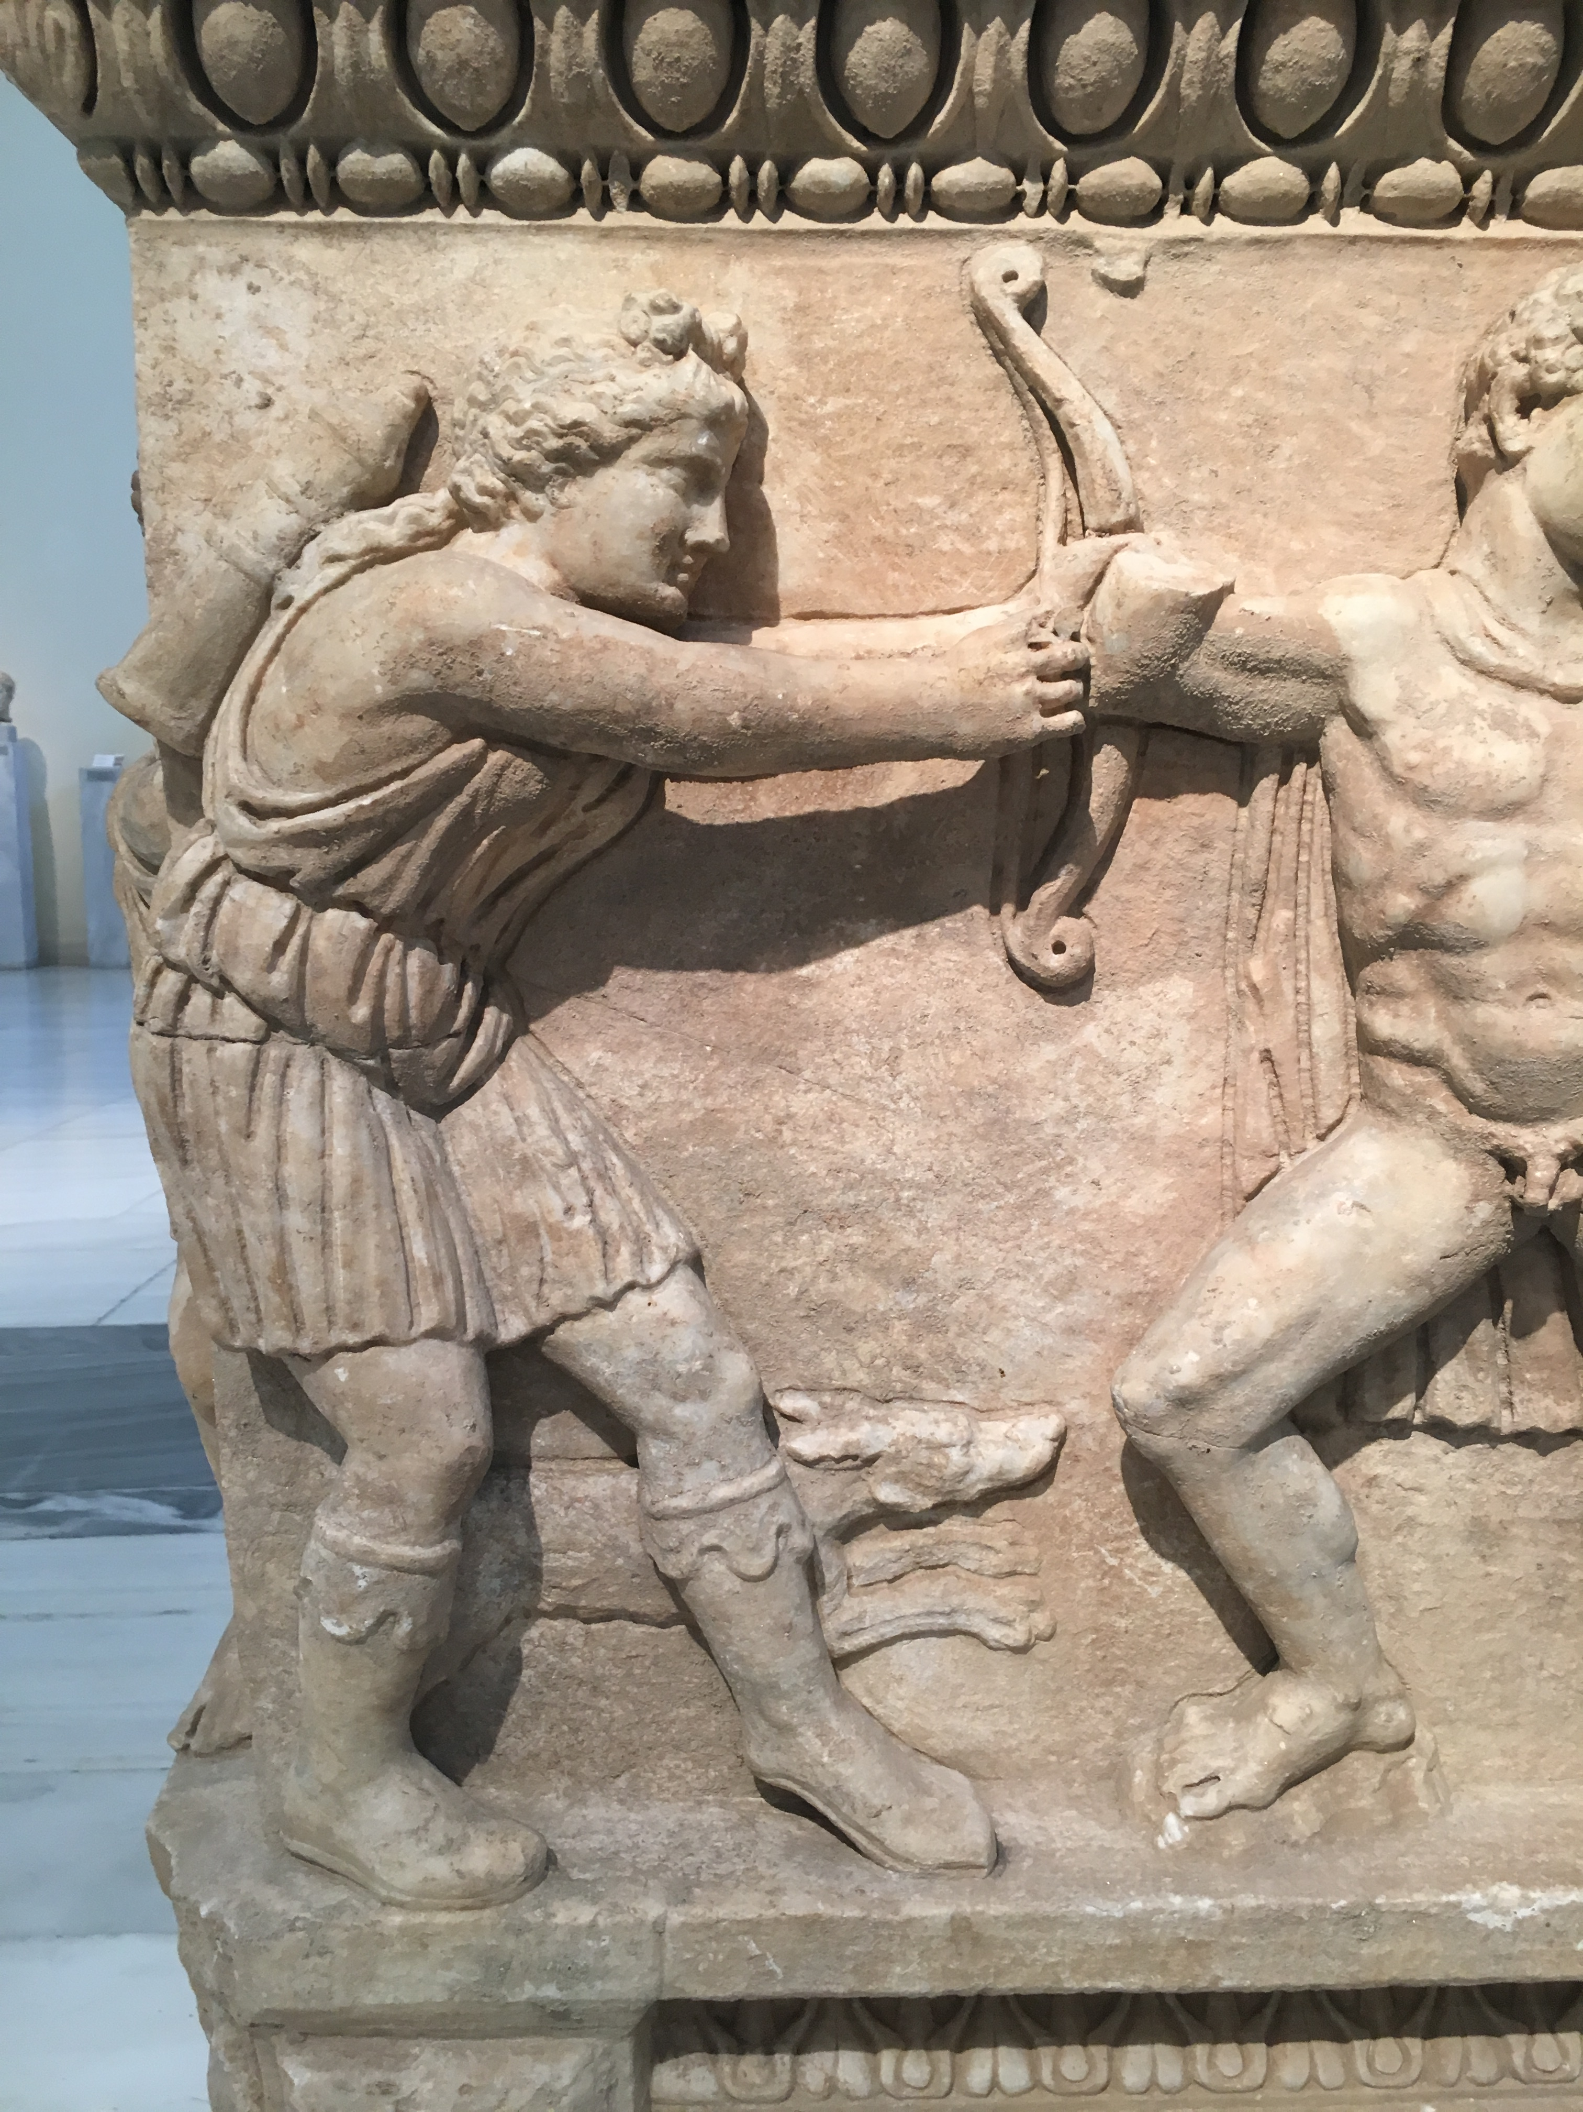

Slide 21
οἱ δὲ συναθροισθέντες εἰσὶν οἵδε: … Κάστωρ καὶ Πολυδεύκης Διός, Τελαμὼν καὶ Πηλεὺς Αἰακοῦ, Ἡρακλῆς Διός, Θησεὺς Αἰγέως, … Ἀταλάντη Σχοινέως …
Atalanta and the voyage of the Argonauts in ancient Greek sources
Apollodorus Library 1.9.16
And these are the heroes whom Jason assembled: … Castor and Pollux, sons of Zeus; Telamon and Peleus, son of Aeacus; Hercules, Zeus’ son; Theseus, son of Aegeus; … Atalanta, daughter of Schoineus…
περὶ γὰρ μενέαινεν ἕπεσθαι
τὴν ὁδόν: ἀλλὰ γὰρ αὐτὸς ἑκὼν ἀπερήτυε κούρην,
δεῖσεν δ᾽ ἀργαλέας ἔριδας φιλότητος ἕκητι.
Apollonius Argonautica 1.771-3
for Atalanta eagerly desired to follow on that quest; but Jason of his own accord prevented the maid, for he feared bitter strife on account of her love.
transl. E.V. Rieu

Slide 22
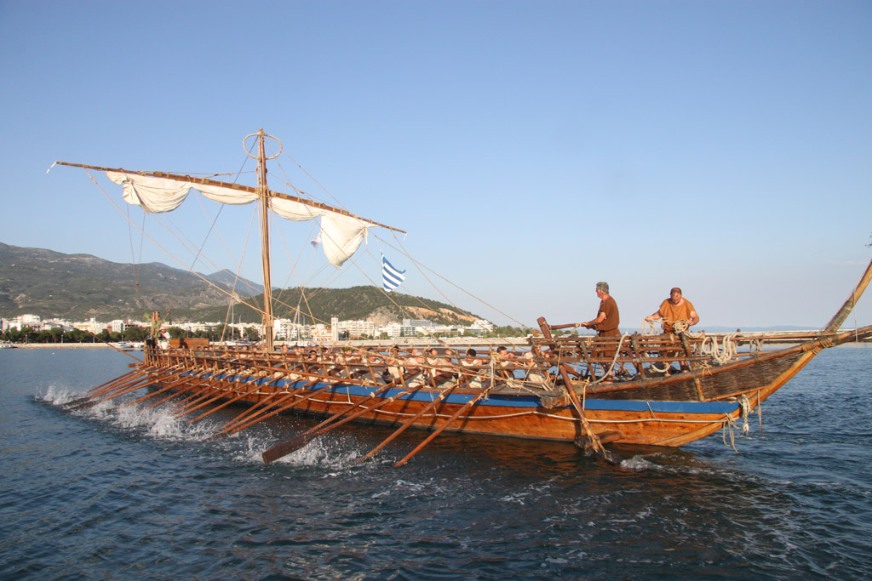

Slide 23
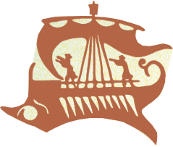

Slide 24
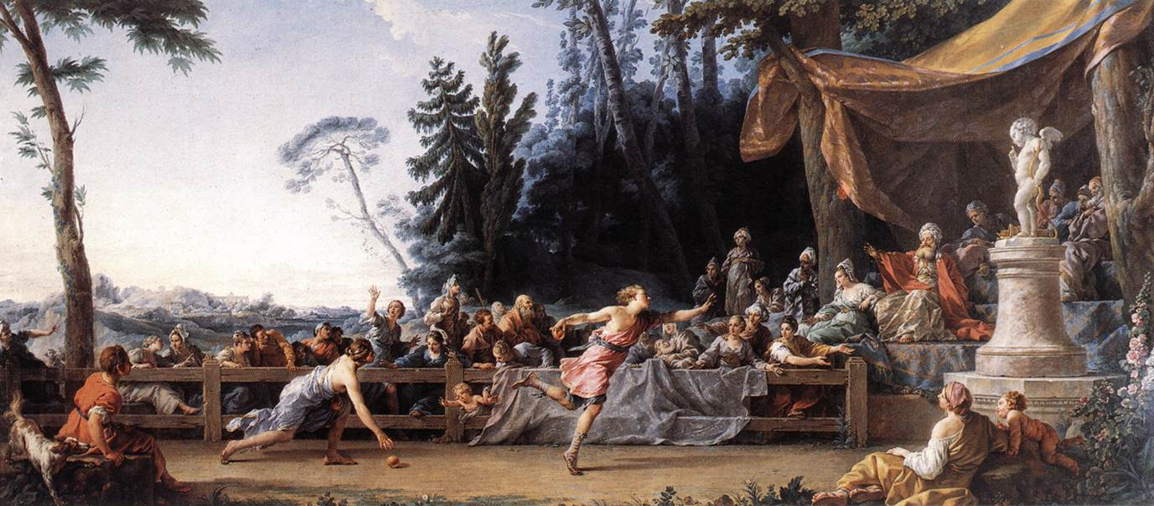

Slide 25
Some three thousand years ago, in a time before history, the warriors of Greece journeyed to the ends of the earth in the greatest expedition the world had ever seen.
One woman fought alongside them.
“Recreates one of the oldest tales in Greek myth with great skill and panache”
— THE SUNDAY TIMES
“Brilliant” — CRYSTAL KING, author of Feast of Sorrow
“Fascinating and innovative” — ANTONY MAKRINOS, Fellow in Classics at UCL

Slide 26
The age of heroes has begun…
“Emily Hauser’s novels combine thoughtful scholarship with a deep love for the ancient mythology. Her passion for bringing these stories to a modern audience is palpable, and her choice to dig into the untold stories of female characters offers a fresh and feminist take on well-known tales”
— MADELINE MILLER, bestselling author of Song of Achilles and Circe

Slide 27
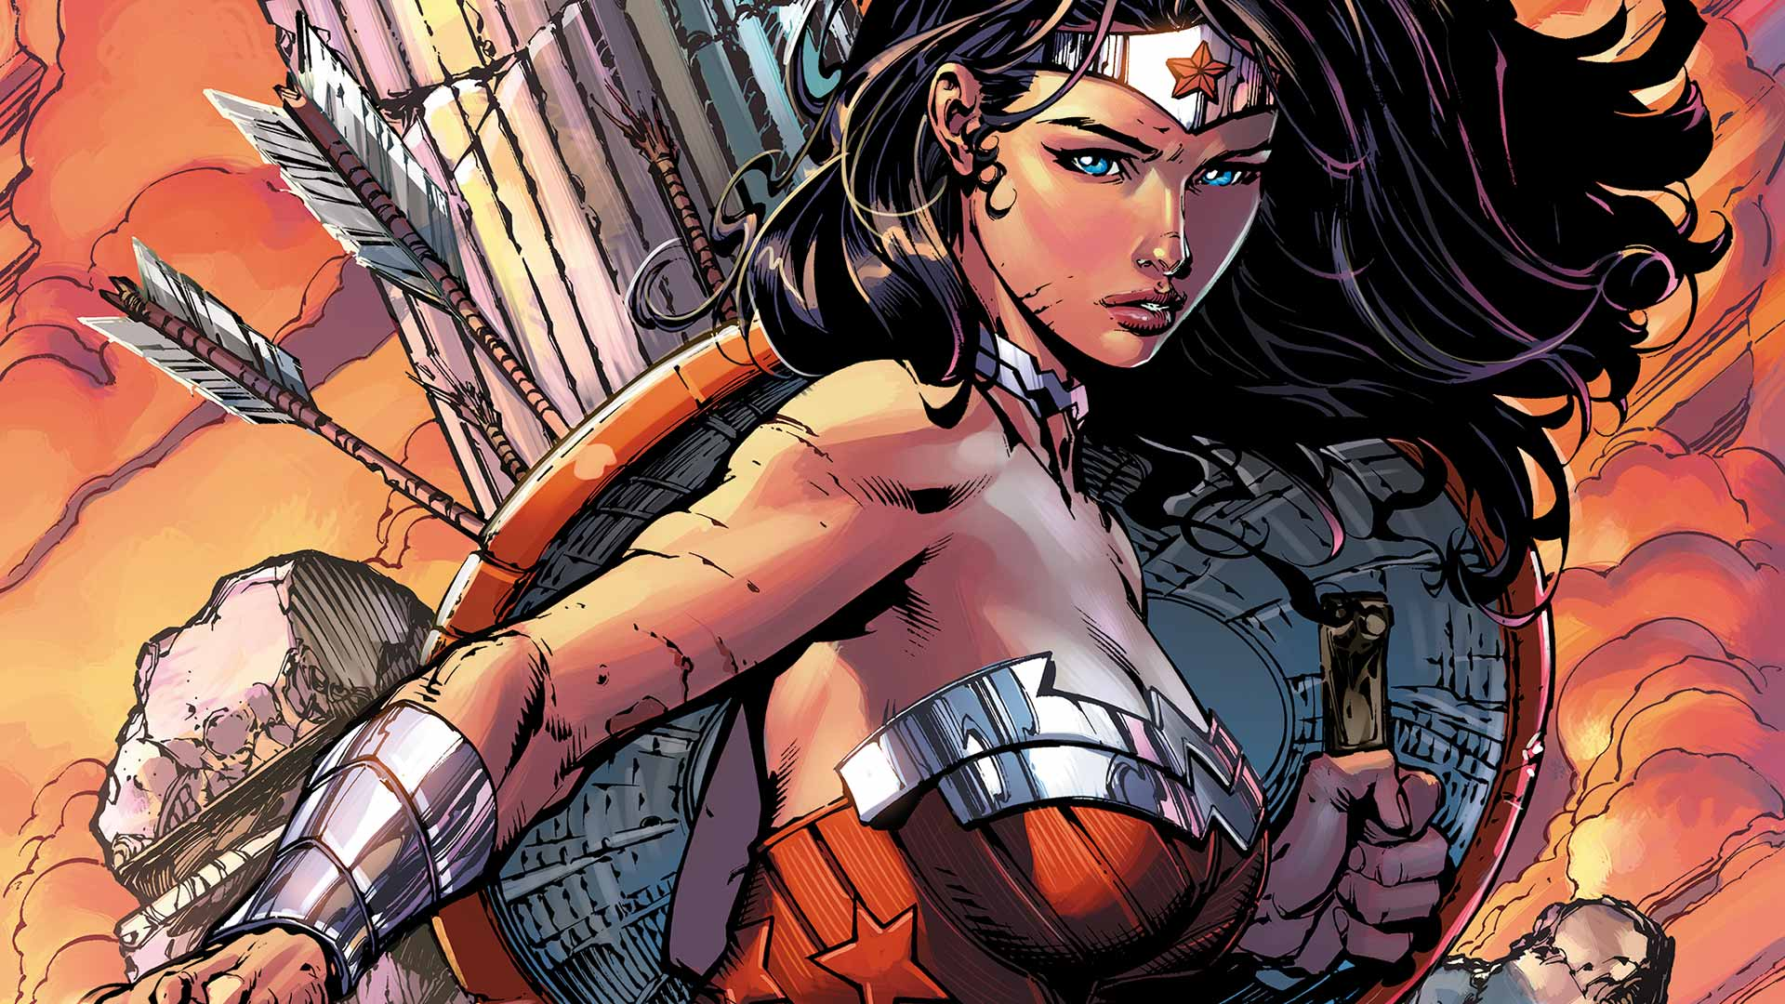
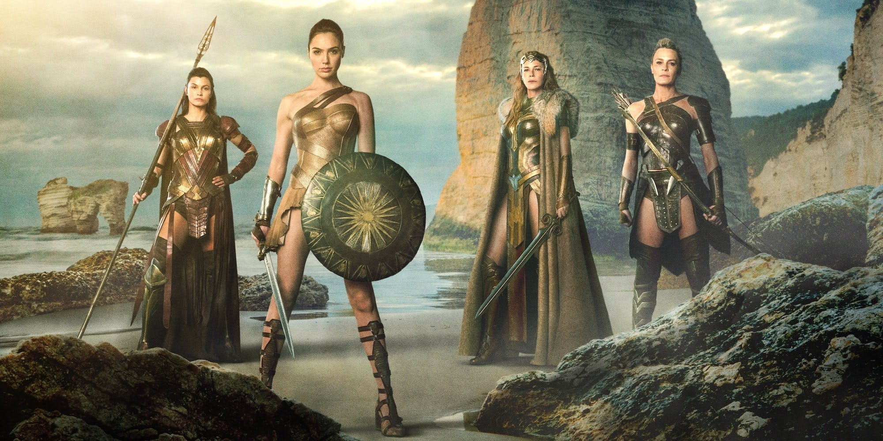

Slide 28
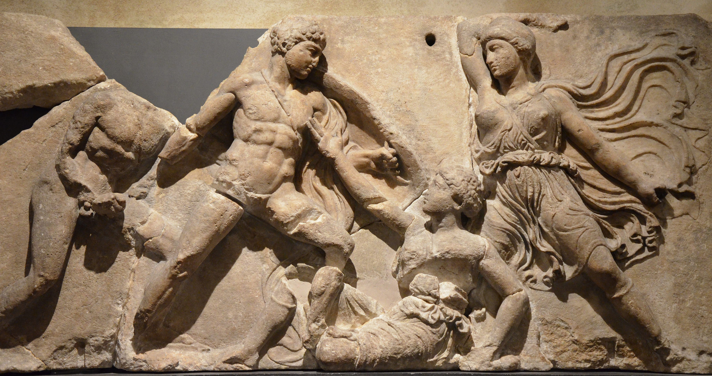

Slide 29
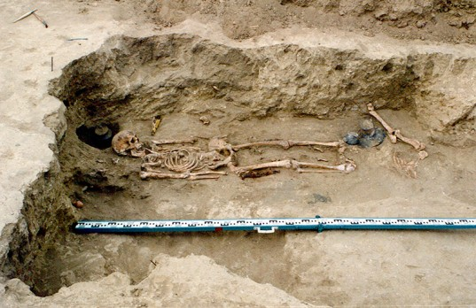
Typical warrior woman skeleton with large iron dagger and two iron arrowheads, Scythian burial, 4th century BC, photo by James Vedder. Source: Color plate 3, in Mayor, The Amazons: Lives and Legends of Warrior Women across the Ancient World (Princeton, 2014).

Slide 30
The age of heroes has begun…
“Emily Hauser’s novels combine thoughtful scholarship with a deep love for the ancient mythology. Her passion for bringing these stories to a modern audience is palpable, and her choice to dig into the untold stories of female characters offers a fresh and feminist take on well-known tales”
— MADELINE MILLER, bestselling author of Song of Achilles and Circe

Slide 31
Stay in touch!
website:
www.emilyhauser.com
email:
ehauserwrites@gmail.com
amazon:
bit.ly/FTMB2016
bit.ly/FTW2017
bit.ly/FTI2018
facebook:
facebook.com/ehauserwrites
twitter:
@ehauserwrites
goodreads:
www.goodreads.com

Slide 32
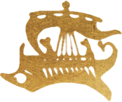
SCROLL 2
AFTER THE FALL OF TROY
… and please fill out Scroll 2 on your handouts and hand to ambassadors on way out.
Thank you!
Now that Troy has fallen, it’s helpful to know what our heroes have learnt (aside from how to sack a city with the Amazons’ help!) and what your next quests will be!
Q
After this event, how much do you feel you know about women in Greek myth?
Please tick the appropriate box.
Q
To what extent has this event increased your interest in women in antiquity?
☐ Not at all
☐ Slightly
☐ Moderately
☐ Very much
Detail, if appropriate:
________________________________
________________________________
☐ Nothing
☐ Slight level of knowledge
☐ Moderate level of knowledge
☐ High level of knowledge
Q
After this event, how confident are you discussing the ways in which fictional retellings rework ancient myth?
Q
To what extent has this event encouraged you to find out more about the ancient world?
☐ Not confident
☐ Slightly confident
☐ Moderately confident
☐ Very confident
☐ Not at all
☐ Slightly
☐ Moderately
☐ Very much
Detail, if appropriate:
________________________________
________________________________
Q
Which of these women are told of in ancient Greek myths about the golden apples?
☐ Helen of Troy
☐ Cleopatra
☐ Hippolyta
☐ Atalanta
Q
If you would like to find out more, how might you like to achieve this?
Q
How likely are you to continue exploring the ideas discussed today?
☐ Participating in more events like this
☐ Reading the Golden Apple trilogy
☐ Reading other historical fiction
☐ Reading non-fiction
☐ Taking a course (online/school/uni)
☐ Writing your own fiction
☐ Other: ________________________
☐ Not likely
☐ Slightly likely
☐ Moderately likely
☐ Very likely

