Slide 1
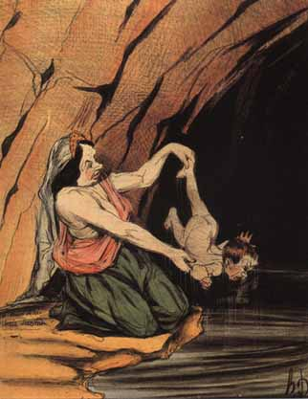
ACHILLES’ BIRTH & DEATH: ART, EPIC, MYTH & DRAMA
ANCIENT WORLDS, STORY TELLING, NOV. 21, 2019

Slide 2
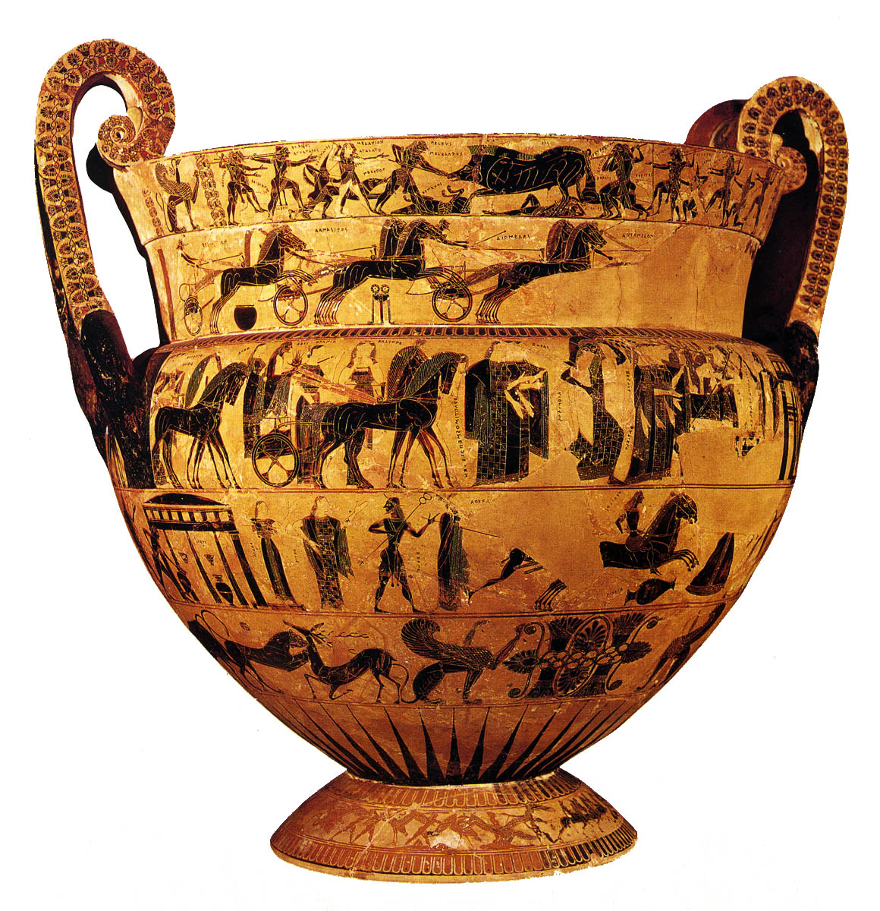
Attic bf volute krater, Ergotimos and Kleitias, ca.570 BC, Florence 4209

Slide 3
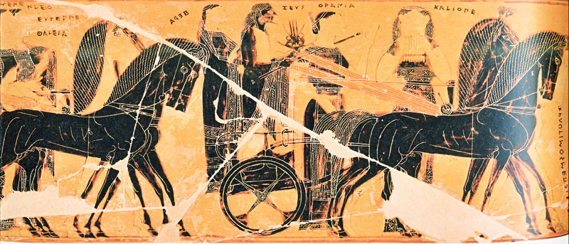
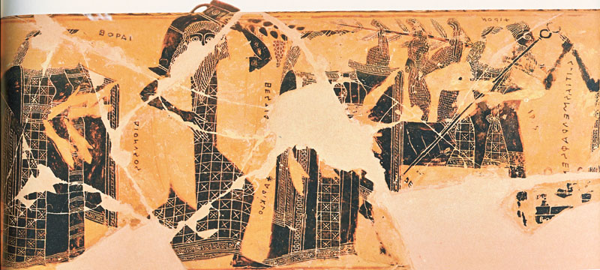
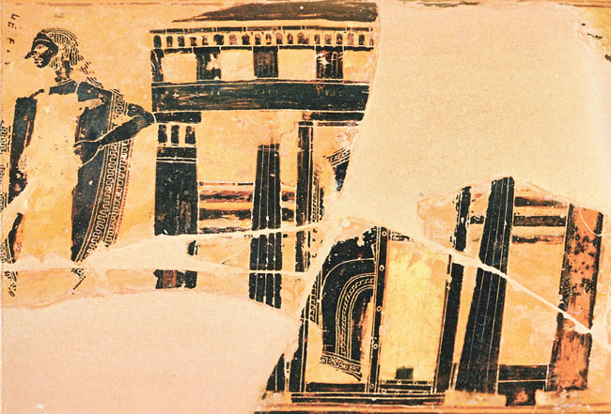
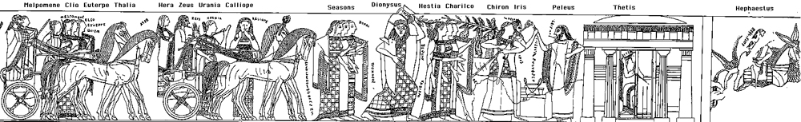
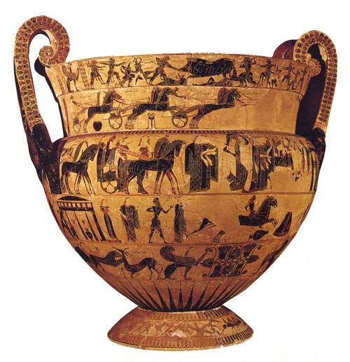
Wedding of Peleus and Thetis: All gods but Strife (Eris) invited.
PELEUS
THETIS
‘François Vase,’
Attic bf volute krater, Ergotimos and Kleitias, ca.570 BC, Florence 4209

Slide 4

SOPHOCLES, TrGF F 618:
‘He [Peleus] wed when he wed voiceless marriages
once entwined with Thetis who took all shapes...’

Slide 5
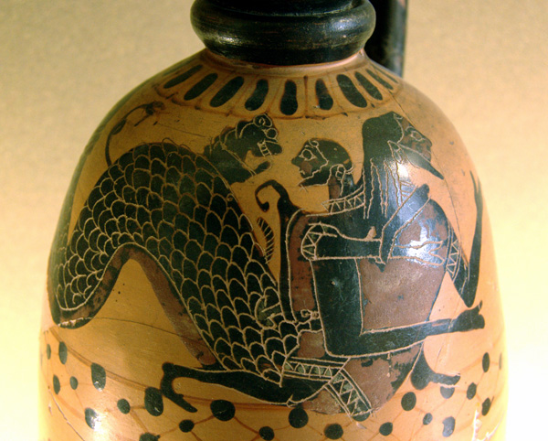
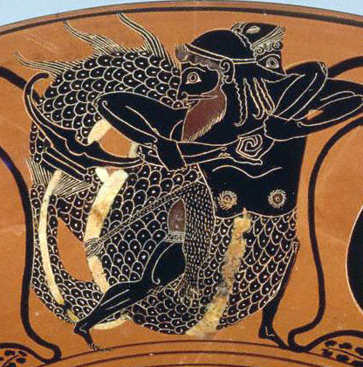
Heracles and Nereus
OLD MEN OF
THE SEA:
NEREUS
PROTEUS
GLAUCUS
Boeotian bf lekythos, Istanbul Painter, 590-580 BC
Louvre CA823
Attic bf lekythos, Lysippides Painter, ca. 520 BC
Malibu 87AE22

Slide 6
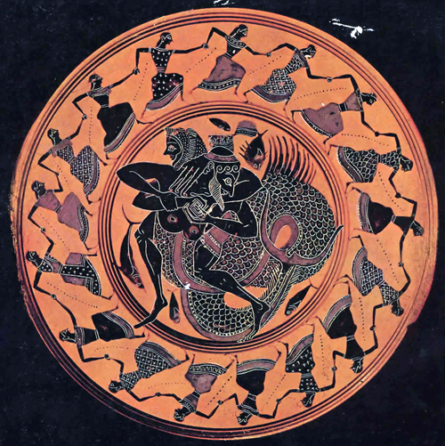
NEREIDS DANCE ON RIM AS HERACLES WRESTLES NEREUS ON TONDO
Attic bf cup, ca. 575-550 BC
Museo Archeologico Nazionale
di Tarquinia RC 4194

Slide 7
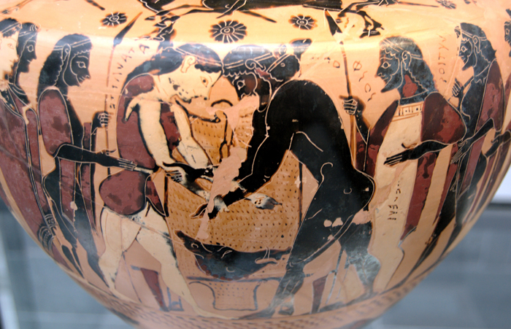
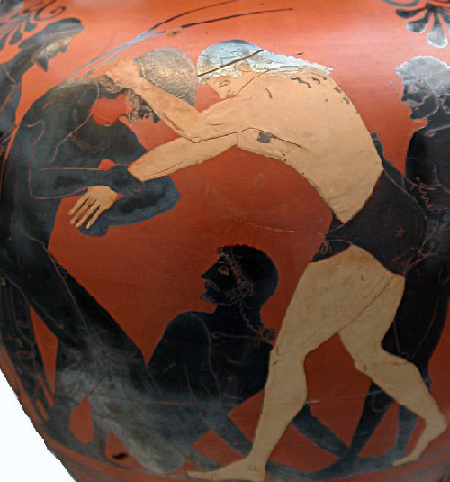
PELEUS = ‘WRESTLER’
Chalcidian hydria, Inscription Ptr
ca. 550 BC, Munich 596
Chalcidian hydria, ca. 550 BC
PELEUS WRESTLES WITH ATALANTA FOR THE HIDE OF THE CALEDONIAN BOAR

Slide 8
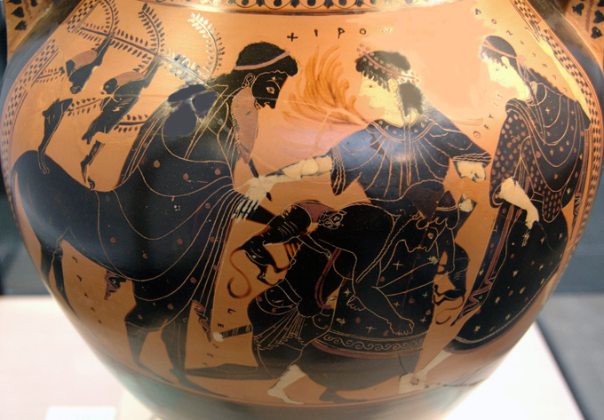
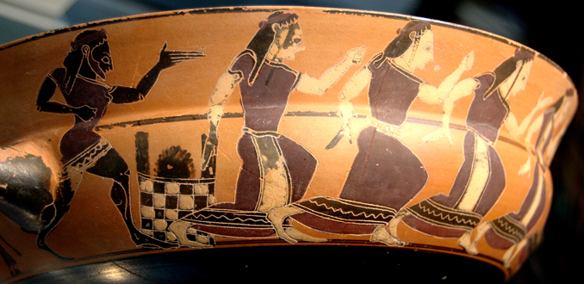
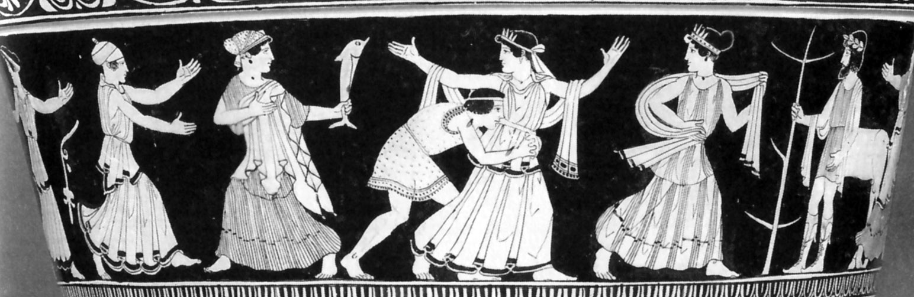
CHIRON, PELEUS
AND THETIS
Attic bf amphora, Manner of Leagros Group
ca. 510 BC, Munich 1415
Attic bf cup, C Painter, ca. 560 BC, Munich 8966, 8954
Attic rf calx krater, ca. 460 BC,
Boston MFA 1972.850

Slide 9
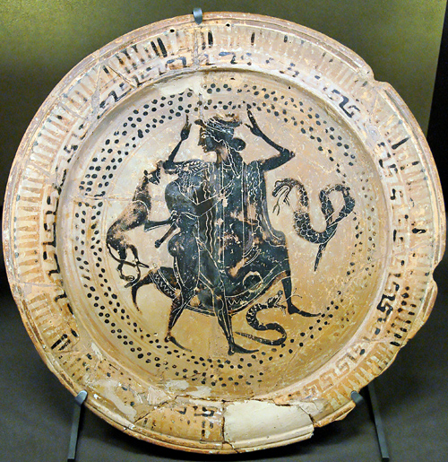
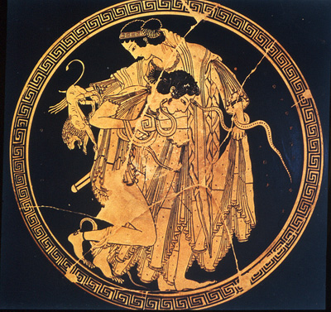
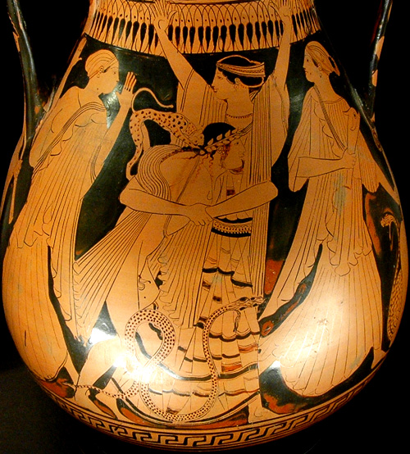
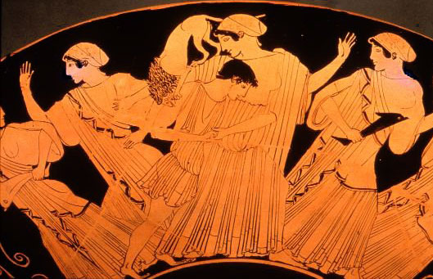
PELEUS AND THETIS
Boeotian bf dish, 500-474 BC, Louvre CA 2569
Tondo of rf cup by Peithinos, Berlin F2279
Attic rf calx pelike, Oinanthe Painter
ca. 460 BC, Louvre G373
Attic rf cup, Douris, Munich 2646

Slide 10
Wedding of Peleus and Thetis: All gods but Strife (Eris) invited.
PELEUS
THETIS
‘François Vase,’
Attic bf volute krater, Ergotimos and Kleitias, ca.570 BC, Florence 4209

Slide 11
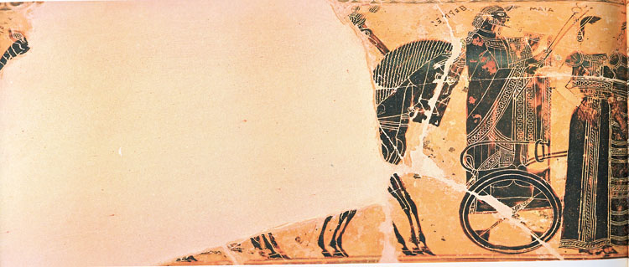
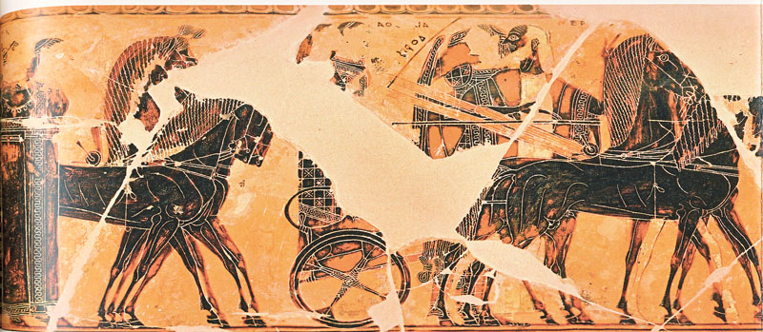
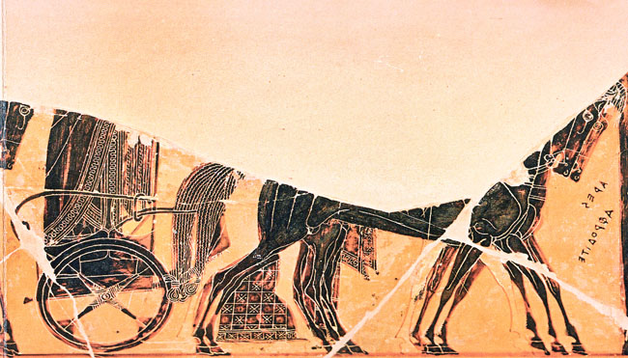
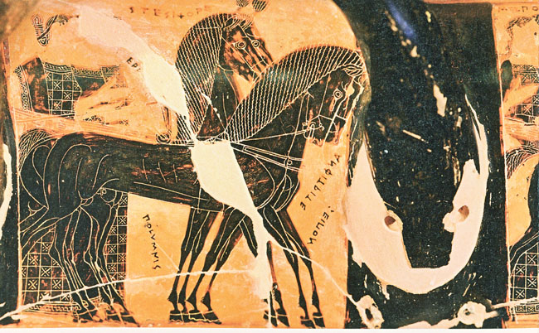
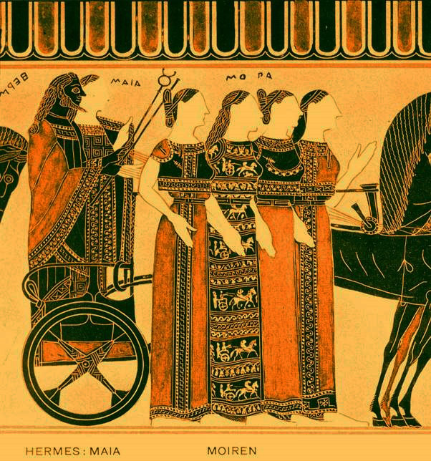
Wedding of Peleus and Thetis: All gods but Strife (Eris) invited.
FOUR FATES
HERMES
MAIA
NEREUS
DORIS
ARES
APHRODITE
POSEIDON
AMPHITRITE
FATES
ATHENA
APOLLO
MUSES
‘François Vase,’
Attic bf volute krater, Ergotimos and Kleitias, ca.570 BC, Florence 4209

Slide 12

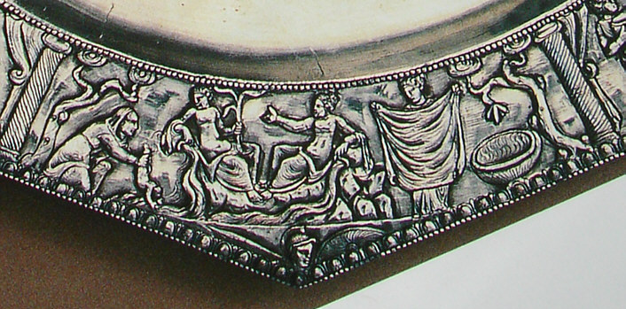
ACHILLES’ ‘BAPTISM’ IN ART FROM THE END OF THE 1ST C. AD
Stone relief, ca. 100 AD, Rome
Musei Capitolini 64
Silver Plate,
made in
Thessaloniki
ca. 330 AD
Kaiseraugst

Slide 13
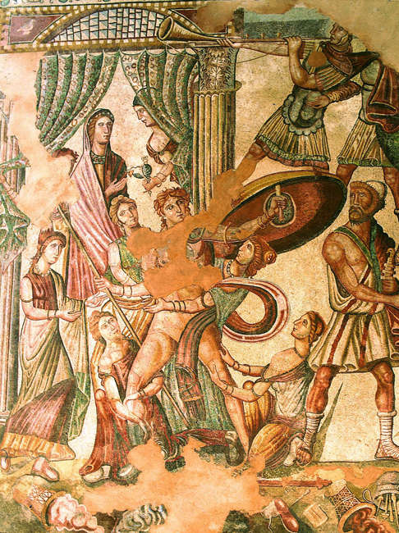
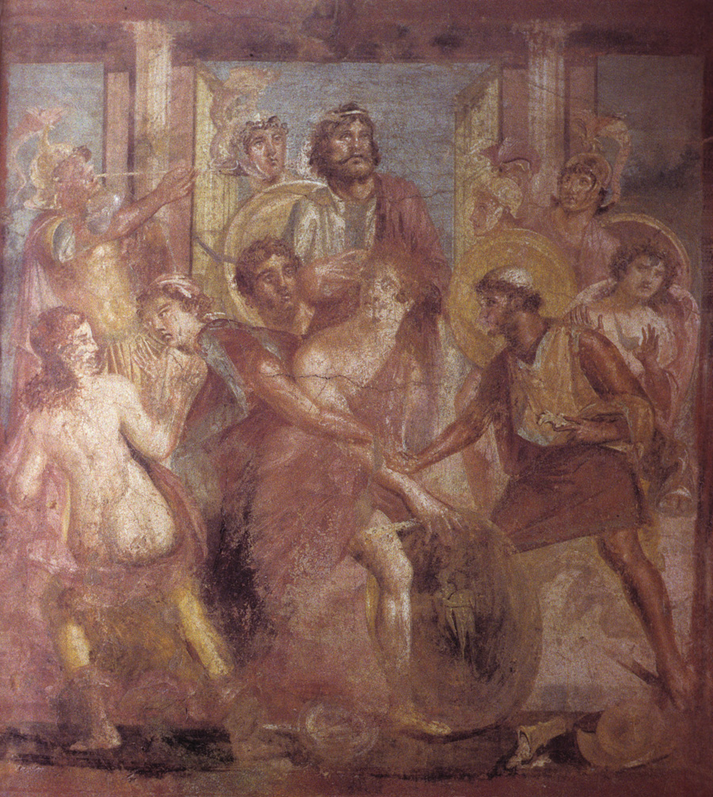
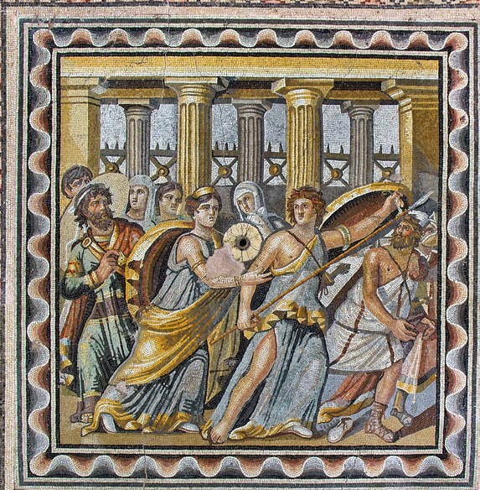
Achilles at Skyros with daughters of Lycomedes
Roman wall painting from Pompeii
ca. AD 70, Naples MN
Roman mosaic, Villa Romana de la Olmeda, 300-450 AD
Roman mosaic from Zeugma

Slide 14
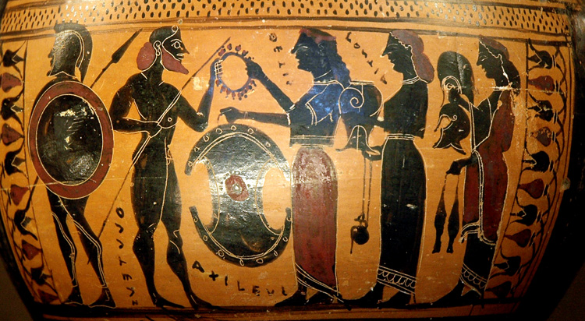
THETIS GIVES ACHILLES IMPENETRABLE ARMS
Attic bf hydria, Near the Tyrrhenian Group, 575-550 BC, Louvre E 869

Slide 15
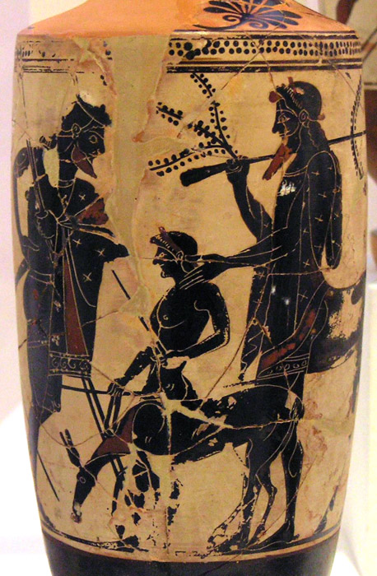
CHIRON SCHOOLS
ACHILLES IN WARFARE
Attic bf lekythos, ca. 500 BC, Athens NM

Slide 16
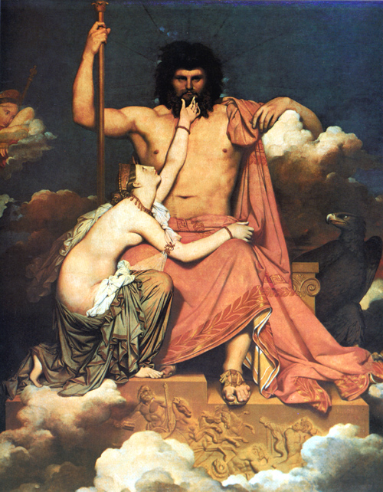
THETIS BEGS ZEUS
TO SUPPORT THE
TROJAN ADVANCE IN
ORDER TO MAKE THE
GREEKS RESENT
AGAMEMNON’S
TREATMENT OF
ACHILLES
Ingres, Juppiter and Thetis, 1811
Musée Granet, Aix-en-Provence

Slide 17
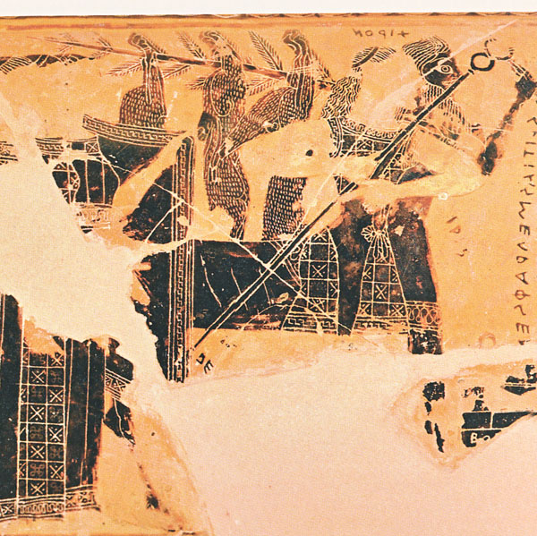
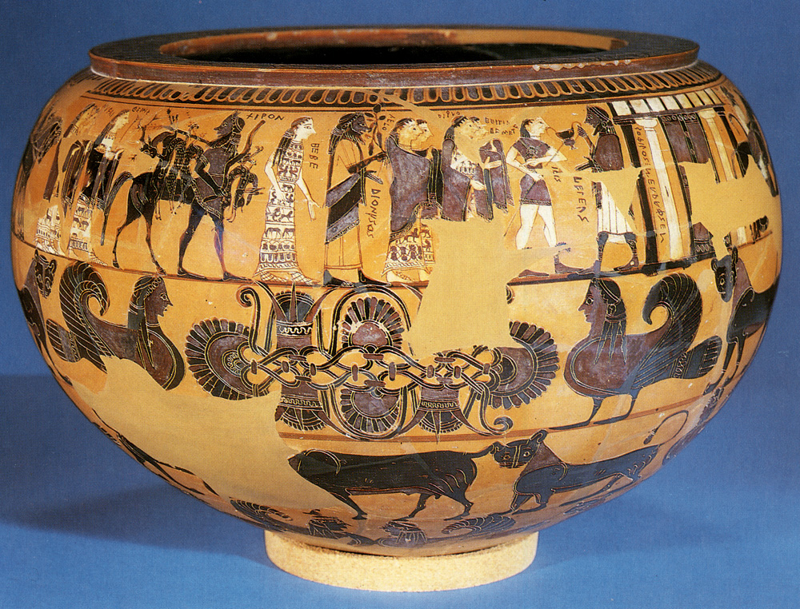
Wedding of Peleus and Thetis: All gods but Strife (Eris) invited.
CHIRON
PELEUS
CHIRON
‘François Vase,’
Erskine Dinos,’ Attic BF dinos, Sophilos,
ca. 580, London 1971.11-1.1

Slide 18
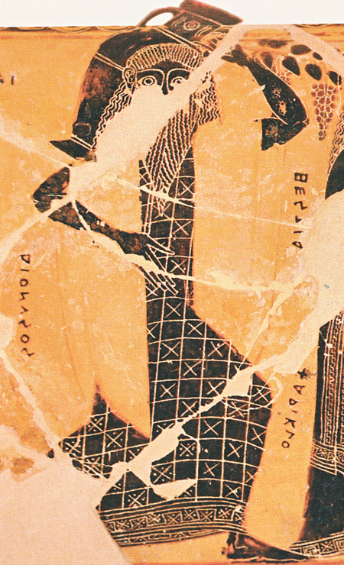
Wedding of Peleus and Thetis: All gods but Strife (Eris) invited.
DIONYSUS
PELEUS
‘François Vase,’
Attic bf volute krater, Ergotimos and Kleitias, ca.570 BC, Florence 4209

Slide 19
1. Hesiod fr. 300. From the Aigimios, an epic poem variously attributed to Hesiod or Kerkops. Possibly 7th or 6th c. BC.
The author of the Aigimios in his second book says that Thetis put all the children she had by Peleus into a cauldron of water because she wished to know if they were mortal. Others say that she put them into fire. And, indeed, when many had died Peleus became enraged and prevented Achilles being thrown into the cauldron.

Slide 20
2. Scholiast to Apollonius 4.816.
The poet of the Aigimios says that Thetis threw her children by Peleus into a cauldron of water because she wished to know if they were mortal. Others say fire. And when many had perished Peleus got angry and prevented Achilles being thrown into the cauldron and that Thetis left him because of this. But Sophocles in The Lovers of Achilles (TrGF F 151) says that Thetis abandoned Peleus when she was scolded by him.

Slide 21
3. Apollonius of Rhodes, Argonautica 4.865-879. Thetis comes to warn Peleus that he and the Argonauts should hurry and pass through the Wandering Rocks. 3rd c. BC.
She spoke and then vanished into the depths of the sea. But a terrible pain struck Peleus, for he had not seen her since the day she left her bridal chamber and marriage, when she became enraged for the sake of her noble son Achilles, then a baby. For she used regularly to burn off his mortal flesh with the flame of fire in the middle of the night, and during the day she anointed his tender body with ambrosia, so that he would become immortal, and so that she could keep disgusting old age from his body. But Peleus leaped up from his bed and noticed his dear child writhing in the flame. And he uttered a fearful cry at the sight, fool that he was. When she heard it, Thetis snatched the baby up and threw him, screaming, to the ground, and she, like a puff of wind, like a dream, fled swiftly from the house and jumped into the sea in anger and she never came back again.

Slide 22
ACHILLES’ ‘BAPTISM’ IN ART FROM THE END OF THE 1ST C. AD
Stone relief, ca. 100 AD, Rome
Musei Capitolini 64
Silver Plate,
made in
Thessaloniki
ca. 330 AD
Kaiseraugst

Slide 23
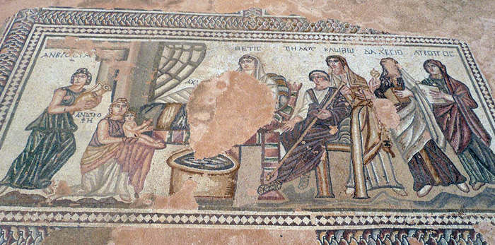
ACHILLES’ ‘BAPTISM’ IN ART FROM THE END OF THE 1ST C. AD
Mosaic, Paphos Cyprus, 4th c. AD

Slide 24
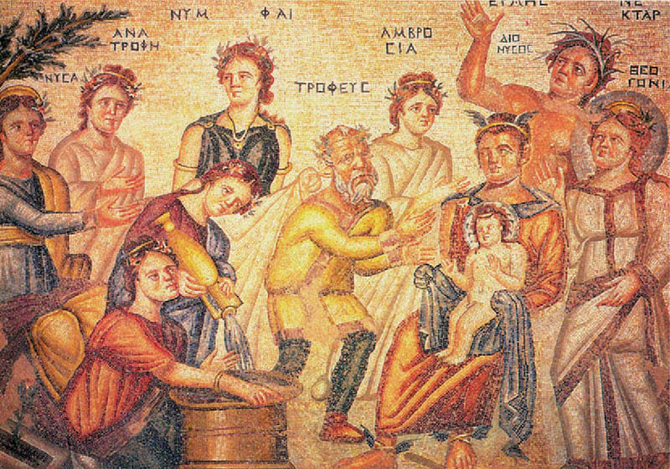
DIONYSUS’ FIRST BATH
Mosaic, 4th c. AD, House of Aion, Nea Paphos,

Slide 25
ACHILLES’ ‘BAPTISM’ IN ART FROM THE END OF THE 1ST C. AD
Mosaic, Paphos Cyprus, 4th c. AD

Slide 26
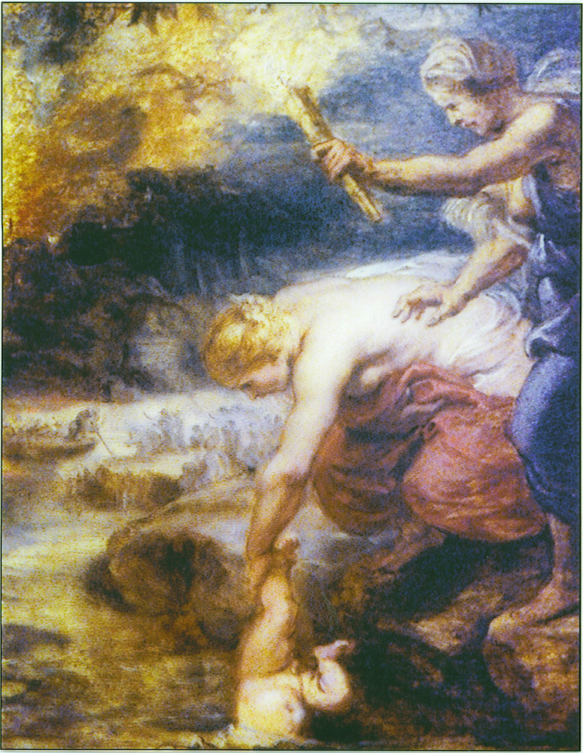
THETIS DIPS ACHILLES IN THE RIVER STYX
Oil Painting, Peter Paul Rubens, ca. 1625
The Baptism of Achilles, lithograph by Honoré Daumier, 1842
talus Achillei = Achilles’ ankle (not ‘heel’)

Slide 27
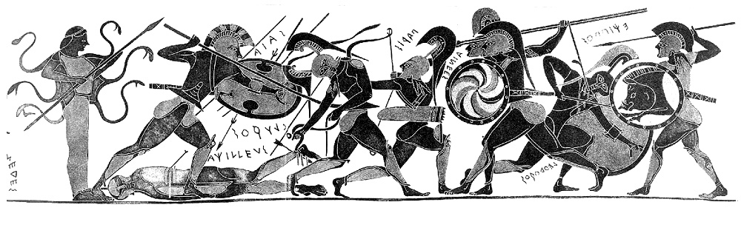
DEATH OF ACHILLES
Chalcidian amphora, ca. 540 BC, Lost

Slide 28
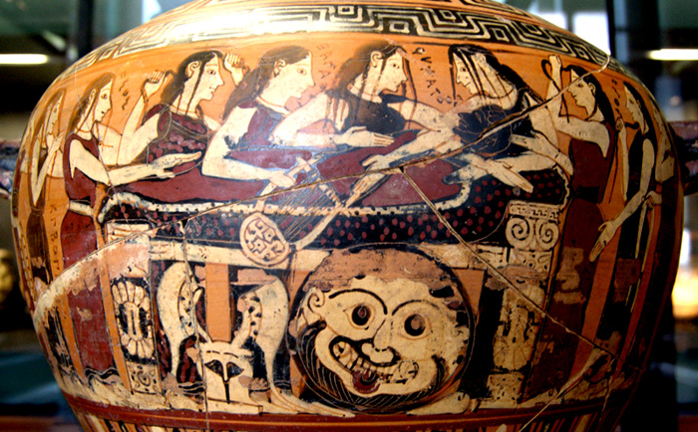
END
Corinthian bf hydria, Damon Painter, 560 BC, Louvre E643

