Slide 1
Heracles – he does get around!
Warwick Classics Network and A. G. Leventis Study Day ‘Ancient Worlds’
University of Warwick
Professor Michael Scott
m.c.scott@warwick.ac.uk

Slide 2
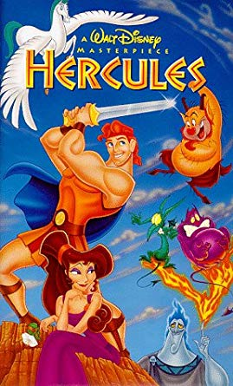

Slide 3
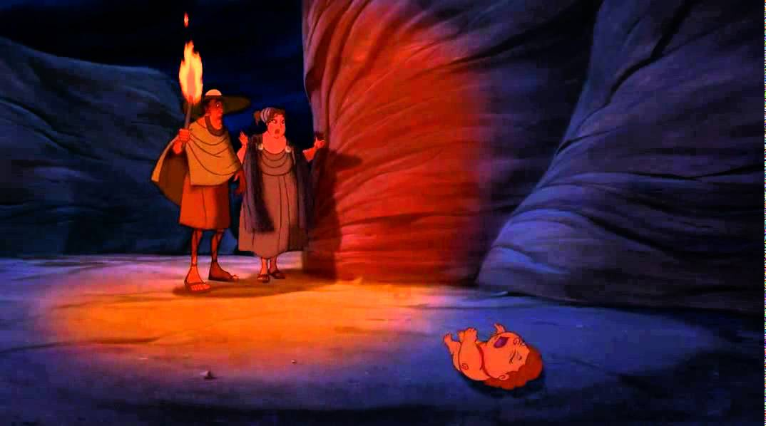
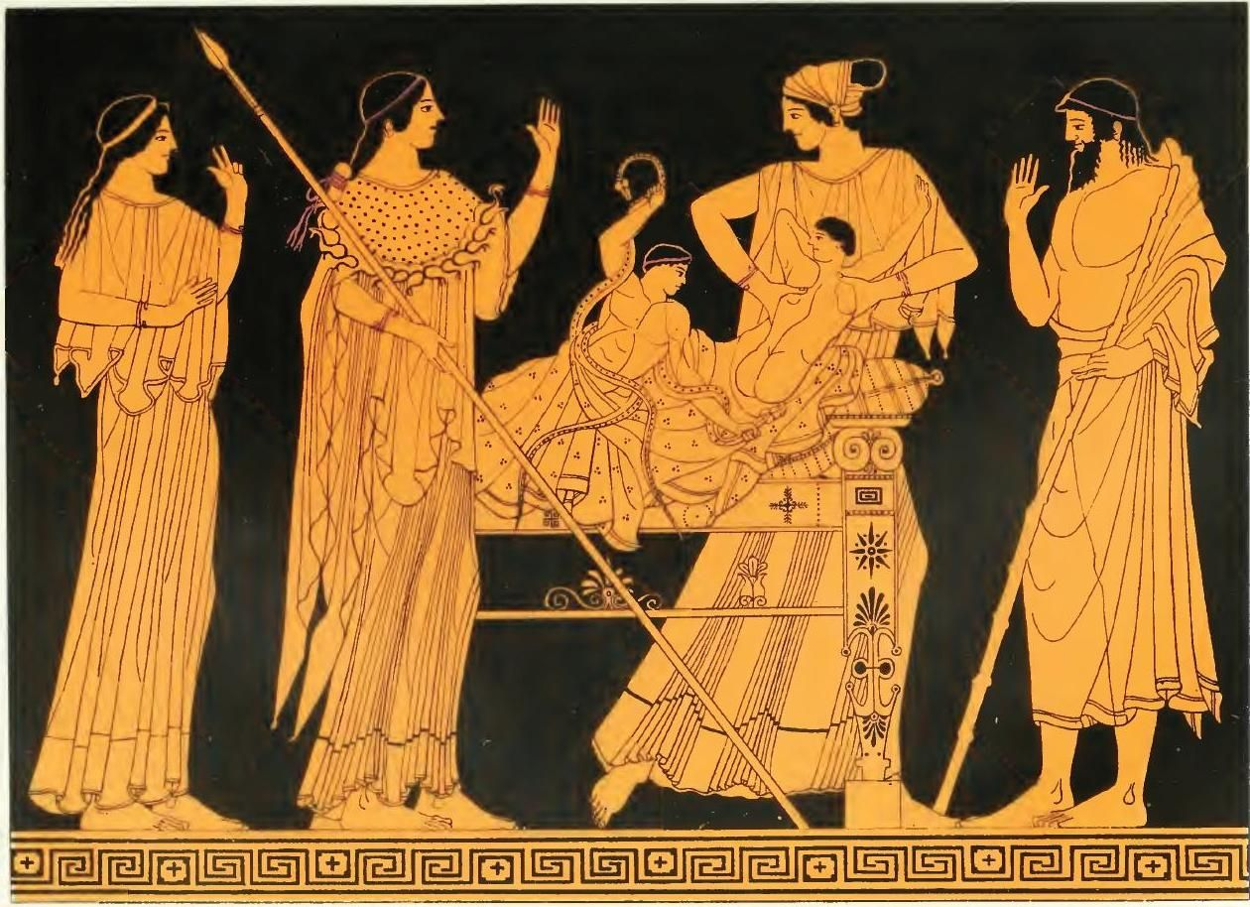
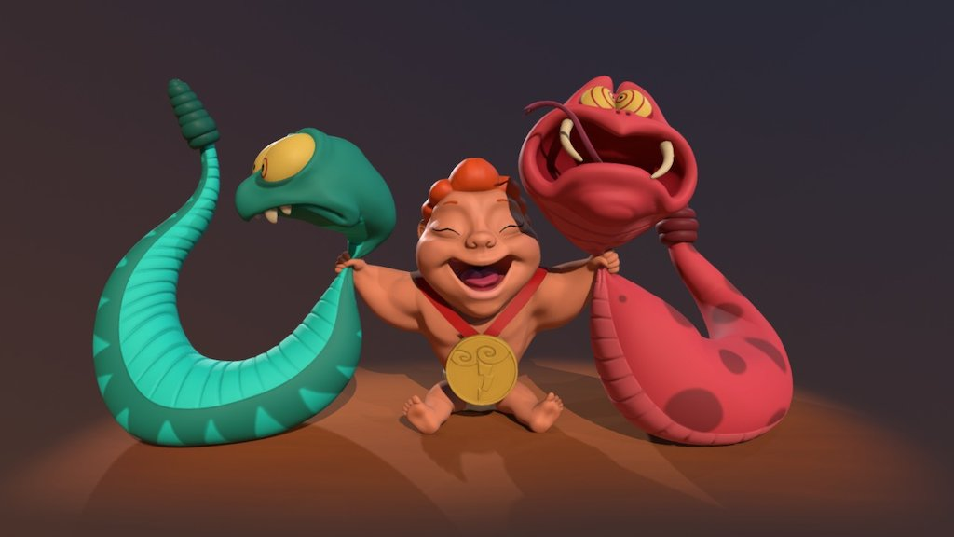

Slide 4
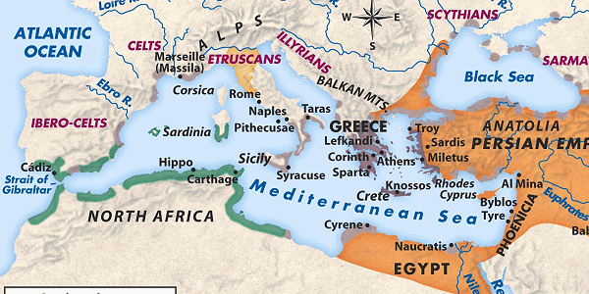

Slide 6
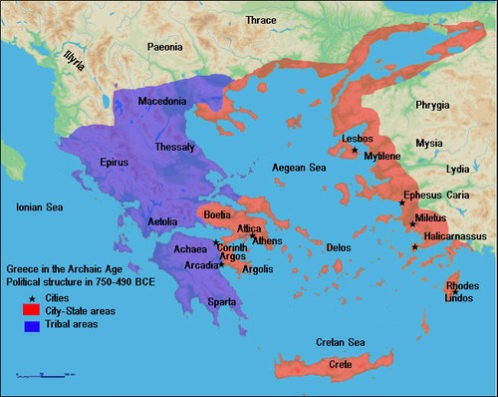
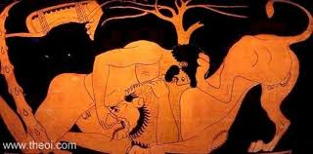

Slide 7
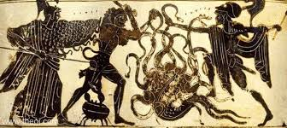

Slide 8
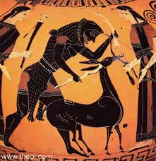

Slide 9
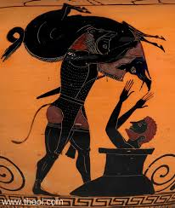

Slide 10
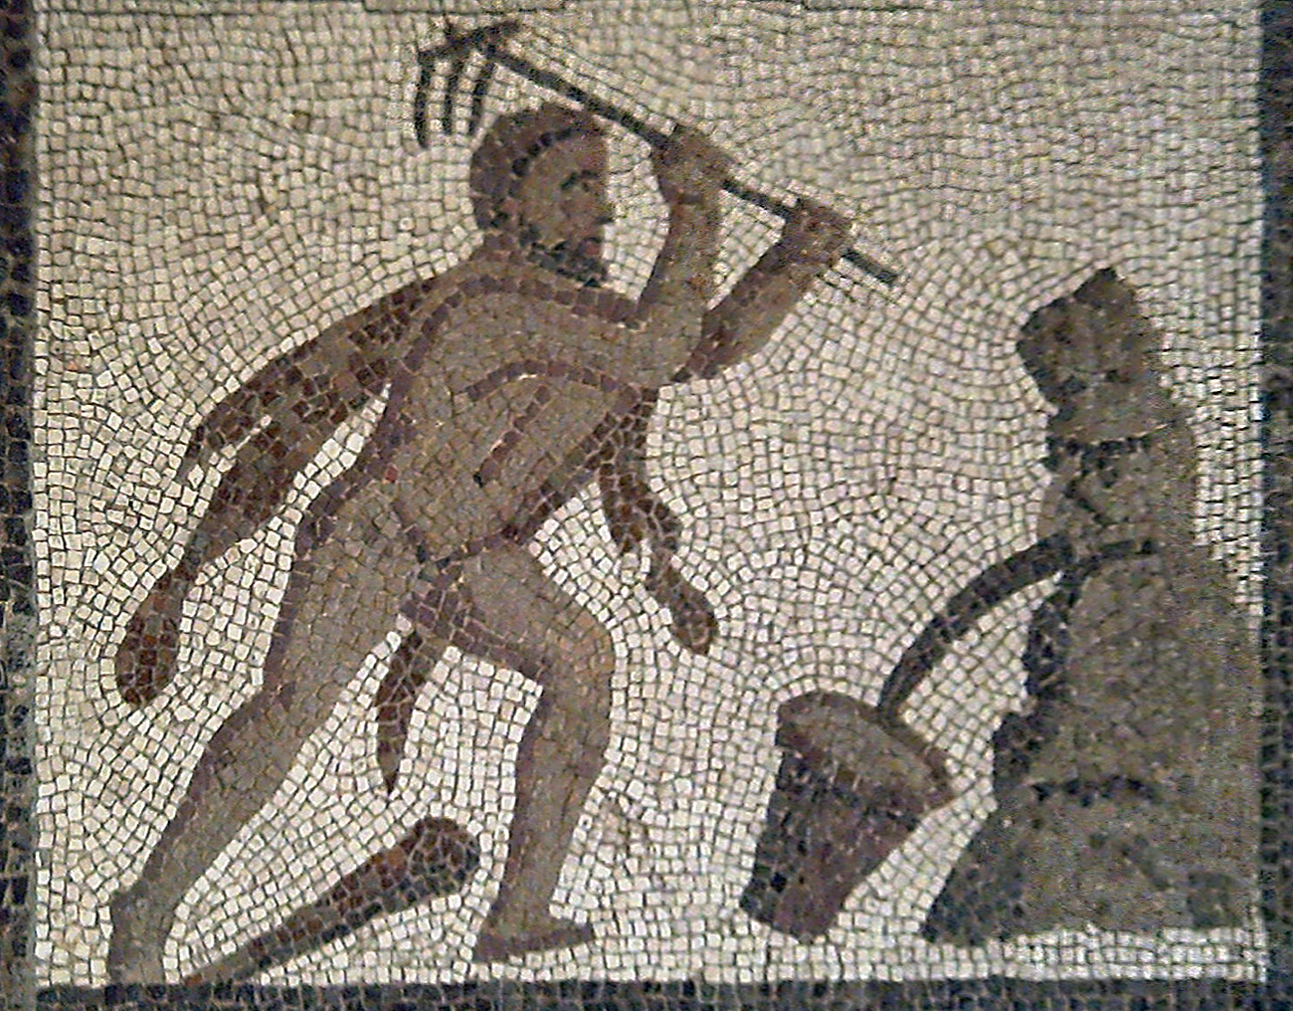

Slide 11
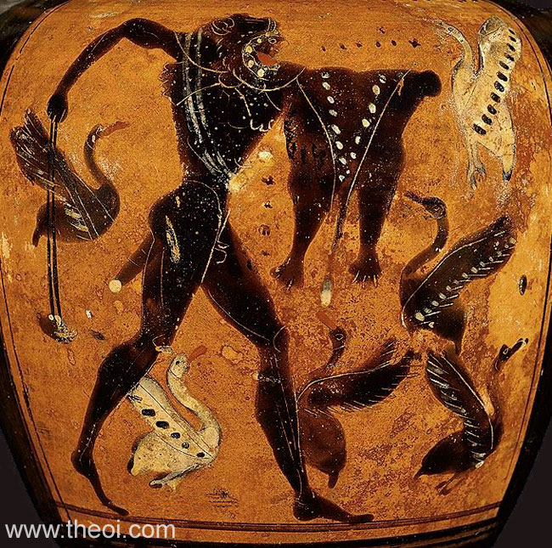

Slide 12
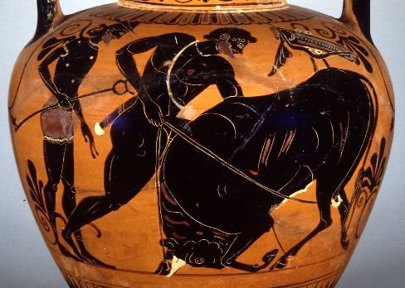

Slide 13
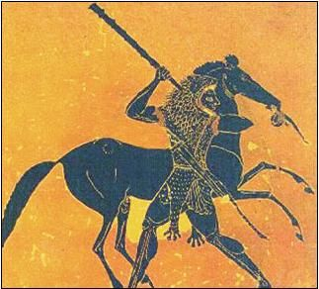

Slide 14
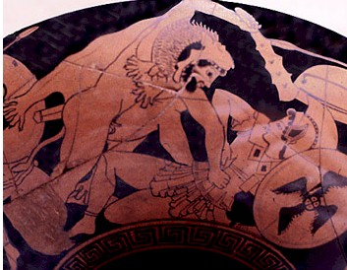

Slide 15
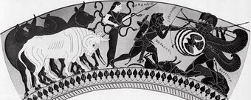

Slide 16
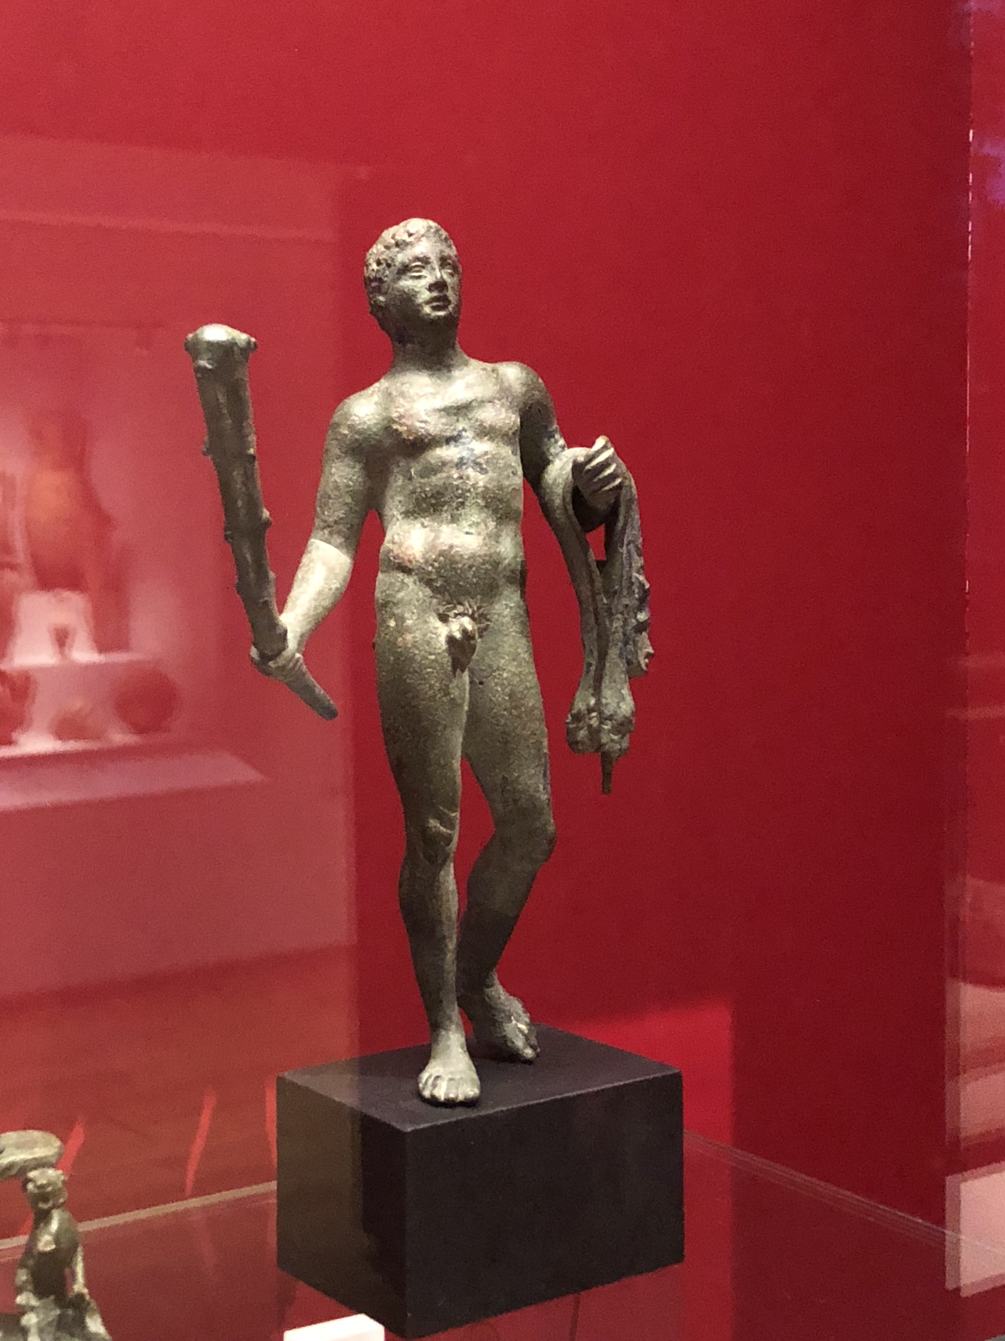

Slide 17
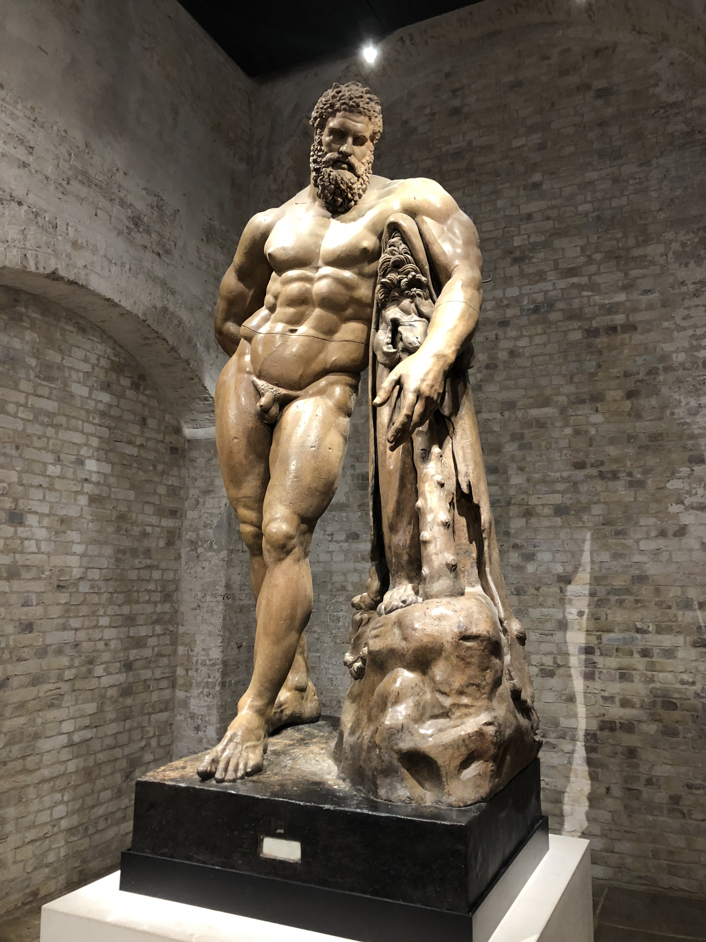

Slide 18
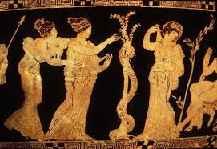

Slide 19
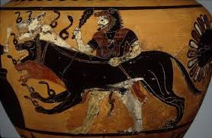

Slide 20
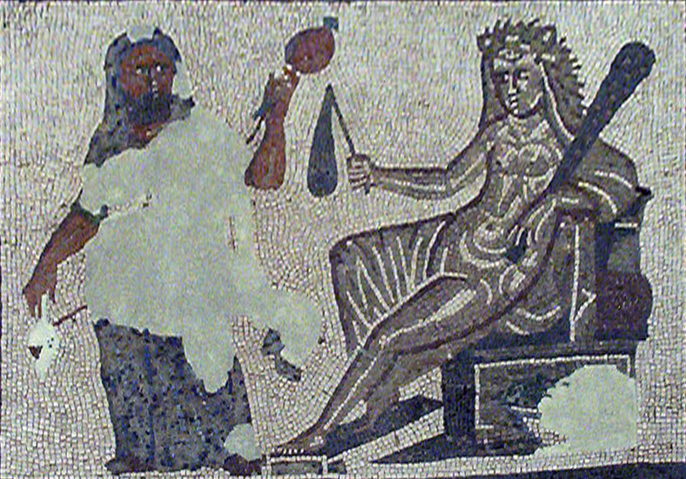

Slide 21
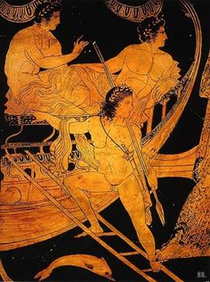

Slide 22
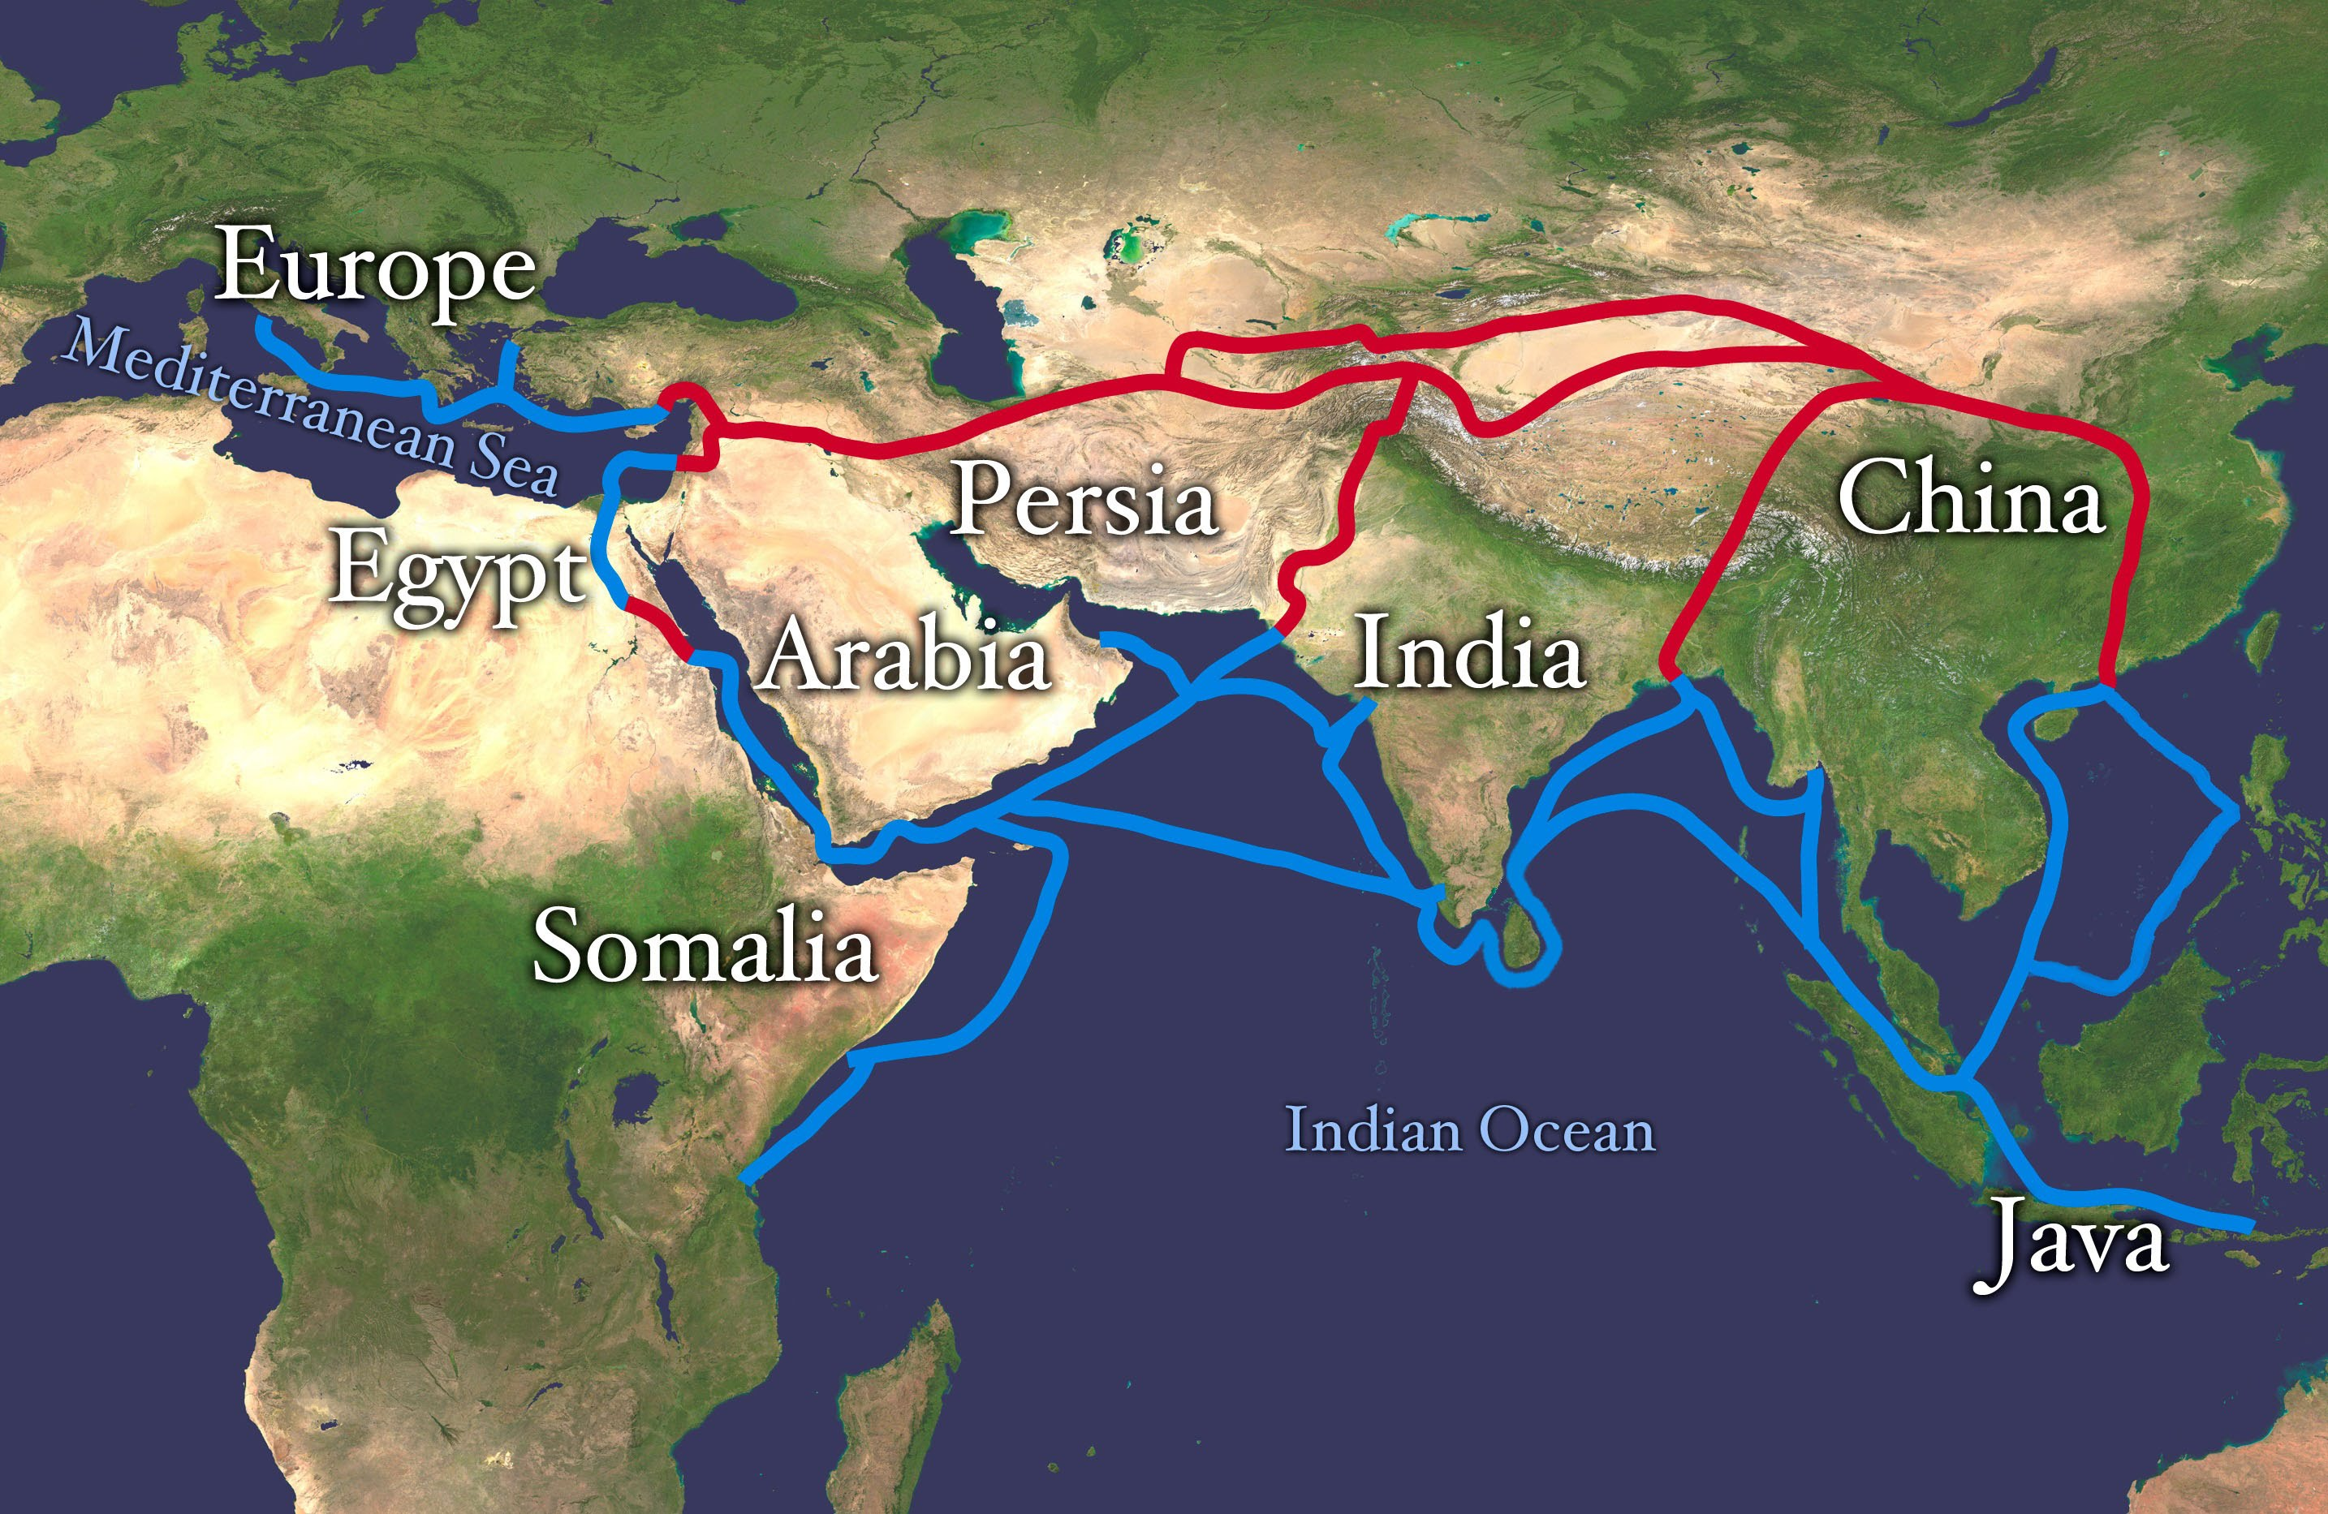

Slide 24
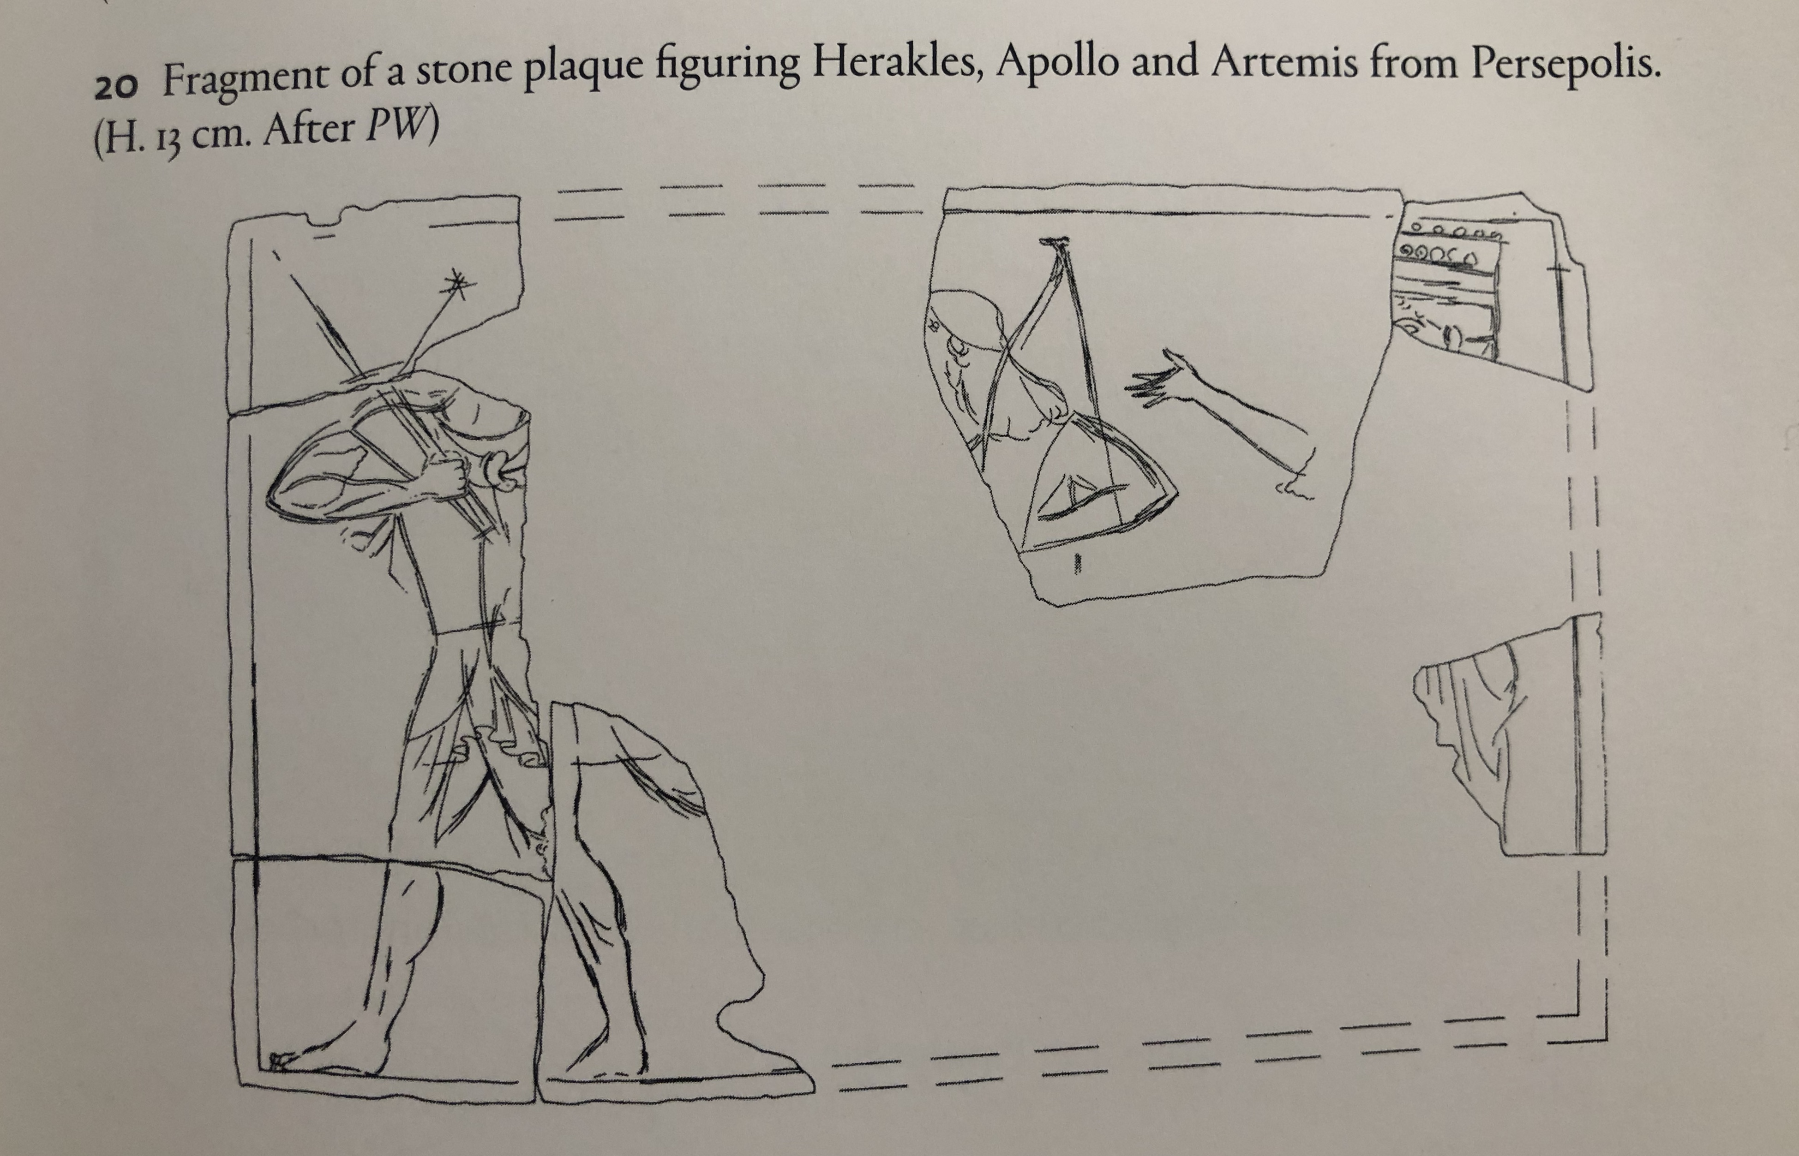

Slide 25
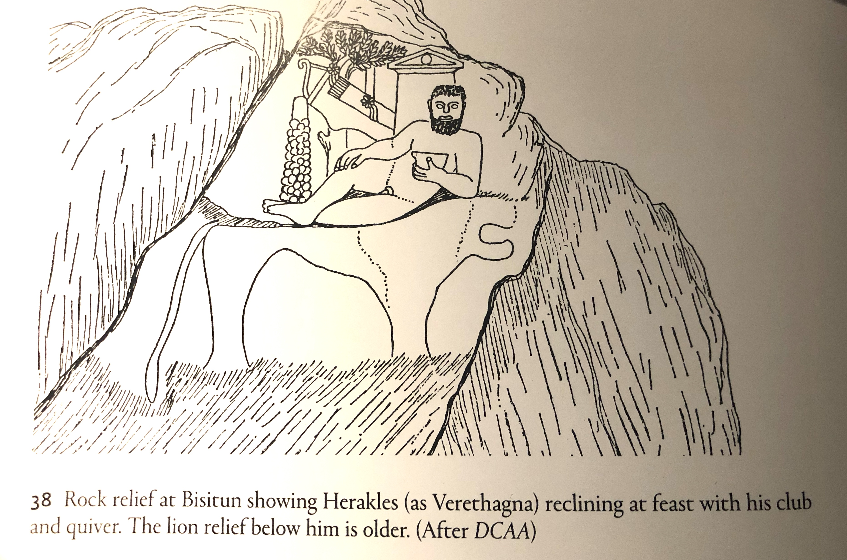

Slide 26
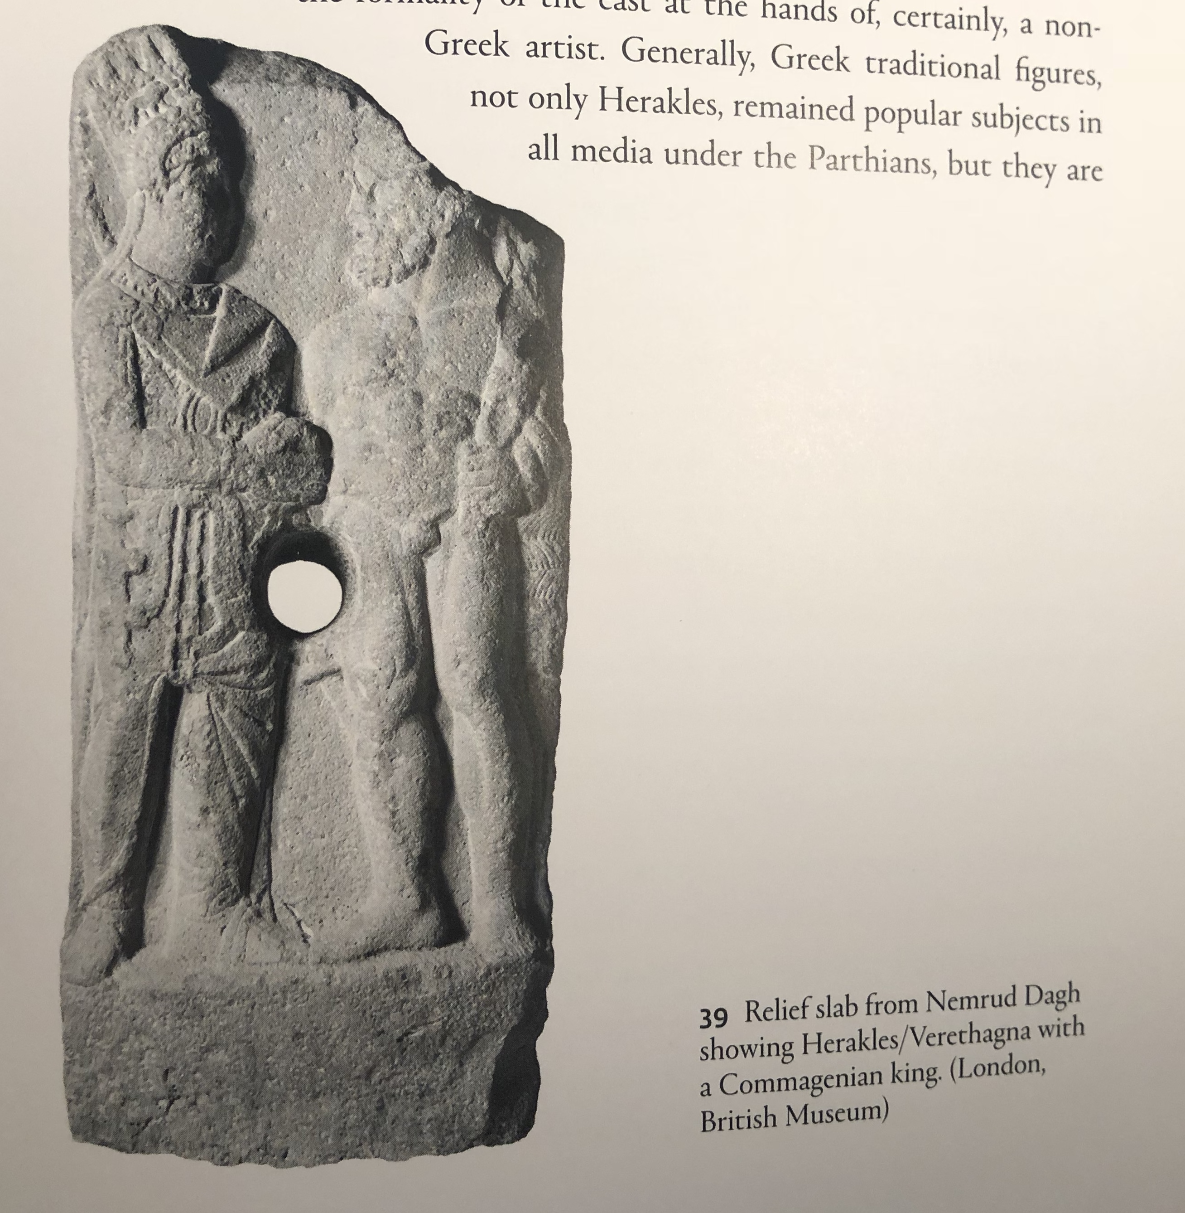

Slide 27
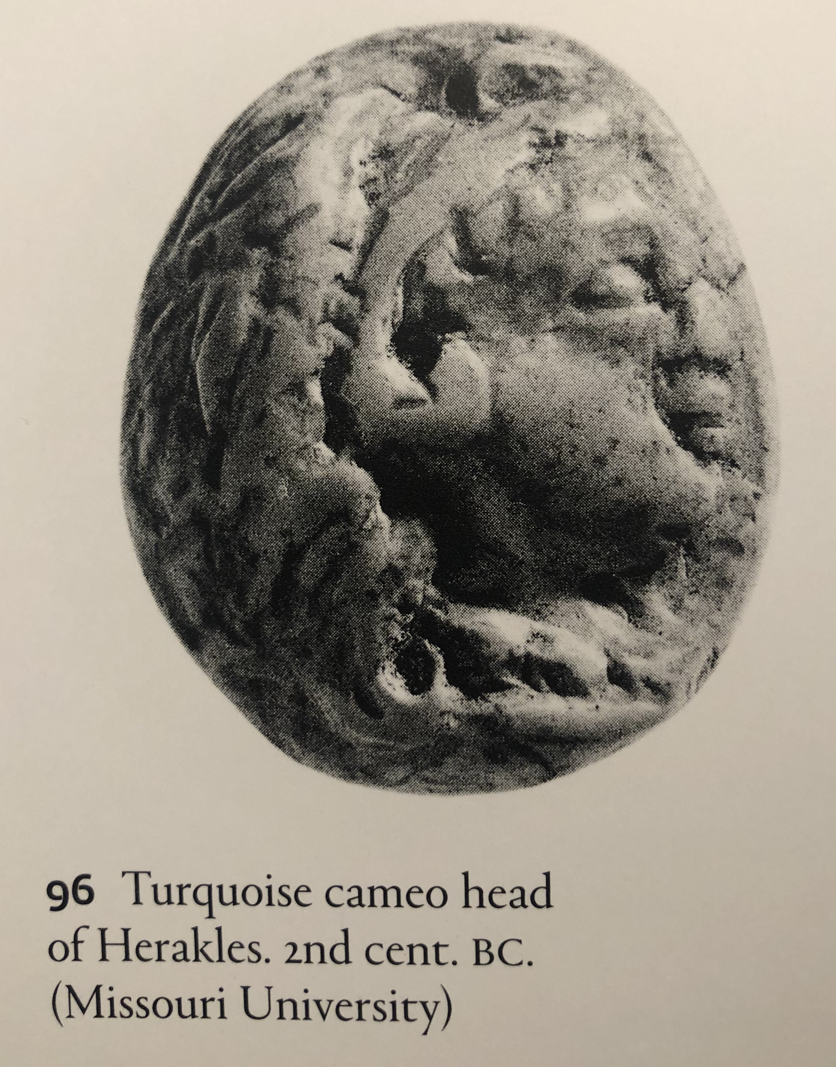

Slide 28
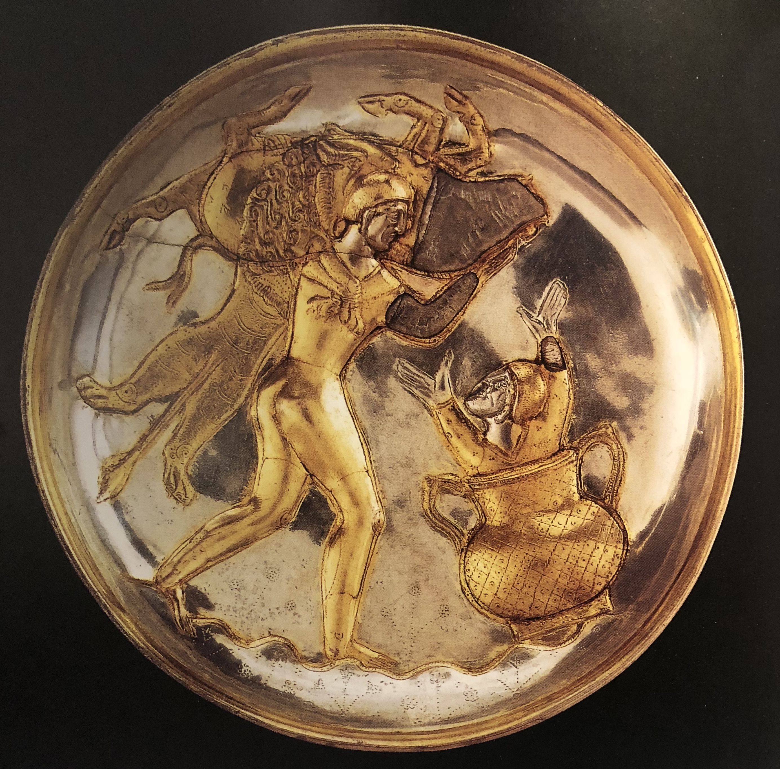

Slide 29
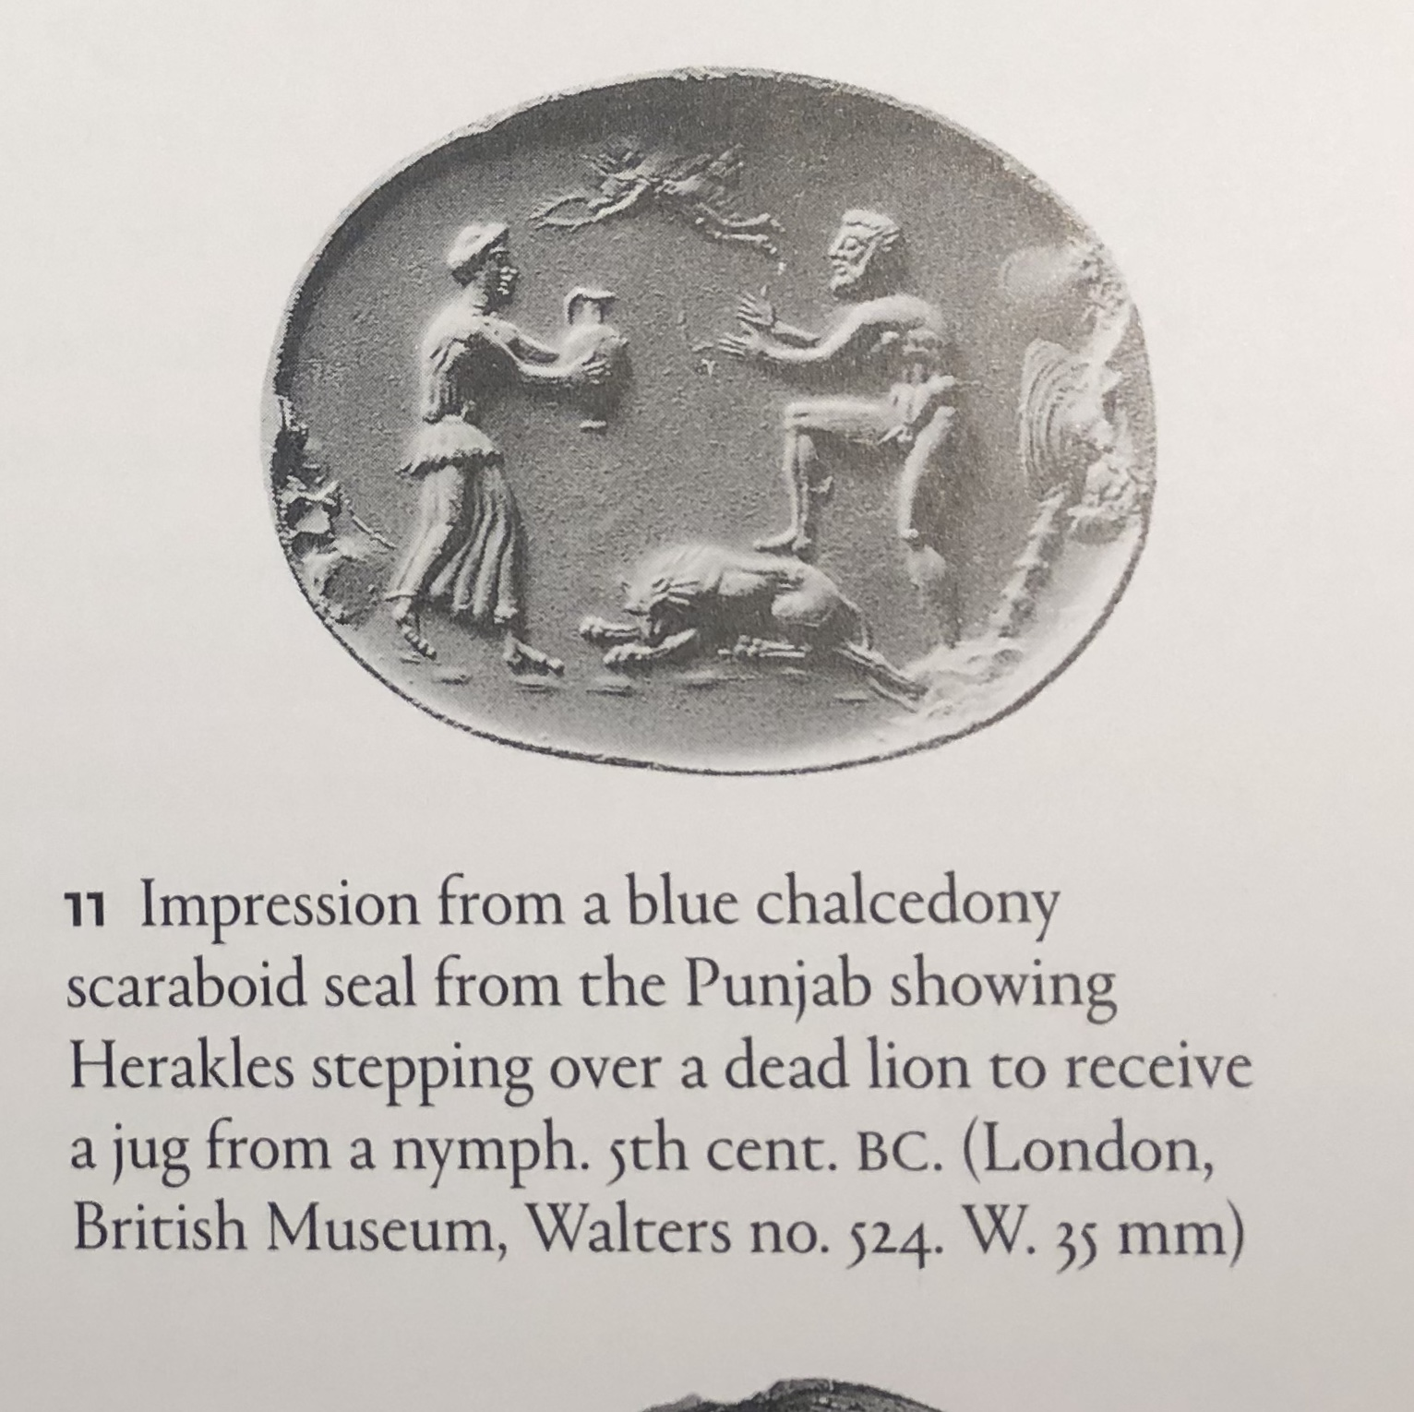

Slide 30
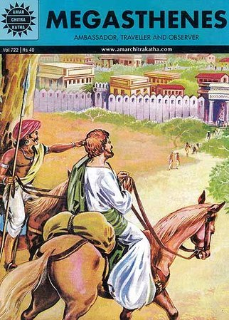

Slide 31
Such, then are the traditions regarding Dionysus and his descendants current among the Indians who inhabit the hill-country. They further assert that Herakles also was born among them. They assign to him like Greeks, the clubs and the lion's skin. He far surpassed other men in personal strength and prowess, and cleared sea and land of evil beasts. Marrying many wives he begot many sons, but one daughter only. The sons having reached man's estate, he divided all India into equal portions for his children, whom he made kings in different parts of his dominion. He provided similarly for his daughter, whom he reared up and made a queen. He was the founder, also, of no small number of cities, the most renowned and greatest of which he called Palibothra (Pataliputra). He built therein many sumptuous palaces, and settled within its walls a numerous population. The city he fortified with trenches of notable dimensions, which were filled with water introduced from the river. Herakles, accordingly, after his removal from among the men, obtained immortal honor; and his descendants, having reigned for many generations and signalized themselves by great achievements, neither made any expedition beyond the confines of India, nor sent out any colony abroad.
Megasthenes Fragment 1 (Diodorus II.39-40)

Slide 32
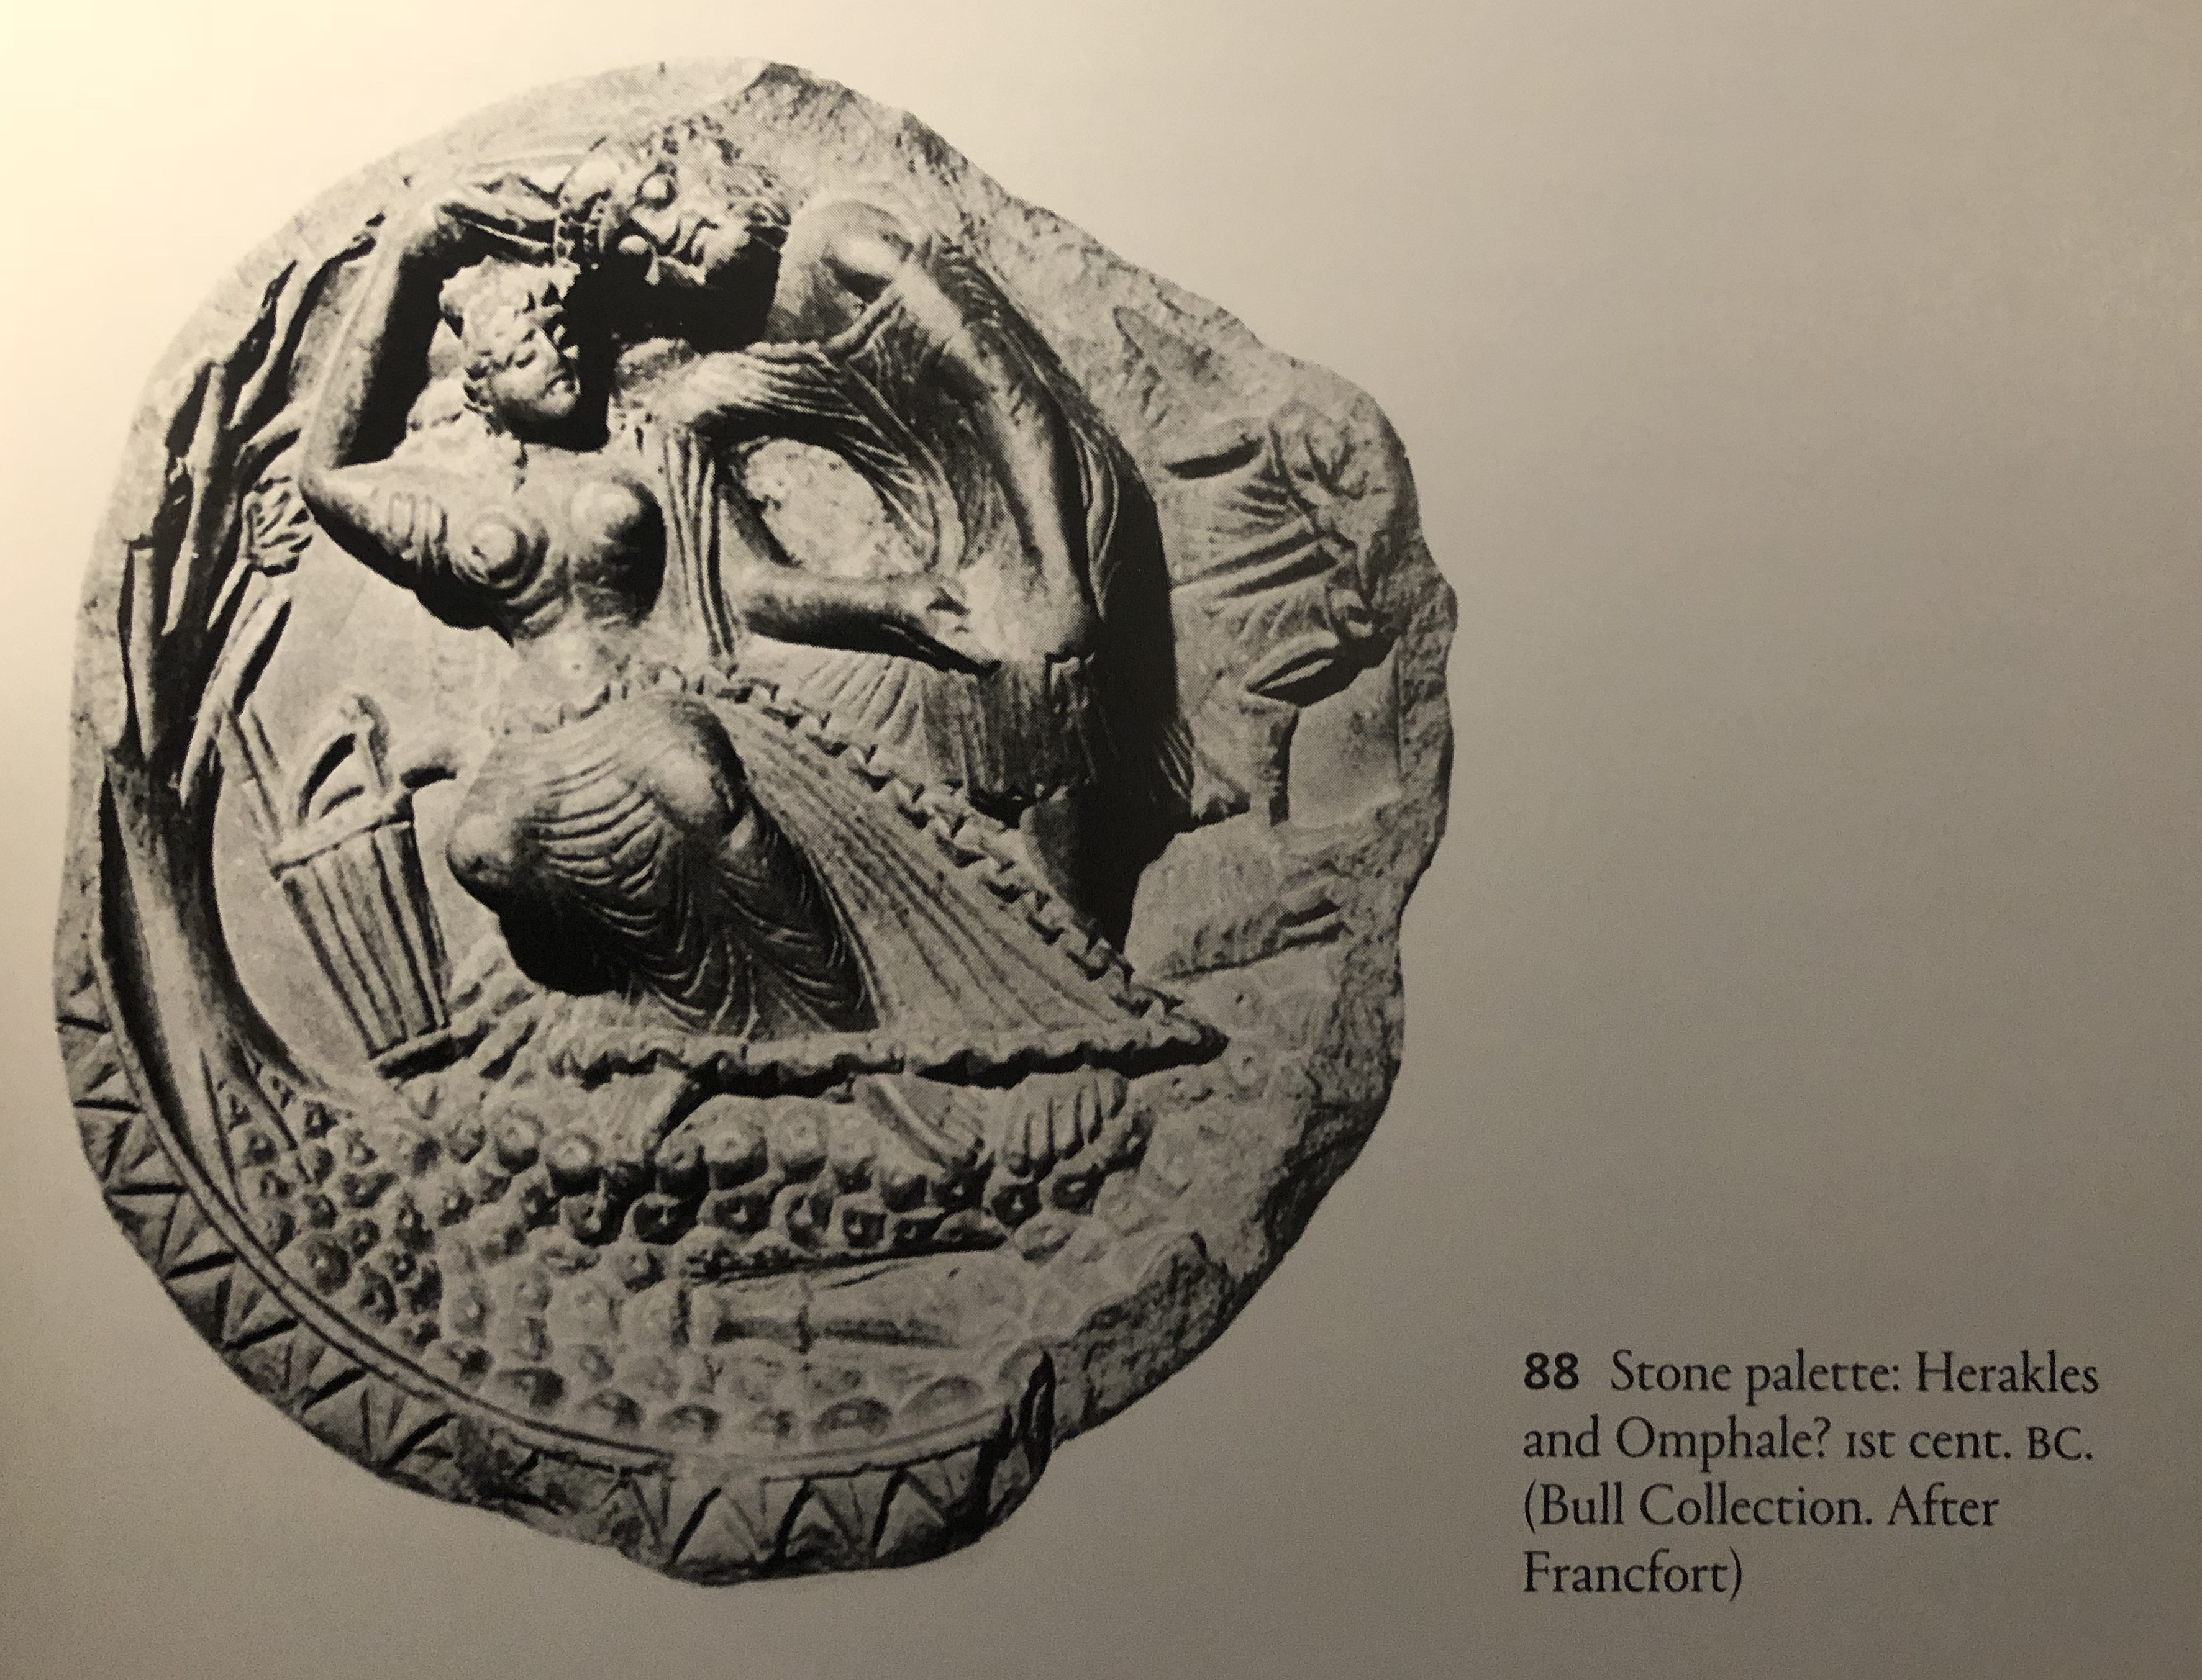

Slide 33
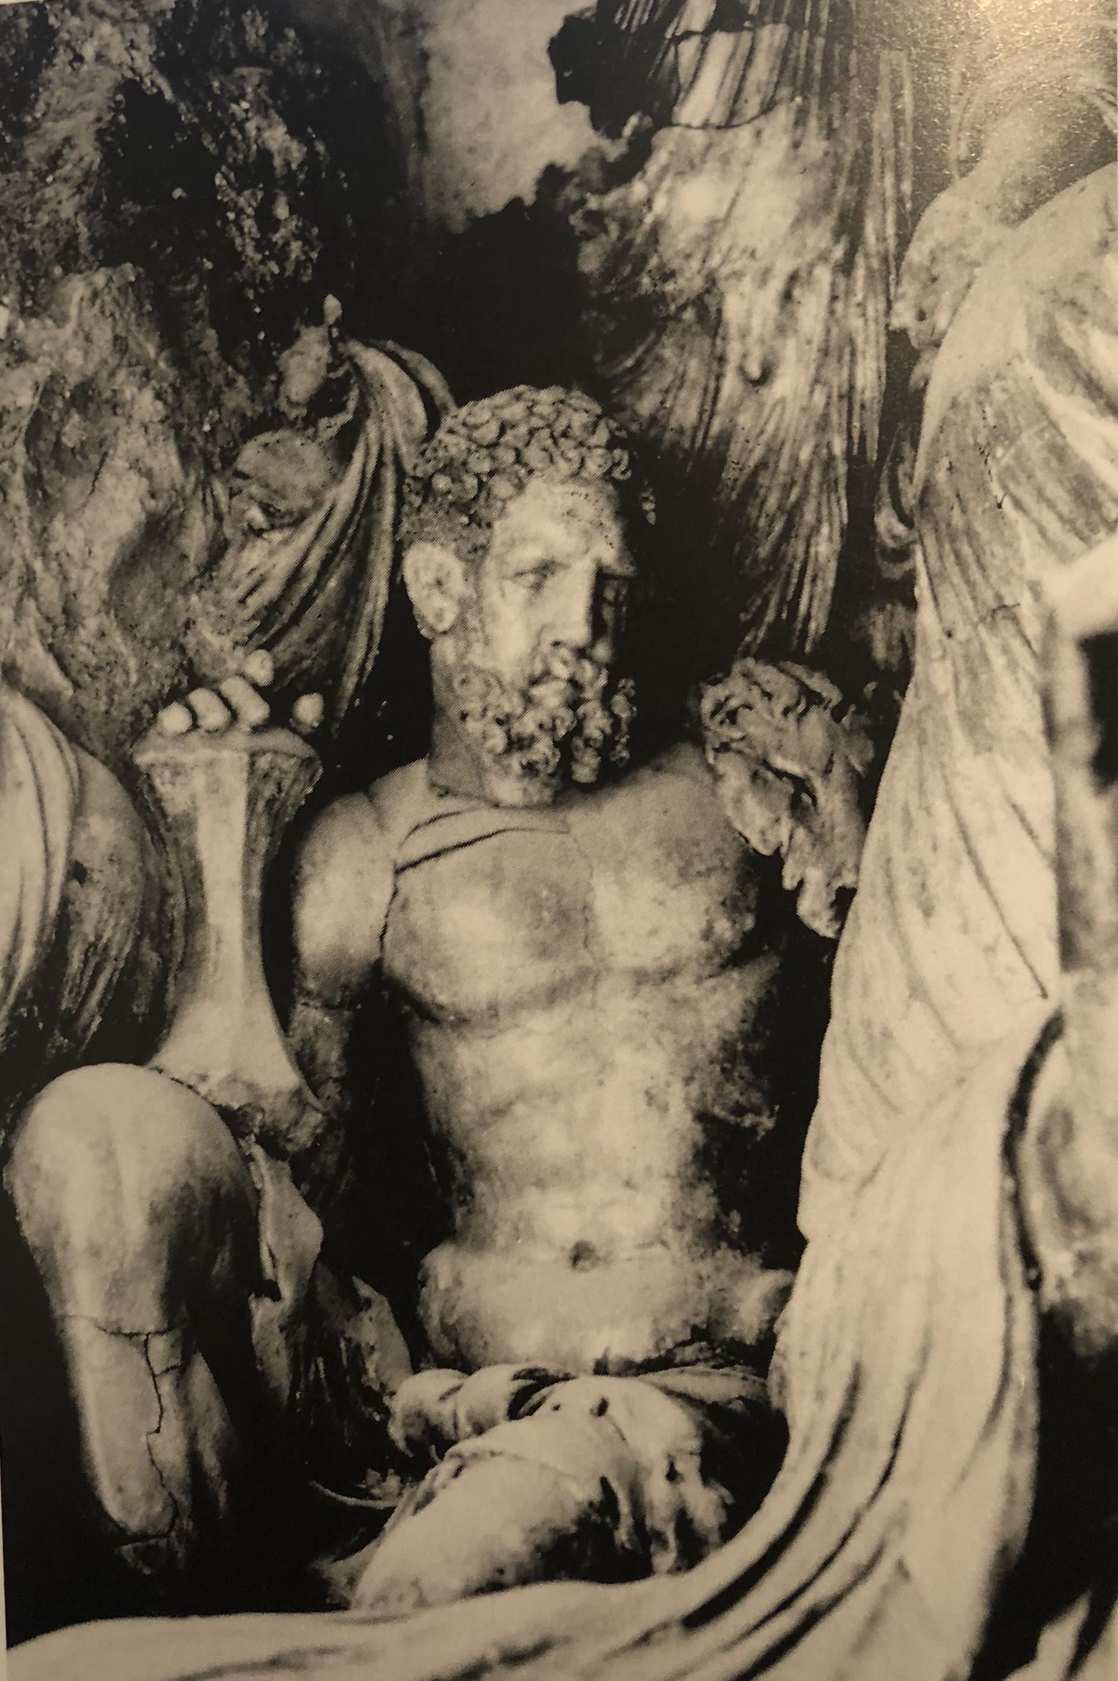

Slide 34
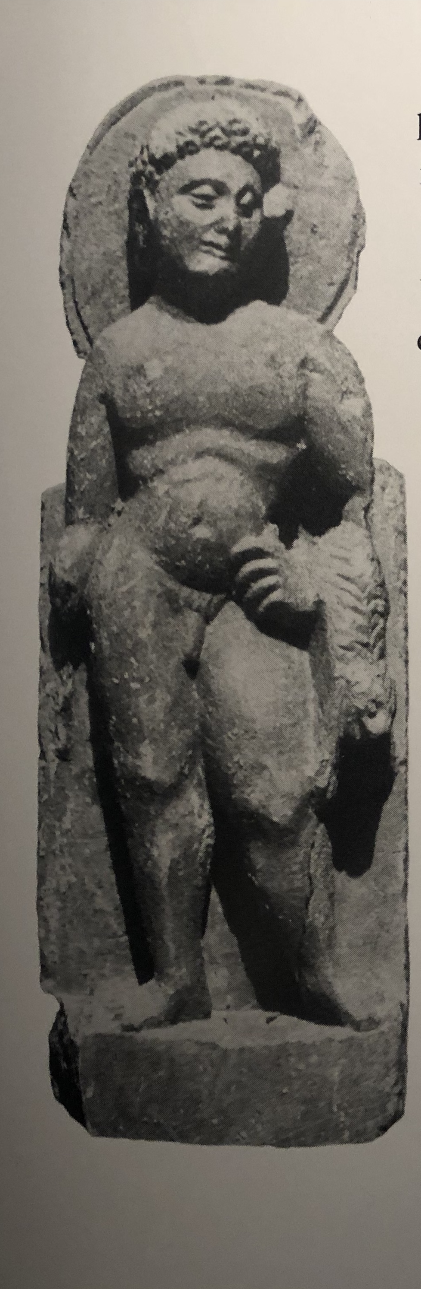

Slide 35
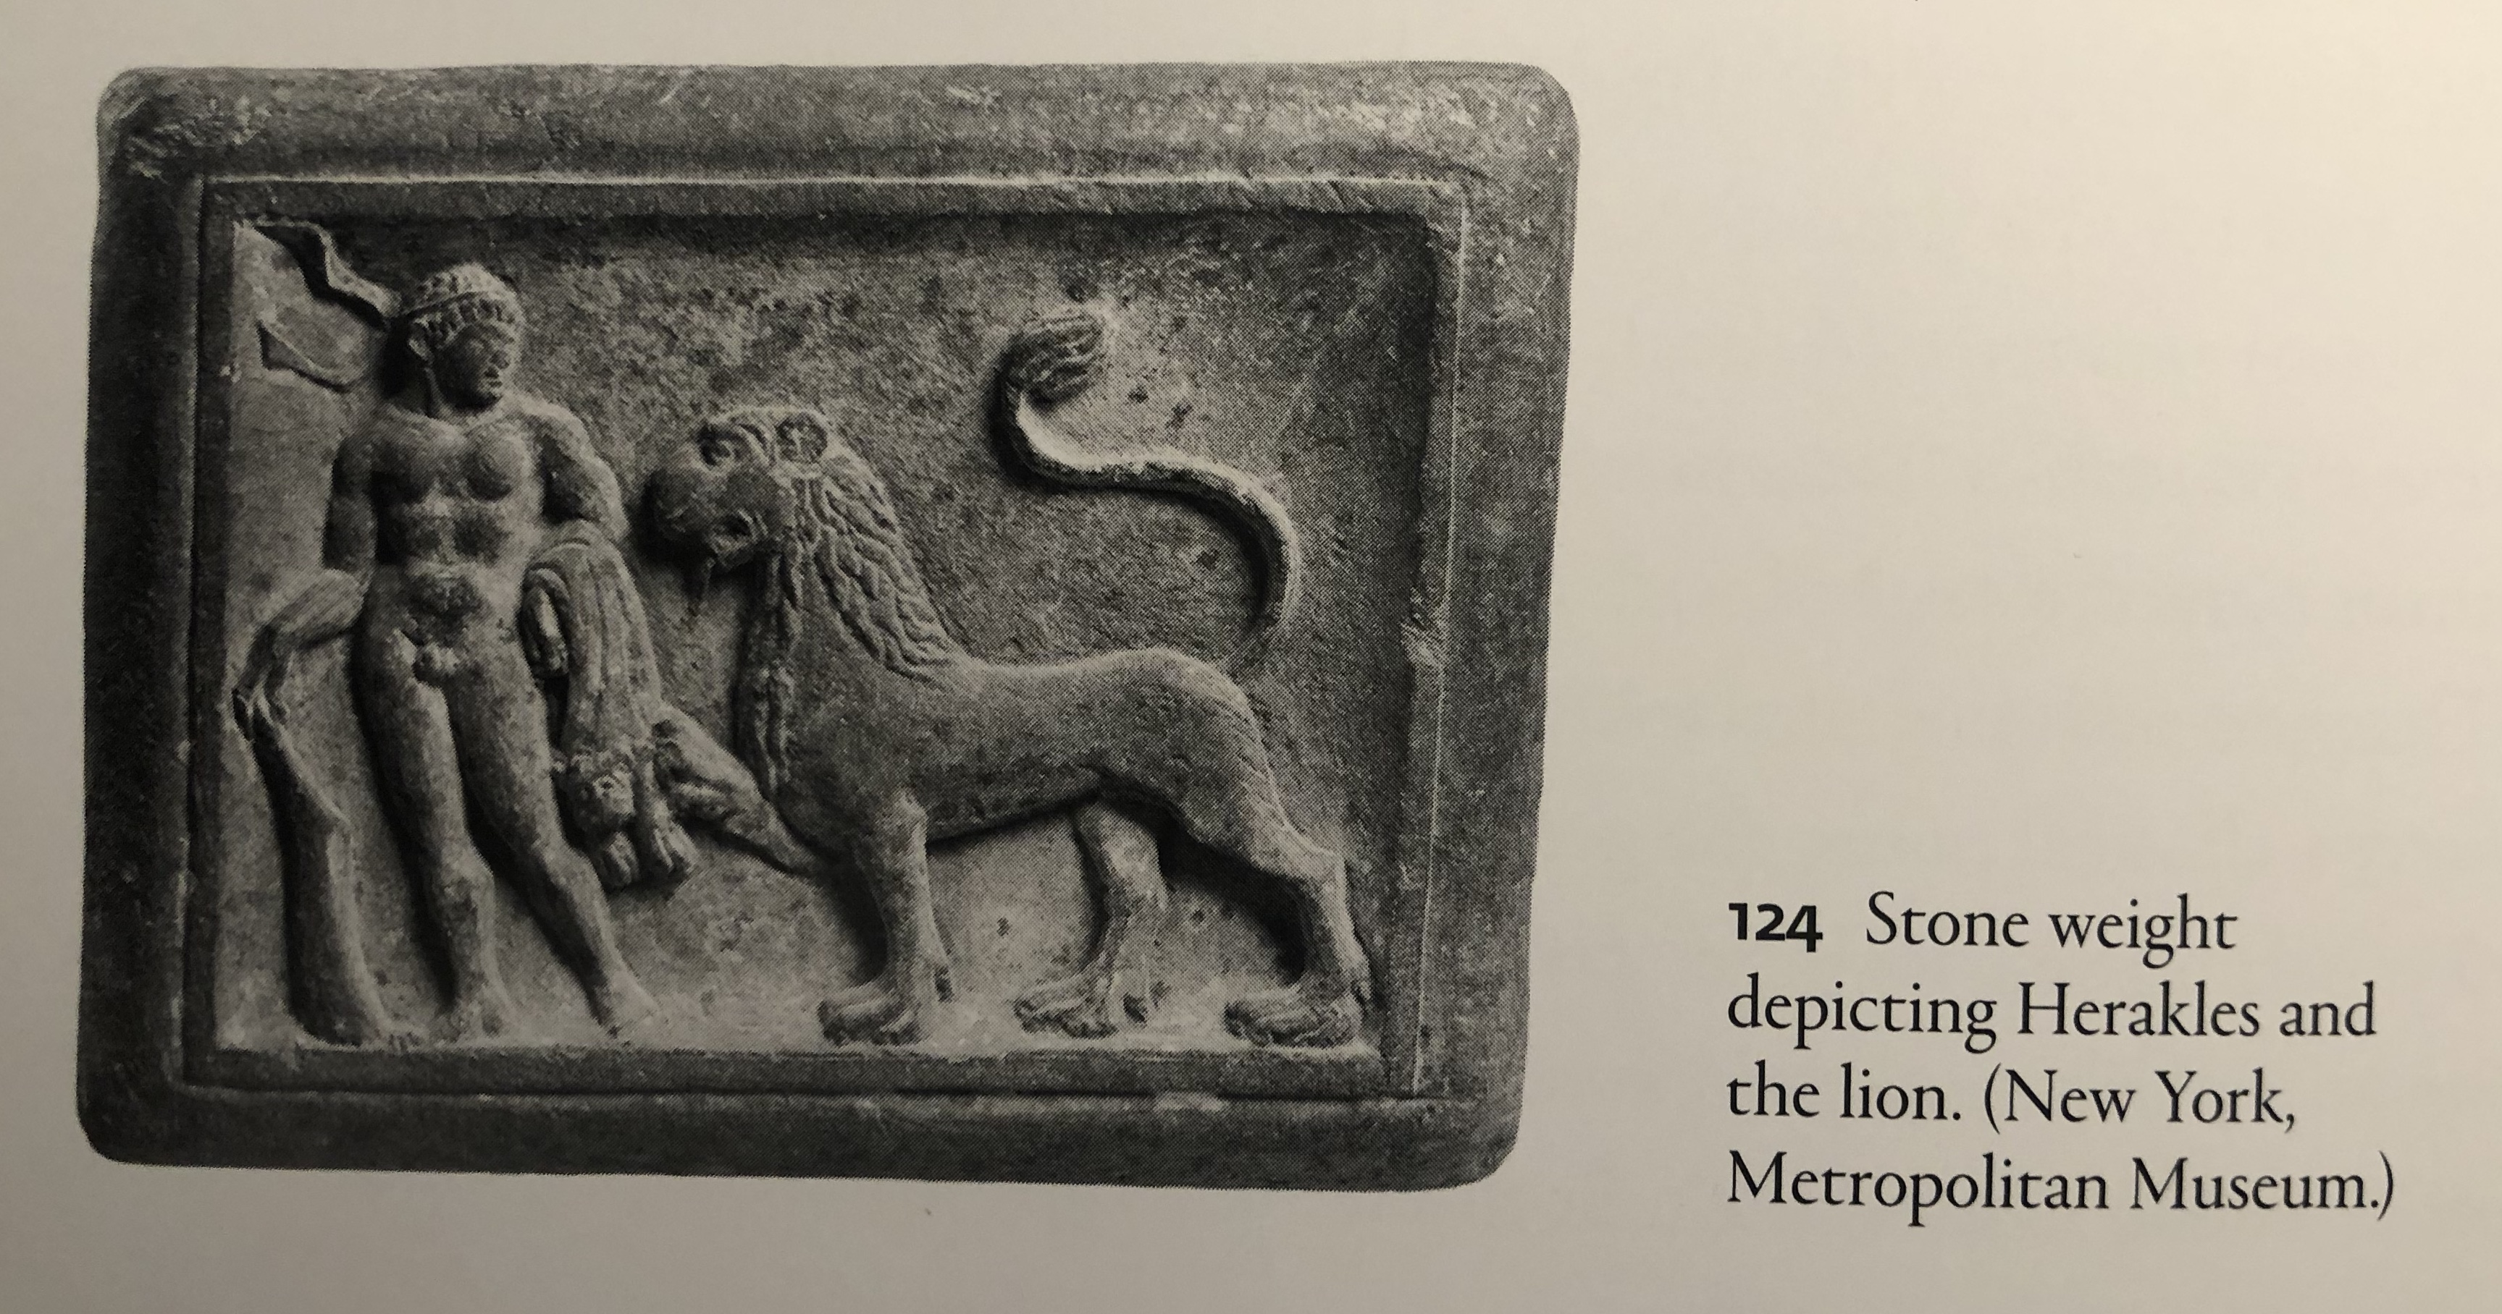

Slide 36
