Slide 1
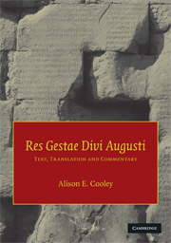
Warwick Classics Network
Imperial Image
Augustus in his own words:
Res Gestae divi Augusti
Prof Alison Cooley
University of Warwick

Slide 2
First meeting of the Senate
Instructions about funeral
Summary of his achievements (index rerum a se gestarum)
Brief account of the whole empire (breviarium totius imperii)

Slide 3
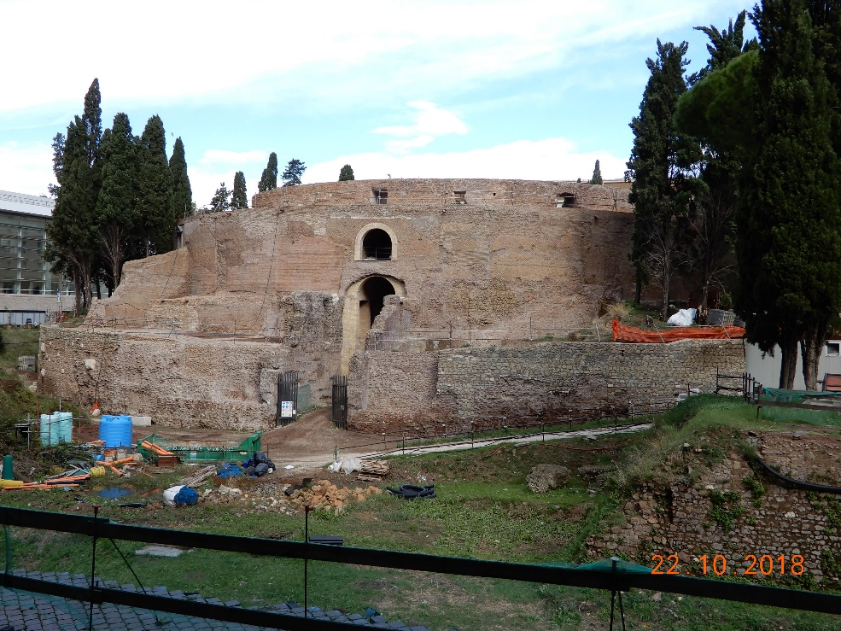
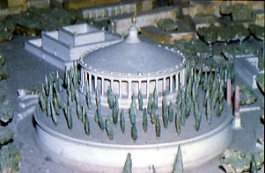
Augustus’ Mausoleum

Slide 4
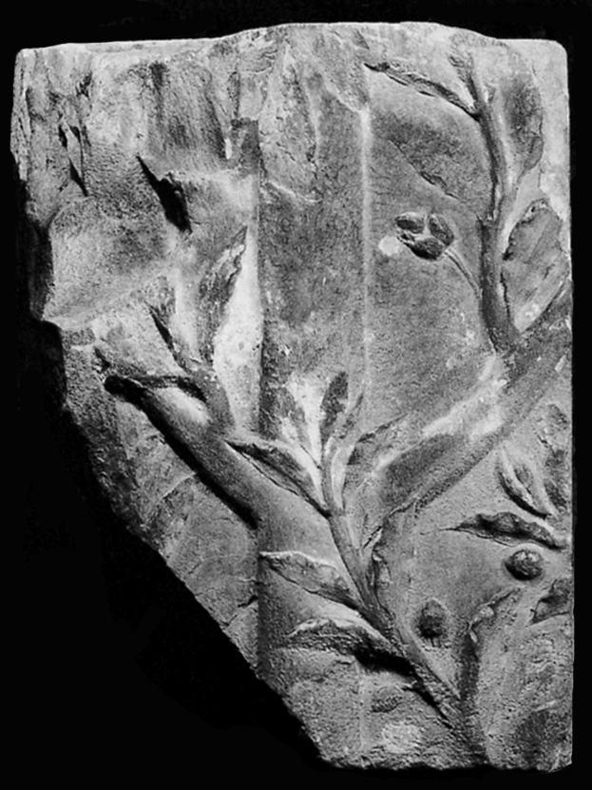
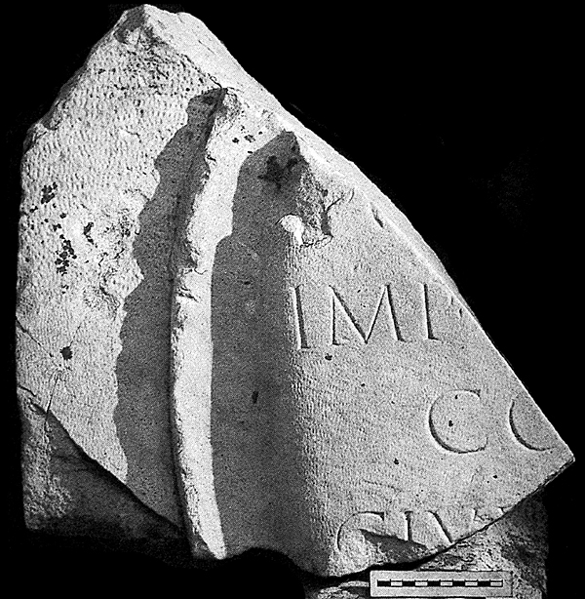
Laurel trees and shield at the Mausoleum

Slide 5

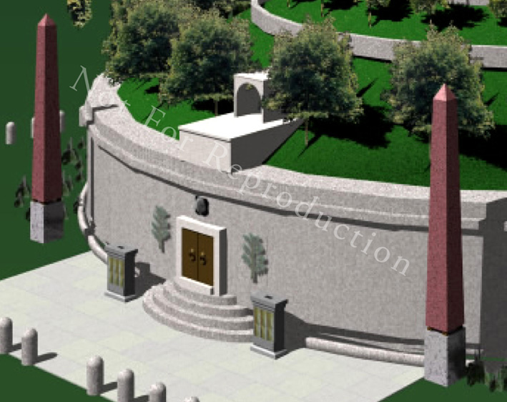
Augustus’ Mausoleum Reconstructed

Slide 6
Augustus’ self-presentation:
World Conquest
RGDA heading:
‘Below is a copy of the achievements of the deified Augustus by which he made the world subject to the rule of the Roman people’
RGDA 32:
‘Kings of the Parthians, namely Tiridates and later Phrates, son of king Phrates, Artavasdes king of the Medes, Artaxares of the Adiabenians, Dumnobellaunus and Tincomarus of the Britons, Maelo of the Sugambri, Segimerus of the Suebic Marcomanni fled for refuge to me as suppliants.’

Slide 7
Augustus’ self-presentation:
World Conquest
RGDA 26.4:
‘My fleet navigated through Ocean from the mouth of the Rhine to the region of the rising sun as far as the territory of the Cimbri; no Roman before this time has ever approached this area by either land or sea, and the Cimbri and Charydes and Semnones and other German peoples of the same region sent envoys to request my friendship and that of the Roman people.’
RGDA 26.2:
‘I settled peacefully Gauls and Hispanias, and likewise also Germania, an area enclosed by Ocean from Gades up to the mouth of the river Elbe.’

Slide 8
Augustus’ self-presentation:
Restoring religion
RGDA 7.3:
‘I have been chief priest, augur, one of the Fifteen for conducting sacred rites, one of the Seven in charge of feasts, Arval brother, member of the fraternity of Titus, and fetial priest.

Slide 9
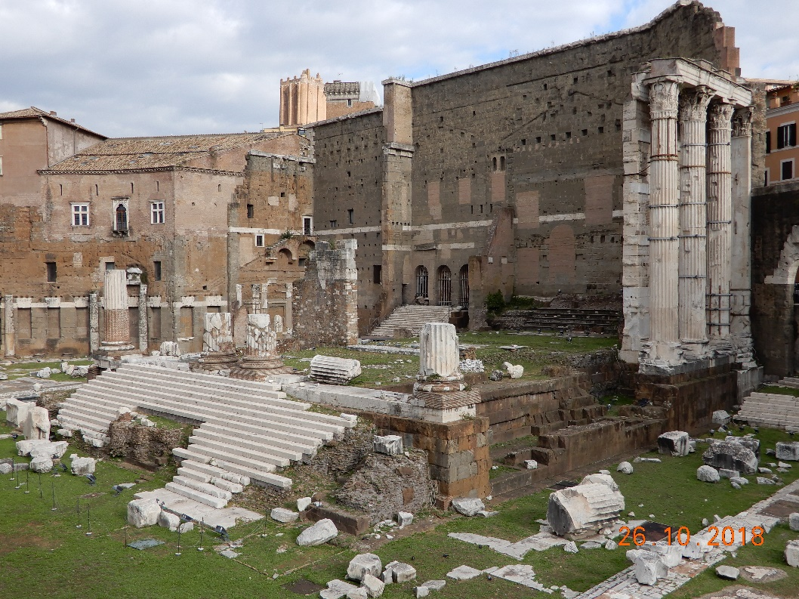
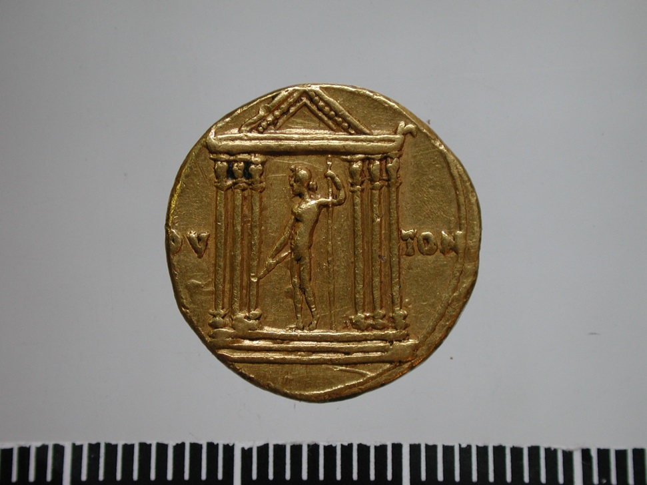
Augustus’ self-presentation:
Transformation of city of Rome
Temple of Mars the Avenger,
Forum of Augustus
Temple of Jupiter the Thunderer

Slide 10
Augustus’ self-presentation:
Restoring constitutional government
RGDA 5.1
‘Even though the post of dictator was conferred upon me both when I was absent and when I was present by both people and senate in the consulship of Marcus Marcellus and Lucius Arruntius, I did not accept it.’

Slide 11
Augustus’ declaration
Suetonius, Aug. 28.2:
“May I be permitted in such a way to set the state safe and sound on its proper footings and to harvest the fruit of this achievement, which I seek, that I may be called the originator of the best state of affairs and that as I die I may take with me the hope that the foundations for the state which I have laid will remain in position.”

Slide 12
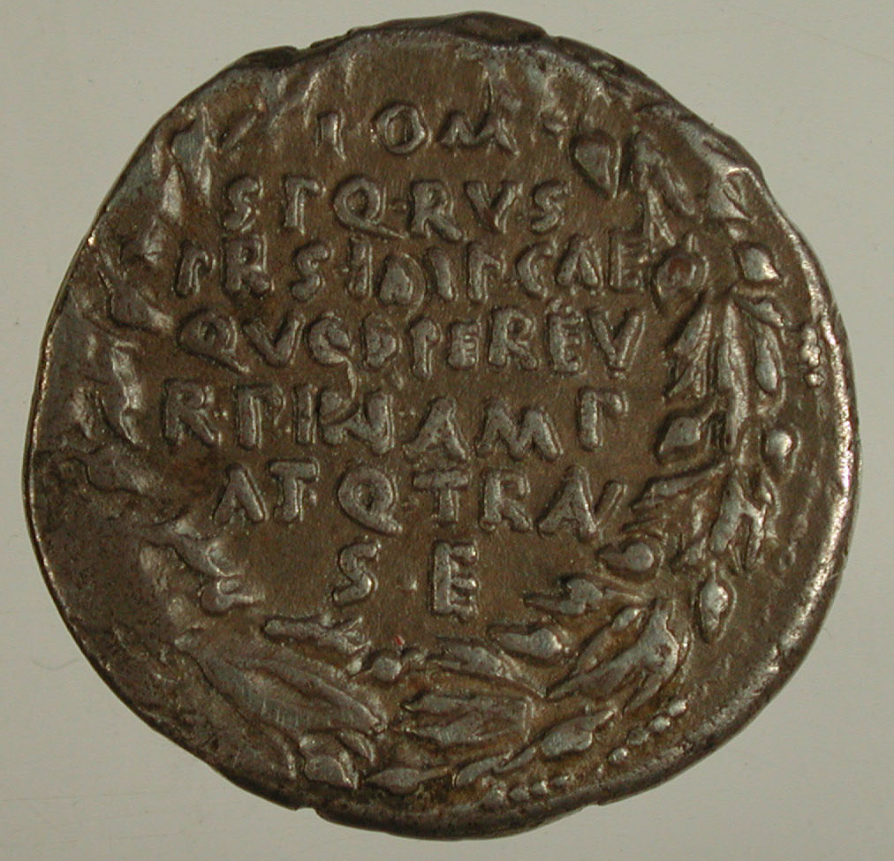
Restoring constitutional government
quod per eu(m) r(es) p(ublica) in amp(liore) atq(ue) tran(quilliore) s(tatu) e(st)
LACTOR L10. BM Coins Rom. Emp. I 17-18 nos 91-94

Slide 13
Mos maiorum/ ancestral practice
RGDA 27.2:
‘I preferred, in accordance with the example set by our ancestors’
RGDA 6.1:
‘I accepted no magistracy conferred upon me that contravened ancestral custom’
RGDA 10.2:
‘I rejected the idea that I should become chief priest as a replacement for my colleague during his lifetime, even though the people were offering me this priesthood, which my father had held. After several years, on the eventual death of the man who had taken the opportunity of civil unrest to appropriate it, I did accept this priesthood.’

Slide 14
Facts and Figures
RGDA 8.2-4:
I performed the ceremony of purification forty-two years after the last one; in this census 4,063,000 individual Roman citizens were registered. Then for a second time I conducted a census on my own with consular power in the consulship of Gaius Censorinus and Gaius Asinius; in this census were registered 4,233,000 individual Roman citizens. And for a third time I conducted a census with consular power with Tiberius Caesar my son as colleague in the consulship of Sextus Pompeius and Sextus Appuleius; in this census were registered 4,937,000 individual Roman citizens.

Slide 15
Constitutional legitimacy
RGDA 7.1:
I was one of the triumvirs for settling the state for ten consecutive years.
triumvirum rei publicae constituendae fui per continuos annos decem.

Slide 16
Augustus and the army: RGDA 30
1. The Pannonian peoples had never had an army of the Roman people come near them before I became leader. I made them subject to the rule of the Roman people, once they were subdued through the agency of Tiberius Nero, who at that time was my stepson and deputy, and I advanced the boundary of Illyricum to the bank of the river Danube. 2. An army of Dacians which crossed over onto this side of that river was conquered and overwhelmed under my auspices, and afterwards my army was led across the Danube and compelled the Dacian peoples to endure the commands of the Roman people.

Slide 17
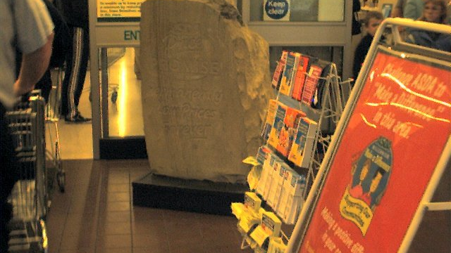
‘Asda Price Promise. Permanently low prices forever’

Slide 18

The whole truth?
Battles of Philippi
RGDA 2
Those who murdered my father I drove into exile by way of the courts of law, exacting retribution for their crime and afterwards I defeated them twice in battle while they were making war upon the state.

Slide 19
The whole truth?
Pirates defeated
RGDA 25.1
I brought the sea under control from pirates. In this war I handed back to their masters for punishment almost 30,000 captured slaves who had run away from their masters and taken up arms against the state.

Slide 20
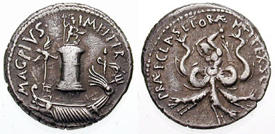
Sextus Pompey
MAG PIVS IMP ITER
‘Great, loyal, commander for a second time’
[ship with eagle, sceptre, and trident in front of column decorated with a statue of Neptune]
PRAEF CLAS ET ORAE MARIT EX S C ‘commander of the fleet and coasts’
[Scylla, wielding a rudder as a club]

Slide 21
The whole truth?
Temple of Jupiter Feretrius
RGDA 19.2:
I built the temples on the Capitol of Jupiter Feretrius and of Jupiter the Thunderer

