Slide 1
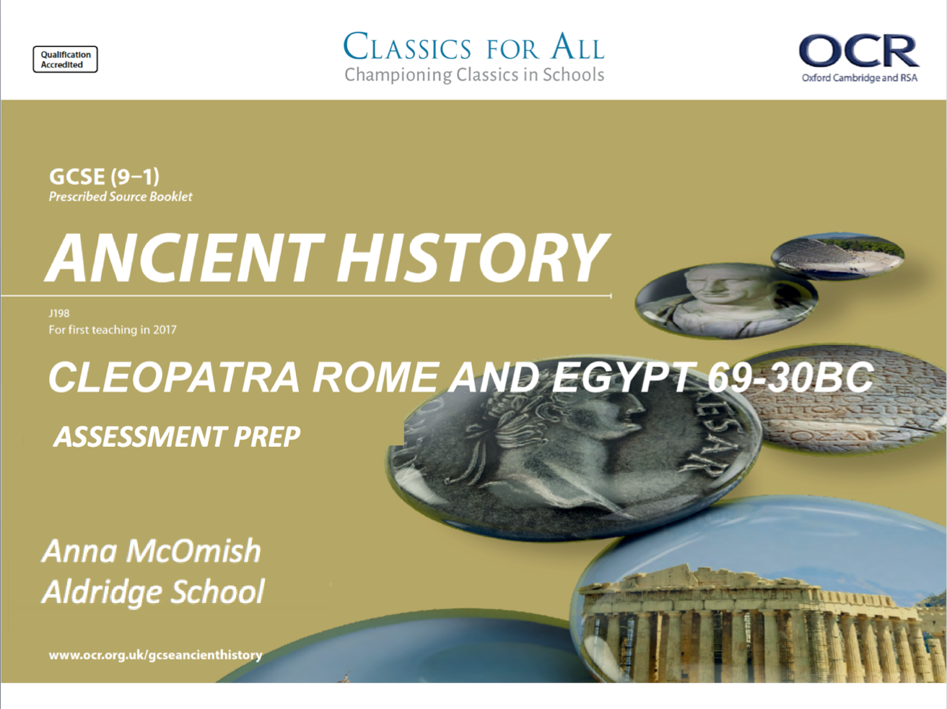

Slide 2
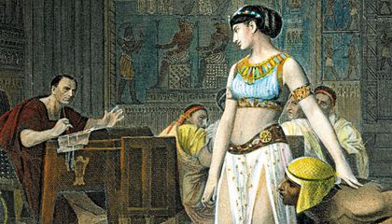
February 27, 2020
Cleopatra and Julius Caesar assessment
(Underline date and title using a pencil and ruler)
Lesson Objectives:
L.O. To complete our next assessment
Key words/Spellings: Cleopatra, Caesar, Caesarion,

Slide 3
Structure of today’s assessment
NO 5 mark questions on;
‘what can we learn…’
or
‘how accurate..’
Today’s assessment will include;
A selection of factual recall questions to begin.
A 10-marker focusing on the consequences of a chosen event.
An essay question that wants you to consider the importance of Caesar to Cleopatra’s securing of the throne of Egypt.

Slide 4
Structure of paragraphs in a Cleopatra/ Alexander essay
How to structure each paragraph in your Cleopatra essay.
Repeat this 3-4 times, making a different point of discussion each time.
Conclusion at the end, no matter how many points you write.
Identify and explain the point you’ll be making in the paragraph, reference the source your information is coming from (no analysis yet, though!)
Include the historical detail that proves the point you’re making. Keep it focused and detailed!
Consider and (briefly) discussion the reliability and accuracy of the source that you got your history from. Make sure to say why you CAN, overall, use the source for your point
reliability = trustworthy accuracy = being correct
Link what you’ve said back to the question. – why has what you’ve said answered the question you were given!

