Slide 1
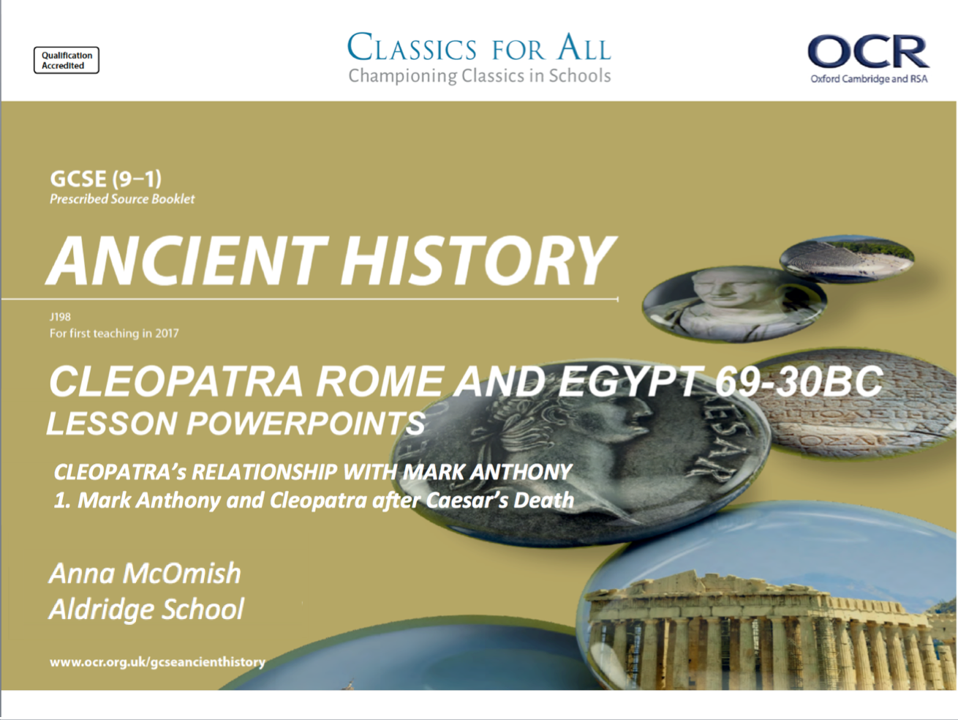

Slide 2
Mark Anthony and Cleopatra after Caesar’s death
To understand the tension between Mark Anthony and Octavian following Caser’s death.
2. To assess the difficulties faced by Cleopatra after Caser’s death.

Slide 3
Mark Anthony vs. Octavian
The assassination of Julius Caesar threw Rome into chaos. The conspirators insisted that in killing Caesar, they had spared Rome tyranny and corruption, whereas the friends and supporters of Caesar were shocked by the actions and eager for revenge.
The Caesarion supporters were led by Marcus Antonius, known to us as Mark Anthony, who was Consul of Rome and used his influence to fire up the public during Caesar’s emotive funeral.
Mark Anthony seemed to be the obvious next leader of Rome, but Caesar’s 18yr old Great-Nephew, Octavian, had been adopted as Caesar’s son and was now also in contention for control of Rome….
As part of his work to take control from Octavian, Mark Anthony became reacquainted with Cleopatra and their love affair began.
We need to get to grips with the background on Mark Anthony, his conflict with Octavian, and when Cleopatra becomes involved.
TASK: watch the following clip, and answer the questions on the quiz sheet.
How do you think Cleopatra would have viewed the activity in Rome after Caesar’s death?
Explain your views?
Notes:
https://www.youtube.com/watch?v=sakeU_hTHRg – brief intro to key facts about Mark Anthony.
https://www.youtube.com/watch?v=fG5KbSXqGf8 – 11min video for question grid

Slide 4
Who was the obvious candidate to take over power when Caesar died?
Who was named as Caesar’s heir in his will?
What did Mark Anthony gain from Caesar?
Why did many men in the empire automatically transfer their loyalty straight to Octavian?
What happened during the funeral of Julius Caesar?
Why was Octavian allowed to run for Consul?
Why did Mark Anthony and Octavian agree to work together?
Who did Mark Anthony marry, to cement the agreement on splitting the empire between the two men?
How did Mark Anthony seriously insult Octavian?
How did Octavian present himself to the people of Rome?
How did Octavian present Cleopatra and Mark Anthony?
How long did the manoeuvring between Octavian and Mark Anthony last for?
What was the name of the battle at which Anthony and Cleopatra were defeated?

Slide 5
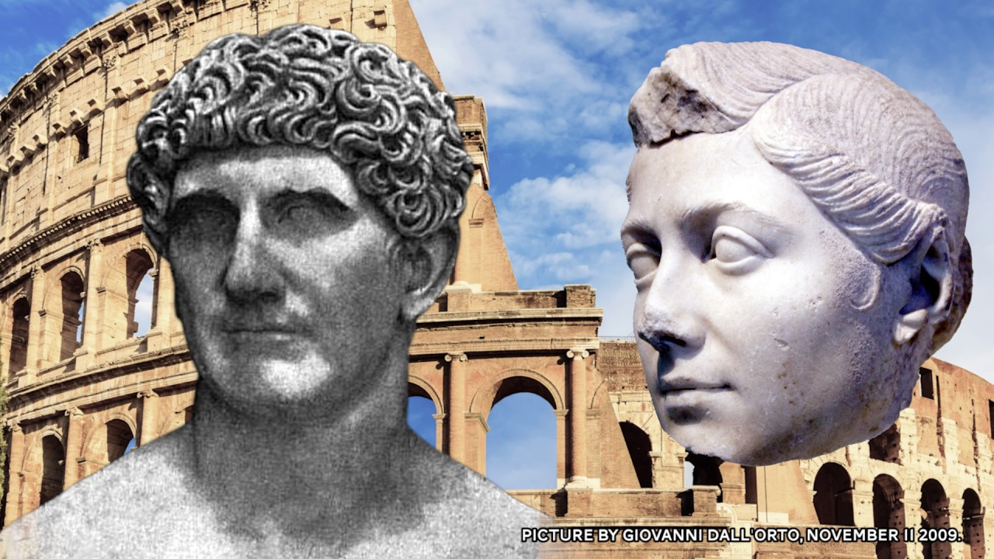
Mark Anthony vs. Octavian - the early years
As the video made clear, Octavian and Mark Anthony did have a working relationship/ a peace in the early years of their relationship. This included the splitting of the Roman empire, which seemed to be a perfect solution for a while.
CHALLENGE: to what extent do you agree with Cleopatra’s decision to choose Mark Anthony as an ally, instead of Octavian?
Support your answer with reference to the ancient sources.
- What do they say that would help you come to a conclusion on this question?
TASK: read the section from p.182-183 under the subheading ‘Mark Anthony and Octavian’.
Using the road template, record the differing actions and fortunes of Mark and Octavian.
Give each figure one side of the road. If events happen at the same time, they should be at the same point on either side of the road.

Slide 6


Slide 7
What was Cleopatra doing 41-44bc?
The uncertainty of Rome’s political situation, the fact that Mark Anthony and Octavian were duelling for power, left Cleopatra in a difficult position. She had left Rome shortly before Caesar’s death, and understood that her main aim must be to stabilise and cement her own power in Egypt.
As if you would believe it, around the time of her return, her brother, Ptolemy XIV, died of unknown causes…
Caesarion was the proclaimed co-ruler with Cleopatra.
TASK: reading p.183, complete the table summarising the problems Cleopatra faced now that Caesar was dead and MARK Anthony and Octavian were battling for control.
Then, explain the actions she took to attempt to solve these problems.
Cleopatra 41-44BC
Problems for Cleopatra | Actions she took to solve these problems
EXTENSION
How do you think Cleopatra would have viewed these events in Rome? Explain your views.
Do you think that Anthony’s political position was strong in 42BC than 44BC?

Slide 8
Cleopatra 41-44BC
Problems for Cleopatra | Actions she took to solve these problems

