Slide 1
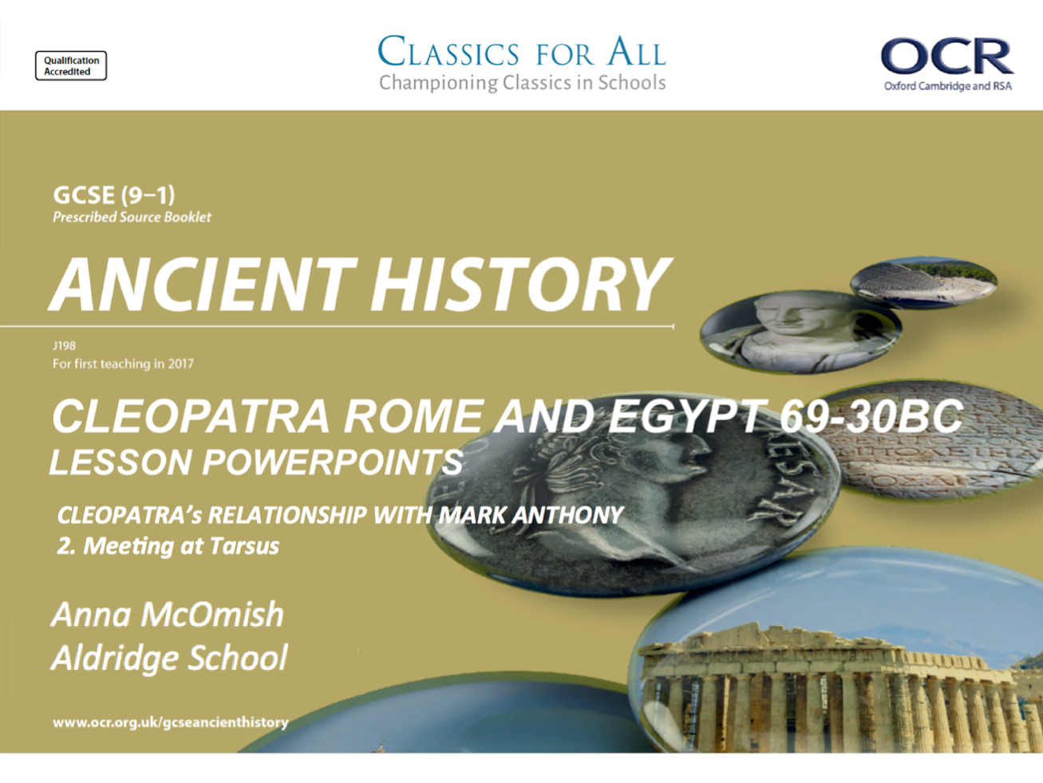

Slide 2
Name given to the system where Mark Anthony and ? shared power after Caesar.
How did Roman soldiers mock Caesar and Cleopatra’s relationship?
Explain two ways in which Caesar and Cleopatra benefitted from their relationship
Identify one consequence of the assassination of Caesar, for Cleopatra?
What position did Mark Anthony hold in Rome, when Caesar died?
A
b
Name of the man who was Caesar’s legal heir and successor?
Why did Cicero have such a dislike for Cleopatra?
List the 3 possible reasons why Caesar chose to support Cleopatra over Ptomley XIII?
What in Egypt, 43-41BC, that was a challenge for Cleopatra?
Identify one reason to believe that Caesar WAS Caesarion’s father.
Get from A to B by leap frogging from one triangle to the next and answering each question.
RULES: you can move up/down, diagonally or in a straight line, (any triangle that touches) but you cannot skip a triangle!

Slide 3
Cleopatra’s meeting with Mark Anthony at Tarsus
To explain the developing relationship between Cleopatra and Mark Anthony.
2. To analyse the reliability of the sources in portraying this relationship

Slide 4
Plutarch’s presentation of Mark Anthony
Anthony spent the winter of 42BC in Athens, enjoying his time there and preparing for further excursions East. He quickly endeared himself to the Athenians by taking part in their religious customs and adopting the Greek style of dress.
According to Plutarch, Mark Anthony had a playful nature and he enjoyed the finer things in life. This element of his personality is what would draw him towards the wealth of Egypt, but also earn the scorn of more traditional Romans who didn’t like such traits.
Mark Anthony first met Cleopatra after turning to the wealth of Egypt to fund his campaigns, and aimed to have a positive relationship with Cleopatra.
He summoned her to Tarsus, which she agreed to, and Plutarch believes that her intention to win Anthony over was clear from that moment.
TASK 1:
Read p.185 and the three sections of Plutarch noted on your table.
For each, give one way in which Mark Anthony is presented and a quote to support this.
Remember, it does not have to be a point directly about him for you to be able to infer things about his personality!
TASK 2 (read top of p. 185)
In his wider writing, who does Plutarch compare Mark Anthony to?
What is the moralistic point/ warning that Plutarch is trying to give when comparing these two?

Slide 5
Source | How is Mark Anthony’s personality presented? | Quotes to support this analysis
Plutarch, Life of Mark Anthony, 24
Plutarch, Life of Mark Anthony, 25
Plutarch, Life of Mark Anthony, 28

Slide 6
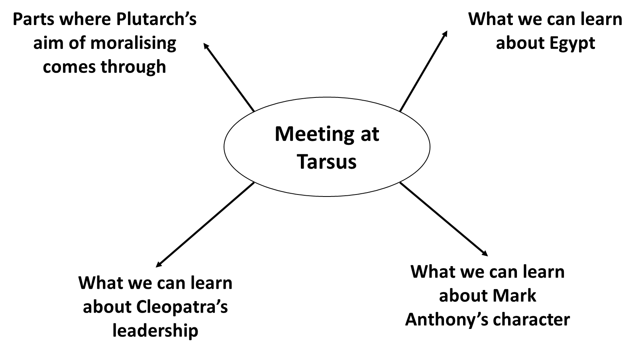
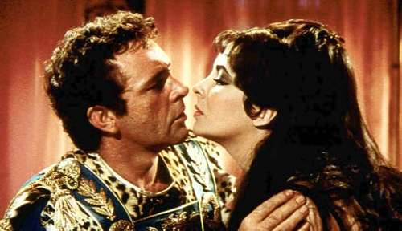
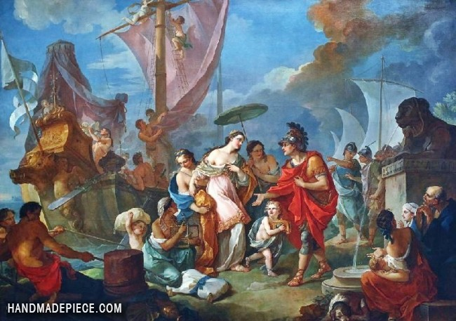
The meeting at Tarsus
Cleopatra’s arrival at Tarsus was, supposedly, magnificent. She arrived on one of her huge boats, a pleasure boat of the grandest proportions, and was dressed as the goddess Aphrodite.
Her arrival quickly drew large crowds, but Plutarch reports that Anthony initially missed it as he was receiving other guests at the local market.
It would seem as though a connection quickly built between the two figures, and they soon became allies as well as lovers.
TASK: read p. 186, and Plutarch, Life of Mark Anthony, 26 and 27.
Complete the revision spider diagram on the key points we can learn from this encounter between Mark Anthony and Cleopatra
Notes:
CHALLENGE WRITTEN ON THE WHITE BOARD – How reliable do you consider Plutarch’s account of the meeting at Tarsus to be? Explain your answer with reference to Plutarch’s moralising aim.

Slide 7
Parts where Plutarch’s aim of moralising comes through
What we can learn about Egypt
Meeting at Tarsus
What we can learn about Mark Anthony’s character
What we can learn about Cleopatra’s leadership

