Slide 1
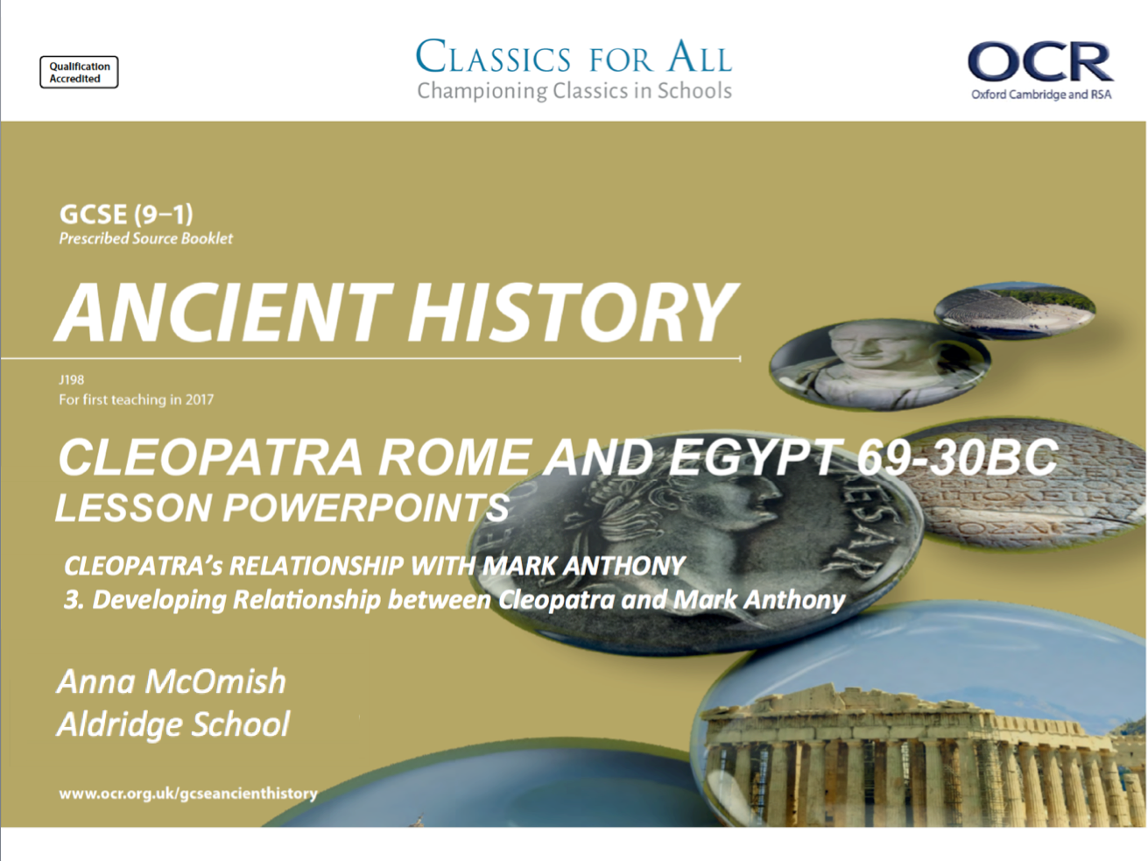

Slide 2
True or False
Read the following states, decide whether each one if true or false. If you think they are false, write the correct statement in your books. If they are true, simply write the statement out in full as it is.
It was preferable to be Egyptian, rather than Macedonian, in Alexandria.
Cleopatra was one of 6 main siblings, fathered by Ptolemy Auletes, that were in contention for the throne.
Cleopatra is characterised in the ancient sources as a withdrawn and shy woman.
Greek sources tend to present Cleopatra as having short, very curly hair.
Client states were able to refuse to pay Rome taxes and could amass armies against the Roman empire.
Caesar chose to support Cleopatra because of his romantic feelings towards her.
Cleopatra’s relationship with Julius Caesar brought little benefit to Egypt as a nation.
Caesar ignored the birth of Cleopatra’s son, Caesarion, and denied he was the father.
Mark Anthony had a clear path to power after the death of Julius Caesar.
The meeting of Cleopatra and Mark Anthony at Tarsus was a quiet event.
CHALLENGE:
Why was Plutarch so keen to characterise Mark Anthony negatively, as a luxury-loving fool?
In which sources do you think this characterisation is best exemplified? Why that source?

Slide 3
Developing relationship between Cleopatra and Mark Anthony; political and personal
L.O. To explain the developments in the political and personal relationship
L.O. To assess the importance of this union for Rome and Egypt.

Slide 4
The Perusine War and ‘peace’ between Mark Anthony and Octavian
Anthony spent the winter of 41-40BC in Alexandria with Cleopatra. Plutarch, life of Mark Anthony, 28, continues the negative and moralising view of Anthony, claiming that he ‘let himself be carried off by (Cleopatra) to Alexandria’, and says that the two spent the whole winter at grand leisure – demonstrating their focus on extravagance and spoilt riches.
Plutarch also reveals one of his sources, Philotas, a doctor who knew one of Cleopatra’s cooks, and who passed information on to Plutarch’s grandfather.
Sections 28 and 29 are full of anecdotes of Anthony and Cleopatra enjoying their time together and playing amusing games. It’s a very human portrayal of the two figures, but we have to wonder how Plutarch knew this in such detail, and whether this is just rumour that he added to help his own moralistic characterisation of the two figures.
Key figures for the story board
Mark Anthony
Octavian
Sextus Pompey – Pompey the Great’s son
The Triumvirs
Octavia – Octavian’s sister
Key events for the story board
Sextus taking control of the Mediterranean
The decision of the Triumvirs and marriage of Octavia and Mark.
Treaty of Tarentum
Antony sails back to Antioch – last event
This winter of leisure would not go on forever, and eventually Anthony had to return to Italy to supress the threat from Pompey’s Son, Sextus, who had taken the Mediterranean in a bid to reclaim his father’s power…
This meant he had to, once again, work with Octavian to save Rome.
TASK: using p.187-bottom of 188, complete the story board summarising the Perusine War and the political complications that developed as a part of it!
CHALLENGE:
read Plutarch, Life of Mark Anthony, 31. What can we learn about the marriage of Mark Anthony and Octavia. (5)
How accurate do you think Plutarch’s account of Octavia’s character is? (5)

Slide 5
Mark Anthony and Cleopatra reunite!
While the Perusine war had been raging, and Anthony and Octavia had seemingly entered a new period of peace, Cleopatra had continued to rule Egypt from 41-37BC with the support of Rome and Anthony.
In the winter of 37BC, Anthony summoned Cleopatra to winter with him in Antioch, for both romantic and political reasons…
This, obviously, was a huge insult to his new marriage to Octavia and it was worsened by his decision to recognise the twin boy and girl that he had, had with Cleopatra.
Exam Practise
TASK: read p. 188-189 (stop before you begin reading the bullet point lists on significance for Egypt and Rome).
You will need to find and note down at least 3 consequences (things that happened/ changed) because of Anthony called Cleopatra to join him in 37BC.
Once you have bullet pointed these down in your books, number them in your margin to keep track, you must take this information and turn it into an answer for the practise exam question…
Explain the consequences of Mark Anthony’s request for Cleopatra to winter with him in 37BC. (10)
Check list for a 10-marker on Cleopatra/ Alexander paper
3 points of discussion
Excellent, detailed historical info to support your points
A STRONG focus on the S.O.C of the question, which in this case is CONSEQUENCES!
Come to an overall judgement on the question. The most important consequence/ was it of consequence at all?

Slide 6
Homework – significance of their relationship for Rome and Egypt
This is an idea that we have already thought about before, when studying Cleopatra’s relationship with Julius Caesar. We must now do the same for Cleopatra’s relationship with Mark Anthony.
TASK: using p. 189-190 of the textbook, complete the table summarising the significance of the relationship for both nations.
When you are putting the details onto the table, make sure you write them down in order of SIGNIFICANCE! – e.g. if you think ‘loss of land’ is the most significant for Rome, that goes at the top of the Rome column.
To what extent do you agree that the relationship between Cleopatra and Mark Anthony, had more significant effects than her relationship with Julius Caesar?
Let’s be real…
The exams are fast approaching, and the single most effective form of revision is when recapping of info is combined with immediate exam practise.
WITH THIS IN MIND…
‘Explain the significance of Cleopatra’s relationship with Mark Anthony for Rome and Egypt’. (10)
‘Explain whether the impact of Cleopatra’s relationship with Mark Anthony was different between Rome and Egypt’. (10).

Slide 7
Significance of Cleopatra and Mark Antony for Rome | Significance of Cleopatra and Mark Antony for Egypt

