Slide 1
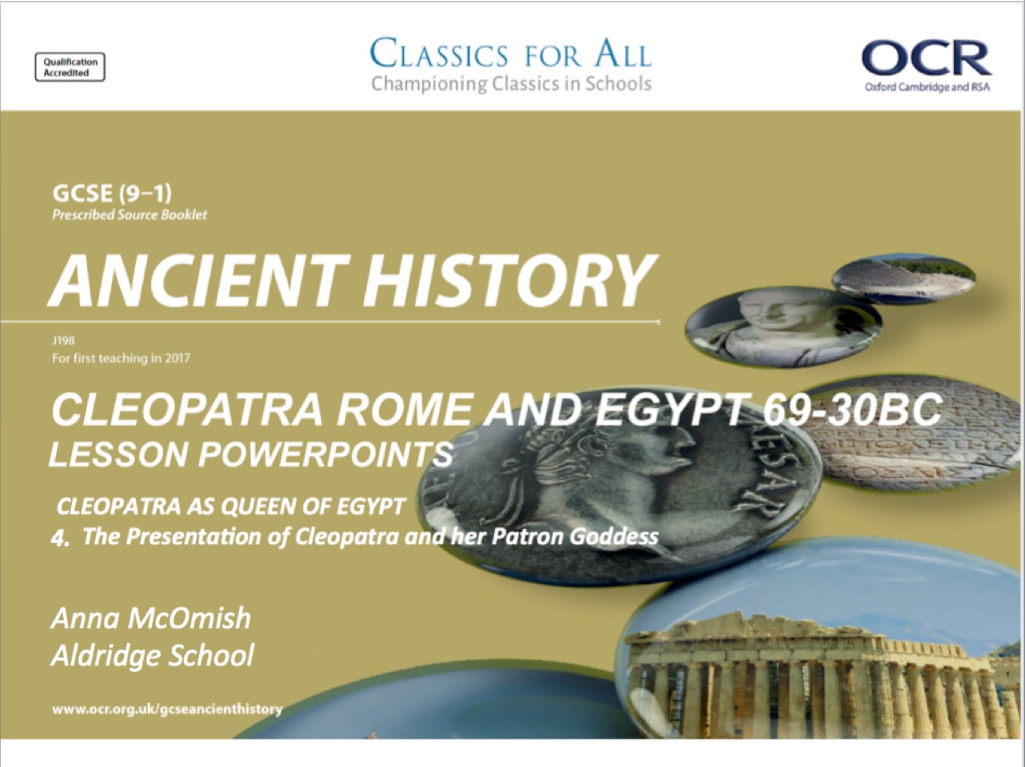

Slide 2
The presentation of Cleopatra and her patron Goddess, Isis
February 27, 2020
(Underline date and title using a pencil and ruler)
Revise, Review, Recap – true or false
Cleopatra had 3 siblings
Cleopatra was of Macedonian/Greek heritage
She was part of the Ptolemaic dynastry
She was known for seducing 3 famous Roman leaders
Cleopatra wasn’t well educated and could only speak Latin
Lesson Objectives:
1. To understand how Cleopatra was presented in Graeco-Egyptian sources.
2. To assess the rationale for choosing Isis as her patron goddess.
Key words/Spellings: Cleopatra, Macedonian, heritage, Alexandria

Slide 3
Hellenistic vs. Egyptian images of Cleopatra
When Ptolemy I took control of Egypt in 305BC, after the death of Alexander the Great, he understood the importance of combining Greek and Egyptian cultures, so that the Egyptians would warm to their new leaders.
This meant the pharaohs needed to adopt Egyptian imagery and customs, which was something that Cleopatra understood and continued during her own reign.
The majority of visual sources we have depict Cleopatra in the Hellenistic (Greek/Macedonian) style, but there are some purely Egyptian images of her that remain, and prove to us that she was adopting elements of Egyptian culture to strengthen he relationship with her people.
TASK: Turn to p. 162-3 of the textbook, then taking an A4 page of your book, create a Venn diagram to record the specific features of each style of representations.
One side for Egyptian style, and one side for Hellenistic.
Use the middle section of the diagram to note any similarities in the way that Cleopatra was represented across these cultures.
CHALLENGE:
To what extent do you think that any of these physical sources influenced the written sources’ comments of Cleopatra’s character that we studied last lesson?

Slide 4
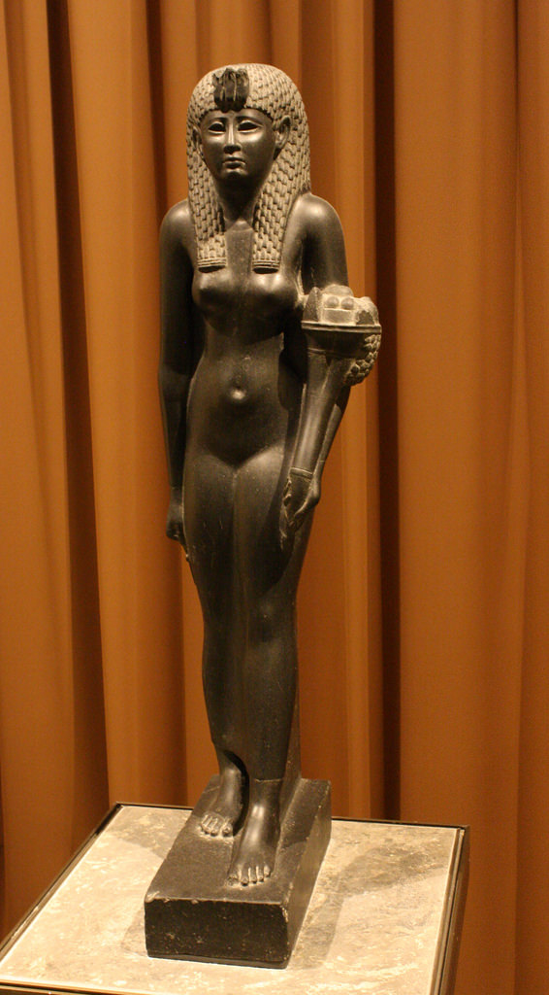
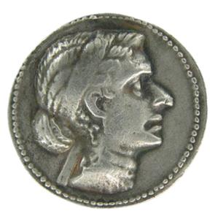
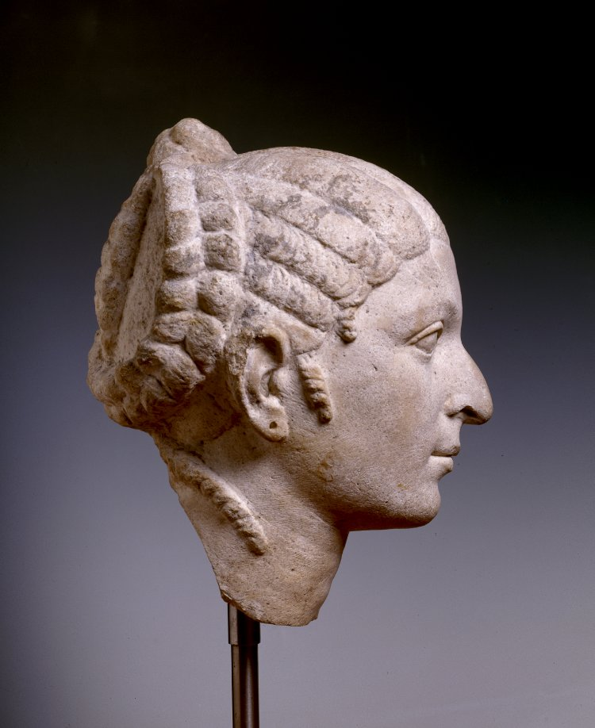
Bust of Cleopatra, again note the distinctive hairstyle and hooked nose, commonly portrayed by the Hellenistic style (PS)
Coin of Cleopatra, note the distinctive hairstyle and hooked nose, commonly portrayed by the Hellenistic style (PS)
Statue of Cleopatra, Egyptian style, note that she looks far grander in this and is wearing a headdress.

Slide 5
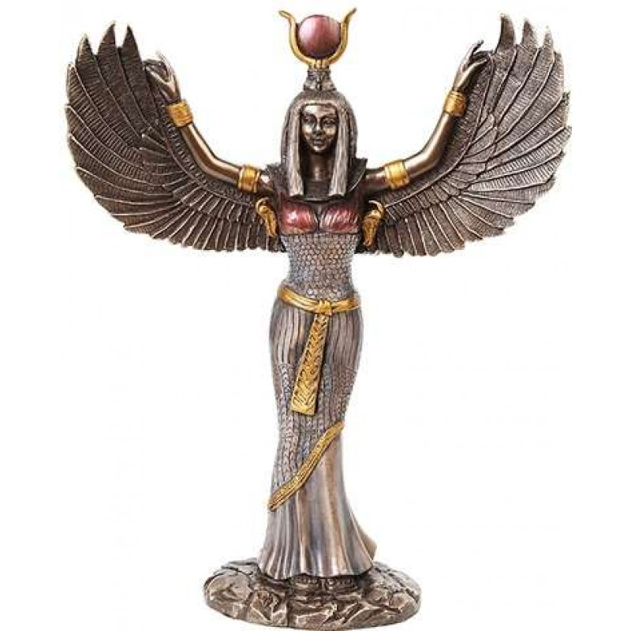
Why did Cleopatra have Isis as her patron Goddess?
Around the time of the birth of her and Caesar’s son, Caesarion, Cleopatra began to closely associate herself with the Goddess Isis. Isis was idealised as the perfect wife and mother, but she was also an extremely powerful figure who represented magic and re-birth.
The story of Isis runs surprisingly close to the real life story of Cleopatra, which helps us to understand why she was the perfect choice of god to support the queen.
Features from the story of Isis | Features from Cleopatra’s life
TASK 1: Read p,163-165 and the story of Isis. Draw up and complete a table on similarities between the story of Isis and Cleopatra’s life, explain how each similarity would have helped improve Cleopatra’s image.
TASK 2: Find figure 3.7 (Coin of Cleopatra and Caesarion minted in Cyprus) and 3.8 (relief of Cleopatra and Caesarion). Find and annotate areas in these image where Cleopatra is being likened to Isis.
  HOW she is being made to look like Isis, what exact features?
  WHY she would have done this, on this particular type of source?

Slide 6
The Story of Isis
Isis had strong links with Egyptian kingship, and she was most often represented as a beautiful woman wearing a sheath dress and either the hieroglyphic sign of the throne or a solar disk and cow’s horns on her head. Occasionally she was represented as a scorpion, a bird, a sow, or a cow.
Isis was the daughter of the earth god Geb and the sky goddess Nut and the sister of the deities Osiris, Seth, and Nephthys. Married to Osiris, king of Egypt, Isis was a good queen who supported her husband and taught the women of Egypt how to weave, bake, and brew beer. But Seth was jealous, and he hatched a plot to kill his brother. Seth trapped Osiris in a decorated wooden chest, which he coated in lead and threw into the Nile. The chest had become Osiris’s coffin. With his brother vanished, Seth became king of Egypt. But Isis could not forget her husband, and she searched everywhere for him until she eventually discovered Osiris, still trapped in his chest, in Byblos. She brought his body back to Egypt, where Seth discovered the chest and, furious, hacked his brother into pieces, which he scattered far and wide. Transforming into a bird, and helped by her sister, Nephthys, Isis was able to discover and reunite the parts of her dead husband’s body. Using her magical powers, she was able to make Osiris whole; bandaged, neither living nor dead, Osiris had become a mummy. Nine months later Isis bore him a son, Horus. Osiris was then forced to retreat to the underworld, where he became king of the dead.
Isis hid with Horus in the marshes of the Nile delta until her son was fully grown and could avenge his father and claim his throne. She defended the child against attacks from snakes and scorpions. But because Isis was also Seth’s sister, she wavered during the eventual battle between Horus and Seth. Eventually she and Horus were reconciled, and Horus was able to take the throne of Egypt.
Isis was the perfect traditional Egyptian wife and mother—content to stay in the background while things went well, but able to use her wits to guard her husband and son should the need arise. The shelter she afforded her child gave her the character of a goddess of protection. But her chief aspect was that of a great magician, whose power transcended that of all other deities.

Slide 7
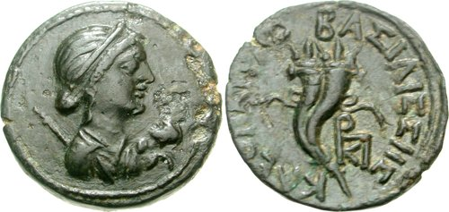
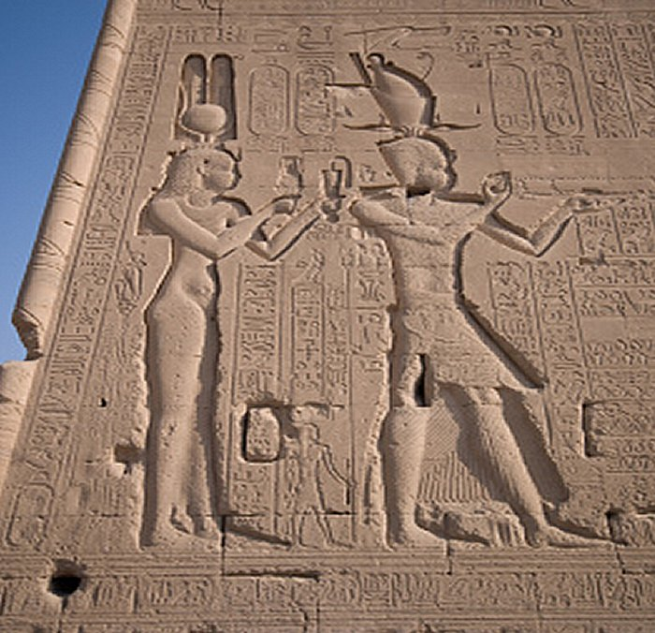
Coin of Cleopatra and Caesarion, minted in Cyprus, this shows Cleopatra with her son and presented like the goddess Isis (PS)
Relief of Cleopatra and Caesarion, on the side of a temple in Egypt, this shows Cleopatra with her son offering gifts to the gods – note that Cleopatra is behind her son (PS)

