Slide 1
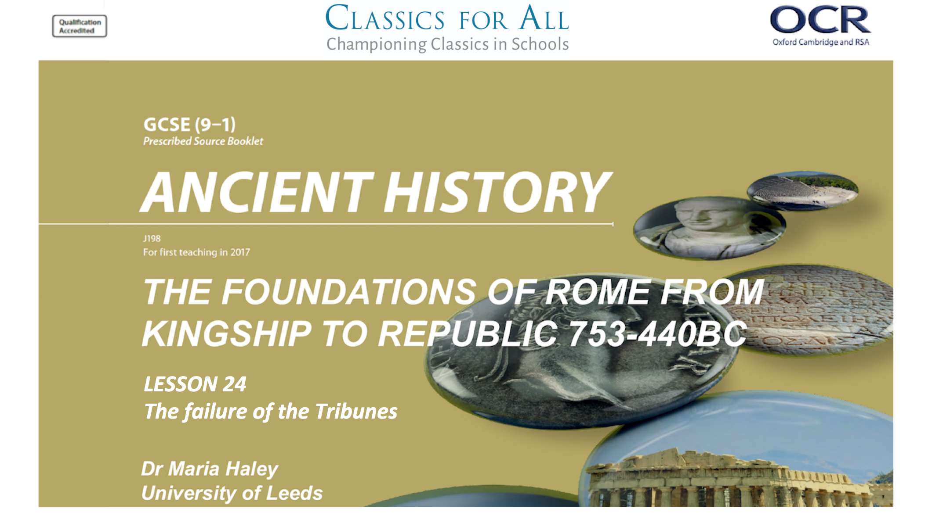

Slide 2
Why had the Tribunes failed to improve the lives of the Plebeians by 462BC?
To understand and explain the roles of key individuals in the First Secessions. To assess the impact of the First Secession on Plebeian lives.
TASK:
Get your “If/ then/because” homework out and swap with your neighbour.
Add anything you got that they did not in a different colour.
We will feedback as a group soon.

Slide 3
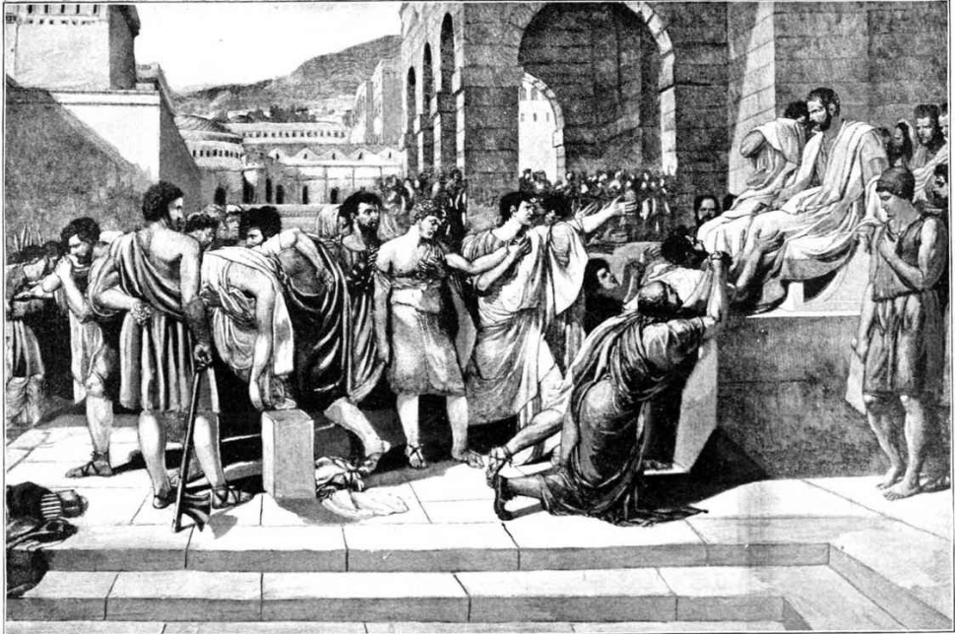
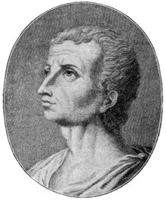
First Secession- Quick Fire!
SERVIUS
OVERPROMISES
(QUORUM)
BATTLE OF
REGULIUS
WAR VETERAN
Hands up, can you name the right part of the story?
“While the plebeians were fighting for freedom on the battlefield at Regulius, their families were being imprisoned at home by those they were fighting to protect.”
PLEBS
KICK OFF!
“Violence was the order of the day”

Slide 4
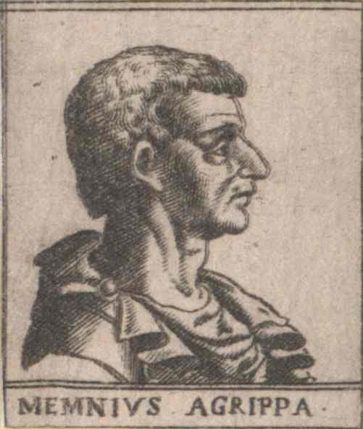
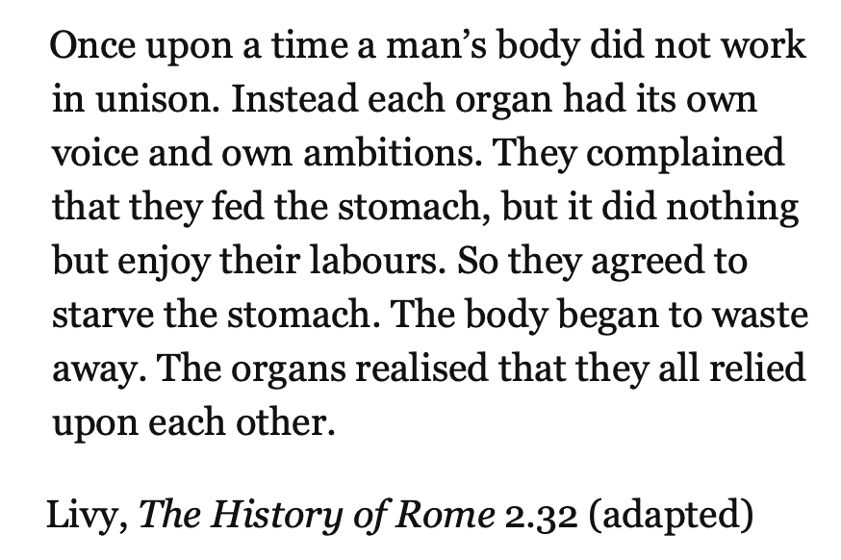
Memnius Agrippus on Work Together (Livy.2.32)

Slide 5
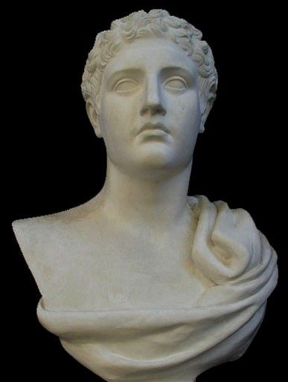
FOOD, LAND AND VOTING RIGHTS
MARCIUS CORIOLANUS
Tries to redistribute land
Changes tribune voting system
SPURIUS CASSIUS
Don’t save plebs
from famine they caused
TASK:
Read pp. 58-8 and match the strategy to the key figure.
(Marcius Coriolanus left)
VOLERO PUBILIUS

Slide 6
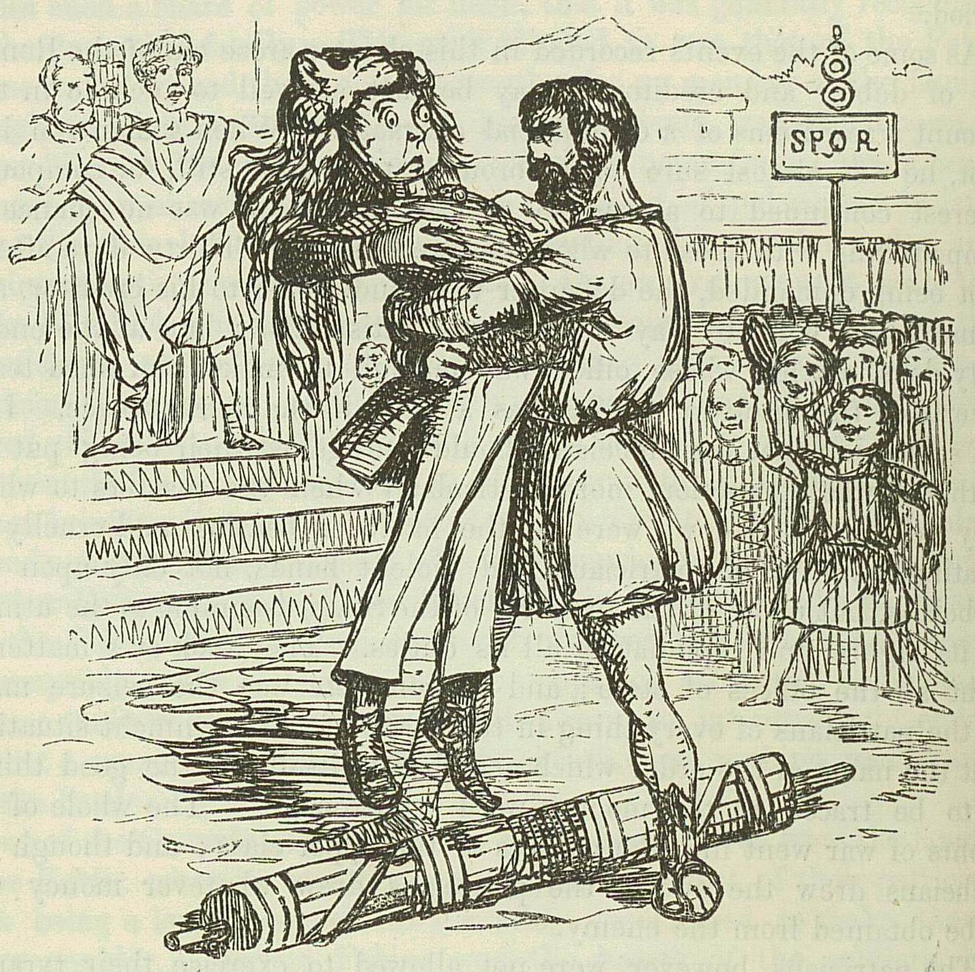
“Volero, having been taken into favour by the plebs…”
“I appeal, and implore the protection of the plebs; help, citizens! help, fellow-soldiers! It is useless for you to wait for the tribunes, who themselves stand in need of aid from you.”
TASK:
Read Livy 2.56 and explain how Volero’s change to the election of tribunes gave the plebs more power in 1 sentence.
“Then for the first time tribunes were elected in the tribal assembly.”
John Leech, A Lictor is sent to arrest Publilius Volero, from The Comic History of Rome. In this account, the powerful Publilius seized the lictor and set him down roughly on the ground.

Slide 7
PLEB’S PRIORITIES
PLEB’S PRIORITIES | JEOPARDISED BY | IMPROVED BY
FOOD
LAND
VOTING RIGHTS
KEY FIGURE
TASK:
Read pp. 59-60 and your notes from last lesson to complete the table.
There may be more than one point in each column
CHALLENGE:
Add the Key figure responsible to your table and 1 sentence on how Livy characterises them in your sourcebook.

