Slide 1
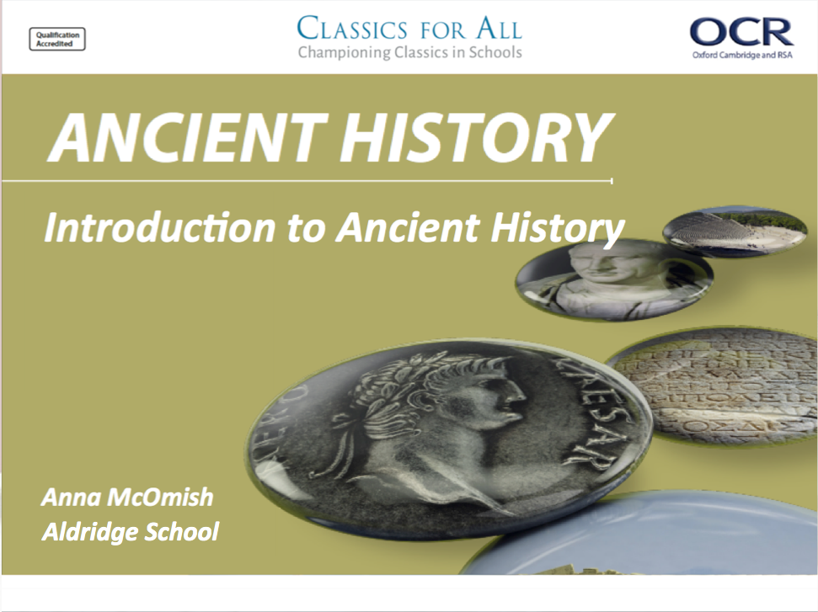

Slide 2
Starter:
What do you already know about the ancient world?
Think about – EVENTS, PEOPLE, BELIEFS, COUNTRIES, EMPIRES

Slide 3
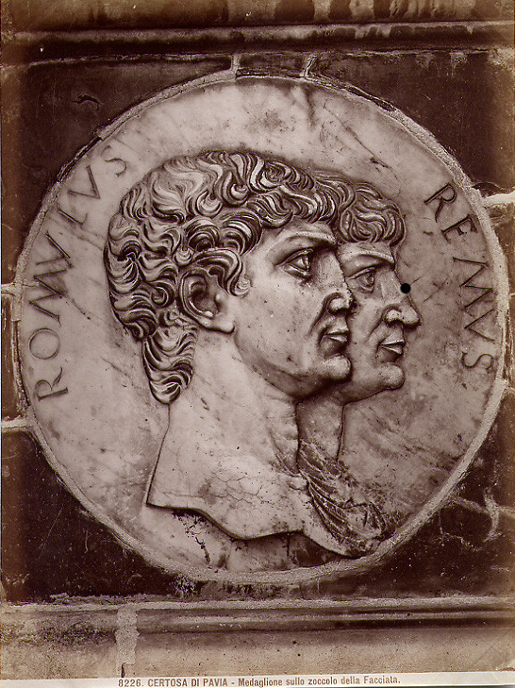
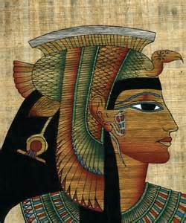
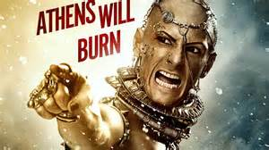
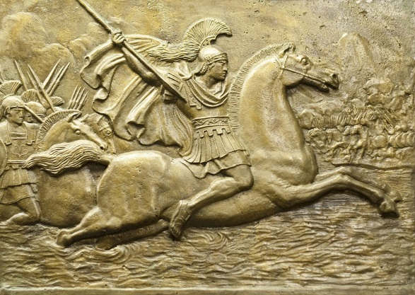
GCSE Ancient History

Slide 4
Why Should I Study GCSE Ancient History?
Fascinating content that engages students and helps us understand the modern world.
The skills that it gives students;
Critical thinking
Developing argument/judgement
Literacy skills and extended writing
Straightforward assessment/exams
EBACC accredited for Humanities.

Slide 5
Y11; Rome and its neighbours
Y10; Greece and Persia
Compulsory period study
The Persian Empire, 559 – 465 BC
Compulsory period study
Rome: Kingship to Republic 753 – 440 BC
Depth study
Depth study
Depth study
Depth study
Depth study
Depth study
Tyranny to democracy
546 - 483
Athens and Pericles 462 - 429
Alexander the Great 356 - 323
Hannibal and 2nd Punic War 218 - 201
Cleopatra and Rome 69-30
Britannia: Conquest to Province
43 – 84 AD
How will this be examined?
1 hour 45 min paper
100 marks + 5 marks spag
How will this be examined?
1 hour 45 min paper
100 marks + 5 marks spag

Slide 6
What is the difference between the period studies and depth studies?
Depth studies (Alexander the Great + Cleopatra)
Shorter time period in depth
Critical use of ancient sources
Historical context of events
Focus on ancient source material
Period study (Persia + Foundations of Rome)
Unfolding narrative of developments and issues.
Learners understand process of change.
Longer Period study (Rome)
Wider changes over time e.g. political, social, religious, military.
Longer period study to focus on nature of historical evidence.

Slide 7
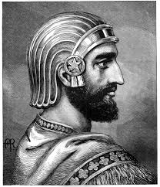
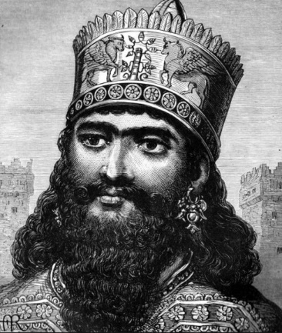
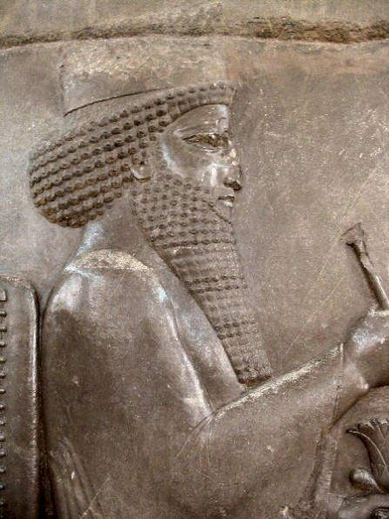
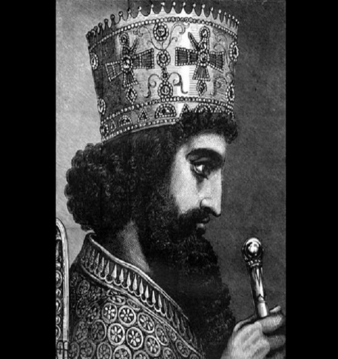
Persian period study (Y10)
Rise of Achaemenid Empire – Cyrus, Cambyses, Darius and Xerxes
Key topic: Narrative of rise of the Persian Empire
Themes:
Expansion of Persian territory and construction projects
Treatment of own, and foreign, peoples
Building projects and infrastructure
Personalities and priorities of Cyrus, Cambyses II, Darius and Xerxes
Cyrus: Accession, conquest of Lydia, Babylon, liberation of Jews, Pasargadae, brutal death.
Cambyses: Conquest of Egypt, attitude toward Egyptians, untimely death
Darius: Pacification of the empire, Susa/Persepolis,expansion/administration, Ionian Revolt, Marathon
Xerxes: Accession, revolts, Greek invasion, battles of Thermopylae and Salamis.

Slide 8
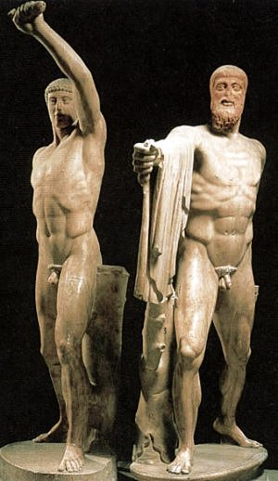
Greek depth study 1 (27 – 32 hours to teach)
Tyranny to Democracy 546 – 483 BC: Athens and Samos
Political transformation of Athens and Samos
Athens under the tyrants – Peisistratids, political structure, Harmodius and Aristogeiton, Hippias’ tyranny and fall.
Tyranny and Samos – Polycratesm attitude toward Egypt and Persia, Spartan and Corinthian influence, comparison with Athenian tyranny.
Democracy in Athens – Cleisthenes vs Isagoras, Cleisthenes’ reforms and political structure, Spartan attempt to restore Hippias.
Athenian democracy – 10 strategoi, Ionian Revolt, Themistocles and the navy, impacts of Marathon on democracy, ostracism.

Slide 9
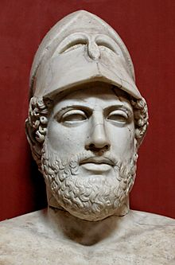
Greek depth study 2 (27 – 32 hours to teach)
Athens in the age of Pericles, 462 – 429 BC
Athens at the peak of power and Athenian culture
Working of Athenian democracy – Ephialtes and Pericles, ecclesia, boule, archontes and strategoi, assembly, public speaking, sophists and examples of ostracism
Athens and Sparta– Long walls, Delian League = Athenian Empire, Megarian Decree, Archidamian War and plague.
Cultural and religious life in Athens– Pericles’ building programme, Acropolis buildings and criticisms, Panatheneia and Dionysia, Pericles’ Funeral Oration.
Women in Athens – Daily life, marriage, Pericles’ citizenship laws, Medea representations, Aspasia.

Slide 10
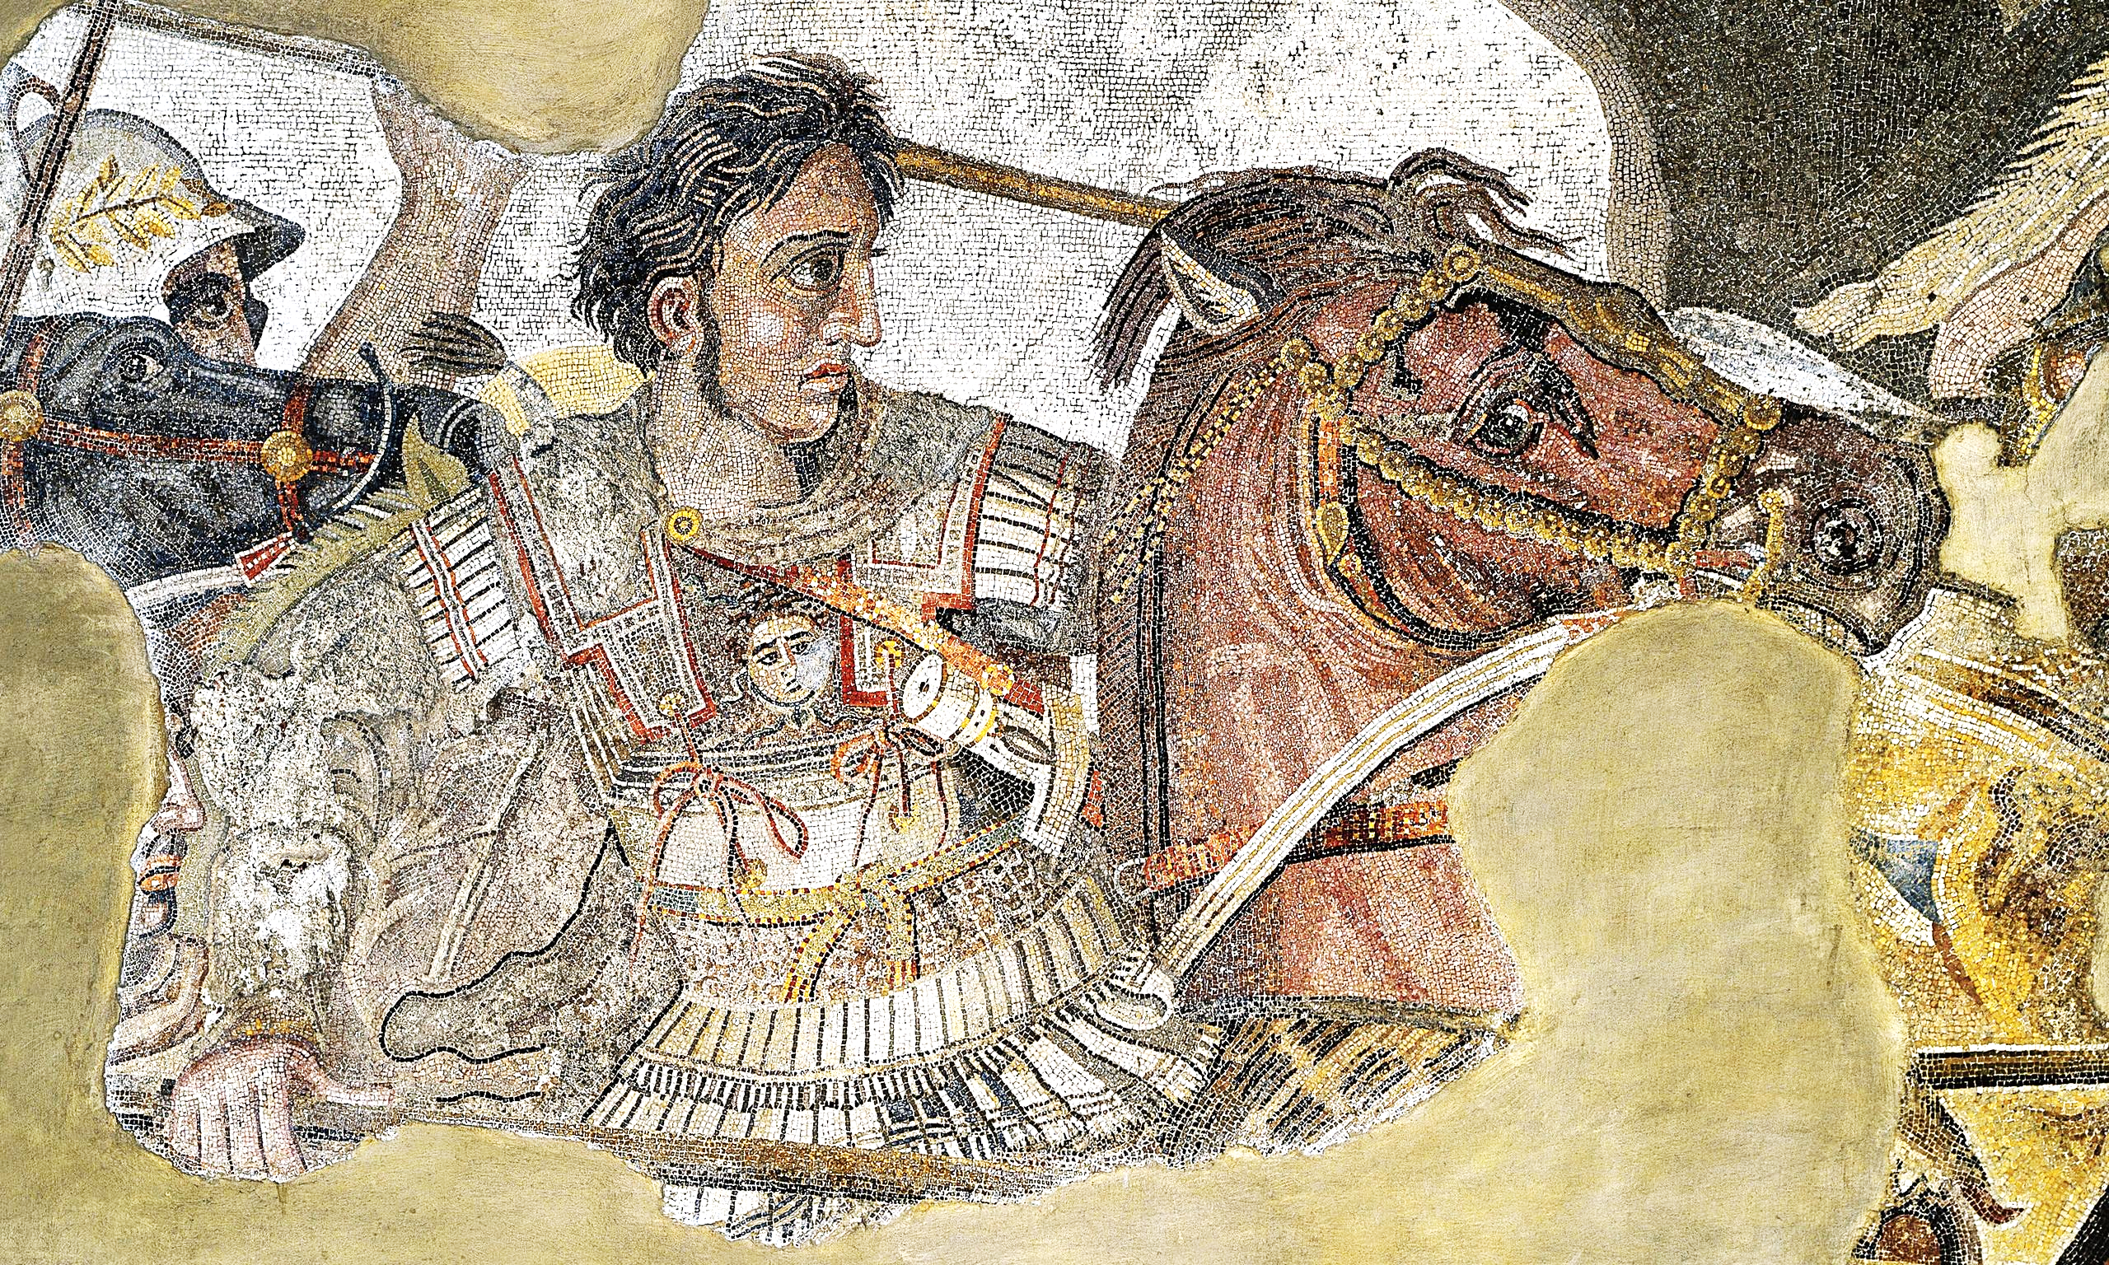
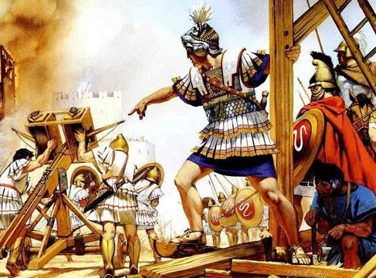
Greek depth study 3 (27 – 32 hours to teach)
Alexander the Great, 356 – 323 BC
We will study this incredible, and near mythical, Macedonian leader. Looking at the main; political, military, religious, cultural and technological factors
Upbringing– Youth, Olympias, Philip, key relationships.
Campaign– Granicus, Gaugamela, Persian Gates, Darius and Bessus, Hydaspes, Hyphasis, Gedrosian Desert, cities.
Significant events – Philip’s assassination and views, battles, Persepolis, Cleitus’ murder, mass marriages, death.
Macedonian Army – Cavalry, phalanx, tactics, sieges at Tyre and Aornos, relationship with the army.

Slide 11
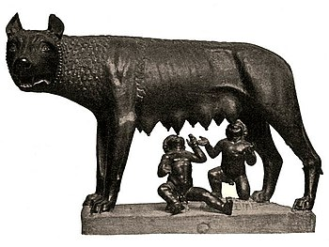
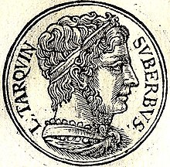
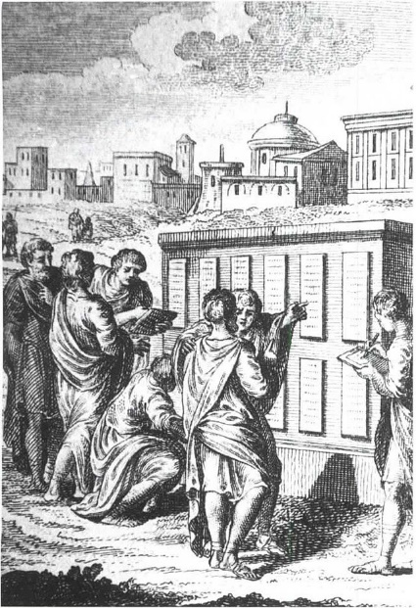
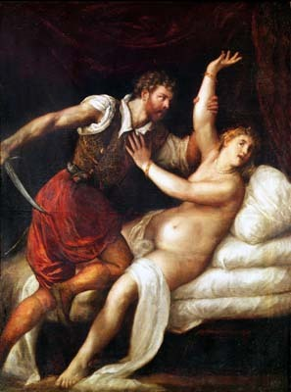
Longer Roman period study (Y11)
Rome: Kingship to Republic, 753 – 440 BC
Key themes:
Complex relationships between the kings, Roman people and other countries.
Changing role of plebeians (lower class) and patricians (higher class)
Sub themes:
Political change
Religious and social change
Impact of warfare and military change
Separating myth from reality
Origins: Aeneas, Romulus & Remus, Sabines, Senate, Numa, Tullus Hostilius, Ancus Marcius
Etruscans: Servius Tullius’ army reforms, Tarquinius Pricus, Tarquinius Superbus
Republic: Early Republic, consulship and senate, patricians and plebeians, military challenges, Lars Porsena
494 – 440 BC: Secessions of plebs, reforms of 440’s, Appius Claudius, impacts of war

Slide 12
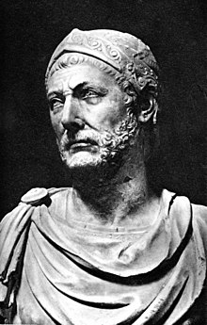
Roman depth study 1 (27 – 32 hours to teach)
Hannibal and the 2nd Punic War, 218 – 201 BC
Reasons for the outbreak of the 2nd Punic War – Impacts of 1ST Punic War, Hamilcar and Hasdrubal, war parties, Roman expansion.
Hannibal’s leadership – Siege of Saguntum, Alps, Battles of Trebiam Trasimene and Cannaea, Fabius’ tactics, Hannibals’ failures.
Changing nature of Rome’s response to Hannibal – Various ledership mistakes, Fabius’ Maximus; influence, Scipio Africanus and invasion of Africa.
How did Rome defeat Carthage? Hannibal’s withdrawal, Hasdrubal’s murder, Battle of Zama, consequence of Roman victory.

Slide 13
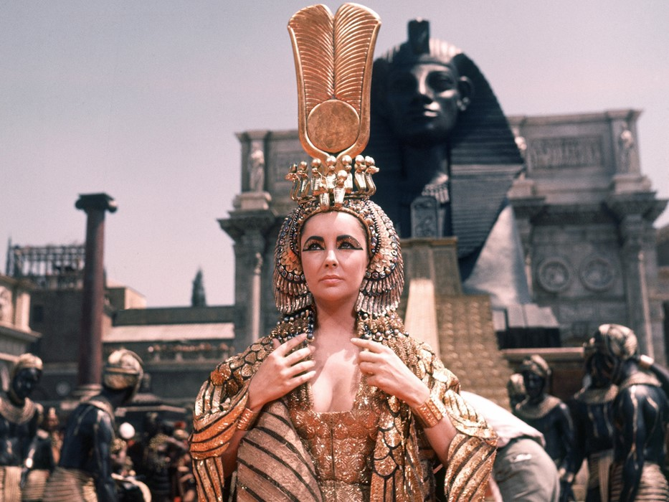
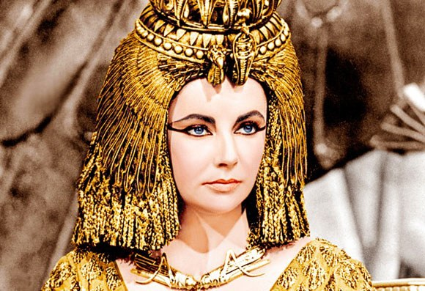
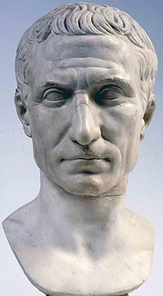
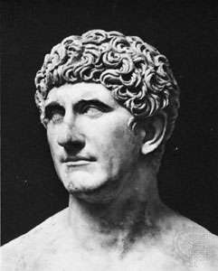
Roman depth study 2 (27 – 32 hours to teach)
Cleopatra: Rome and Egypt, 69-30 BC
Cleopatra’s life and character – education and upbringing, character – charm, humour and courage.
Cleopatra as queen: political, domestic and foreign policies – early civil war, Arsinoe, expansion and relationship with subjects, Graeco-Egyptian persona, promotion of Isis.
Cleopatra’s relationships with Caesar and Mark Antony – Egypt’s importance, Pompey, relationship with Caesar and Caesarion, visit to Rome, fall-out from assassination, relationship with Antony, Donations of Alexandria, Octavian.
Battle of Actium and its significance – Octavian vs Antony / Cleopatra, differing views of battle, impacts and suicides, significance for Octavian.

Slide 14
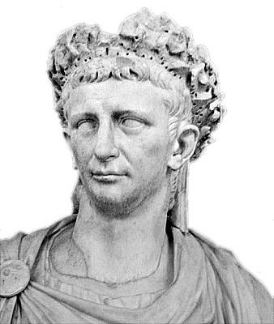
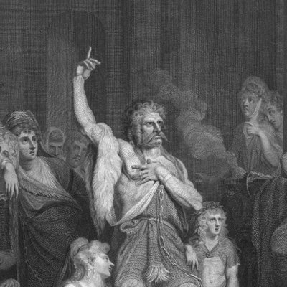
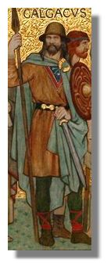
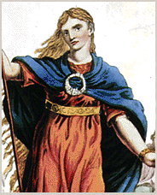
Roman depth study 3 (27 – 32 hours to teach)
Brittania: Conquest to province, AD 43 - 84
Claudius’ invasion – Caesar background, political situation in Britain, Caligula, Claudius accession and context, preparations and early encounters, role of Claudius and Vespasian.
Changing policies of governors – Scapula, Suetonius Paulinus, Agricola et al, influence of emperors.
Coperation between Romans and Britons – submission of tribes, client states, Romanisation, impact of change, towns and villas.
Resistance after the invasion – Caratacus, Boundicca, Venutius and Calgacus, Roman response, source portrayal of Britons.

Slide 15
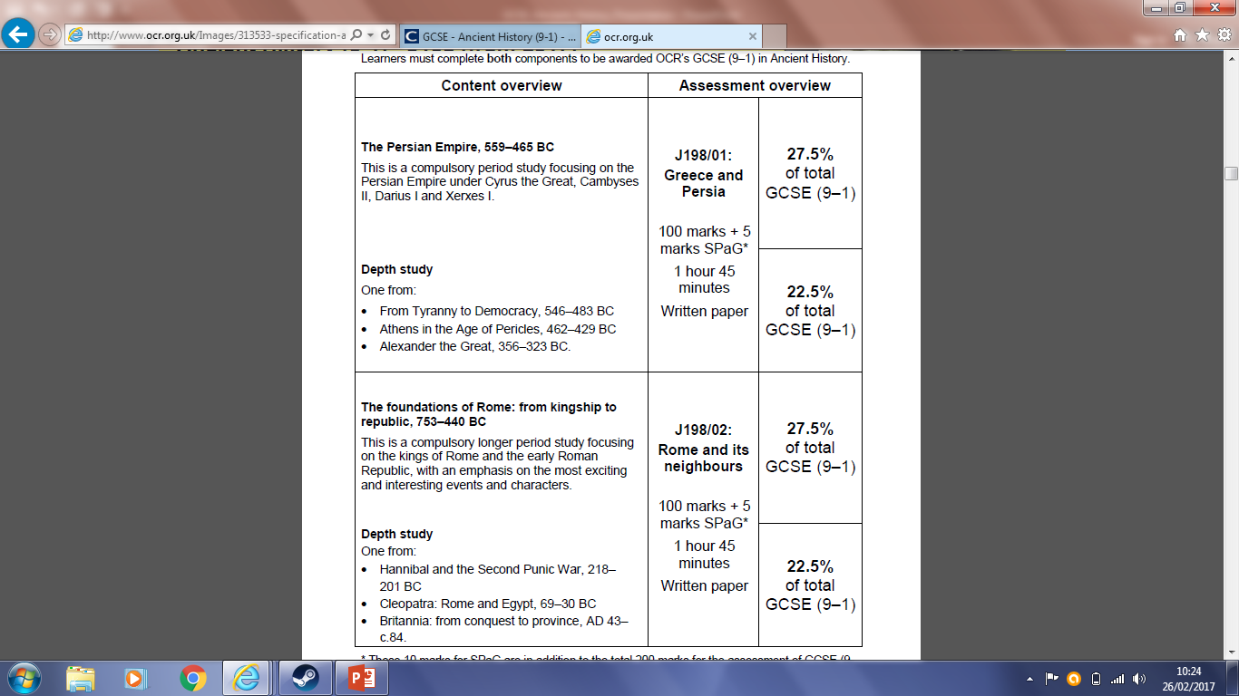

Slide 16
Exam 1 – GREECE AND PERSIA
The Persian Empire 559-465BC period study
Alexander the Great 356-323BC depth study
Exam 2 – ROME AND ITS NEIGHBOURS
The foundations of Rome 753-440BC period study
Cleopatra; Rome and Egypt 69-30BC depth study

