Slide 1
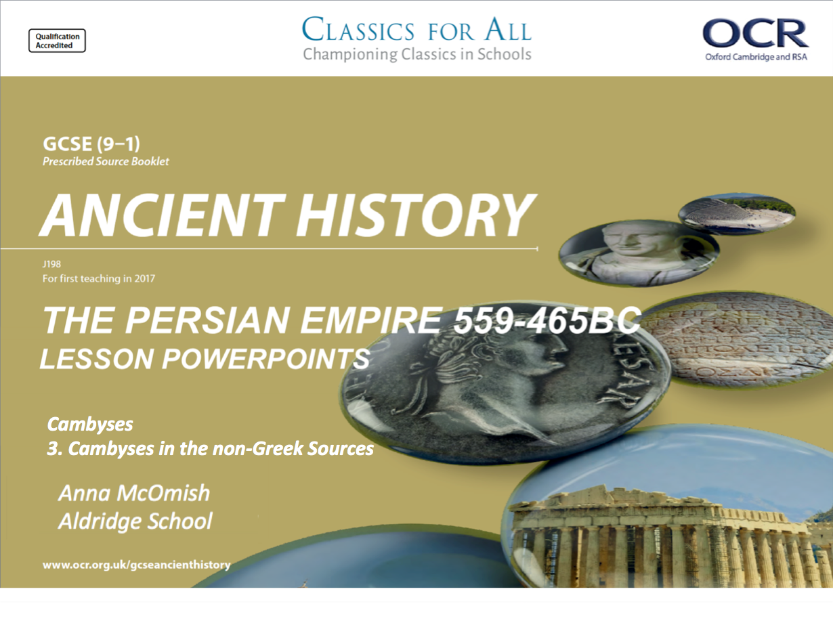
Cambyses
3. Cambyses in the non-Greek Sources

Slide 2
Starter:
Which statements are TRUE and FALSE?
Cambyses was respectful of King Amasis’ body once he had died.
Cambyses was able to bring the Phonecian navy into the Persian empire.
According to the Nabonidus Chronicle, Cambyses killed the holy Apis Bull.
Cambyses dreamt that Smerdis sat on a throne and his head touched the sky. Cambyses sent him into exile.
The main battle in the Persian invasion of Egypt was Pelusium.
According to Herodotus Cambyses lost an army of 50,000 in the desert.
Cambyses ruled the Persian empire for only 8 years.
The Egyptians had previously had an alliance with the Lydians.
Cambyses was respectful of the Apis bull

Slide 3
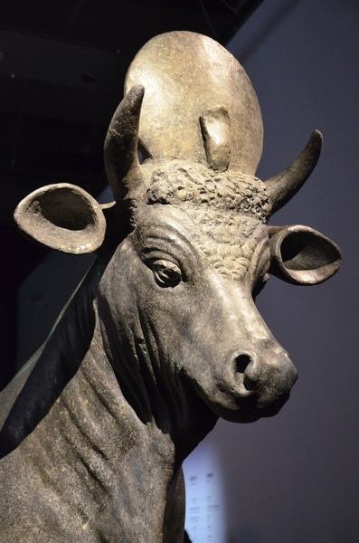
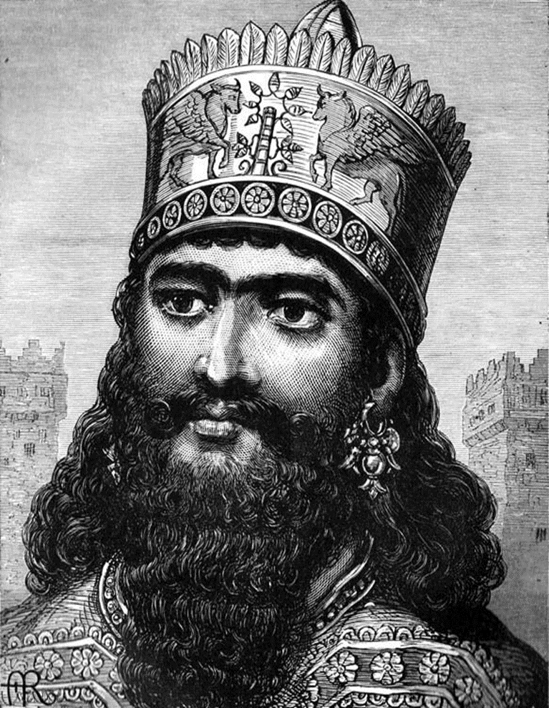
Title: Cambyses in the non-Greek sources
February 27, 2020
RRR: How does Udjahossrene present Cambyses in his writings?
Lesson Objectives:
To know the details of how Cambyses is presented in the non Greek sources
To compare Cambyses in both sets of ancient sources.
To understand why there is a difference in the sources

Slide 4

Cambyses and the Apis Bull
For Herodotus, and most of the Egyptians, this was the beginning of the height of Cambyses’ madness. Herodotus tells us of other events that supposedly happened, which in his mind prove Cambyses was insane.
1. Cambyses apparently has his own brother murdered after he has a dream that Bardiya/ Smerdis was sitting on a throne with his head touching the sky. Cambyses had already been jealous of his brother, and had sent him from Egypt back to Persia, and interpreted this dream to mean tat Bardiya/ Smerdis would try to kill him. So he sent his most-trusted advisor, Prexaspes, to kill Bardiya/ Smerdis.
2. Cambyses had his sister killed, for referencing their brother’s murder; Herodotus does not tell us her name, but does tell us that she was also one of Cambyses’ wives. It was not Persian tradition for siblings to marry, but it was accepted in Egypt and Cyrus had encouraged it to keep power in the family. One version of the murder states that Cambyses kicked her to death while pregnant.
Apis Bull: a scared bull of Egyptian religion which Cambyses fatally wounded. Ptah was an important creator god for the Egyptians, and particularly associated with Memphis. People rejoiced when a new Apis bull was identified
3. Cambyses was dishonoured the Egyptian gods in other ways. Herodotus records; “all this may pass for a sample of the manical savagery with which Cambyses treated the Persians and his allies during his stay in Memphis; amongst other things, he broke into ancient tombs and examined the bodies, and even entered the temple of Hephaestus and jeered at the god’s statue”.

Slide 5
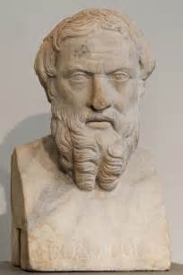
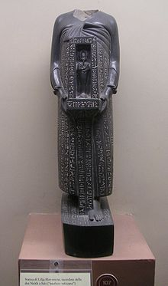
Cambyses: two sides of the same story….
HERODOTUS:
Working from very biased Egyptian sources.
These sources were probably priests and temple administrators who hated Cambyses.
Cambyses had forced them to pay taxes that previously they had avoided paying.
Herodotus was also very uncritical of the stories he heard and was inclined to believe them.
UDJAHORRESNE:
An Egyptian official who switched to the Persian side after Cambyses invaded Egypt.
He became an advisor to Cambyses and later to Darius too.
He was keen to praise his own and Persian achievements.
TASK: Which of the two sides do you believe is true?

Slide 6
Task 1 – positive reports of Cambyses!
Use the OCR textbook p26-28. Read first as a class, then answer the following questions;
What does the discovery of the Serapeum temple suggest about how Cambyses had treated the Apis Bull? – think about; does it suggest the same good things that Udjahorresne suggested?
How does this compare with what Herodotus tells us Cambyses did to the Apis Bull? –think about; is this very different from that Herodotus tells us?
What positives does Udjahorresne give us about Cambyses’ rule of Egypt? – make a list of these
Overall how would you describe Cambyses as a ruler from these two sources?
CHALLENGE: What would you identify as the most significant differences between Cambyses and his father, Cyrus, in terms of their style of rule?
Notes:
My advice – read through these pages as a class, takes about 7-8mins, but really helps them get it!

Slide 7
Task 3
A second order concept you could be asked to look at is CHANGE AND CONTINUITY between the different Persian rulers.
Questions to discuss;
What evidence is there of CHANGE and CONTINUITY between the reigns of Cyrus and Cambyses.
Think about
The methods they used to expand Persia
Their treatment of the people they conquered
Their religious attitudes
Military policies

Slide 8
Plenary
3 ways that Cambyses is portrayed in the ancient sources
2 reasons why we have to be careful when using Herodotus as a source for Cambyses
1 similarity between the reigns of Cyrus and Cambyses.

