Slide 1

Darius I
10. The Battle of Marathon

Slide 2
Starter:
Questions for answers:
BATTLE OF LADE
ARISTOGORAS

Slide 3
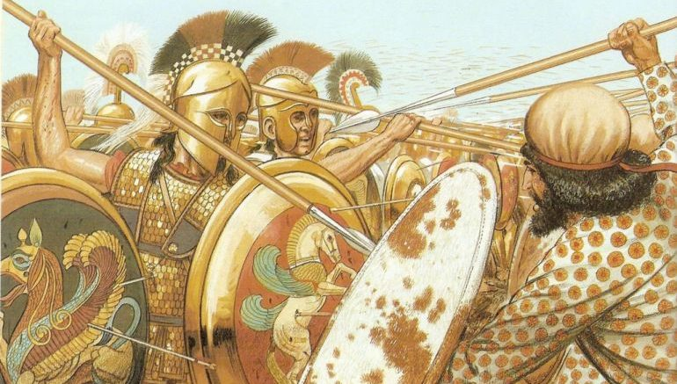
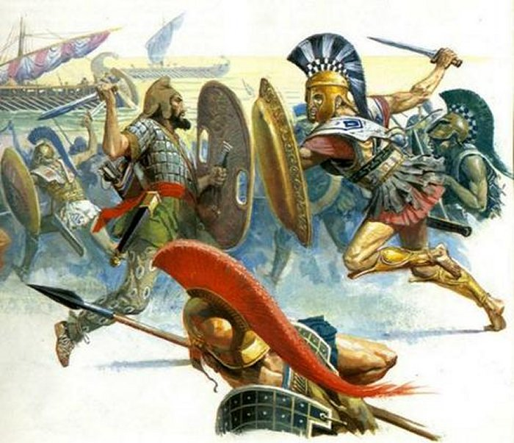
Challenges to mainland Greece and the Battle of Marathon
L.O. to understand and explain the events of the battle of Marathon.

Slide 4
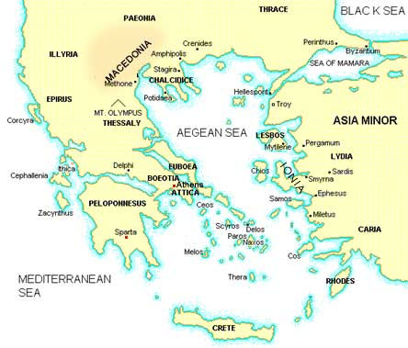
Darius begins to move into the Aegean…
After Darius had finally successfully dealt with the Ionian Revolt, his eye turned and he looked to deal with the Greek nations that had become involved in the revolt, or that he suspected had been involved.
Herodotus tells us that Darius first expedition, lead by his general Mardonius in 492BC, had the initial aim of attacking Eretria and Athens. But more historians think that Darius was actually looking to begin securing territory in northern Greece.
This first attempt by Mardonius is a complete failure, but Darius continues to pursue his aims in Greece, and bit by bit moves his empire towards Athens…
He visits the islands of Naxos, then Delos and then Eretria, before landing near Athens as the Bay of Marathon.

Slide 5
Darius’ actions in Greece
Before the battle of Marathon, there were a series of important events involving Darius’ Persian empire and various peoples of Greece. They tell us a lot about the style of fighting and tactics of the Persians, as well as the attitudes of the Greeks.
TASK: using the information on p.47, from the subheading ‘Challenges to Mainland Greece’, and sections of Herodotus, complete the flowchart on Darius’ actions up until the Battle of Marathon.
CHALLENGE: using the sections from Herodotus on Naxos, Delos and Eretria, answer the following question;
‘What can we learn from the passages about Darius’ treatment of foreign peoples?’ (10).
Remember!
Point, what can we learn?
Evidence, which quote from the passage supports your point?
Explain, how does that quote prove your point? What more historical detail can you add to support your explanation?

Slide 6
In 492 BC, Mardonius lead the first expedition into mainland Greece on behalf of Darius, the aim of this was…
The following year Darius sent heralds to Greek nations demanding that they submit to him as their leader, most nations…
In 490BC a new invasion came, lead by…
The first islands Darius’ troops moved against was Naxos, here the Persians…
Next, the Persian fleet moved on to the island of Delos, in contrast to their behaviour at Naxos, the Persians…
Finally, before arriving at Marathon, the Persians landed at Eretria, here they…

Slide 7
Herodotus on Mardonius’ expedition of 492BC.
But at the beginning of spring Mardonius son of Gobryas, a man young in years and recently married to Darius' daughter Artozostre, came down to the coast at the head of a very great army and fleet.
When a great multitude of ships and a great army were assembled, the Persians crossed the Hellespont on shipboard and marched through Europe, with Eretria and Athens as their goal.
This was the stated end of their expedition, but they intended to subdue as many of the Greek cities as they could. Their fleet subdued the Thasians, who did not so much as lift up their hands against it; their land army added the Macedonians to the slaves that they had already… Crossing over from Thasos they travelled near the land as far as Acanthus, and putting out from there they tried to round Athos. But a great north wind fell upon them as they sailed past and dealt very roughly with them, driving many of their ships upon Athos.
It is said that about three hundred ships were lost, and more than twenty thousand men. Since the coasts of Athos abound in wild beasts, some men were carried off by beasts and so perished; others were dashed against the rocks; those who could not swim *perished because of that, and still others by the cold.
*Perished = died

Slide 8
Herodotus on Naxos, Delos and Eretria
On Naxos = “When they approached Naxos from the Icarian sea and came to land (for it was Naxos which the Persians intended to attack first), the Naxians, remembering what had happened before, fled away to the mountains instead of waiting for them. The Persians enslaved all of them that they caught, and burnt their temples and their city. After doing this, they set sail for the other islands”.
On Delos = “Datis said to the people of Delos, “Holy men, why have you fled away, and so misjudged my intent? It is my own desire, and the king's command to me, to do no harm to the land where the two gods were born, neither to the land itself nor to its inhabitants. So return now to your homes and dwell on your island.” He made this proclamation to the Delians, and then piled up three hundred talents of frankincense on the altar and burnt it”. (Burning Frankincense would be RESPECTFUL thing to do at a temple!)
On Eretria = “After sieging the city of Eretria for 6 days, the Persians finally broke through with the help of a traitorous Eretrian. They entered the city and plundered and burnt the temples, in revenge for the temples that were burnt at Sardis; moreover, they enslaved the townspeople, according to Darius' command”.

Slide 9
The Battle of Marathon, 490BC.
After destroying and enslaving Eretria, the Persians landed in the Bay of Marathon, north of the city of Athens. An Athenian army met them, and there was a tense 2-day stalemate in which neither side wanted to be the one to attack first.
The Athenians had appealed to the Spartans for help in the battle, but the Spartans were days away from being able offer support because they were in the middle of a religious celebration. The Athenians only had help from a few Plataeans.
Lead by the great Athenian general Miltiades, the Athenians took the opportunity of the Persians putting their cavalry back on their ships, and attacked the Persians. Tricking the Persians into attacking the middle of their ranks by making that part of the Athenian army look weaker. The Athenians then pincered their enemy.
TASK 1: watch the video on the Battle of Marathon and note down the key events and details in chronological order.
Challenge yourself by noting down any evidence you see that would explain the Athenian victory.
TASK 2: using p.48 of the textbook, add to your notes with any details not gained from the video clip.
EXTENSION
To what extent do you agree that the Battle of Marathon was a greater defeat than the expedition to Scythia?
Notes:
https://www.britannica.com/event/Battle-of-Marathon – print out the website page as well for reading.
https://www.youtube.com/watch?v=vvBoCATqriM – 7min video
https://www.youtube.com/watch?v=KgijJ-zdHow – 21mis video!

Slide 10
Practise 6 marker – outline the key features of the Battle of Marathon
The ‘musts’
This answer should be a continuous prose, not bullet points! – write your answer in the form of a paragraph.
Discuss 3 key points, use historical detail to illustrate the points you are making.
Keep it in chronological order if possible.
All historical information you include should be COMPLETELY RELEVANT to the topic in the question. – do not include information about other places or events that aren’t mentioned in the question!
Outline the key features of the Battle of Marathon (6).
What to include;
Numbers from both sides.
Why Sparta were not part of the battle.
Miltiades’ tactics.
Persian mistakes.
How the Greeks won.
Why the battle lived on in Athenian memory.

Slide 11
Christmas Homework
Create revision notes on the following topics
People Darius conquered
Darius’ building projects
Darius’ changes to administration (how the country was run)
Darius’ religious policy
Darius’ imperial expansions, and how they compare against other kings.
Royal road, Satraps, Postal system, ideology = NOT EXPANSION! Because they are happening WITHIN the empire.
Notes in your book
A3 spider diagram
PPT presentation
Revision cards
Etc…
Notes:
https://www.britannica.com/event/Battle-of-Marathon – print out the website page as well for reading.

