Slide 1
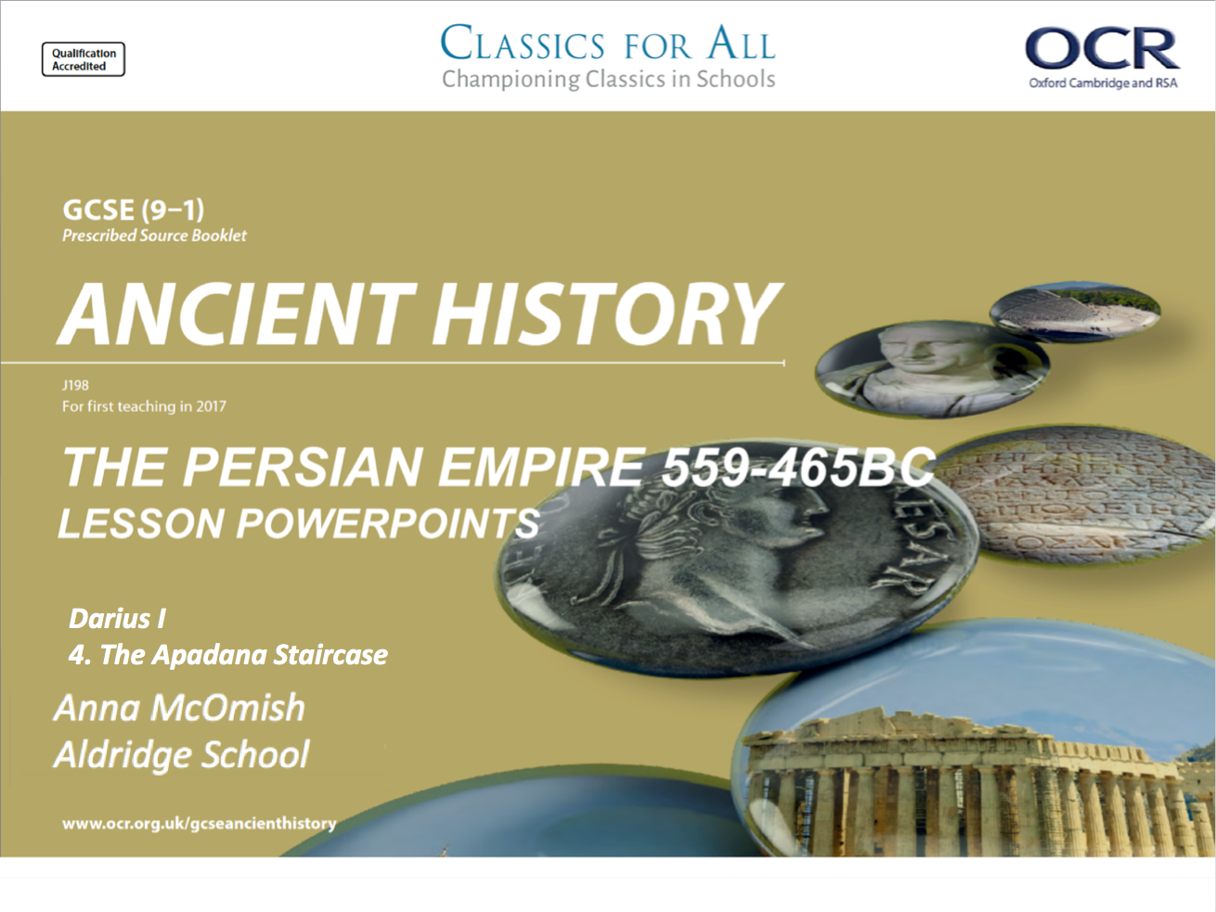
Darius I
4. The Apadana Staircase

Slide 2
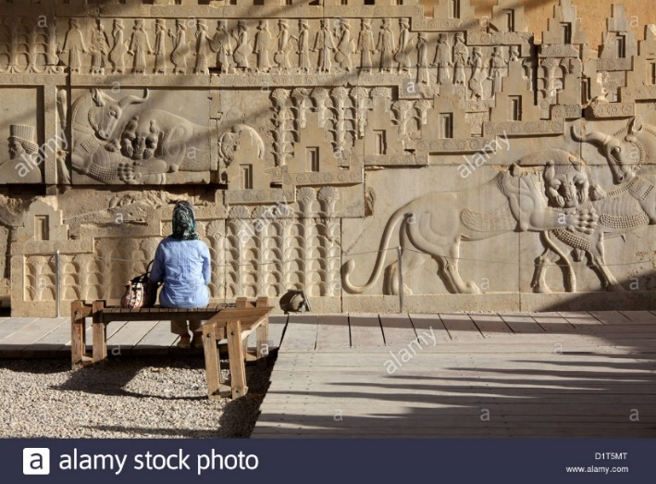
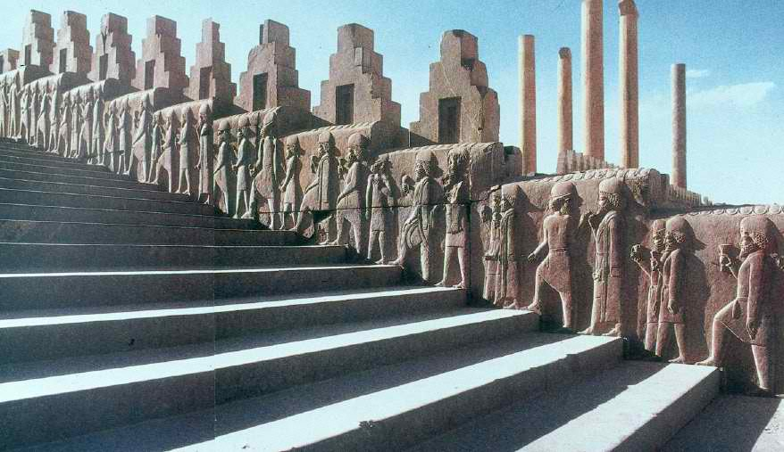
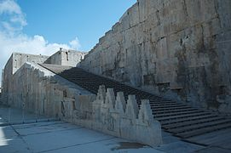
Title: The Apadana Staircase
February 27, 2020
RRR: what was the significance of the Apadana Staircase?
Lesson Objectives:
L.O. to investigate the significance of the Apadana Staircase, and assess what it can tell us about the reign of Darius.
L.O. to practise essay-style exam questions.

Slide 3
Persepolis – Apadana Staircase
The Apadana is the name given to the great Square and entrance hall of the palace at Persepolis, as built by Darius. There are many incredible features, such as the hall of 100 pillars, and numerous great carved statues.
A particularly outstanding feature is the stair of the Apadana, which has carved into it the images of the many nations under the control of Darius/ the Persian empire.
It’s a catalogue of Darius’ subjects.
TASK; watch the first 2-3mins of the video and make notes to answer the following questions.
What are the key physical features of the Apadana?
What kinds of details are depicted on the staircase?
What might the purpose of decorating the staircase in this way be?
CHALLENGE: what impression would the staircase have given to visiting subjects first arriving at Persepolis and entering the Apadana?
Notes:
https://www.youtube.com/watch?v=8L4E9m27aKY – first 2mins.

Slide 4
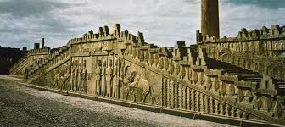
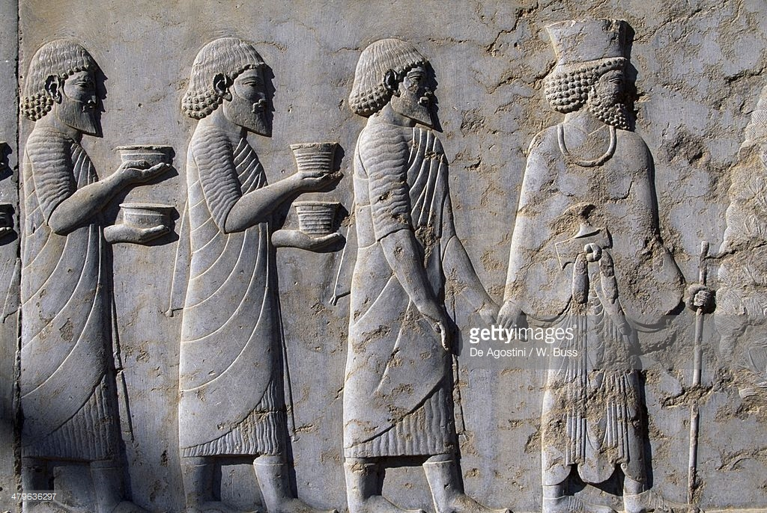
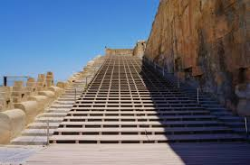

Slide 5
1. What are the key physical features of the Apadana?
2. What kinds of details are depicted on the staircase?
3. What might the purpose of decorating the staircase in this way be?
1. What are the key physical features of the Apadana?
2. What kinds of details are depicted on the staircase?
3. What might the purpose of decorating the staircase in this way be?

Slide 6
Identifying the people of Persia
The relief, which has miraculously survived the sack of Persepolis by the soldiers of Alexander the Great in 330 BCE, consists of three parts and is flanked by the Old Persian inscription known as XPb:
The northern wall: representations of all kinds of Persian dignitaries, horsemen, and chariots.
The centre: eight soldiers.
The southern wall (picture above): all nations of the Persian Empire, in the following arrangement:
TASK: using the information about the details of the Southern Wall of the Apadana, annotate your diagram with information about those peoples.
CHALLENGE: What message would the image of so many different, controlled, peoples send to those visiting Darius at Persepolis?
EXT: In terms of his building projects, how does Darius compare to Cyrus the Great?

Slide 7
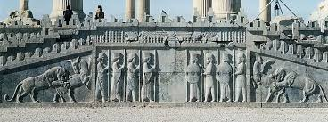
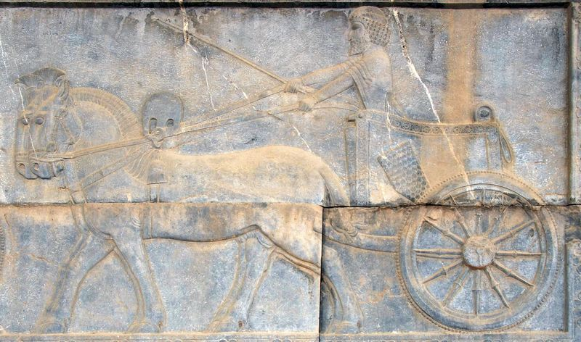
The centre: eight soldiers.
Two horses
Dignitary
The northern wall: representations of all kinds of Persian dignitaries, horsemen, and chariots.
chariot

Slide 8
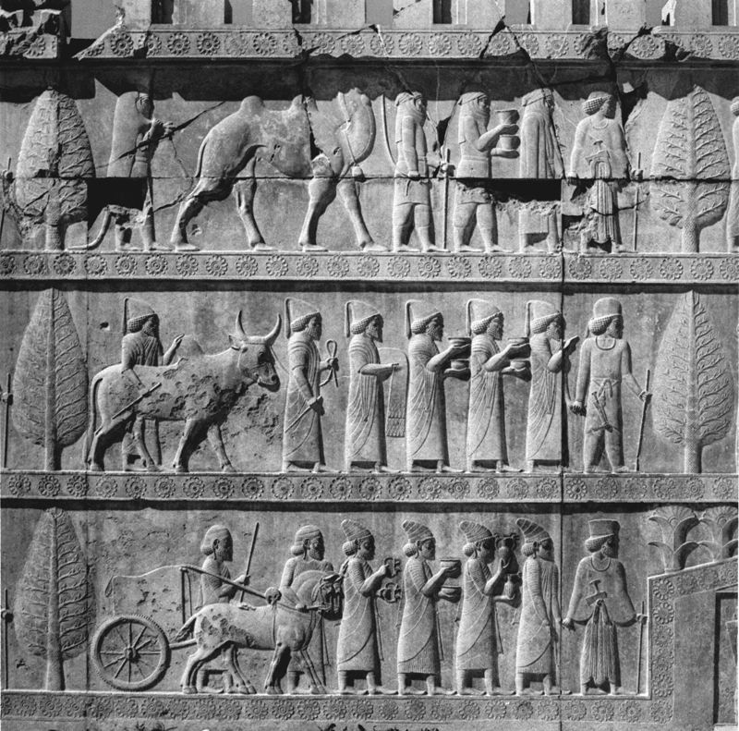
Babylonins and the Lydians
Parthians and the Armenians.
Parthians
Armenian
Babylonians
Lydians

Slide 9
Parthians and Armenians
Like their neighbours, the Medes, the Armenians wear horseman's dresses and cloaks. Their tribute consists of a/o a bridled stallion, which more or less confirms the statement by the Greek geographer Strabo of Amasia that the Armenians paid 20,000 colts. The Armenians carry the other present for the king: a beautiful metal vessel with griffin handles. These objects have been found. The Armenian's turban resembles the Median headgear, although he has the cheek parts tied in his neck.
The Parthians are also dressed in a Median horseman's dress and cloaks, but they have a completely different turban, which is better suited to their country, close to the desert. It protects the face. The leader of the Parthian delegation almost hides himself in his cloak. The presents they offer are two bowls and a Bactrian (i.e. two-humped) camel. The last member of the delegation wears the skin of a feline. It may be a present, but is also possible that it is a rather unusual dress, which may or may not have some sort of ritual significance. The Arians bring identical presents.

Slide 10
Babylonians and Lydians
Below is the Babylonian embassy, wearing conical caps with odd tassels. In his Histories, the Greek researcher Herodotus of Halicarnassus tells us that Babylonia was very wealthy and paid an immense tribute - enough to pay a third of the Persian army. The Babylonians offer shallow bowls and a garment with a netted and tasseled border. The last man leads a humped bull. These are small presents, which seems to contradict the literary sources. On the other hand, the relief is a piece of art and not an account book.
The Lydian embassy is at the beginning of the lower register, suggesting the importance of their country. Their king Croesus, proverbially rich, had been defeated by Cyrus the Great in or after 547 BCE. The Lydian presents are two metal phials, two bowls, two beautifully decorated metal rings with griffins' heads, and a chariot, drawn by two stallions. The chariot seems to be a bit too small to be used in warfare, but this may, again, be the artist's liberty. The Lydians are dressed in long garments with horizontal stripes. They also have remarkable, conical hats that are not otherwise known. Their shoes are remarkably pointed.

Slide 11
Question 4 (15.) – source based and S.O.C
Question 4; S.O.C of ‘significance (importance)’.
It requires you to develop the content of the unseen source with your own knowledge in order to create an argument.
AO3 = 5 marks = Use and analyse ancient sources within their historical context to make judgements and draw conclusions about historical events and historical periods studied. - can you use evidence from the source to support your answer?
AO1 = 5 marks = Demonstrate knowledge and understanding of the key features and characteristics of the historical periods studied. - can you use your own historical knowledge to support your answer?
AO2 = 5 marks = Analyse and explain historical events and historical periods to arrive at substantiated judgements – can you come to a conclusion on the question, that is supported by what your argument as already said?
Question 4. Using details from Source A and your own knowledge, explain the importance of the Apadana and Southern Staircase to Darius.
HINT; what does the Apadana make people think? Why might it help Darius if people think that/ feel like that about Darius?
What events has Darius had to deal with in his first year of rule?

Slide 12

Question 4. Using details from Source A and your own knowledge, explain the importance of the Apadana and Eastern Staircase to Darius.
Source A.
southern section of the eastern wall of the Apadana staircase.

