Slide 1

Darius I
7. Causes of the Ionian Revolt

Slide 2
Starter:
Who am I?
1) I am a Greek state located in the north. I gave the Persians earth and water and was incorporated into their empire.
2) I was a nomadic people who were invaded by Darius. We defeated him by running away and using cattle as bait.
3) I lived in Lydia in the cities on the coast line of Asia Minor. I was populated by Greeks.
4) I was built by Darius as part of the creation of Persepolis. I included images of 23 different ethnic peoples bearing gifts to the King.
5) I ruled the satrapies on behalf of the king. Darius created my position to ensure loyalty.
6) I was a Greek who was sent by the Persians to explore the Indus Valley. Soon after the Indus Valley was conquered by Darius.

Slide 3
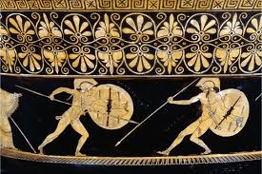
Title: Causes of the Ionian Revolt 499-494BC
February 27, 2020
Lesson Objectives:
To gain an overview of the Ionian Revolt and its main events between 499-494BC.
To analyse the causes of the Ionian Revolt and the war with Greece and Persia
RRR: What caused the Ionian revolt to start?

Slide 4
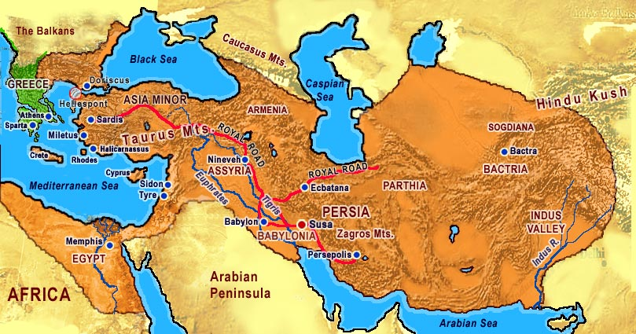
The Ionian Revolt – how and why?
  The Ionian Revolt (499-493 BC) was a major uprising of the Greek cities of Asia Minor against Persian rule, and is said to have either delayed an inevitable Persian invasion of mainland Greece, or made that invasion more likely (Greco-Persian Wars).
  The Greek cities of Ionian and Aeolia on the coast of Asia Minor had fallen into Persian hands in the aftermath of the Persian Conquest of Lydia (547-6 BC). The Persians first crossed into Europe in around 513 BC when Darius launched a fairly unsuccessful campaign against the Scythian nomads north of the Danube. This was followed by the conquest of parts of Thrace in 512-5122, giving the Persians a foothold in Europe, and threatening the Greek grain trade routes into the Black Sea.
  The obvious next target for Persian attack were the cities of mainland Greece, but the Ionian Revolt came first, and gave the Persians a convincing reason for their invasion.
Our only major literary source for the revolt is Herodotus, and his account doesn't allow us to be entirely sure about the dates of events within the revolt.

Slide 5
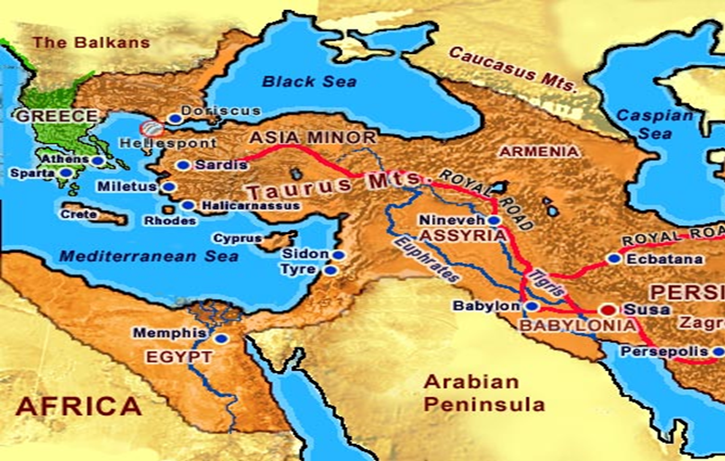

Slide 6
Task 2 – Causes of the Ionian Revolt
He’s not actually taking any new land with the Ionian Revolt, simply putting down a rebellion. This is a topic which could easily come up in your exams, either as a question on its own or as part of an essay, SO YOU NEED TO KNOW THE EVENTS BACKWARDS!
TASK: Using p.43 of the textbook, fill in the flow diagram to explain the causes of the Ionian Revolt in 499BC.
Your flow chart should include;
Cyrus conquering the area
Ionians being unhappy, but ignored by the Persians
Aristagoras being the Tyrant of the area
Aristagoras leading an expedition against Naxos
That going wrong and his drastic response!
NEED MORE INFO?:
Use the online article to develop and deepen your notes on the Ionian Revolt!
CHALLENGE | CORE | FOUNDATION
To what extent did Darius face more serious rebellion during his reign, than any other Persian King? | Identify and explain 3 factors that lead to the start of the Ionian Revolt. Explain which you consider to be the most significant. | Explain why the Ionian revolt began.
Notes:
https://ehistory.osu.edu/articles/ionian-revolt

Slide 7
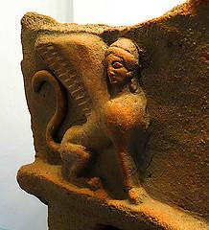
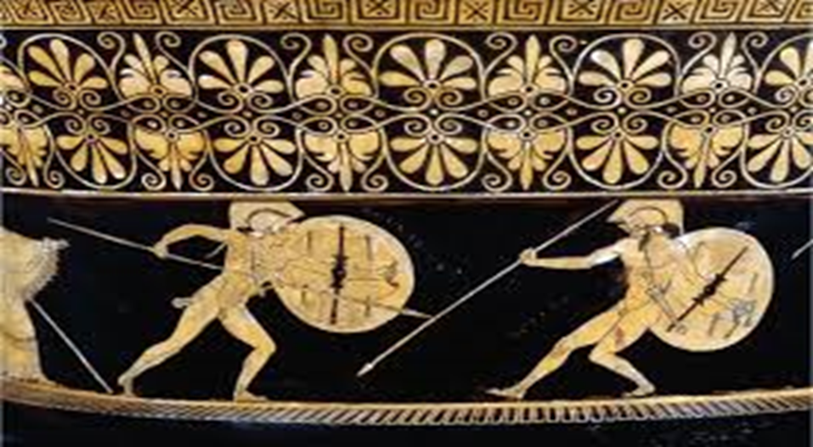
The Ionian Revolt
About 2500 years ago, the Persian Empire was expanding through Asia and into Asia Minor (the area between the Black and Mediterranean Seas) and taking control of the eastern world. A Persian ruler was installed over every city-state that they conquered. It was this action that eventually provoked the Ionian revolt which marked the beginning of the long confrontation between the Greek and Persian empires.
About BC 550, Cyrus I, emperor of Persia, conquered the territory of Ionia (the west coast of Modern Turkey). For all of their advances in science and mathematics, these well-established city-states seemed the most prominent in Greece. The people of Ionia, were discontent with their new, dictatorial rulers. The Persian rulers knew the feelings of the populace, but did little to alleviate the hostilities. Around BC 500, Artaphrenes, ruler of the western capital of Persia (Sardis) met with other leaders of Ionia. Seeing that many of them were anxious for gains in power and land, he made them agree not to attack each other. Artaphrenes knew that internal conflict could result in disintegration of the empire.
In BC 499, Aristagoras, the ruler of the Ionian city Miletus, yearned to control the city of Naxos. He tried to gain help from surrounding cities but failed. Fearing punishment from Darius I (Persian Emperor from BC 521-486) or Artaphrenes, for breaking the agreement, he incited a rebellion. Aristagoras encouraged the Ionians to remove their leaders. In response, many cities in the area rebelled and ousted their Persian rulers. Knowing that it would not be long until Darius retaliated, Aristagoras began to reach out for support in Greece…

Slide 8
The Ionian Revolt
About 2500 years ago, the Persian Empire was expanding through Asia and into Asia Minor (the area between the Black and Mediterranean Seas) and taking control of the eastern world. A Persian ruler was put into place in area that they conquered. It was this action that eventually caused the Ionian revolt.
In 550, Cyrus the Great, conquered the area of Ionia (the west coast of Modern Turkey). These areas were felt to be very developed because of their knowledge in science and mathematics. The people of Ionia, were unhappy with their new Persia rulers and satraps. The Persian rulers knew how the Ionians felt, but did almost nothing to make them feel happier about being in the empire.
Around 500, Artaphrenes, the Satrap of the area/ the western capital of Persia (Sardis) met with other leaders of Ionia. Seeing that many of the local leaders (called tyrants) were keen to gain more power and land, he made them agree not to attack each other so that there would not be any fighting in the area. Artaphrenes knew that if the local leaders (tyrants) fought each other, it could damage the rest of the empire.
In BC 499, Aristagoras, the local ruler of the Ionian city Miletus, became very keen to control a nearby island and its city, Naxos. He tried to gain help from other local leaders (tyrants), but failed. Fearing punishment from Darius I (Persian Emperor from BC 521-486) or Artaphrenes, for breaking the agreement not to attack local areas, he decided to begin a FULL SCALE REBELLION against the empire. Hoping to attack them, before they attacked him! Aristagoras encouraged the Ionians to remove their Persian leaders. In response, many cities in the area rebelled and ousted their Persian rulers. Knowing that it would not be long until Darius retaliated, Aristagoras began to look for support in Greece…
Notes:
LOWER ABILITY VERSION!

Slide 10
Cyrus conquering the area
Cyrus first conquered the area in…
Ionians being unhappy, but ignored by the Persians
The Ionians were unhappy with Persian rule because…
Aristagoras being the Tyrant of the area
To keep the tyrants in order, Artaphrenes made them promise that…
Aristagoras leading an expedition against Naxos
Aristagoras wanted to gain more land and lead an expedition against…
That going wrong and his drastic response!
He knew Darius would be angry, so before the Persian could arrive he decided to…
Notes:
LOWER ABILITY VERSION

Slide 11
Ionian Revolt – Keyword Map
How do the following keywords work together to create the Ionian revolt and Darius’ invasion of Greece?
HIPPIAS
THE PERSIANS
ARISTOGORAS
SPARTA
Sparta wanted to install leaders in Athens who were more friendly towards them
Aristogoras’ planned the invasion of Naxos but this failed. He quickly called for a revolt against Persia.
INVASION OF NAXOS
ATHENS

Slide 12
Plenary
3 reasons why there was tension between the Persians and Greeks
2 important people from today’s lesson
1 Greek state that helped the Ionian Greeks

