Slide 1
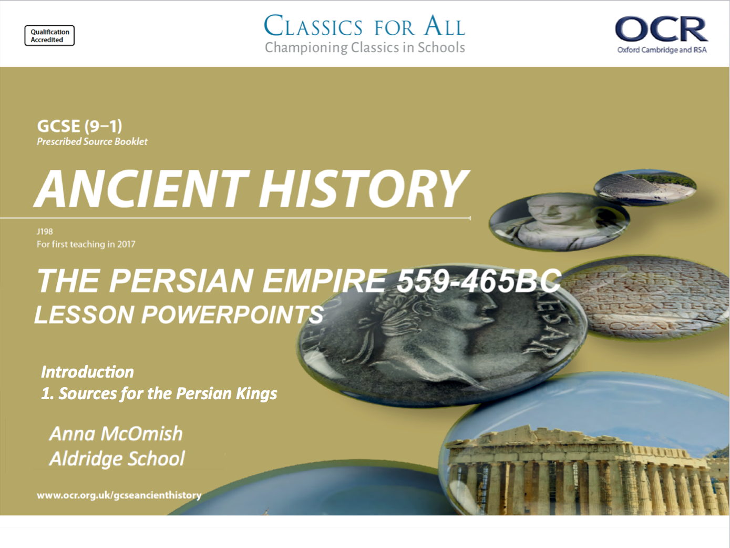

Slide 2
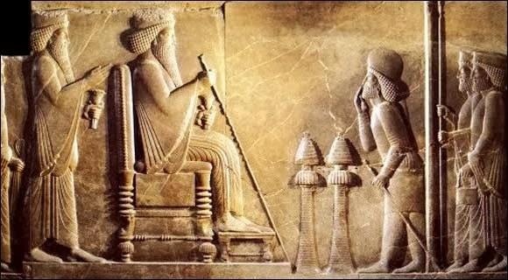
Activity 1; Put this list of Persian Kings in the correct Chronological (time) order.
Darius
Cambyses Xerxes
Cyrus
Activity 2a. List as many modern-day countries as you can remember that come under the boundaries of the Persian empire.
2b. Write a paragraph explaining how far the Persian empire stretched, in all directions. Use modern-day places and geographical areas to help your written description.
Activity 3a. Look at the carving of the Persian King giving an audience to some of his subjects; explain what we can learn from this about Persian Kings and how they liked to be seen.
3b. How RELIABLE (trustworthy) do you think this source is? – Given that the carving was commissioned by a King…
Persian King having an audience with his some of his subjects.

Slide 3
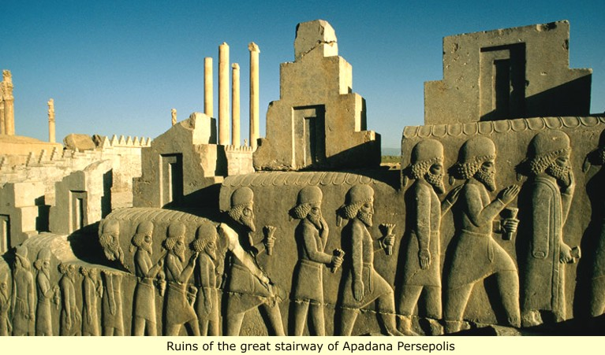
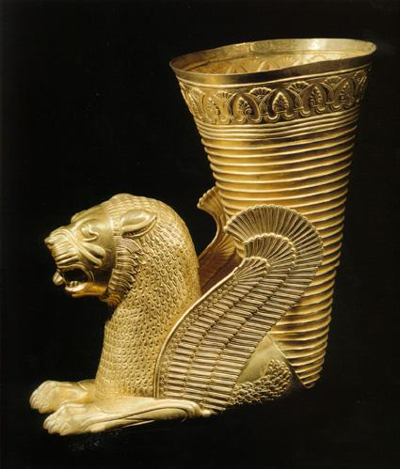
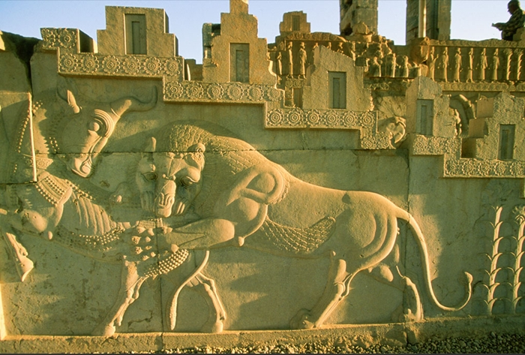
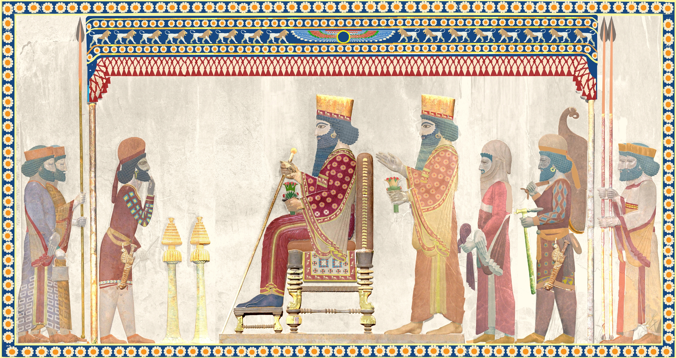
Ancient sources for the Persian Kings
L.O. to investigate the range of sources we will be using during this unit.
L.O. to assess the reliability and potential difficulties of ancient sources.

Slide 4
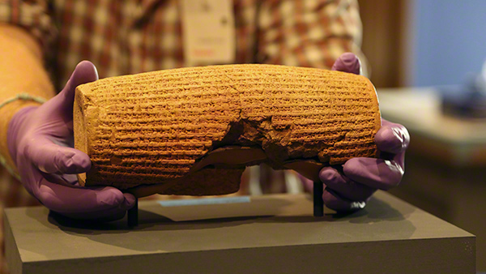
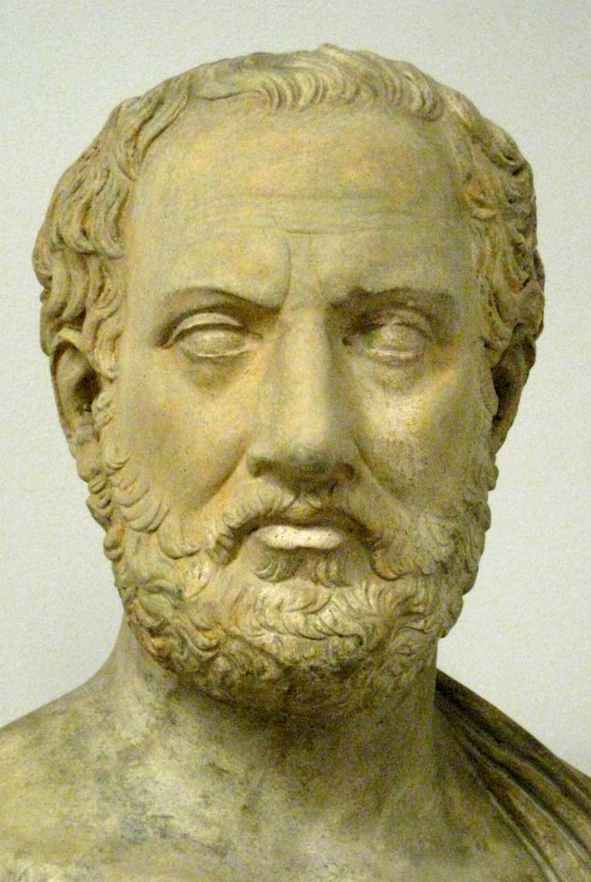
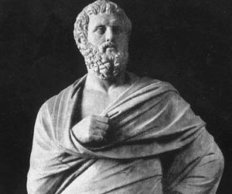
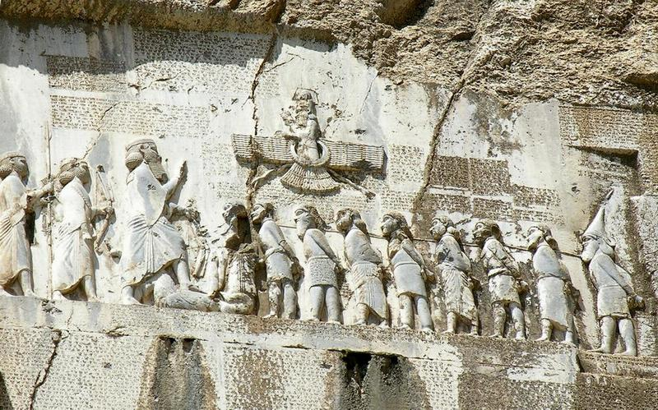
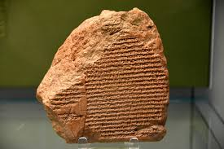
Which sources will we be using…
Herodotus
Thucydides
Plutarch
Aeschylus
Cyrus Cylinder
Bitsitun Inscription
Datiya Fortification Tablet
Nabonidus Chronicle
Account of Udjahorresne
Archaeological evidence from key sites, e.g. Pasargadae, Persepolis and Susa.

Slide 5
The Historians, writers and poets
How these kinds of sources are useful to us:
They given us detailed information of key figures and events.
Often they are actively looking to educate us, they want us to know what happened and they’re telling us. E.g. Herodotus was the first ‘historian’ because his writing wanted to explain why the Persian Wars started.
They can help us know what cultures and people were like long, long before anyone was able to photograph or record such things.
They are easy to translate because we can read Greek!
The difficulties with using these kinds of sources:
They are often massively BIASED! – this means they want to portray events in a particular way to make you think a particular thing. Or they’re playing for an audience. E.g. Aeschylus became a famous Athenian playwright and poet, so OF COURSE he wanted to make the Persian King Xerxes look weak when he wrote about him.
They will often tell you about conversations/ discussions as if they were fact, but there can be no way that those writers were actually there for the conversation…

Slide 6
Cyrus Cylinder, Nabonidus Chronicle and the Bisitun Inscription etc.
How these kinds of sources are useful to us:
They are formal, administrative texts that are given the approval of the reigning power, e.g the King. So we can be fairly confident that they are official opinion.
They survive the test of time well because they are made of hardy materials such as stone, so we can date them and know they come from a specific time period.
They can be used as tools to help translate other sources, because they are written in ancient languages like elamite.
The difficulties with these kinds of sources:
They do not always survive in complete pieces, and sometimes we are only left with fragment of the original object. E.g. the Nadonidus Chronicle is a small section of what was originally a bigger text.
They can still be biased! The Bistiun inscription is a message put out by Darius and then Xerxes (which is good for historians), but it’s THEIR message about what THEY WANTED people to see them as (less good). So they don’t necessarily show us an exact reality.

Slide 7
Archaeological remains
How these kinds of sources are useful to us:
Physical evidence offers historians and archaeologists some firm facts about the past, that can’t really be debated. E.g. remains at Susa make it undeniably clear that there was a massive, Persian palace there.
Physical remains can be dated so that we can be sure of the time period they relate to.
The difficulties with these kinds of sources:
Archaeological sites can often be ransacked by thieves before, or during, excavations so that artefacts from the site can be sold on the black-market. As these sites are unique, there’s no way to replace stolen evidence and it’s lost to everyone.
They are only ruins, archaeologists are have use the evidence they are left with to work out what the sites would have looked like 2500 years ago.
Inscriptions or artwork don’t always come with explanations, so, again, archaeologists have to try and work out their meaning.

Slide 8
How reliable are the sources?
Activity
Using the information on your tables, read through each of the sources, looking carefully at when they were made, who made them and the state they are in for historians to use today, and complete the A3 grid.
What does ‘reliable’ mean?
The reliability of a source is an assessment of how trustworthy the source is.
Can we trust that source is giving us accurate information?
What is the source? What type of source is it? | Why will this source be useful to us? | Will this be a reliable or unreliable source? Why? | What do you imagine this source will be able to tell us/ help us learn about the Persian Kings?
Herodotus’ ‘Histories’ | This will be useful because… | This source might be considered reliable/ unreliable because… | I would argue that this source will tell us ‘X’ about Persian kings because…

Slide 9
What is the source? What type of source is it? | Why will this source be useful to us? | Will this be a reliable or unreliable source? Why? | What do you imagine this source will be able to tell us/ help us learn about the Persian Kings?
1.
2.
3.
4.
5.

Slide 10
What is the source? What type of source is it? | Why will this source be useful to us? | Will this be a reliable or unreliable source? Why? | What do you imagine this source will be able to tell us/ help us learn about the Persian Kings?
6.
7.
8.
9.
10.

Slide 11
Herodotus – ‘Histories’ Herodotus (c. 484 – 425/413 BCE) was a writer who invented the field of study known today as `history’. He was called `The Father of History’ by the Roman writer and orator Cicero for his famous work The Histories but has also been called “The Father of Lies” by critics who claim these `histories’ are little more than tall tales. Herodotus wrote The Histories to explain why the Persian Wars happened, which meant he was the first writer to be looking to explain causation. Many argue that he is very biased in favour of Athens and had grudges against other Greek cities, such as Corinth, that he let come out in his writings. He also has a habit of recounting conversations and events that he was absolutely not present at, but records through the memories and stories of others – this is how he gained almost all of his information. | Thucydides – ‘History of the Peloponnesian War’ Thucydides, (born 460 bc or earlier?—died after 404 bc?), greatest of ancient Greek historians and author of the History of the Peloponnesian War, which looked to record the history of the wars that he lived through, in a way which explained HOW and WHY things happened. He was an Athenian, old enough when the war began to estimate its importance and judge that it was likely to be a long one and to write an account of it, observing and making notes from its beginning. He attempted to write the final history for later generations. He had a strong Athenian/ Greek bias, and his writing would regularly try to blame anyone else apart from Athens for mistake that were made, or if no one else could be blamed, explain why things weren’t actually Athens’ fault. He was a spectator to/ there for many of the events he recorded, however he too has a habit of recounting speeches and conversations that he couldn’t have possibly been there for, as if he heard them in person…

Slide 12
Plutarch – ‘Life of Cimon’ Plutarch, was a biographer and author whose works strongly influenced the evolution of the essay, the biography, and historical writing. Among his approximately 227 works, the most important are the Bioi parallēloi (Parallel Lives), in which he recounts the noble deeds and characters of Greek and Roman soldiers, legislators, orators, and statesmen, and compares them against one another. One of the main issues with Plutarch’s writings that cover our time period is that he writing over 400years AFTER our events. Plus, he isn’t trying to record and explain historical events, just to write interesting biographies of important men. | Aeschylus – ‘The Persians’ Aeschylus was a dramatist/ playwrite who lived and fought during the Persian wars – where the Kings of Persian went to war against the various cities of Greece. He fought at the Battle of Marathon, King Darius’ battle against the Greeks, and Aeschylus’ brother died at the battle of Salamis, one of King Xerxes’ battles against the Greeks. He entered a competition in Athens, to find the best play written that year, and he won it with his play ‘The Persians’. This play recounts the Persians bemoaning their loss of the Persian Wars, how many of their great soldiers died, and then portrays a devastated and weak Xerxes returning to Susa to explain to his mother why he lost the war. It is not based on any conversation or meeting that Aeschylus witnessed or heard about!

Slide 13
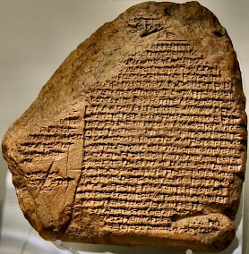
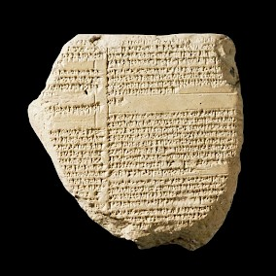
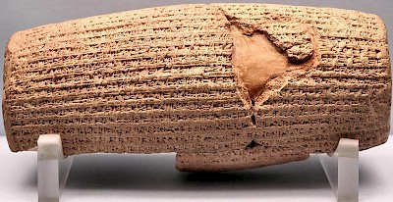
Cyrus Cylinder The Cyrus cylinder, made in 593BC, is a clay cylinder that has a Babylonian account of the conquest of Babylon by Cyrus in 539 BC. It tells us of his restoration to various temples of statues removed by Nabonidus, the previous king of Babylon, and of his own work at Babylon. Many parts of the text are written like it is Cyrus himself speaking, and the Persian king presents himself as the perfect king to his newly conquered subjects. The cylinder was written to be buried in the foundations of the city wall of Babylon. It was deposited there after the capture of the city by Cyrus in 539 BC, and presumably written on his orders. IMPORTANTLY, the Cyrus cylinder describes the conquest of Babylon in the SAME way that the Nabonidus Chronicle does, as peaceful at the end. | Nabonidus Chronicle The Chronicle is a two-sided stone tablet that focuses on the Reign of Nabonidus (of Babylon) and is one of the most important historiographical texts from ancient Babylonia. It deals not just with the reign of Nabonidus (r.556-539 BCE), but also with the rise of the Persian king Cyrus the Great, the demise of the Babylonian Empire, and the founding of the Achaemenid Empire (the empire of the Persian Kings we are studying!). The Nabonidus Chronicle tells the story of the rule of Nabonidus, the last king of independent Babylonia. The text is badly damaged and contains many lacunas (gaps or dents). However, it makes clear that the rise of Cyrus was not unexpected.
The two sides of the stone tablet.
The Cyrus Cylinder today.

Slide 14
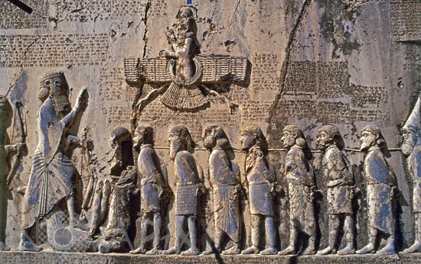
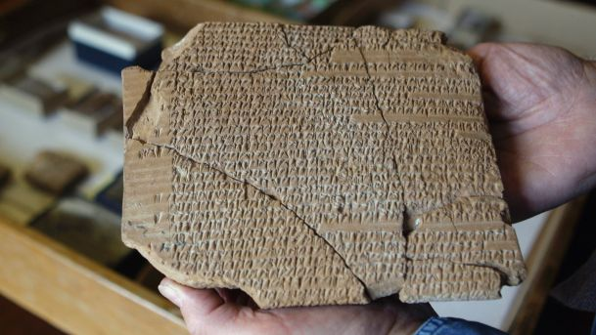
Bisitun Inscription The Bisitun Inscription is a multilingual inscription and large rock relief on a cliff at Mount Behistun in the Kermanshah Province of Iran, and was commissioned by King Darius during his reign to make clear he had legitimately deserved the throne and had defended the empire that belonged to him. The inscription begins with a brief autobiography of Darius, including his family heritage and rightful link to the throne. Later in the inscription, Darius provides a lengthy sequence of events following his gaining the throne (after Cambyses II) in which he fought nineteen battles in a period of one year to put down multiple rebellions throughout the Persian Empire. The inscription states in detail that the rebellions were orchestrated (organised) by several impostors in various cities throughout the empire, in an attempt to take the crown off the rightful ruler, Darius! The image shows the 9 imposters chained up before Darius, indicating that Darius is in complete control of his empire. | Dayita Fortification tablet Also known as the Persepolis fortification tablets, they are a large collection of ancient Persian administrative texts, written between 506 and 497 BCE. They are one of the most important sources for the study of the administration of the Achaemenid Empire. They record the economic transactions of the empire, and the organisation of resources relating to food and rations. They also tell us about the issue of passports for travelling within the empire, orders for payments of silver and gold to the chief treasurer of the King, and the dispatching of judges, accountants, caravans and teams of laborers. There are more than 20,000 texts in existence, and about 2000 have been translated into English, many are in a very poor condition due to their age.
Darius standing before the 9 imposters to his throne.
One of the many Dayita/ Persepolis fortification tablets.

Slide 15
Account of Udjahorresnet | Archaeological remains – Persepolis, Pasargadae, and Susa All three are important sites of the Persian empire, administrative centres that the Kings ruled from and created to stand as monuments to their power and authority. Cyrus the Great began building the capital at Pasargadae in 546 BC; but it was unfinished when he died in battle. The remains of the tomb of Cyrus‘ are still there today. Pasargadae remained the capital of the Achaemenid empire until Cambyses II moved it to Susa; later, Darius founded another in Persepolis. Under Cyrus' son Cambyses II, Susa became a centre of political power as one of 4 capitals of the Achaemenid Persian empire, while reducing the significance of Pasargadae. Following Cambyses' brief rule, Darius the Great began a major building program in Susa and Persepolis. Cyrus the Great chose the site of Persepolis, but it was Darius I who built the terrace and the palaces. It was under Darius that Persepolis became the capital of Persia proper.
Udjaḥorresnet was an ancient Egyptian high official who is mainly known for his efforts in promoting the Egyptian customs to the early Achaemenid kings, particularly Cambyses II.
His influence grew unexpectedly under the reign of Cambyses and his successor Darius I, and Udjahorresnet apparently became a sort of collaborationist (someone who helps two different groups of people work together) for the Persians, managing to enter in the royal court as chancellor and chief physician. From his statue is known that he used his influence to make Cambyses acknowledge and respect Egyptian customs.
His career is inscribed (carved writing) on a well known statue depicting him, and it tells of Cambyses being a good, and respectful king. Which is very different from how Herodotus portrays Cambyses…

Slide 16
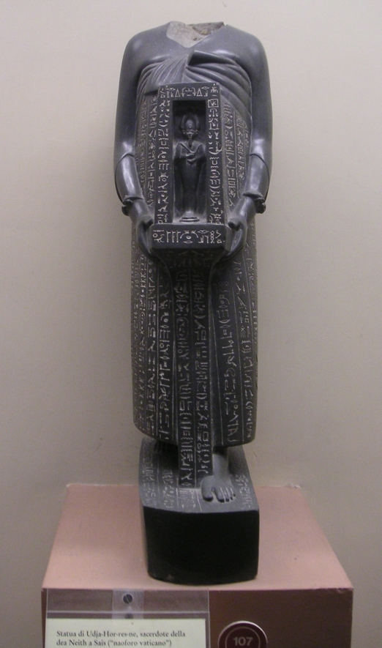
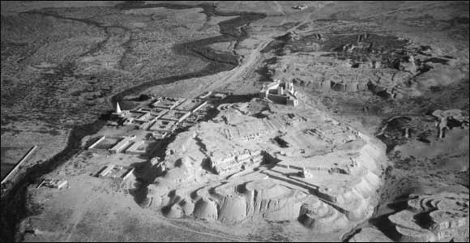
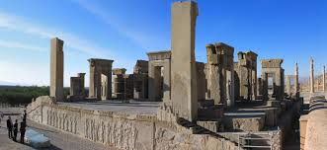
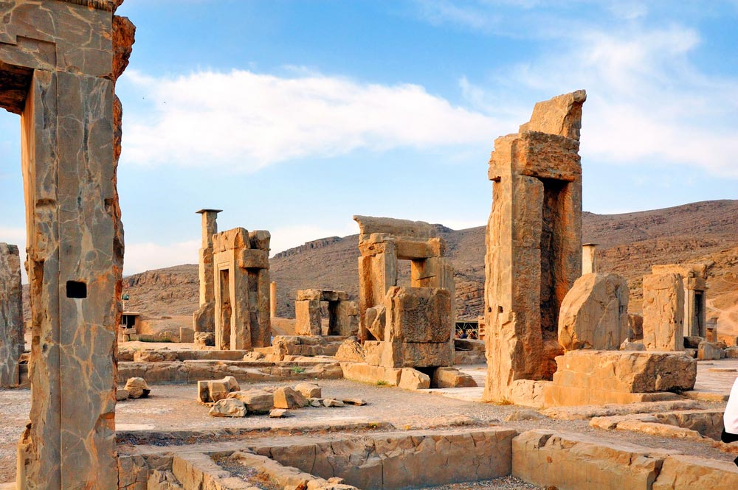
Account of Udjahorresnet | Archaeological remains – Persepolis, Pasargadae, and Susa
Aerial shot of Susa.
Persepolis
Pasargadae.

