Slide 1
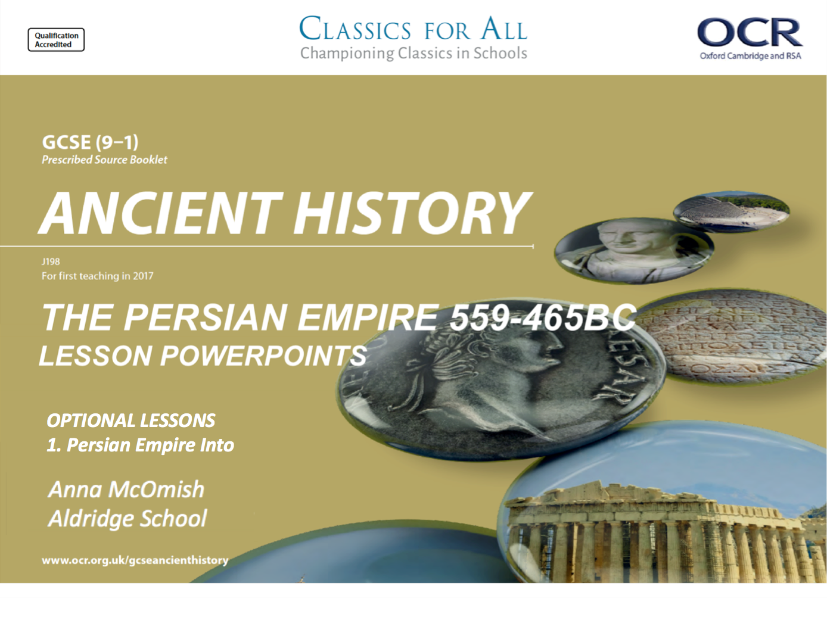
OPTIONAL LESSONS
1. Persian Empire Into

Slide 2
Starter:
Try to put the following years in the correct chronological order;
1066 AD
10BC
1500BC
896 BC
894 BC
56 AD
2013 BC
2013 AD

Slide 3
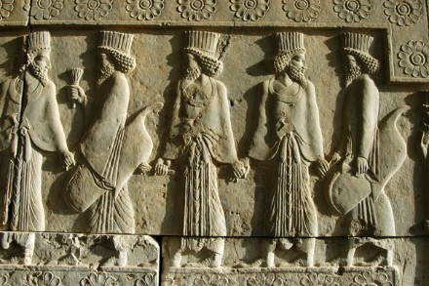
What was the Middle East like in 600BC?
LESSON OBJECTIVES:
To know some more details about the different places within the Persian Empire.
To evaluate the various rivals to the Persians in the Middle East.

Slide 4
Task 1
Watch the clip about empires in the Ancient Middle East?

Slide 5
Task 2
Paired discussion;
What do you need to carve out an empire?
What do you need to be able to keep your empire?

Slide 6
Task 3
Use the Geography of the Persian Empire sheet.
Make brief notes on each of the following regions;
The Levant
Egypt
Mesopotamia
Phoenicia
Asia Minor
Focus your notes on;
What was in the region?
Why the Medes would want to conquer the territory.

Slide 7
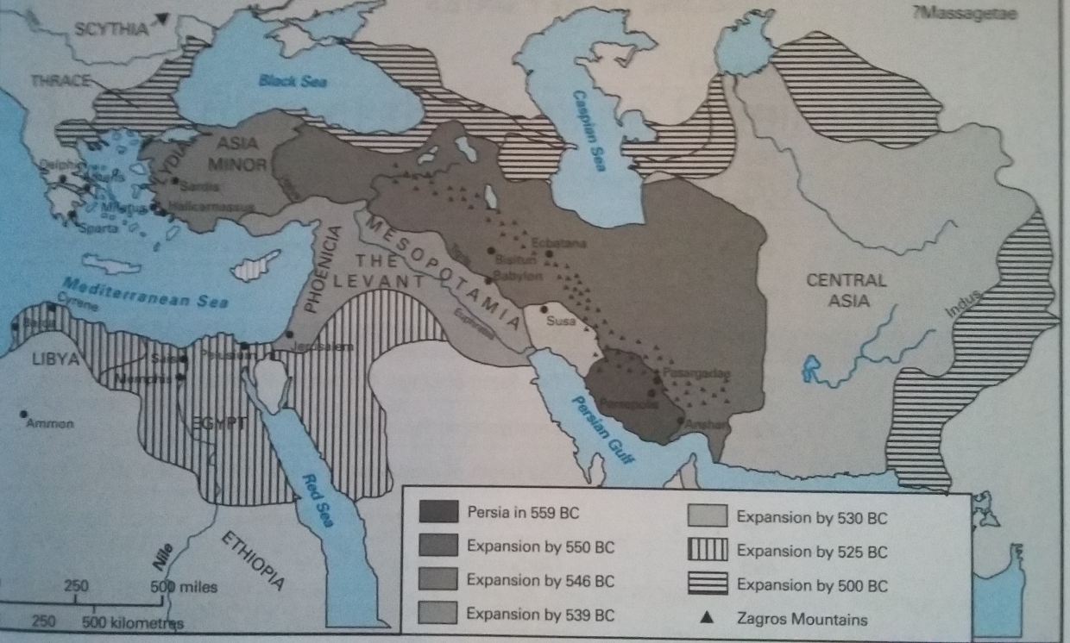
Geography of the Persian Empire

Slide 8
Task 4
Read the OCR textbook p6-7.
Who were the main rivals to the Medes (Persians) in 600BC?
Which rival posed the greatest threat? Why?

Slide 9
Plenary
What kind of king would be needed to rule an empire like this?
What qualities would they have to have?

